Slide 1

Global Alliance for Technology Transfer and Entrepreneurship (GATTE):
Taiwan-Northeast Indiana Region
Opportunities and Capacities
For Presentation at
2012 Taipei International Invention Show & Tecnomart
Taipei, Taiwan
September 20-23, 2012
Max Yen, Dean, College of ETCS
Paul I-Hai Lin, Professor of Electrical & Computer Engineering Technology
Sean Ryan, Director of University Engagement
Steve Franks, Director of Programs, NIIC
Scott Naltner, Executive Vice President, Northeast Indiana Economic Development Alliance

Slide 2
Acknowledgements
Thanks to the sponsors and organizers of 2012 International Invention Show & Technomart
This presentation is a collection of efforts of an interdisciplinary team who are dedicated to help improving the current regional (if not global) economic challenges
The concept of ITTTES and GATTE are developed and led by Michael Wartell (IPFW Chancellor) and Walter Branson (IPFW VC for Financial Affairs)

Slide 3
The GATTE Members in Taiwan
Chung Yuen Christian University (CYCU): http://www.cycu.edu.tw
Feng Chia University (FCU): http://www.fcu.edu.tw
I-Shou University (ISU): http://www.isu.edu.tw
National Cheng Kung University (NCKU): http://www.ncku.edu.tw
National Formosa University (NFU): http://www.nfu.edu.tw
National Taipei University of Technology (NTUT): http://www.stutu.edu.tw
National Taipei University (NTPU): http://www.ntpu.edu.tw
Southern Taiwan University of Technology (STUT): http://www.stut.edu.tw
Taipei Medical University (TMU): http://www.tmu.edu.tw

Slide 4
Some Observations
Shakedown on global economy is still underway due to depletion of fossil energy source, wars in middle east, disasters, collapse of financial market, people lives longer premeum of healthcare, etc.
No place to hide your money without losing its value. The only way to preserve the value of money is to invest on innovation, thus promoting entrepreneurship
Entreprenurship creates “new” jobs and keeps industrial & business activities moving forward
Entrepreneurship would require a fundamental change in higher education its delivery systems and governing policy; e.g. P&T, soft skills leadership, info tech, engage in economic development
Tradition on making big bucks is replaced with creating long-steady wealth
Sustainability of energy, environment, healthcare, and information technology are the key global issues

Slide 5
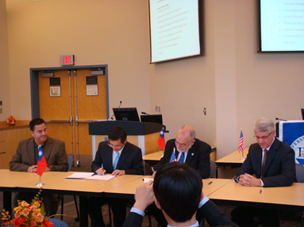
Global Alliance for
Technology Transfer and Entrepreneurship
Taiwan
Indiana
Academia &
Innovators
Academia &
Innovators
GATTE
A Global Market Place for
Entrepreneurship
Tech Transfer
Patents Acquisition
Resource Leveraging
Econ. Development
Outsourcing, Training
Partnership
Venturers &
Industry
Venturers &
Industry
Government & Chambers
Government & Chambers
Legal & Intellectual
Legal & Intellectual

Slide 6
Indiana-Taiwan Technology Transfer
and Entrepreneurship Summit
(ITTTES)
09/27 – 09/30, 2011
Initiated by
Academia
To expand the market for the intellectual properties developed in Taiwan
To promote entrepreneurship through transfer of Taiwan’s innovative technology to Indiana and vice versa; aiding to economy recovery through global business/technology partnership; GATTE
To develop an accelerated process toward bringing technology to market; GATTE
To develop a global market place for technology patents, intellectual licensing, business development, investment attainment; GATTE: an international enabling task-force for tech transfer and repository of global intellectual properties
To secure “soft landing” status for NIIC
  Indiana Partners:
  Indiana University-Purdue University Fort Wayne
  Purdue University
  Indiana University
  U of Southern Indiana, NSWC Crane
  Taiwan Partners (from North to South:)
    National Taipei University of Technology
    Chung Yuan Christian University
    Feng Chia University
    National Formosa University
    National Cheng Kung University

Slide 7

Energy, Environment, Information Technology, and Healthcare
Track 1: Nano-Scale, Electronics and Thermoelectric Material Technologies
Track 2: Renewable Energy, Environmental and Water Management Technology
Track 3: Wireless Sensors, Data Acquisition, and Monitoring Technology
Track 4: Novel Instrumentation and Detection
Poster Presentations: NSWC Crane (17), Purdue Research Foundation (6), Taiwan Research Partners (5)

Slide 8
GATTE
Technology-Market Profile
Academia &
Innovators
Yes | No | Maybe
x |  |  | License technology to U.S. investors/businesses
x |  |  | Establish U.S. sales and marketing office
 |  | x | Create a U.S.-based business start-up with Taiwanese investment
 |  | x | Develop a strategic manufacturing partnership
x |  |  | Sales and distribution of product to U.S
Venturers &
Industry
Yes | No | Maybe
 |  | x | Legal services (intellectual property and commercial law)
x |  |  | Business valuation
 | x |  | Technical support (including testing, engineering and prototyping)
 | x |  | Regulatory compliance
 |  | x | Marketing and Market Survey
 |  | x | Business planning
x |  |  | Investment capital and financing
Government & Chambers
Legal & Intellectual

Slide 9
NCKU, FCU, CYCU, I-Shou, NTPU, TMU, etc....
NTUT, NFU, STUT, ...
Southern Illinois University
Purdue University, IPFW
Texas A & M University
Formosa Plastics
Taiwan Electric Power Co.
China Engineering Consulting
Materials Industry
Deere & Co.
Auto-Air Composites
Auto-Design Composites
Primex Inc.
Quantum Composites
National Science Council
Ministry of Education
Small to Medium Business Enterprise Administration
Ministry of Economy Affairs
Bureau of Industry
National Science Foundation
National Institute of Standard Technology
Department of Energy
US Army Research Laboratory

Slide 10
Venturers &
Industry
Northeast Indiana
Adams, Allen, DeKalb, Huntington, LaGrange, Noble, Steuben, Wabash, Wells, and Whitley Counties
Demographics:
~685,000 people 2010 Census
~3,960 sq. miles
Population growth this decade 2000-2009
  4.1% regionally
  2.8% Midwest US (IL, IN, KY, MI, and OH)
  8.7% nationally
Manufacturing employment Private, 2009
  24.1% of Northeast Indiana jobs
  11.0% nationally
Wages from manufacturing Private, 2009
  31.8% Northeast Indiana
  13.4% nationally
GDP from manufacturing Private, current $, 2009
  21.7% Fort Wayne MSA
  12.3% nationally
Regional Industry Clusters:
Advanced Manufacturing; SDI
Defense; Communication
Financial Services; Lincoln
Food Processing
Life Sciences; Hospitals, Orthopedics, Biomedical
Transportation and Logistics
Data from the Community Research Institute at IPFW

Slide 11







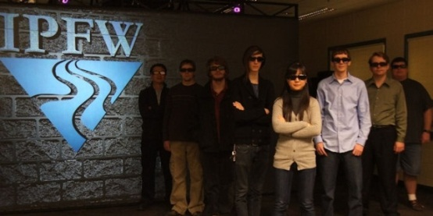








DEFENSE
Suppliers
Universities
Government Agencies
Centers of Excellence
Systems Engineering
Wireless Communications
Visualization and Analytics
Notes:
11

Slide 12












MEDICAL DEVICES
Businesses
Universities
Innovation
Notes:
12

Slide 13







NE Indiana Top Employers
Company | FTE
Lutheran Health Network | 4,156
Parkview Health System | 3,933
General Motors | 3,341
Steel Dynamics | 2,435
Lincoln Financial Group | 1,750
BF Goodrich Tire Manufacturing | 1,584
ITT Corporation | 1,581
Nucor | 1,525
Raytheon | 1,200
Company | FTE
Frontier Communication | 1,200
Fleetwood RV | 1,199
Navistar International | 1,150
Norfolk Southern | 942
BAE Systems | 899
United Technologies | 648
Fort Wayne Metals | 491
Vera Bradley | 407
* Data from the Northeast Indiana Regional Partnership and the Community Research Institute

Slide 14
Government & Chambers
IEDC
Alliance
NSF, DoE, NIST, DoD
$$-$$$
NIIC
Discovery Park
$$
SBIR & STTR, TAP
Chamber of Commerce
$$
$-$$
$
Tax incentive/credit
Land acquisition
Infrastructure zoning
Free training
TAP allowance
Construction support
Product development
Cash & Equipment
Development
Establishment

Slide 15
The Alliance Project
(Allen County Economic Development Alliance)
SDI La Farga,LLC , April 2011
  Steel Dynamic Inc. (5th) invests $39 million in new joint-venture
  La Farga Group, Spanish Metals Manufacturer, headquartered in Barcelona, Spain
  Advanced Manufacturing Technology to make copper wire
  Created by La Farga Group
Franklin Electric, $25M, http://www.franklin-electric.com/corporate/default.aspx
  The world’s leading global provider of complete water and fueling systems
General Mills Inc., total investment $34.6 M, May 2011, http://www.generalmills.com/
  The 6th largest food company and market some of the world’s best-loved brands: Cheerios, Green Giant, Betty Crocker, Pillsbury, Yoplait…
Wireless Technology Center, funded by Talent initiative and regional defense industry
  In the process to develop software defined radio lab (SDR)

Slide 16
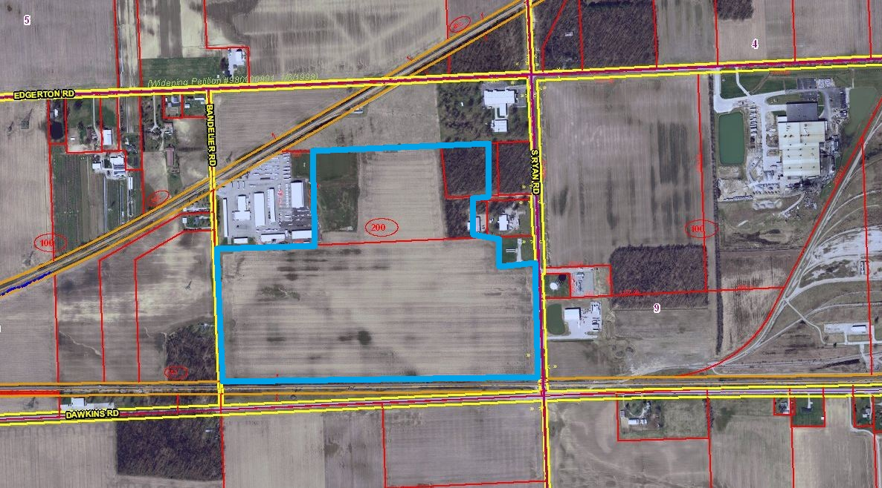
Item | Value to SDI La Farga, LLC
Real & Personal Property Tax Abatement | $1,869,257
Performance Base Incentive | $102,695
Property Purchase Assistance | $700,000
Hoosier Business Investment Credit (HBI) | $300,000
Skills Enhancement Fund (SEF) | $20,000
Customized Recruitment/ Screening | $10,000
On-the-Job Training | $75,000
Computer & Core Competencies Workshops | $4,500
Total Value to SDI La Farga, LLC | $3,081,452
Item | Value to SDI La Farga, LLC
Total Investment | $38,998,500
Projected Payroll Total | $2,478,740
-Average Salary | $70,824
-New Jobs | 35
-Retained Jobs | 0

Slide 17
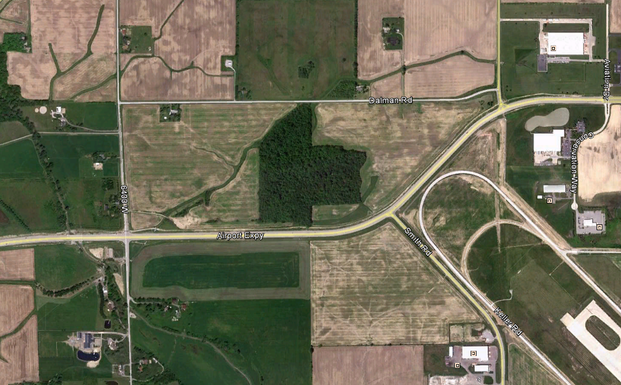
Relocation of Headquarters to Fort Wayne
Center of Excellence
Partnership with IPFW; IMSE, Global Workforce Development
Item | Franklin Electric
Total Investment | $25,252,000
Projected Total Payroll | $20,768,800
-Average Salary | $79,880
-New Jobs | 35
-Retained Jobs | 225
Incentives
-TIF | $7,082,714
-EDGE Tax Credit | $2,700,000
-WorkOne Northeast | $250,000
-Total | $10,392,714

Slide 18
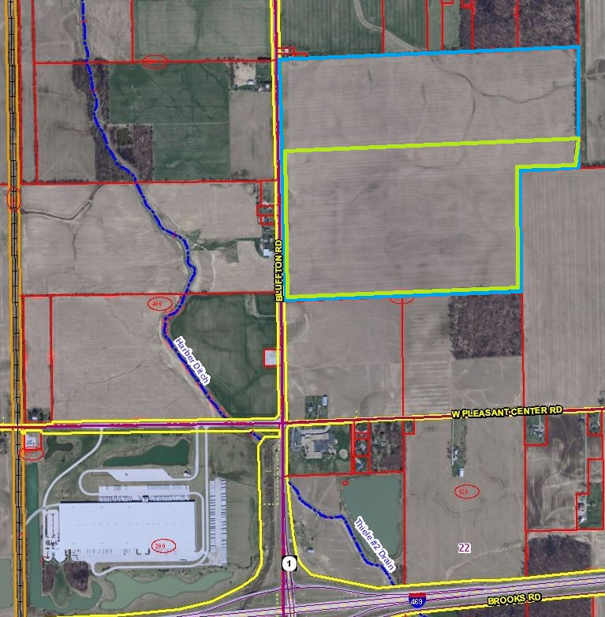
Item | Value to General Mills
Total Investment | $34,600,000
Projected Total Payroll | $1,950,000
-Average Salary | $30,902
-New Jobs | 65
-Retained Jobs | 78
Item | Value to General Mills
Incentives
-Tax Abatement | $2,845,599
- Land Purchase Assistance | $250,000
-EDGE Tax Credit | IEDC $500,000
-WorkOne Northeast | $70,000
Benefits
-120,000 sq. ft. access road -Accelerate/Decelerate Lanes | $300,000
-Reconstructing the Drains | $200,000
-Sewer Infrastructure | $350,000
-Total | $4,515,599

Slide 19
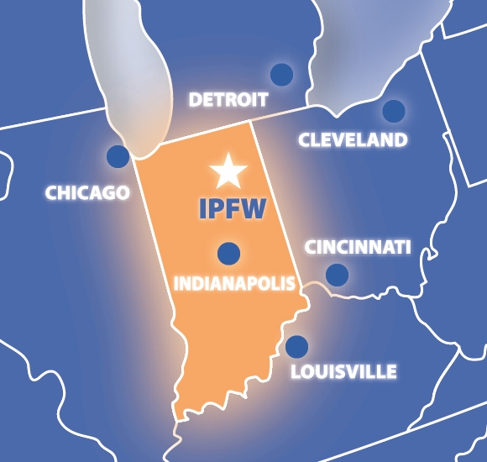


IPFW
  Largest and most comprehensive public university in Northeast Indiana
  Opened in 1964 as a combined campus of Indiana and Purdue Universities
  Indiana University and Purdue University degree programs
  IPFW has grown into a multi-campus community with over 20 buildings
  Graduates over 1,700 students per year at all degree levels

Slide 20



  Over 14,000 students
  Diversity of students with 45 states and more than 67 countries represented
  Additional 24,000 students pursue non-credit opportunities through Continuing Studies
  Nine academic units offer more than 200 academic degree programs
  Students can earn Associate, Bachelor, and Master’s degrees, undergraduate and graduate-level certificates

Slide 21
Engineering, Technology, and Computer Science
Engineering
CE, ME, CPE, EE
Wireless
MCET
ID, CET, CNET, MET ARET., IET,
Visualization
CEIT
EET, CPET, IT
Systems
ETCS
Organization
Leadership & Supervision
Built Environ.
Computer Science & IS
HAAS Manufacturing
ROTC
Student Success
Outreach

Slide 22
Centers of Excellence
Wireless
Embedded systems, software defined radio, sensors & sensors network, wireless communication, RFID
Integrated visualization and simulation, 3-D virtual navigation, mobile education (STEM and beyond), apps development
Bridge health monitoring systems, cyber physical systems, automnous robot systems
Energy economy and new industrial revolution, renewable energy, core facility, green technology
Rapid prototyping
Visualization
Systems
Built Environ.
HAAS Manufacturing

Slide 23
Petroleum, Coal, Nuclear, Bio-mass,
Solar, Wind, Geo-thermal, etc.
Energy Sources
Utilization
Coal Combustion (Power Plant)
Petroleum-fuels (Transportation)
Bio-Fuel
Bio-Diesel/Oil
Hydrogen
Coal-Fuel Conversion
New Fuels
CBE-Initiatives
Fuel Cells
Electric Batteries
Composite Electric Vehicles
Functional Combustion Engine
Distribution of Micro-grid
Jet/Auto Engine Test Stand
Manufacturing and Prototyping
Power Transformation
Demonstration
MS
Energy Management
Training & Education
To Study Feasibility, Performance, Efficiency,
Environmental Impact, …

Slide 24
Materials Catalytic Reaction
A Gateway toward Energy and Materials by Design
Validation & Tests
Growth Mechanism of Carbon Nanotubes
Bio-catalytic Process for Bio-fuels
Therapeutic Drug Delivery Mechanism
Catalyst Assisted Oil, Coal, and Gas Refining Process
Photo-Catalytic Synthesis
Design of Adhesion Interface
Energy Storage and Fuel Cell Concept
Detection Mechanisms of Sensors
Phase Transformation of Materials
Self Assembly of Matters
Cyber Based
Prototyping
Neural Network
Computation
SBE&S
Multi-Scales
Knowledge Base
Physical Modeling
Database
Governing Rules

Slide 25
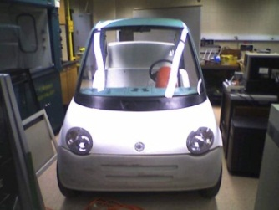
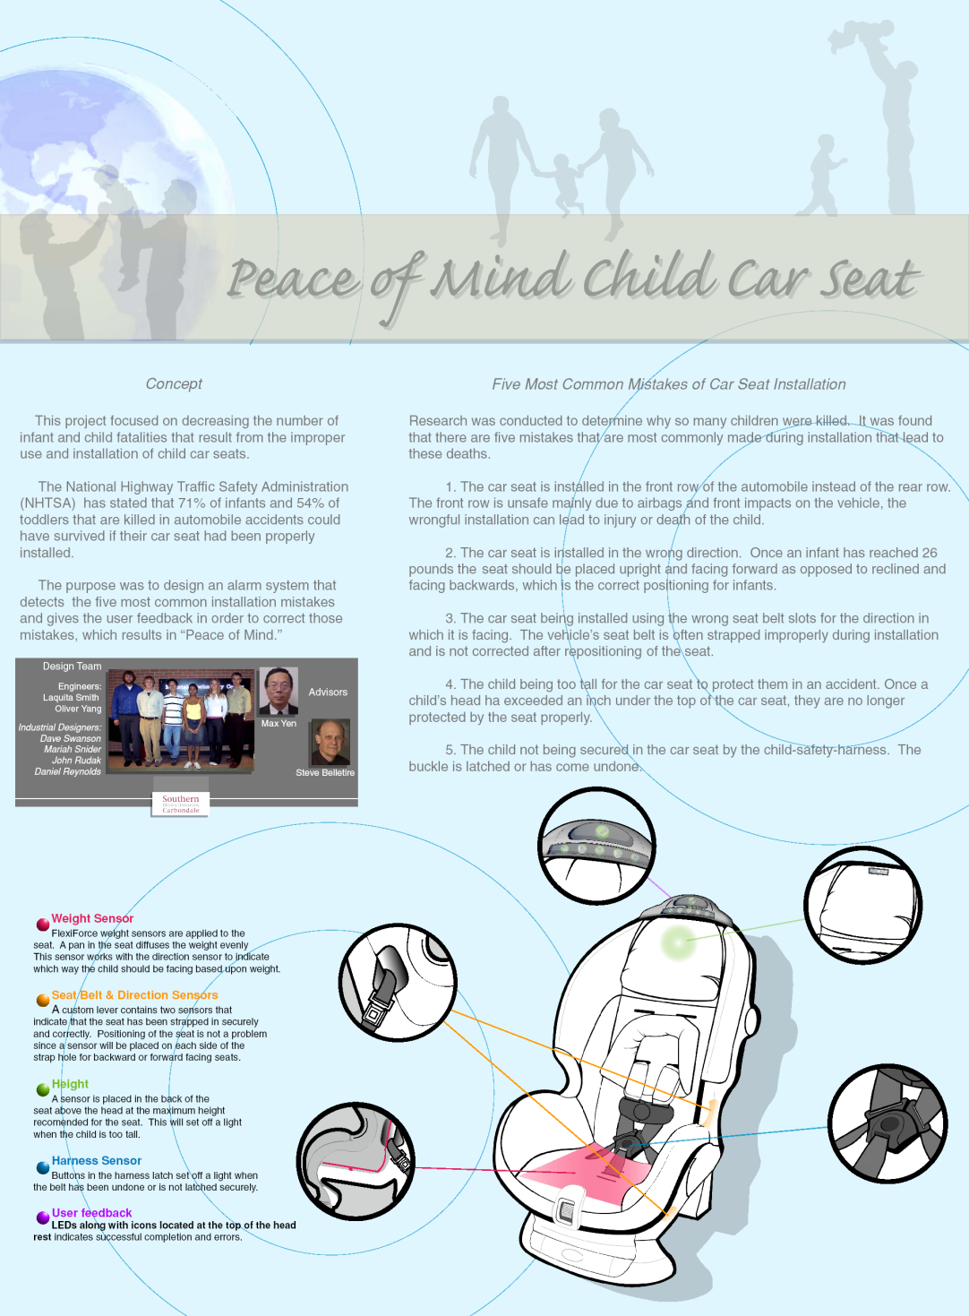
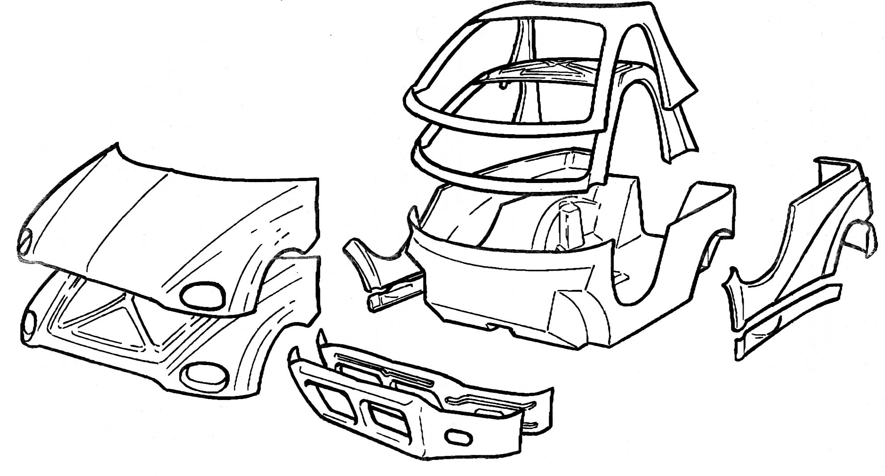
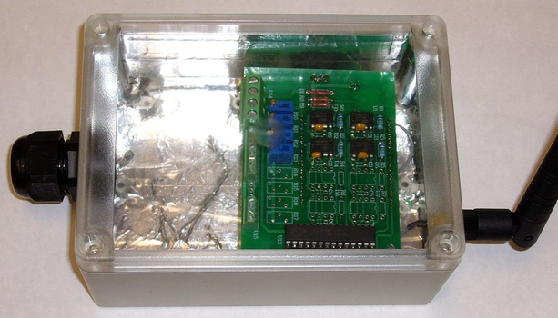
Resources/Opportunities
Academia &
Innovators
Initiatives & Centers
Industry
Partners
Univ.
Enterprise
Gov.
Resources
Service
Station
Students & Staffs
Creativity must meet society needs
Faculty
Invention must address market needs
Patents must be deployable
Promotion
& Tenure
Entrepreneurship is not just business and technology
Rewards & Awards
Entrepreneurship generates sustainable wealth not big bucks
Curricula & Coop.
People/Career
Ideas/Mind-set

Slide 26

IPFW Office of Engagement
Key contact for access to IPFW, Purdue and Indiana University programs for businesses, government and community partnerships
Facilitate access to:
  Research capabilities (Government Grants & Industry Research)
  Technical expertise (Faculty and Student Projects)
  Intellectual property (Purdue, Indiana University and NSWC Crane)
  Educational services & training opportunities
  Internship/co-op/student hiring programs
Provide representation for regional businesses to the universities in the development and enhancement of programs.

Slide 27
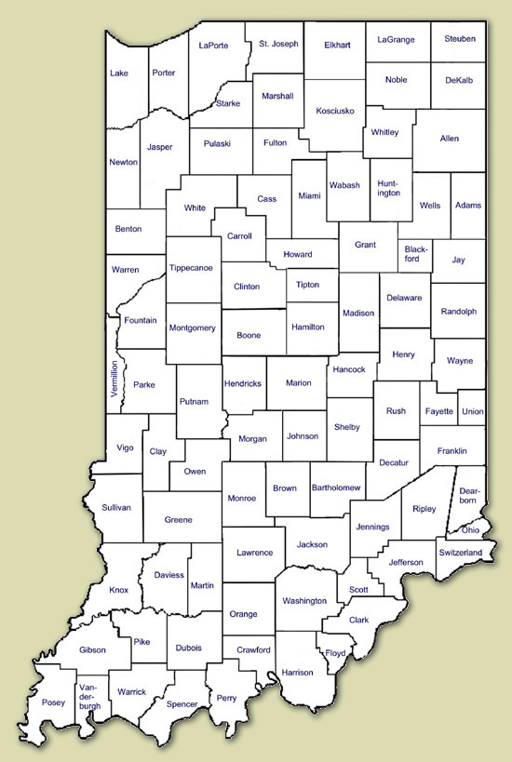


Engagement Office
  Serves to focus the resources of multiple complementary institutions to a single geographic region
  Launched in January 2006
Relationships & Results (through 06/11)
  418 businesses & organizations
  172 businesses with completed engagements
  41% completion rate

Slide 28
Engagement Office Projects
Business Plan Competition (5 years)
  Program to educate entrepreneurs and support writing of business plans
  Entrants competed for $50,000 in prizes to fund their business venture
IU – Purdue Technology Showcase (5 years)
  Presentations of university IP ready for commercialization
  Showcase technologies for businesses, entrepreneurs and investors
Work One Economic Growth Summit (4 years)
  Program to connect industry and K-12 educators to enhance student outcomes
Defense Industry Association – NIDIA (3 years)
  Lilly Endowment Talent Initiative($20M grant)
  Networking and educational programs with regional business and federal labs
Notes:
Business Plan Competition – 2 years
Technology Showcase – 2 years
Economic Growth Summit – 2 years

Slide 29
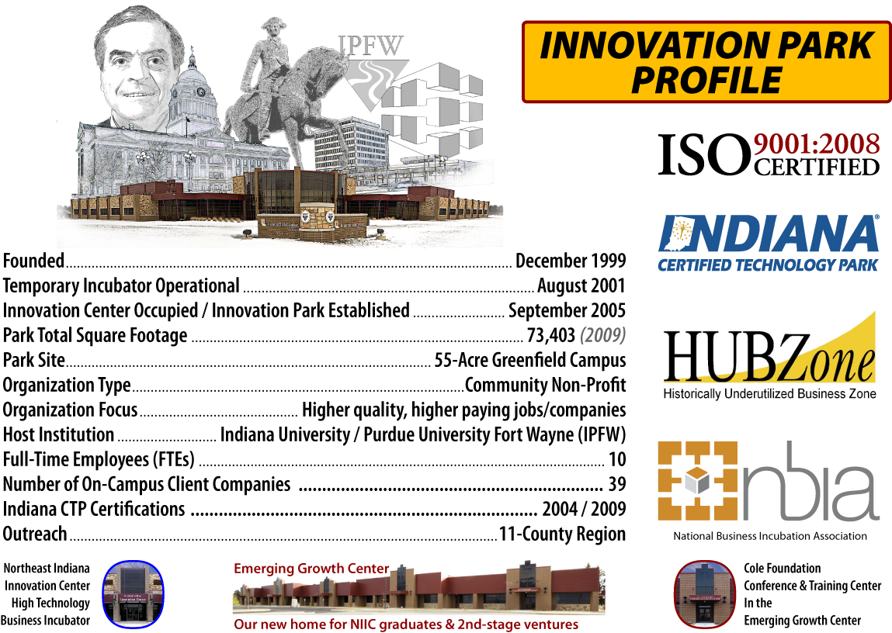

Slide 30
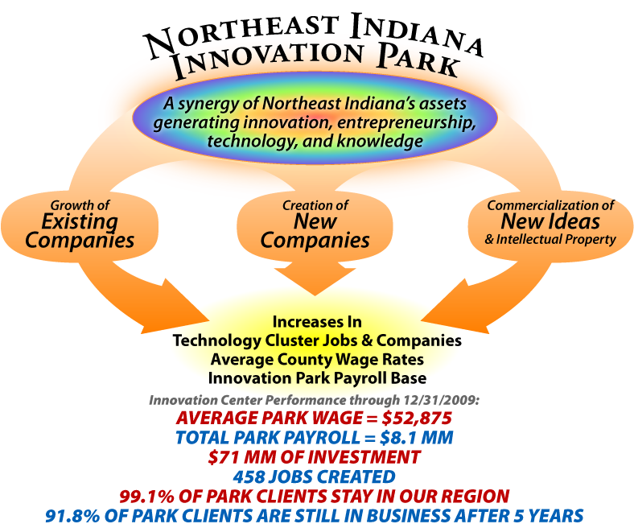

Slide 31
NIIC’s Current Tenant Profile
Information Technology Companies – 23
  Cirrus ABS – a web technology company
  GooRoo LLC – a NIIC student venture Lab company
  Guild Press LLC – a NIIC student venture Lab company
  Honor Education – a NIIC student venture Lab company
  IntelliTek Systems – a Cloud-based integrated CRM, Sales Force Automation, etc.
  BBK Group, Inc – corporation telecommunication management and cost control
  Scadata Scientific, LLC – communication and data transfer technologies
Biomedical Companies – 5
  BioDuct LLC – developing patent protected avascular tissue repair platform technology
  BioPoly RS LLC – developing a joint resurface biomaterial
  Schwartz Biomedical – Tissue engineering research
  Solistice Medical - a medical device asset lifecycle management company

Slide 32
NIIC’s Current Tenant Profile (cont.)
Advanced Manufacturing Companies – 3
  Digital Hydraulic LLC
  Phoenix Consulting, LLC
  American Axle - leading companies in the automobile industry
  SysteMental Inc – Lean manufacturing/enterprise methods technical services and software
Entrepreneurial Service and Support and Other Companies – 18
  Siemens Industries, Inc
  Stahl Engineering & Failure Analysis, LLC

Slide 33
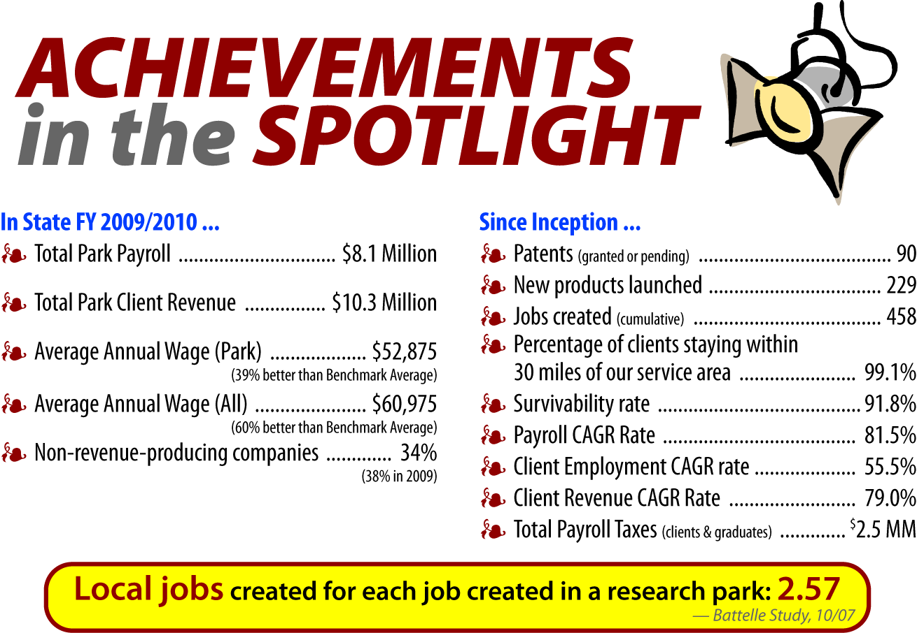

Slide 34
Venturers, Investors, Patent Services
Ruffalo & Benson LLC
Baker and Daniels
Huron Group
Chase Bank
Lincoln Financial Group
Bank of America
Wells Fargo
Independent Venture Firms
Innovation Centers (NIIC, PU Discovery Park)

Slide 35

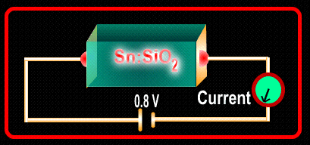
Examples
NSF
DoD
Spin
Off
Venture
State
Ind
DoD
FHWA

Slide 36
GATTE Purposes/Priorities
It makes an international market for intellectual property.
It engages international business and educational resources in the commercialization of international IP.
It helps member universities and incubators throughout the world to form new companies to commercialize international IP in their locales

Slide 37
GATTE Structure, Governance, and Operation
Structure
  A program jointly operated by the Northeast Indiana Innovation Center (NIIC), and the IPFW College of Engineering, Technology, and Computer Science (ETCS)
  Engaging universities and incubators, throughout the world, who will be interested in reciprocal technology/commercialization transactions and exchanges

Slide 38
GATTE Structure, Governance, and Operation
Operation
  Under the direction of NIIC’s President and CEO, in close cooperation with the Dean of IPFW’s ETCS
Advisory Committee: representatives from
  IPFW, Foreign universities, IURTC, Purdue Technology Transfer, the City of Fort Wayne, Allen County, the Northeast Indiana Regional Partnership, LEDOs from throughout Northeast Indiana, Elevate Ventures, and selected business and cultural leaders throughout Northeast Indiana

Slide 39
GATTE Structure, Governance, and Operation
Will establish a visiting professor and executive exchange program throughout the world
Will establish employ interns from IPFW and participating international universities to supplement NIIC’s student exchange program

Slide 40
GATTE Related NE Indiana Institutions and Their Services
IPFW – for intern, faculty consulting, lab facilities support, Office of Engagement technology transfer support
NIIC – for incubator office and lab space
NIIC LEAP Fund, Elevate Ventures, and other venture or angel groups - for capital
Regional economic development agencies – for expansion space
Local service providers (banks, accountants, attorneys, marketing agencies) as necessary

Slide 41
Portfolio of Programs/Services
Six Revenue-Producing Services
List/inventory IP available to license
List/broker entities interested in licensing IP
Soft Landings program to help international entities from a U.S. company
Soft Landings program to help local international students starts a company
Annual Global Showcase and Conference
Licensing Agency (TTO/TLO) for International Entities

Slide 42
Roadmap for a Global TechnologyTransfer
Water Jet Project
Taiwan-Indiana
Initiate Inquiry and Develop First Refusal Right
Submit Business/Marketing Plan
On –site Visit
Develop Partnership and Legal Binding Document
Preliminary Phase – “Loan” Marketing and Capacity Estimation
Disclose Supply Chains
Full Scale Operation
Develop Tech Support
NIIC
GATTE
Inventor
Engagm’
Partner
Investor
ETCS
IUTRC
Option
Clause
Due Diligence
Partners
Licensor
Joint Venture
Stock Option
Equity
Royalty
Distribution
Template
mediator

Slide 43
The GATTE Members in Taiwan
National Formosa University (NFU): http://www.nfu.edu.tw
I-Shou University (ISU): http://www.isu.edu.tw
National Cheng Kung University (NCKU): http://www.ncku.edu.tw
Southern Taiwan University of Technology (STUT): http://www.stut.edu.tw
National Taipei University of Technology (NTUT): http://www.stutu.edu.tw
National Taipei University (NTPU): http://www.ntpu.edu.tw
Taipei Medical University (TMU): http://www.tmu.edu.tw
Chung Yuen Christian University (CYCU): http://www.cycu.edu.tw
Feng Chia University (FCU): http://www.fcu.edu.tw

Slide 44
Summary
Technology Innovation Requires Developing a Roadmap for Product Development and Commercialization at the Inception Stage; Analogous to the Concept of Virtual Prototyping or Can be Referred to As Virtual Systems Engineering
The Best Practices of Technology Innovation, Commercialization, and Entrepreneurship Requires a Team Approach from the Very Beginning; Partnership, Trust, Communication, Marketing, and Ability to Harvest Resources are the Keys to Success; Analogous to Concurrent Engineering
The Role of Academia and Researchers is to Continue Pursuing Innovative Ideas/Technology and Let the Entrepreneurs, Industry, and Economic Development Sector to make it happened
A Global Common Market Place for Intellectual Properties, Entrepreneurship, Economic Development, and Resource Leveraging is Needed; Go GATTE

Slide 45
Global Alliance for
Technology Transfer and Entrepreneurship
Taiwan
Indiana
Academia &
Innovators
Academia &
Innovators
GATTE
A Global Market Place for
Entrepreneurship
Tech Transfer
Patents Acquisition
Resource Leveraging
Econ. Development
Outsourcing, Training
Partnership
Venturers &
Industry
Venturers &
Industry
Government & Chambers
Government & Chambers
Legal & Intellectual
Legal & Intellectual

Slide 46
Thank You!
Questions?

