Slide 1
A Cloud-enabled Parking Garage Monitoring System with Smartphone
Notification
Andrew White, Jacob Pitcher
Gary Steffen and Paul Lin
September 20-23, 2012

Slide 2
Project Outline
Executive Summary
Problem Statement
Solution Statement
System Design
System Testing
Conclusion
One university. Two great names.

Slide 3
Executive Summary
Monitor vehicles entering and exiting
Maintain a count of vehicles currently in the garage
IPFW used as case study
Prevent students from wasting time
Spring Semester 2009 – Fall Semester 2009
Final deliverables
  GarageMon Software
  Web Page
  SMS Alert Component
One university. Two great names.

Slide 4
Problem Statement
Project members were frustrated with parking
Survey of 12,000 active Spring-Semester students
Approximately 20% of these students responded
IPFW students verified to be frustrated with parking
IPFW Chief of Police Jeff Davis
  A system such as this was investigated a number of years ago, it was proposed to cost $60,000
Our project cost significantly less
  Project Cost Was Less than $1000
One university. Two great names.

Slide 5
Solution Statement
Create a system which monitors the number of cars in the garage and displays this information to the user
INPUT
  Car Trips Sensor
OUTPUT
  LED Sign
  Web Page
  SMS Message Notification
One university. Two great names.

Slide 6
System Design
One university. Two great names.

Slide 7
Hardware System Architecture
Figure 1 – Hardware System Architecture
One university. Two great names.

Slide 8
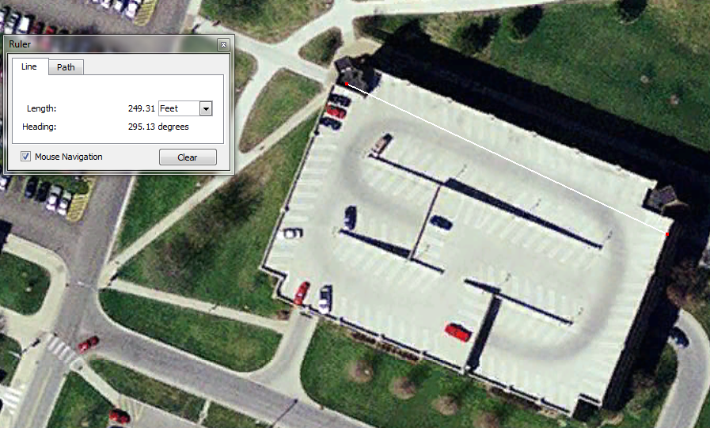
Engineering Technology Garage Measurement
Figure 2 – Garage Map and Measurement
One university. Two great names.

Slide 9
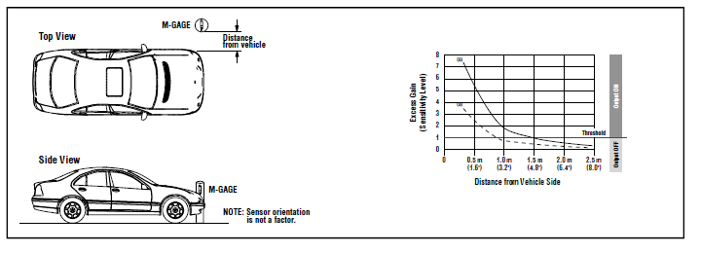
Sensor Mounted 1 Meter Above Ground
Figure 3 – Sensor Response When Mounted 1 Meter Above Ground Beside Vehicle [1]
One university. Two great names.

Slide 10
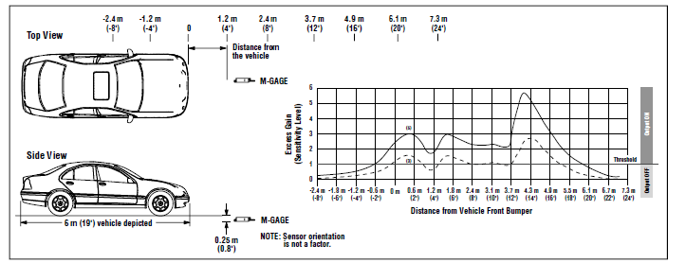
Sensor Mounted 0.25 Meters Below Ground
Figure 4 – Sensor Response When Mounted 0.25 Meters Below Ground in Center of Traffic Lane [1]
One university. Two great names.

Slide 11
EMI Filter
AC Connection (INT)
AC Connection (EXT)
AC Connection (EXT)
AC Connection (INT)
Figure 5 – EMI Filter Circuit Diagram [2]
One university. Two great names.

Slide 12
Sensor Power Supply
Figure 6 – Sensor Power Supply Block Diagram [3]
One university. Two great names.

Slide 13
Input Subsystem
NPN Output
Digital I/O Board Input Pin
PNP
Output
Digital I/O Board Ground
Figure 7 – Input Subsystem, ABB Optocoupler Circuit Diagram [4]
One university. Two great names.

Slide 14
Output Subsystem
Digital I/O Board +5V DC
Remote Teach Pin
Digital I/O Board Ground
Sensor Power Supply DC - Pin
Digital I/O Board Output
Figure 8 – Output Subsystem, Weidmuller Optocoupler [5]
One university. Two great names.

Slide 15
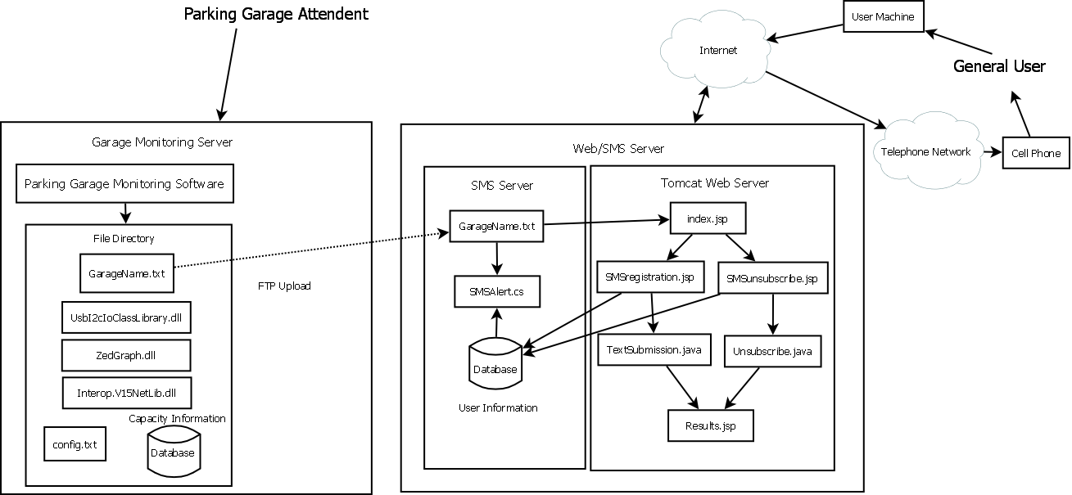
Overview of Software System Architecture
Figure 9 – Software System Architecture
One university. Two great names.

Slide 16
Sensor Server Software Class Diagram
Program
Main Form
Sign Class
FTP
LED Sign Simulator
Add Sensors Form
Sign Form
FTP Form
Graph Form
Garage Sensors
Add Garage Form
Garage
Figure 10 – Sensor Server Software Class Diagram
One university. Two great names.

Slide 17
Sensor Server Software State Transition Diagram
Figure 11 – Sensor Server Software State Transition Diagram
One university. Two great names.

Slide 18
SMS Alert Software State Transition Diagram
Figure 12 - SMS Alert Software State Transition Diagram
One university. Two great names.

Slide 19
User Input Servlets State Transition Diagram
Figure 13 – User Input Servlets State Transition Diagram
One university. Two great names.

Slide 20
System Testing
20
One university. Two great names.

Slide 21
Sensor Testing
Figure 14 – Sensor Testing Rig
One university. Two great names.

Slide 22
Sensor Testing (cont.)
Distance Vehicle Detected | Height Above Ground | Distance From Vehicle | Vehicle Speed | Sensitivity Level | Errors?
0 | 18 inches | 9 inches | 5mph | 6 | Tripped Twice
0 | 18 inches | 9 inches | 5mph | 5 | No Trips
0 | 18 inches | 9 inches | 5mph | 4 | No Trips
0 | 18 inches | 9 inches | 5mph | 3 | No Trips
0 | 18 inches | 9 inches | 5mph | 2 | No Trips
0 | 18 inches | 9 inches | 5mph | 1 | No Trips
16 feet | 30 inches | 9 inches | 2mph | 6
0 | 30 inches | 9 inches | 2mph | 5 | No Trips
0 | 30 inches | 9 inches | 2mph | 4 | No Trips
0 | 30 inches | 9 inches | 2mph | 3 | No Trips
0 | 30 inches | 9 inches | 2mph | 2 | No Trips
0 | 30 inches | 9 inches | 2mph | 1 | No Trips
12 feet | 30 inches | 19 inches | 2mph | 6
 | 30 inches | 19 inches | 2mph | 5 | No Trips
 | 30 inches | 19 inches | 2mph | 4 | No Trips
 | 30 inches | 19 inches | 2mph | 3 | No Trips
 | 30 inches | 19 inches | 2mph | 2 | No Trips
 | 30 inches | 19 inches | 2mph | 1 | No Trips
Table 1 – Sensor Testing Results
One university. Two great names.

Slide 23
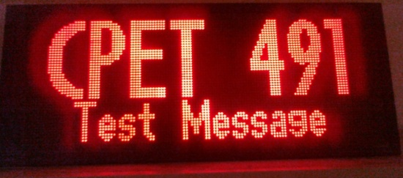
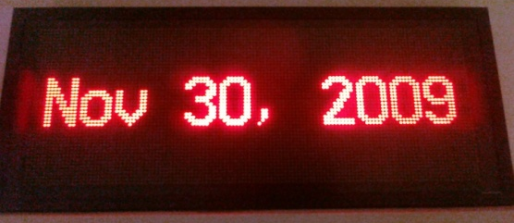
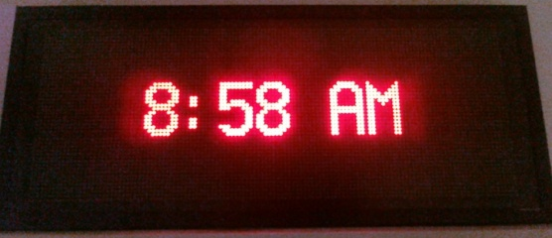
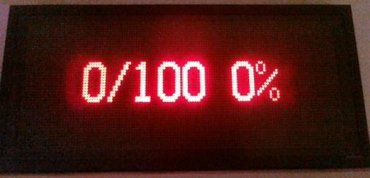
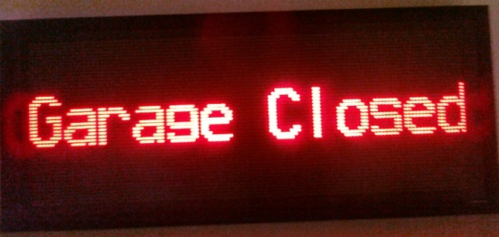
LED Sign Testing
Figure 15 – LED Sign Testing
One university. Two great names.

Slide 24
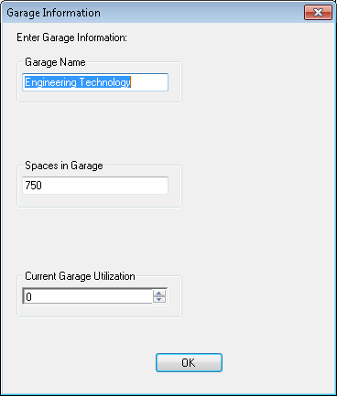
Garage Configuration Dialog
Figure 17 – Garage Configuration Dialog
One university. Two great names.

Slide 25
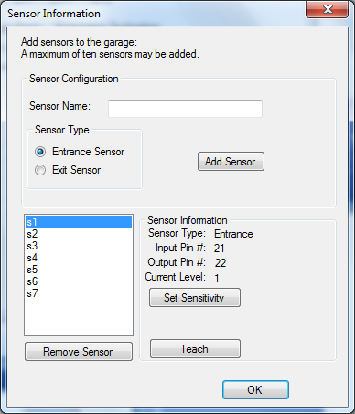
Sensor Configuration Dialog
Figure 18 – Sensor Configuration Dialog
One university. Two great names.

Slide 26
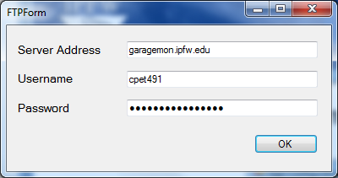
FTP Configuration Dialog
Figure 20 – FTP Configuration Dialog
One university. Two great names.

Slide 27
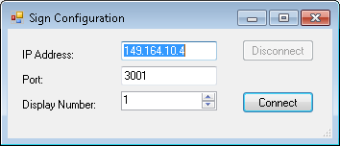
Sign Configuration Dialog
Figure 19 – Sign Configuration Dialog
One university. Two great names.

Slide 28
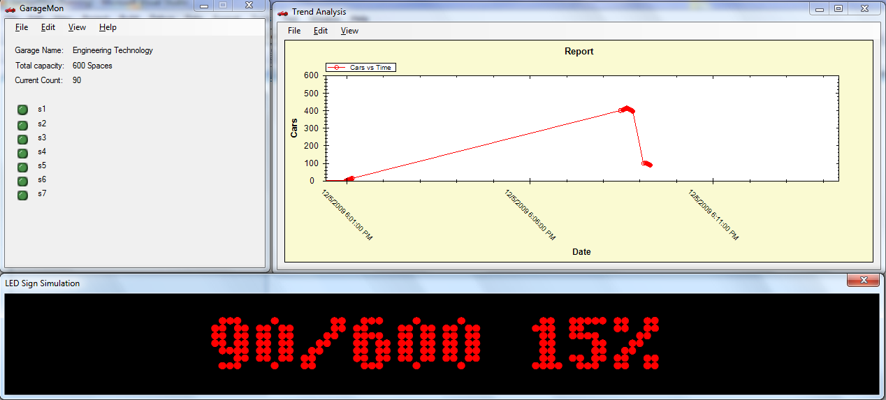
Sensor Server Software Main Form
Figure 16 – Sensor Server Software Main Form
One university. Two great names.

Slide 29
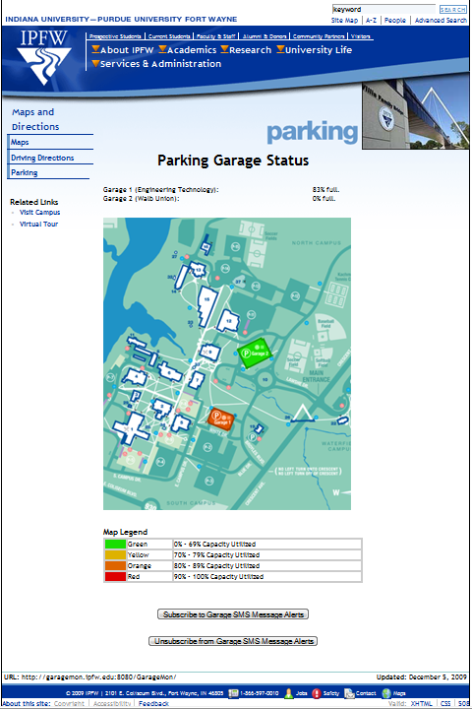
Parking Garage Status Web Page
Figure 21 - Parking Garage Status Web Page
One university. Two great names.

Slide 30
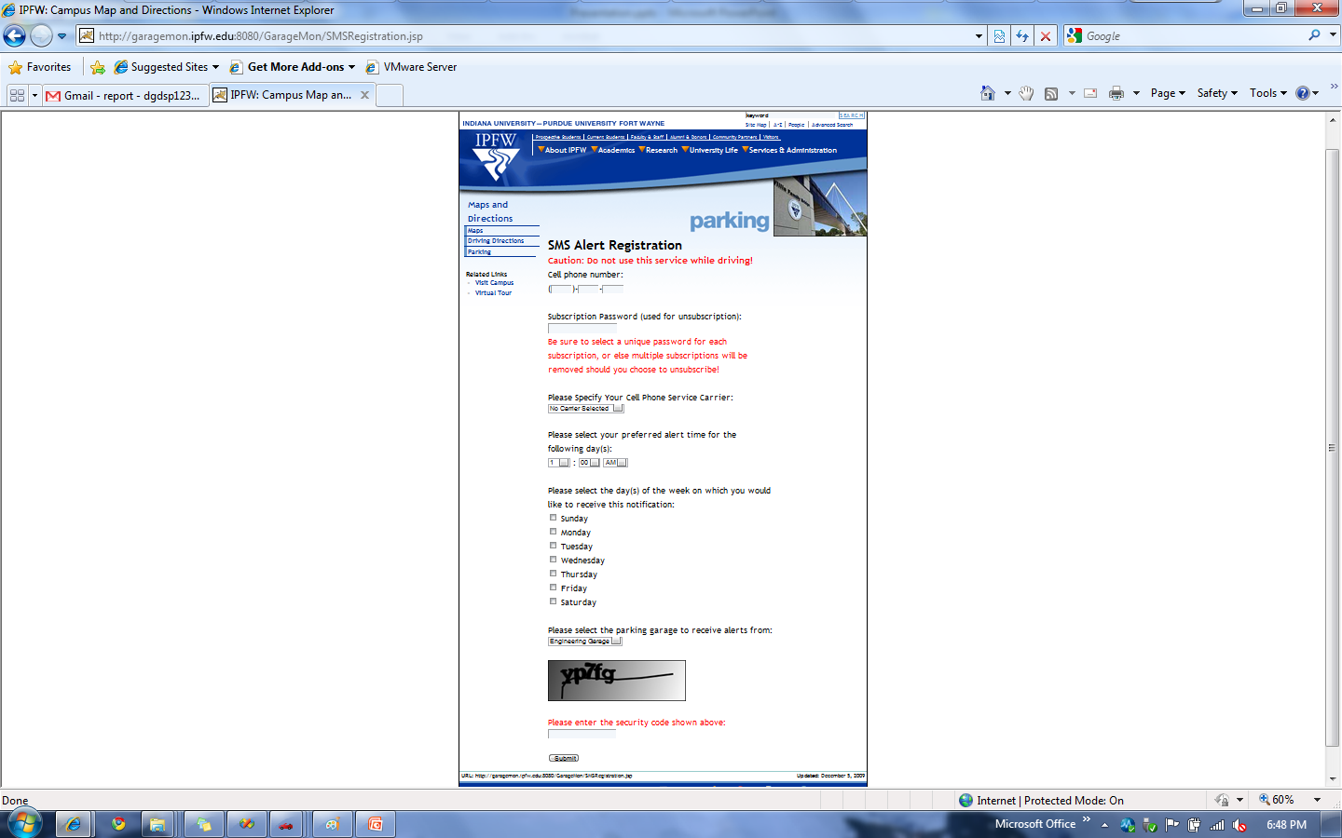
Parking Garage SMS Alert Subscription Page
Figure 22 – Parking Garage SMS Alert Registration Form
One university. Two great names.

Slide 31
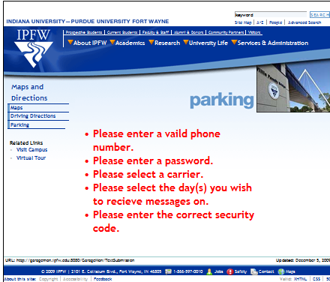
SMS Alert Subscription Error Page
Figure 23 – Parking Garage SMS Alert Registration Form
One university. Two great names.

Slide 32
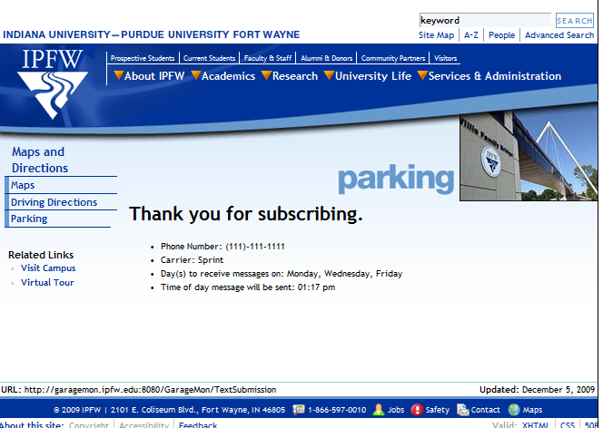
SMS Alert Subscription Confirmation Page
Figure 24 –SMS Alert Registration Confirmation Page
One university. Two great names.

Slide 33
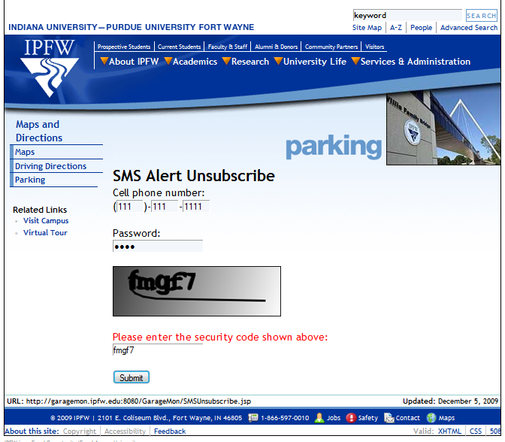
Parking Garage SMS Alert Unsubscribe Page
Figure 25 – Parking Garage SMS Alert Registration Form
One university. Two great names.

Slide 34

SMS Alert Unsubscribe Error Page
Figure 26 –SMS Alert Unsubscribe Confirmation Form
One university. Two great names.

Slide 35

SMS Alert Unsubscribe Confirmation Page
Figure 27 –SMS Alert Unsubscribe Confirmation Form
One university. Two great names.

Slide 36
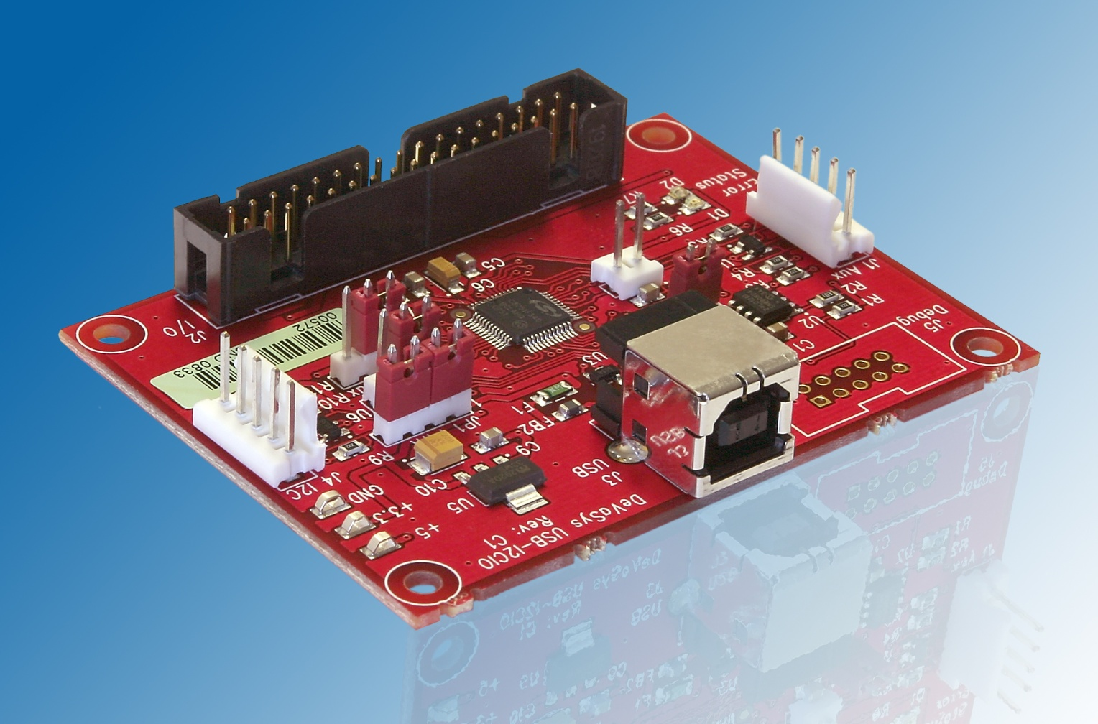
USB I²C/IO Board
Figure 28 – USB I²C/IO Board [6]
One university. Two great names.

Slide 37
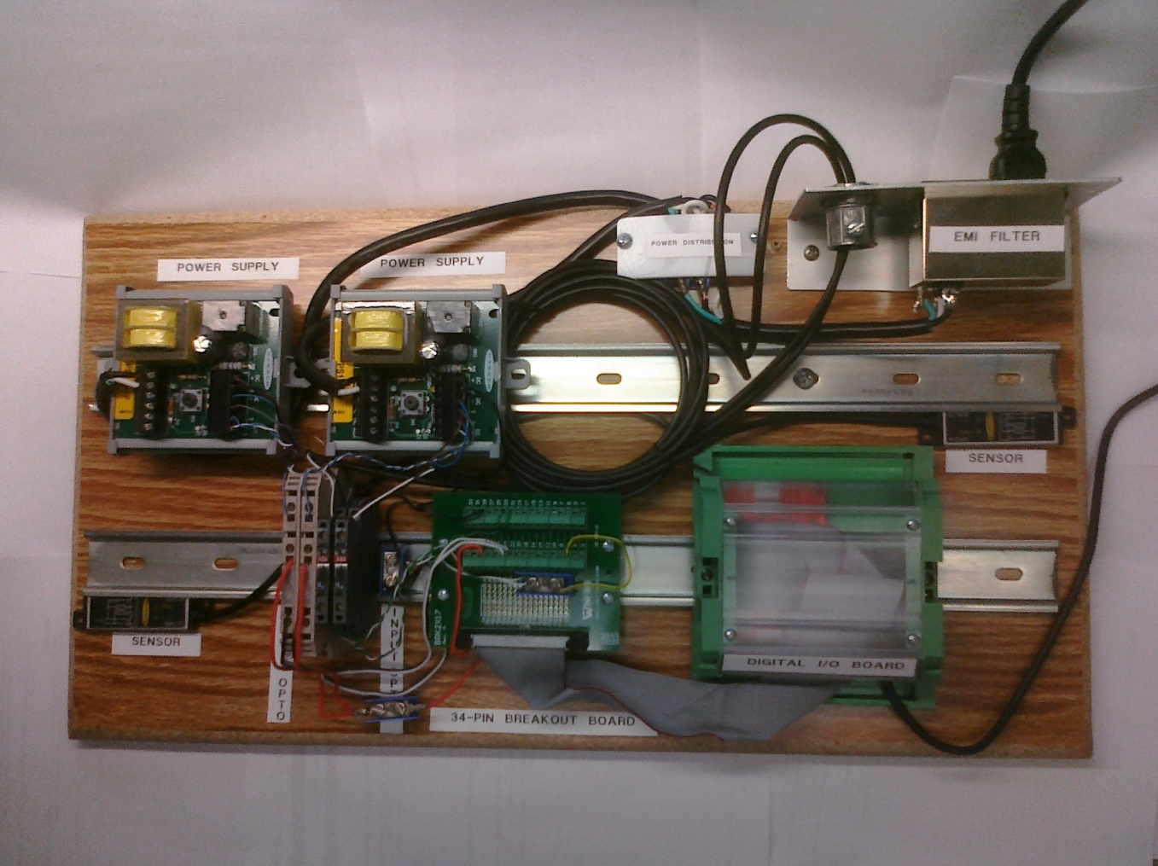
Final Project Board
Power Supply
Power Distribution
Power Supply
EMI Filter
Output Optocoupler
Sensor
Sensor
Digital I/O Board
Input Optocoupler
34-Pin Breakout Board
Figure 29 – Final Project Board
One university. Two great names.

Slide 38
Project Cost
Item | Quantity | Unit Cost | Total Cost | Actual Cost
Banner Engineering Q7MB Sensor | 2 | $221.00 | $442.00 | $0.00 (Donated)
PS115-1P Sensor Power Supply | 2 | $68.00 | $136.00 | $0.00 (Donated)
ABB R900 OBC0100-24VDC Optocoupler | 2 | $29.29 | $58.58 | $0.00 (Donated)
Weidmuller 839894-TTL Optocoupler | 2 | $31.08 | $62.16 | $0.00 (Donated)
Devasys USB Digital I/O Board | 1 | $89.00 | $89.00 | $0.00 (Donated)
34-pin Breakout Board | 1 | $29.50 | $29.50 | $29.50
34-pin Ribbon Cable | 1 | $1.75 | $1.75 | $0.00 (Had Part)
1 Meter DIN Rail | 1 | $8.90 | $8.90 | $8.90
Qualtek 862-06/001 Power Line Filter | 1 | $13.25 | $13.25 | $0.00 (Donated)
2x1’ Laminated Wood Board | 1 | $15.00 | $15.00 | $0.00 (Donated)
Electrical Conduit End | 1 | $1.50 | $1.50 | $0.00 (Donated)
High Quality Power Cable | 2 | $12.00 | $24.00 | $0.00 (Donated)
Philips Wood Screws | 8 | $0.34 | $2.72 | $0.00 (Donated)
PVC Plastic Sheet | 1 | Unknown | Unknown | $0.00 (Donated)
Spool of Wire | 3 | $3.99 | $11.97 | $11.97
Aluminum Sheet, stamped | 1 | Unknown | Unknown | $0.00 (Donated)
Fuse | 1 | Unknown | Unknown | $0.00 (Donated)
Screw-down Terminal | 5 | Unknown | Unknown | $0.00 (Donated)
1 Hour of Work Time | 120 | Unknown | Unknown | Unknown
 |  |  | $896.33 | $50.37
Table 2 – Project Cost
One university. Two great names.

Slide 39
Summary
Conclusion
  Project was a success
  Project goals reached
  Provided invaluable project design, build, and management experience
Lessons Learned
  Project completion estimate is a difficult matter
  Learned how to work with third party vendors for support / donations
  Exercised programming skills
  Exercised system integration skills
One university. Two great names.

Slide 40

References
[1] Banner Engineering Inc. (2009, Sep.) M-GAGE Q7M Flat-Pak. [Online]. http://info.bannersalesforce.com/xpedio/groups/public/documents/literature/117172.pdf
[2] Qualtek Electronics Corp. (2009, Sep.) Qualtekusa.com. [Online]. http://www.qualtekusa.com/Catalog/EMI_Filters/pdf/86206001.pdf
[3] Banner Engineering. (2009, Sep.) Models PS24-1.andPS115-1.Sensor Interface Modules. [Online]. http://info.bannersalesforce.com/xpedio/groups/public/documents/literature/123566.pdf
[4] ABB Electronics Corporation. (2009, Sep.) R600 optocoupler modules. [Online]. http://www.abb-control.com/electronicscat/AC02020.19-22.pdf
[5] Weidmuller. (2009, Sep.) Product catalogue. [Online]. http://catalog.weidmueller.com/procat/Product.jsp;jsessionid=8E30EB96587EA790A4F2FBEF92631B36?productId=([8398940000])&page=Product
[6] Devasys. (2009, Dec.) USB-I2C/IO P.C.B. (Rev. C1). [Online]. http://www.devasys.com/images/products/usbi2cio/rev_c1/i2cio_lg.jpg
One university. Two great names.

Slide 41
Questions?
One university. Two great names.

Slide 42
DEMO
One university. Two great names.

