Slide 1

Wind Speed Data Logger
Chuck Craft, Chuck Craft., Jr.,
Professor Paul I-Hai Lin
Date: Sept. 20-23, 2012

Slide 2
Project Outline
Introduction
Problem Statement/Solution
System design
Hardware design
Software design
Integration
testing
Conclusion

Slide 3
Introduction
Wind Speed Data Logger project supports the renewable energy market
Large wind generator installations are located in Indiana and Ohio
Average wind speed site surveys predict wind generator return on investment
Test towers erected at potential wind generator sites to gauge average wind conditions
Residential wind generator installations have the potential to be profitable
Wind speed data logger project provides affordable tool for residential wind survey

Slide 4
Problem Statement/Solution
Viable wind energy exists in our area
Wind generator output power is dependent on
  Structures
  Site topology
Industrial wind survey equipment is expensive
Wind speed data logger provides affordable easy to use tool for residential wind survey

Slide 5
System Design
Anemometer
End point controller
Access point controller
Data logger controller

Slide 6
System Requirements
The prototype shall measure wind speed
The prototype shall transfer wind speed information from sensor to data logging device
The prototype shall store wind speed information in non-volatile memory
The prototype shall accept operator input and display wind speed
The prototype shall be capable of measuring wind speeds between 5 and 50 miles per hour

Slide 7
System requirements (Cont.)
The anemometer output shall be electrically conditioned to logic levels
The pulse stream from the anemometer shall be converted to one pulse per second at a wind velocity of 2.5 miles per hour
The anemometer shall be designed for pole mounting
Outdoor based electronics shall be mounted in an enclosure
The electronics shall operate off of standard household AC power
Information shall be transferred from the anemometer to a processing element via a data link, either cabled or RF

Slide 8
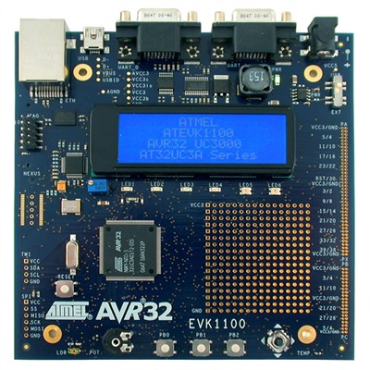
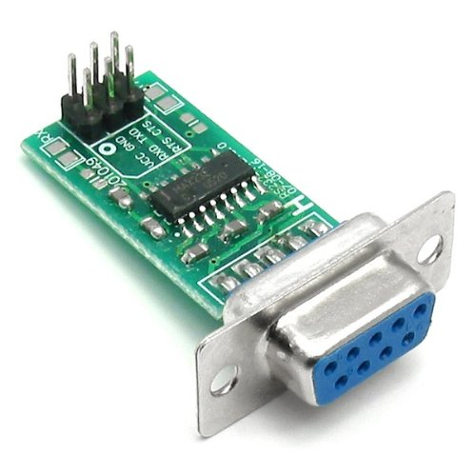
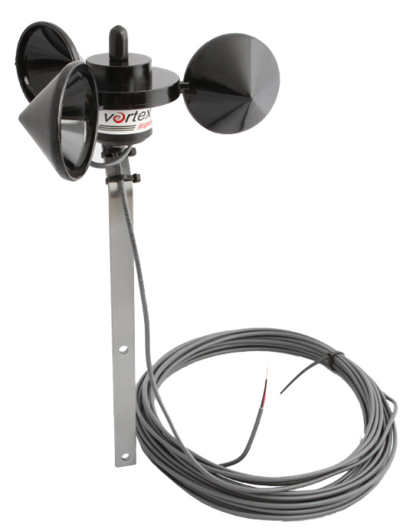
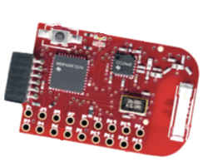
Hardware Design
Commercial Off The Shelf (COTS)building blocks
  Vortex anemometer
  Texas Instruments eZ430 evaluation module
  Atmel AVR32 EVK1100 development module
  RS232 adaptor

Slide 9
Hardware Design (Cont.)
Vortex Anemometer Specifications
Sensor type
  3-Cup rotor reed switch/magnet provides 1 pulse per rotation
Output
  1 pulse per rotation at 2.5 mph
Rotor diameter
  Approximately 5 inches
Speed range
  Approximately 3 mph to 125+ mph

Slide 10
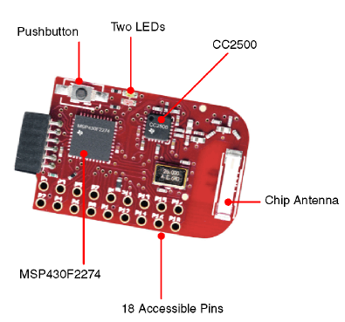
Hardware Design (Cont.) eZ430 Module Specifications
MSP430F2274
  16-bit RISC architecture
  Internal calibrated oscillator
  16-bit timers A and B with capture/compare registers
  UART
CC2500
  2.4 GHz to 2.4835 GHz output
  +1 dBm output level (~1.3mW)
  Multiple modulation formats
  SPI digital interface

Slide 11
  Hardware Design (Cont.)
  EVK1100 Development Module Specifications
AT32UC3A0512 processor
  32-bit RISC architecture
  Real Time Operating System (RTOS)
  512 Kbytes Flash memory
Peripherals
  RS232 (x2)
  USB
  LCD
  Ethernet
  Secure Digital memory slot

Slide 12
  Hardware Design (Cont.)
  RS232 to TTL Adaptor Module Specifications
MAX232A device from Maxim-ic
  Logic level serial data receive and transmit pins
  RS232 level serial receive and transmit pins
  0.1” center stakes for logic signal connection to custom circuit board
  Standard 9-pin D connector for RS232 cable connection

Slide 13
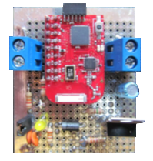
  Hardware Design (Cont.)
  End point controller Construction
Custom built module
  eZ430 module
  6 VDC to 40 VDC input, 3.3 VDC output linear regulator circuit
  Anemometer cable termination circuit
  Power indicator LED
  Terminal blocks for external power supply and anemometer connections

Slide 14
  Hardware Design (Cont.)
  End point controller Schematic

Slide 15
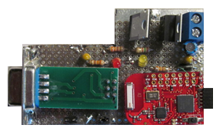
  Hardware Design (Cont.)
  Access point controller Construction
Custom built module
  eZ430 module
  6 VDC to 40 VDC input, 3.3 VDC output linear regulator circuit
  6 VDC to 40 VDC input, 5.0 VDC output linear regulator circuit
  Power indicator LED (x2)
  Terminal block for external power
  TTL to RS232 adaptor module

Slide 16
  Hardware Design (Cont.)
  Access point controller Schematic

Slide 17
Software Design Overview
End point controller function
  Join radio network as end point
  Measure anemometer and calculate wind speed
Access point controller function
  Control radio network as access point function
  Receive information from all end point controllers and send to data logger
Data logger function
  Provide UART shell interface to allow access to display and SD memory peripherals
Software design tools
  Code Composer Studio v4
  AVR Studio 5.0

Slide 18
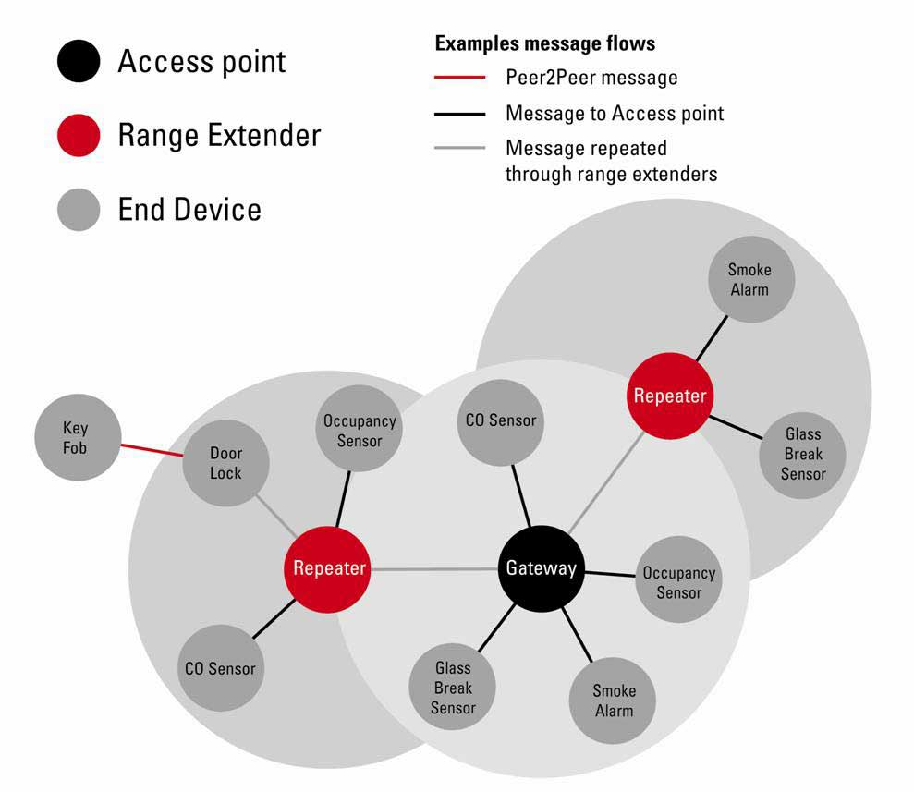
Software Design (Cont.)
SimpliciTI network protocol
Five command API

Slide 19
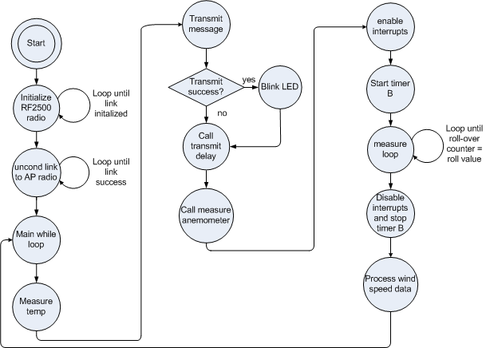
Software Design (Cont.)
End Point Controller

Slide 20
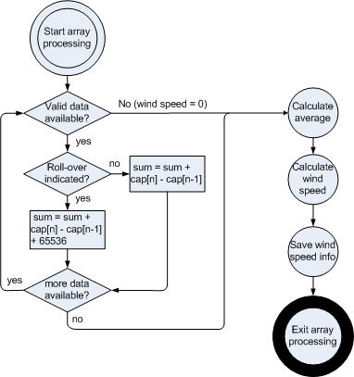
Software Design (Cont.)
End Point Controller Data Processing
$$Wind Speed \left(mph\right)=\left(int\right) (0.5+\frac{25}{\left(average count∗0.000008\right)})$$

Slide 21
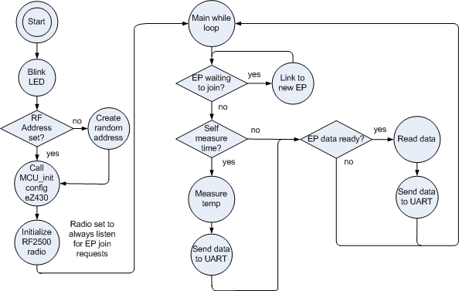
Software Design (Cont.)
Access Point Controller

Slide 22
Software Design (Cont.)
Data Logger Controller
Real Time Operating System (RTOS) example program
Shell tasks provided for UART, Ethernet, and USB ports
Modified memory control task to include system time on memory append command
Four commands used by access point to control data logger
  Write string to LCD line four
  Select drive B (SD memory module)
  Append string to log file
  ^q (exit append and save file)

Slide 23
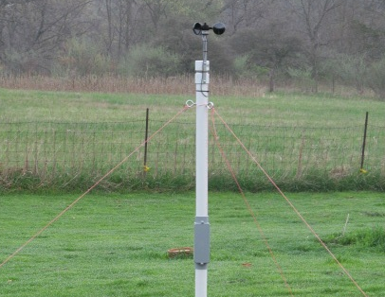
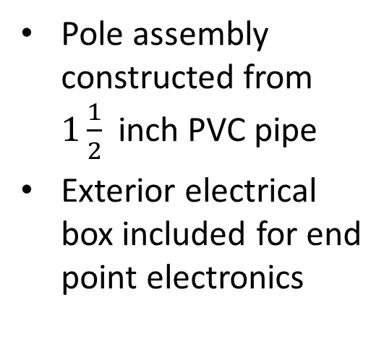
Integration
Pole assembly constructed from $1\frac{1}{2}$inch PVC pipe
Exterior electrical box included for end point electronics

Slide 24
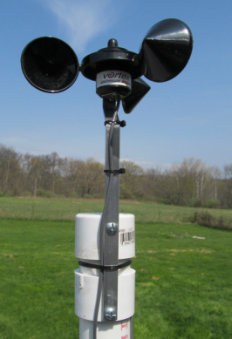
Integration (Cont.)
Anemometer mounted to top of pole with cable coiled inside top section of pipe
End point electronics module and power adaptor located in center box

Slide 25
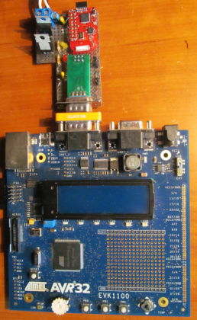
Integration (Cont.)
Access point controller connected to data logger module
Null modem adaptor used to reverse transmit and receive signals

Slide 26
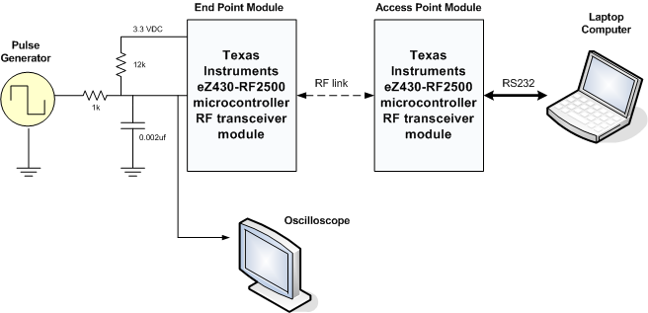
RF Subsystem Testing
Signal generator used to emulate anemometer input signal
Testing from 5 mph to 50 mph in 5 mph steps indicated a maximum error of 0.4 mph

Slide 27
System Testing
System installed in outdoor location for 6 days
Unit ran continuously through rain and cold weather
Recorded 90,225 data entries during test
Log file size at end of test was 4,848 Kbytes
Example data from log file
  EP 1, TEMP = 60.4 F,RSSI = 016, WS = 00.0 mph201203242137000
  EP 1, TEMP = 61.1 F,RSSI = 017, WS = 02.9 mph201203242137000
  EP 1, TEMP = 60.4 F,RSSI = 017, WS = 03.2 mph201203242137000
  EP 1, TEMP = 60.4 F,RSSI = 017, WS = 03.2 mph201203242137000
  EP 1, TEMP = 60.4 F,RSSI = 016, WS = 03.3 mph201203242138000
  EP 1, TEMP = 60.4 F,RSSI = 016, WS = 02.8 mph201203242138000
  EP 1, TEMP = 61.1 F,RSSI = 017, WS = 00.0 mph201203242138000
  EP 1, TEMP = 60.4 F,RSSI = 015, WS = 02.9 mph201203242138000

Slide 28
System Testing (Cont.)
6 day test data plotted using Microsoft Excel

Slide 29
Conclusion
Project exceeded all requirements
Completed on time and under budget
Future versions could eliminate EVK1100 module to save money

Slide 30
Questions?

Slide 31

Demonstration

