Slide 1
ITC 250/CPET 499 Web Systems
E-Commerce & Business: an Introduction
References: *Chapter 1 of the text book: e-Commerce: Business, Technology, and Society, 9th edition, 2014, by K. C. Laudon and C. G. Traver, publisher Pearson Education Inc., * World Street Journal * U.S. Census Bureau
Paul I-Hai Lin, Professor
http://www.etcs.ipfw.edu/~lin

Slide 2
Topics
E-Commerce
Major Trend in E-Commerce
E-Commerce Definitions
E-Commerce vs. E-Business
Unique Features of E-Commerce Technology
Types of E-Commerce
Origins and Growth of E-Commerce
Technology and E-Commerce in Perspective
Insights on Technology

Slide 3
Topics (continue)
E-Commerce: A Brief History
E-Commerce 1995-2000: Innovation
E-Commerce 2001-2006: Consolidation
E-Commerce 2006-Present: Re-innovation
Insight on Business
Assessing E-Commerce: Success, Surprises, and Failure
Prediction for the Future

Slide 4
Topics (continue)
Understanding E-Commerce
Technology: Infrastructure
Business: Basic Concepts
Society: Taming the Juggernaut
Insight on Society
Online Privacy
Case Study: The Pirate Bay

Slide 5
Types of Business & E-Commerce
U.S. Census Bureau Definitions, http://www.census.gov/econ/estats/definitions.html#e
E-Commerce: This term describes transactions sold on-line whether over open networks such as the Internet or proprietary networks running systems such as Electronic Data Interchange (EDI).
Brick-and-mortar retailers: This is a business model by which a company integrates both offline (bricks) and online (clicks) presences.

Slide 6
Types of Business & E-Commerce
Business-to-business (B-to-B or B2B): This term describes commerce transactions between businesses, such as between a manufacturer and a wholesaler, or between a wholesaler and a retailer. In regards to the E-Stats report, this by definition is transactions by Manufacturers and Merchant Wholesalers.
Business-to-consumer (B-to-C or B2C): This term describes activities of businesses serving end consumers with products and/or services. An example of a B2C transaction would be a person buying a pair of shoes from a retailer.

Slide 7
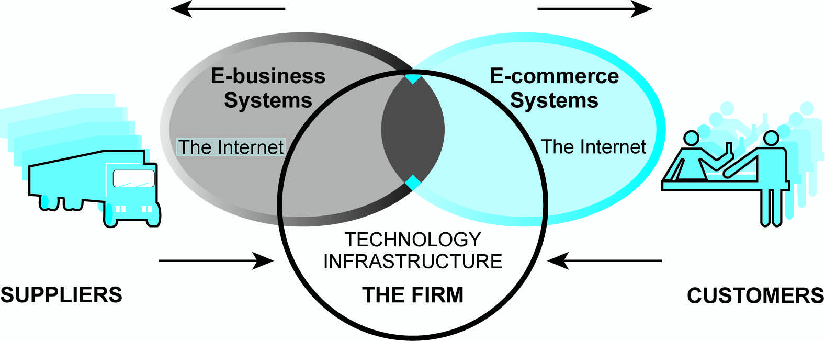
Figure 1.1 The Difference Between E-Commerce & E-Business (page 11)

Slide 8
Major Types of E-Commerce
Classified by Market Relationship or Technology
Business-to-Consumer (B2C)
Business-to-Business (B2B)
Consumer-to-Consumer (C2C)
Social E-Commerce
Mobile E-Commerce (M-commerce)
Local E Commerce

Slide 9
Major Types of E-Commerce
Classified by Market Relationship
Business-to-Consumer (B2C)
Portals Model (with search engines)
Horizontal portals (Yahoo, Google, Bing, Altivista, etc)
Vertical portals (WebMD)
Online Retailers (Store-Front Model with shopping cart: Amazon.com)
Content Providers
Transaction Brokers
Market Creators
Service Providers
Community providers, …

Slide 10
Major Types of E-Commerce
Classified by Market Relationship
Business-to-Consumer (B2C)
Business-to-Business (B2B)
E-Distributors
E-Procurement companies
Exchanges and Industry Consortia
Industrial Networks: single firm networks, industry-wide networks
Consumer-to-Consumer (C2C)

Slide 11
Major Types of E-Commerce
Classified by Market Relationship
Business-to-Consumer (B2C)
Business-to-Business (B2B)
Consumer-to-Consumer (C2C)
Auction Model: eBay
Craigslists Inc., https://www.craigslist.org/about/sites

Slide 12
Major Types of E-Commerce
Classified by Market Relationship
Business-to-Consumer (B2C)
Business-to-Business (B2B)
Consumer-to-Consumer (C2C)
Social E-Commerce
Facebook
Twitters
Mobile Commerce (M-commerce)
Using Mobile technology
iPhone, iPad, Android, Tablet,
Local E-Commerce

Slide 13
E-Stats from U.S. Census Bureau
E-Stats – Measuring the Electronics Economy, the 2012 E-commerce multi-sector “E-Stats” report, released May 22, 2014, http://www.census.gov/econ/estats/
U.S. Shipments, Sales, Revenue and E-Commerce: 2010 and 2011 (in billions of dollars)
Sector Analysis
Manufacturing
Merchant Wholesale
Retail
Selected Services

Slide 14
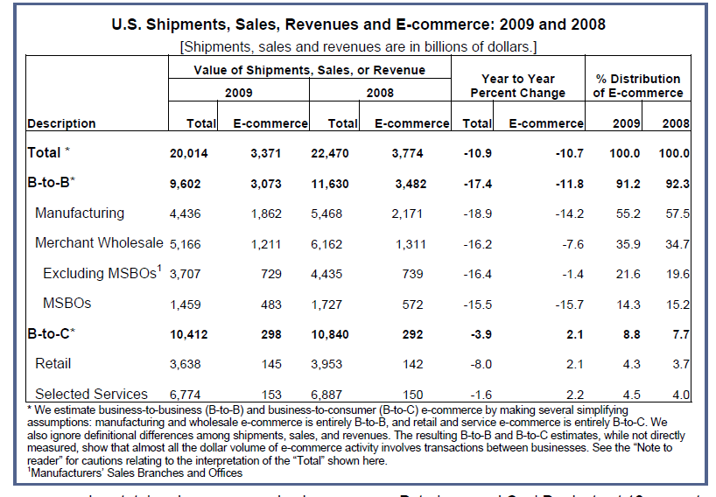
U.S. Shipments, Sales, Revenues and E-Commerce: 2009 and 2008

Slide 15
E-Commerce: Innovation, Consolidation, and Re-innovation
E-Commerce: A Brief History
E-Commerce 1995-2000: Innovation
E-Commerce 2001-2006: Consolidation
E-Commerce 2007-Present: Re-innovation
Insight on Business
Assessing E-Commerce: Success, Surprises, and Failure
Prediction for the Future

Slide 16
Summary

