Slide 1
CPET 499/ITC 250 Web Systems
Chapter 2
Introduction to HTML
Text Book:
* Fundamentals of Web Development, 2015, by Randy Connolly and Ricardo Hoar, published by Pearson
*E-Book on Building Web Applications with HTML, 2012, by Paul I. Lin, http://www.etcs.ipfw.edu/~lin/CECourses/2_HTML/CE_02WebHhtmlindex.html
Paul I-Hai Lin, Professor
http://www.etcs.ipfw.edu/~lin

Slide 2
Topics
What is HTML
HTML Syntax
Semantic Markup
Structure of HTML Documents
Quick Tour of HTML Elements
HTML Semantic Structure Elements
Summary

Slide 3
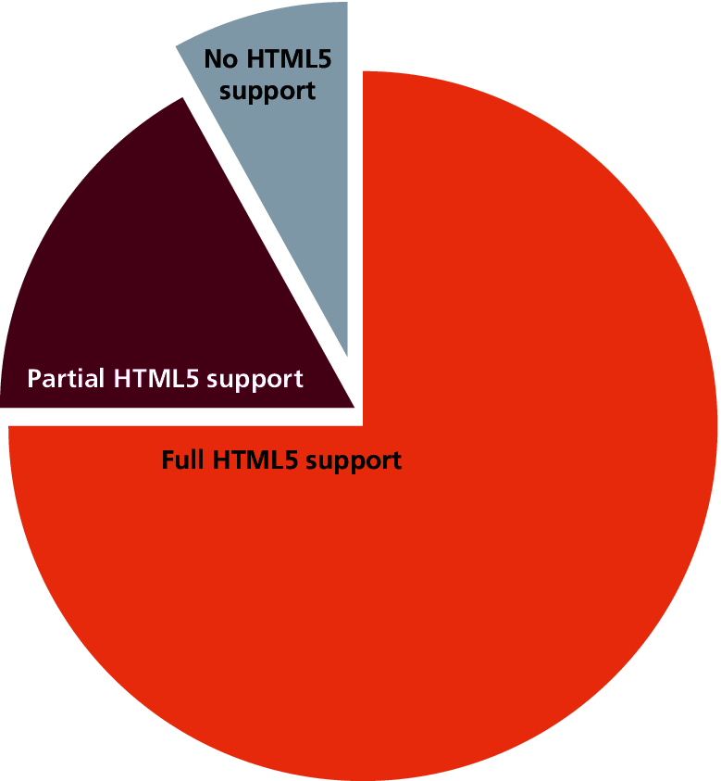
HTML Syntax
References of HTML standards
  HTML 5 - http://www.w3.org/TR/2014/REC-html5-20141028/
Figure 2.3 Browser usage and HTML support

Slide 4
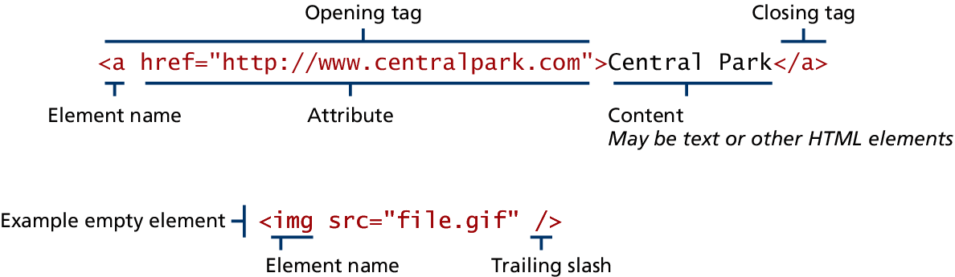
HTML Syntax
Figure 2.4 The parts of an HTML element

Slide 5
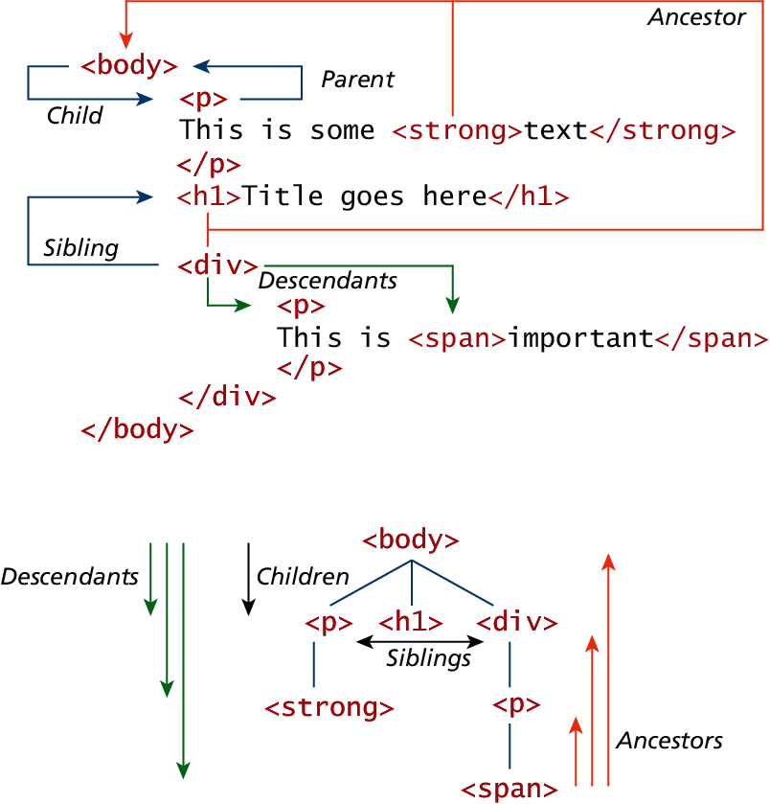
Figure 2.5 HTML document outline

Slide 6
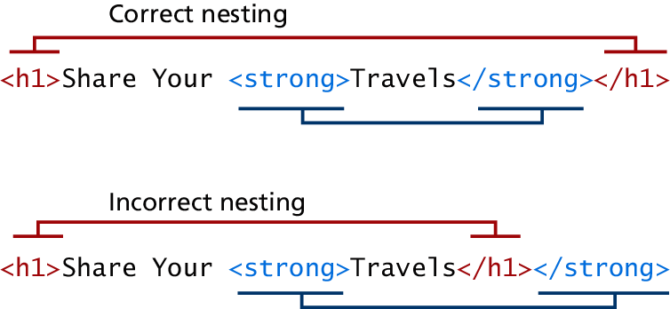
Figure 2.6 The proper nesting of HTML

Slide 7
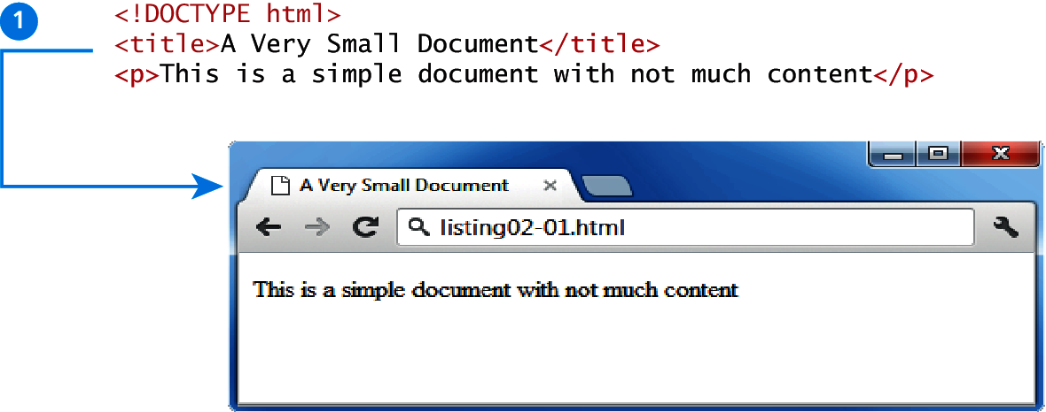
Figure 2.8 One of the simplest possible HTML5 documents

Slide 8
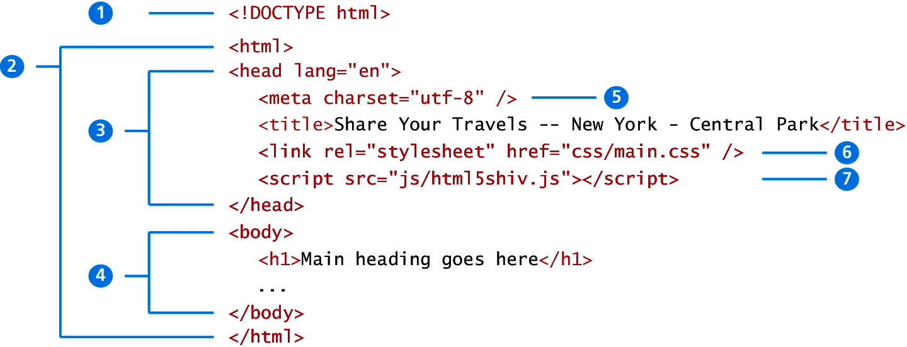
Figure 2.9 Structure elements of an HTML5 document

Slide 9
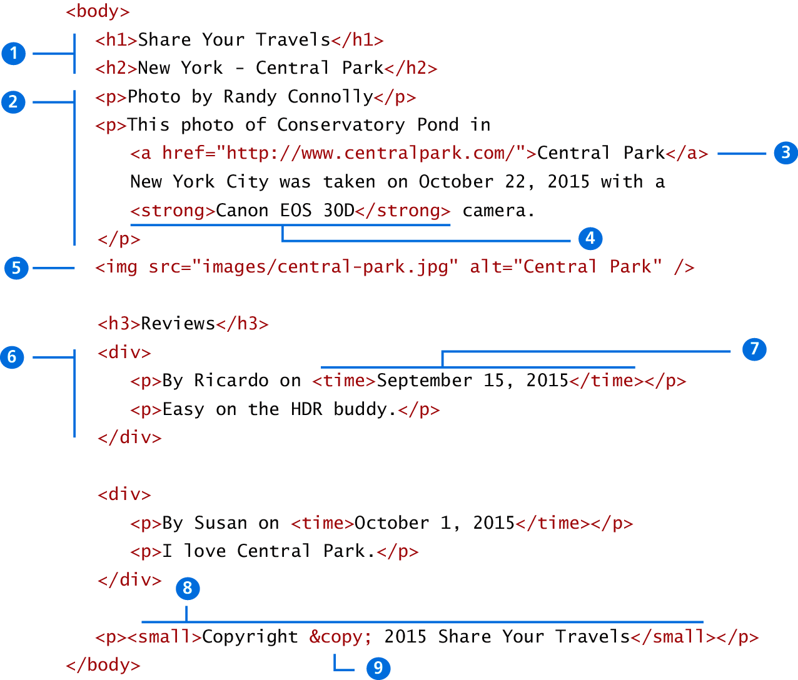
Figure 2.10

Slide 10
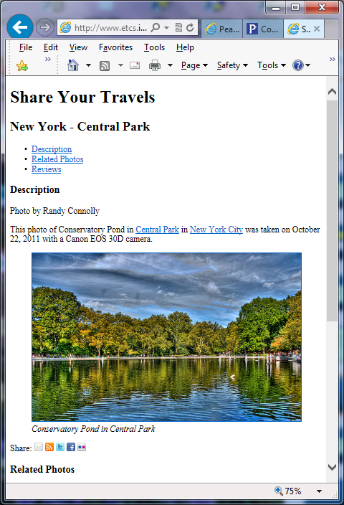
Figure 2.11 Share Your Travels – New York Central Park

Slide 11
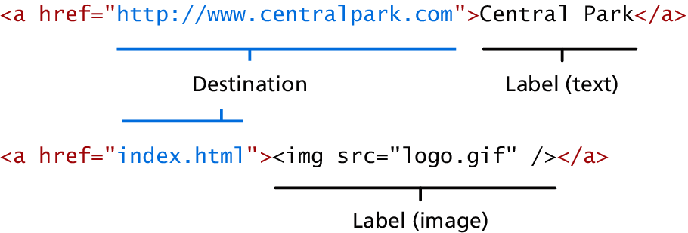
Figure 2.15 Two parts of a link

Slide 12
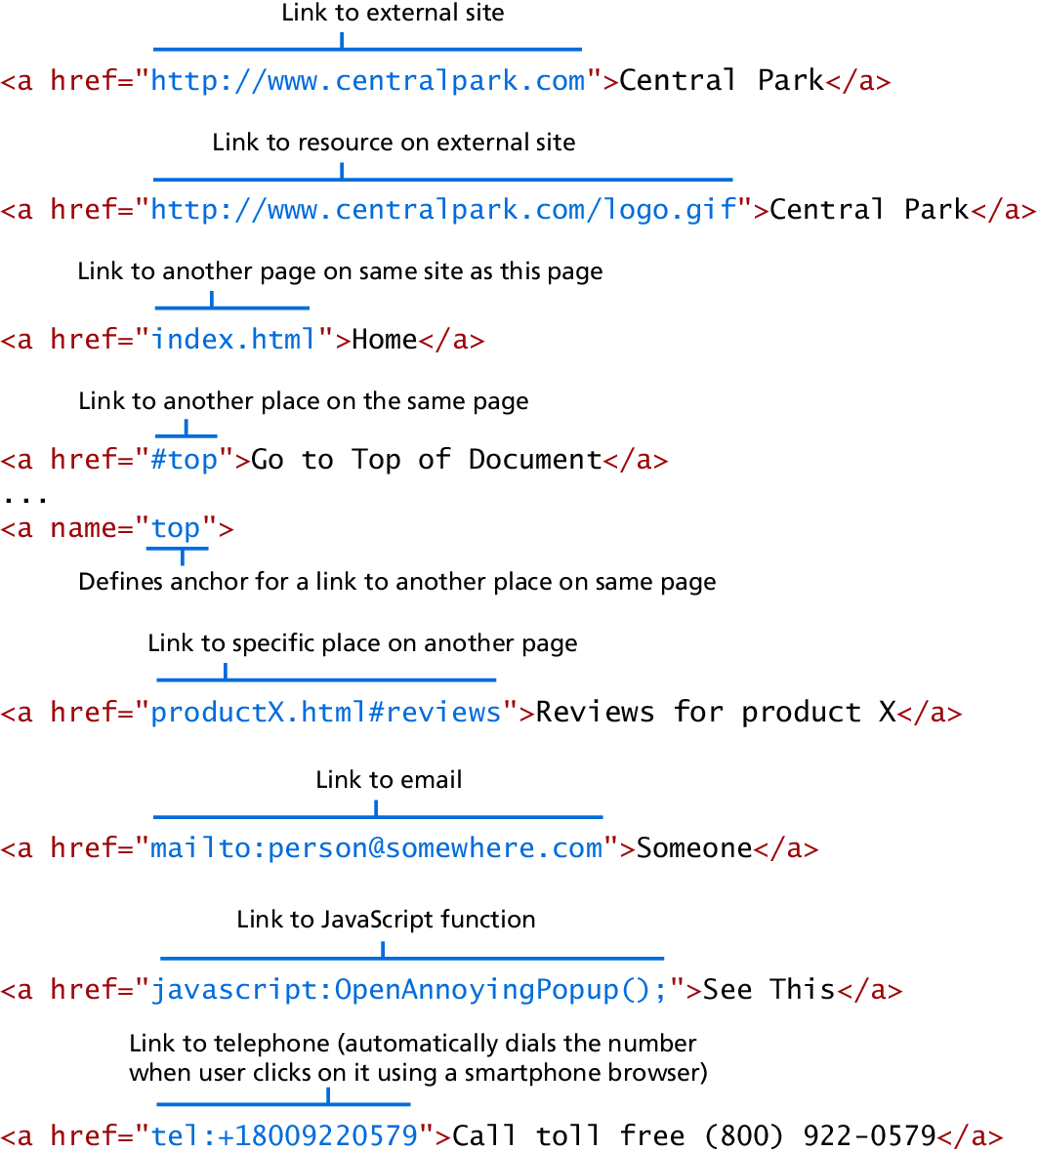
Figure 2.16 Different link destinations

Slide 13
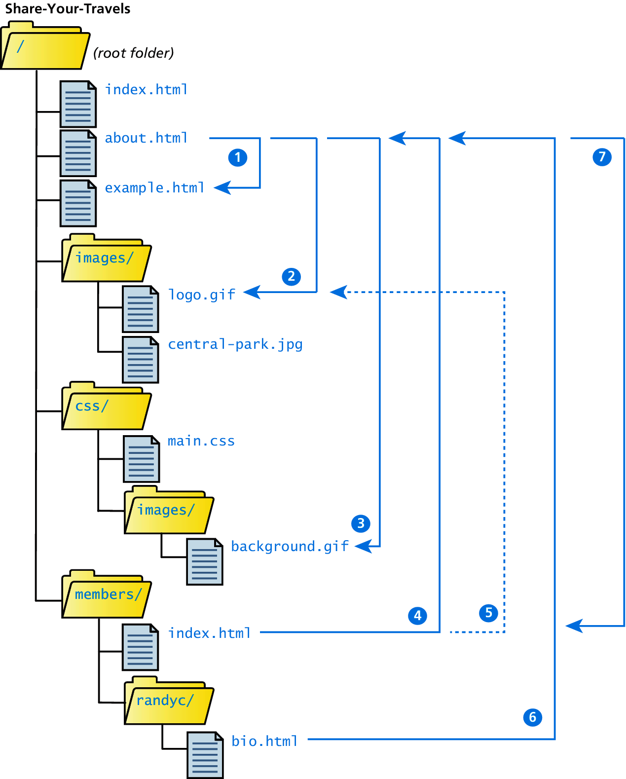
Figure 2.17 Example site directory tree

Slide 14
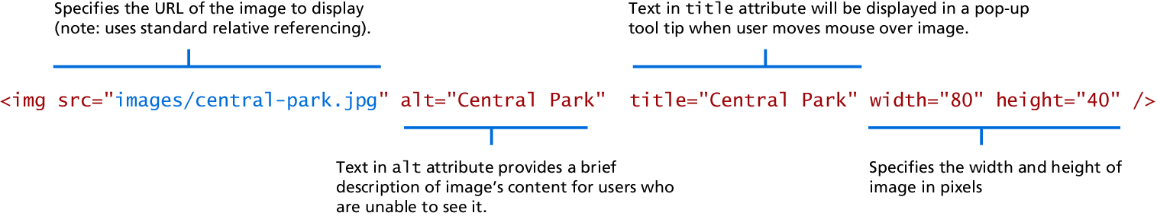
Figure 2.18 The <img> element

Slide 15
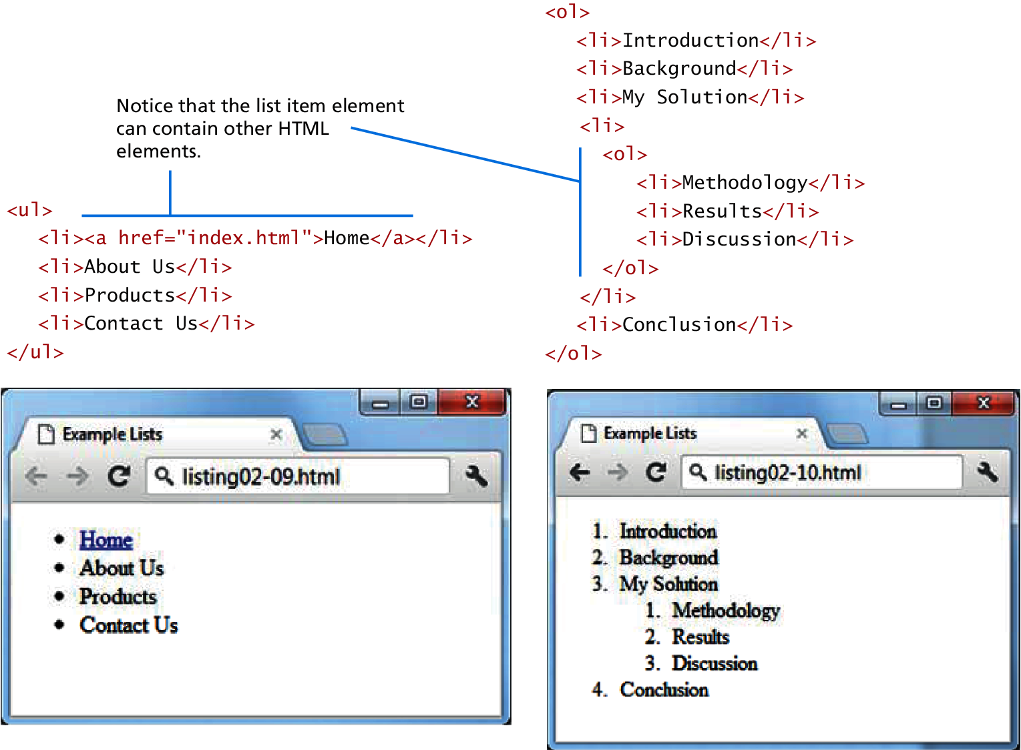
Figure 2.19 List elements and their default rendering

Slide 16
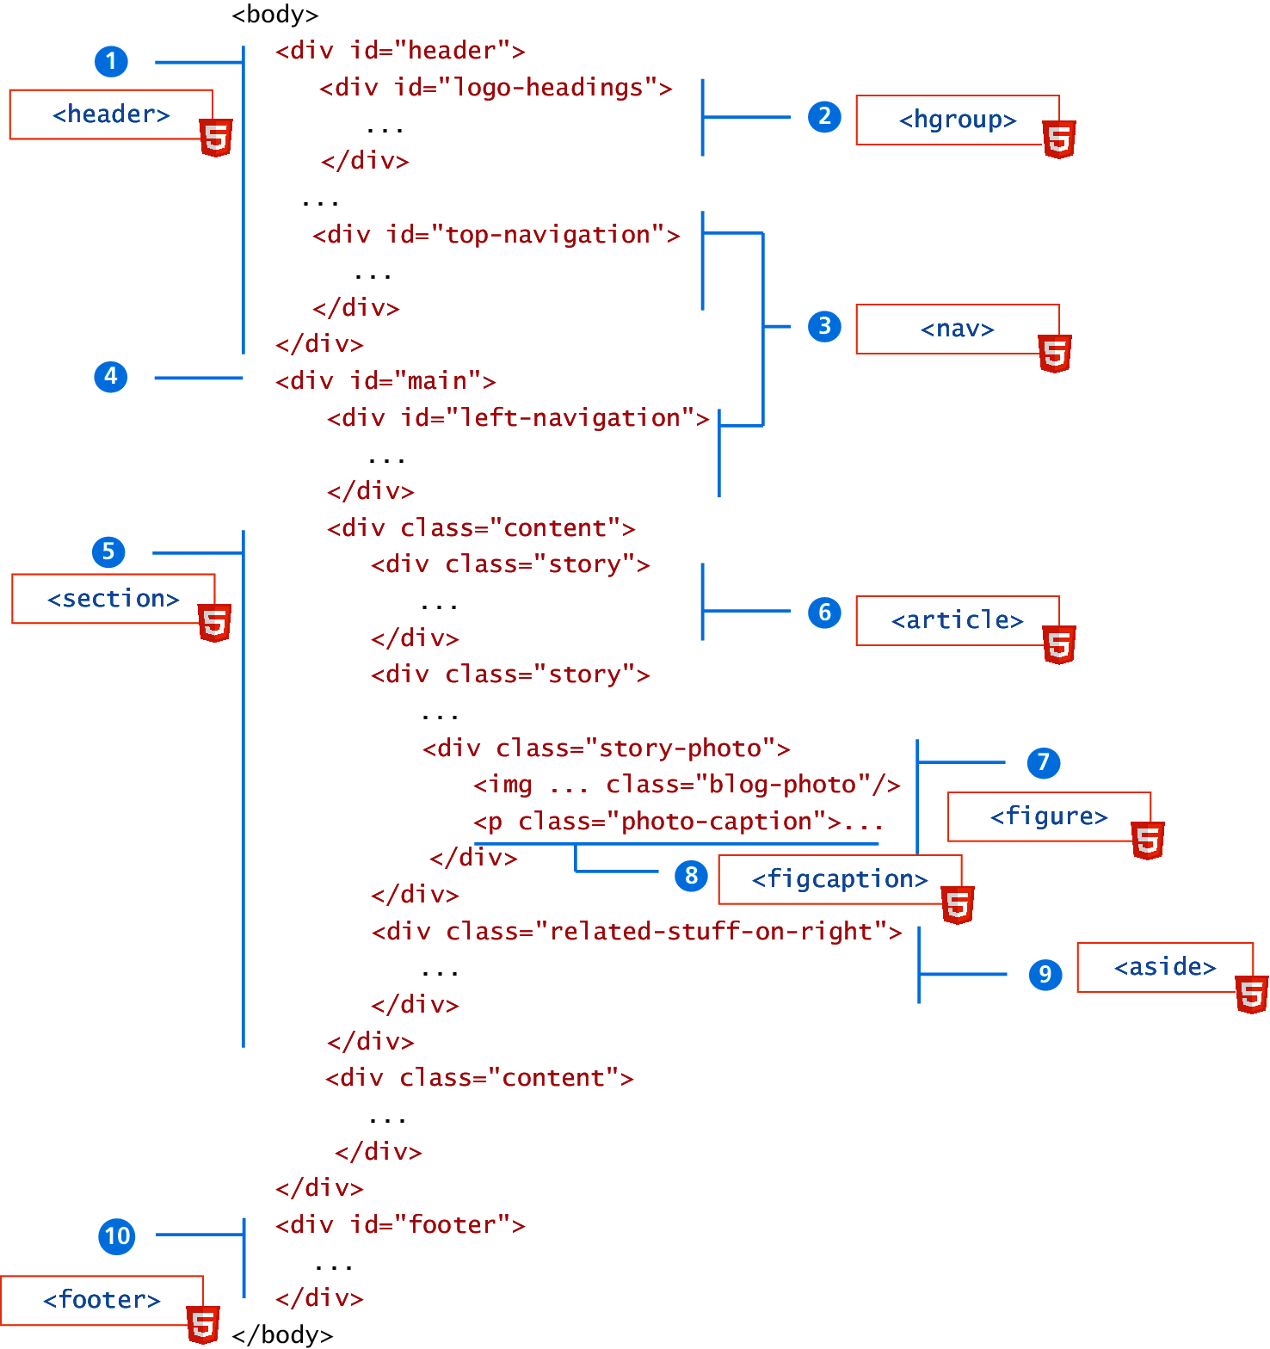
Figure 2.20 Sample <div> based XHTML layout (with HTML 5 equivalent) elements and their default rendering

Slide 17
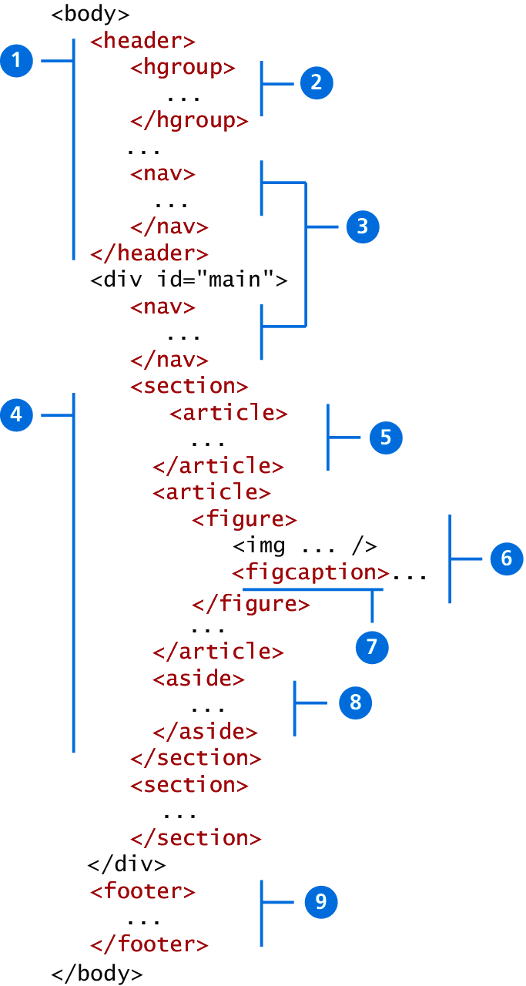
Figure 2.21 Sample layout using new HTML 5 semantic structure elements

Slide 18
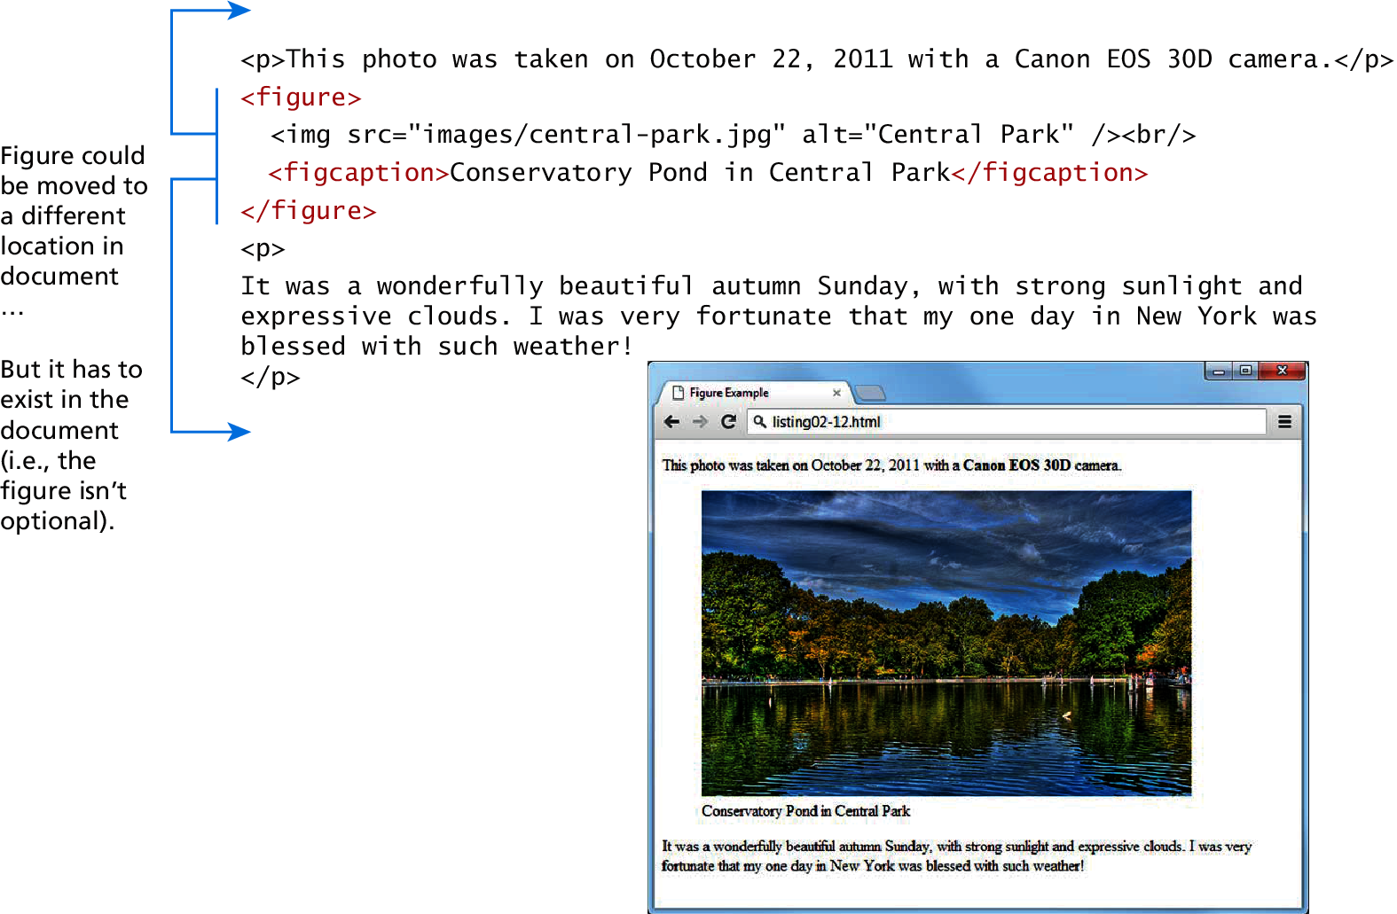
Figure 2.22 The figure and figcaption elements in the browser

Slide 19
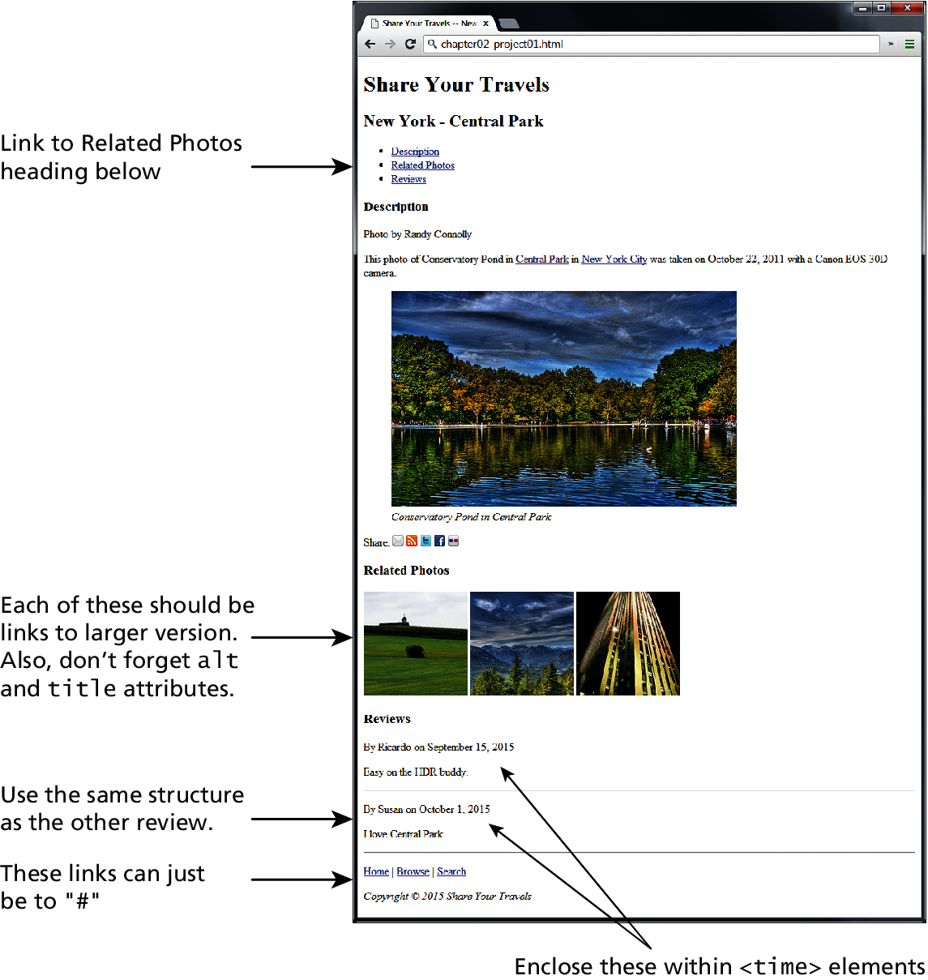
Figure 2.23 Complete Project 1 – pp. 90-92

Slide 20
Figure 2.24 Complete Project 2 – pp. 92-93

Slide 21
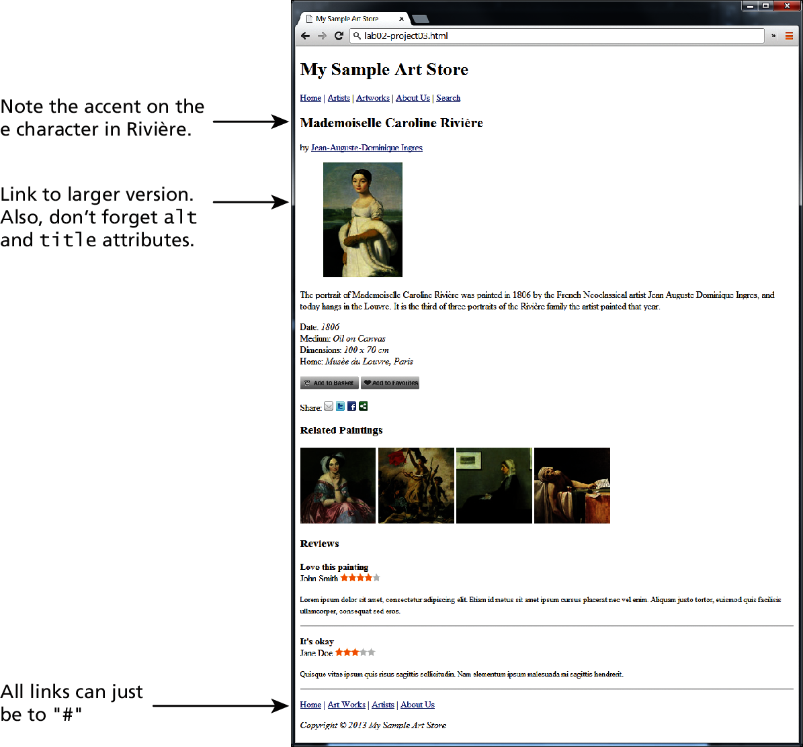
Figure 2.25 Complete Project 3 – pp. 93-94

Slide 22
Summary

