Slide 1
CPET 499/ITC 250 Web Systems
Chapter 16
Security
Text Book:
* Fundamentals of Web Development, 2015, by Randy Connolly and Ricardo Hoar, published by Pearson
Paul I-Hai Lin, Professor
http://www.etcs.ipfw.edu/~lin

Slide 2
Topics
Chapter Objectives
A wide range of security principles and practices
Best practices of authentication systems and data storage
About public key cryptography, SSL, and certificates
How to proactively protect your site against common attacks

Slide 3
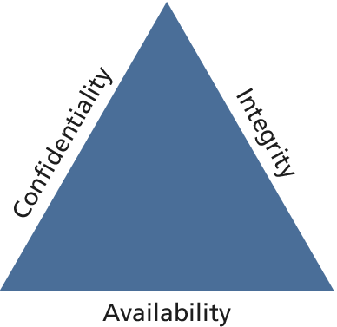
Security Principles
Information Security
The CIA Triad (Figure 16.1)
Confidentiality – The principle of maintaining privacy for the data you are storing, transmitting, etc
Integrity – The principle of ensuring that data is accurate and correct.
Availability – The principle of making information available when needed to authorized people.
Security Standards
ISO standards ISO/IEC 27002-27--37

Slide 4
Risk Assessment and Management
Risk – a measure of how likely an attack is, and how costly the impact of the attack would be if successful
Security Standards – ISO/IEC 27002-270037
Actors, Impacts, Threats, and Vulnerability
Actors
Internal actors
External actors
Partner actors
Impacts
A loss of availability
A loss of confidentiality
A loss of integrity

Slide 5
Risk Assessment and Management
Threats
Refers to a particular path that a hacker cloud use to exploit a vulnerability and gain unauthorized access to your system.
Also called attack vectors
Categories of Threats (STRIDE)
Spoofing – use someone else’s info to access the system
Tampering – modify some data in unauthorized ways
Repudiation – remove all trace of their attack, so they cannot be held accountable for other damage done
Information disclosure – access data they should bot be able to
Denial of service – prevent the real users from accessing the systems
Elevation of privilege

Slide 6
Risk Assessment and Management
Vulnerability – the security holes in your system
The top 10 classes of vulnerability from the Open Web Application Security Project (2013): https://www.owasp.org/index.php/Top_10_2013-Top_10
A1. Injection
A2. Broken authentication and session management
A3. Cross-site scripting
A4. Insecure direct object reference
A5. Security misconfiguration
A6. Sensitive data exposure
A7. Missing function level access control
A8. Cross-site request forgery (CSRF)
A9. Using components with unknown vulnerabilities
A10. Un-validated redirects and forwards

Slide 7
Assessing Risk
NIST Risk Management Guide for Information Technology Systems, http://csrc.nist.gov/publications/nistpubs/800-30/sp800-30.pdf
Table 16.1 Examples an Impact/Probability Risk Assessment Table Using 16 as the Threshold
Impact(n²)
Probability
 | Very Low | Low | Medium | High | Very High
Very High | 5 | 10 | 20 | 40 | 80
High | 4 | 8 | 16 | 32 | 64
Medium | 3 | 6 | 12 | 24 | 48
Low | 2 | 4 | 8 | 16 | 32
Very low | 1 | 2 | 4 | 8 | 16

Slide 8
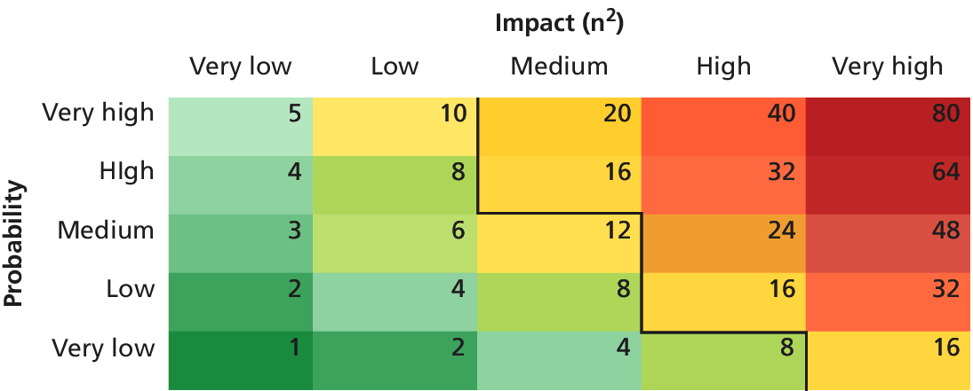
Assessing Risk
Table 16.1 Examples an Impact/Probability Risk Assessment Table Using 16 as the Threshold

Slide 9
Security Policy
Usage Policy
Social networking policy at work?
Authentication Policy
Access badge
Biometric ID
Password
VPN
Legal Policy

Slide 10
Business Continuity & Plans
Admin Password Management
Backups and Redundancy
Geographic Redundancy
Storage Mock Events
Auditing

Slide 11
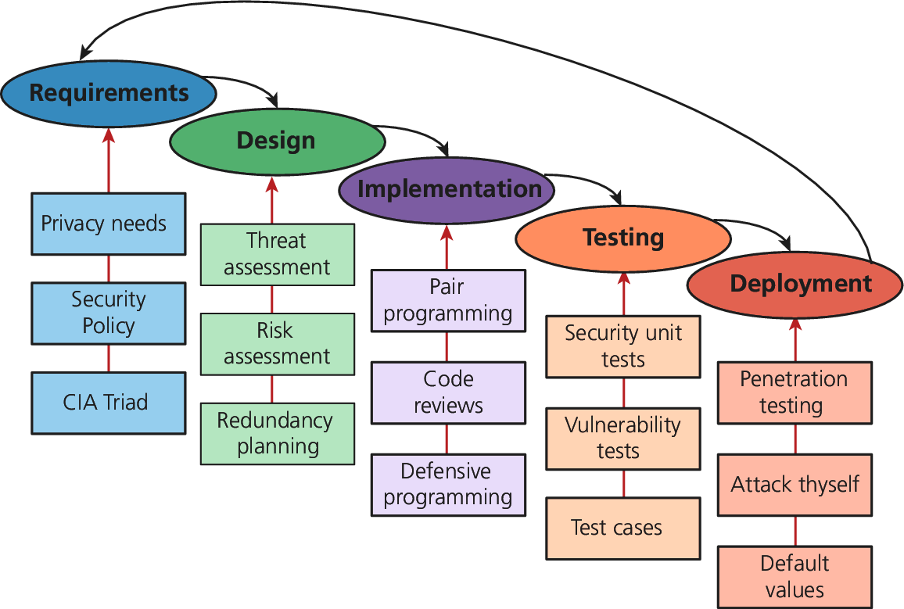
Security By Design Figure 16.2 Some examples of security input into the SDLC

Slide 12
Security By Design
Code Reviews
Peer-reviewed before committing it to the repository
Company coding style and practice
Informal and formal review process
Unit Testing
Code Modules
Class
Security holes
Pair Programming
Two programmers working together
Security Testing
Testing the system against scenarios that attempt to break the final system
Penetration testing
Secure by Default

Slide 13
Social Engineering
Social engineering
A broad term given to describe the manipulation of attitudes and behaviors of a populace, often through government or industrial propaganda and/or coercion.
A human part of information security that increases the effectiveness of an attack.
Social Engineering (Security), https://en.wikipedia.org/wiki/Social_engineering_(security)
http://www.social-engineer.org/
Two popular techniques
Phishing scams
Security theater

Slide 14
Social Engineering
Other References
Social Engineering (Security), https://en.wikipedia.org/wiki/Social_engineering_(security)
http://www.social-engineer.org/
Top 5 Social Engineering Exploit Techniques, by James Heary, Network World, http://www.pcworld.com/article/182180/top_5_social_engineering_exploit_techniques.html
1) Familiarity exploit
2) Creating a hostile situation
3) Gathering and using information
4) Get a job there
5) Reading body language

Slide 15
Authentication Figure 16.3 Authentication Factors

Slide 16
Authentication
Authentication Factors
Knowledge factors: password, PIN, challenge questions
Ownership factors: driver license, passport, cell phone, key to a lock
Inherence factors: biometric data – fingerprints, retinal patterns, DNA sequence
Single-Factor Authentication
Password/ Magnetized key badge
Multi-Factor Authentication
ATM Machine: Access card and PIN
Third-Party Authentication
Open Authentication (OAuth)

Slide 17
Third Party Authentication
Open Authentication (OAuth), http://oauth.net/
A open protocol to allow secure authorization in a simple standard method from web, mobile and desktop applications.
This specification is likely to produce a wide range of non-interoperable implementation.
OAuth 2.0, http://oauth.net/2/, Client and Server Libraries for Java, PHP, Python, NodeJS, Ruby, .NET, etc
Four Roles: Resource owner, Resource server, Client, Authorization server

Slide 18
Third Party Authentication
Open Authentication (OAuth), http://oauth.net/
Four Roles
Resource owner – normally the end user who can gain access to the resource
Resource server – host the resources and can process request using access tokens
Client – the application making requests on behalf of the resource owner
Authorization server – issues tokens to the client upon successful authentication of the resource owner. (often this is the same as the resource server)

Slide 19
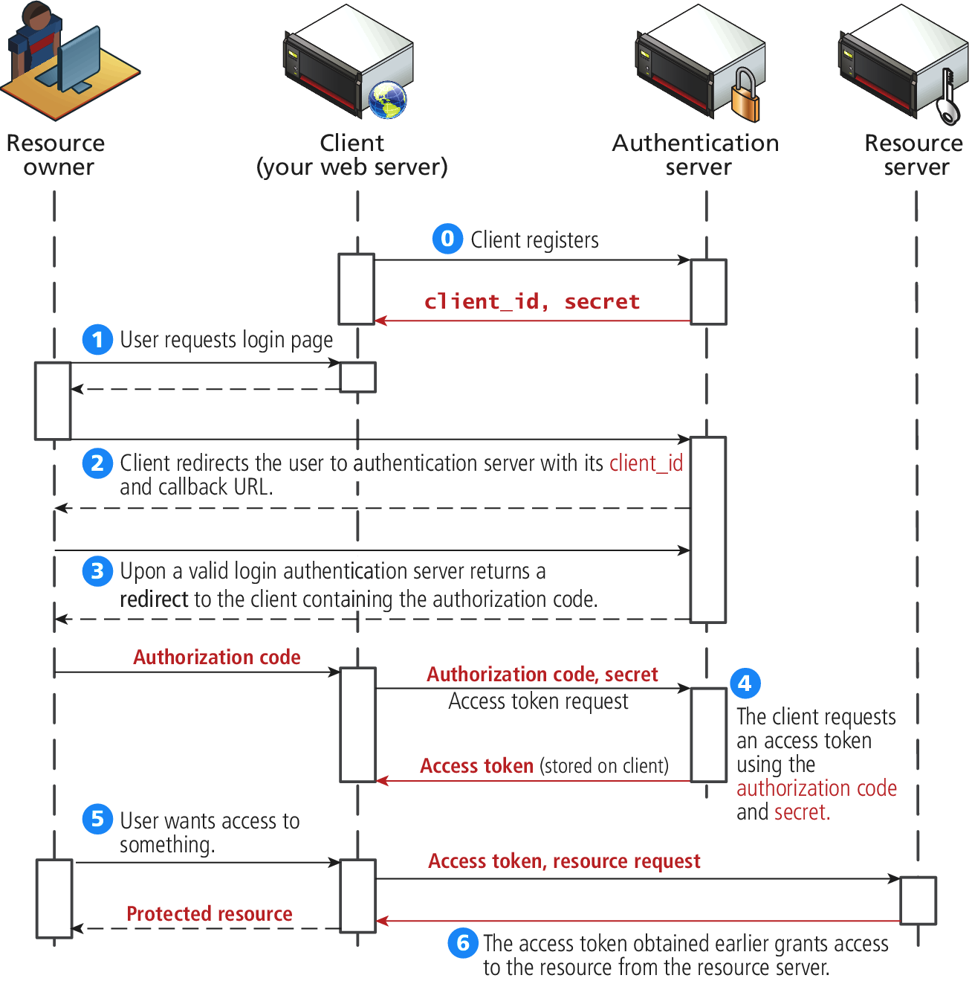
Third-Party Authentication
Figure 16.4 The Steps required to register and authenticate a user using OAuth

Slide 20
Authorization
Some examples in web development where proper authorization increases security
Using a separate database user for read/write privileges on a database
Providing each user an account where they can access their own file securely
Setting proper Read/Write/Execute permissions
Ensuring Apache is not running as the root account (an account that can access everything)

Slide 21
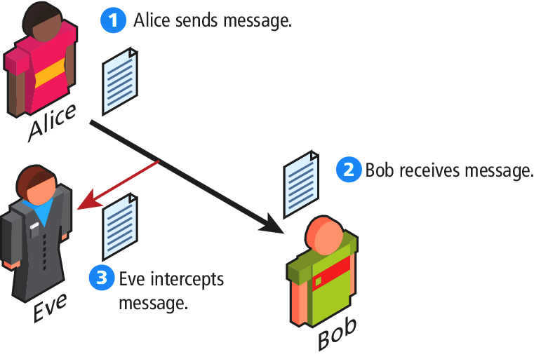
Cryptography Figure 16.4 Message Intercepting

Slide 22
Cryptography
Cipher – a message that is scrambled so that it cannot easily be read, unless one has some secrete key
Key – Can be a “number”, “phrase”, “page from a book”
Encryption
Decryption

Slide 23
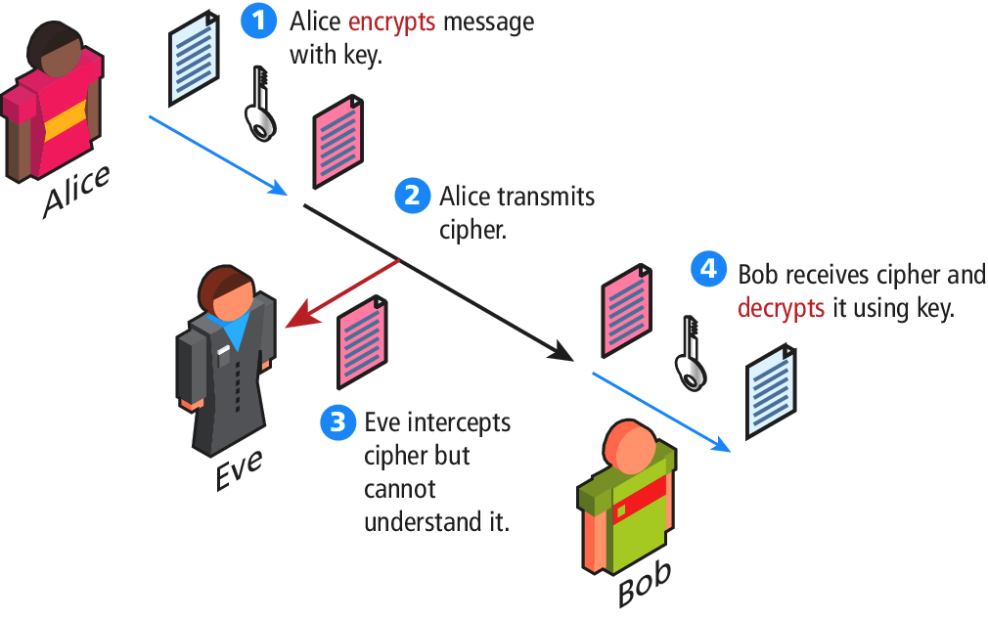
Cryptography Figure 16.5 Symmetric encryption

Slide 24
Substitution Ciphers – Cesar Cipher
Figure 16.7 Caser Cipher for shift value of 3 (Hello => KHOOR)

Slide 25
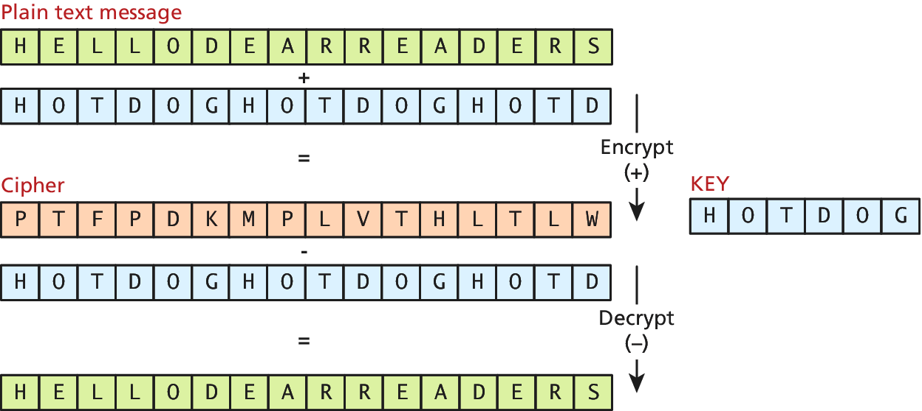
Substitution Ciphers – Vigenere
Figure 16.7 Vigenere cipher example with key “hotdog”

Slide 26
Substitution Ciphers
One-time Pad Cipher
Modern Block Ciphers
Scrambled 64 or 128 bits block as a time
Data Encryption Standard (DES)
Advanced Encryption Standard (AES)

Slide 27
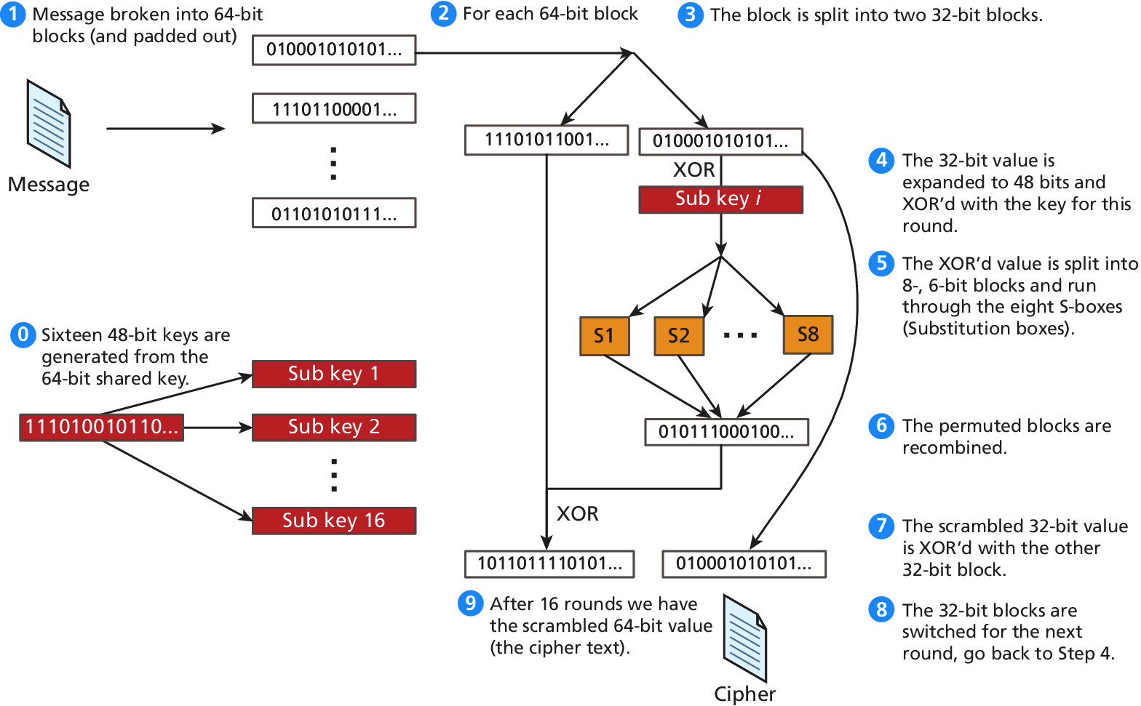
Figure 16.10 High-level illustration of the EDF cipher

Slide 28
Public Key Cryptography
Public key cryptography (asymmetric cryptography)
Using two distinct keys:
A public key – widely distributed
A private key
Diffie-Hellman Key Exchange algorithm
RSA (Ron Rivest, Adi Shamir and Leonard Adeleman) algorithm underpinning the HTTPs protocol

Slide 29
Digital Signatures
A mathematically secure way of validating that a particular digital document
was created by the person claiming to create it (authenticity)
was not modified in transit (integrity), and
cannot be denied (non-repudiation)
An example using public key cryptography

Slide 30
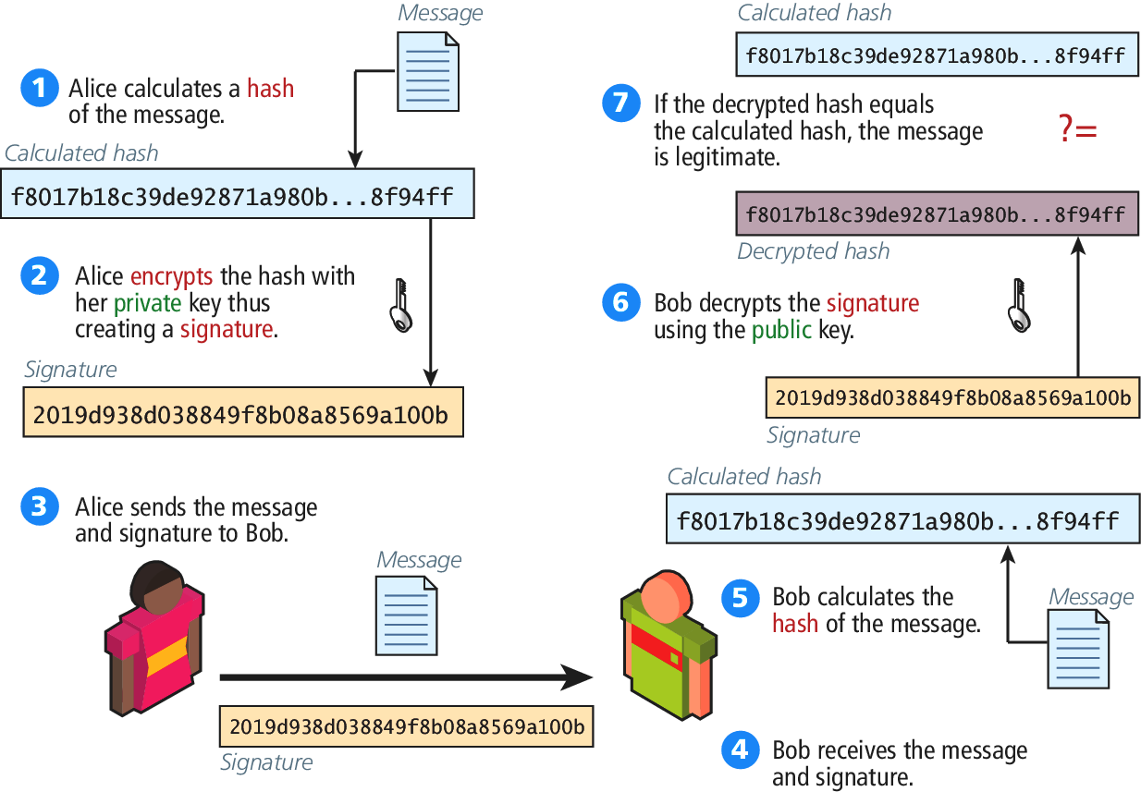
Digital Signatures Figure 16.12 Digital Signature and Validation

Slide 31
Hypertext Transfer Protocol Secure (HTTPs)
HTTPs is the HTTP running on top of the Transport Layer Security (TLS)
TLS v1.0 – an improvement on Secure Socket Layer 3.0 (SSL)
For compatibility reason, we refer it as HTTP running on TLS/SSL
Secure Handshakes
Certificates and Authorities
Self-signed Certificates

Slide 32
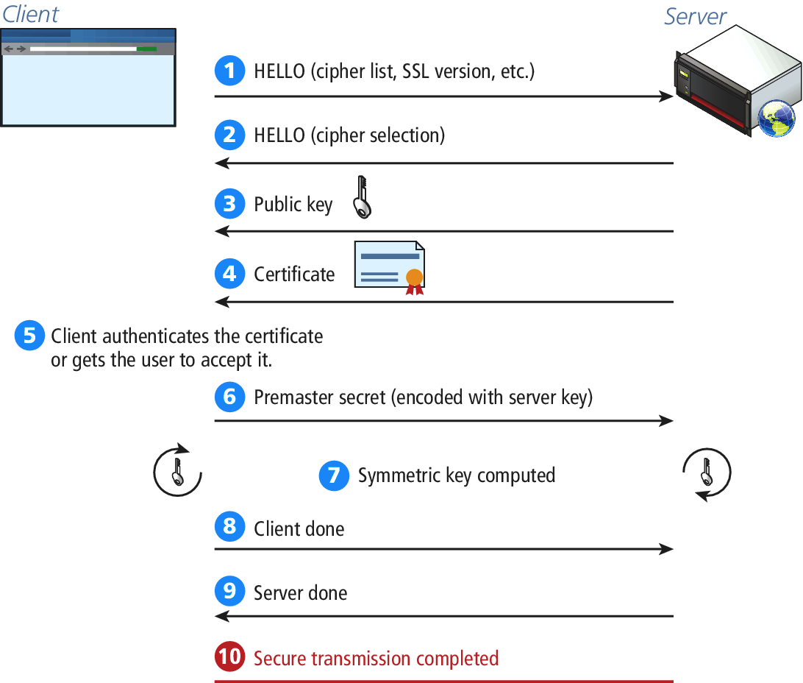
Figure 16.14 SSL Secure Handshake

Slide 33
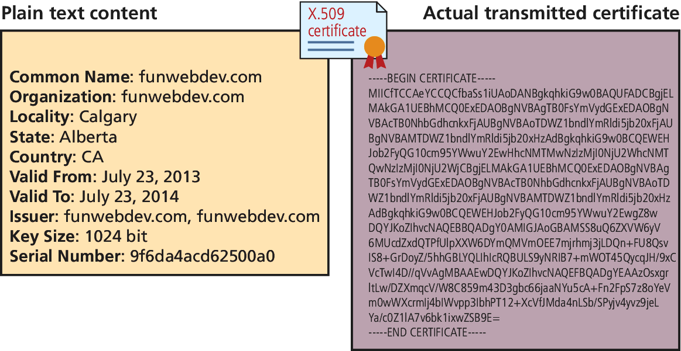
Certificates and Authorities
Figure 16.15 The content of a self-signed certificate for funwebdev.com (X.509 certificate Example)

Slide 34
Certificates and Authorities
Certificate - X.509 certificate which contains many details including
Algorithm used
The domain it was issued for
Some public key information
X.509 Client Certificate, https://help.sap.com/saphelp_nw73/helpdata/en/43/dc1fa58048070ee10000000a422035/content.htm
X.509 Certificate Tool, https://msdn.microsoft.com/en-us/library/aa529278.aspx
X.509 Certificates and Certificate Revocation Lists (CRLs), http://docs.oracle.com/javase/7/docs/technotes/guides/security/cert3.html

Slide 35
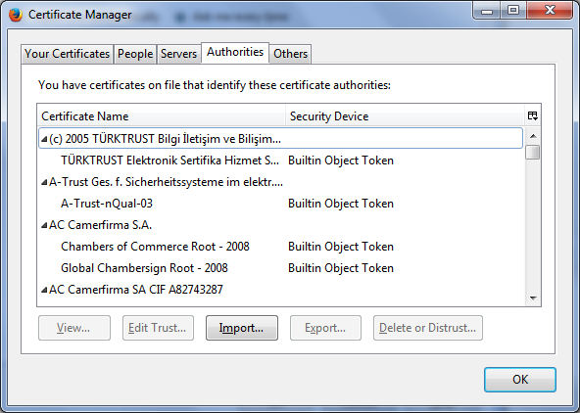
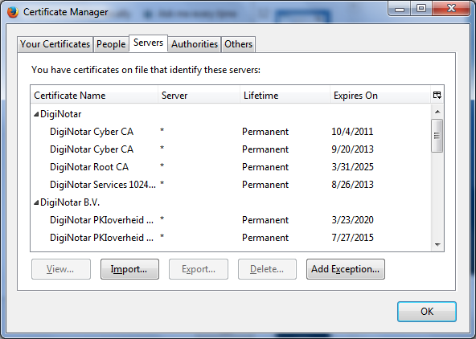
Firefox Certificate Management Interface
Options => Certificates => View Certificates (Some examples)

Slide 36
Security Best Practices
Data Storage
Secure Hash
Salting the Hash
Monitor Your Systems
System Monitors
Access Monitors
Automate Intrusion Blocking
Audit and Attack Thyself

Slide 37
Security Best Practices – Linux Systems
References
Ch. 15 Security, Linux System Administration, Linux System Administration, 2nd ed, by Vicki Stanfield and Roderick Smith, published by Sybex
Ch. 15 System Security, A Practical Guide to Ubuntu Linux, by Mark G. Sobell, 4th edition, published by Prentice Hall
Password Formats - Basic Authentications, https://httpd.apache.org/docs/2.2/misc/password_encryptions.html
The apache-md5 package (OpenSSL MD5() function), https://hackage.haskell.org/package/apache-md5

Slide 38
Security Best Practices – Microsoft Systems and Servers
References
Windows 7: Security Features, http://www.microsoft.com/security/pc-security/windows7.aspx
Windows 10 Security Overview, https://technet.microsoft.com/en-us/library/mt601297(v=vs.85).aspx
What's New in Windows Server 2016 Technical Preview, Aug. 18, 2015, https://technet.microsoft.com/en-us/library/dn765472.aspx
Security Best Practice for IIS 8, June 24, 2013, https://technet.microsoft.com/en-us/library/jj635855.aspx
Windows Server, https://technet.microsoft.com/en-us/library/bb625087.aspx

Slide 39
Security Best Practices – Linux Systems
Reference - Linux System Administration, 2nd ed, by Vicki Stanfield and Roderick Smith, published by Sybex
User-based Security
Port Security
Host-based Security
Physical Access Security
File and/or Device Assignment of Permission

Slide 40
Security Best Practices – Linux Systems
Reference - Linux System Administration, 2nd ed, by Vicki Stanfield and Roderick Smith, published by Sybex
User-based Security:
What resources should be available to the claimed user at this time?
Pluggable Authentication Modules (PAM) to secure the system from intrusion by unauthorized users.
Password Authentication Algorithms
DES (Data Encryption Standard) – encoded using the Federal Data Encryption standard algorithm
MD5 (Message Digest Algorithm, version 5) –
Uses RSA Data Security, Inc’s algorithm
By default on most Linux system

Slide 41
Security Best Practices – Linux Systems
Reference - Linux System Administration, 2nd ed, by Vicki Stanfield and Roderick Smith, published by Sybex
User-based Security: Hashing Passwords
Creating Password
Salt (2-character) + Clear Text Password => [Hashing Algorithm ] => Salt/Password Hash
Logging In
(User Supplied Password) + (/etc/shadow or /etc/passwd) Salt => [Hashing Algorithm] => Hash + Stored Hash (/etc/shadow or /etc/password) => Login Fail (Not equal to) OR Login Succeeds (Equal to)

Slide 42
Security Best Practices – Linux Systems
Reference - Linux System Administration, 2nd ed, by Vicki Stanfield and Roderick Smith, published by Sybex
User-based Security:
What resources should be available to the claimed user at this time?
Pluggable Authentication Modules (PAM) to secure the system from intrusion by unauthorized users.
Port Security:
Protect network ports from unauthorized hosts and networks
Handled by the kernel
IP firewall administration (IP chains or IP tables)
Host-based Security:
Restrict network access to system resources and services based on the requesting hosts.

Slide 43
Security Best Practices – Linux Systems
Reference - Linux System Administration, 2nd ed, by Vicki Stanfield and Roderick Smith, published by Sybex
User-based Security:
What resources should be available to the claimed user at this time?
Pluggable Authentication Modules (PAM) to secure the system from intrusion by unauthorized users.
Port Security:
Protect network ports from unauthorized hosts and networks
Handled by the kernel
IP firewall administration (IP chains or IP tables)
Host-based Scurity:
Restrict network access to system resources and services based on the requesting hosts.

Slide 44
Common Threat Vectors
SQL Injection
The attack technique of using reserved SQL symbol to try and make the web server execute a malicious query other than what was intended.
Must Sanitize inputs
Give Least possible privileges
Cross-Site Scripting (XSS)
Insecure Direct Object Reference
Denial of Service
Security Misconfiguration

Slide 45
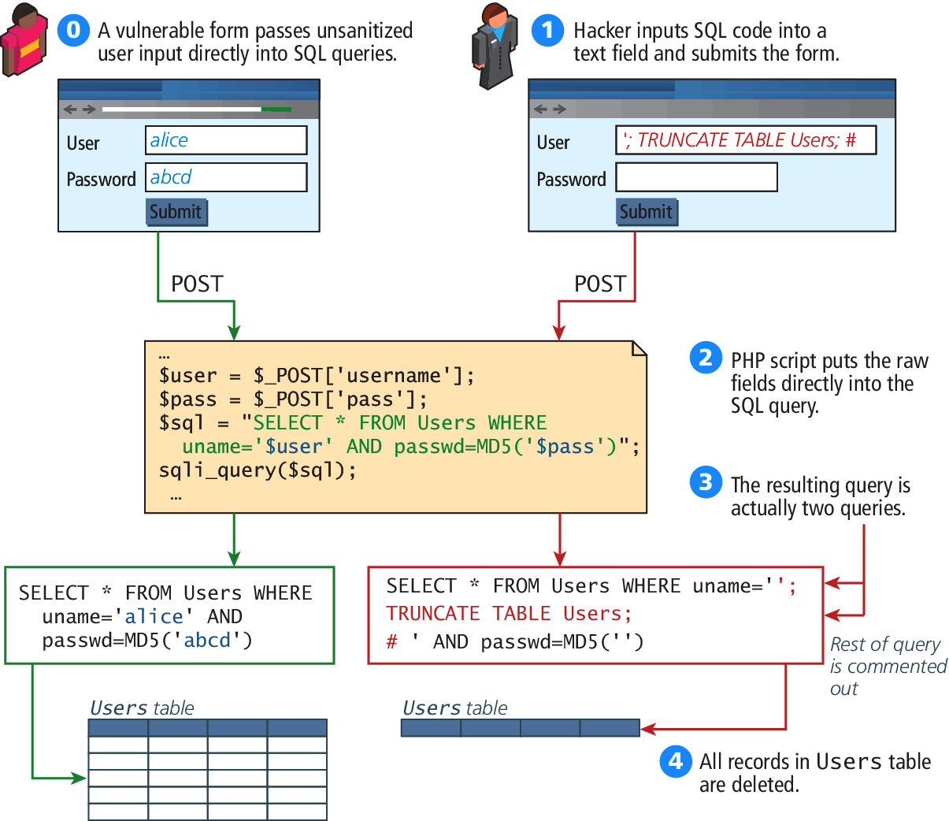
Figure 16.19 a SQL Injection attack (right) and intended usage (left)

Slide 46
Cross-Site Scripting
Cross-Site Scripting (XSS) refers to a type of attack in which a malicious script (JavaScript, VBScript, or Action Script, etc) is embedded into an otherwise trustworthy website.
Two main categories of XSS
Reflected XSS (Non-persistent XSS)
Are attacks that send malicious content to the sever, so that in the server response, the malicious content is embedded
Store XSS (Persistent XSS)
More dangerous which may impacts all users visit the site

Slide 47
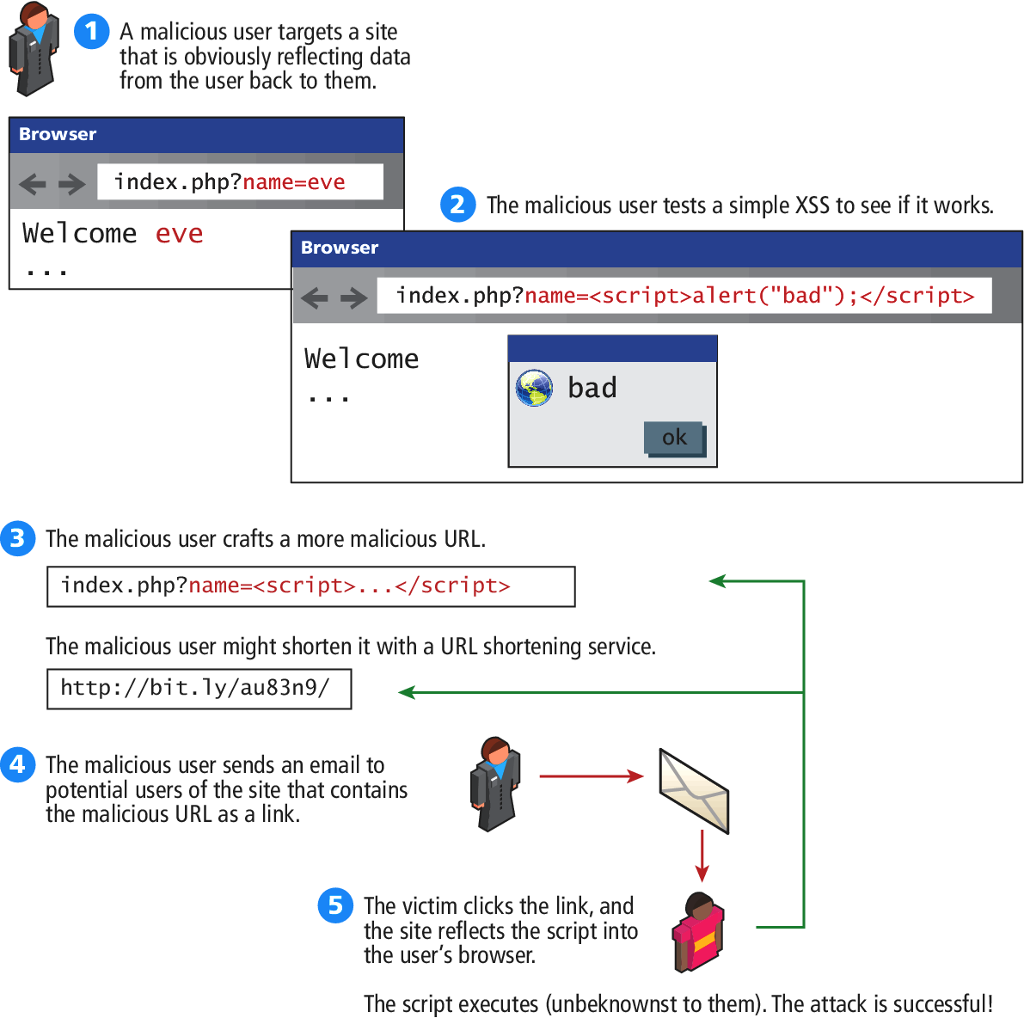
Figure 16.20 Illustration of a Reflection XSS Attack

Slide 48
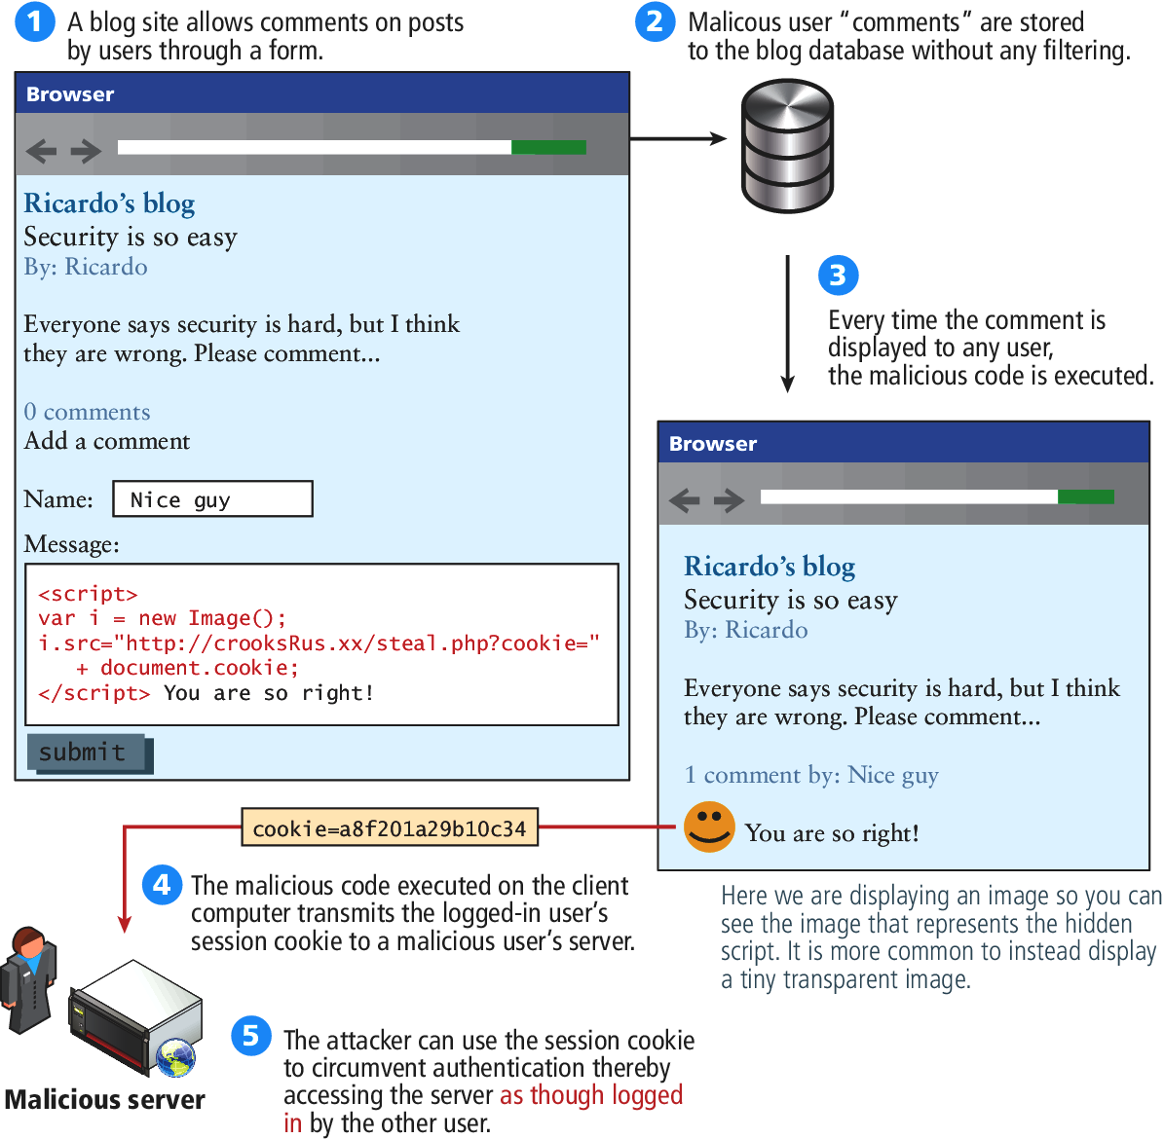
Figure 16.21 Illustration of a Stored XSS Attack

Slide 49
Common Threat Vectors
Insecure Direct Object Reference
Expose some internal value or key of the application to the user
Then the attackers can then manipulate the internal keys to gain access to things that should not have access to
Examples:
An archive of the site’s PHP code or passwords can be potentially accessed or downloaded
A database key in the URLs that are visible to users
Storing files on the server
Denial of Service
Security Misconfiguration

Slide 50
Denial of Services
Denial of Service attacks (DoS)
are attacks that aim to overload a server with illegitimate requests in order to prevent the site from responding to the legitimate ones,
Methods of prevention
Blocking the IP address in the firewall or the Apache server
Distributed DoS Attack (DDoS)
Attacks are coming from multiple machines
Recent DDoS attack on Spamhaus servers (generates 300 Gbps worth of requests), http://www.spamhaus.org/news/article/695/answers-about-recent-ddos-attack-on-spamhaus

Slide 51
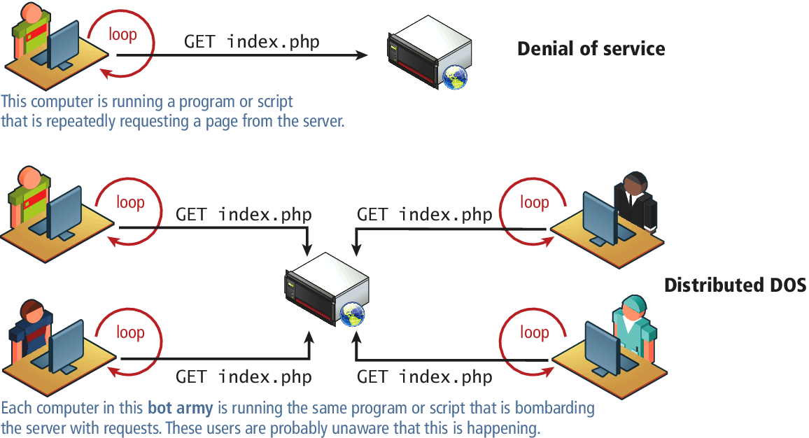
Figure 16.22 DoS and DDoS

Slide 52
Security Misconfiguration
Out-of-Date Software
Open Mail Relays
Refers to any email server that allows someone to route email through without authentication
More Input Attacks
Refers to the potential vulnerability that occurs when the users through their HTT requests, transmit a variety of strings and data that are directly used by the server without sanitation.
Virtual Open Mail Relay – Figure 14.23
HTML web email send to any email addresses
Arbitrary program execution – Figure 16.24

Slide 53
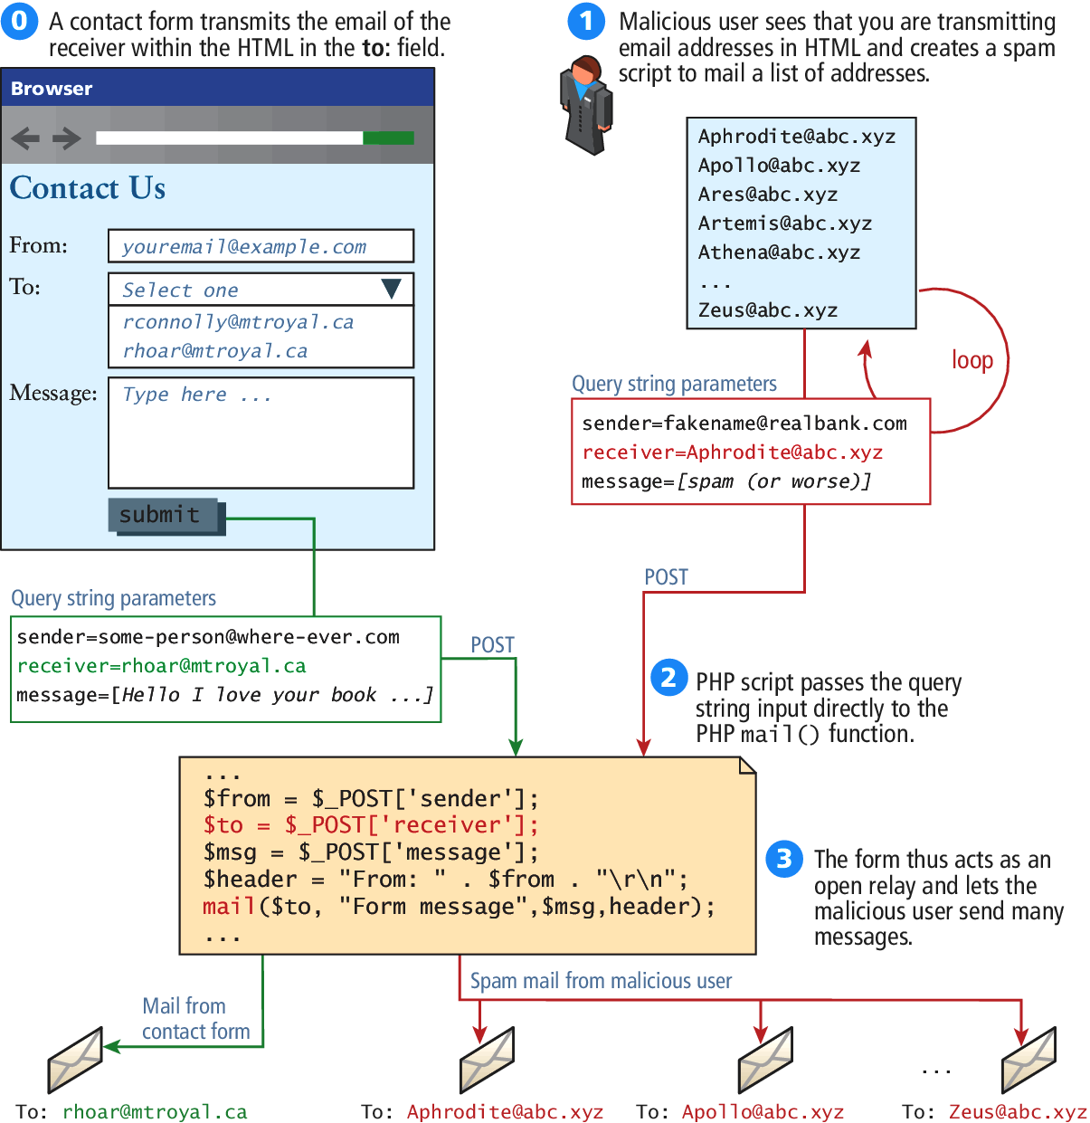
Figure 16.23 Virtual open relay exploit

Slide 54
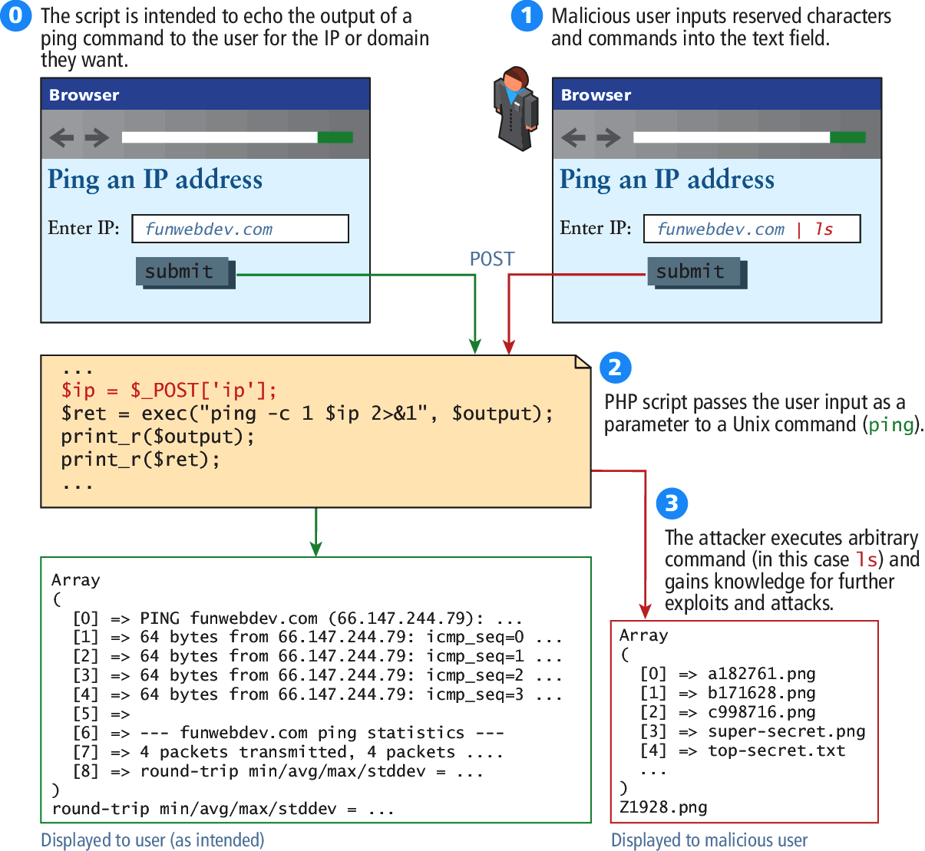
Figure 16.24 Command-line pass-through of user input

Slide 55
Summary and Conclusion
Q/A ?

