Slide 1
CPET 499/ITC 250 Web Systems
Chapter 16
Security
Text Book:
* Fundamentals of Web Development, 2015, by Randy Connolly and Ricardo Hoar, published by Pearson
Paul I-Hai Lin, Professor
http://www.etcs.ipfw.edu/~lin

Slide 2
Topics
Chapter Objectives
A wide range of security principles and practices
Best practices of authentication systems and data storage
About public key cryptography, SSL, and certificates
How to proactively protect your site against common attacks

Slide 3
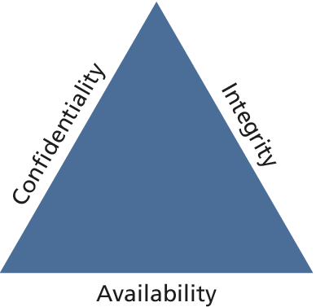
Security Principles
Information Security
The CIA Triad (Figure 16.1)
  Confidentiality – The principle of maintaining privacy for the data you are storing, transmitting, etc
  Integrity – The principle of ensuring that data is accurate and correct.
  Availability – The principle of making information available when needed to authorized people.
Security Standards
  ISO standards ISO/IEC 27002-27--37

Slide 4
Risk Assessment and Management
Risk – a measure of how likely an attack is, and how costly the impact of the attack would be if successful
Security Standards – ISO/IEC 27002-270037
Actors, Impacts, Threats, and Vulnerability
Actors
  Internal actors
  External actors
  Partner actors
Impacts
  A loss of availability
  A loss of confidentiality
  A loss of integrity

Slide 5
Risk Assessment and Management
Threats
  Refers to a particular path that a hacker cloud use to exploit a vulnerability and gain unauthorized access to your system.
  Also called attack vectors
Categories of Threats (STRIDE)
  Spoofing – use someone else’s info to access the system
  Tampering – modify some data in unauthorized ways
  Repudiation – remove all trace of their attack, so they cannot be held accountable for other damage done
  Information disclosure – access data they should bot be able to
  Denial of service – prevent the real users from accessing the systems
  Elevation of privilege

Slide 6
Risk Assessment and Management
Vulnerability – the security holes in your system
The top 10 classes of vulnerability from the Open Web Application Security Project (2013): https://www.owasp.org/index.php/Top_10_2013-Top_10
  A1. Injection
  A2. Broken authentication and session management
  A3. Cross-site scripting
  A4. Insecure direct object reference
  A5. Security misconfiguration
  A6. Sensitive data exposure
  A7. Missing function level access control
  A8. Cross-site request forgery (CSRF)
  A9. Using components with unknown vulnerabilities
  A10. Un-validated redirects and forwards

Slide 7
Assessing Risk
NIST Risk Management Guide for Information Technology Systems, http://csrc.nist.gov/publications/nistpubs/800-30/sp800-30.pdf
Table 16.1 Examples an Impact/Probability Risk Assessment Table Using 16 as the Threshold
Impact(n²)
Probability
 | Very Low | Low | Medium | High | Very High
Very High | 5 | 10 | 20 | 40 | 80
High | 4 | 8 | 16 | 32 | 64
Medium | 3 | 6 | 12 | 24 | 48
Low | 2 | 4 | 8 | 16 | 32
Very low | 1 | 2 | 4 | 8 | 16

Slide 8
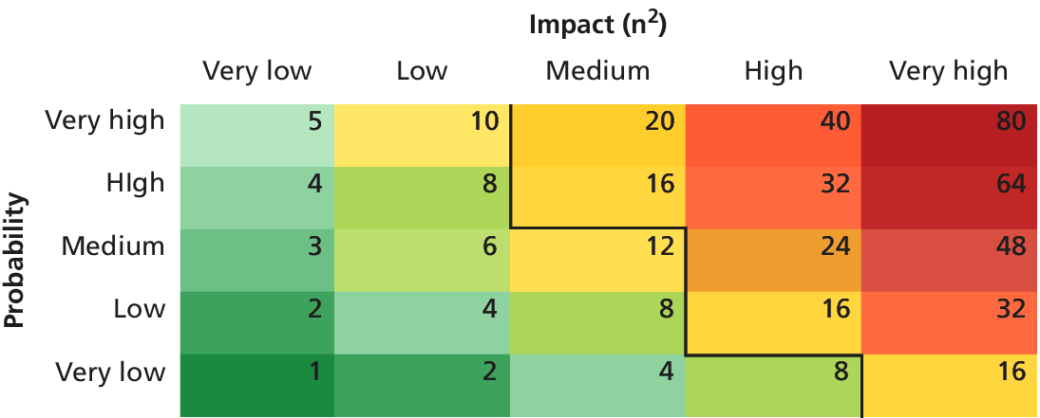
Assessing Risk
Table 16.1 Examples an Impact/Probability Risk Assessment Table Using 16 as the Threshold

Slide 9
Security Policy
Usage Policy
  Social networking policy at work?
Authentication Policy
  Access badge
  Biometric ID
  Password
  VPN
Legal Policy

Slide 10
Business Continuity & Plans
Admin Password Management
Backups and Redundancy
Geographic Redundancy
Storage Mock Events
Auditing

Slide 11
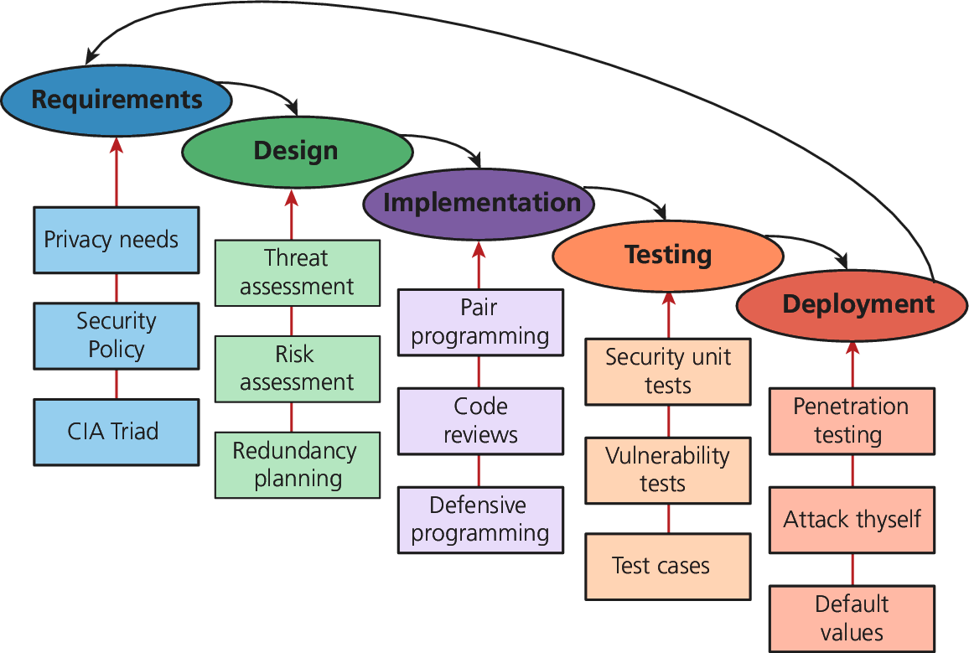
Security By Design
Figure 16.2 Some examples of security input into the SDLC

Slide 12
Security By Design
Code Reviews
  Peer-reviewed before committing it to the repository
  Company coding style and practice
  Informal and formal review process
Unit Testing
  Code Modules
  Class
  Security holes
Pair Programming
  Two programmers working together
Security Testing
  Testing the system against scenarios that attempt to break the final system
  Penetration testing
Secure by Default

Slide 13
Social Engineering
Social engineering
  A broad term given to describe the manipulation of attitudes and behaviors of a populace, often through government or industrial propaganda and/or coercion.
  A human part of information security that increases the effectiveness of an attack.
  Social Engineering (Security), https://en.wikipedia.org/wiki/Social_engineering_(security)
  http://www.social-engineer.org/
Two popular techniques
  Phishing scams
  Security theater

Slide 14
Social Engineering
Other References
  Social Engineering (Security), https://en.wikipedia.org/wiki/Social_engineering_(security)
  http://www.social-engineer.org/
Top 5 Social Engineering Exploit Techniques, by James Heary, Network World, http://www.pcworld.com/article/182180/top_5_social_engineering_exploit_techniques.html
  1) Familiarity exploit
  2) Creating a hostile situation
  3) Gathering and using information
  4) Get a job there
  5) Reading body language

Slide 15
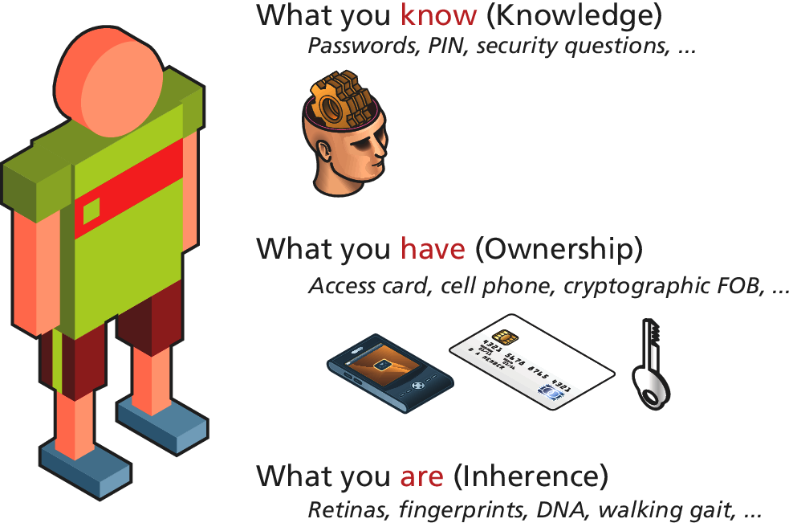
Authentication
Figure 16.3 Authentication Factors

Slide 16
Authentication
Authentication Factors
  Knowledge factors: password, PIN, challenge questions
  Ownership factors: driver license, passport, cell phone, key to a lock
  Inherence factors: biometric data – fingerprints, retinal patterns, DNA sequence
Single-Factor Authentication
  Password/ Magnetized key badge
Multi-Factor Authentication
  ATM Machine: Access card and PIN
Third-Party Authentication
  Open Authentication (OAuth)

Slide 17
Third Party Authentication
Open Authentication (OAuth), http://oauth.net/
  A open protocol to allow secure authorization in a simple standard method from web, mobile and desktop applications.
  This specification is likely to produce a wide range of non-interoperable implementation.
  OAuth 2.0, http://oauth.net/2/, Client and Server Libraries for Java, PHP, Python, NodeJS, Ruby, .NET, etc
  Four Roles: Resource owner, Resource server, Client, Authorization server

Slide 18
Third Party Authentication
Open Authentication (OAuth), http://oauth.net/
  Four Roles
    Resource owner – normally the end user who can gain access to the resource
    Resource server – host the resources and can process request using access tokens
    Client – the application making requests on behalf of the resource owner
    Authorization server – issues tokens to the client upon successful authentication of the resource owner. (often this is the same as the resource server)

Slide 19
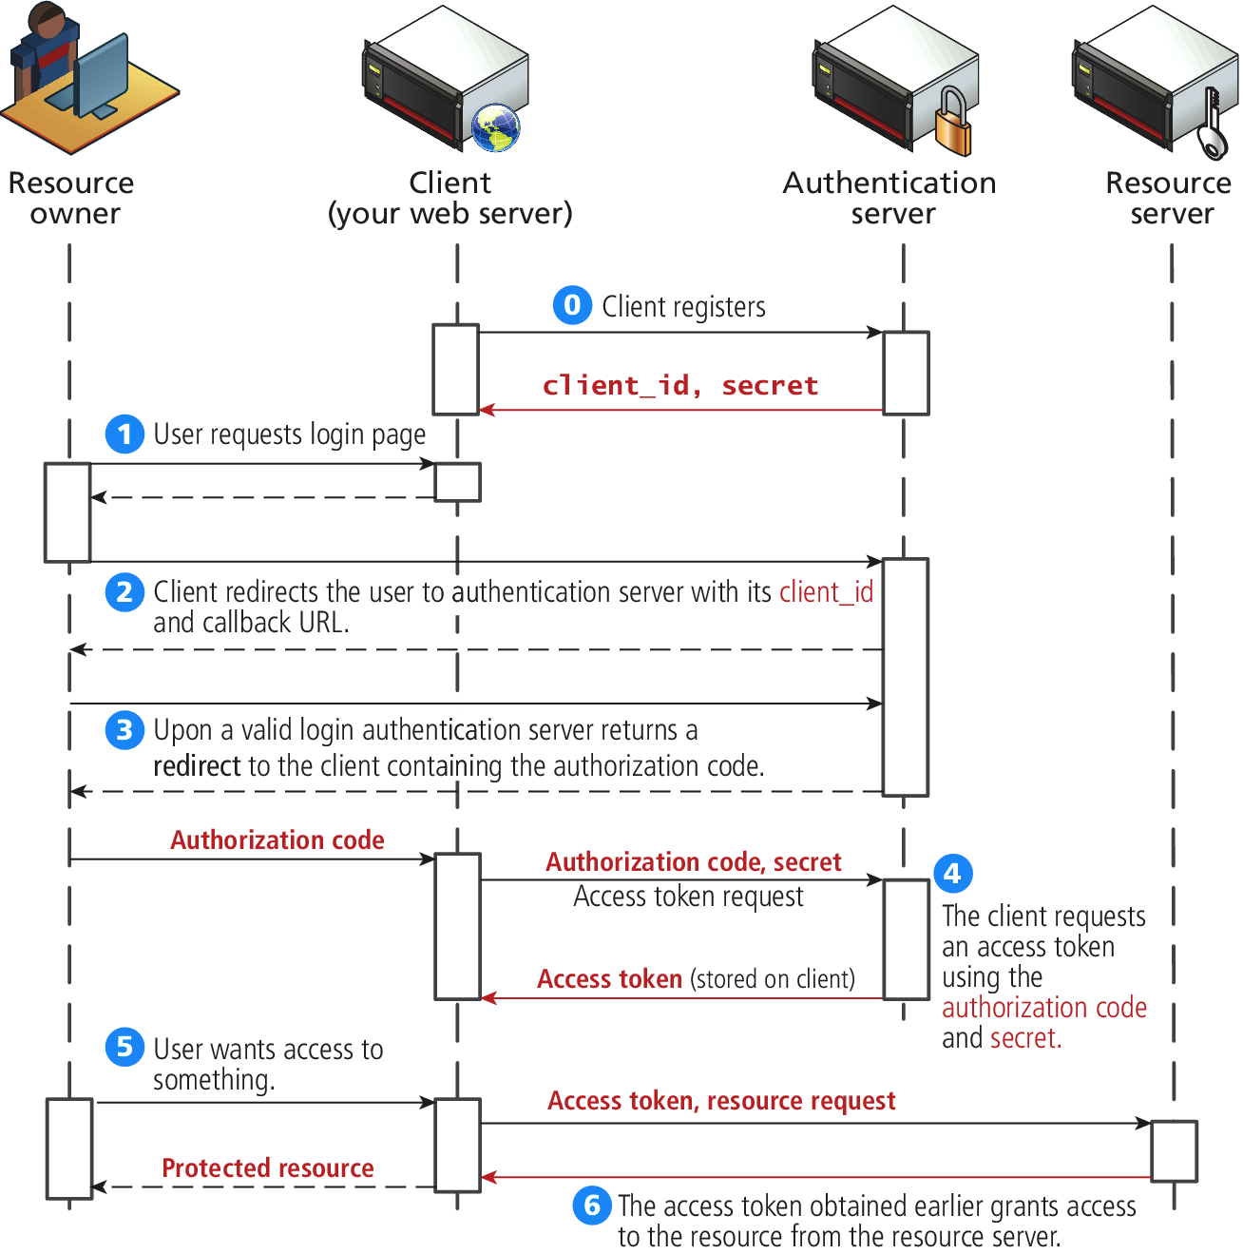
Third-Party Authentication
Figure 16.4 The Steps required to register and authenticate a user using OAuth

Slide 20
Authorization
Some examples in web development where proper authorization increases security
Using a separate database user for read/write privileges on a database
Providing each user an account where they can access their own file securely
Setting proper Read/Write/Execute permissions
Ensuring Apache is not running as the root account (an account that can access everything)

Slide 21
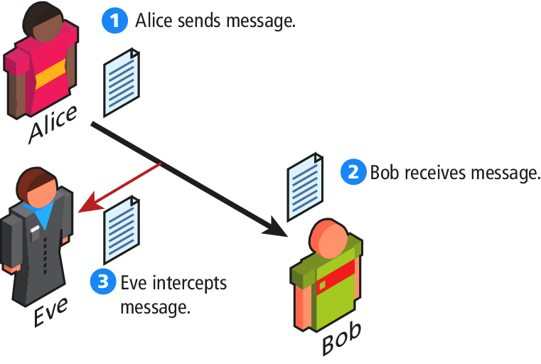
Cryptography
Figure 16.4 Message Intercepting

Slide 22
Cryptography
Cipher – a message that is scrambled so that it cannot easily be read, unless one has some secrete key
Key – Can be a “number”, “phrase”, “page from a book”
Encryption
Decryption

Slide 23
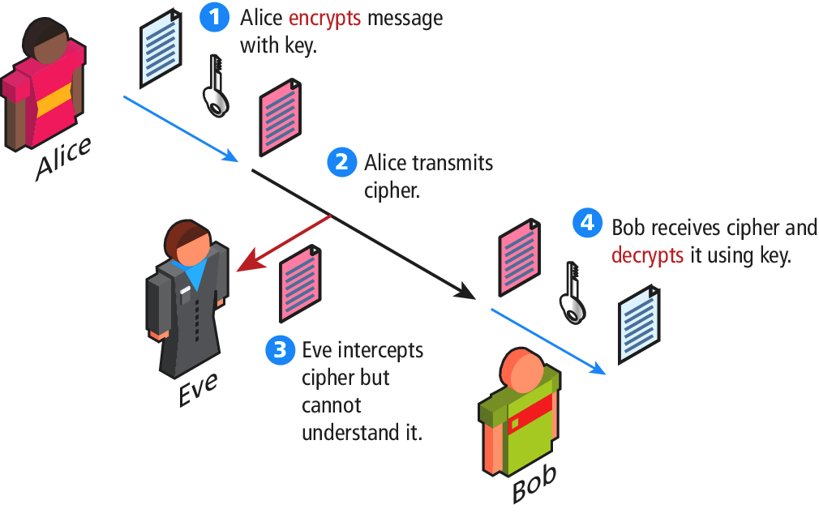
Cryptography
Figure 16.5 Symmetric encryption

Slide 24
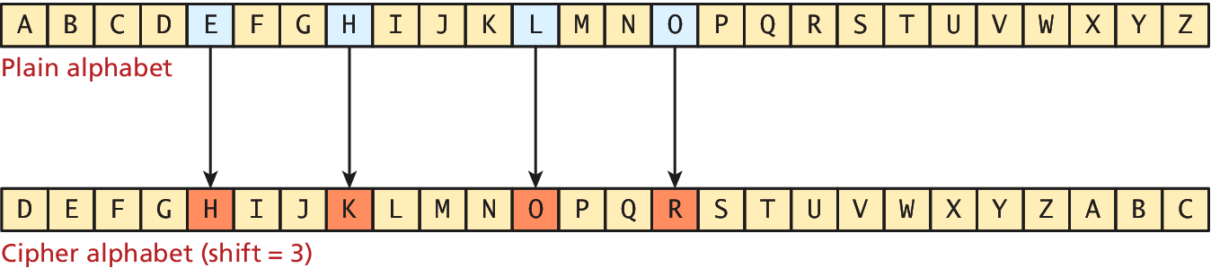
Substitution Ciphers – Cesar Cipher
Figure 16.7 Caser Cipher for shift value of 3 (Hello => KHOOR)

Slide 25
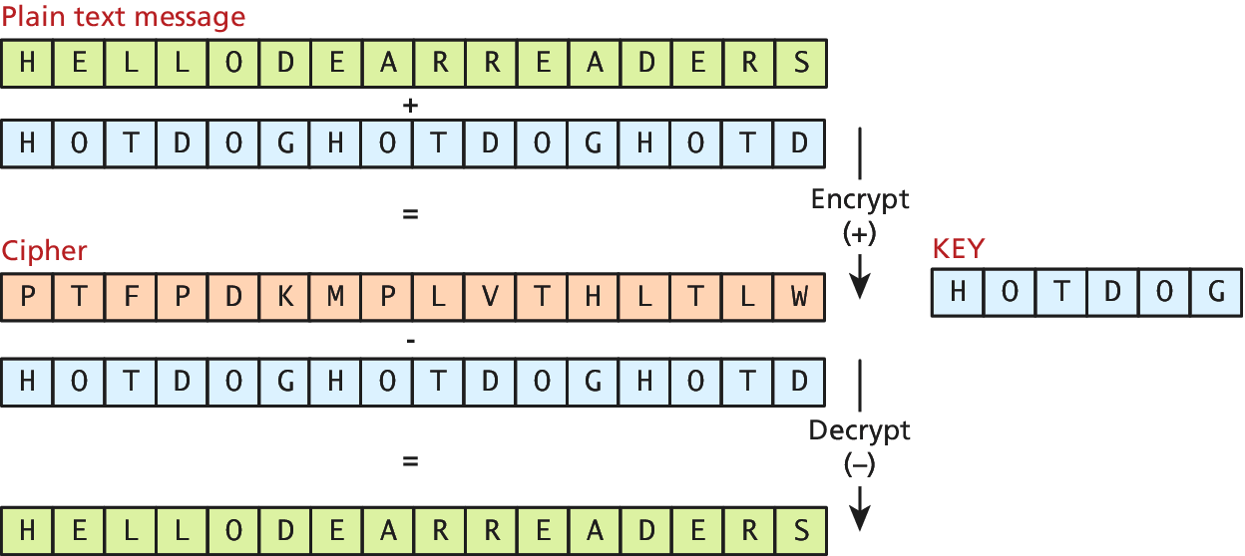
Substitution Ciphers – Vigenere
Figure 16.7 Vigenere cipher example with key “hotdog”

Slide 26
Substitution Ciphers
One-time Pad Cipher
Modern Block Ciphers
  Scrambled 64 or 128 bits block as a time
  Data Encryption Standard (DES)
  Advanced Encryption Standard (AES)

Slide 27
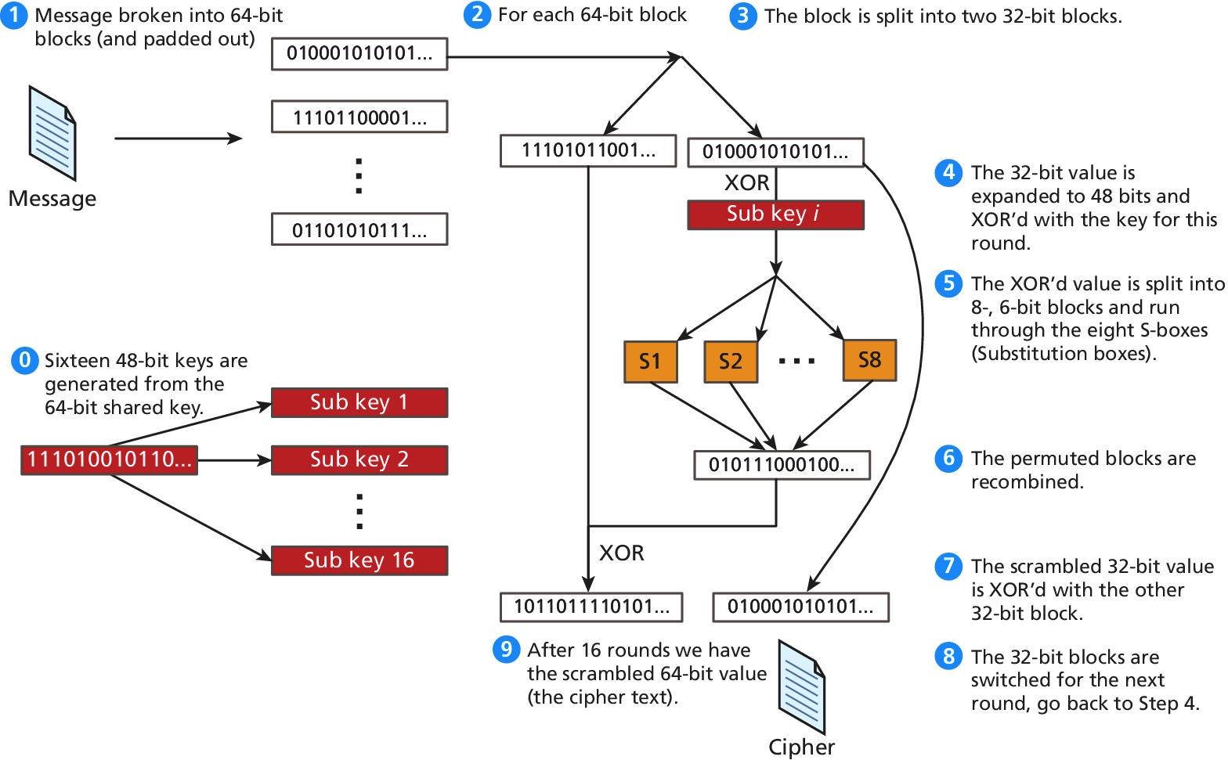
Figure 16.10 High-level illustration of the EDF cipher

Slide 28
Public Key Cryptography
Public key cryptography (asymmetric cryptography)
Using two distinct keys:
  A public key – widely distributed
  A private key
Diffie-Hellman Key Exchange algorithm
RSA (Ron Rivest, Adi Shamir and Leonard Adeleman) algorithm underpinning the HTTPs protocol

Slide 29
Digital Signatures
A mathematically secure way of validating that a particular digital document
  was created by the person claiming to create it (authenticity)
  was not modified in transit (integrity), and
  cannot be denied (non-repudiation)
An example using public key cryptography

Slide 30
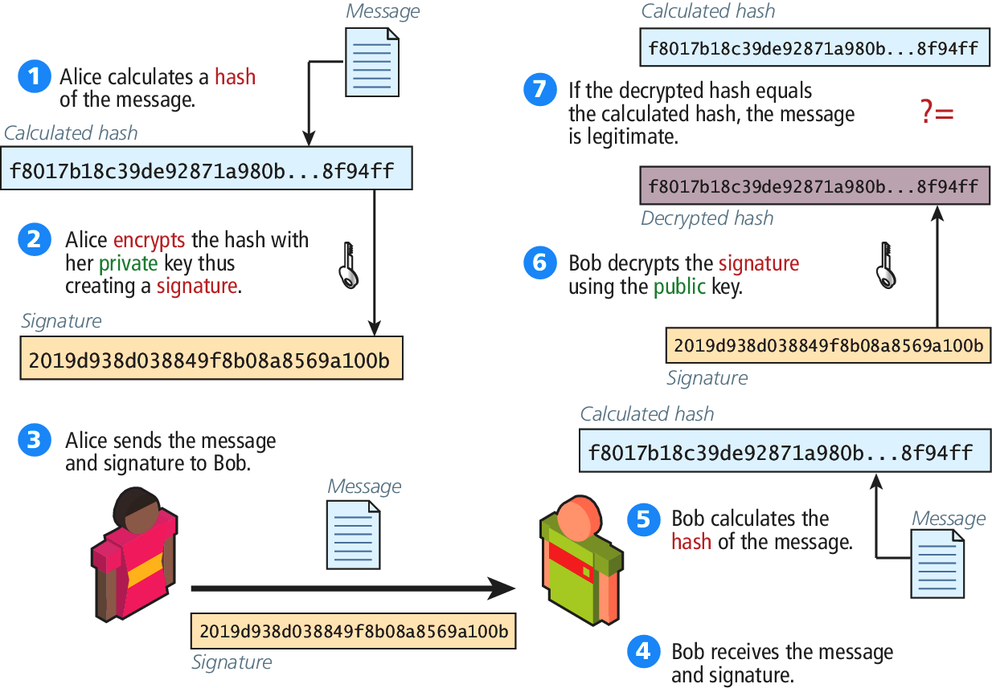
Digital Signatures
Figure 16.12 Digital Signature and Validation

Slide 31
Hypertext Transfer Protocol Secure (HTTPs)
HTTPs is the HTTP running on top of the Transport Layer Security (TLS)
TLS v1.0 – an improvement on Secure Socket Layer 3.0 (SSL)
For compatibility reason, we refer it as HTTP running on TLS/SSL
Secure Handshakes
Certificates and Authorities
  Self-signed Certificates

Slide 32
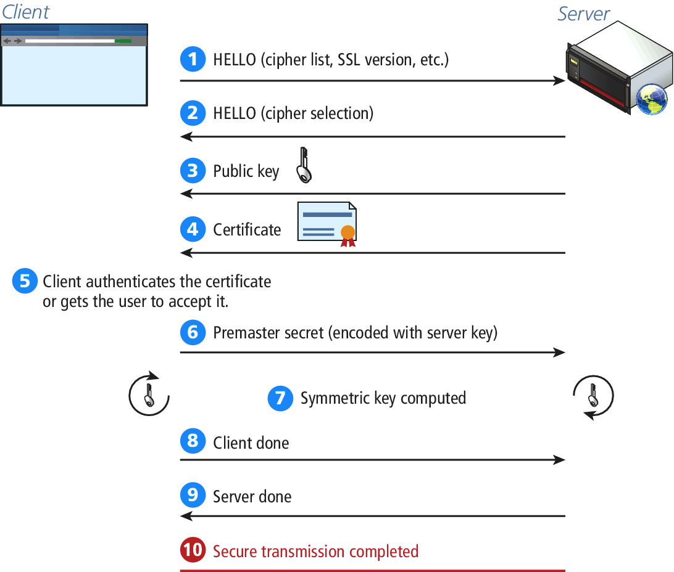
Figure 16.14 SSL Secure Handshake

Slide 33
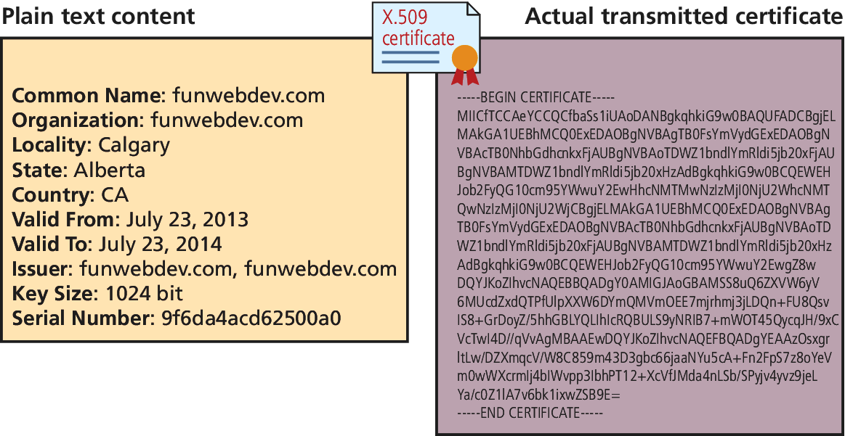
Certificates and Authorities
Figure 16.15 The content of a self-signed certificate for funwebdev.com (X.509 certificate Example)

Slide 34
Certificates and Authorities
Certificate - X.509 certificate which contains many details including
  Algorithm used
  The domain it was issued for
  Some public key information
X.509 Client Certificate, https://help.sap.com/saphelp_nw73/helpdata/en/43/dc1fa58048070ee10000000a422035/content.htm
X.509 Certificate Tool, https://msdn.microsoft.com/en-us/library/aa529278.aspx
X.509 Certificates and Certificate Revocation Lists (CRLs), http://docs.oracle.com/javase/7/docs/technotes/guides/security/cert3.html

Slide 35
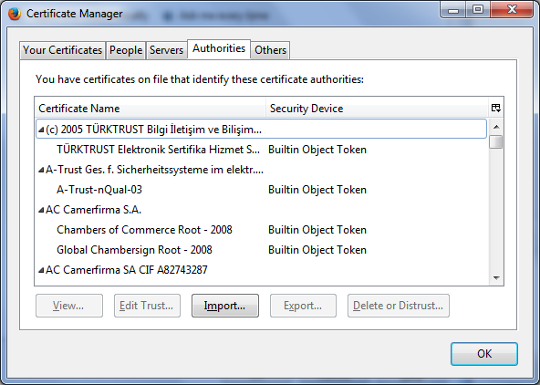
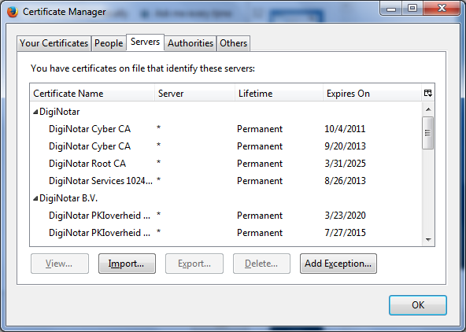
Firefox Certificate Management Interface
Options => Certificates => View Certificates (Some examples)

Slide 36
Security Best Practices
Data Storage
  Secure Hash
  Salting the Hash
Monitor Your Systems
  System Monitors
  Access Monitors
  Automate Intrusion Blocking
Audit and Attack Thyself

Slide 37
Common Threat Vectors
SQL Injection
  The attack technique of using reserved SQL symbol to try and make the web server execute a malicious query other than what was intended.
  Must Sanitize inputs
  Give Least possible privileges
Cross-Site Scripting (XSS)
Insecure Direct Object Reference
Denial of Service
Security Misconfiguration

Slide 38
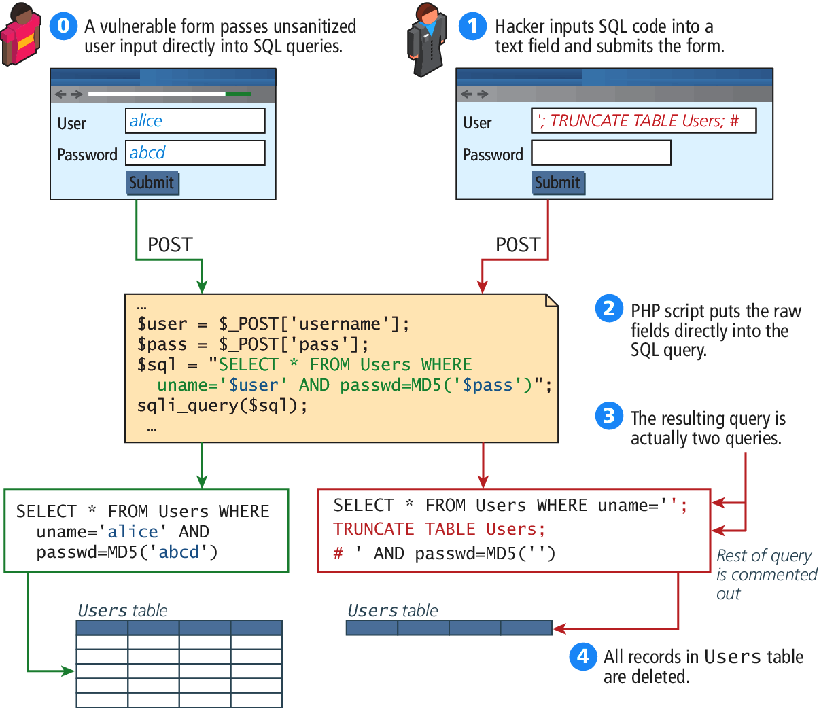
Figure 16.19 a SQL Injection attack (right) and intended usage (left)

Slide 39
Cross-Site Scripting
Cross-Site Scripting (XSS) refers to a type of attack in which a malicious script (JavaScript, VBScript, or Action Script, etc) is embedded into an otherwise trustworthy website.
Two main categories of XSS
  Reflected XSS (Non-persistent XSS)
    Are attacks that send malicious content to the sever, so that in the server response, the malicious content is embedded
  Store XSS (Persistent XSS)
    More dangerous which may impacts all users visit the site

Slide 40
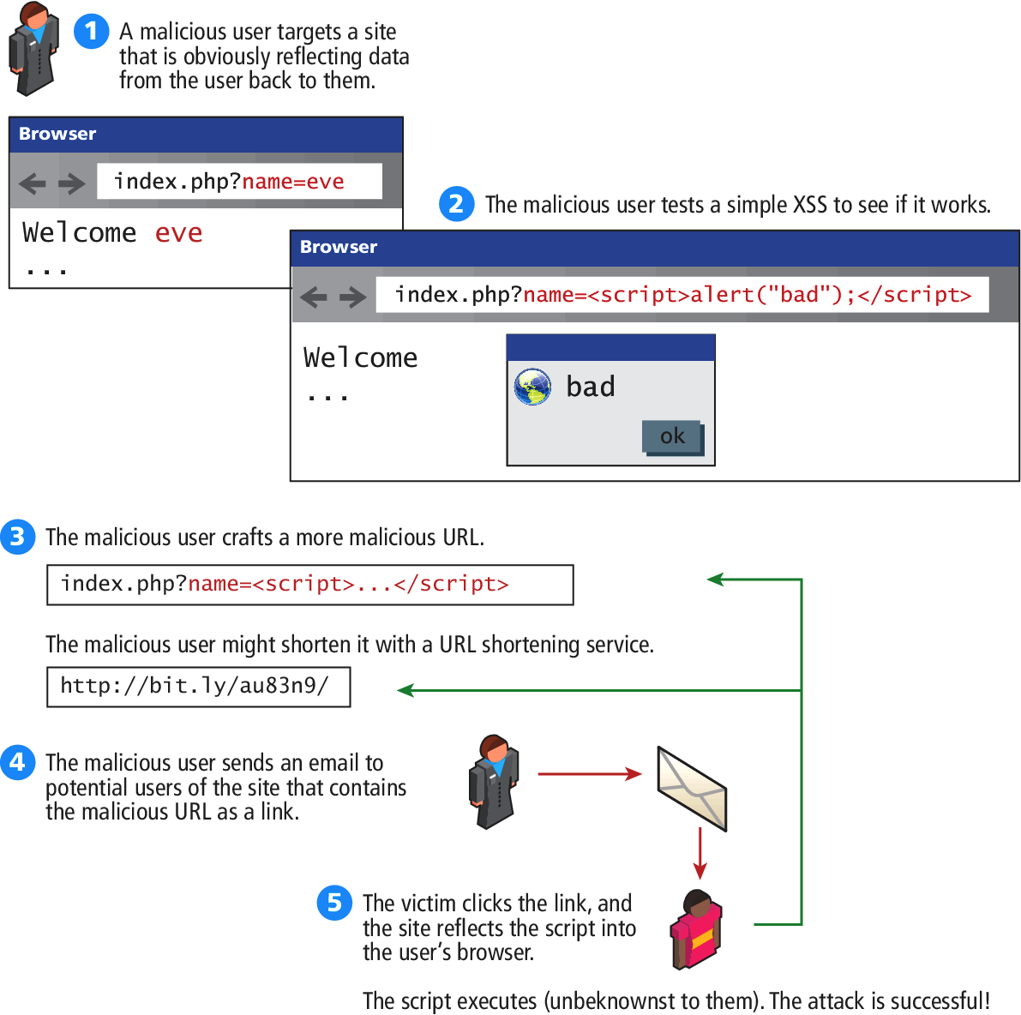
Figure 16.20 Illustration of a Reflection XSS Attack

Slide 41
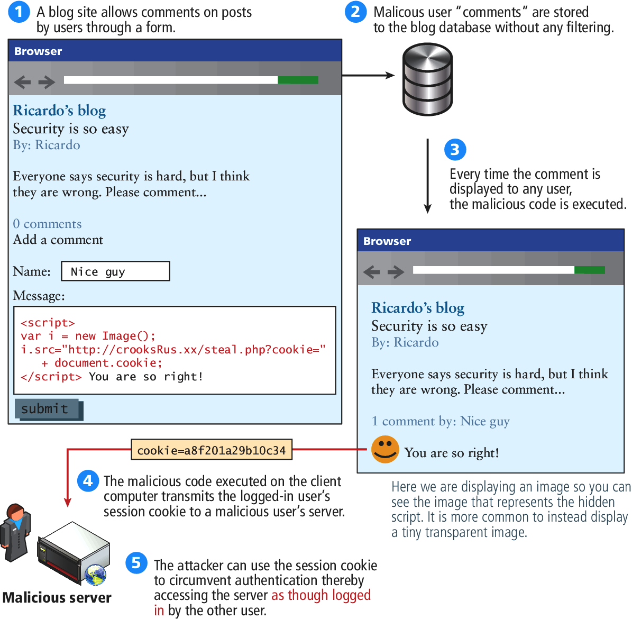
Figure 16.21 Illustration of a Stored XSS Attack

Slide 42
Common Threat Vectors
Insecure Direct Object Reference
  Expose some internal value or key of the application to the user
  Then the attackers can then manipulate the internal keys to gain access to things that should not have access to
  Examples:
    An archive of the site’s PHP code or passwords can be potentially accessed or downloaded
    A database key in the URLs that are visible to users
    Storing files on the server
Denial of Service
Security Misconfiguration

Slide 43
Denial of Services
Denial of Service attacks (DoS)
  are attacks that aim to overload a server with illegitimate requests in order to prevent the site from responding to the legitimate ones,
  Methods of prevention
    Blocking the IP address in the firewall or the Apache server
Distributed DoS Attack (DDoS)
  Attacks are coming from multiple machines
  Recent DDoS attack on Spamhaus servers (generates 300 Gbps worth of requests), http://www.spamhaus.org/news/article/695/answers-about-recent-ddos-attack-on-spamhaus

Slide 44
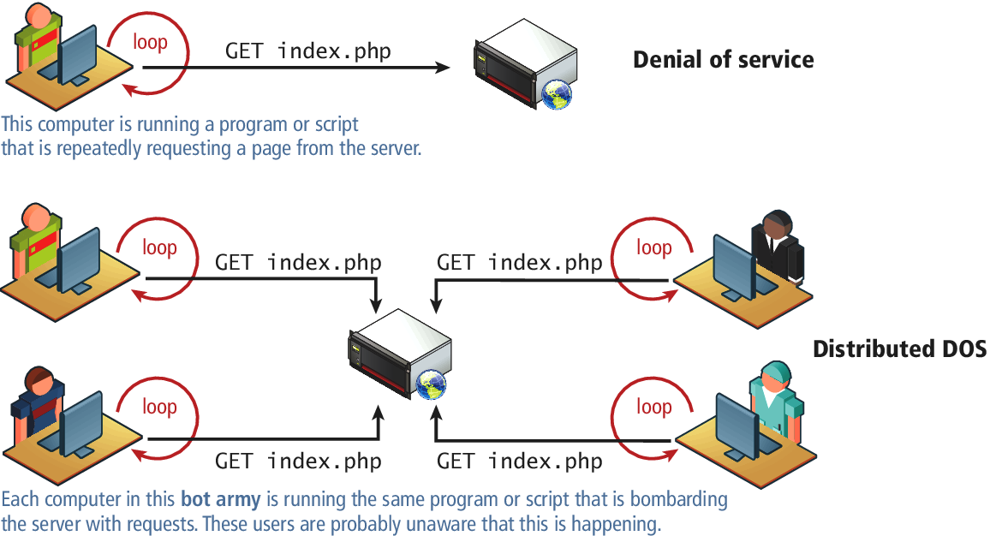
Figure 16.22 DoS and DDoS

Slide 45
Security Misconfiguration
Out-of-Date Software
Open Mail Relays
  Refers to any email server that allows someone to route email through without authentication
More Input Attacks
  Refers to the potential vulnerability that occurs when the users through their HTT requests, transmit a variety of strings and data that are directly used by the server without sanitation.
Virtual Open Mail Relay – Figure 14.23
  HTML web email send to any email addresses
Arbitrary program execution – Figure 16.24

Slide 46
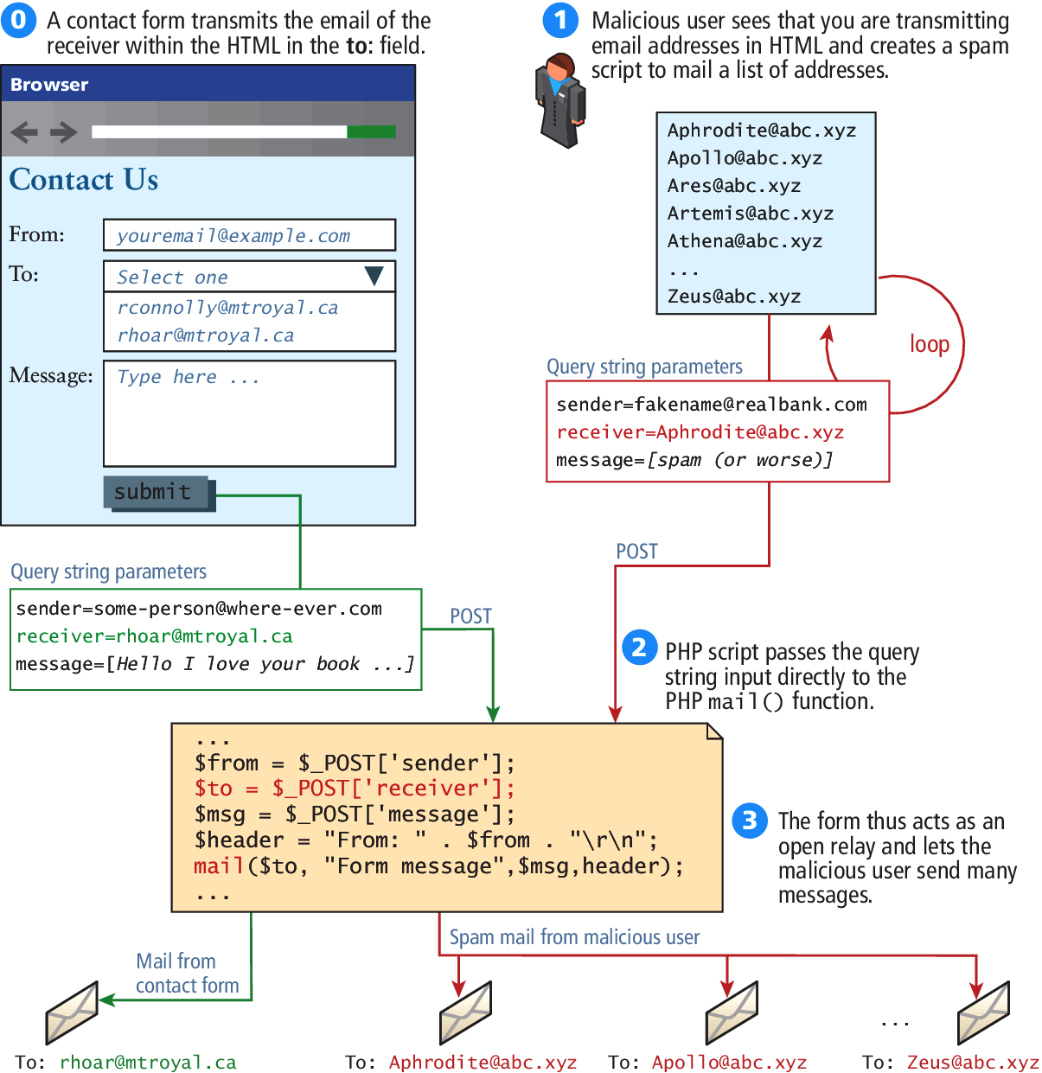
Figure 16.23 Virtual open relay exploit

Slide 47
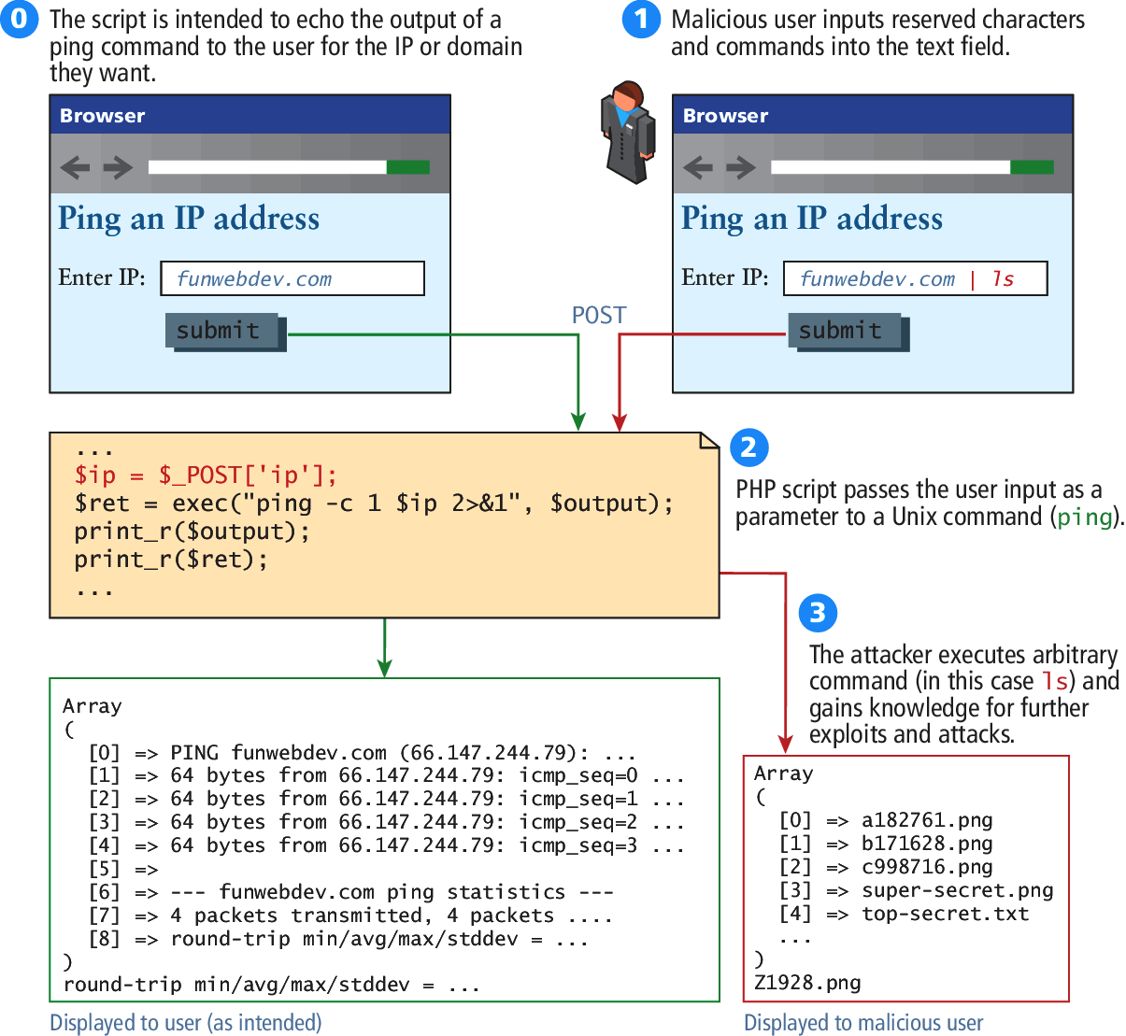
Figure 16.24 Command-line pass-through of user input

Slide 48
Summary and Conclusion
Q/A ?

