Slide 1
ITC 250/CPET 499 Web Systems
Special Lecture on
NIST Cloud Computing Definition, Standards & Roadmap, Security & Privacy Guidelines
Fall 2015
Paul I-Hai Lin, Professor
Dept. of Computer, Electrical and Information Technology
Purdue University Fort Wayne Campus

Slide 2
Topics of Discussion
NIST Cloud Definition
NIST Cloud Computing and Standards Roadmap
NIST Cloud Computing Security & Privacy Guidelines

Slide 3
ANSI Cloud Definition
NIST Definition of Cloud Computing, Special publication 800-145, by Peter Mell and Timothy Grance, Sept., 2011, U.S. Dept. of Commerce, http://www.nist.gov/itl/csd/cloud-102511.cfm
NIST Cloud Computing Standards and Roadmap, Version 1.0, Specification 500-291, July 2011, http://www.nist.gov/manuscript-publication-search.cfm?pub_id=909024
NIST Government Cloud Computing Technology Roadmap Vol I, Special Pub. 500-293, Nov. 2011, http://www.nist.gov/itl/cloud/upload/SP_500_293_volumeI-2.pdf
NIST Cloud Computing Reference Architecture, Sept. 2011, http://www.nist.gov/customcf/get_pdf.cfm?pub_id=909505
Business Use Case, NIST Information Technology Laboratory, http://www.nist.gov/itl/cloud/bususecases.cfm

Slide 4
The NIST Definition of Cloud Computing
Special publication 800-145, by Peter Mell and Timothy Grance, Sept. 2011
“Cloud computing is a model for enabling ubiquitous, convenient, on-demand network access to a shared pool of configurable computing resources (e.g., networks, servers, storage, applications, and services) that can be rapidly provisioned and released with minimal management effort or service provider interaction. This cloud model is composed of five essential characteristics, three service models, and four deployment models. ”

Slide 5
The NIST Definition of Cloud Computing
Five Essential Characteristics
  On-demand self-service, Broad network access, Resource pooling, Rapid elasticity, Measured service
Three Service Models
  Software as a Service (SaaS)
  Platform as a Service (Paas)
  Infrastructure as a Service (IaaS)
Four Deployment Models
  Private cloud
  Community cloud
  Public cloud
  Hybrid cloud

Slide 6
The NIST Definition of Cloud Computing
Three Service Models
  Software as a Service (SaaS)
    The capability provided to the consumer is to use the provider’s applications running on a cloud infrastructure.
    The applications are accessible from various client devices through either a thin client interface, such as web browser (e.g., web-based email), or program interface.
    The consumer does not manage or control the underlying cloud infrastructure including network, servers, operating systems, storage, or even individual application capabilities, with the possible exception of limited specific application configuration settings)
  Platform as a Service (Paas)
  Infrastructure as a Service (IaaS)

Slide 7
The NIST Definition of Cloud Computing
Three Service Models
  Software as a Service (SaaS)
  Platform as a Service (Paas)
    The capability provided to the consumer is to deploy onto the cloud infrastructure consumer-created or acquired application created using programming languages, libraries, services, and tools supported by the provider.
    The consumer does not manage or control the underlying cloud infrastructure
    The consumer has control over the deployed applications and possibly configuration settings for the application-hosting environment
  Infrastructure as a Service (IaaS)

Slide 8
The NIST Definition of Cloud Computing
Three Service Models: Software as a Service (SaaS), Platform as a Service (Paas), and
  Infrastructure as a Service (IaaS)
    The capability provided to the consumer is to provision processing, storage, networks, and fundamental computing resources where the consumer is able to deploy and run arbitrary software which can include operating systems and applications.
    The consumer does not manage or control the underlying cloud infrastructure but has control over operating systems, storage, and deploying applications; and possibly limited control of select networking components (e.g. host firewalls)

Slide 9
The NIST Definition of Cloud Computing
Four Deployment Model
  Private Cloud
    The cloud infrastructure is provisioned for exclusive use by a single organization comprising multiple consumers (e.g. business units).
    It may owned, managed, and operated by the organization, or some combination of them. And
    It may exist on or off premises.
  Public Cloud
  Community Cloud
  Hybrid Cloud

Slide 10
The NIST Definition of Cloud Computing
Four Deployment Model
  Private Cloud
  Public Cloud
    The cloud infrastructure is provisioned for open use by the general public.
    It may be owned, managed, and operated by a business, academic, or government organization, or some combination of them.
    It exits on the premises of the cloud provider.
  Community Cloud
  Hybrid Cloud

Slide 11
The NIST Definition of Cloud Computing
Four Deployment Model
  Private Cloud, Public Cloud
  Community Cloud
    The cloud infrastructure is provisioned for exclusive use by a specific community of consumers from organizations that have shared concerns (e.g., mission, security, requirements, policy, and compliance considerations.)
    It may be owned, managed, and operated by one or more of the organizations in the community, a third party, or some combination of them, and
    It may exist on or off premises.
  Hybrid Cloud

Slide 12
The NIST Definition of Cloud Computing
Four Deployment Model
  Private Cloud, Public Cloud, Community Cloud
  Hybrid Cloud
    The cloud infrastructure is a composition of two or more distinct cloud infrastructures (private, community, or public) that remain unique entities, but are bound together by standardized or proprietary technology that enable data and application portability (e.g. cloud bursting for load balancing between clouds)

Slide 13
The NIST Cloud Computing Roadmap
Actors in Cloud Computing
Cloud Computing Definition and Reference architecture
Cloud Computing Use Cases and Requirements
Cloud Computing and Gap Analysis
High-Priority Security Requirements
Other Related Works
  Cloud Data Issues
  Service-Level Agreement Taxonomy
  Reliability Research in Cloud-Based Complex System

Slide 14
NIST Cloud Actor Definitions: Actors
Cloud Consumer; Cloud Provider; Cloud Auditor; Cloud Broker; Cloud Carrier
Figure 1. Interaction between actors in Cloud Computing

Slide 15
NIST Cloud Actor Definitions
Cloud Consumer
  Person or organization that maintains a business relationship with, and use service from, Cloud Providers.
Cloud Provider
  Person, organization, or entity responsible for making a service available to Cloud Consumers.
Cloud Auditor
  A party that can conduct independent assessment of cloud services, information system operations, performance, and security of the cloud implementation.
Cloud Broker
Cloud Carrier

Slide 16
NIST Cloud Actor Definitions
Cloud Broker
  An entity that manages the use, performance, and delivery of cloud services, and negotiates relationships between Cloud Providers and Cloud Consumers.
Cloud Carrier
  The intermediary that provides connectivity and transport of cloud services from Cloud Providers to Cloud Consumers.

Slide 17
Cloud Consumer & Cloud Provider Activities
Source: Table 2 of NIST Cloud Computing Standards Roadmap
Type | Consumer Activities | Provider Activities
SaaS | Uses application/service for business process operations. | Install, manages, maintains, and supports the software application on a cloud infrastructure.
PaaS | Develops, tests, deploys, and manages applications hosted in a cloud environment. | Provisions and manages cloud infrastructure and middleware for the platform consumers; provides development, deployment, and administration tools to platform consumers.
IaaS | Creates/installs, manages, and monitors services for IT infrastructure operations. | Provisions and manages the physical processing, storage, networking, and the hosting environment and cloud infrastructure for IaaS consumers.

Slide 18
Figure 2. Example of Services Available to a Cloud Consumer

Slide 19
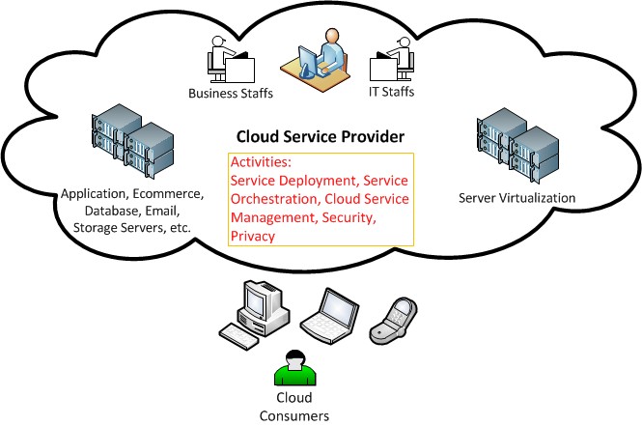
Cloud Consumer & Cloud Provider Activities
Revised based on Figure 3 of NIST Cloud Computing Standards Roadmap

Slide 20
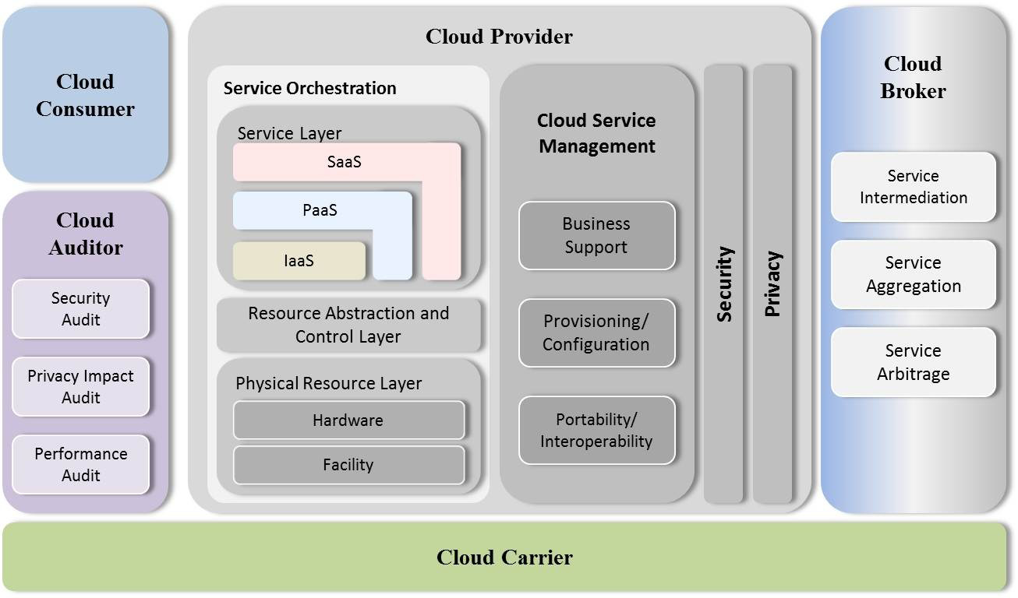
The NIST Cloud Conceptual Model
Figure 12 The Combined Conceptual Reference Diagram, NIST Cloud Computing Standards Roadmap

Slide 21
IT Standards Development and Life Cycle (pp. 31)

Slide 22
Cloud Computing Standards (pp. 43-45)
Security Standards Mapping
  Authentication & Authorization
  Confidentiality
  Integrity
  Identity Management
  Security Monitoring & Incident Response
  Security Policy Management
  Availability
Interoperability Standards Mapping
Portability Standards Mapping

Slide 23
Definitions – Appendix B (pp. 60-76)
Source: American National Standard Dictionary of Information Technology (ANSDIT)
Information Technology (IT) – Encompasses all technologies for the capture, storage, retrieval, processing, display, representation, organization, management, security, transfer, and interchange of data and information.
Data Migration: The periodic transfer of data from one hardware or software configuration to another or from one generation of computer technology to a subsequent generation. Migration is necessary action for retaining the integrity of the data and for allowing users to search, retrieve, and make use of data in the face of constantly changing technology (source: http://www.ischool.utexas.edu/~scisco/lis3891.5/email/gloss.html)

Slide 24
Definitions – Appendix B (pp. 60-76)
Source: American National Standard Dictionary of Information Technology (ANSDIT)
Interoperability: The capability to communicate, execute programs, or transfer data among various functional units under specified conditions.
Maintainability: A measure of the ease with which maintenance of a functional unit can be performed using prescribed procedures and resources. Synonymous with serviceability.
Portability: The capability of a program to be executed on various types of data processing systems with little or no modification and without converting the program to a different language.

Slide 25
Definitions – Appendix B (pp. 60-76)
Source: American National Standard Dictionary of Information Technology (ANSDIT)
Reliability: A measure of the ability of a functional unit to perform a required function under given conditions for a given interval.
Network Resilience: A computing infrastructure that provides continuous business operation (i.e.., highly resistant to disruption and able to operate in a degraded mode if damaged), rapid recovery if failure does occur, and the ability to scale to meet rapid or unpredictable demands. [source: The Committee on National Security Systems Instruction No. 4009, “National Information Assurance Glossary.” CNSSI-4009]

Slide 26
Cloud Computing Standards
Cloud Computing Standards for Interoperability
Functional Interface:
  The interface provided to/by what is resident in the cloud
  For Iaas Functional Interface is a virtualized CPU, memory, I/O used by an OS
Management Interface:
  Cloud user managers their use of the cloud services
  Starting, Stopping, Manipulation of VM images and associated resources

Slide 27
Cloud Computing Standards for Interoperability (page 34)
IaaS Interface:
  Functional Interface:
    The VM and disk interfaces that the OS stack runs on
  Management Interface
    Cloud user manages their use (VM life cycle, etc. ) of the infrastructure

Slide 28
Cloud Computing Standards for Interoperability (page 34)
PaaS Interface:
  Functional Interface:
    The interfaces (service and library )to which the application is written.
  Management Interface
    Cloud user manages their use (application life cycle, etc. ) of the platform.

Slide 29
Cloud Computing Standards for Interoperability (page 35)
SaaS Interface:
  Functional Interface:
    The user or Web services interface of the application
  Management Interface
    Cloud user manages their use (Number of users, etc.) of the application

Slide 30
Cloud Computing Standards (pp. 43-45)
Security Standards Mapping
Interoperability Standards Mapping (Service Interoperability)
  Open Cloud Computer Interface (OCCI), http://occi-wg.org/ ; Open Grid Forum (approved standard) , https://www.ogf.org/ogf/doku.php
  Cloud Data Management Interface (CDMI); Storage Networking Industry Association, SNIA (approved), http://www.snia.org/cdmi
  IEEE P2301, Draft Guide for Cloud Portability and Interoperability Profiles (CPIP), IEEE, (under development), http://standards.ieee.org/develop/project/2301.html
  IEEE P2302, Draft Standard for Intercloud Interoperability and Federation (SIIF), IEEE (under development), http://standards.ieee.org/develop/project/2302.html
Portability Standards Mapping

Slide 31
Cloud Computing Standards (pp. 43-45)
Security Standards Mapping
Interoperability Standards Mapping (Service Interoperability)
Portability Standards Mapping
  System Portability
    Open Virtualization Format (OVF): DMTF (Distributed Management Task Force, www.dmtf.org , approved standard, market acceptance
    IEEE P2301, Draft Guide for Cloud Portability and Interoperability Profiles (CPIP), IEEE, (under development)

Slide 32
Cloud Computing Standards (pp. 43-45)
Portability Standards Mapping
  Data Portability
    Cloud Data Management Interface (CDMI): SNIA (Storage Networking Industry Association, http://www.snia.org/cdmi, approved standard
  Workload Portability

Slide 33
Use Case Analysis
(candidates for standardization)
Management APIs
Data Exchange Formats
Federated Identity and Security Policy APIs
Resource Descriptions
Data Storage APIs

Slide 34
10 Use Cases
6.4.1 Creating, accessing, updating, deleting data objects in clouds
6.4.2 Moving VMs and virtual appliances between clouds
6.4.3. Selecting the best IaaS cloud vendor, public or private
6.4.4 Portable tools for monitoring and managing clouds

Slide 35
10 Use Cases (cont.)
6.4.5 Moving data between clouds
6.4.6 Single sign-on access to multiple clouds
6.4.7 Orchestrated processes across clouds and Enterprise Systems
6.4.8 Discovering cloud resources
6.4.9 Evaluating SLAs and penalties
6.4.10 Auditing clouds

Slide 36
6.4.1 Use Case: Creating, Accessing, Updating, Deleting data objects in clouds
Benefits: Cross-cloud applications
Deployment Mode Considerations
  Basic Create-Read-Update-Delete (CRUD) operations on data objects
Standardizations Needed
  Standard interface to metadata and data objects
Possible Standards: CDMI (Cloud Data Management Interface) from SNIA (Storage Networking Industry Association)

Slide 37
6.4.2 Use Case: Moving VMs and virtual appliances between clouds
Benefits: Hybrid Clouds, Disaster Recovery, Cloud Bursting
Deployment Mode Considerations
  When moving a VM out of one cloud and into another as two separate actions, conceivably two different ID management systems can be used.
  When moving VMs in a truly hybrid cloud, however, federated ID management standards will ne needed.
Standardizations Needed
  Common VM description format
Possible Standards: OVM (Open Virtualization Format Specification, 2013) from DMTF (Distributed Management Task Force, www.dmtf.org ) ; OpenID, Oauth

Slide 38
6.4.3 Use Case: Selecting the best IaaS cloud vendor, public or private
Benefits: Provide cost-effective reliable deployments
Deployment Mode Considerations
  When considering hybrid or distributed (inter) cloud deployments, uniform and consistent resources, performance, and policy descriptions are needed.
Standardizations Needed
  Resource and performance requirements description languages
Possible Standards:
  For basic resource descriptions, DMTF CIM (Common Information Model), http://www.dmtf.org/standards/cim and OGF GLUE (Open Grid Forum) are candidates. Other more extensive description languages for performance or policy enforcement are to be determined.

Slide 39
6.4.4 Use Case: Portable tools for monitoring and managing clouds
Benefits: Simplifies operations as opposed to individual tools for each cloud
Deployment Mode Considerations
  Monitoring and managing are separated but closely related tasks. The standard required will differ depending on whether the monitoring and managing must be done across trust boundaries or across distributed environments.
Standardizations Needed
  Standard monitoring and management interfaces to IaaS resource
Possible Standards:

Slide 40
6.4.4 Use Case: Portable tools for monitoring and managing cloud (continue)
Possible Standards:
  Basic monitoring standards exist, such as the Syslog Protocol (IETF RFC 5424, March 2009, https://tools.ietf.org/html/rfc5424 ), which can be used with the Transport Layer Security (TLS) Transport Mapping for Syslog (IETF RFC 5425).
  Basic management standards include the Cloud Management WG (Work Group) from DMTF, and OCCI from OGF.

Slide 41
6.4.5 Use Case: Moving data between clouds
Benefits: Migrate between Clouds, cross-cloud application and B2B integration
Deployment Mode Considerations
  Migrating data from one cloud to another in two separate moves through the client is a simple case.
  Migrating data directly from one cloud to another will require standards for federated identity, delegation of trust, and secure third-part transfers.
Standardizations Needed: Standard metadata/data format for movement between clouds
Standardized query languages (NoSQL for IaaS)
Possible Standards: AS4 (Application Statement), OAGIS (Open Application Group Integration Specification, http://www.oagi.org/oagis/9.0/) , NoSQL, GridFTP

Slide 42
6.4.6 Use Case: Single sign-on access to multiple clouds
Benefits: Simplified access, Cross-cloud applications
Deployment Mode Considerations
  Single sign-on can mean the same credentials to access different clouds independently at different times.
  Single sign-on to access an inter-cloud application that spans multiple clouds will require federated identity management, delegation of trust, and virtual organization.
Standardizations Needed: Federated identity, authorization, and virtual organizations
Possible Standards: OpenID (http://opened.net/ , Oauth (Open Standard to Authorization, http://oauth.net/2/ , SAML, WS-Federation and WS-Trust, CSA outputs; VOMS (Virtual Organization Management System)

Slide 43
6.4.6 Use Case: Single sign-on access to multiple clouds
Possible Standards:
  OpenID http://opened.net/
  Oauth (Open Standard to Authorization), http://oauth.net/2/
  SAML (Security Assertion Markup Language), http://saml.xml.org/
  WS-Federation (Web Service), http://docs.oasis-open.org/wsfed/federation/v1.2/os/ws-federation-1.2-spec-os.html
  WS-Trust, http://docs.oasis-open.org/ws-sx/ws-trust/200512
  CSA outputs;
  VOMS (Virtual Organization Membership Service), http://toolkit.globus.org/grid_software/security/voms.php

Slide 44
6.4.7 Use Case: Orchestrated processes across clouds and Enterprise Systems
Benefits: Direct support for necessarily distributed systems
Deployment Mode Considerations
  This use case is inherently distributed and across trust boundaries. This can be generally termed Federated Resource Management and is a central concept in grid computing community. The term inter-cloud can also be used to denote this concept.

Slide 45
6.4.7 Use Case: Orchestrated processes across clouds and Enterprise Systems (cont.)
Standardizations Needed: To address this use case complexity, an entire set of capabilities need to be standardized, e.g.,
  Infrastructure services;
  Execution Management services;
  Data services;
  Resource Management services;
  Security services;
  Self-management services; and
  Information services.

Slide 46
6.4.7 Use Case: Orchestrated processes across clouds and Enterprise Systems (cont.)
Possible Standards:
SOA standards (such as WS-I) and grid standards (such as the OGSA WSRF (Open Grid Service Architecture, Web Services Resource Framework) Basic Profile, OGF GFD-R-P.072: Grid Forum Document) exist that cover these areas, but issues around stateful resources, callbacks/notifications, and remote content lifetime management has cause these to be eclipsed by the simplicity of Representational State Transfer (REST).
Hence, standard, REST-based versions of these capabilities must be developed.
Such work is being done in several organizations, including the IEEE.

Slide 47
6.4.7 Use Case: Orchestrated processes across clouds and Enterprise Systems (cont.)
Possible Standards: DMTF (The Distributed Management Task Force, http://www.dmtf.org/) and OGF (Open Grid Forum, http://www.gridforum.org/gf/group_info/view.php?group=dcifed-wg )
The OGF Distributed Computing Infrastructure Federations Working Group (DCI Federal [F=DCIfed]-WG) is addressing two usage scenarios: (1) delegation of workload from one domain into the other, covering job description, submission, and monitoring; and (2) leasing of resources, including resource definition, provisioning, and monitoring.

Slide 48
6.4.7 Use Case: Orchestrated processes across clouds and Enterprise Systems (cont.)
Possible Standards:
Existing standards to support this include
  WS-Agreement, http://www.ogf.org/documents/GFD.107.pdf
  Job Submission Description Language (JSDL), http://www.gridforum.org/documents/GFD.56.pdf
  GLUE Information Model, http://redmine.ogf.org/dmsf_files/102
  OGSA Basic Execution Service, http://www.ogf.org/documents/GFD.108.pdf

Slide 49
6.4.7 Use Case: Orchestrated processes across clouds and Enterprise Systems (cont.)
Possible Standards:
Existing standards to support this include
  OCCI (Open Cloud Computing Interface) – Infrastructure, http://www.gridforum.org/documents/GFD.184.pdf, http://occi-wg.org/tag/specification/
  Usage Record. https://www.ogf.org/documents/GFD.98.pdf
  Specific Business application data formats may be supported by OAGIS.

Slide 50
6.4.7 Use Case: Orchestrated processes across clouds and Enterprise Systems (cont.)
Possible Standards:
Workflow and workflow engines will also need standardization and adoption in the cloud area. BPEL is one existing standards but extensions might be needed to efficiently support scientific and engineering workflows.
(WS-BPEL 2.0, http://bpel.xml.org/specifications )

Slide 51
6.4.8 Use Case: Discovering cloud resources
Benefits: Selection of appropriate cloud for applications
Deployment Mode Considerations : To support inter-cloud resource discovery, secure federated catalog standards are needed.
Standardizations Needed: Description languages for available resources, Catalog interfaces
Possible Standards:
  This use case actually requires two areas of standardization: (1) description language for the resources to be discovered, and (2) the discovery APIs for the discovery process itself.
  Some existing standards and tools cover both areas:

Slide 52
6.4.8 Use Case: Discovering cloud resources (cont.)
Possible Standards: …Some existing standards and tools cover both areas:
  RFD (Resource Description Framework) is a standard formalism for describing resources as triples consisting of “subject-Predicate-Object”. (http://www.w3.org/TR/rdf-concepts/ )
  The Dublin Core is a small, fundamental set of text elements for describing resources of all types.
  It is commonly expressed in RDF. Since the Dublin Core is a “core” set, it is intended to be extensible for a broad range of application domains. Such work is being pursued by the Dublin Core Medatdata Initiative, http://dublincore.org/ .

Slide 53
6.4.8 Use Case: Discovering cloud resources (cont.)
Possible Standards: …Some existing standards and tools cover both areas:
  ebXML Registry Information Model (ebRIM) actually defined both a description language and a discovery method, ebXML Registry Services (ebRS); http://www.ebxml.org/
  ID-WSF (Identity Web Service Framework), http://www.projectliberty.org/resource_center/specifications/liberty_alliance_id_wsf_2_0_specifications/
  LDAP (Lightweight Directory Access Protocol), http://www.rfc-editor.org/rfc/rfc4512.txt

Slide 54
6.4.8 Use Case: Discovering cloud resources (cont.)
Possible Standards: …Some existing standards and tools cover both areas:
  UDDI (Universal Description, Discovery, and Integration), https://www.oasis-open.org/committees/tc_home.php?wg_abbrev=uddi-spec
  CSW (Catalogue Service), OGC (Open Geospatial Consortium) standards, http://www.opengeospatial.org/standards/is

Slide 55
6.4.9 Use Case: Evaluating SLAs and penalties
Benefits: Selection of appropriate cloud resources
Deployment Mode Considerations: …
Standardizations Needed: SLA description language
Possible Standards:
  WS-Agreement (GFD.107)
  WS-Agreement Negotiation (OGF)

Slide 56
6.4.10 Use Case: Auditing clouds
Benefits: Ensure regulatory compliance. Verify information assurance.
Deployment Mode Considerations: …
Standardizations Needed: Auditing standards and verification check lists
Possible Standards:
  CSA Cloud Audit
  Guidelines for Auditing Grid Certificate Authorities (OGF GFD.169)

Slide 57
Summary & Conclusion

