Slide 1
CPET 499/ITC 250 Web Systems
Lecture 3
Introduction to HTML and XHTML,
Web Browsers, and Web Servers
References: *Chapter 2 of the Text Book: Programming the World Wide Web, 8th ed, by Robert W. Sebesta, from Pearson
*Internet & World Wide Web How to Program, 5th ed, by Paul Deitel, et. al.,
From Pearson
*Webmaster in a Nutshell, by Stephen Spainbour & Robert Eckstein, from O’Reilly
*E-Book on Building Web Applications with HTML, 2012, by Paul I. Lin, http://www.etcs.ipfw.edu/~lin/CECourses/2_HTML/CE_02WebHhtmlindex.html
Paul I-Hai Lin, Professor
http://www.etcs.ipfw.edu/~lin

Slide 2
Topics
Introduction to HTML Documents
Versions of HTML
HTML5 Standards
Topics on Web Browsers and Web Servers
A Basic Web Site - Design

Slide 3
HTML Documents
HTML
A structured language defines syntax and placement of WWW document for Web browsers.
The HTML syntax contains definitions of tags and attributes that allows the separation of the presentation and structure of a document.
It enables the creation of machine independent WWW documents.
References of HTML standards
HTML 5 - http://www.w3.org/TR/2014/REC-html5-20141028/

Slide 4
Web Pages - HTML Documents
A Web page normally includes text (content of the page) that mixed with "markup" tags for describing its structure, appearance, and function of the content.
The HTML (HyperText Markup Language) language is a document-layout and hyperlink-specification language for encoding Web pages or documents, which may include text, image, and other supported media.

Slide 5
Web Pages - HTML Documents
A HTML web page may include the following information
Text of its document with appropriate layout settings such as front, color, alignment, numbered and bulleted lists, etc; any hypertext links to other documents, images, and other media; tables and user feedback form
Embedded client-side scripts such as JavaScript
Embedded images and media
Embedded other objects such as Java Applet program, ActiveX, audio, video, and VRML objects
Embedded video, audio, and other formats via Plug Ins

Slide 6
Evolution of HTML Specifications
1993 Original version of HTML was defined with SGML (Standard Generalized Markup Language)
HTML 2.0 - 1995, HTML 3.2 - 1997,
HTML 4.0 - 1997, HTML 4.01 - 1999, http://www.w3.org/TR/html4/
XHTML 1.0 - 2000
XHTML2 Working Group, http://www.w3.org/MarkUp/
Drop XHTML 2.0 development effort in 2009
HTML 5 - http://www.w3.org/TR/2014/REC-html5-20141028/

Slide 7
HTML5 Semantics, Structure and APIs
HTML 5 – A vocabulary and associated APIs for HTML and XHTML
Documents elements are defined by tags
Opening tag: <name_of_the_tag>
Document Contents
Closing tang: </name_of_the_tag>
Comments: <!-- …… -->
Elements
Content Models
Global Attributes

Slide 8
HTML5 Semantics, Structure and APIs
HTML 5, http://www.w3.org/html/wg/drafts/html/CR/
The Elements of HTML
The root element: <html> </html>
Document Metadata: <head> </head>, <title> </title>, <base> </base>, <link> </link>, <meta> </meta>
Sections: <body>, <article>, <section>, <nav>, <aside>, <h1>, <h2>, <h3>, <h4>, <h5>, <h6>, <header>, <footer>, <address>
Grouping content: <p>, <hr>, <pre>, <blockquote>, <ol>, <ul>, <li>. <dl>, <dt>, <dd>, <figure>, <figcaption>, <div>, <main>
Text-Level Semantics: <a>, <em>, <strong>, <small>, <s>, <cite>, <q>, <dfn>, <abbr>, <data>, <time>, <code>, <var>, <samp>, <kbd>, <sub>, <sup>, <i>, <b>, <u>, <mark>, <ruby>, <rb>, <rt>, <rtc>, <rp>, <dbi>, <bdo>, <span>, <br>, <wbr>

Slide 9
HTML5 Semantics, Structure and APIs
HTML 5, http://www.w3.org/html/wg/drafts/html/CR/
The Elements of HTML (continue)
Edits: <ins> <del>
Embedded contents: <img>, <iframe>, <embed>, <object>, <param>, <video>, <audio>, <source>, <track>, <map>, <area>
Links: <a>, <alternate>, <author>, <bookmark>, <help>, <icon>, <license>, <nofollow>, <noreferrer>, <prefectch>, <search>, <stylesheet>, <tag>, <next>, <prev>
Tabular Data: <table>, <caption>, <colgroup>, <col>, <tbody>, <thread>, <tfoot>, <tr>, <td>, <th>
Forms: <form>, <label>, <input>, <type>, <button>, <select>, <datalist>, <optgroup>, <option>, <textarea>, <keygen>, <output>, <progress>, <meter>, <fieldset>, <legend>, …
Scripting: <script>, <noscript>, <template>, <canvas>

Slide 10
Standard XHTML Document Structure
Every XHTML document must begin with:
<!DOCTYPE html>
<html>, <head>, <title>, and <body> are required
in every document (in XHTML, not HTML)
The whole document must have <html> as its root
html must have the lang attribute:
<html lang = ″en″> (this one is for English)
A document consists of a head and a body
The <title> tag is used to give the document a title,
The meta tag is used to provide the character set used
<meta charset = ″utf-8″ />
UTF-8: 8-bit Unicode Transformation Format or ASCII characters

Slide 11
Basic Text Markup
Paragraph elements: <p> tag
<!DOCTYPE html>
<!– welcome.html -- >
<html lang = ″en″>
<head>
<title> Welcome to our Web site </title>
<meta charset = ″utf-8″ />
</head>
<body>
<p> Greeting from all of us!
</p>
</body>
</html>

Slide 12
welcome.html
Microsoft Expression Web 4 – Web page authoring software
<!DOCTYPE html PUBLIC "-//W3C//DTD XHTML 1.0 Transitional//EN" "http://www.w3.org/TR/xhtml1/DTD/xhtml1-transitional.dtd">
<html xmlns="http://www.w3.org/1999/xhtml">
<head>
<meta content="text/html; charset=utf-8" http-equiv="Content-Type" />
<meta content="en-us" http-equiv="Content-Language" />
<title>Greeting from all of us</title>
</head>
<body>
<p>Greeting from all of us</p>
</body>
</html>

Slide 13
URL for the Web Page: htmlstruc.html
http://www.etcs.ipfw.edu/~lin/CECourses/2_HTML/Lectures/3_HTMLBasics.html
<html>
<!-- htmlstruc.html
Author:
Version:
-->
<head>
<title> Basic html Document Structure/Template </title>
</head>
<body>
<!-- Contents of html Document -->
<h1> Basic html Document Structure/Template </h1>
</body>
</html>

Slide 14
URL for the Web Page: htmlstruc.html
Structured Markup Tags (for overall document)
Begin Tag End Tag Meaning
<html> </html> Placed at the beginning and end of
the document
<head> </head> Define the header portion
<title> </title> Define the title of the document
<body> </body> Define document body
<!-- --> One line comment
<!-- This is a comment -->

Slide 15
Optional Elements
<base> -- Establish the document base location
<meta> -- Provide keywords, descriptions to search engines, and client pull functions
<link> -- Link a document to another document or an external style sheet
<script> -- Add JavaScripts and VBScripts
<style> -- Add embedded style sheet

Slide 16
Base Tag Example, http://www.etcs.ipfw.edu/~lin/CECourses/2_HTML/03HTMLBasicsExs/basehref.html
<html>
<!-- basehref.html -->
<title> BASE href testing </title>
<head>
<base href="http://www.etcs.ipfw.edu/~lin/html/">
</head>
<body>
<h1>
<!-- The file "headers.html" is located in the <BASE
href="http://www.etcs.ipfw.edu/~lin/html/"> -->
<a href="headers.html"> Header Example
<br>
</h1>
</body>
</html>

Slide 17
Web Browsers and Web Pages
A web browser is a software application for retrieving, presenting, and traversing information resources on the World Wide Web, (source: https://en.wikipedia.org/wiki/Web_browser )
The major web browsers are
Firefox, https://www.mozilla.org/en-US/firefox/new/
Internet Explorer (IE 11), http://windows.microsoft.com/en-us/internet-explorer/download-ie
Google Chrome, http://www.google.com/chrome/index.html
Opera, www.opera.com
Safari, https://support.apple.com/downloads/safari
dia.org/wiki/Web_browser).

Slide 18
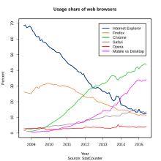
Web Browsers and Web Pages
2015 Internet Browser Software Product Comparisons, http://internet-browser-review.toptenreviews.com/
StatCounter – Web traffic analysis tool, https://statcounter.com/

Slide 19
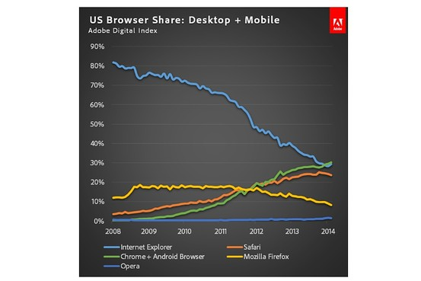
Web Browsers and Web Server Market Shares
Web Browsers Market Share
Google Passes Microsoft in U.S. Browser Market Share, http://blogs.wsj.com/digits/2014/06/05/google-passes-microsoft-in-u-s-browser-market-share/

Slide 20
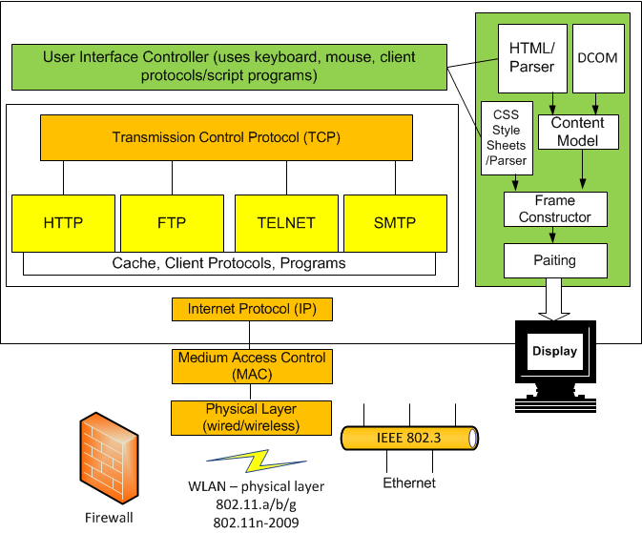
Web Browser and Supporting Protocols

Slide 21
Web Browsers and Web Pages
HTML 5, http://www.w3.org/html/wg/drafts/html/CR/
The Window object
The WindowProxy object
Session History and Navigation
The History interface, The Location interface
Web application APIs
The ErrorEvent interface
Events: Document objects and Window objects
Dynamic markup insertion: document.write(), ocument.writeln()
Timers
User prompts
System state and capabilities
User interaction

Slide 22
Web Browsers Monitoring Tools
Employee Monitoring Software
Program activity
Screen shots
Email/Webmail
Document Tracking
Websites visited
Online Searches
Chat/IM
Detected Keywords
Keystrokes
Logon/Logoff

Slide 23
Web Server Market Shares
April 2014 Web Server Survey, http://news.netcraft.com/archives/2014/04/02/april-2014-web-server-survey.html
NetCraft May 2014 Web Server Survey, http://news.netcraft.com/archives/2014/05/07/may-2014-web-server-survey.html
Microsoft threatening Apache’s market lead
Total number of web sites
Web server developers: Market share of all sites
Web server developers: Market share of active sites
Server Hardware Stat (4Q13), http://www.gartner.com/newsroom/id/2671315
HP 28.1%, IBM 26.5%, Dell 15.2%, Cisco 4.7%, Oracle 4.2%, other Vendors 21.3%.

Slide 24
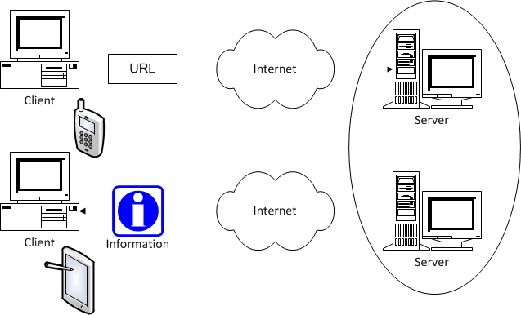
Web Client-Server Computing Model

Slide 25
Design & Build A Web Site
Web Site Design
Types of Web Site: E-commerce, Business and Services, Topic sites, personal sites,
System requirements – Analysis Phase
Modular Design – Design Phase
Presentation tier, Business logic tier, Data tier
Web server
Apache, IIS (Microsoft Internet Information Server), IBM WebShpere
Application server
Database server
Application authoring and Programming Tools

Slide 26
Software for Web Site Design
HTML (HyperText Markup Language) Web page authoring
XML (eXtensible Markup Language) page authoring
Common Gateway Interface programming
Generating and parsing HTML and XML
Creating dynamic HTML pages
HTTP clients and server Apps
Web site management
Databases and Apps
Web applications

Slide 27
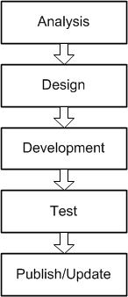
Design & Build An E-Commerce Site
Web Site Design
Business and Services
System requirements
Modular Design
Web server
Database server
Application server
Programming Tools

Slide 28
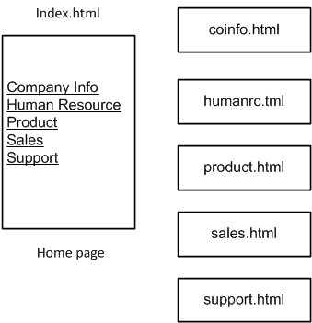
Design A Company Web Site

Slide 29
Summary

