Slide 1
How the Web Works
Chapter 1

Slide 2
Objectives
1
2
Definitions and History
Internet Protocols
3
4
Client-Server Model
Where is the Internet?
5
6
Domain Name System
Uniform Resource Locators (URL)
7
8
Hypertext Transfer Protocol (HTTP)
Web Servers

Slide 3
Definitions and history
Section 1 of 8

Slide 4
Internet = Web?
The answer is no
The World-Wide Web (WWW or simply the Web) is certainly what most people think of when they see the word “Internet.”
But the WWW is only a subset of the Internet.

Slide 5
Communication Definitions
We will begin with the telephone
Telephone networks provide a good starting place to learn about modern digital communications.
In the telephone networks of old, calls were routed through operators who physically connected caller and receiver by connecting a wire to a switchboard to complete the circuit.

Slide 6
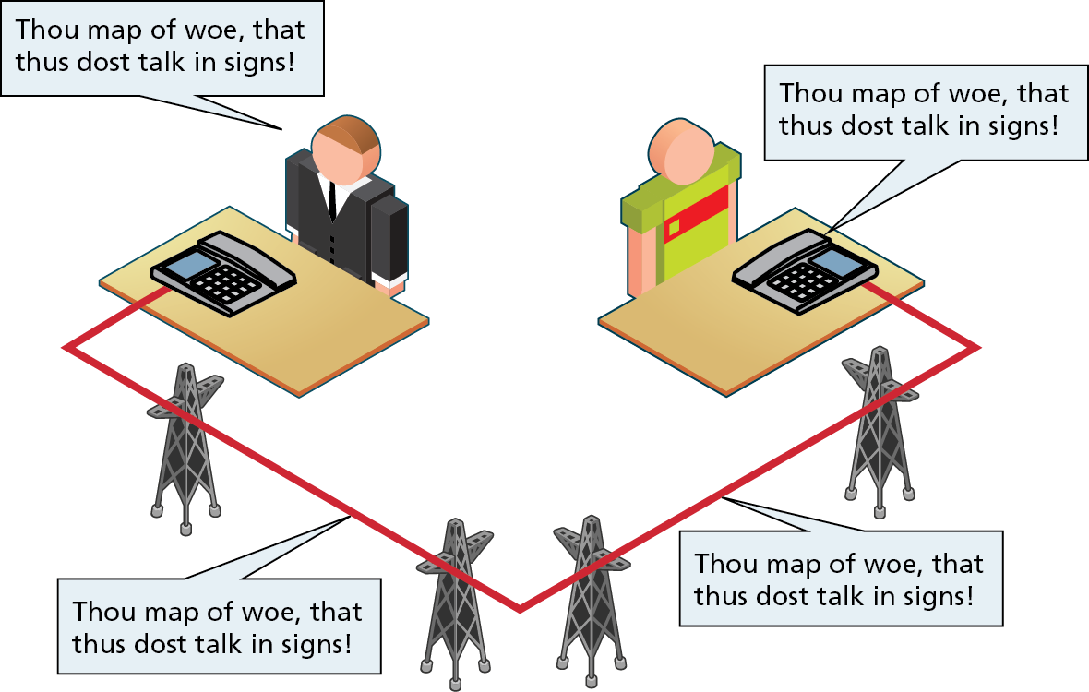
Circuit Switching
A circuit switching establishes an actual physical connection between two people through a series of physical switches.

Slide 7
Circuit Switching
Its Limitations
Circuit Switching Weaknesses
You must establish a link and maintain a dedicated circuit for the duration of the call
Difficult to have multiple conversations simultaneously
Wastes bandwidth since even the silences are transmitted

Slide 8
ARPANET
The beginnings of the Internet
The research network ARPANET was created. In the 1960s
ARPANET did not use circuit switching
it used packet switching
A packet-switched network does not require a continuous connection. Instead it splits the messages into smaller chunks called packets and routes them to the appropriate place based on the destination address.
The packets can take different routes to the destination.

Slide 9
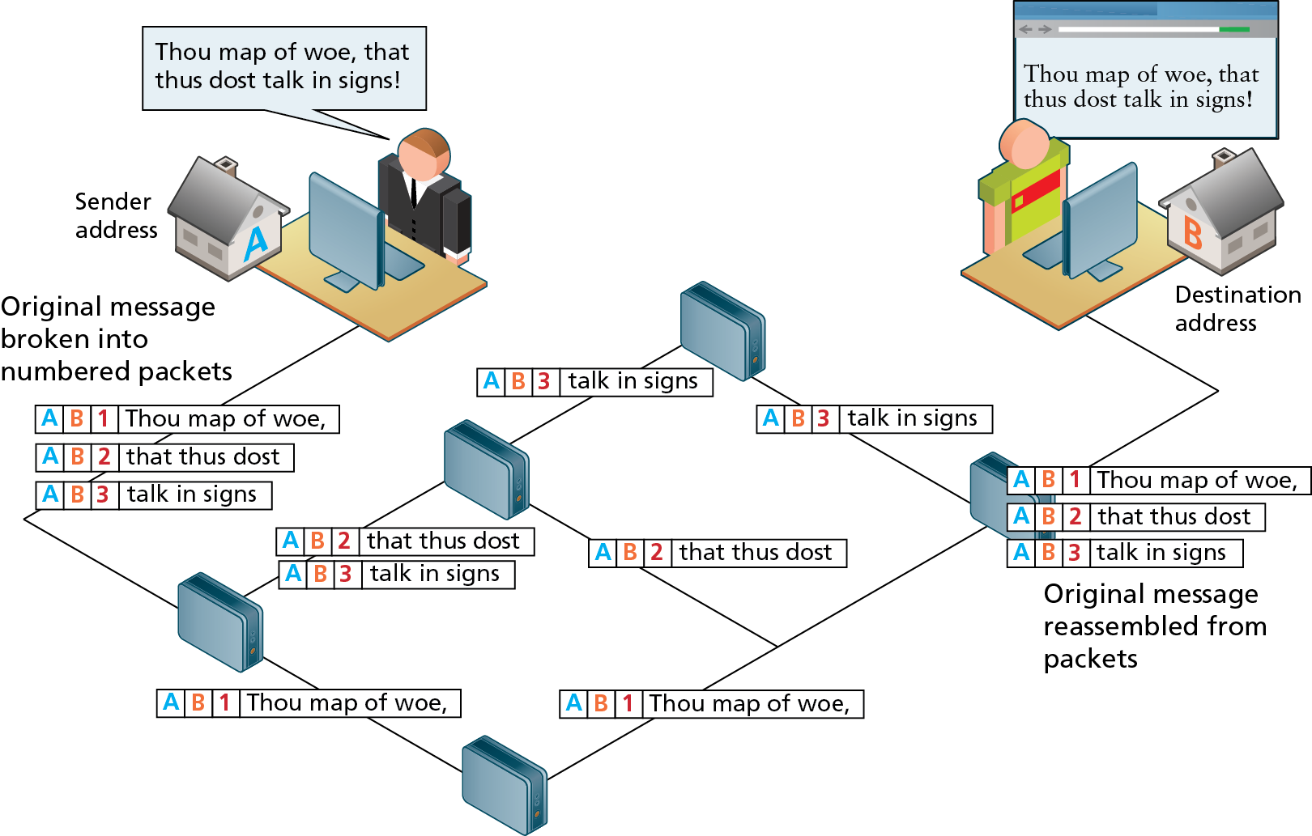
Packet Switching

Slide 10
Packet Switching
Isn’t this more complicated?
While packet switching may seem a more complicated and inefficient approach than circuit switching, it is:
more robust (it is not reliant on a single pathway that may fail) and
a more efficient use of network resources (since a circuit can communicate multiple connections).

Slide 11
Short History of the Internet
Perhaps not short enough
The early ARPANET network was funded and controlled by the United States government, and was used exclusively for academic and scientific purposes.
The early network started small with just a handful of connected campuses in 1969 and grew to a few hundred by the early 1980s.

Slide 12
TCP/IP
Rides to the rescue
To promote the growth and unification of the disparate networks a suite of protocols was invented to unify the networks together.
By 1981, new networks built in the US began to adopt the TCP/IP (Transmission Control Protocol / Internet Protocol) communication model (discussed in the next section), while older networks were transitioned over to it.

Slide 13
Tim Berners-Lee
I meant Sir Tim Berners-Lee
The invention of the WWW is usually attributed to the British Tim Berners-Lee, who, along with the Belgian Robert Cailliau, published a proposal in 1990 for a hypertext system while both were working at CERN in Switzerland.

Slide 14
Core Features of the Web
Shortly after that initial proposal Berners-Lee developed the main features of the web:
A URL to uniquely identify a resource on the WWW.
The HTTP protocol to describe how requests and responses operate.
A software program (later called web server software) that can respond to HTTP requests.
HTML to publish documents.
A program (later called a browser) to make HTTP requests from URLs and that can display the HTML it receives.

Slide 15
W3C
The World Wide Web Consortium
Also in late 1994, Berners-Lee helped found the World Wide Web Consortium (W3C), which would soon become the international standards organization that would oversee the growth of the web.
This growth was very much facilitated by the decision of CERN to not patent the work and ideas done by its employee and instead left the web protocols and code-base royalty free.

Slide 16
Web Apps Compared to Desktop Apps
First the advantages of web apps
Some of the advantages of web applications include:
Accessible from any Internet-enabled computer.
Usable with different operating systems and browser platforms.
Easier to roll out program updates since only need to update software on server and not on every desktop in organization.
Centralized storage on the server means fewer concerns about local storage (which is important for sensitive information such as health care data).

Slide 17
Web Apps Compared to Desktop Apps
Now the disadvantages of web apps
Some of the disadvantages of web applications include:
Requirement to have an active Internet connection (the Internet is not always available everywhere at all times).
Security concerns about sensitive private data being transmitted over the Internet.
Concerns over the storage, licensing and use of uploaded data.
Problems with certain websites on certain browsers not looking quite right.
Limited access to the operating system can prevent software and hardware from being installed or accessed (like Adobe Flash on iOS).

Slide 18
What is an “Intranet”?
A short digression
One of the more common terms you might encounter in web development is the term “Intranet” (with an “a”), which refers to an Internet network that is local to an organization or business.
Intranet resources are often private, meaning that only employees (or authorized external parties such as customers or suppliers) have access to those resources.
Thus Internet (with an “e”) is a broader term that encompasses both private (Intranet) and public networked resources.

Slide 19
What is an “Intranet”?
Intranets are typically protected from unauthorized external access via security features such as firewalls or private IP ranges.
Because Intranets are private, search engines such as Google have limited or no access to content within a private Intranet.
Due to this private nature, it is difficult to accurately gauge, for instance, how many web pages exist within Intranets, and what technologies are more common in them.
Some especially expansive estimates guess that almost half of all web resources are hidden in private Intranets.

Slide 20
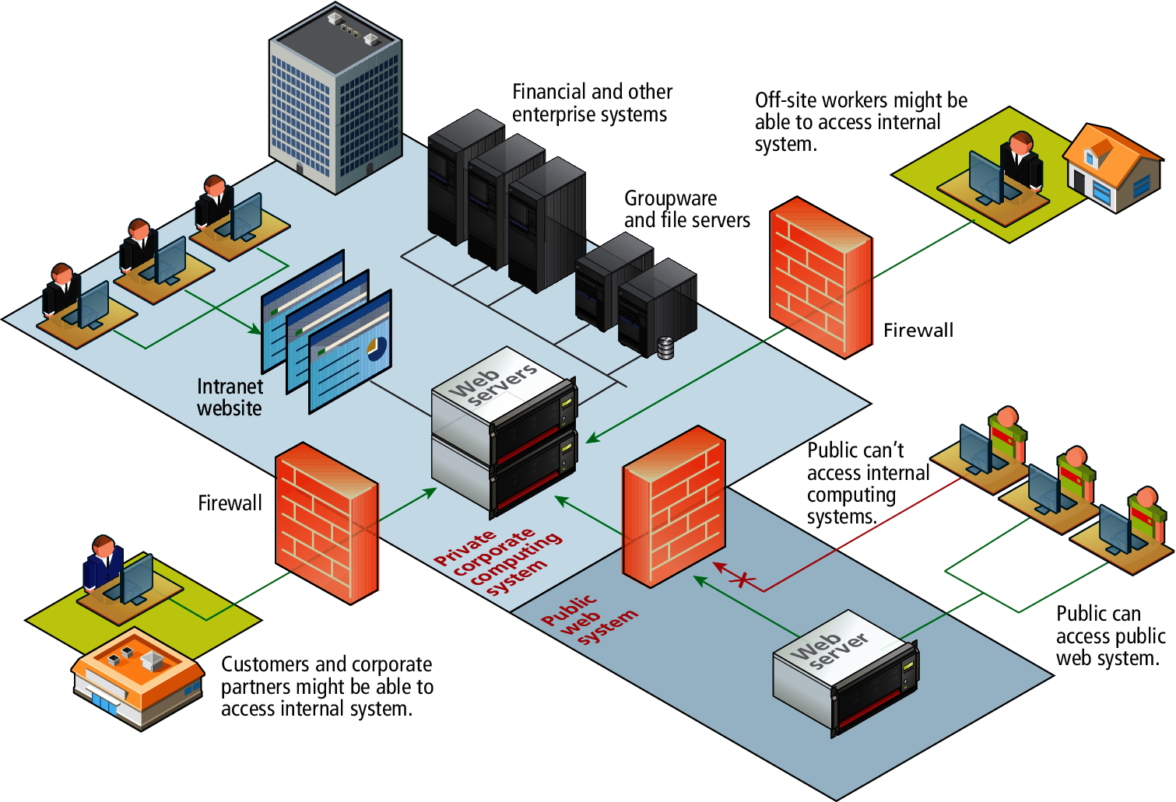
Intranet versus Internet

Slide 21
Intranets and the Job Market
Being aware of Intranets is also important when one considers the job market and market usage of different web technologies.
If one focuses just on the public Internet, it will appear that, for instance, PHP, MySQL, and WordPress, are absolutely dominant in their market share.
But when one adds in the private world of corporate Intranets, other technologies such as ASP.NET, JSP, SharePoint, Oracle, SAP, and IBM WebSphere, are just as important.

Slide 22
Static Web Sites
Partying Like It’s 1995
In the earliest days of the web, a webmaster (the term popular in the 1990s for the person who was responsible for creating and supporting a web site) would publish web pages, and periodically update them.
In those early days, the skills needed to create a web site were pretty basic: one needed knowledge of the HTML markup language and perhaps familiarity with editing and creating images.
This type of web site is commonly referred to as a static web site, in that it consists only of HTML pages that look identical for all users at all times.

Slide 23
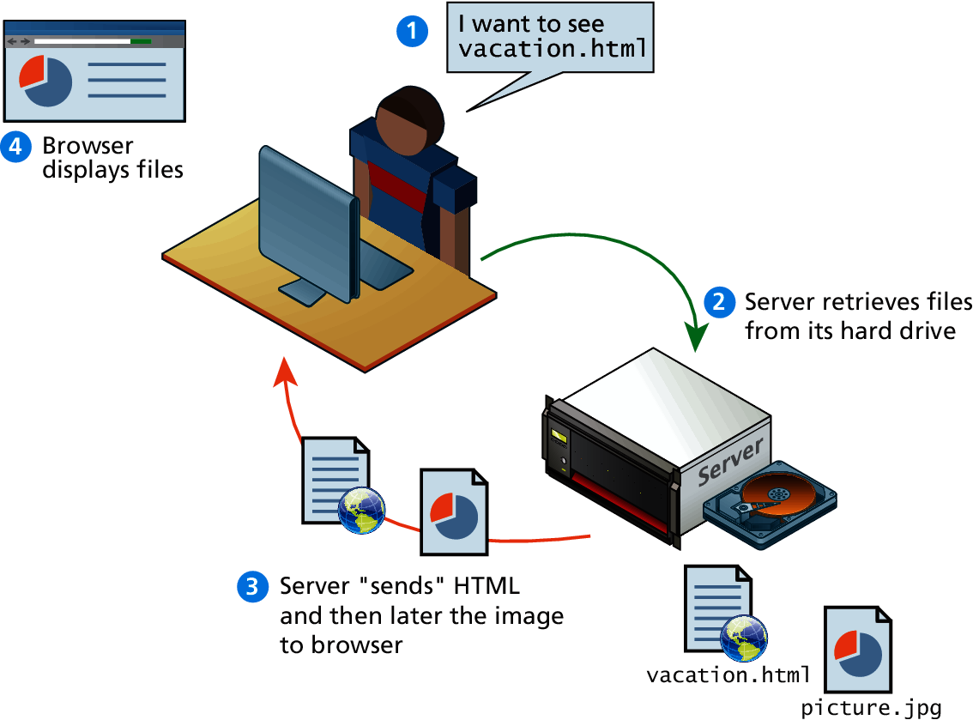
Static Web Sites

Slide 24
Dynamic Web Sites
Within a few years of the invention of the web, sites began to get more complicated as more and more sites began to use programs running on web servers to generate content dynamically.

Slide 25
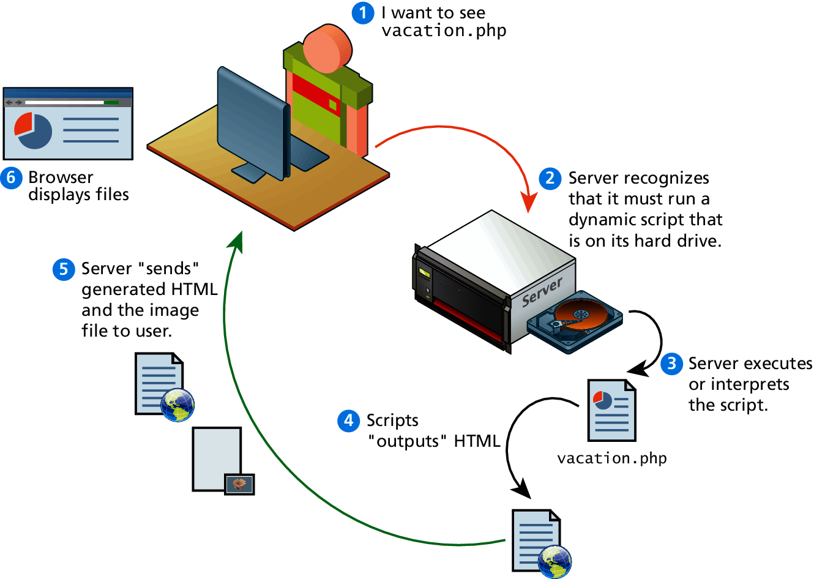
Dynamic Web Sites

Slide 26
Dynamic Web Sites
What are they?
These server-based programs would read content from databases, interface with existing enterprise computer systems, communicate with financial institutions, and then output HTML that would be sent back to the users’ browsers.
This type of web site is called here in this book a dynamic web site because the page content is being created at run-time by a program created by a programmer; this page content can vary for user to user.

Slide 27
Web 2.0 and Beyond
In the mid 2000s, a new buzz-word entered the computer lexicon: web 2.0.
This term had two meanings, one for users and one for developers.

Slide 28
Web 2.0
Its meaning for users
For the users, Web 2.0 referred to an interactive experience where users could contribute and consume web content, thus creating a more user-driven web experience.

Slide 29
Web 2.0
Its meaning for developers
For software developers, Web 2.0 also referred to a change in the paradigm of how dynamic web sites are created.
Programming logic, which previously existed only on the server, began to migrate to the browser.
This required learning Javascript, a rather tricky programming language that runs in the browser, as well as mastering the rather difficult programming techniques involved in asynchronous communication.

Slide 30
Internet protocols
Section 2 of 8

Slide 31
What’s a Protocol?
The Internet exists today because of a suite of interrelated communications protocols.
A protocol is a set of rules that partners in communication use when they communicate.

Slide 32
A Layered Architecture
The TCP/IP Internet protocols were originally abstracted as a four-layer stack.
Later abstractions subdivide it further into five or seven layers.
Since we are focused on the top layer anyhow, we will use the earliest and simplest four-layer network model.

Slide 33
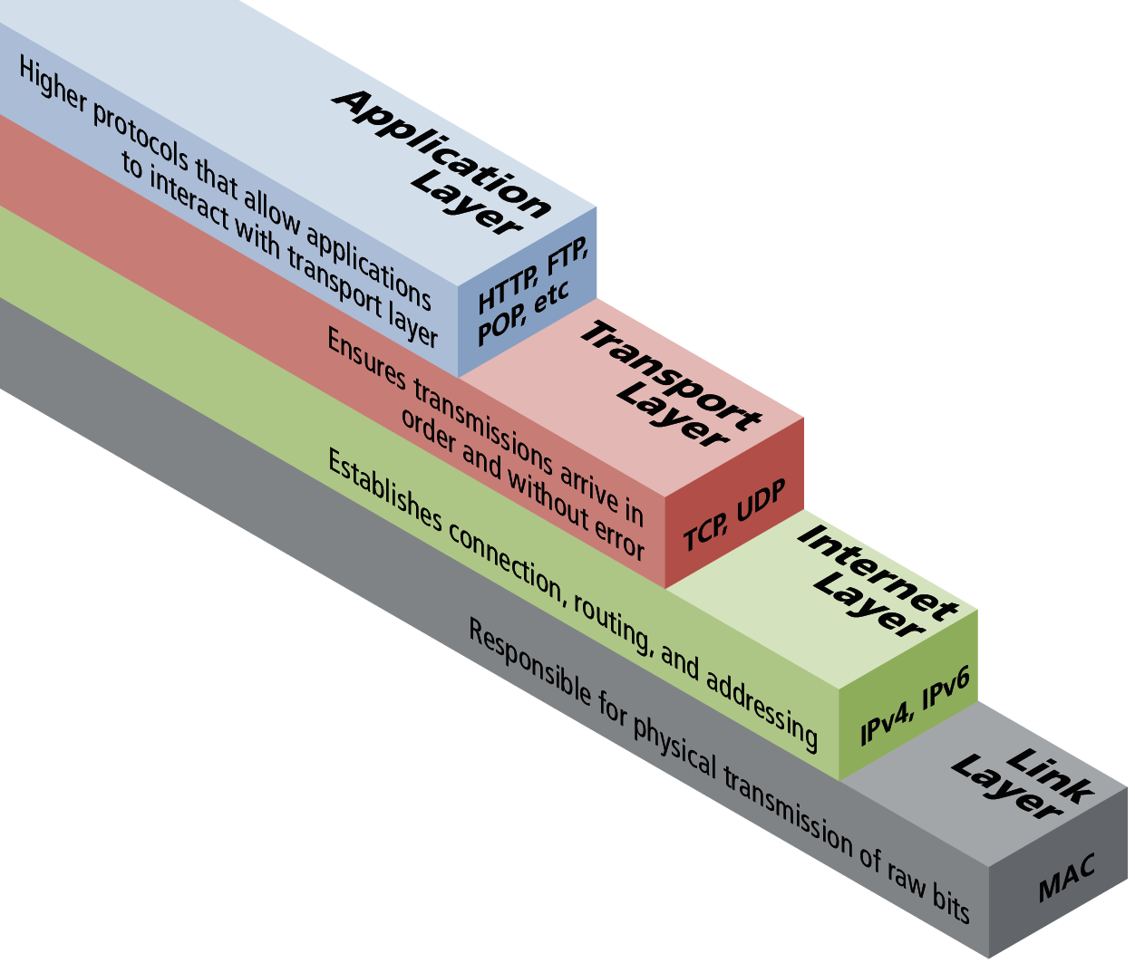
Four Layer Network Model

Slide 34
Link Layer
Save this for your networking course
The link layer is the lowest layer, responsible for both the physical transmission across media (wires, wireless) and establishing logical links.
It handles issues like packet creation, transmission, reception and error detection, collisions, line sharing and more.

Slide 35
Internet Layer
The Internet layer (sometimes also called the IP Layer) routes packets between communication partners across networks.

Slide 36
Internet Protocol (IP)
The Internet uses the Internet Protocol (IP) addresses to identify destinations on the Internet.
Every device connected to the Internet has an IP address, which is a numeric code that is meant to uniquely identify it.

Slide 37
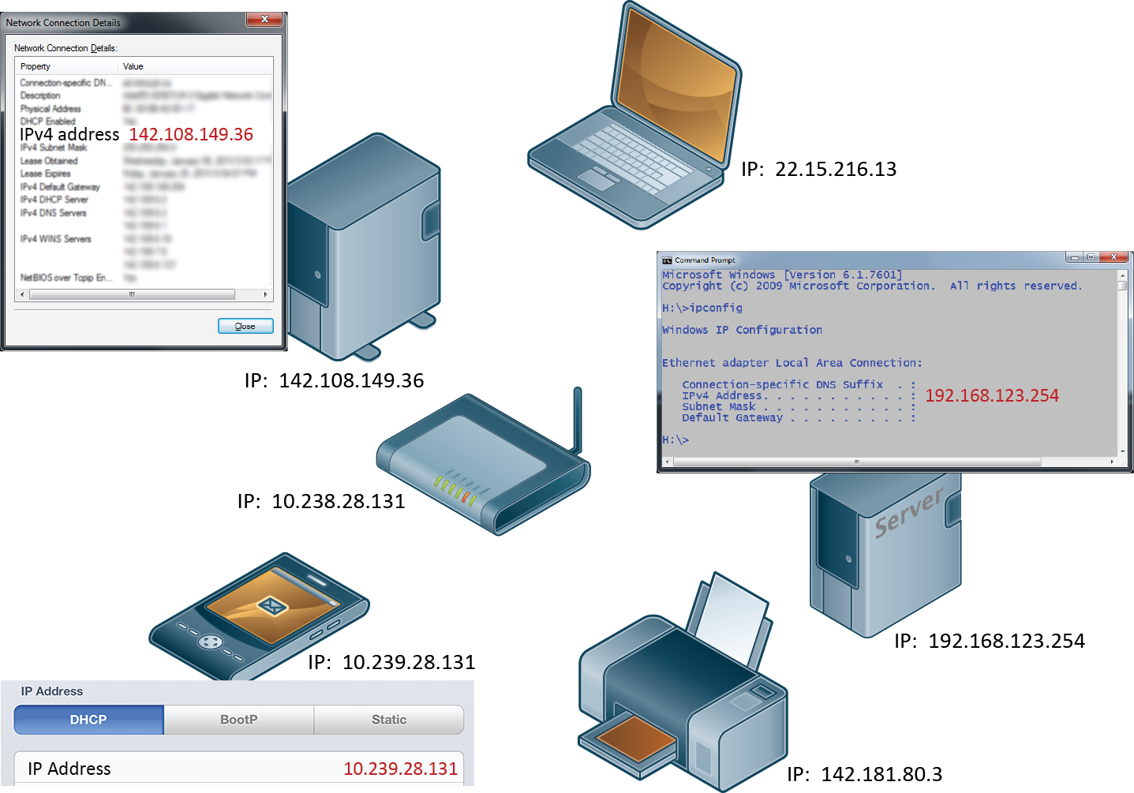
IP addresses and the Internet

Slide 38
IP Addresses
Two types
IPv4 addresses are the IP addresses from the original TCP/IP protocol.
In IPv4, 12 numbers are used (implemented as four 8-bit integers), written with a dot between each integer.
Since an unsigned 8-bit integer's maximum value is 255, four integers together can encode approximately 4.2 billion unique IP addresses.

Slide 39
IP Addresses
Two types
To future proof the Internet against the 4.2 billion limit, a new version of the IP protocol was created, IPv6.
This newer version uses eight 16-bit integers for 2¹²⁸ unique addresses, over a billion billion times the number in IPv4.
These 16-bit integers are normally written in hexadecimal, due to their longer length.

Slide 41
IP Addresses
Inside of networks is different
Your IP address will generally be assigned to you by your Internet Service Provider (ISP).
In organizations, large and small, purchasing extra IP addresses from the ISP is not cost effective.
In a local network, computers can share a single IP address between them.

Slide 42
Transport Layer
The transport layer ensures transmissions arrive, in order, and without error.
This is accomplished through a few mechanisms.
First, the data is broken into packets formatting according to the Transmission Control Protocol (TCP).

Slide 43
Transport Layer
Secondly, each packet is acknowledged back to the sender so in the event of a lost packet, the transmitter will realize a packet has been lost since no ACK arrived for that packet.
That packet is retransmitted, and although out of order, is reordered at the destination.

Slide 44
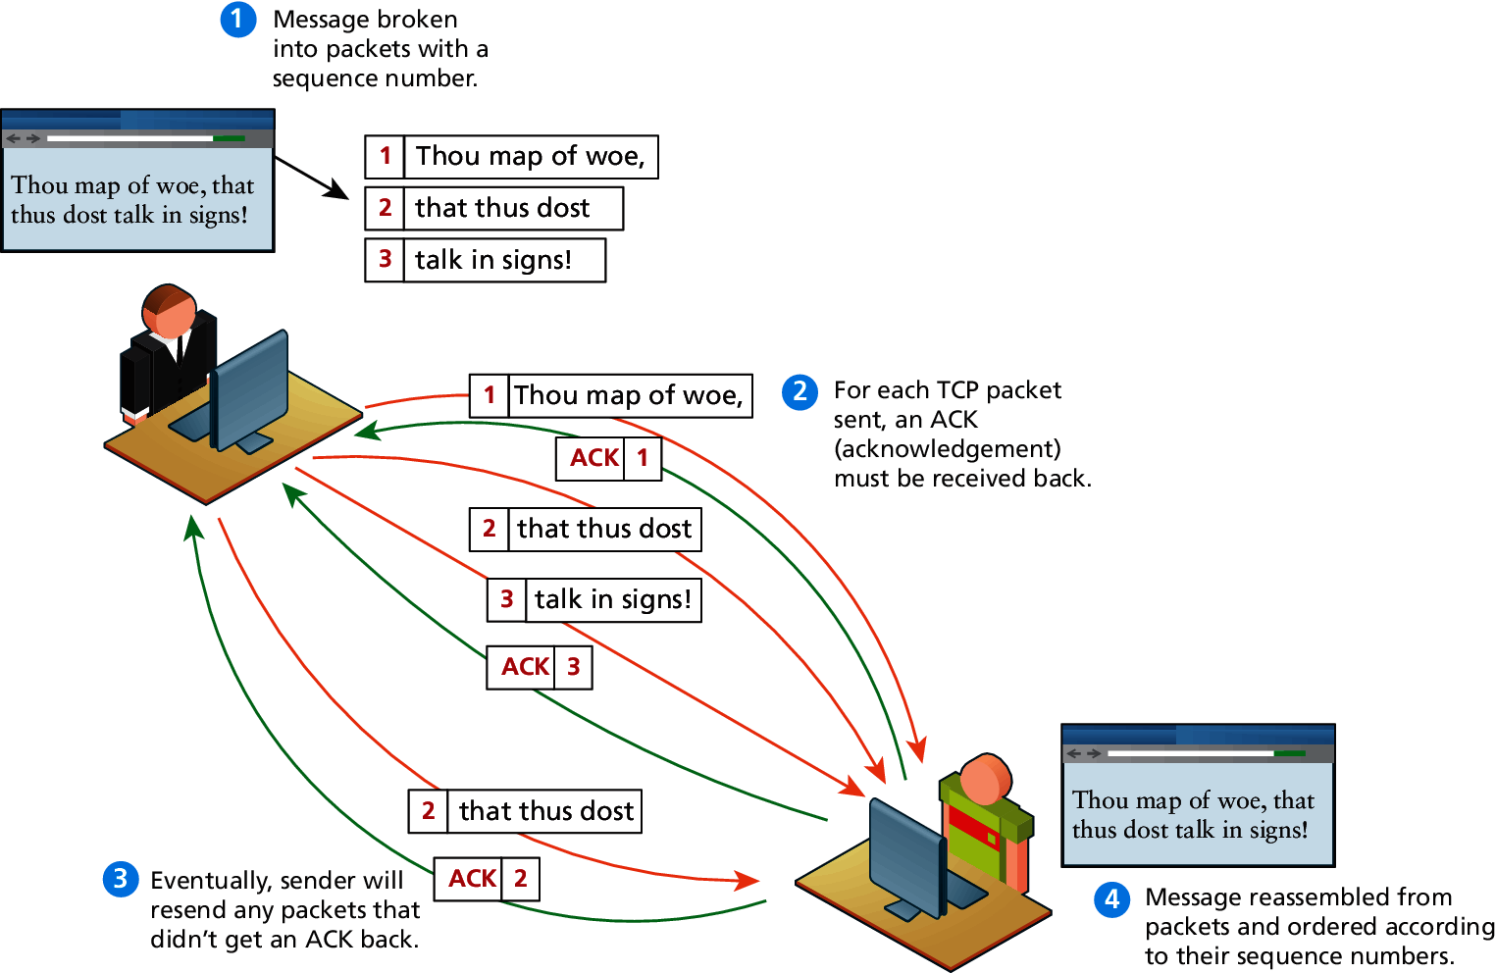
TCP Packets

Slide 45
Application Layer
With the application layer, we are the level of protocols familiar to most web developers.
Application layer protocols implement process-to-process communication and are at a higher level of abstraction in comparison to the low-level packet and IP addresses protocols in the layers below it.
Examples: HTPP, SSH, FTP, DNS, POP, SMTP.

Slide 46
Client-Server MODEL
Section 3 of 8

Slide 47
Client-Server Model
What is it?
The web is sometimes referred to as a client-server model of communications.
In the client-server model, there are two types of actors: clients and servers.
The server is a computer agent that is normally active 24 hours a day, 7 days a week (or simply 24/7), listening for queries from any client who make a request.
A client is a computer agent that makes requests and receives responses from the server, in the form of response codes, images, text files, and other data.

Slide 48
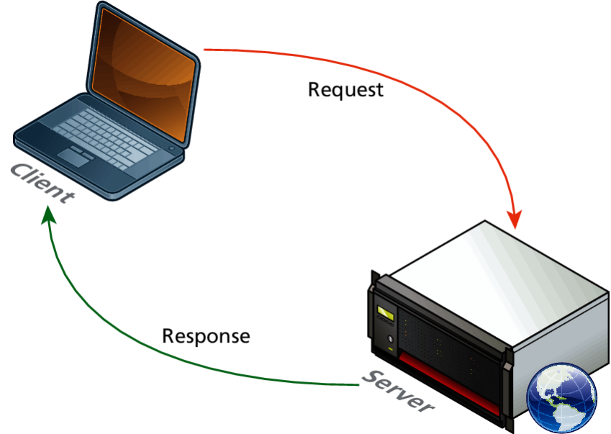
Request-Response Loop
Within the client-server model, the request-response loop is the most basic mechanism on the server for receiving requests and transmitting data in response.
The client initiates a request to a server and gets a response that could include some resource like an HTML file, an image or some other data.

Slide 49
The Peer-to-Peer Alternative
Not actually illegal
In the peer-to-peer model where each computer is functionally identical, each node is able to send and receive directly with one another.
In such a model each peer acts as both a client and server able to upload and download information.

Slide 50
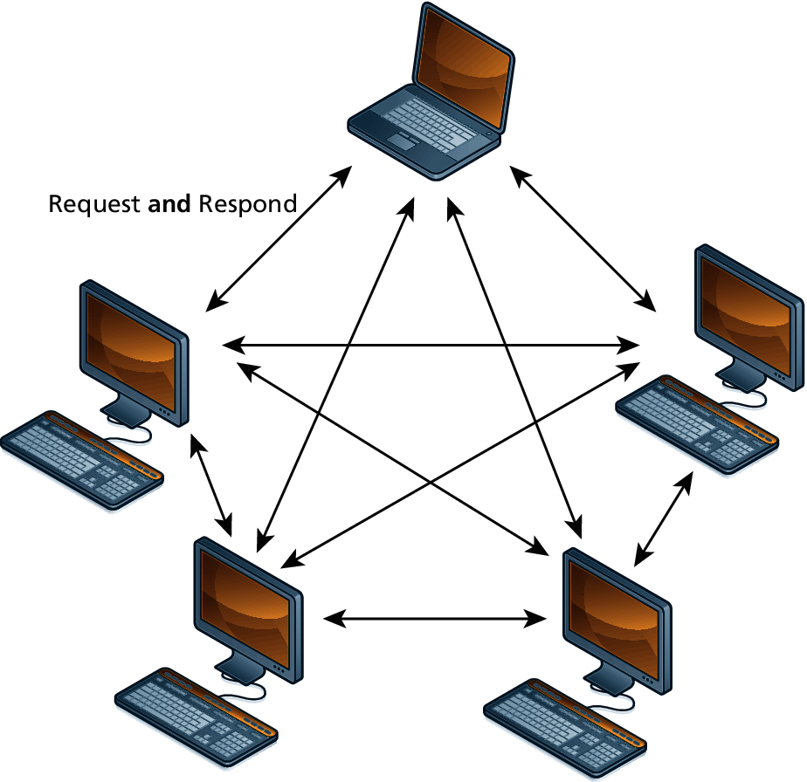
Peer-to-Peer Model

Slide 51
Server Types
A server is rarely just a single computer
Earlier, the server was shown as a single machine, which is fine from a conceptual standpoint.
Clients make requests for resources from a URL; to the client, the server is a single machine.
However, most real-world web sites are typically not served from a single server machine, but by many servers.
It is common to split the functionality of a web site between several different types of server.

Slide 52
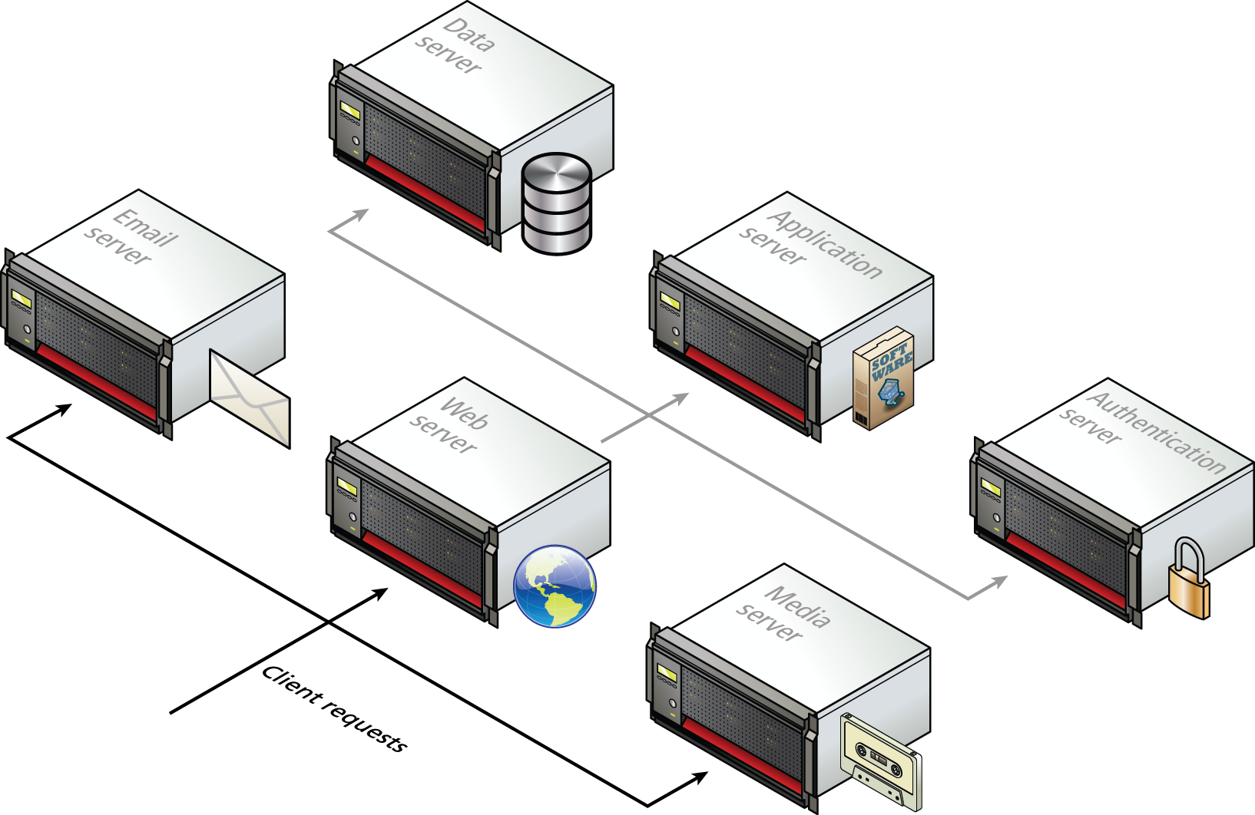
Server Types

Slide 53
Real-World Server Installations
Not only are there different types of servers, there is often replication of each of the different server types.
A busy site can receive thousands or even tens of thousands of requests a second; globally popular sites such as Facebook receive millions of requests a second.

Slide 54
Server Farms
Have no cows
A single web server that is also acting as an application or database server will be hard-pressed to handle more than a few hundred requests a second, so the usual strategy for busier sites is to use a server farm.

Slide 55
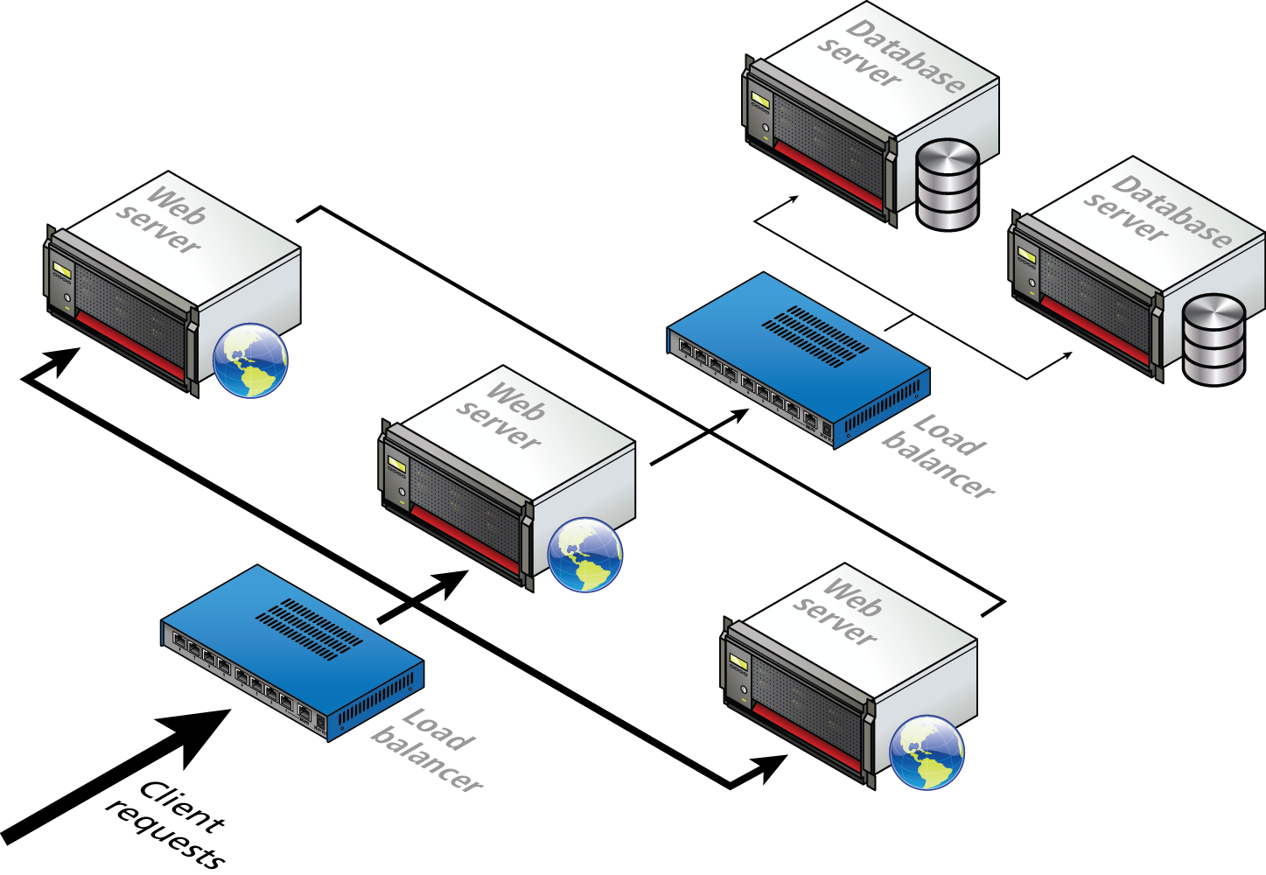
Server Farm

Slide 56
Server Farms
The goal behind server farms is to distribute incoming requests between clusters of machines so that any given web or data server is not excessively overloaded.
Special routers called load balancers distribute incoming requests to available machines.

Slide 57
Server Farms
Even if a site can handle its load via a single server, it is not uncommon to still use a server farm because it provides failover redundancy.
That is, if the hardware fails in a single server, one of the replicated servers in the farm will maintain the site’s availability.

Slide 58
Server Racks
In a server farm, the computers do not look like the ones in your house.
Instead, these computers are more like the plates stacked in your kitchen cabinets.
That is, a farm will have its servers and hard drives stacked on top of each other in server racks.
A typical server farm will consist of many server racks, each containing many servers.

Slide 59
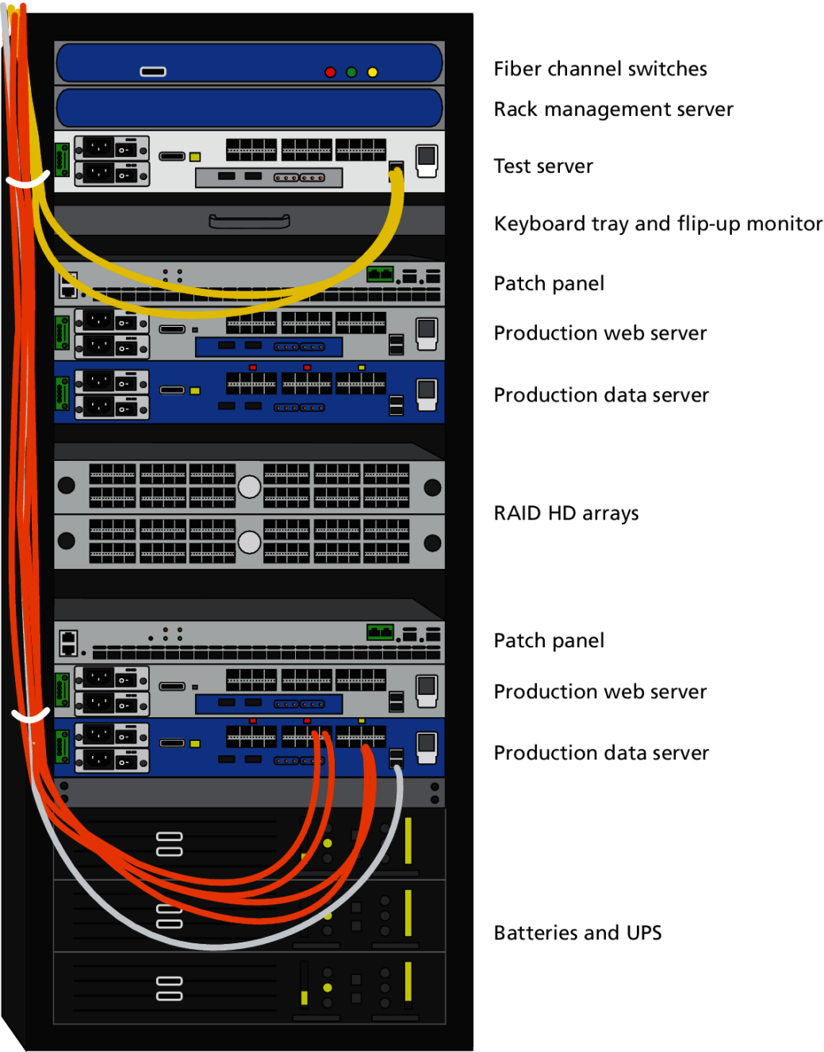
Server Rack

Slide 60
Data Centers
Server farms are typically housed in special facilities called data centers.

Slide 61
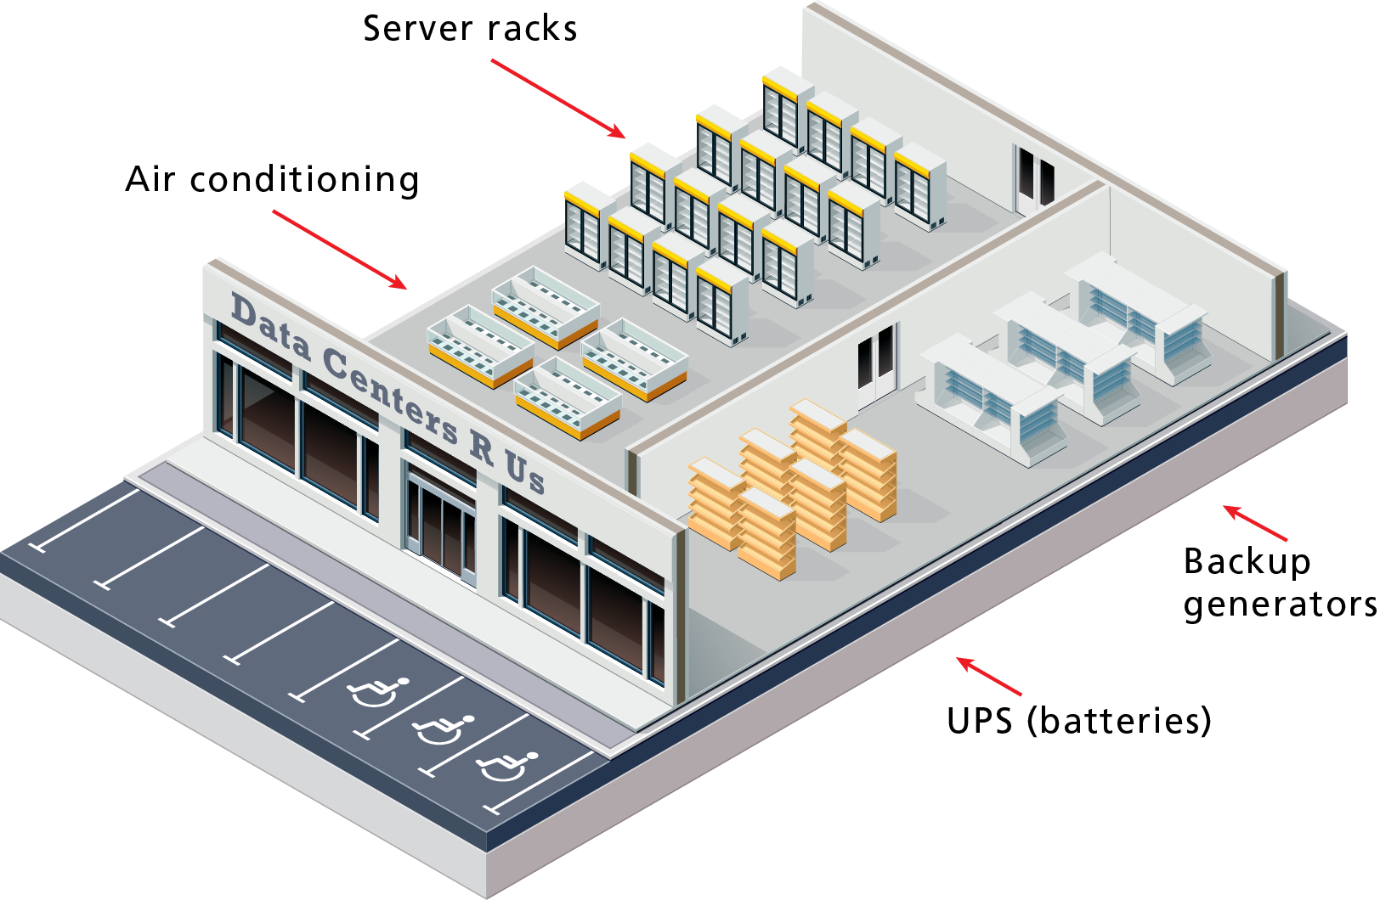
Hypothetical Data Center

Slide 62
Data Centers
Where are they?
To prevent the potential for site down times, most large web sites will exist in mirrored data centers in different parts of the country, or even world.
As a consequence, the costs for multiple redundant data centers are quite high, and only larger web companies can afford to create and manage their own.
Most web companies will instead lease space from a third-party data center.

Slide 63
Commercial Web Hosting
It is also common for the reverse to be true – that is, a single server machine may host multiple sites.
Large commercial web hosting companies such as GoDaddy, Blue Host, Dreamhost, and others will typically host hundreds or even thousands of sites on a single machine (or mirrored on several servers).

Slide 64
WHERE is the Internet?
Section 4 of 8

Slide 65
Is the Internet a Cloud?
The Internet is often visually represented as a cloud, which is perhaps an apt way to think about the Internet given the importance of light and magnetic pulses to its operation.

Slide 66
Is the Internet a Cloud?
No
It is important to recognize that our global network of networks does not work using magical water vapor, but is implemented via
millions of kilometers of copper wires and fiber optic cables, as well as via
hundreds of thousands of server computers
and probably an equal number of routers, switches, and other networked devices,
along with many thousands of air conditioning units and specially-constructed server rooms and buildings.

Slide 67
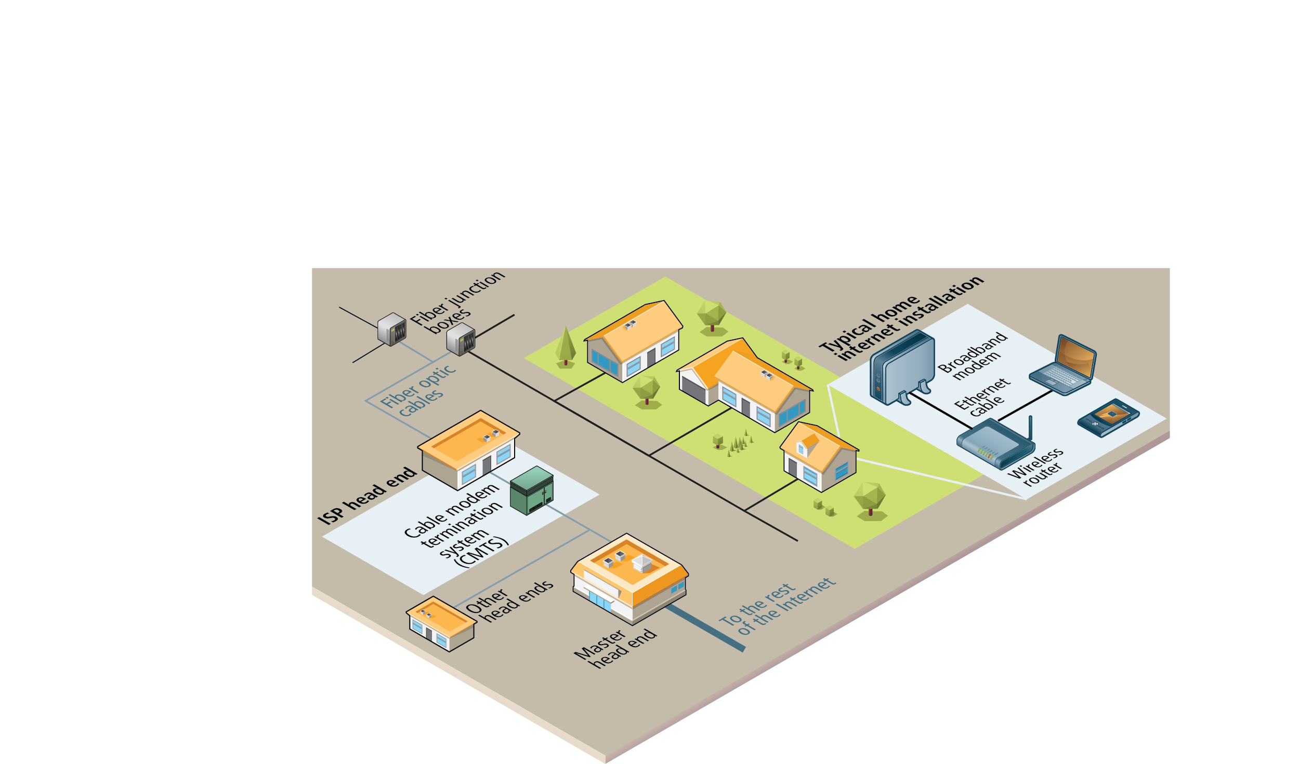
From the Computer to the Local Provider
Our main experience of the hardware component of the Internet is that which we experience in our homes.

Slide 68
In the House
The broadband modem (also called a cable modem or DSL modem) is a bridge between the network hardware outside the house (typically controlled by a phone or cable company) and the network hardware inside the house.
These devices are often supplied by the ISP.

Slide 69
Routers
The wireless router is perhaps the most visible manifestation of the Internet in one’s home, in that it is a device we typically need to purchase and install.
Routers are in fact one of the most important and ubiquitous hardware devices that makes the Internet work.
At its simplest, a router is a hardware device that forwards data packets from one network to another network.

Slide 70
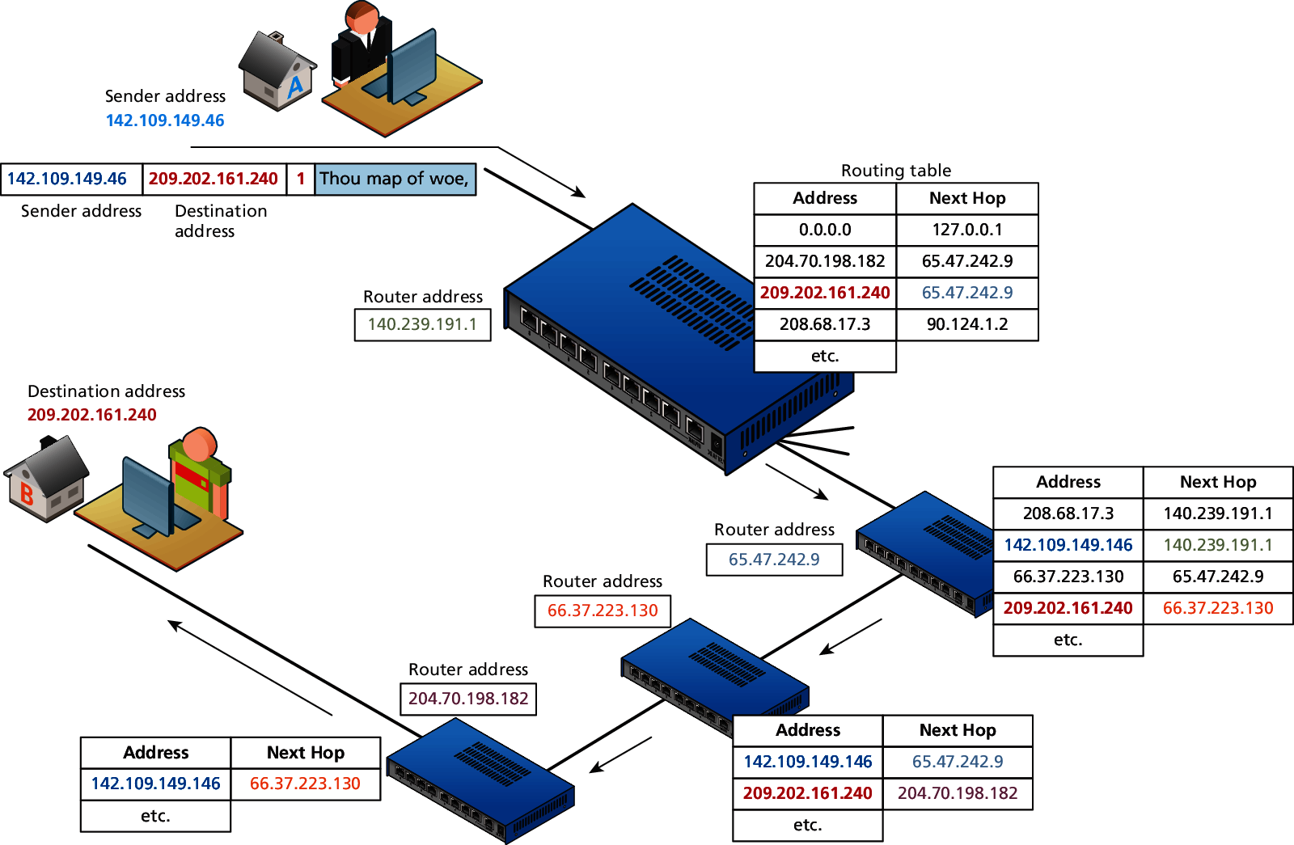
Routers and Routing Tables

Slide 71
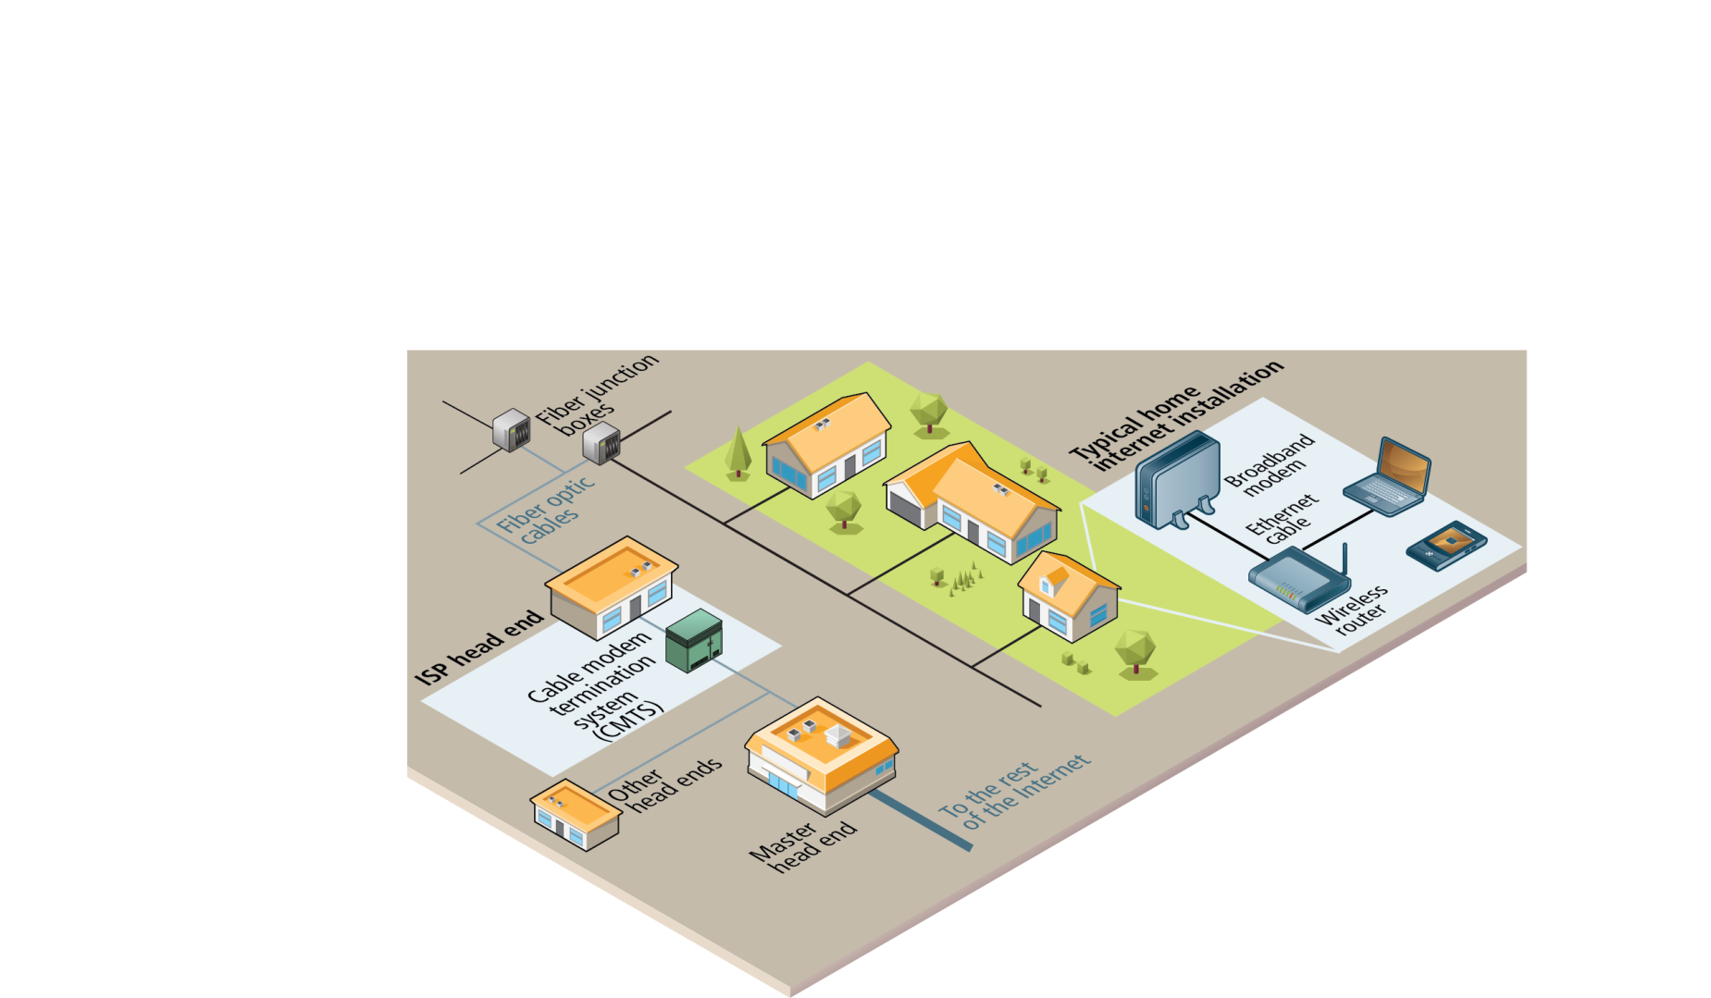
Out of the House
Once we leave the confines of our own homes, the hardware of the Internet becomes much murkier.
In the illustration, the various neighborhood broadband cables (which are typically using copper, aluminum, or other metals) are aggregated and connected to fiber optic cable via fiber connection boxes.

Slide 72
Fiber Optic Cable
Fiber optic cable (or simply optical fiber) is a glass-based wire that transmits light and has significantly greater bandwidth and speed in comparison to metal wires.
In some cities (or large buildings), you may have fiber optic cable going directly into individual buildings; in such a case the fiber junction box will reside in the building.

Slide 73
To the Provider
These fiber optic cables eventually make their way to an ISP’s head-end, which is a facility that may contain a cable modem termination system (CMTS) or a digital subscriber line access multiplexer (DSLAM) in a DSL-based system.

Slide 74
From the Local Provider to the Ocean
Eventually your ISP has to pass on your requests for Internet packets to other networks.
This intermediate step typically involves one or more regional network hubs.
Your ISP may have a large national network with optical fiber connecting most of the main cities in the country.
Some countries have multiple national or regional networks, each with their own optical network.

Slide 75
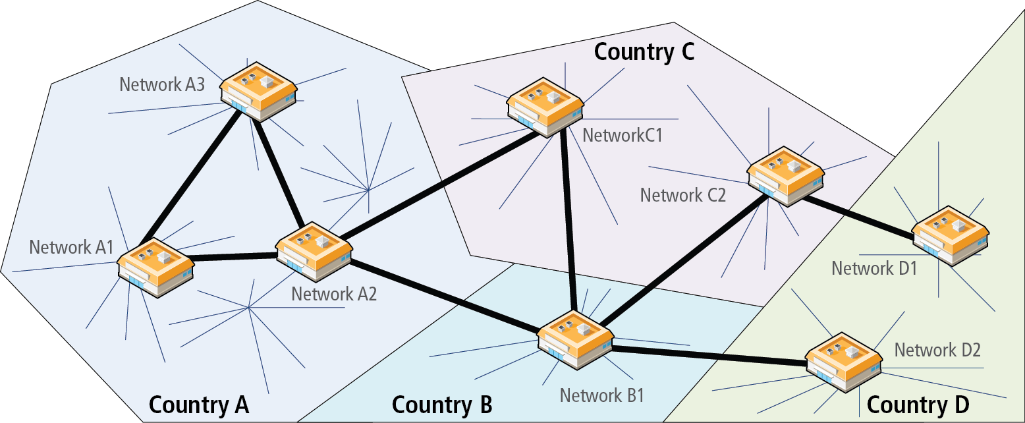
Connecting different networks within and between countries

Slide 76
Internet Exchange Points
Connecting different networks
This type of network configuration began to change in the 2000s, as more and more networks began to interconnect with each other using an Internet Exchange Point (IX or IXP).
These IXPs allow different ISPs to peer with one another (that is, interconnect) in a shared facility, thereby improving performance for each partner in the peer relationship.

Slide 77
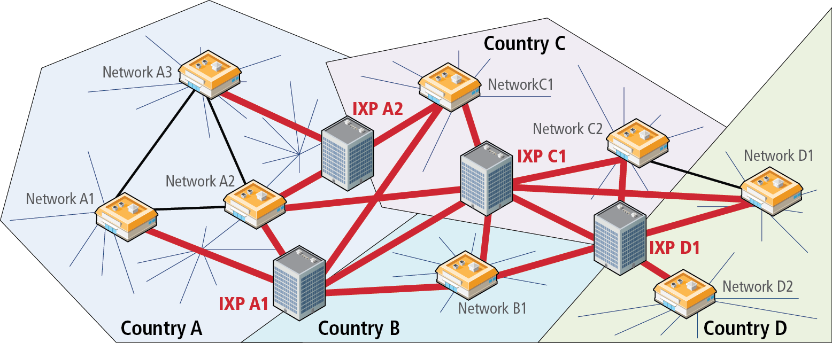
National and regional networks using Internet Exchange Points

Slide 78
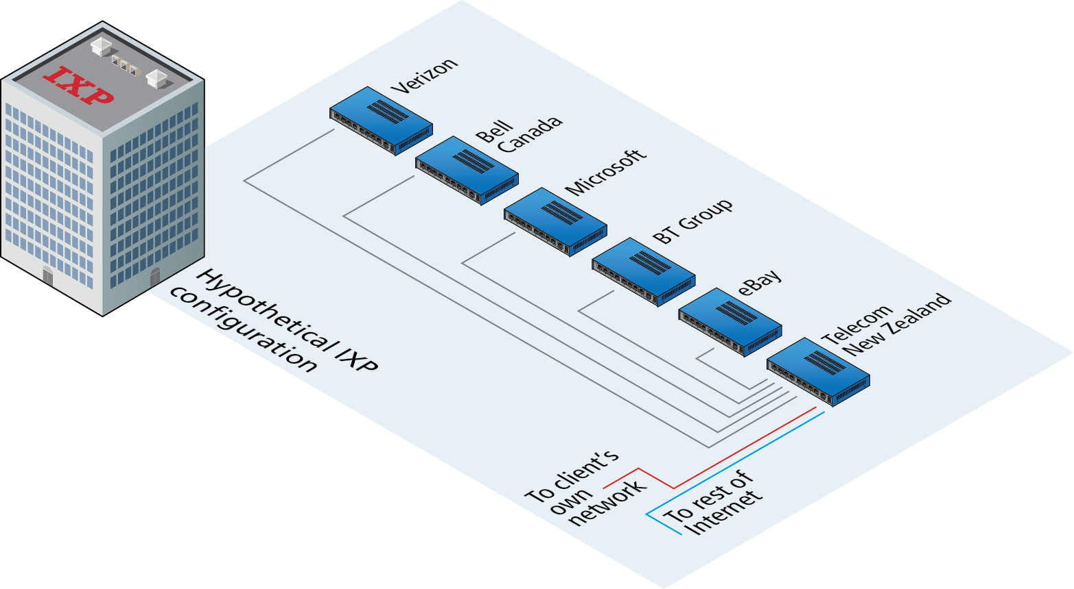
Sample Internet Exchange Point

Slide 79
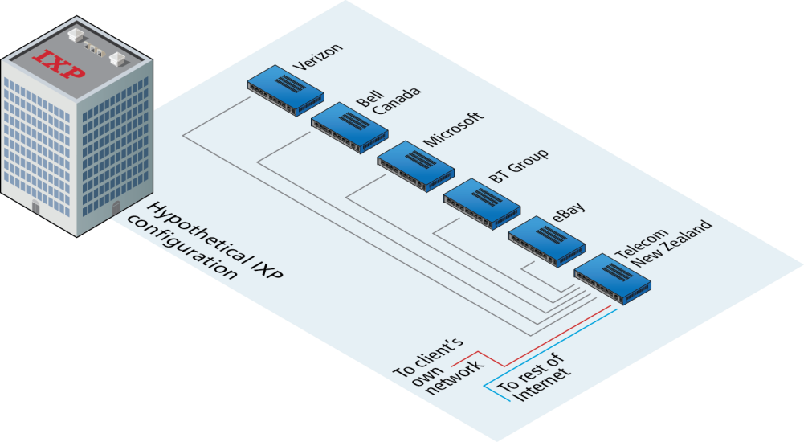
IXPs
Not just for large networks
Different networks connect not only to other networks within an IXP, but now large web sites such as Microsoft and FaceBook are also connecting to multiple other networks simultaneously as a way of improving the performance of their sites.

Slide 80
Real IXPs
Real IXPs, such as at Palo Alto (PAIX), Amsterdam (AMS-IX), Frankfurt (CE-CIX), London (LINX), allow many hundreds of networks and companies to interconnect and have throughput of over 1000 gigabits per second.
The scale of peering in these IXPs is way beyond that shown in the diagram (which shows peering with only five others); companies within these IXPs use large routers from Cisco and Brocade that have hundreds of ports allowing hundreds of simultaneous peering relationships.

Slide 81
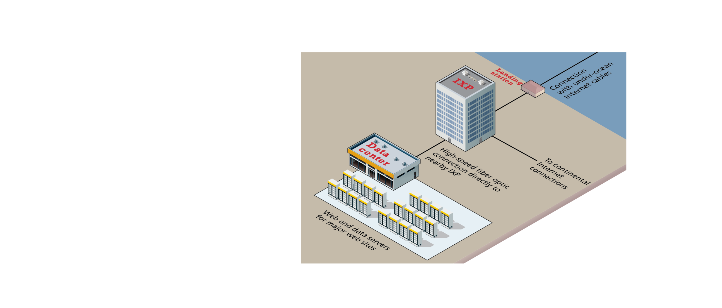
IXPs and Data Centers
In recent years, major web companies have joined the network companies in making use of IXPs.
As shown in the diagram, this sometimes involves mirroring a site’s infrastructure (i.e., web and data servers) in a data center located near the IXP.

Slide 82
Across the Oceans
Eventually, international Internet communication will need to travel underwater.
The amount of undersea fiber optic cable is quite staggering and is growing yearly.

Slide 83
Undersea fiber optic lines (courtesy TeleGeography)

Slide 84
DOMAIN NAME SYSTEM (DNS)
Section 5 of 8

Slide 85
Domain Name System
Why do we need it?
As elegant as IP addresses may be, human beings do not enjoy having to recall long strings of numbers. Instead of IP addresses, we use the Domain Name System (DNS)

Slide 86
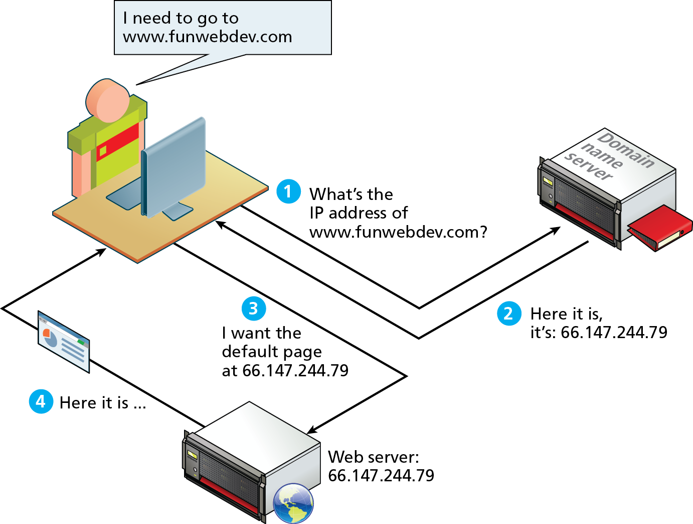
DNS Overview

Slide 87
Domain Levels

Slide 88
Types of TLDs
Generic top-level domains (gTLD)
Country code top-level domain (ccTLD)

Slide 89
Name Registration
How are domain names assigned?
Special organizations or companies called domain name registrars manage the registration of domain names.
These domain name registrars are given permission to do so by the appropriate generic top-level domain (gTLD) registry and/or a country code top-level domain (ccTLD) registry.

Slide 90
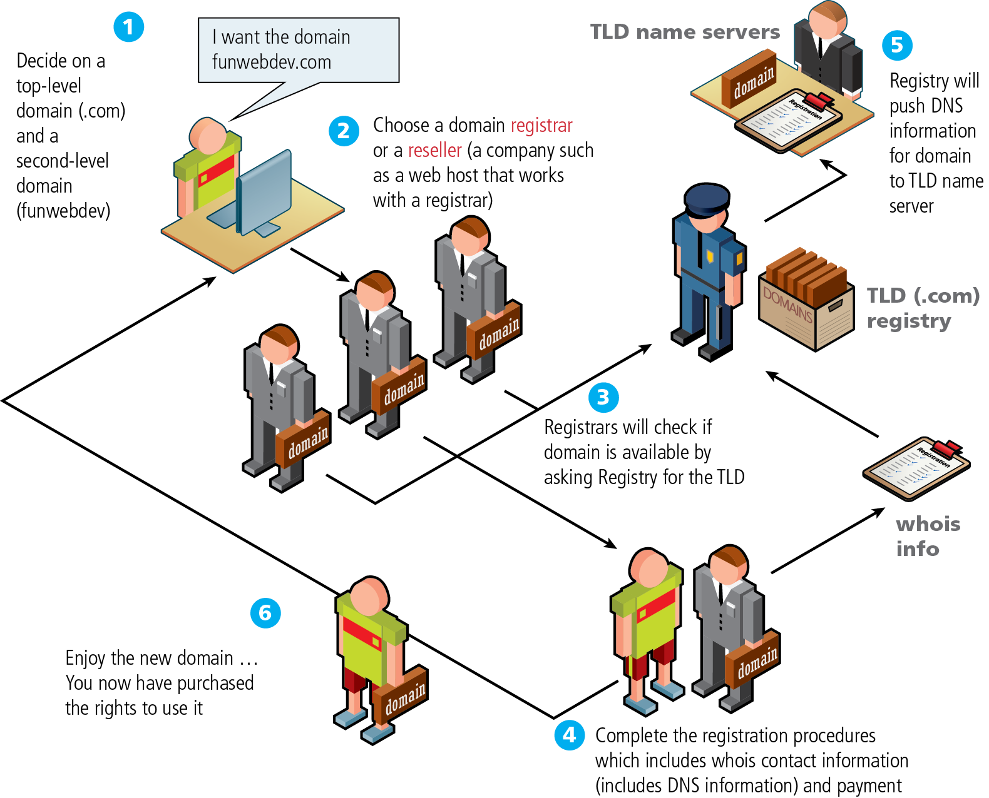
Domain name registration process

Slide 91
DNS Address Resolution
While domain names are certainly an easier way for users to reference a web site, eventually, your browser needs to know the IP address of the web site in order to request any resources from it.
The Domain Name System provides a mechanism for software to discover this numeric IP address.
This process is referred to here as address resolution.

Slide 92
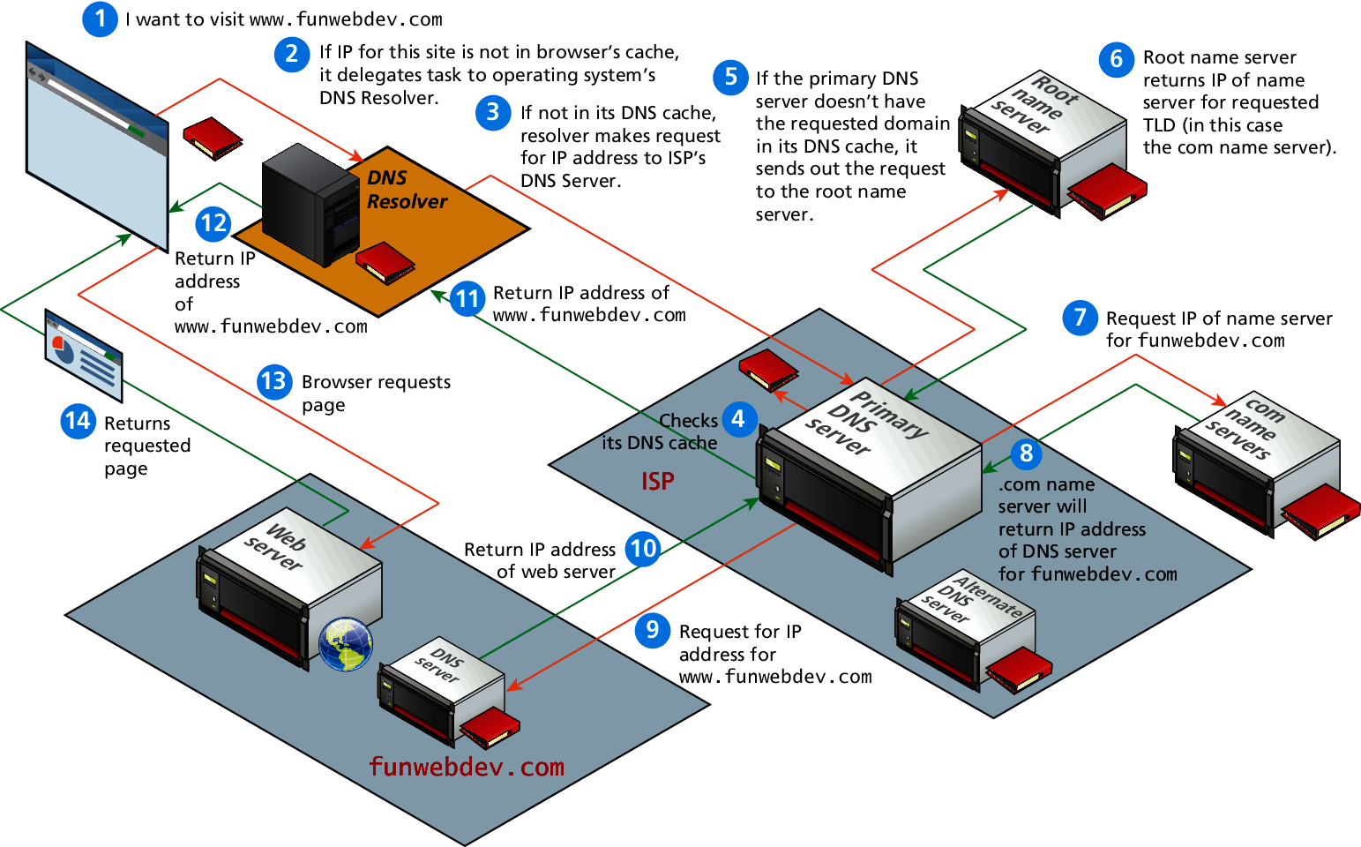
Domain name address resolution process

Slide 93
Uniform Resource Locators (URL)
Section 6 of 8

Slide 94
URL Components
In order to allow clients to request particular resources from the server, a naming mechanism is required so that the client knows how to ask the server for the file.
For the web that naming mechanism is the Uniform Resource Locator (URL).

Slide 95
Query String
Query strings will be covered in depth when we learn more about HTML forms and server-side programming.
They are the way of passing information such as user form input from the client to the server. In URL's they are encoded as key-value pairs delimited by “&” symbols and preceded by the “?” symbol.

Slide 96
Hypertext transfer protocol (http)
Section 7 of 8

Slide 97
HTTP
The HTTP protocol establishes a TCP connection on port 80 (by default).
The server waits for the request, and then responds with a response code, headers and an optional message (which can include files).

Slide 98
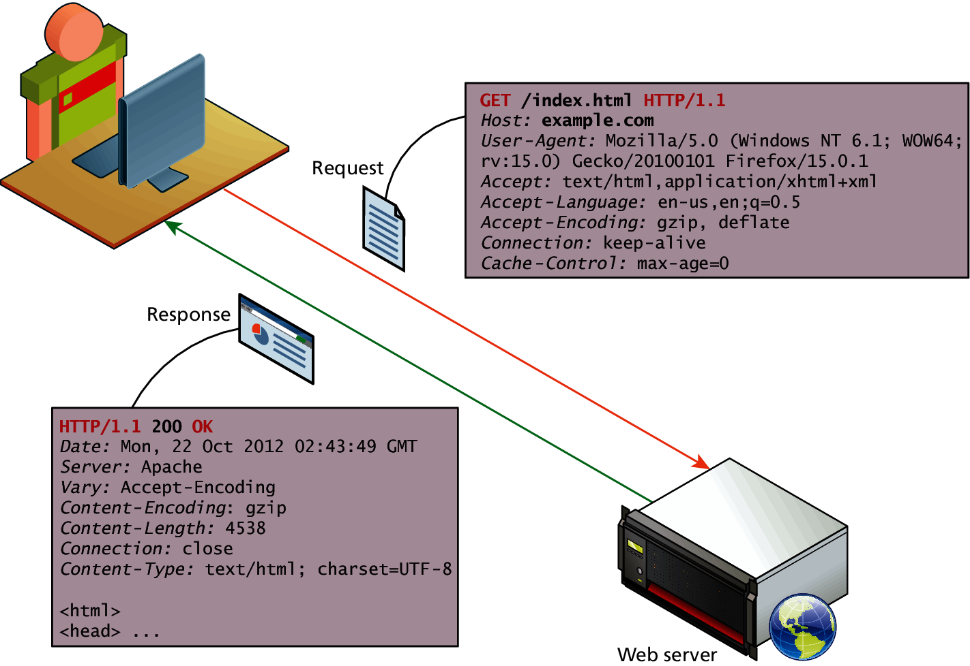
HTTP

Slide 99
Web Requests
While we as web users might be tempted to think of an entire page being returned in a single HTTP response, this is not in fact what happens.
In reality the experience of seeing a single web page is facilitated by the client's browser which requests the initial HTML page, then parses the returned HTML to find all the resources referenced from within it, like images, style sheets and scripts.
Only when all the files have been retrieved is the page fully loaded for the user

Slide 100
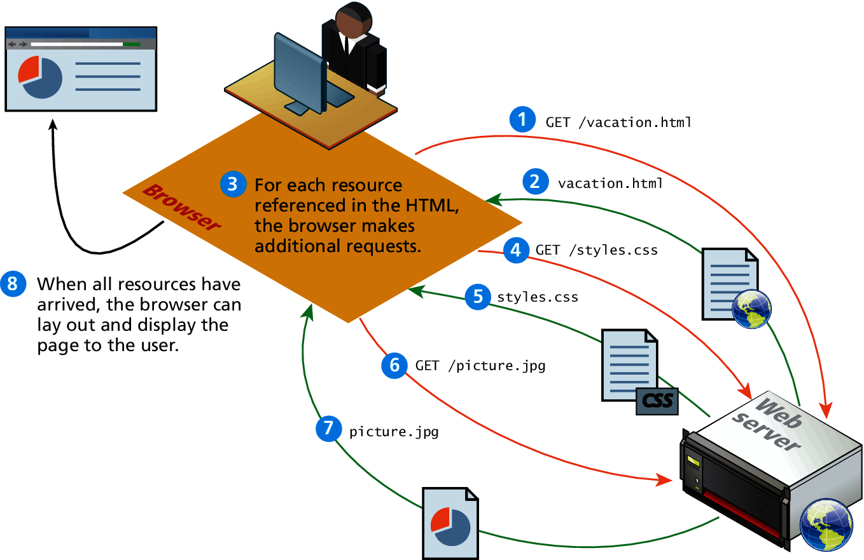
Browser parsing HTML and making subsequent requests

Slide 101
Browser Tools for HTTP
Modern browsers provide the developer with tools that can help us understand the HTTP traffic for a given page.

Slide 102
HTTP Request Methods
The HTTP protocol defines several different types of requests, each with a different intent and characteristics.
The most common requests are the GET and POST request, along with the HEAD request.
Other requests, such as PUT, DELETE, CONNECT, TRACE and OPTIONS are seldom used, and are not covered here.

Slide 103
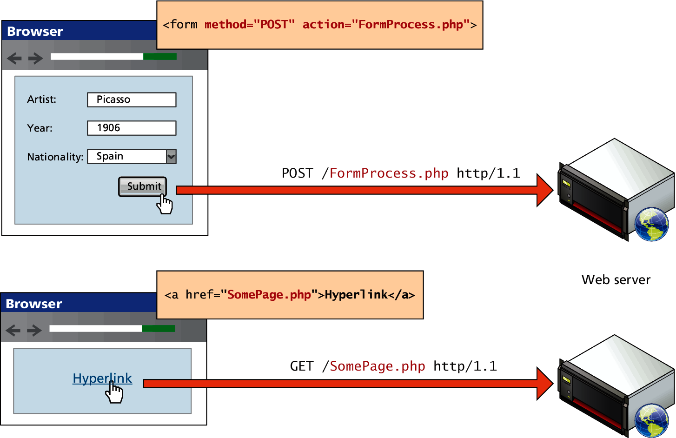
GET versus POST requests

Slide 104
Web Servers
Section 8 of 8

Slide 105
Web Servers
A web server is, at a fundamental level, nothing more than a computer that responds to HTTP requests.

Slide 106
Web Stack
Regardless of the physical characteristics of the server, one must choose an application stack to run a website.
This stack will include an operating system, web server software, a database and a scripting language to process dynamic requests.

Slide 107
LAMP Software Stack
Throughout this textbook we will rely on the LAMP software stack, which refers to the Linux operating system, Apache web server, MySQL database, and PHP scripting language

Slide 108
WISA software stack
Many corporations, for instance, make use of the Microsoft WISA software stack, which refers to Windows operating system, IIS web server, SQL Server database, and the ASP.NET server-side development technologies.

Slide 109
What You’ve Learned
1
2
Definitions and History
Internet Protocols
3
4
Client-Server Model
Where is the Internet?
5
6
Domain Name System
Uniform Resource Locators (URL)
7
8
Hypertext Transfer Protocol (HTTP)
Web Servers

