Slide 1
CPET 499/ITC 250 Web Systems
Chapter 3
Introduction to Cascading Style Sheet (CSS)
Text Book:
* Fundamentals of Web Development, 2015, by Randy Connolly and Ricardo Hoar, published by Pearson
*E-Book on Building Web Applications with HTML, 2012, by Paul I. Lin, http://www.etcs.ipfw.edu/~lin/CECourses/2_HTML/CE_02WebHhtmlindex.html
* Casecading Style Sheet: An Introduction, http://www.etcs.ipfw.edu/~lin/CECourses/2_HTML/Lectures/8CCStyle.html
Paul I-Hai Lin, Professor
http://www.etcs.ipfw.edu/~lin

Slide 2
Topics
What is CSS?
CSS Syntax
Location of Styles
Selectors
The Cascade: How Styles Interact
The Box Model
CSS Text Styling
Summary

Slide 3
What is CSS?
Cascading style sheets (CSS) specification, developed by World Wide Web Consortium (W3C), provides a simple approach for separating the style (font, size, background, layout and position, etc) of document from the content.
Predefined style sheets can be used throughout a page or Web site.
  Allowing multiple style sheets to affect one document
  It is possible that conflicts can come up and the style referenced last generally takes precedence
What is CSS, http://www.w3.org/Style/CSS/Overview.en.html

Slide 4
What is CSS?
HTML & CSS, http://www.w3.org/standards/webdesign/htmlcss:
HTML (the Hypertext Markup Language) and CSS (Cascading Style Sheets) are two of the core technologies for building Web pages. HTML provides the structure of the page, CSS the (visual and aural) layout, for a variety of devices. Along with graphics and scripting, HTML and CSS are the basis of building Web pages and Web Applications.

Slide 5
What is CSS?
HTML & CSS, http://www.w3.org/standards/webdesign/htmlcss:
CSS is the language for describing the presentation of Web pages, including colors, layout, and fonts. It allows one to adapt the presentation to different types of devices, such as large screens, small screens, or printers. CSS is independent of HTML and can be used with any XML-based markup language. The separation of HTML from CSS makes it easier to maintain sites, share style sheets across pages, and tailor pages to different environments. This is referred to as the separation of structure (or: content) from presentation.

Slide 6
What is CSS?
The web standards model – HTML, CSS, and JavaScript, http://www.w3.org/wiki/The_web_standards_model_-_HTML_CSS_and_JavaScript : Most compelling reasons for using CSS and HTML
Efficient of code
Ease of maintenance
Accessibility
Device compatibility
Web crawlers/search engine

Slide 7
What is CSS?
CSS Current Status, http://www.w3.org/standards/techs/css#w3c_all
Standards
  CSS 2.1, June 2011, http://www.w3.org/TR/CSS2/
  CSS Selectors
  CSS Namespaces
  CSS Media Queries
  CSS Color
Drafts: Candidate Recommendations
  Intro to CSS 3, May 2001, http://www.w3.org/TR/2001/WD-css3-roadmap-20010523/
CSS Validation Service, http://www.css-validator.org/

Slide 8
Three Types of Style Sheets
Author Created Style Sheet
User-defined Sheet
Default Browser Style Sheet

Slide 9
CSS Syntax
A CSS document consists of one or more style rules.
A rule consists of a selector that identifies the HTML element or elements that will be affected, followed by a series of property:value pairs (each pair is also called a declaration).
CSS Selectors, http://www.w3.org/TR/CSS21/selector.html%23id-selectors

Slide 10
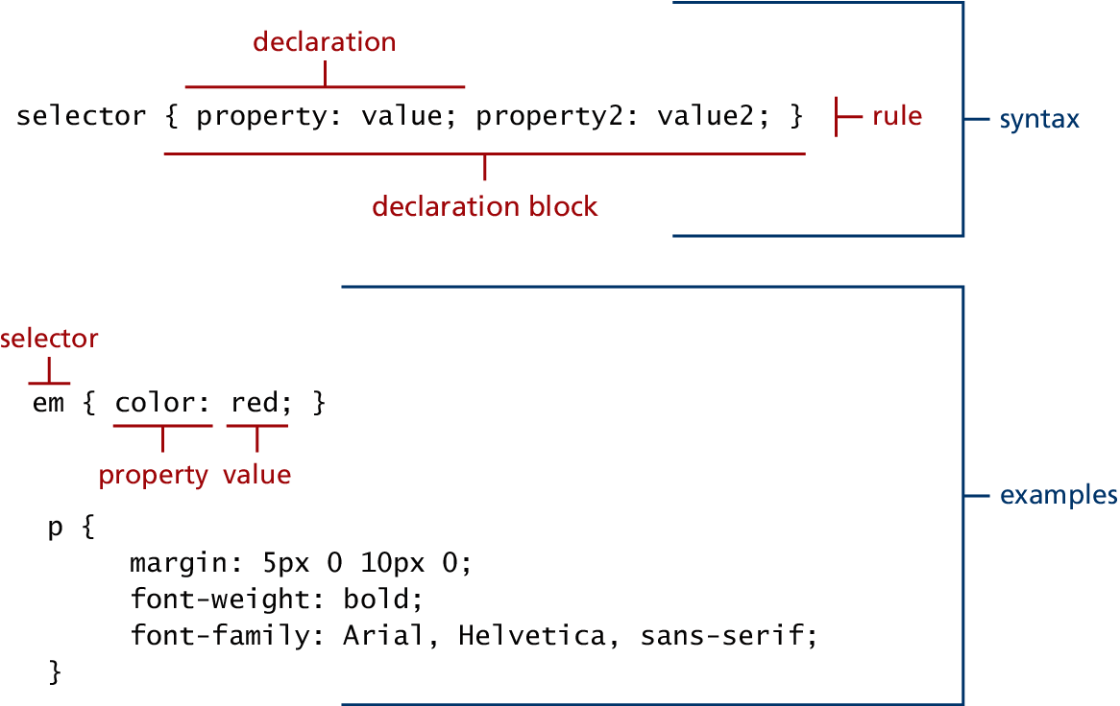
Figure 2.2 CSS Syntax

Slide 11
Location of CSS Style Sheet
Inline Styles (Listing3.1.html)
Embedded Style Sheet (Listing3.2.html)
External Style Sheet (Listing3.3.html)

Slide 12
In-Line Style Sheet
A style applied to a particular tag on a Web page
For formatting individual elements
Inline Styles (Listing3.1.html)
<h1>Share Your Travels</h1>
<h2 style="font-size: 24pt">Description</h2>
...
<h2 style="font-size: 24pt; font-weight: bold;">Reviews</h2>

Slide 13
In-Line Style Sheet Example
Inlinecss.html, http://www.etcs.ipfw.edu/~lin/CECourses/2_HTML/08CCSExs/inlinecss.html
<html>
<!-- inlinecss.html -->
<head><title>Inline Styles Example</title></head>
<body>
<!-- Declare inline Styles -->
<span style="font-weight: bold">
Web Programming Language: HTML.
</span><br>
<p style = "font-size: 20pt">Web Programming Language: HTML.</p>
<p style = "font-size: 20pt; color: #FF0000">
Web Programming Language: JavaScript
</p>
<p>Web Programming Language: Perl.</p>
</body>
</html>

Slide 14
Embedded Style Sheet
Embedded as part of the HTML document
Defined with <style> declaration block
Can be kept in a file outside the document
An Example
<style>
h1 {font-size: 24pt; font-weight: bold; color: red}
h2 {font-size: 16pt; font-style: italic; color: green}
span {font-weight: bold; font-style: italic}
</style>
After the declaration, we will be able to use <h1> </h1>, <h2> </h2>, and <span> </span> as new style definitions

Slide 15
Embedded Style Sheet: Listing3.2.html
<head lang="en">
<meta charset="utf-8">
<title>Share Your Travels -- New York - Central Park</title>
<style>
h1 { font-size: 24pt; }
h2 {
font-size: 18 pt;
font-weight: bold;
}
</style>
</head>
<body>
<h1>Share Your Travels</h1>
<h2>New York - Central Park</h2>
...

Slide 16
External CSS Style Sheet
Used for control styles across several pages or across an entire Web site
Require a style definition file that contains style definitions such as the three lines as shown below and save it as "style.css". Note that the <style> </style> tags are not included in the "style.css"
h1 {font-size: 24pt; font-weight: bold; color: red}
h2 {font-size: 16pt; font-style: italic; color: green}
span {font-weight: bold; font-style: italic}

Slide 17
External CSS Style Sheet
Then, we place the following line within <head> tags to refer to this file.
Link element, href – hypertext reference, rel - relationship
<head>
<title> TEST LINKED STYLE SHEETS </title>
<link href="styles.css" rel=“stylesheet" type="text/css">
</head>
An Example, http://www.etcs.ipfw.edu/~lin/CECourses/2_HTML/08CCSExs/linkcss.html

Slide 18
An Example, http://www.etcs.ipfw.edu/~lin/CECourses/2_HTML/08CCSExs/linkcss.html
<html>
<!-- linkcss.html -->
<head>
<title>Link Style Sheets</title>
<link href="styles.css" rel="stylesheet" type="text/css">
</head>
<body>
<span>Web Programming Applications.</sspan>
<h1>Web Programming Applications.</h1>
<h2>Web Programming Applications.</h2>
<h2 STYLE="font-size: 36pt">Web Programming Applications.</h2>
</body>
</html>

Slide 19
External Style Sheet
External Style Sheet (Listing3.3.html)
<head lang="en">
<meta charset="utf-8">
<title>Share Your Travels -- New York - Central Park</title>
<link rel="stylesheet" href="styles.css" />
</head>

Slide 20
CSS Selectors
For select individual or multiple HTML documents
Selector Types
  Element Selectors
  Class Selectors
  ID Selectors
  Attribute Selectors
  Pseudo-Element and Pseudo-Class Selectors
  Contextual Selectors
References
Class Selectors, https://developer.mozilla.org/en-US/docs/Web/CSS/Class_selectors
5 Selectors, http://www.w3.org/TR/CSS21/selector.html%23id-selectors

Slide 21
Listing3.4.css – Sample grouped selector
/* commas allow you to group selectors */
p, div, aside {
margin: 0;
padding: 0;
}
/* the above single grouped selector is equivalent to the following: */
p {
margin: 0;
padding: 0;
}
div {
margin: 0;
padding: 0;
}
aside {
margin: 0;
padding: 0;
}

Slide 22
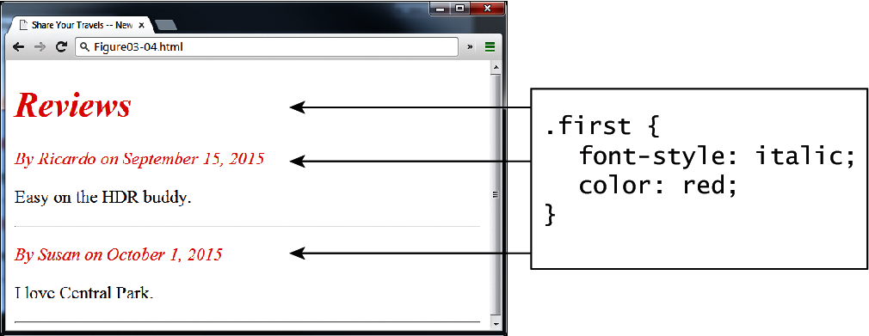
Figure 3.4 Class selector example in browser (Listing3.5.html)

Slide 23
Listing3.5.html: Class selector example
<head>
<title>Share Your Travels </title>
<style>
.first {
font-style: italic;
color: red;
}
</style>
</head>
<body>
<h1 class="first">Reviews</h1>
<div>
<p class="first">By Ricardo on <time>September 15, 2012</time></p>
<p>Easy on the HDR buddy.</p>
</div>
<hr/>
<div>
<p class="first">By Susan on <time>October 1, 2012</time></p>
<p>I love Central Park.</p>
</div>
<hr/>
</body>

Slide 24
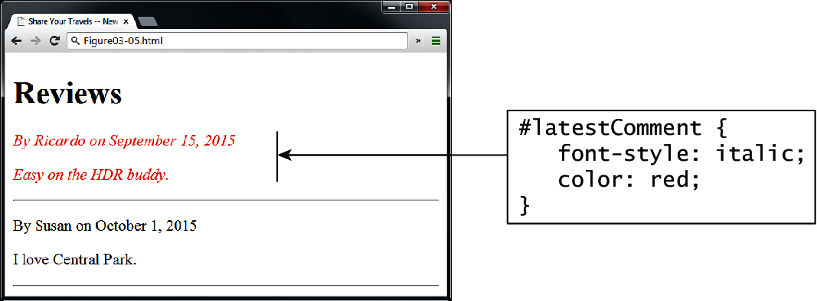
Figure 3.5 Id selector example in browser

Slide 25
<head lang="en">
<meta charset="utf-8">
<title>Share Your Travels -- New York - Central Park</title>
<style>
#latestComment {
font-style: italic;
color: red;
}
</style>
</head>
<body>
<h1>Reviews</h1>
<div id="latestComment">
<p>By Ricardo on <time>September 15, 2012</time></p>
<p>Easy on the HDR buddy.</p>
</div>
<hr/>
<div>
<p>By Susan on <time>October 1, 2012</time></p>
<p>I love Central Park.</p>
</div>
<hr/>
</body>
Listing3.6.html: ID selector example

Slide 26
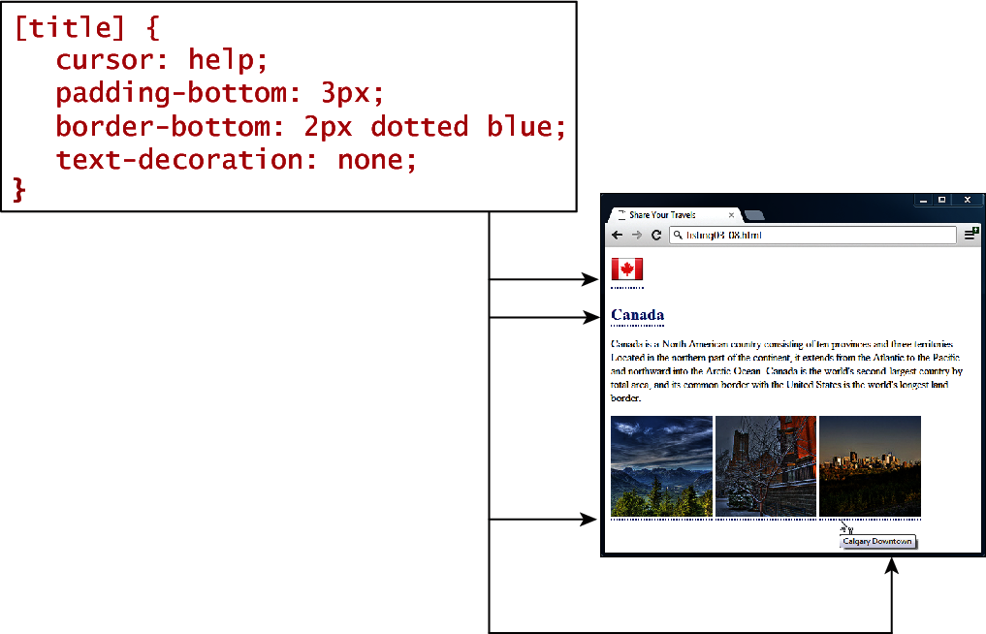
Figure 3.6 Attribute selector example in browser

Slide 27
Listing3.7.html: Attribute selector example
<head lang="en">
<meta charset="utf-8">
<title>Share Your Travels</title>
<style>
[title] {
cursor: help;
padding-bottom: 3px;
border-bottom: 2px dotted blue;
text-decoration: none;
}
</style>
</head>

Slide 28
Listing3.7.html: Attribute selector example
<body>
<div>
<img src="images/flags/CA.png" title="Canada Flag" />
<h2><a href="countries.php?id=CA" title="see posts from Canada">
Canada</a>
</h2>
<p>Canada is a North American country consisting of ... </p>
<div>
<img src="images/square/6114907897.jpg"
title="At top of Sulpher Mountain" />
<img src="images/square/6592317633.jpg"
title="Grace Presbyterian Church" />
<img src="images/square/6592914823.jpg"
title="Calgary Downtown" />
</div>
</div>
</body>

Slide 29
<head>
<title>Share Your Travels</title>
<style>
a:link {
text-decoration: underline;
color: blue;
}
a:visited {
text-decoration: underline;
color: purple;
}
a:hover {
text-decoration: none;
font-weight: bold;
}
a:active {
background-color: yellow;
}
</style> </head>
Listing3.8.html: Styling a link using pseudo-class selector

Slide 30
Listing3.8.html: Styling a link using pseudo-class selector
<body>
<p>Links are an important part of any web page. To learn more about links visit the <a href="#">W3C</a> website.</p>
<nav>
<ul>
<li><a href="#">Canada</a></li>
<li><a href="#">Germany</a></li>
<li><a href="#">United States</a></li>
</ul>
</nav>
</body>

Slide 31
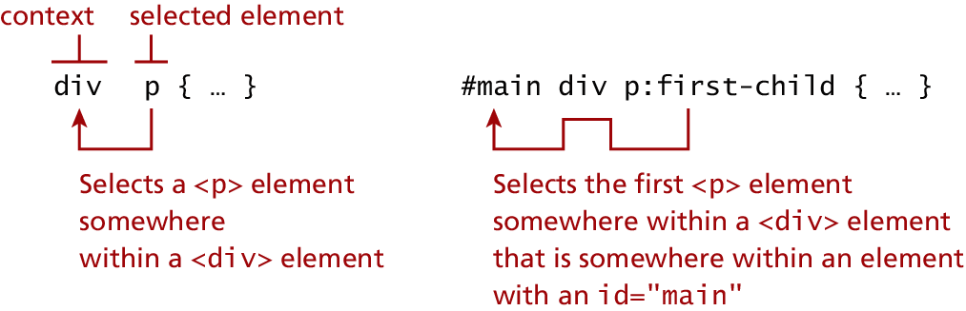
Figure 3.7 Syntax of a descendent selection

Slide 32
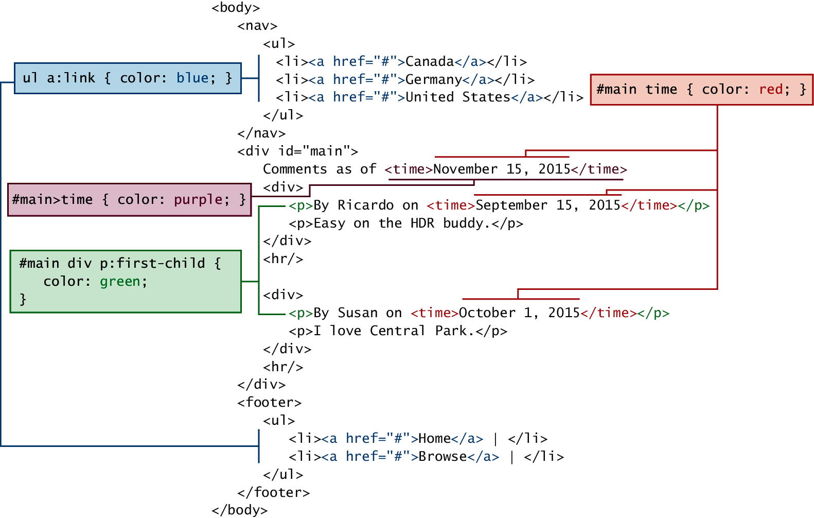
Figure 3.8 Contextual selectors in action

Slide 33
The Cascade: How Styles Interacts
Three Types of Style Sheets
  Author Created Style Sheet
  User-defined Sheet
  Default Browser Style Sheet
Cascade principles for conflict resolution
  Inheritance
  Specificity
  Location
    Inline style override: embedded and external style sheets
    Embedded style sheet override external style sheet

Slide 34
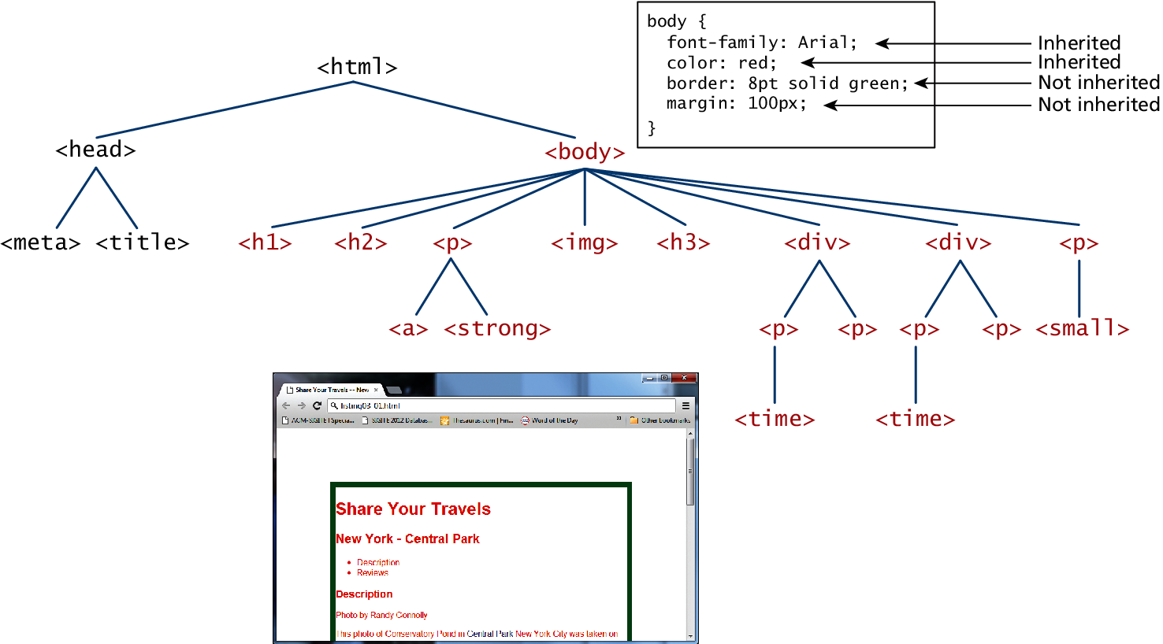
Figure 3.9 Inheritance

Slide 35
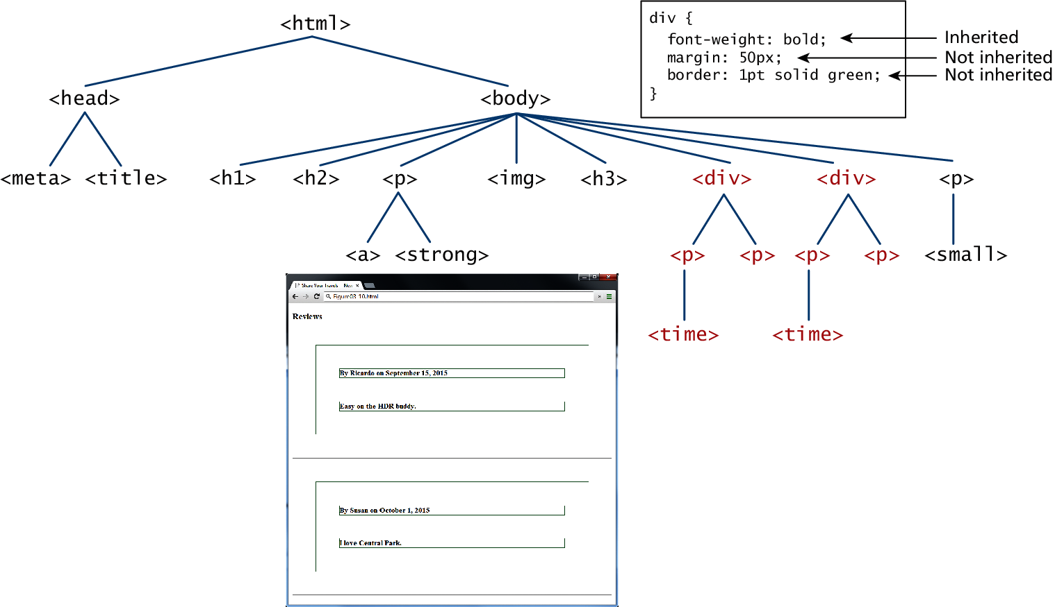
Figure 3.10 More Inheritance

Slide 36
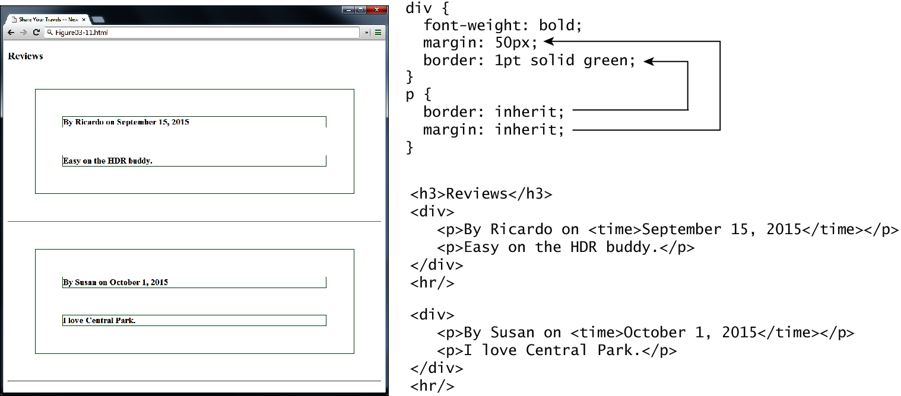
Figure 3.11 Using the inheritance value

Slide 37
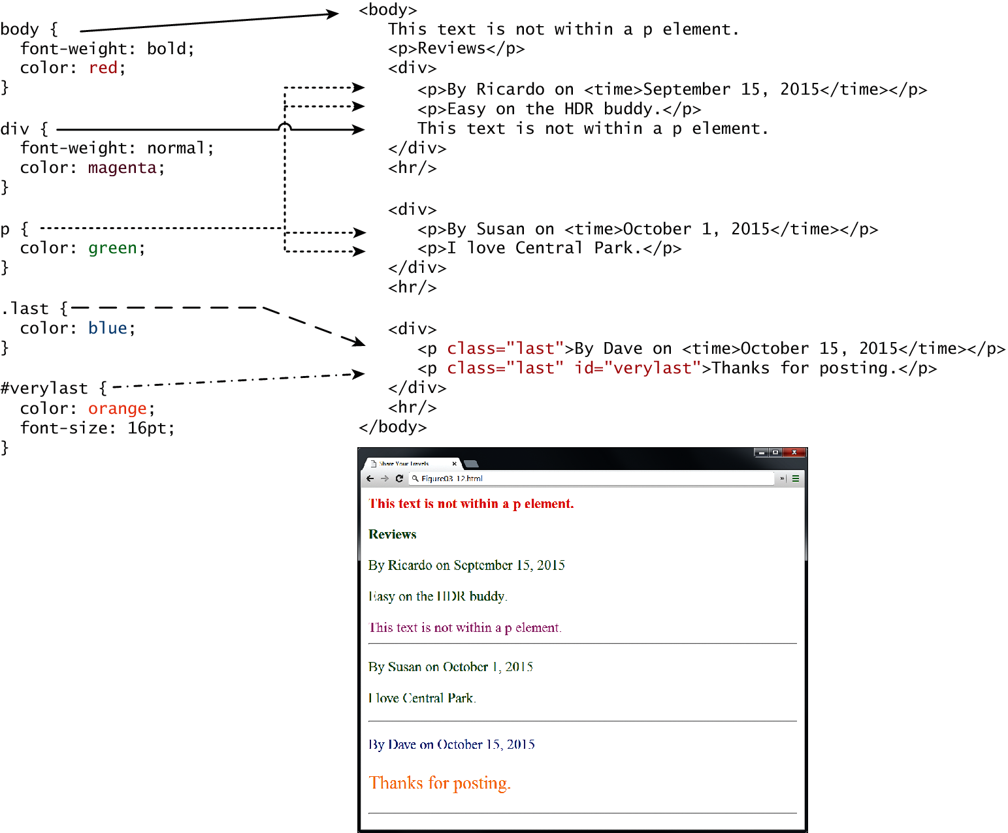
Fig 3.12

Slide 38
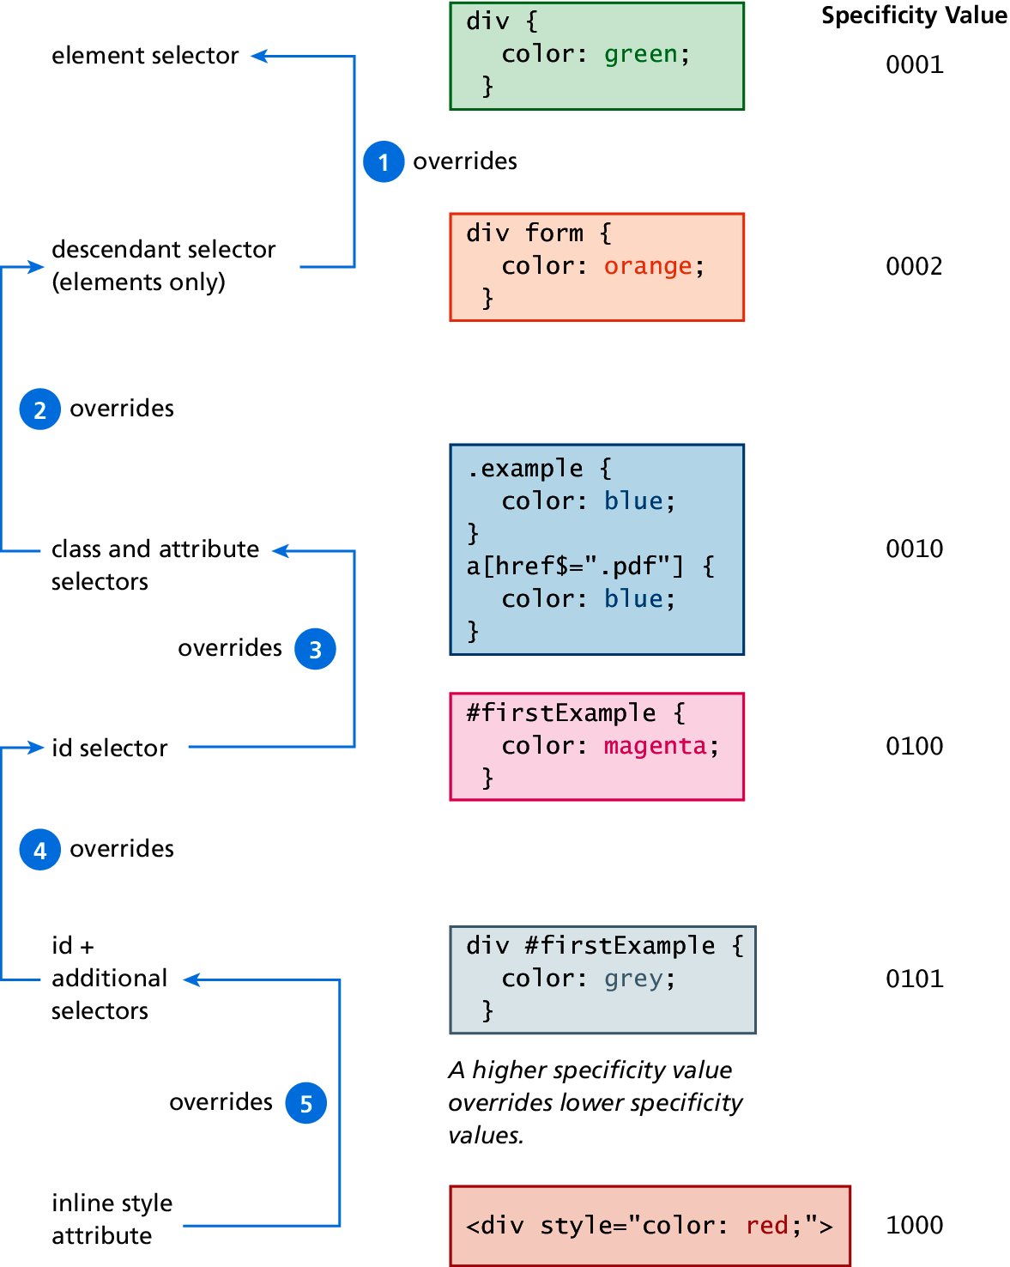
Fig 3.13 Specify Algorithm

Slide 39
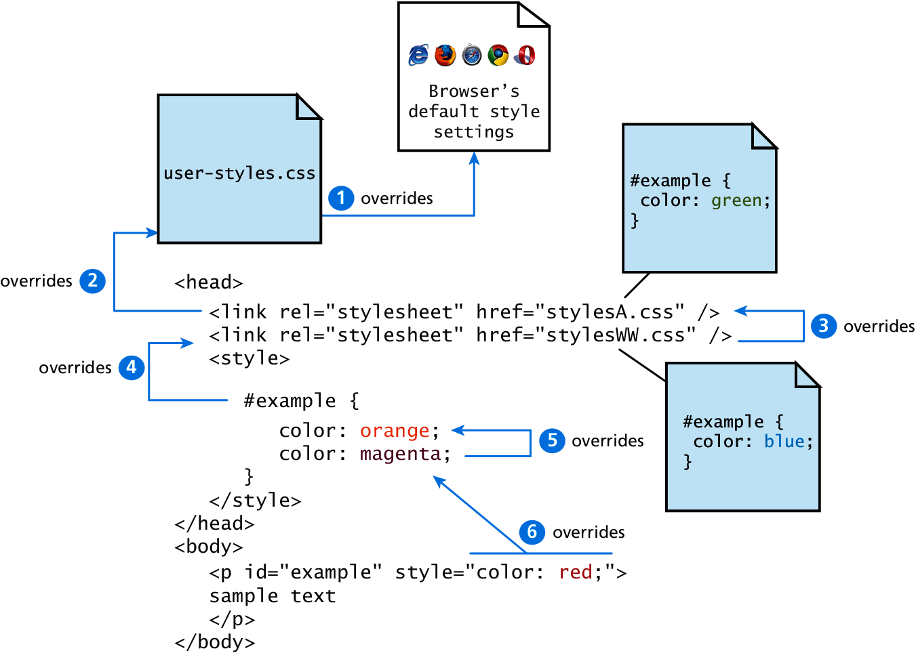
Fig 3.14 Location

Slide 40
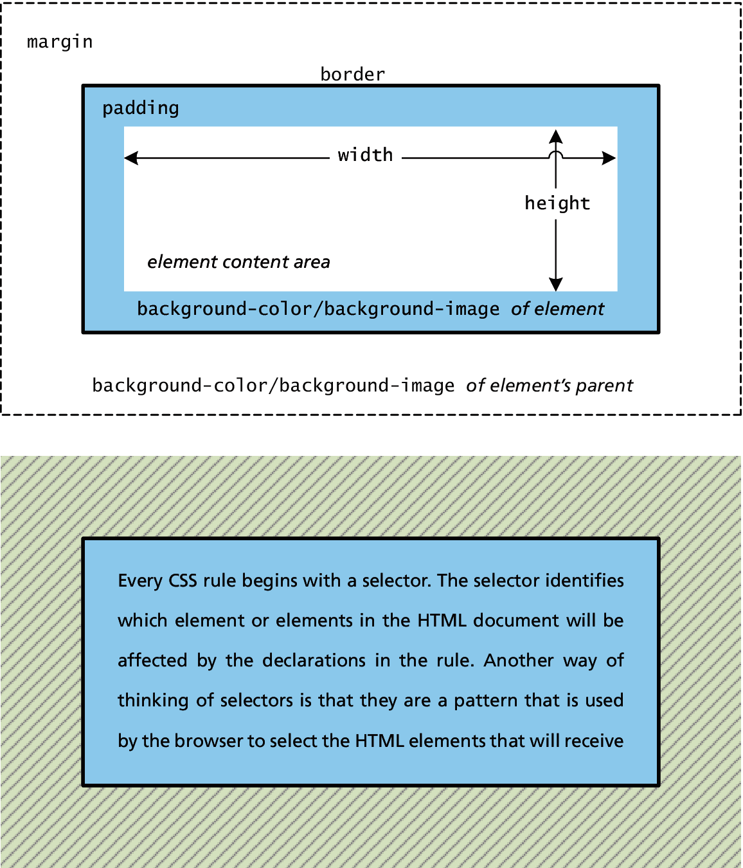
Fig 3.15 CSS Box Model

Slide 41
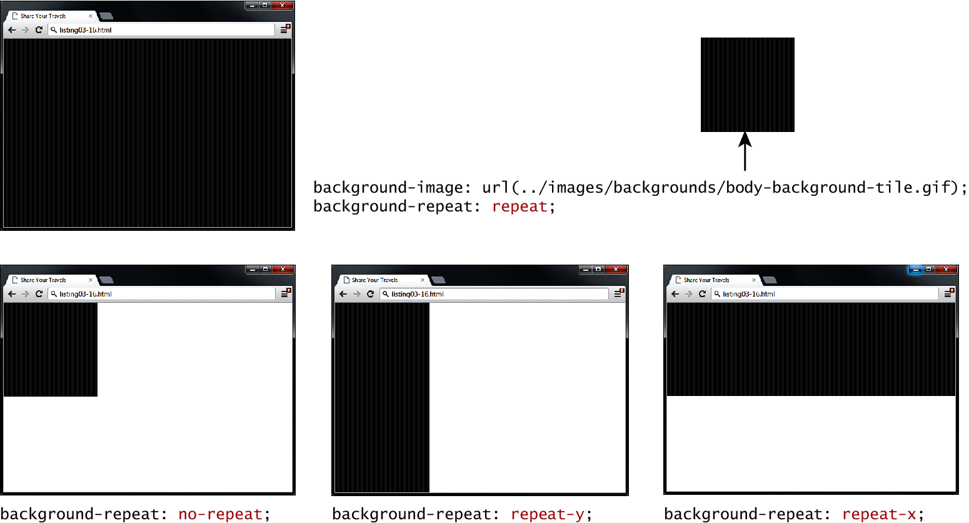
Fig 3.16 Background repeat

Slide 42
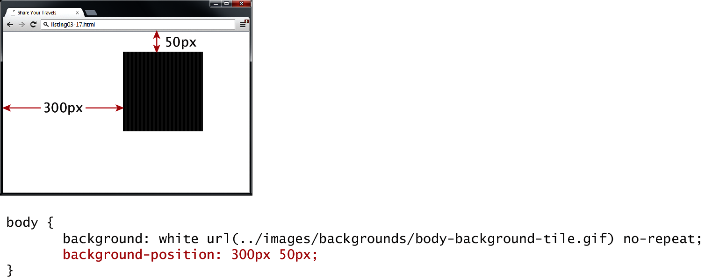
Fig 3.17 Background position

Slide 43
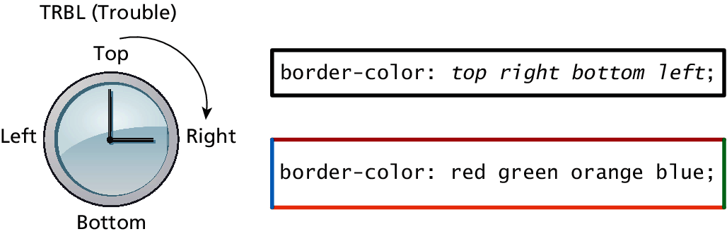
Fig 3.18 CSS TRBL (Trouble) shortcut

Slide 44
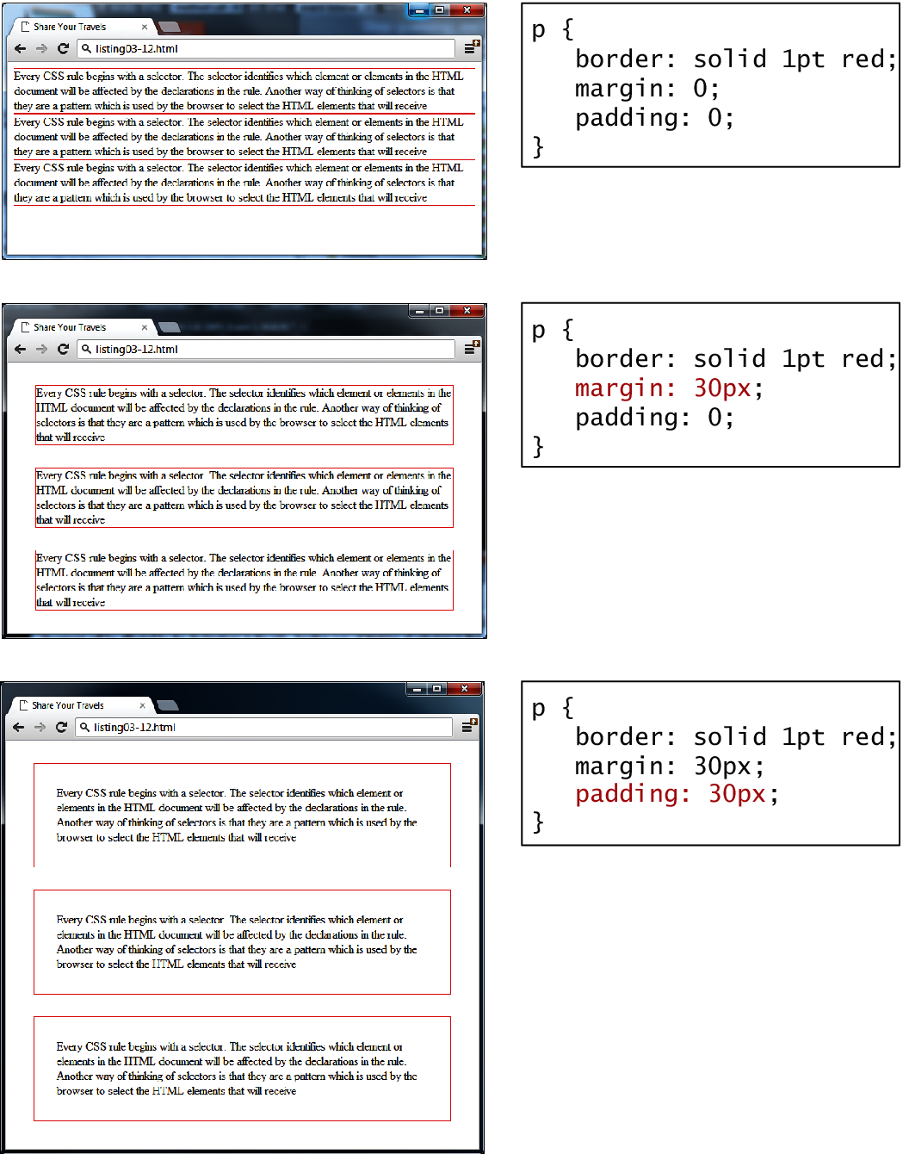
Fig 3.19 Borders, margins, and padding provide element spacing and differentiation

Slide 45
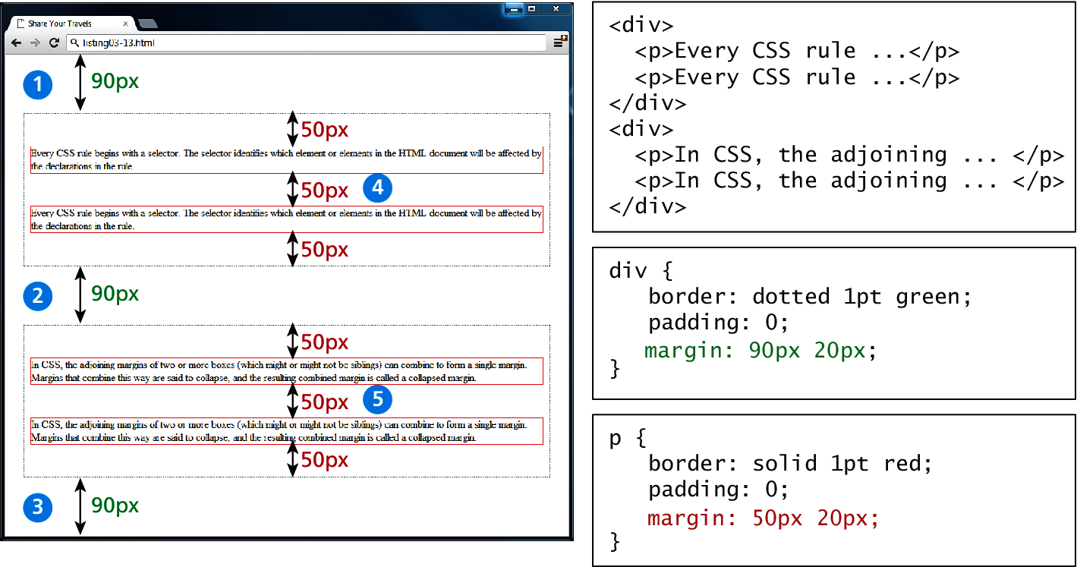
Fig 3.20 Collapsing vertical margins

Slide 46
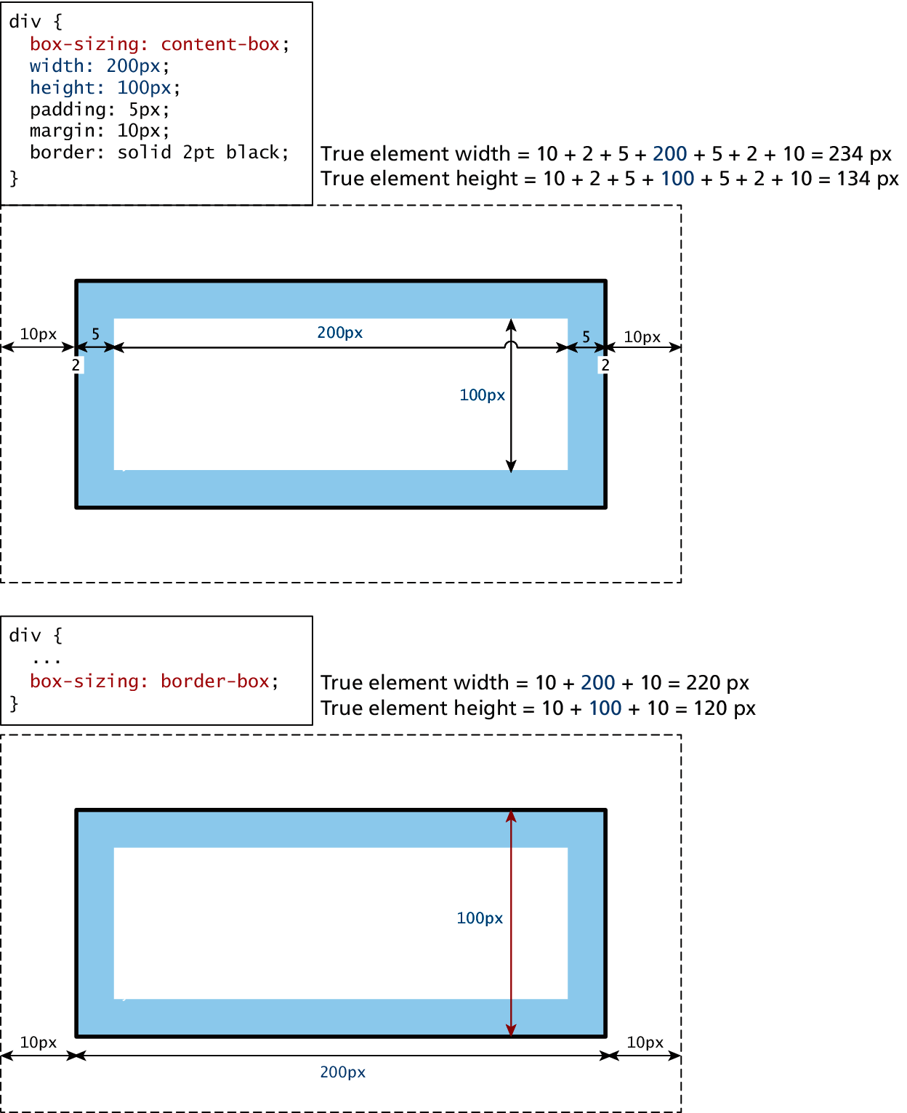
Fig 3.21 Calculating an element true size

Slide 47
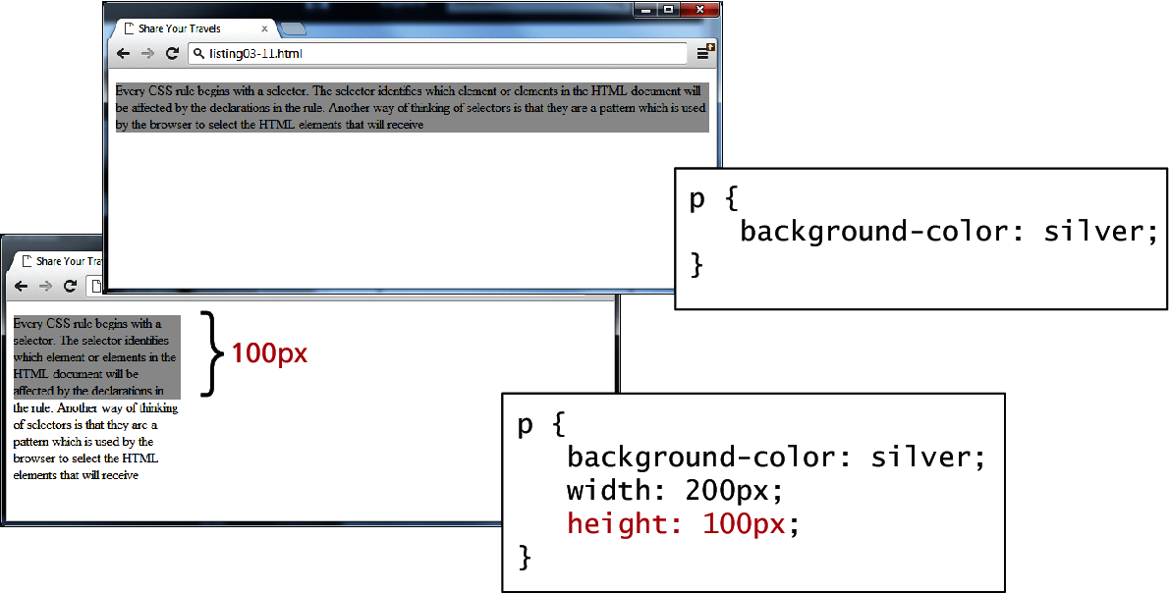
Fig 3.22 Limitations of height property

Slide 48
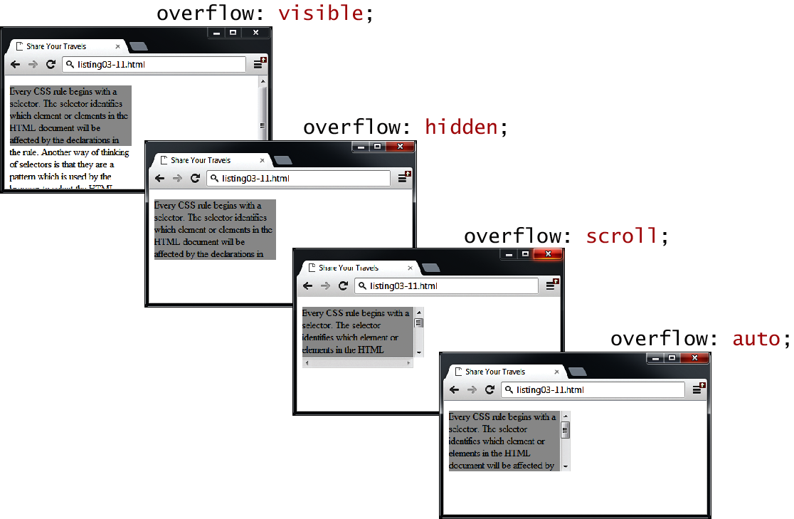
Fig 3.23 Overflow properties

Slide 49
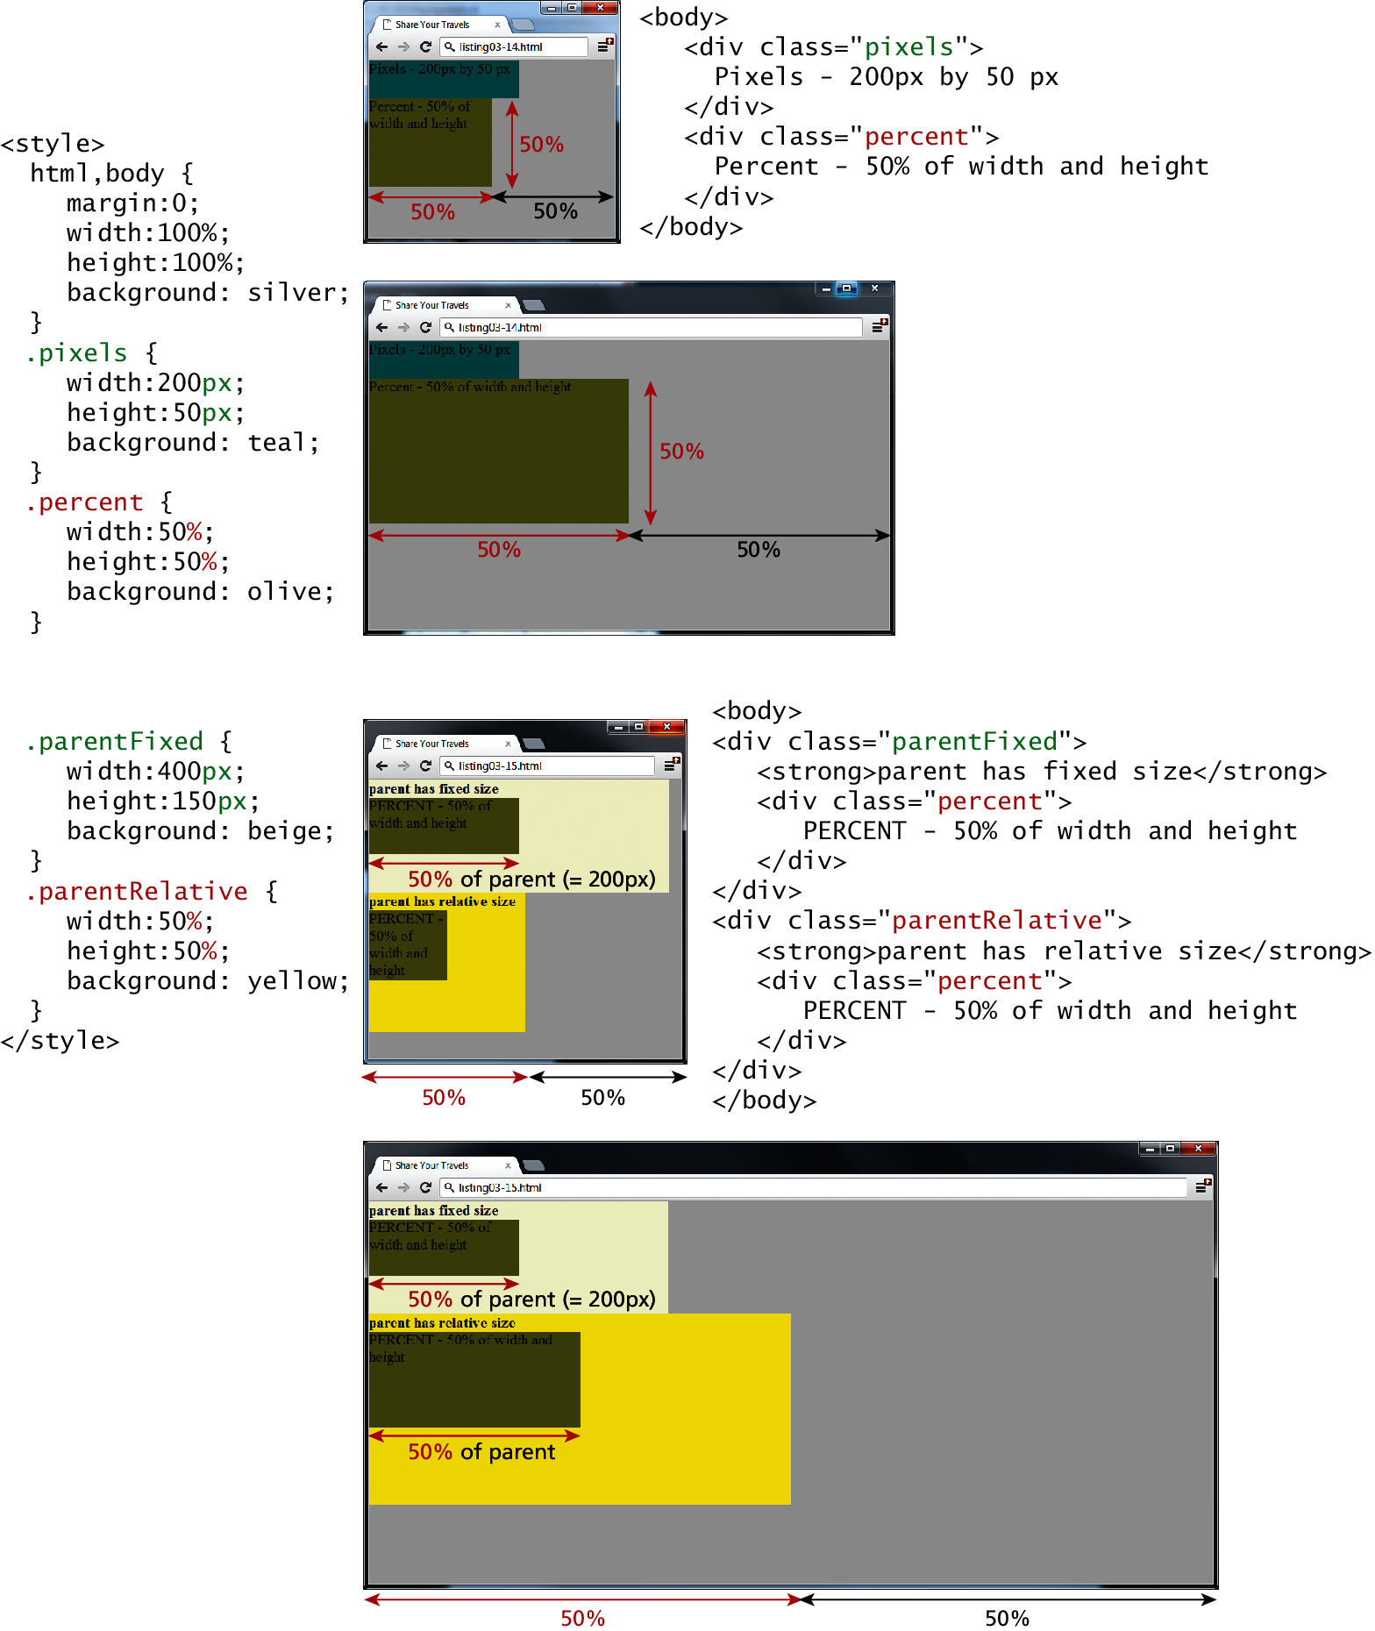
Fig 3.24 Box sizing via percents

Slide 50
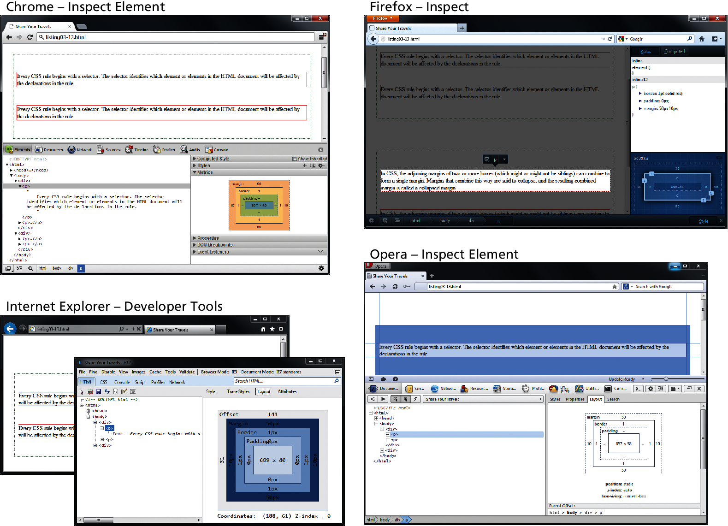
Fig 3.25 Inspecting CSS using developer tools within modern browsers

Slide 51
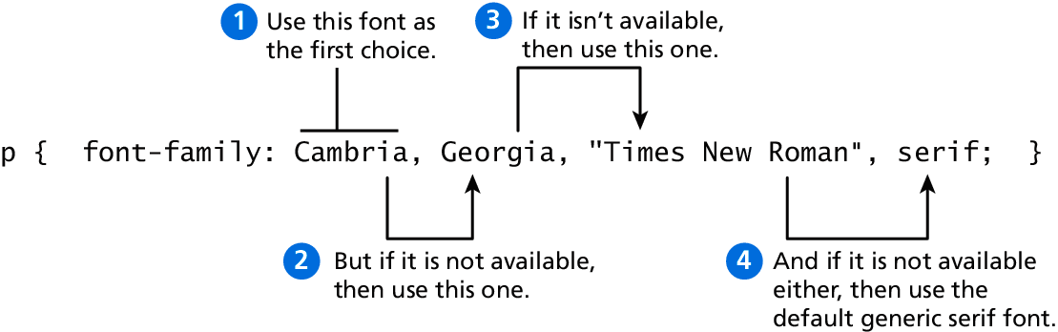
Fig 3.26 Specifying the font family

Slide 52
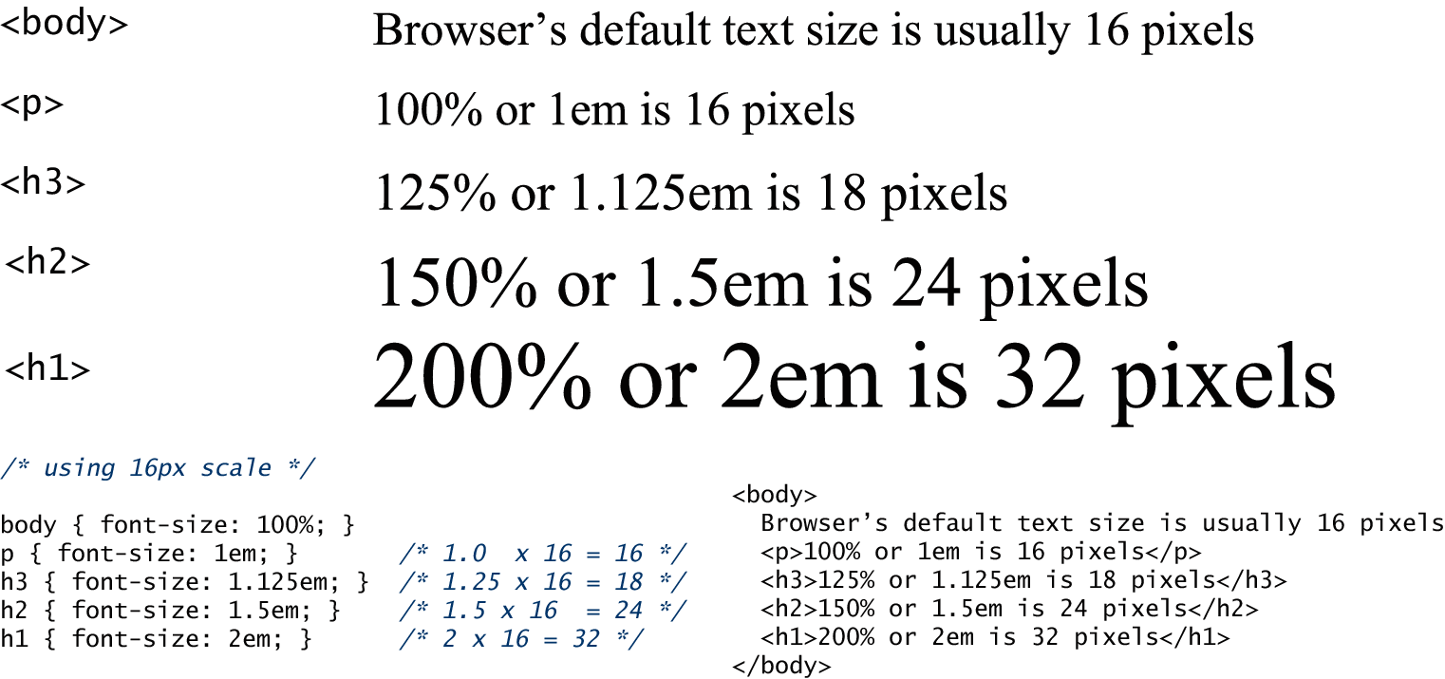
Fig 3.27 The different font families

Slide 53
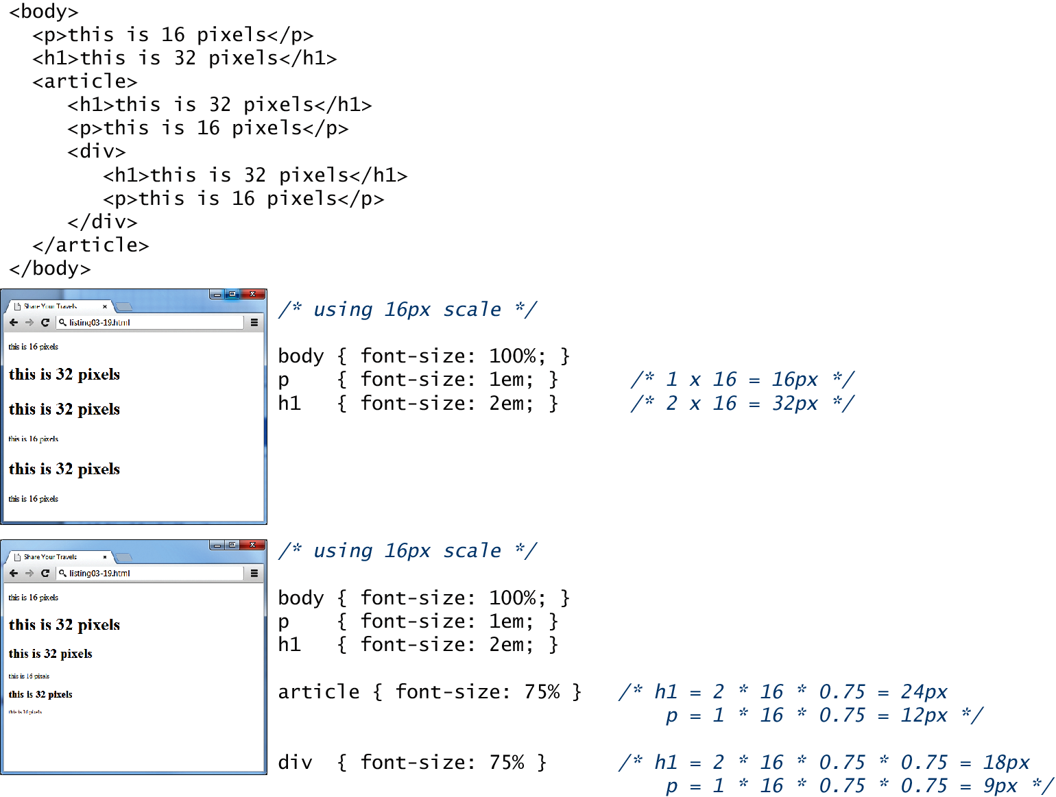
Fig 3.27 The different font families

Slide 54
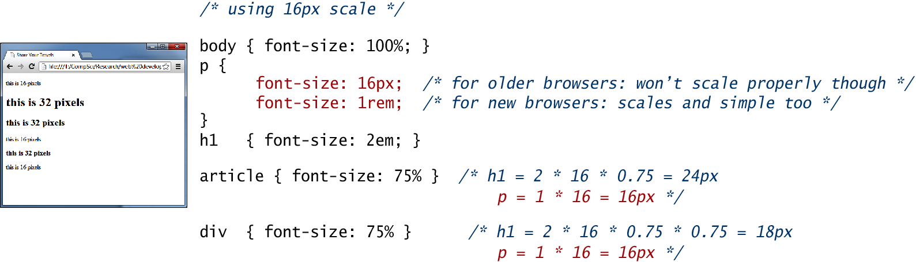
Figure 3.28 Using rem unit

Slide 55
Summary and Conclusion
Q/A ?

