Slide 1
CPET 499/ITC 250 Web Systems
Chapter 11
Working with Databases
Part 1 of 3
Text Book:
* Fundamentals of Web Development, 2015, by Randy Connolly and Ricardo Hoar, published by Pearson
Paul I-Hai Lin, Professor of ECET
http://www.etcs.ipfw.edu/~lin

Slide 2
Topics
Database and Web Development
The Role of Database in Web Development
Database Design
Database Options
SQL (Structure Query Language)
SELECT Statement
INSERT, UPDATE, and DELETE Statements
Transactions: Local Transactions, Distributed Transactions
Data Definition Statements
Database Indexes and Efficiency

Slide 3
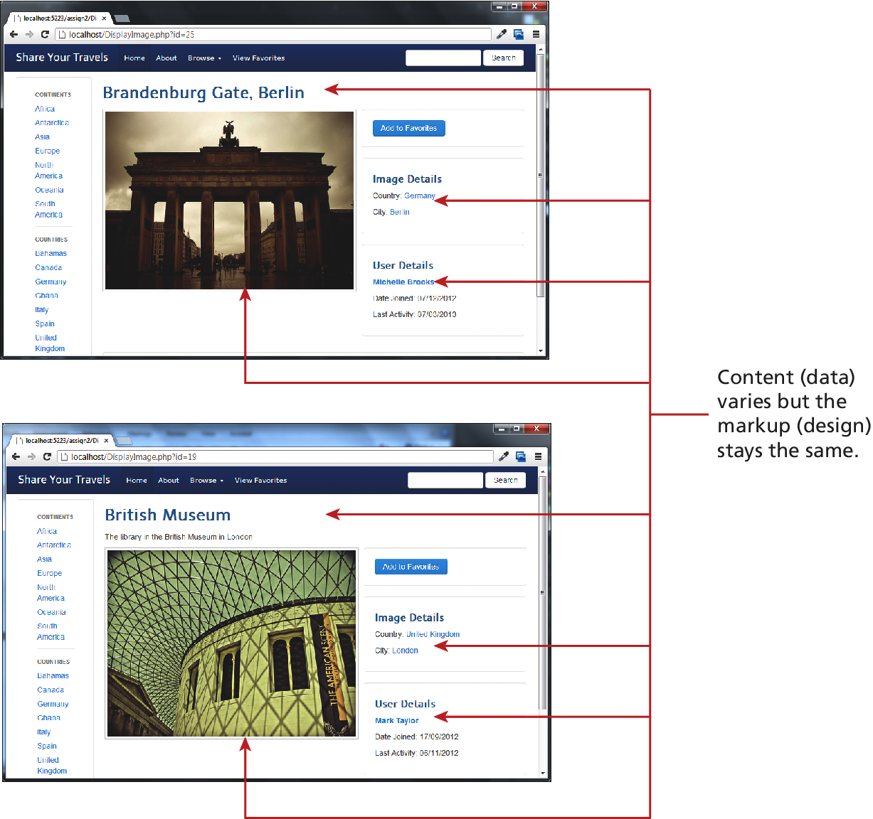
Figure 11.1 Separating content from data

Slide 4
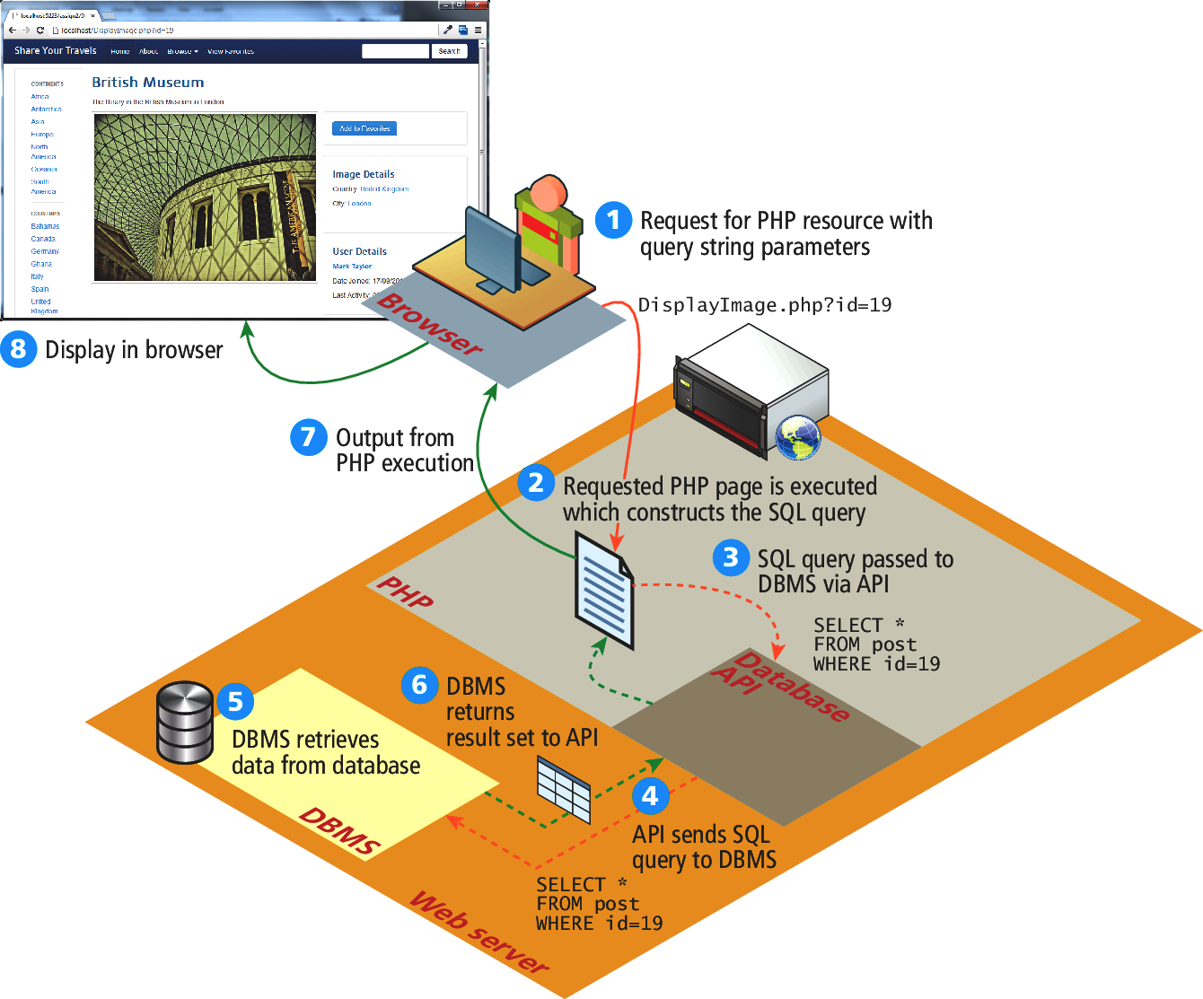
Figure 11.2 How website use databases

Slide 5
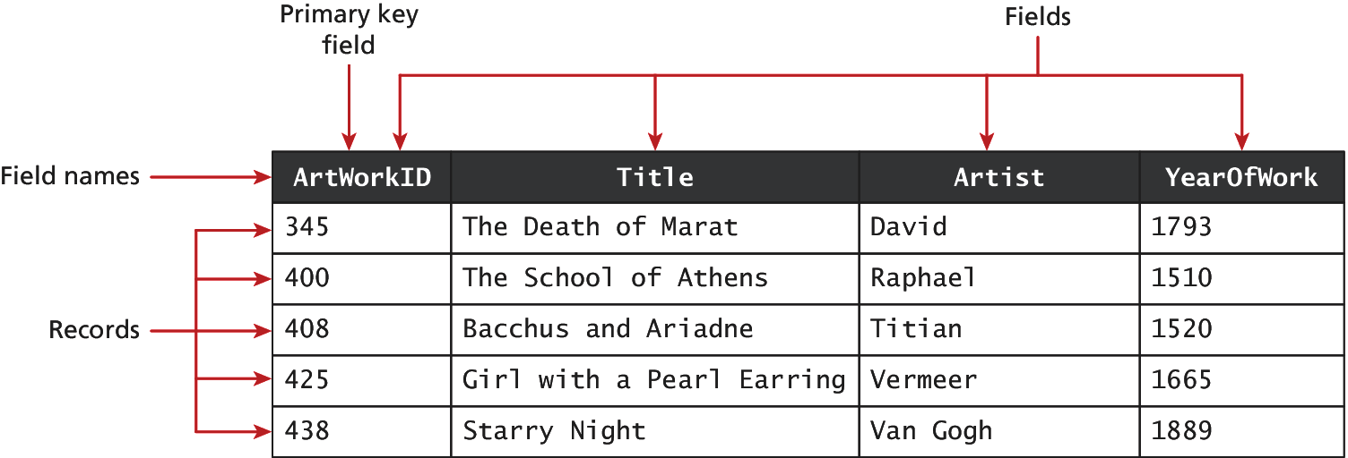
Figure 11.3 A database table

Slide 6
Figure 11.4 Diagraming a table

Slide 7
Table 11.1 Common Database Table Data Types
BIT
BLOG – Binary Large Object
CHAR(n) – a fixed number of character (n = number of chars) that are padded with spaces to fill the field
DATE
FLOAT, DOUBLE, DECIMAL
INT, SMALLINT
VARCHAR(n) – a variable number of characters (n = maximum number of chars with no space padding)

Slide 8
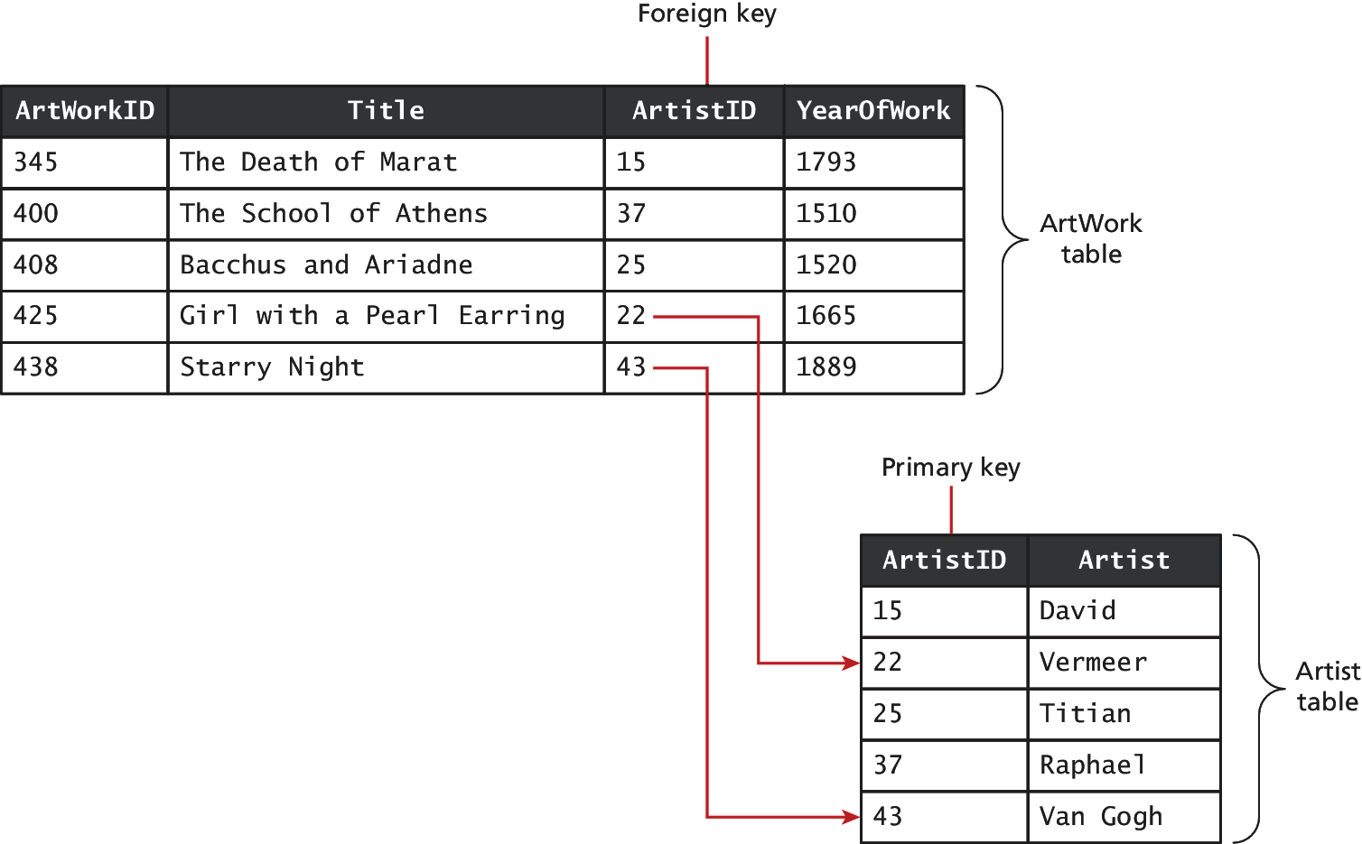
Figure 11.5 Foreign keys links tables

Slide 9
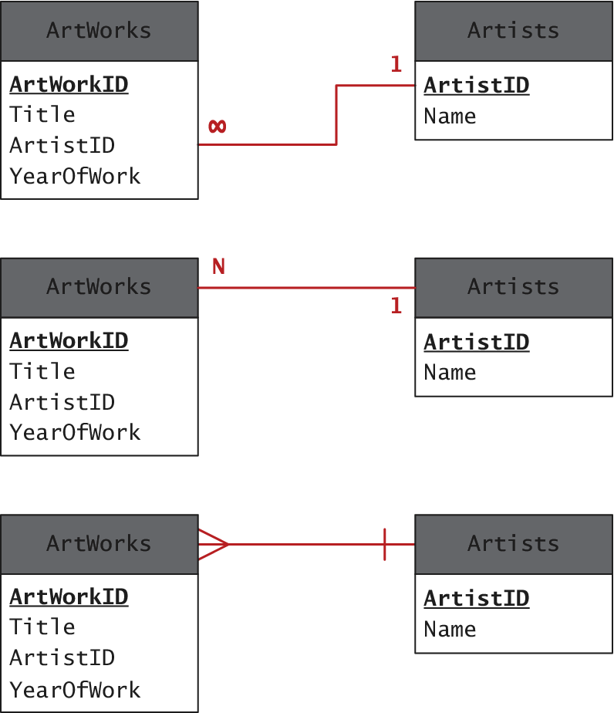
Figure 11.6 Diagraming a one-to-many relationship

Slide 10
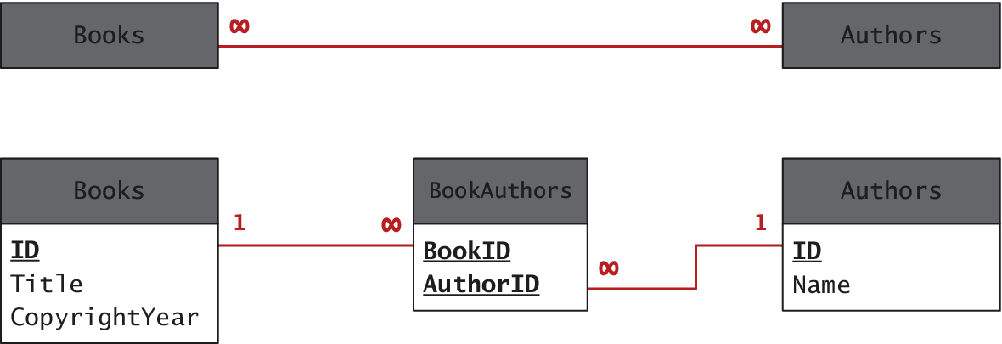
Figure 11.7 Implementing a many-to-many relationship

Slide 11
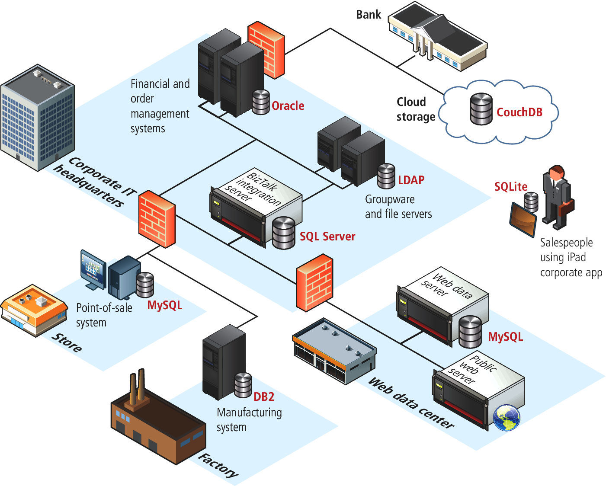
Figure 11.8 Database in the Enterprise

Slide 12
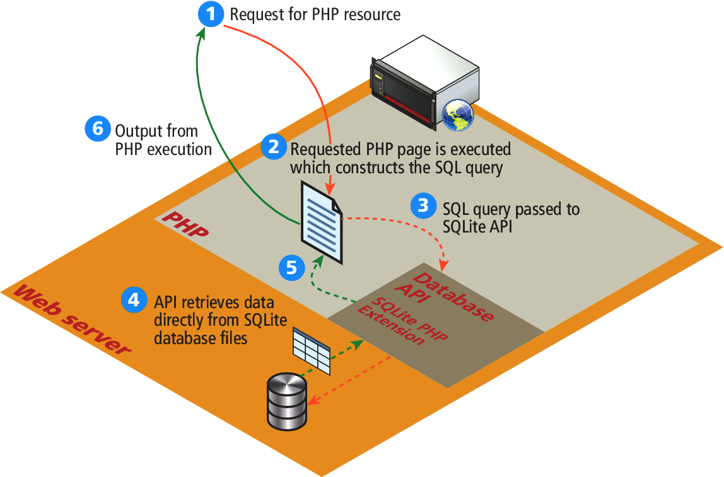
Figure 11.9 SQLite

Slide 13
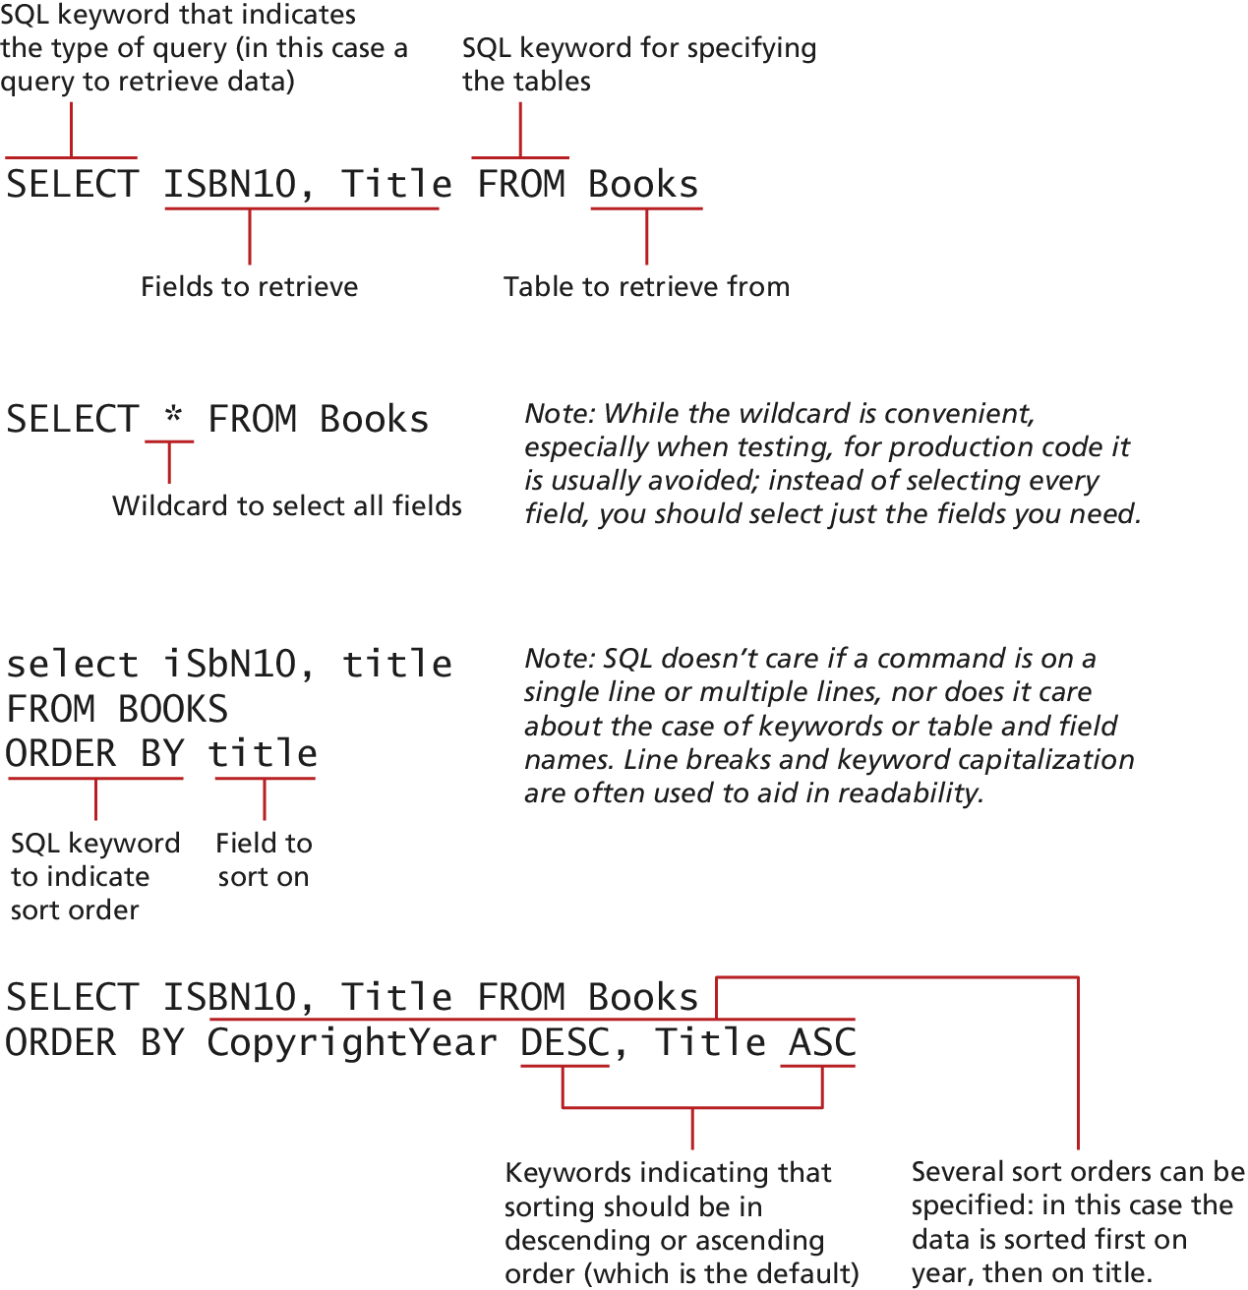
Figure 11.10 SQL SELEC from a single table

Slide 14
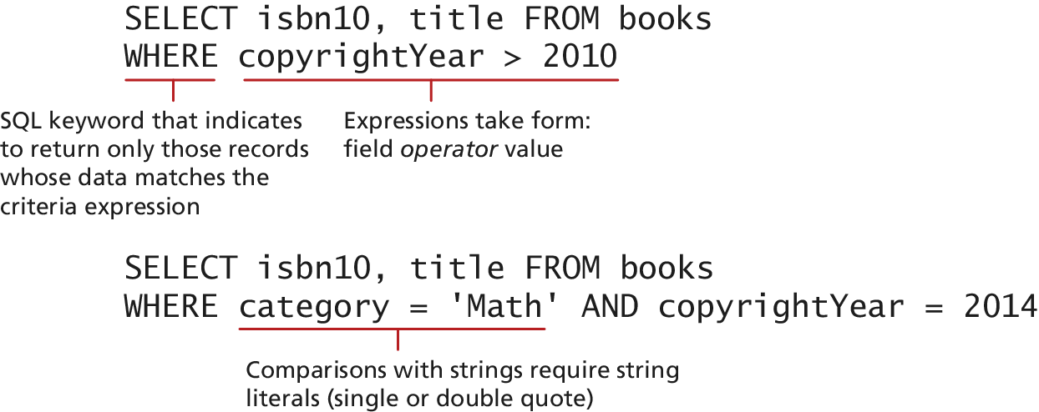
Figure 11.12 Using the WHERE clause

Slide 15
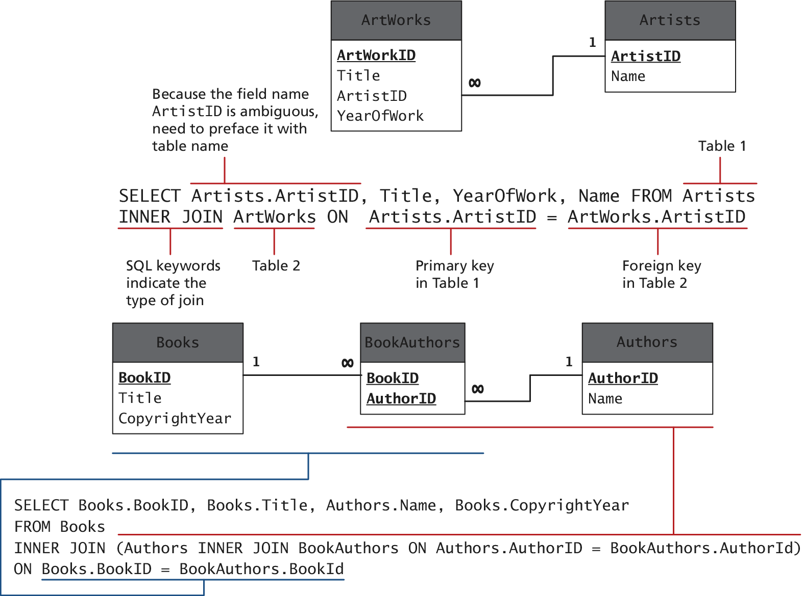
Figure 11.12 SQL SELECT from multiple table using an INNER JOINT

Slide 16
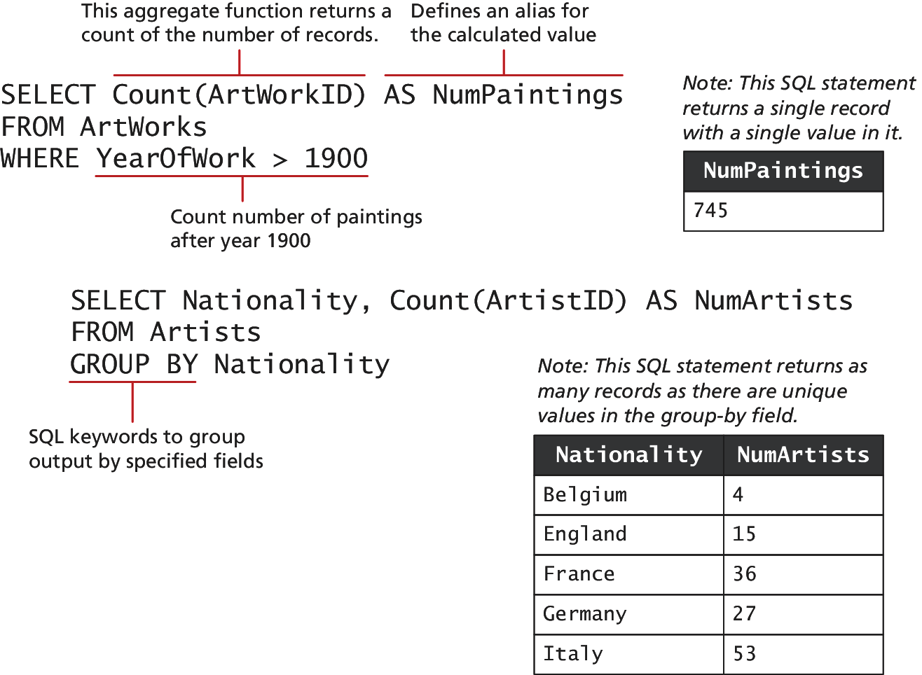
Figure 11.13 Using GROUP BY with aggregate functions

Slide 17
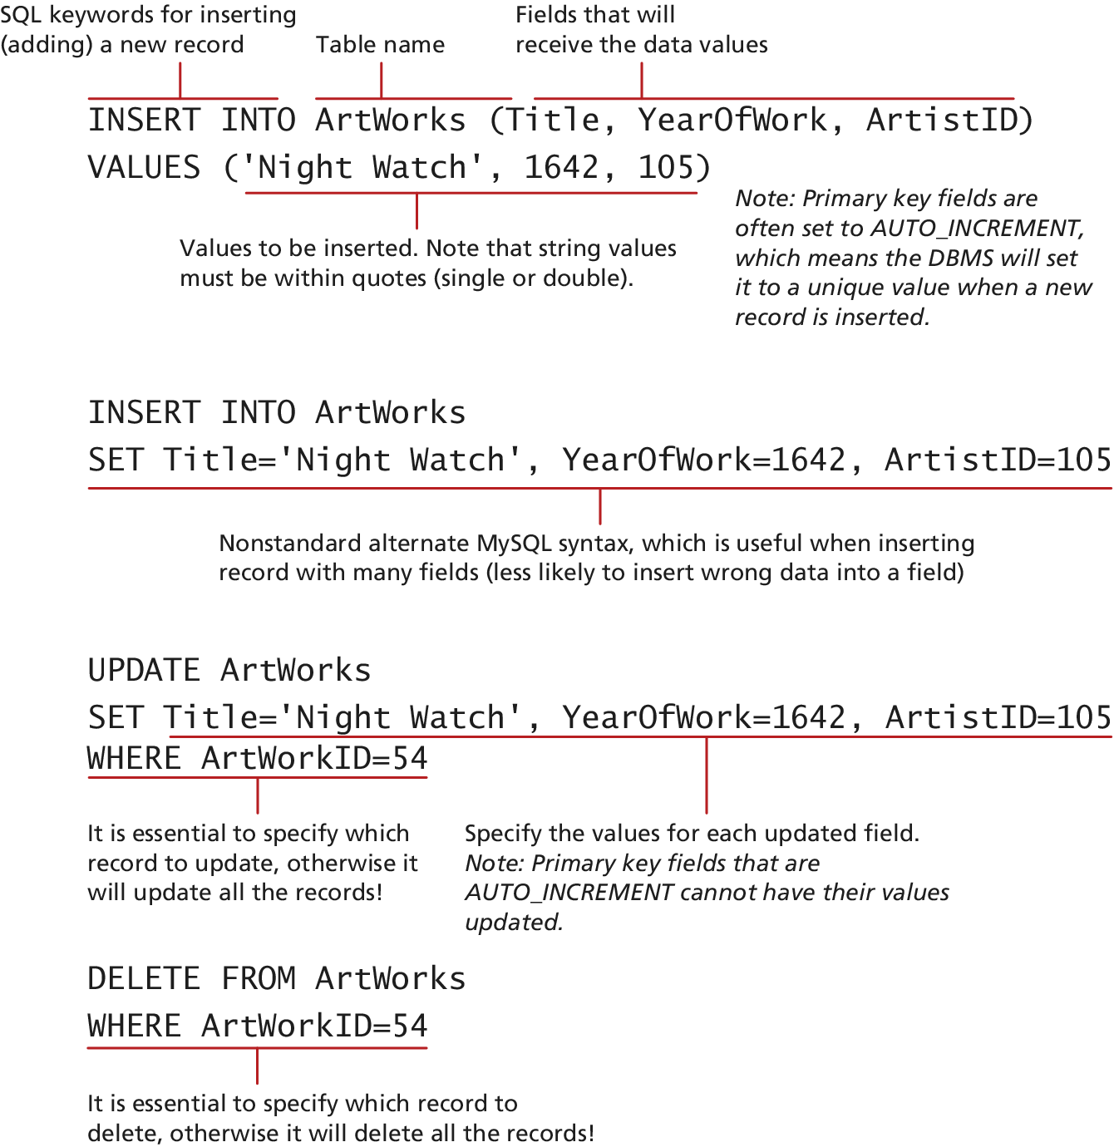
Figure 11.14 SQL INSET, UPDATE, and DELETE

Slide 18
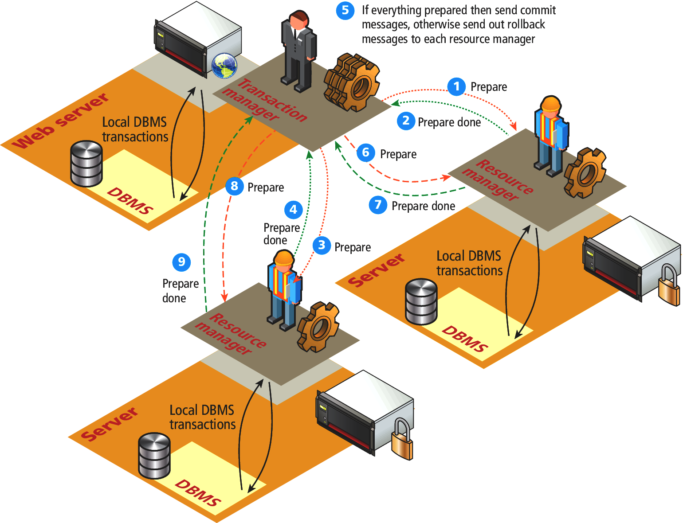
Figure 11.15 Distributed transaction processing

Slide 19
Figure 8.8 Zend Engine

