Slide 1
CPET 499/ITC 250 Web Systems
Chapter 13
Managing State
Text Book:
* Fundamentals of Web Development, 2015, by Randy Connolly and Ricardo Hoar, published by Pearson
Paul I-Hai Lin, Professor
http://www.etcs.ipfw.edu/~lin

Slide 2
Topics
Why state is a problem in web application development
What cookies are and how to use them
What HTML5 web storage is and how to use it
What session state is and what are its typical uses and limitation
What server cache is and why it is important in real-world web sites.

Slide 3
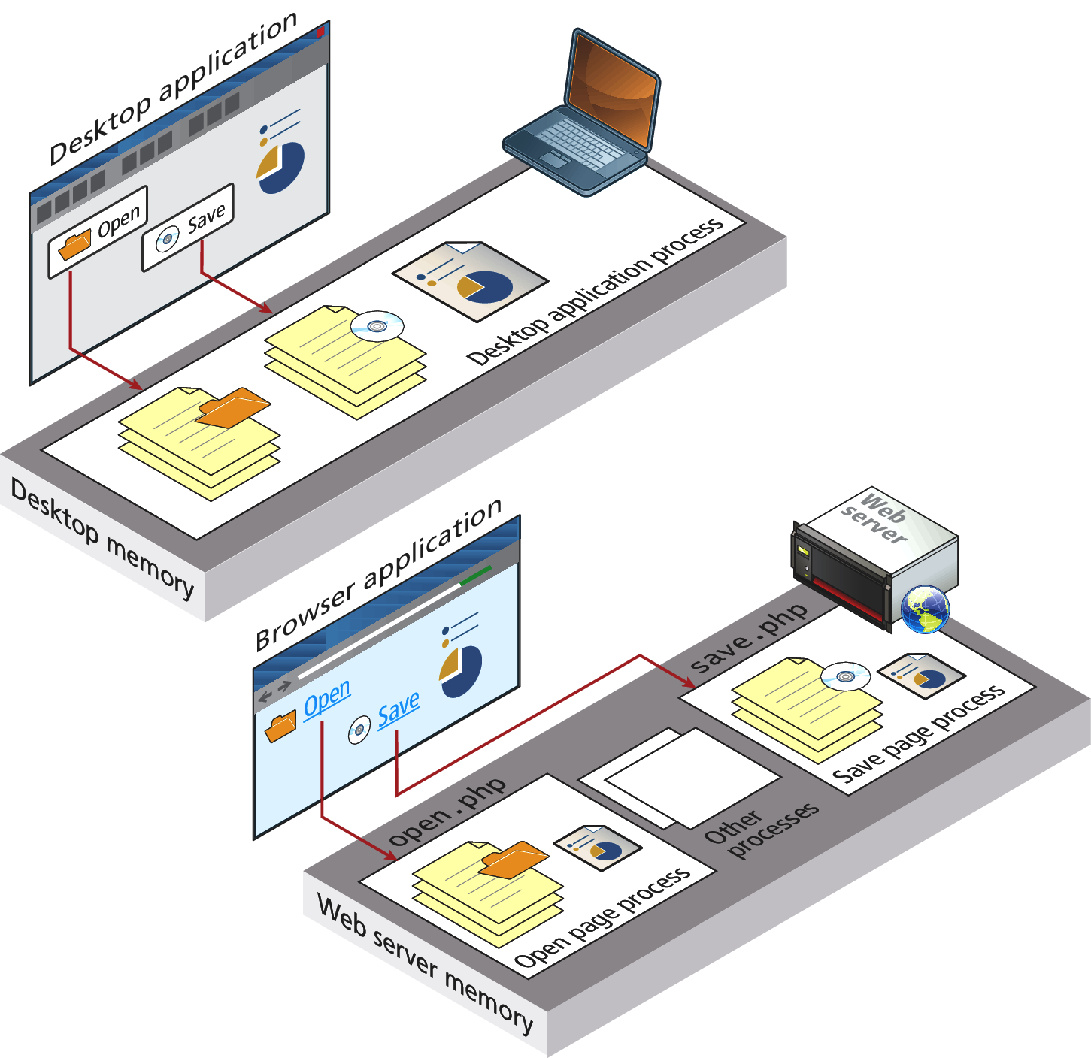
The Problem of State in Web Applications Figure 13.1 Desktop applications vs. web application
All applications need to
Process user inputs
Output information, and
Read/write from databases or other storage media
A web app consists of a series of disconnected HTTP request to a web server

Slide 4
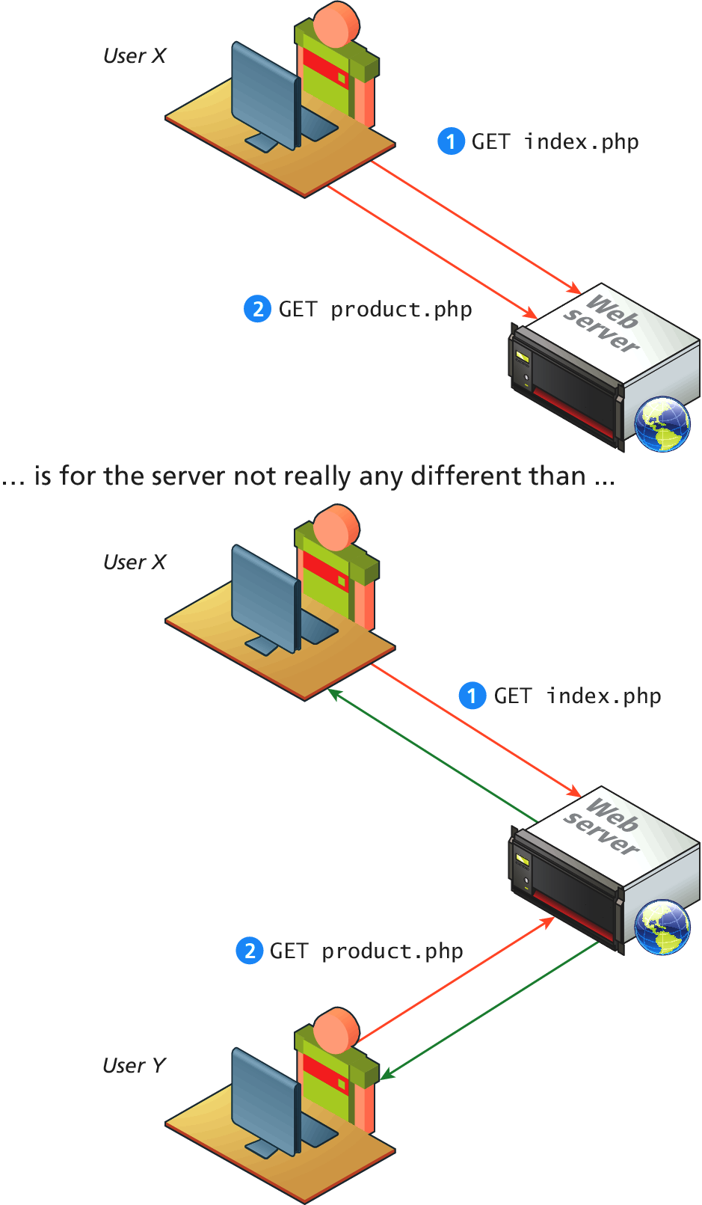
Figure 13.2 What the web server sees
The web server sees only request
The HTTP protocol does not, without programming intervention, distinguish two requests

Slide 5
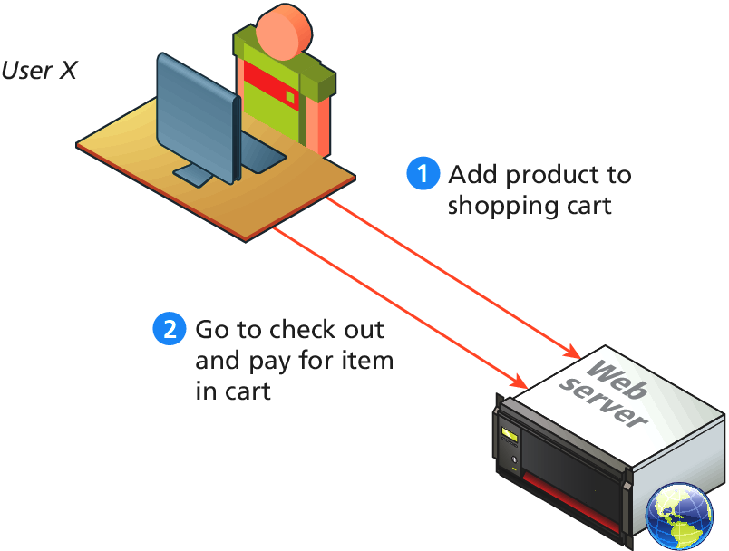
Figure 13.3 What the user wants the server to see
User wants the web server to connect the request together: A web shopping cart example
HTTP request-response interaction constrains information passing/using
We can pass info using: Query strings, Cookies

Slide 6
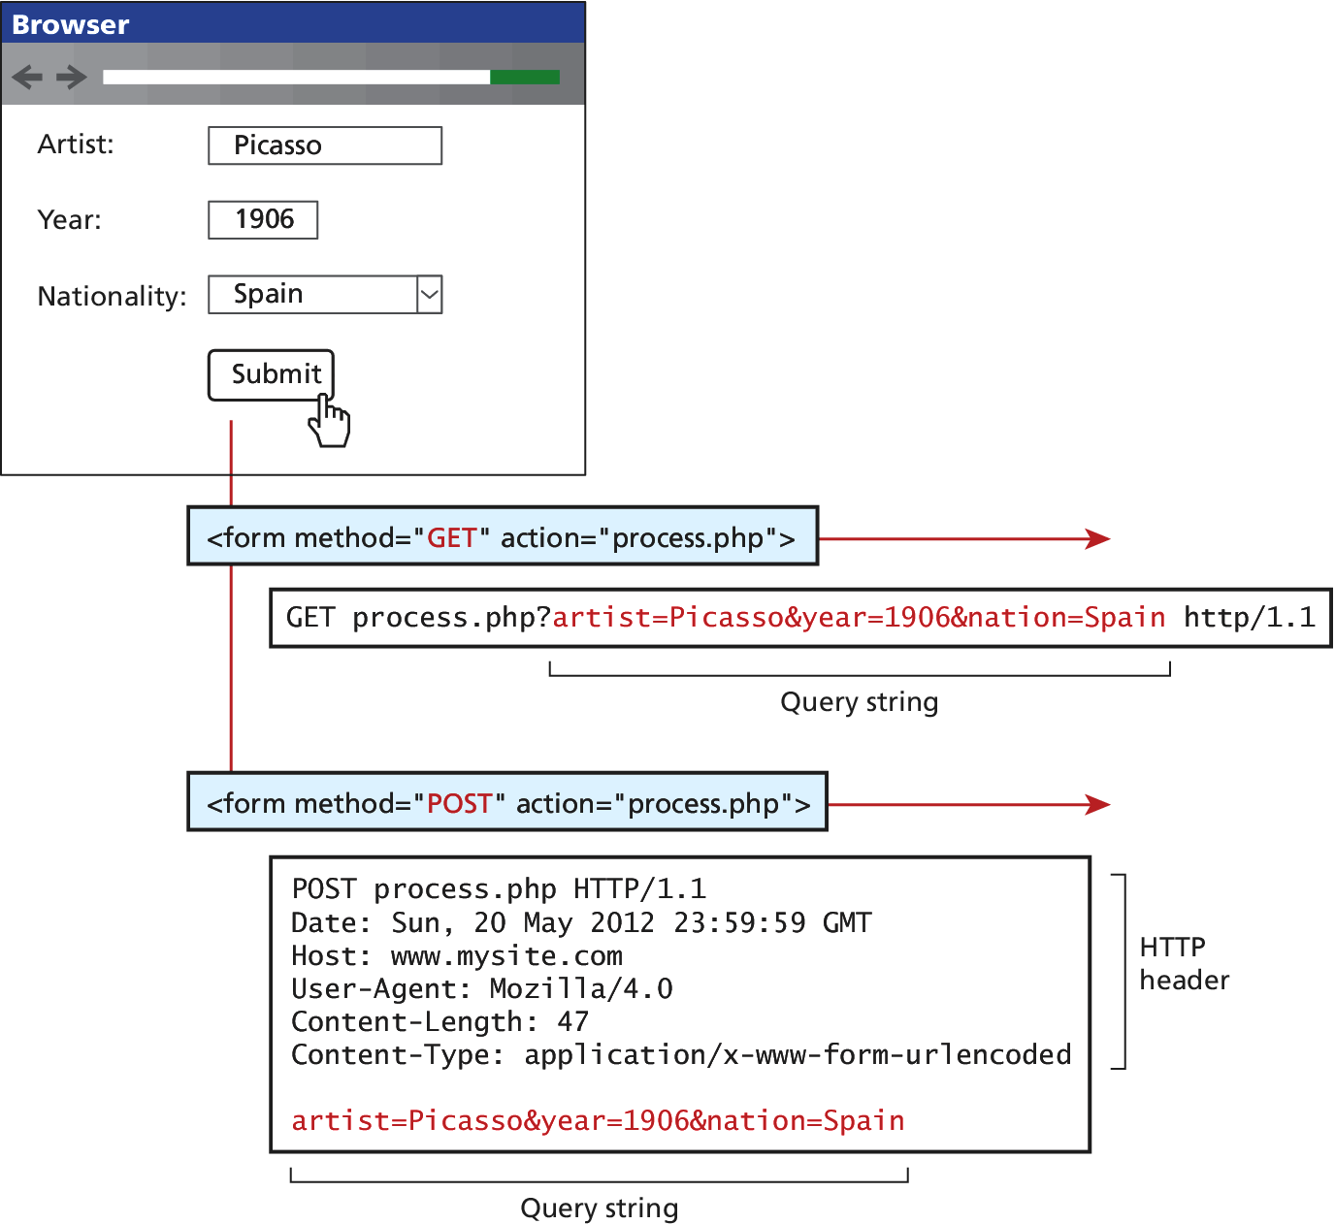
Passing Information via Query Strings Figure 13.4 Recap of Get vs. Post
A query string within the URL (GET)
A query string within HTTP header (POST)

Slide 7
Passing Information via the URL Path
Drawbacks
The URL path and query string can be long and complicated
For search engine application:
A prefer method
SEO (Search Engine Optimization)
Dynamic URLs (query string parameters) – an essential part of web development
URL Rewriting – a process of rewrite the dynamic URL into static one (and vice versa)
Figure 13.5 URLs within a search engine result page

Slide 8
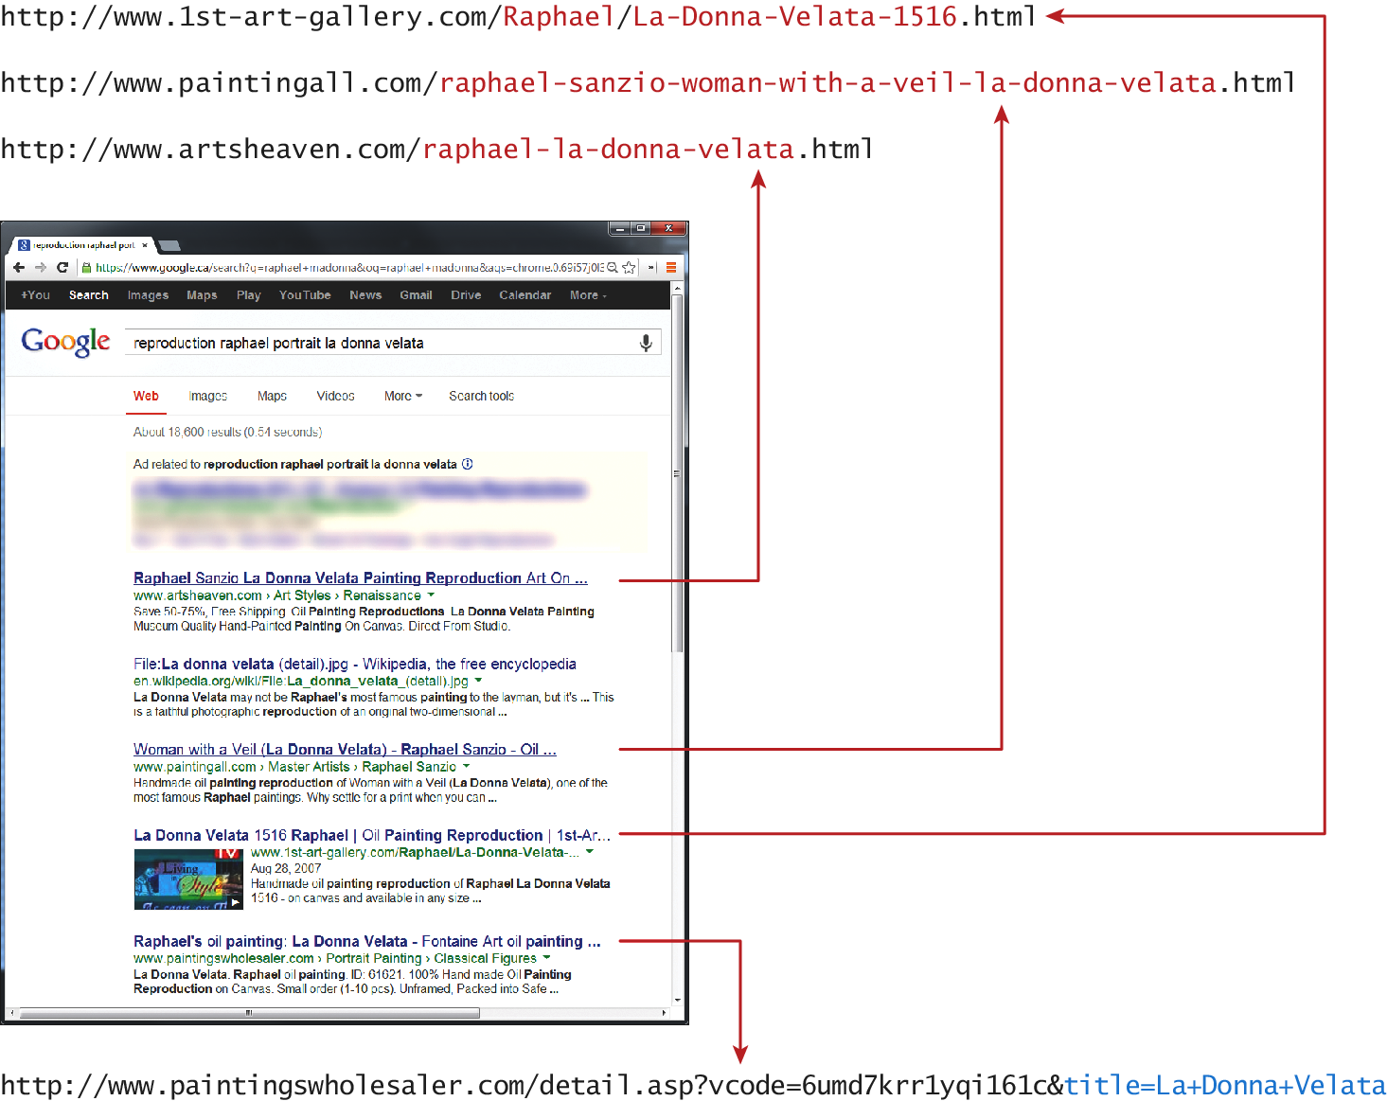
Figure 13.5 URLs with a search engine result page

Slide 9
Passing Information via the URL Path
Figure 13.5 URLs within a search engine result page
Top four commerce-related results for the search term “reproductions Raphael portrait la donna velata”
The top three: do not use query string parameters, use relevant info within the folder path or file name
File name extension is rewritten to make URL friendlier
Rewrite URL
www.somedomain.com/DisplayArtist.php?artist=16
www.somedomain.com/artist/16.php
More SEO friendly
www.somedomain.com/artist/Mary-Cassatt
URL Rewriting in Apache and Linux
mod_rewrite module with .htaccess file

Slide 10
Cookies
HTTP Cookies:
A client-side approach for persisting state information
Intended to be a long-term state mechanism used as a way of maintaining continuity over-time in a web application
They provide web servers with user-related information that can be stored on the user’s computer and be managed by the user’s browser
Also for keep tracking of whether a user has logged into a site
Storage space limitation – 4 k for a domain
Users can refuse to accept cookies

Slide 11
Cookies
Types of Cookies
Session Cookie – no expiry state, will be deleted at the end of the user browsing session
Persistent Cookies – have expiry date specified
Third-party tracking cookies – source of concern for privacy advocates
Writing and Reading Cookies - PHP

Slide 12
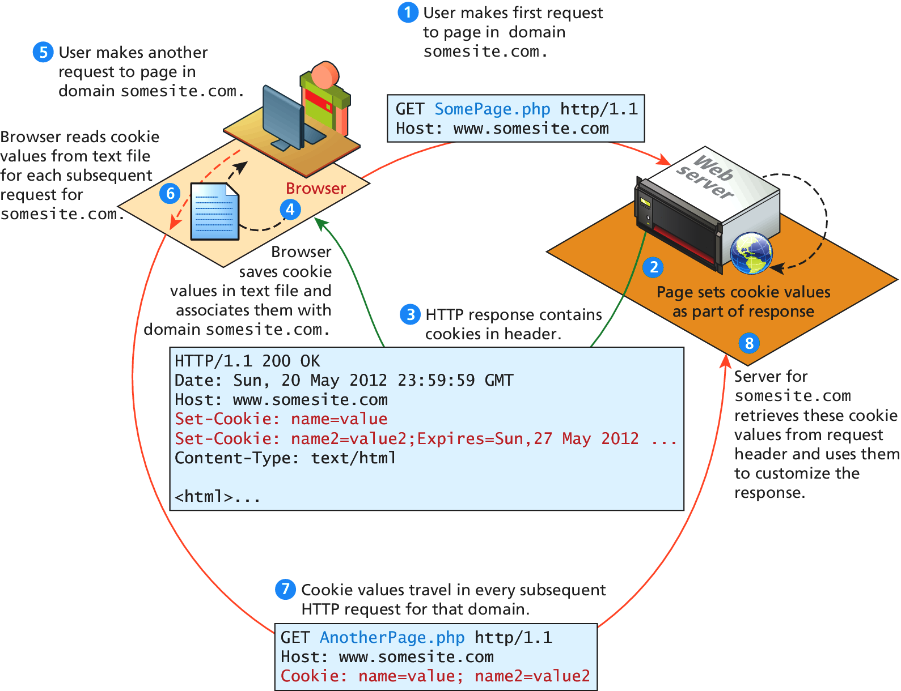
Figure 13.6 Cookies at work

Slide 13
Cookies
Writing Cookies – PHP
<?php
//listing 13.1 Writing a cookie
// add 1 day to the current time for expiry time
$expiryTime = time()+60*60*24;
// create a persistent cookie
$name = "Username";
$value = "Ricardo";
setcookie($name, $value, $expiryTime);
?>

Slide 14
Cookies
Reading Cookies – PHP
<?php
//listing 13.2 Reading a cookie <-visit Listing13.01.php to set the cookie.
if( !isset($_COOKIE['Username']) ) {
//no valid cookie found
}
else {
echo "The username retrieved from the cookie is:";
echo $_COOKIE['Username'];
}
?>

Slide 15
Serialization
Serialization is the process of taking a complicated object and reducing it down to zeros and ones for either storage or transmission.
PHP objects
serialize() – reduce an object down to a binary string
unserialize() – reconstitute the binary string back into an object
Listing 13.3 the Serializable interface

Slide 16
Serialization
Listing 13.3 the Serializable interface
<?php
//listing 13.3 The Serializable interface
interface Serializable {
/* Methods */
public function serialize();
public function unserialize($serialized);
}
?>
serialize($picasso);
$picassoClone = unserialize($data);

Slide 17
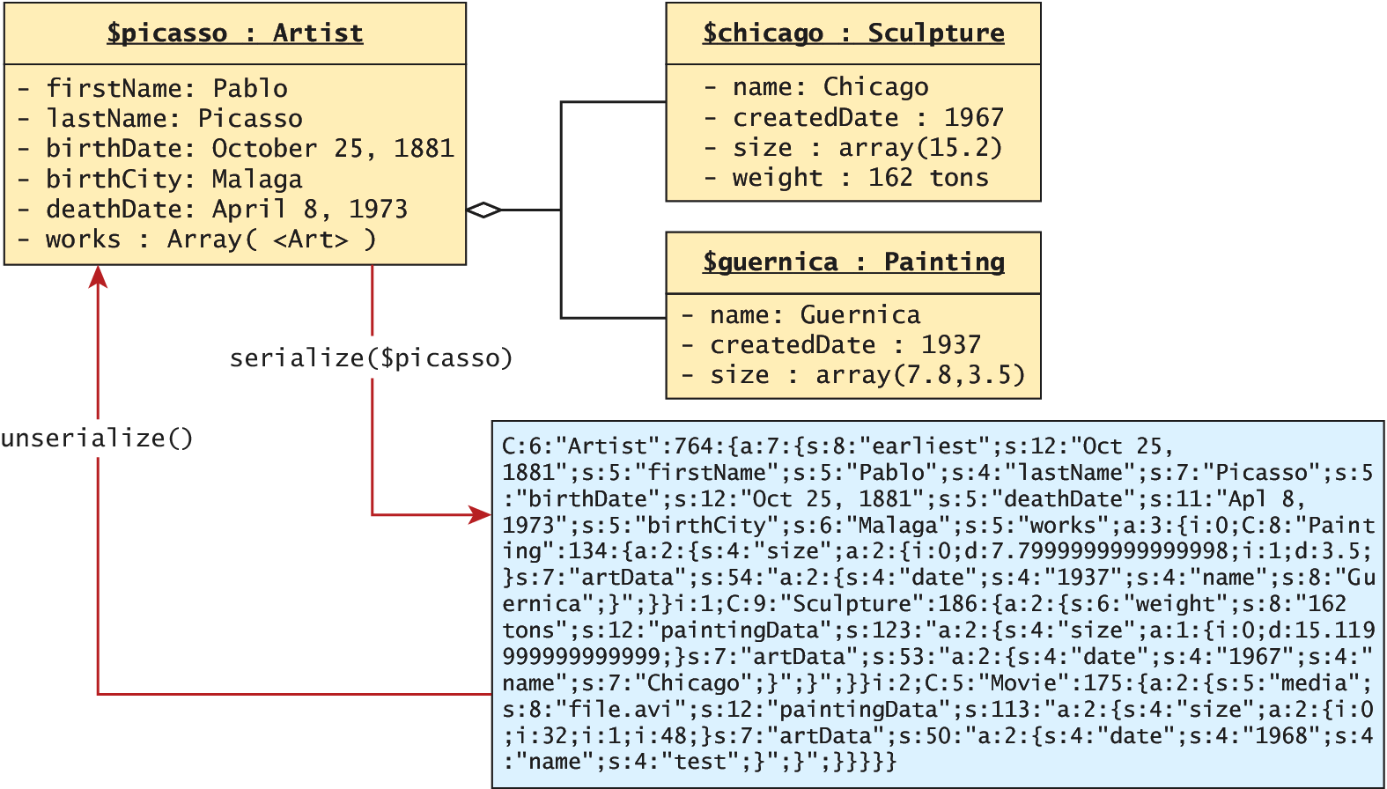
Figure 13.7 Serialization and deserialization

Slide 18
Listing 13.4 Art class modified to implement the Serializable interface
<?php
class Artist implements Serializable {
//some parts borrowed from earlier chapters.
const EARLIEST_DATE = 'January 1, 1200';
private static $artistCount = 0;
private $firstName;
private $lastName;
private $birthDate;
private $deathDate;
private $birthCity;
private $artworks;

Slide 19
Listing 13.4 Art class modified to implement the Serializable interface (continue)
// Implement the Serializable interface methods
public function serialize() {
// use the built-in PHP serialize function
return serialize(
array("earliest" =>self::$earliestDate,
"first" => $this->firstName,
"last" => $this->lastName,
"bdate" => $this->birthDate,
"ddate" => $this->deathDate,
"bcity" => $this->birthCity,
"works" => $this->artworks
)
);
}

Slide 20
Listing 13.4 Art class modified to implement the Serializable interface (continue)
public function unserialize($data) {
// use the built-in PHP unserialize function
$data = unserialize($data);
self::$earliestDate = $data['earliest'];
$this->firstName = $data['first'];
$this->lastName = $data['last'];
$this->birthDate = $data['bdate'];
$this->deathDate = $data['ddate'];
$this->birthCity = $data['bcity'];
$this->artworks = $data['works'];
}
//...
}
?>

Slide 21
Session State
Session state – a server-based state mechanism that let web application store and retrieve objects for each unique session
Store serialized file on the server => deserialized and loaded into memory as needed for each request
In PHP
Superglobal associative arrys
$_GET, $_POST, $_COOKIES
$_SESSION variable – needs additional steps to use
See Figure 3.18

Slide 22
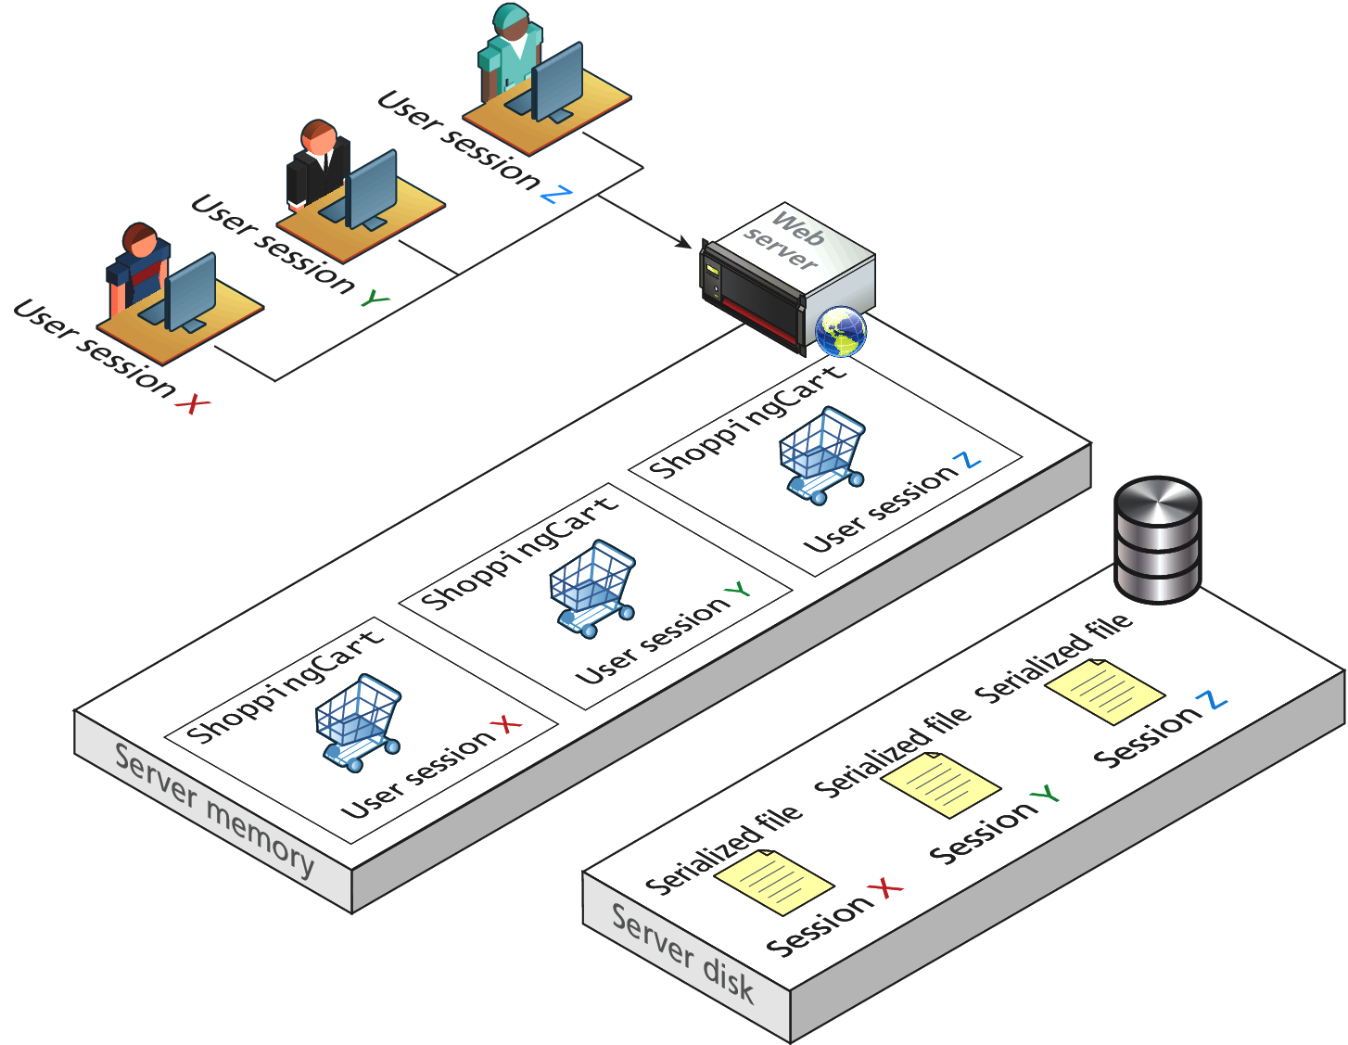
Figure 13.8 Session State

Slide 23
Session State
Listing 13.5 Accessing session state
<?php
//listing 13.5 Accessing session state
session_start();
if ( isset($_SESSION['user']) ) {
// User is logged in
}
else {
// No one is logged in (guest)
}
?>

Slide 24
Session State
Listing 13.6 Checking session existence
<?php
//listing 13.6 Checking session existence
include_once("ShoppingCart.class.php"); //file not provided.
session_start();
// always check for existence of session object before accessing it
if ( !isset($_SESSION["Cart"]) ) {
//session variables can be strings, arrays, or objects, but
// smaller is better
$_SESSION["Cart"] = new ShoppingCart();
}
$cart = $_SESSION["Cart"];
?>

Slide 25
How Does Session State Work?
HTTP is stateless
Some type of user/session identification system is needed
In PHP, see Figure 13-9 Session ID:
A session cookies
Server ⬄ a unique 32-byte string ⬄ User
Listing 13.7 Configuration in php.ini to use a shared location for sessions
;listing 13.7 Configuration in php.ini to use a shared location for sessions
[Session]
; Handler used to store/retrieve data.
session.save_handler = memcache
session.save_path = "tcp://sessionServer:11211"

Slide 26
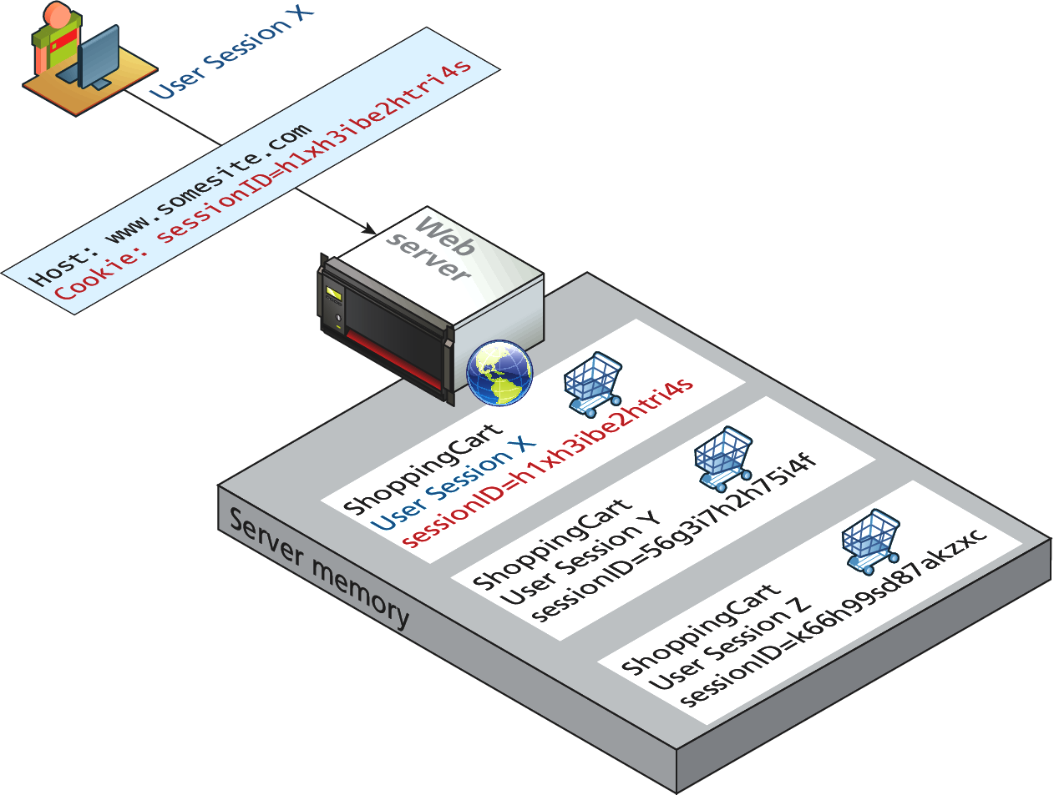
How Does Session State Work?
Figure 13.9 Session ID

Slide 27
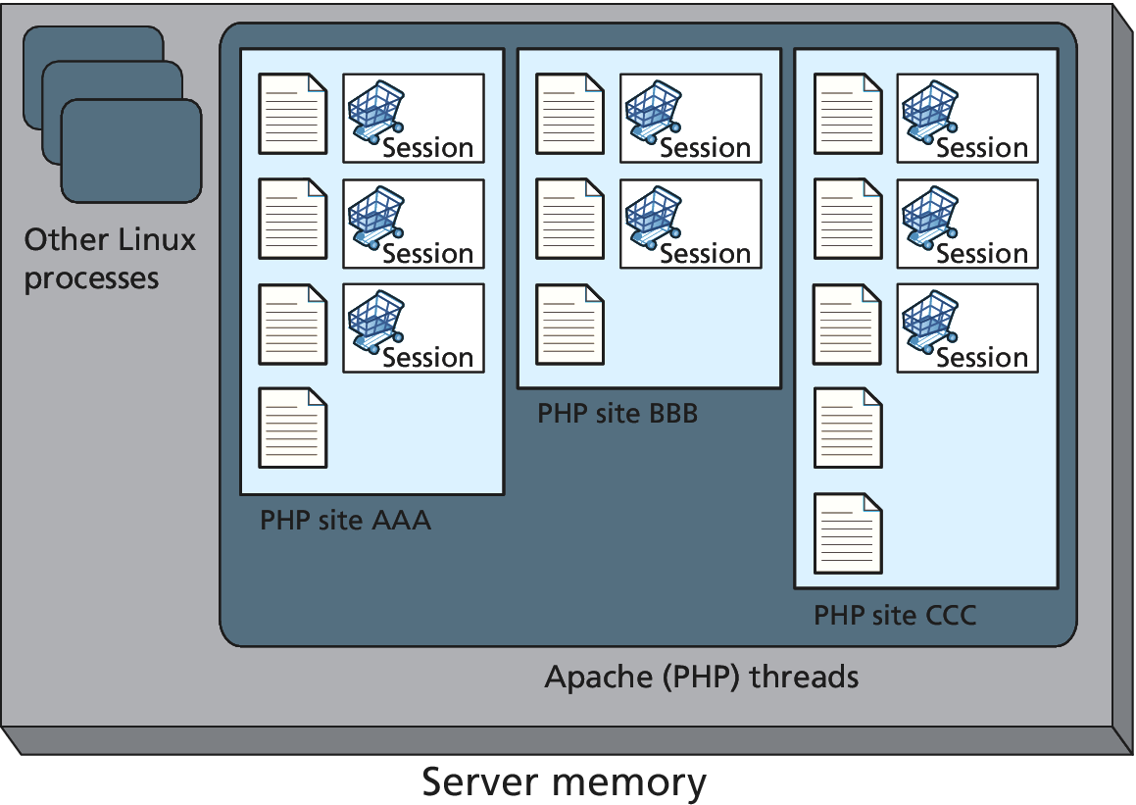
Session Storage and Configuration
Figure 13.10 Applications and server memory
Store session info, pages being executed, and caching info

Slide 28
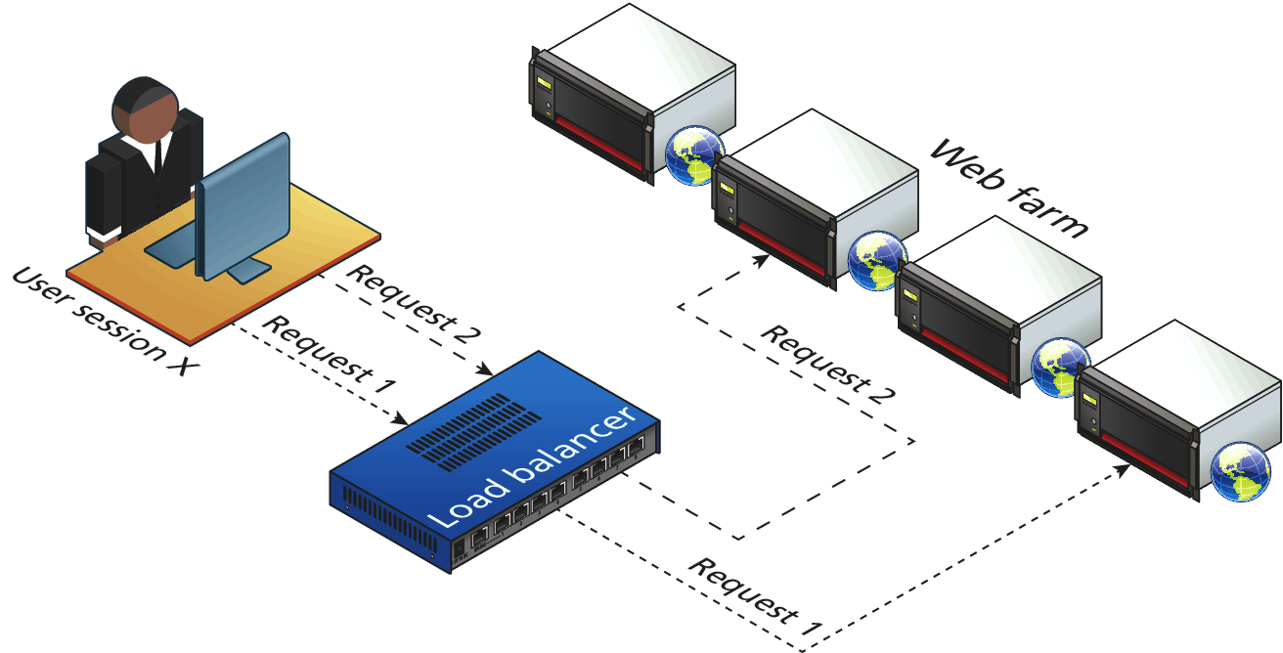
Session Storage and Configuration
Figure 13.11 Web Farm

Slide 29
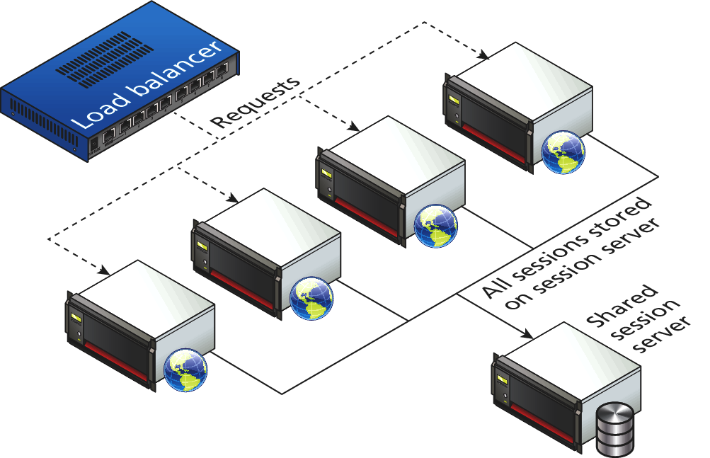
Session Storage and Configuration
Figure 13.12 Shared session provider

Slide 30
HTML5 Web Storage
Web storage – a new JavaScript-only API introduced in HTML5; managed by the browser
It is meant to be a replacement (supplement) to cookies
W3C recommends a limit of 5MB, but browsers are allowed to store more per domain.
Should not be used for mission-critical application functions
Using asynchronous communications via JavaScript to push the info to the server
Two types of global web storage objects (key-value collections):
localStorage
sessionStorage

Slide 31
Listing 13.8 Writing web storage
<form ... >
<h1>Web Storage Writer</h1>
<script language="javascript" type="text/javascript">
if (typeof (localStorage) === "undefined" || typeof (sessionStorage) === "undefined") {
alert("Web Storage is not supported on this browser...");
}
else {
sessionStorage.setItem("TodaysDate", new Date());
sessionStorage.FavoriteArtist = "Matisse";
localStorage.UserName = "Ricardo";
document.write("web storage modified");
}
</script>
<p><a href="Listing13.09.html">Go to web storage reader</a></p>
</form>

Slide 32
Listing 13.9 Reading web storage
<form id="form1" runat="server">
<h1>Web Storage Reader</h1>
<script language="javascript" type="text/javascript">
if (typeof (localStorage) === "undefined" ||
typeof (sessionStorage) === "undefined") {
alert("Web Storage is not supported on this browser...");
}
else {
var today = sessionStorage.getItem("TodaysDate");
var artist = sessionStorage.FavoriteArtist;
var user = localStorage.UserName;
document.write("date saved=" + today);
document.write("<br/>favorite artist=" + artist);
document.write("<br/>user name = " + user);
}
</script> </form>

Slide 33
Why Would We Use Web Storage
Cookies Disadvantages
Limit in size (4 k)
Being send in every single request-response to/from a given domain
Potentially disabled by the user
Vulnerable to XSS (Cross-Site Scripting) attack
Web Storage with JavaScript API
Local cache for relatively static items available to JavaScript
One practical use: store XML or JASON from a web service to reduce server load for subsequent requests by the session

Slide 34
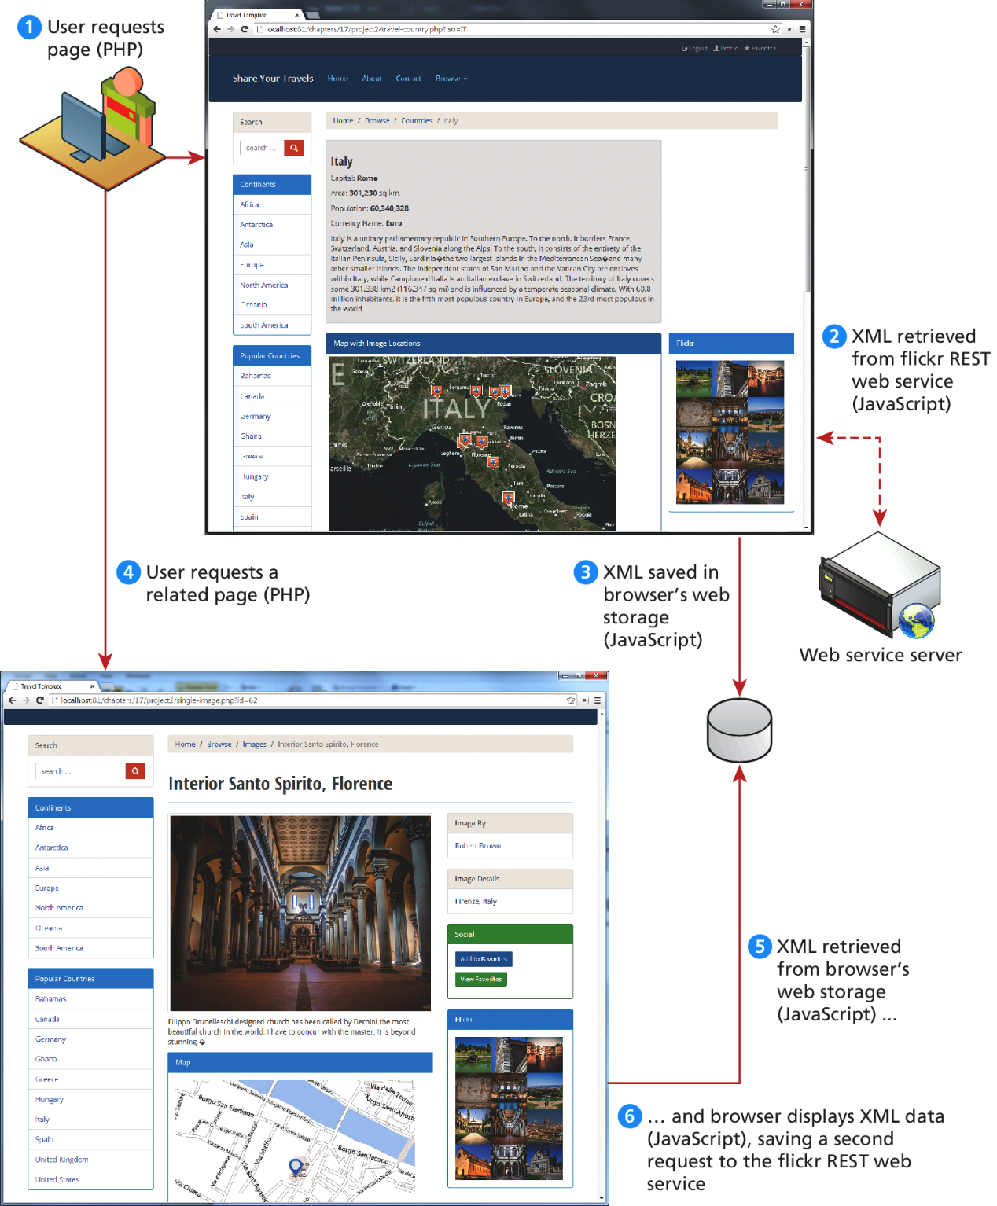
Figure 13.13 Using web storage

Slide 35
Caching
Using local storage
A vital way to improve the performance of web applications
HTTP protocol headers related to caching operations:
Expires
Cache-Control
Last-Modified
Two strategies to caching web applications
Page output caching
Application data caching

Slide 36
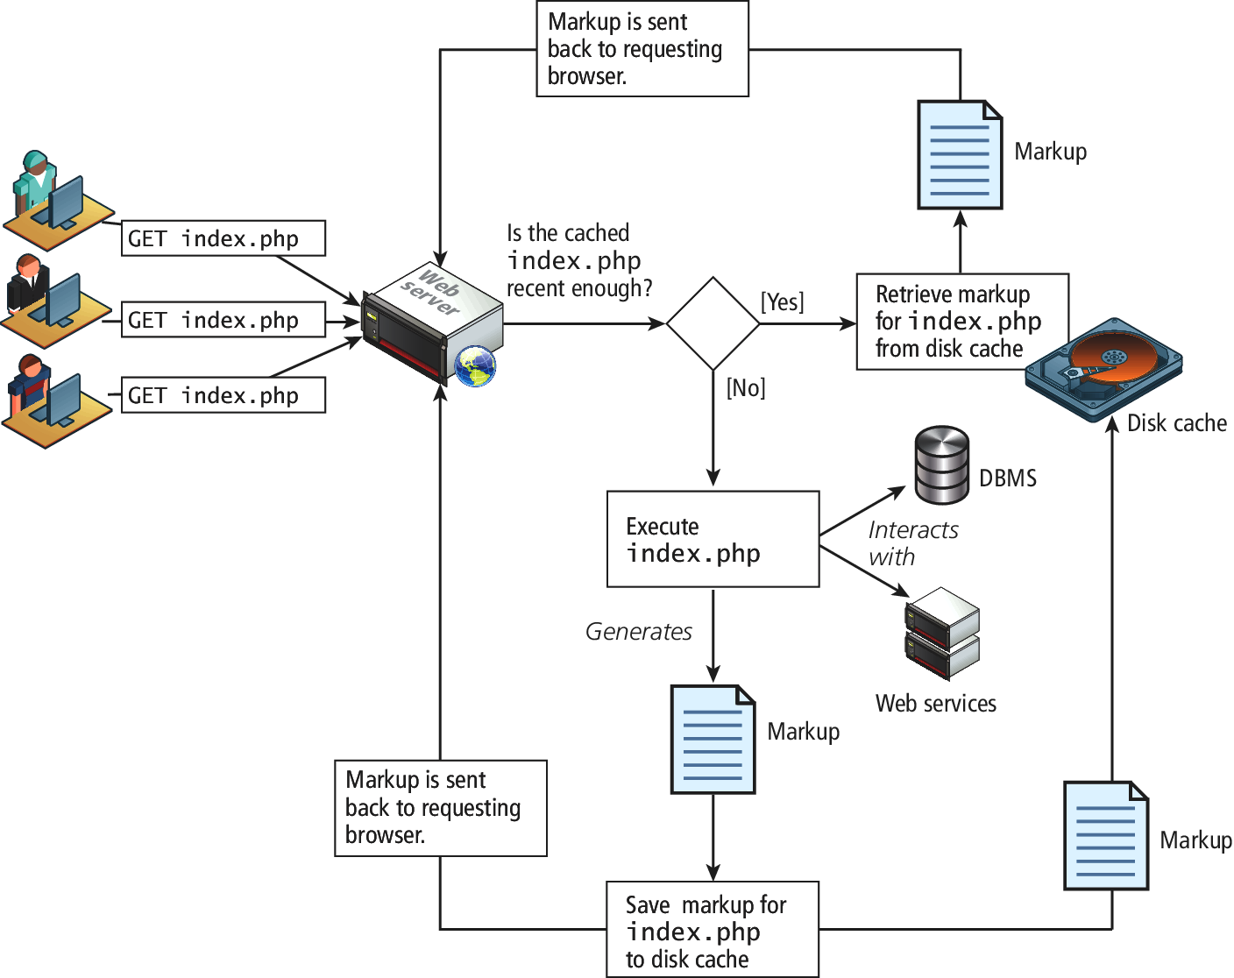
Fig 13.14 Page output caching

Slide 37
Listing 13.10 Using memcache for Application data caching
<?php
//listing 13.10 Using memcache
// create connection to memory cache
$memcache = new Memcache;
$memcache->connect('localhost', 11211)
or die ("Could not connect to memcache server");
$cacheKey = 'topCountries';
/* If cached data exists retrieve it, otherwise generate and cache
it for next time */

Slide 38
Listing 13.10 Using memcache for Application data caching
$countries = $memcache->get($cacheKey);
if ( ! isset($countries) ) {
// since every page displays list of top countries as links
// we will cache the collection
// first get collection from database
$cgate = new CountryTableGateway($dbAdapter);
$countries = $cgate->getMostPopular();
// now store data in the cache (data will expire in 240 seconds)
$memcache->set($cacheKey, $countries, false, 240)
or die ("Failed to save cache data at the server");
}
// now use the country collection
displayCountryList($countries);
?>

Slide 39
Summary and Conclusion
Q/A ?

