Slide 1
CPET 499/ITC 250 Web Systems
Chapter 14
Web Application Design
Text Book:
* Fundamentals of Web Development, 2015, by Randy Connolly and Ricardo Hoar, published by Pearson
Paul I-Hai Lin, Professor of Electrical and Computer Engr. Tech
http://www.etcs.ipfw.edu/~lin

Slide 2
Topics
About software design principles specific to web applications
How design patterns provide modular solutions to common problems
Key web application design patterns

Slide 3
Topics
14.1 Real-World Web Software Design
Challenges in Designing Web Applications
14.2 Principle of Layering
Data layer, Application Layer, and Presentation layer
Common Layer Schemes
14.3 Software Design Patterns in the Web Context
Adapter Pattern, Simple Factory Pattern, Template Method Pattern
14.4 Data and Domain Patterns
Table Data Gateway Pattern, Domain Model Pattern, Active Record Pattern
14.5 Presentation Patterns
Model-View-Controller (MVC) Pattern, Front Controller Pattern

Slide 4
14.1 Real-World Web Software Design
Software Requirements, Software Requirement Specifications, Software Design
IEEE Recommended Practice for Software Requirements, 2010, http://www.cse.msu.edu/~cse870/IEEEXplore-SRS-template.pdf
IEEE Draft Standard for Software Design Descriptions, 2005, http://www.san.uri.br/~pbetencourt/engsoftII/IEEE-P1016-d50.PDF
Software Design Document (SSD) template (summarized from STD 1016), http://www.zeynepaltan.info/SDD-Template.pdf

Slide 5
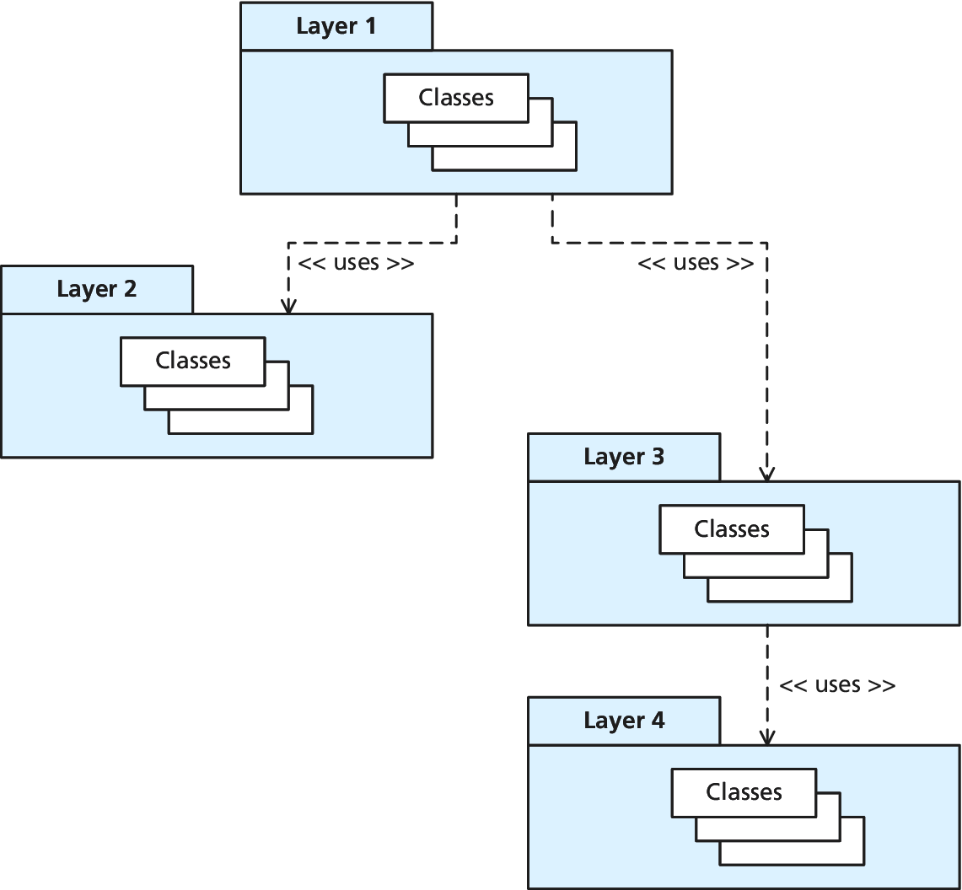
Visualizing Layers
UML - uses Relationship, Dependency

Slide 6
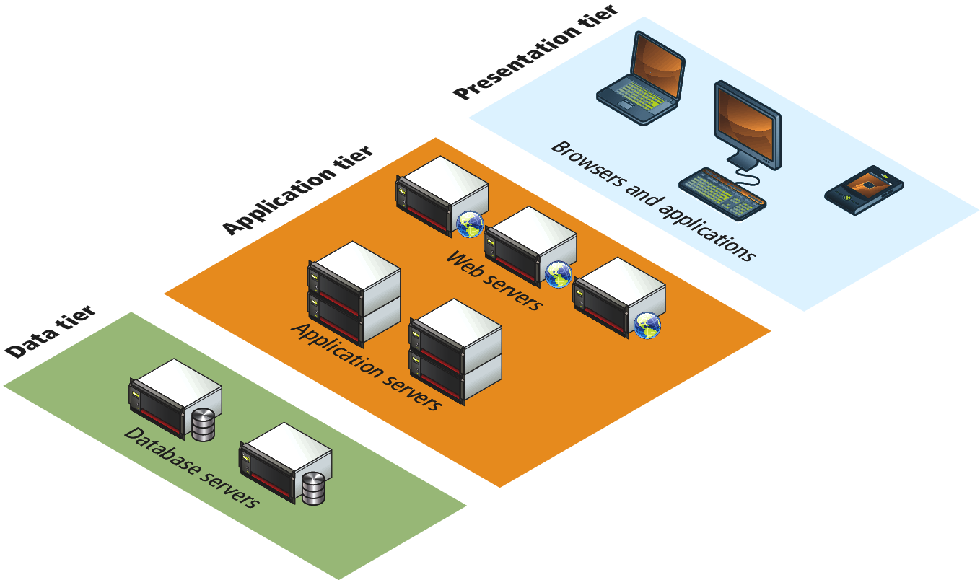
Visualizing Tiers

Slide 7
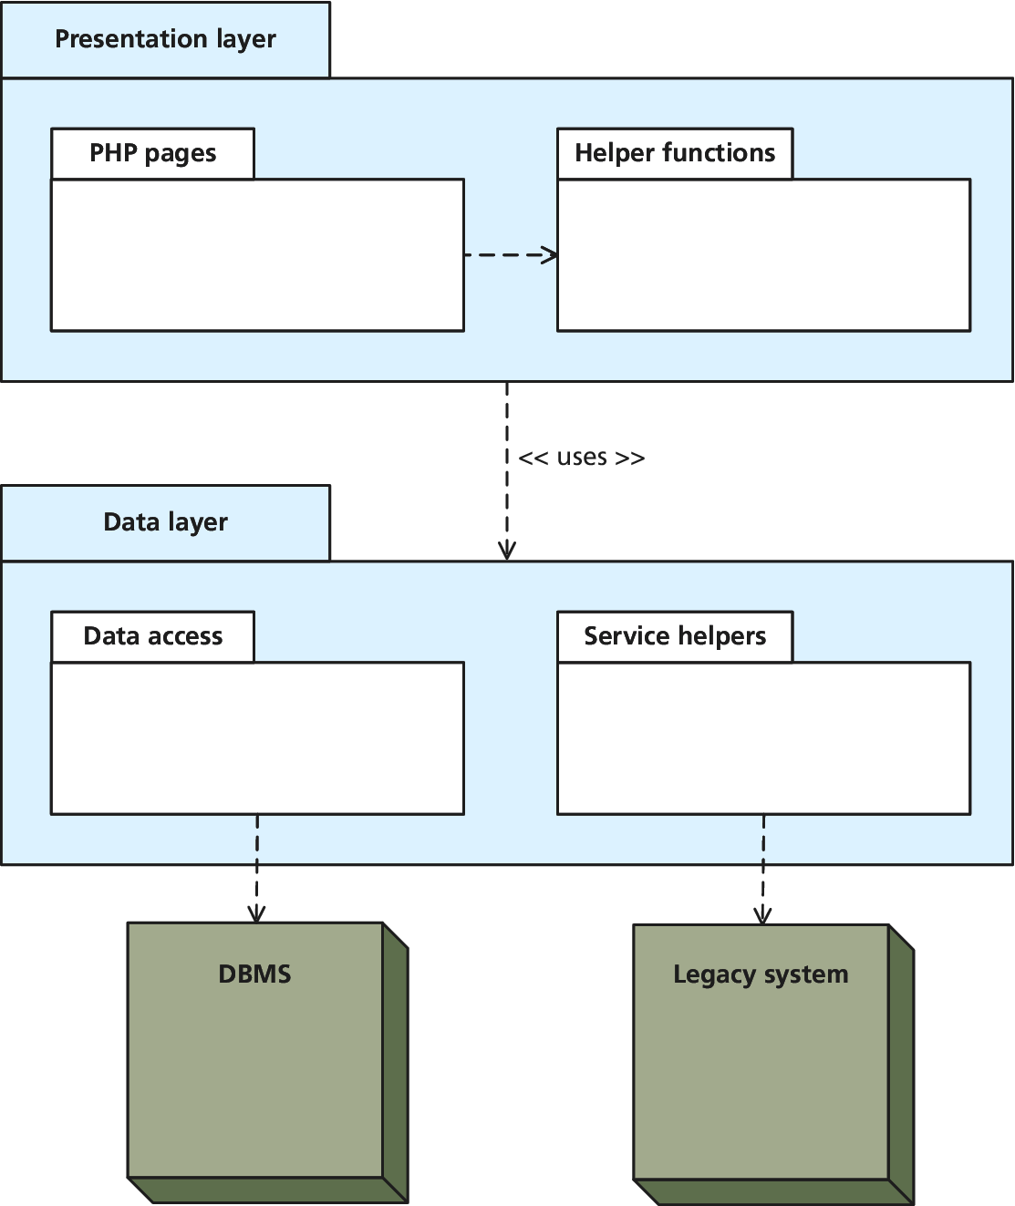
Two-Layer Model

Slide 8
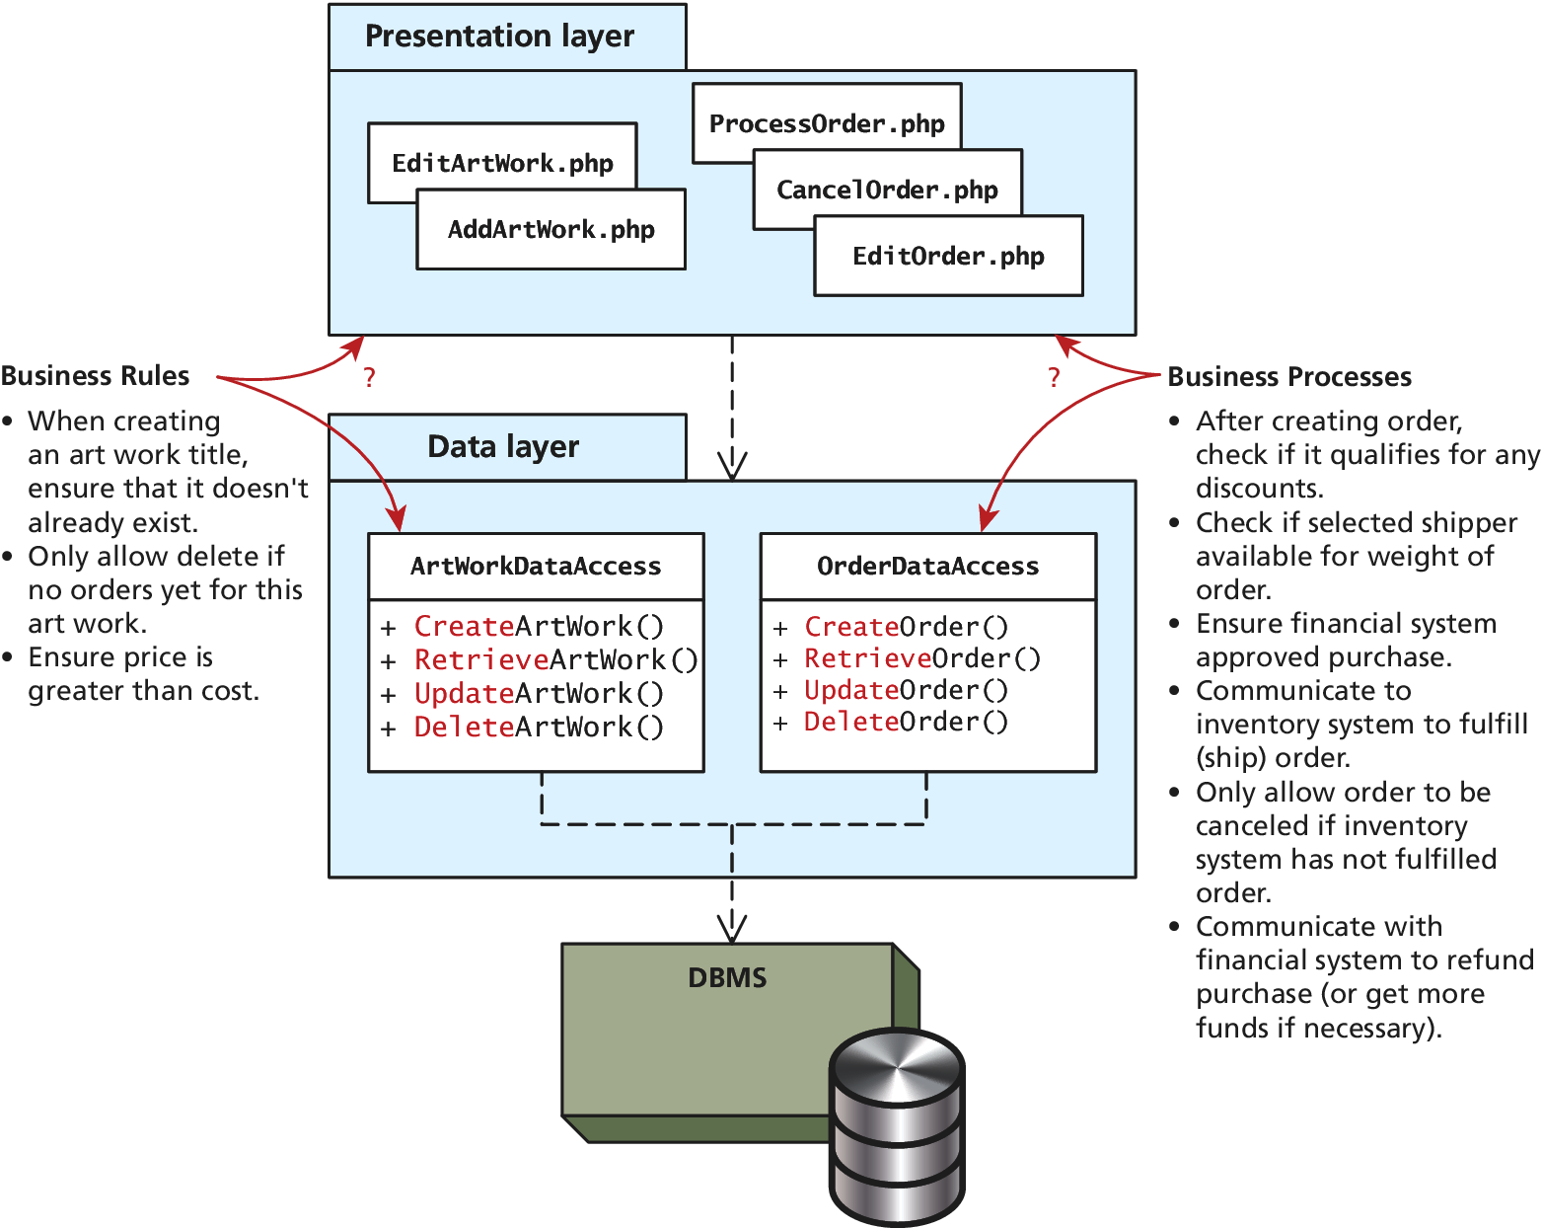
Business Rules and Processes

Slide 9
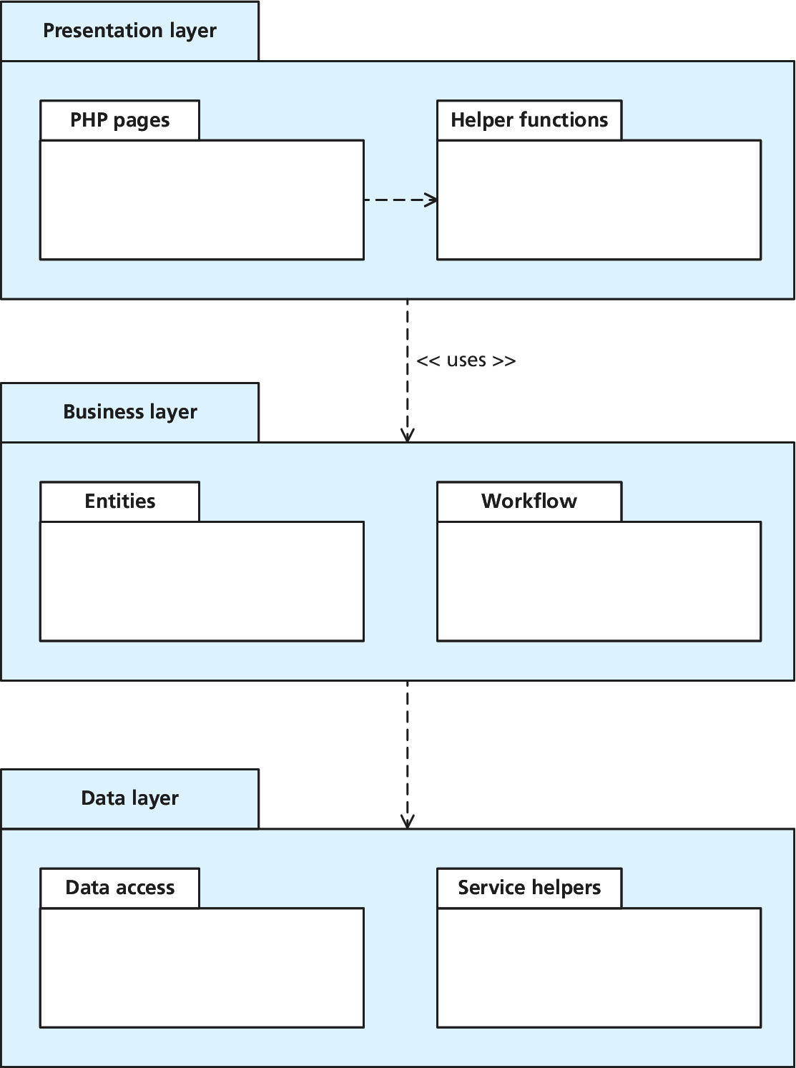
Three-Layer Model

Slide 10
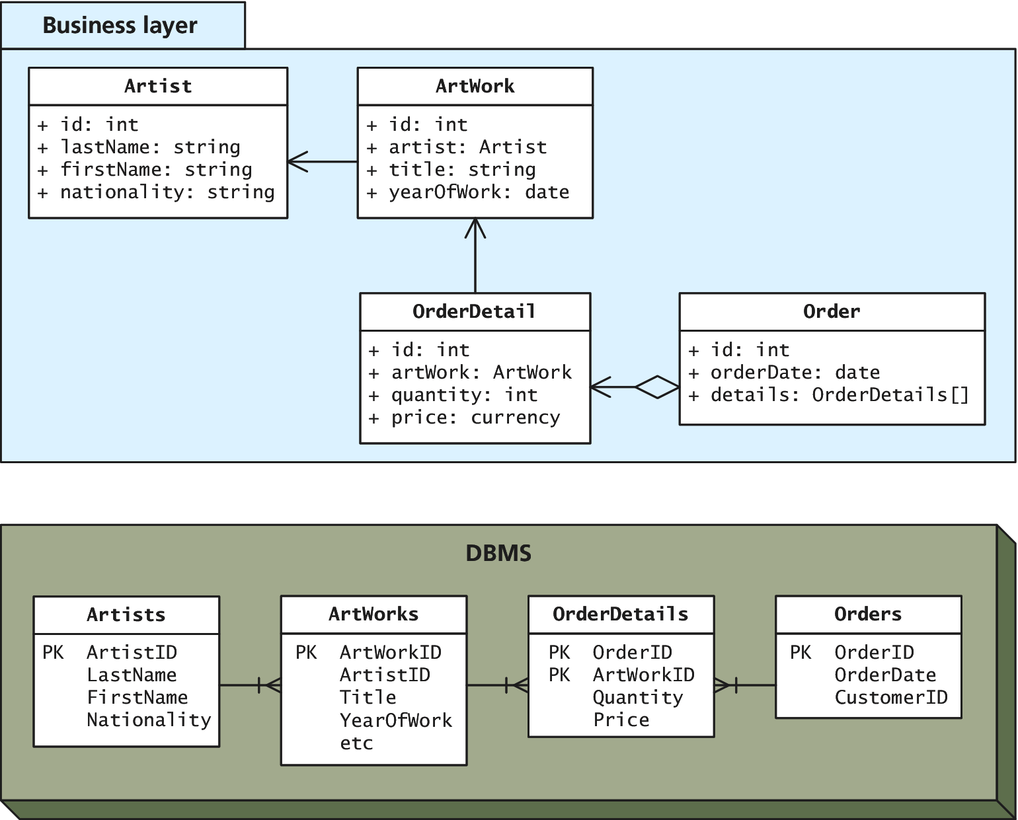
Simple Mapping of Tables to Domain Objects

Slide 11
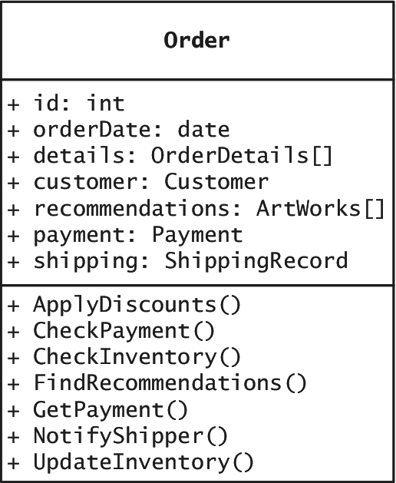
Complex Domain Objects

Slide 12
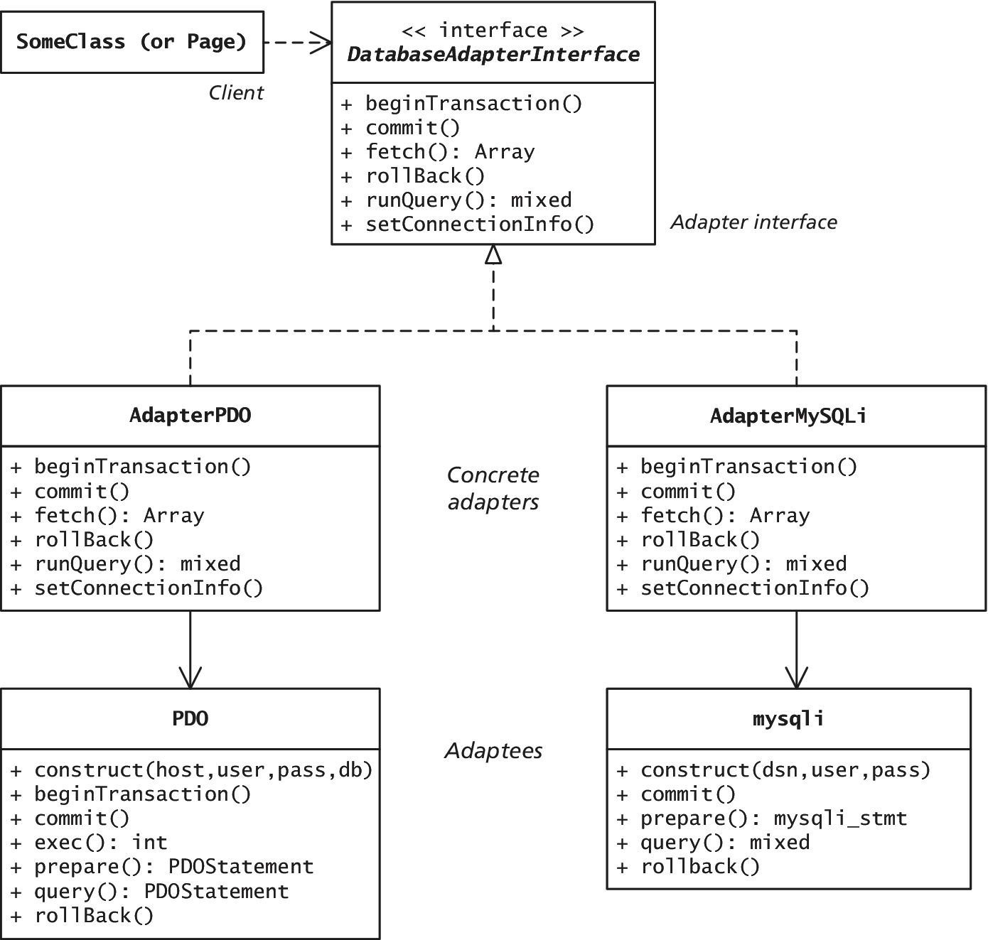
A Database API Adapter

Slide 13
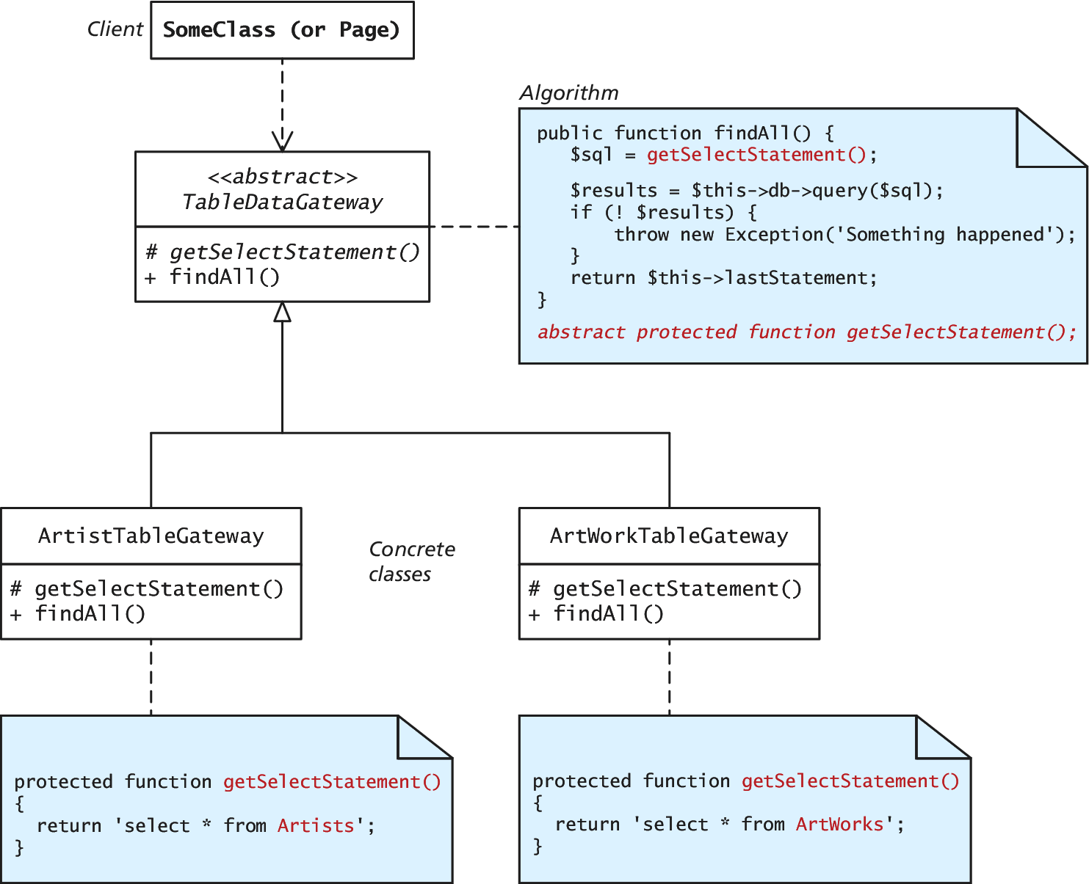
Template Method Pattern

Slide 14
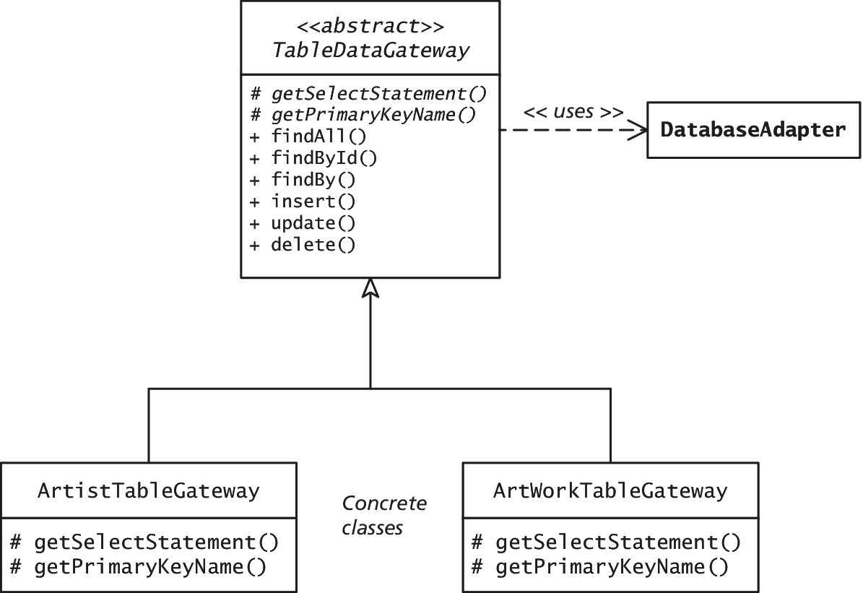
Table Data Gateway Pattern

Slide 15
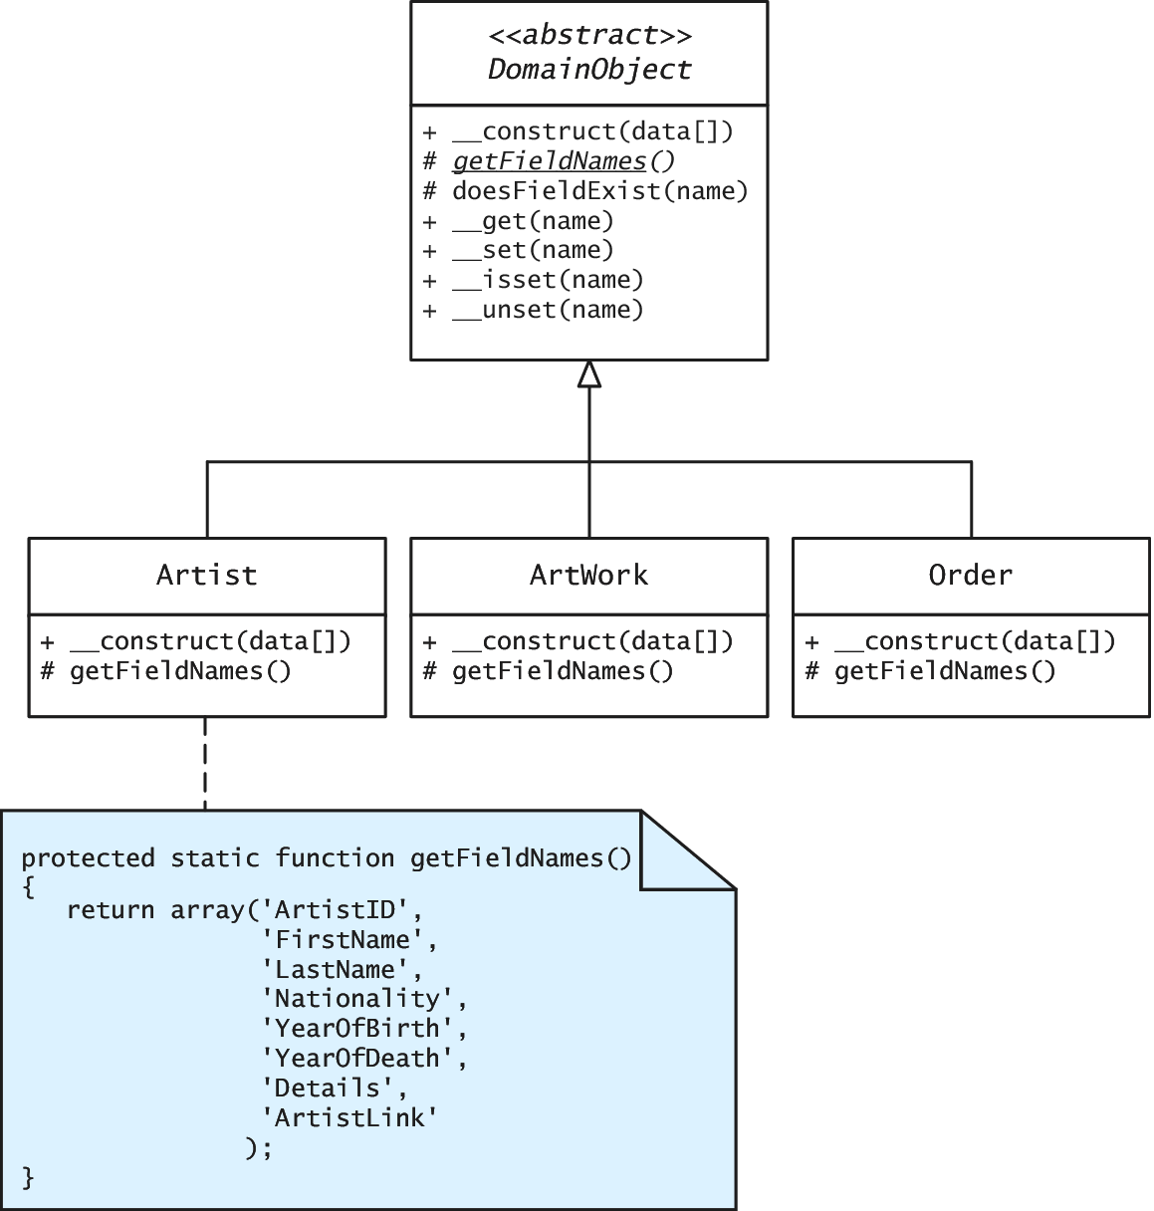
Example Domain Model

Slide 16
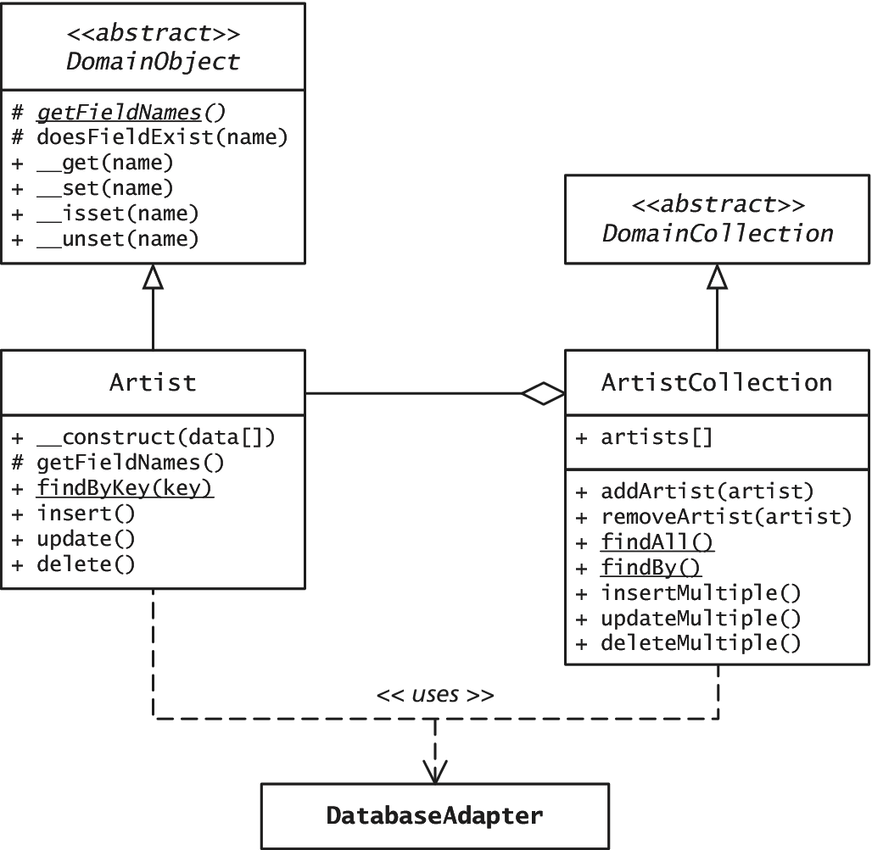
Active Record version of the Artist and ArtistCollection Classes

Slide 17
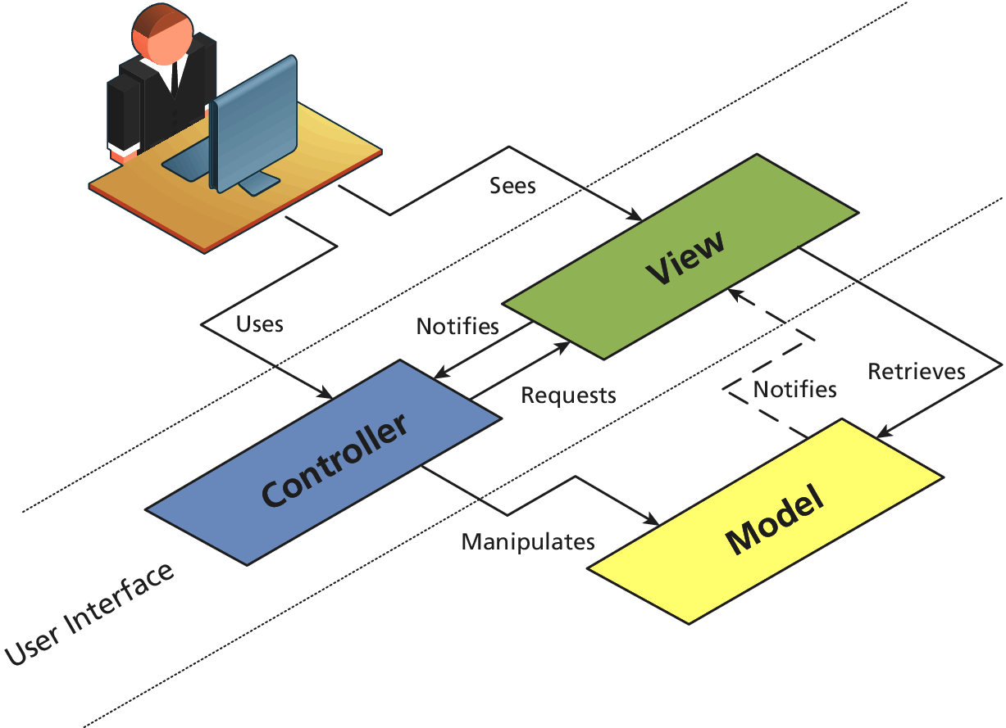
Classic Model-View Control (MVC) Pattern

Slide 18
Classic Model-View Control (MVC) Pattern

Slide 19
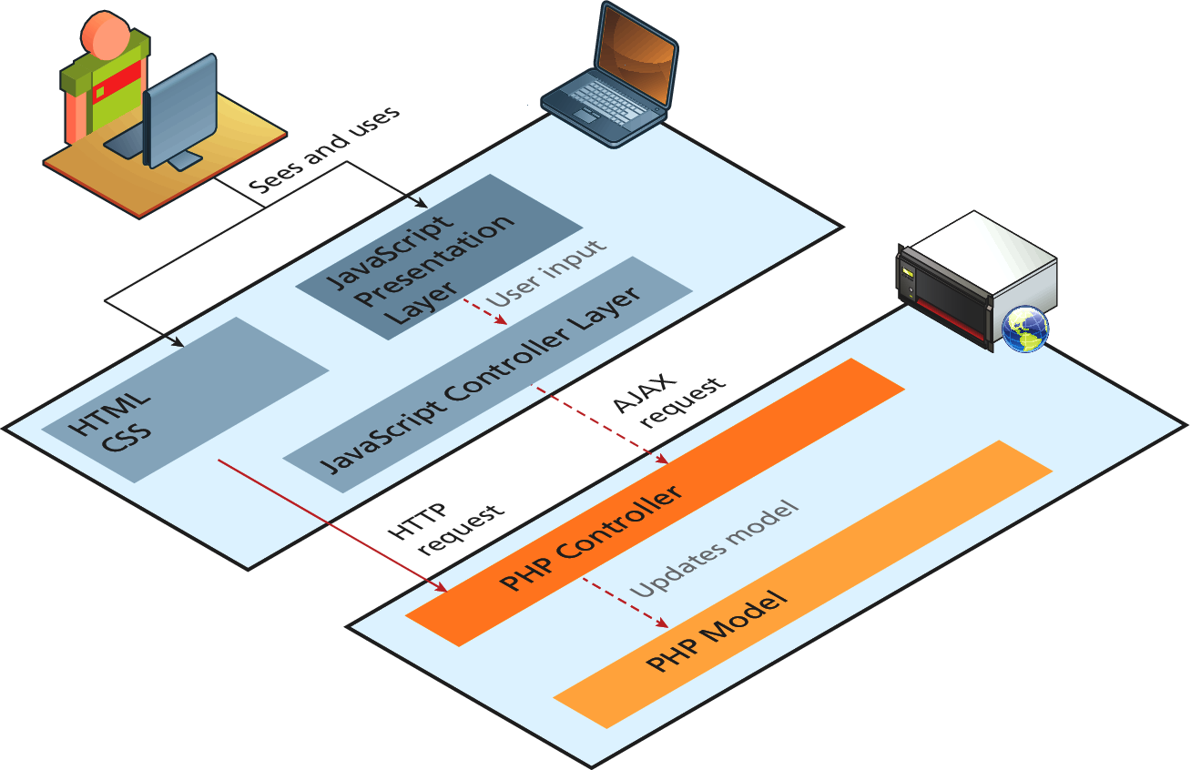
MVC Split Between the Client and the Server

Slide 20
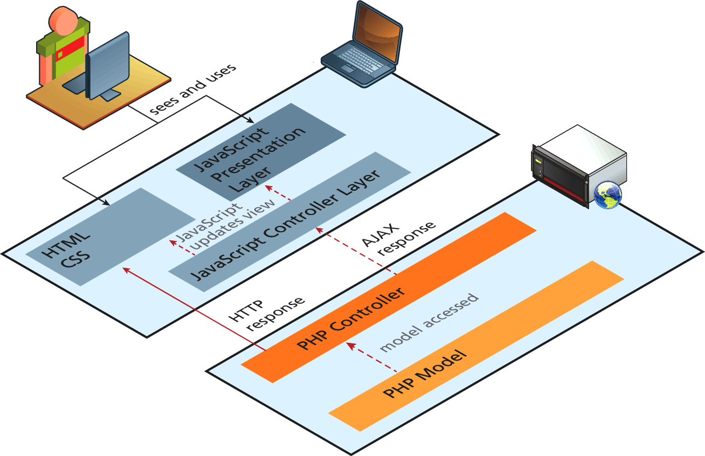
Response in the MVC Between Client and Server

Slide 21
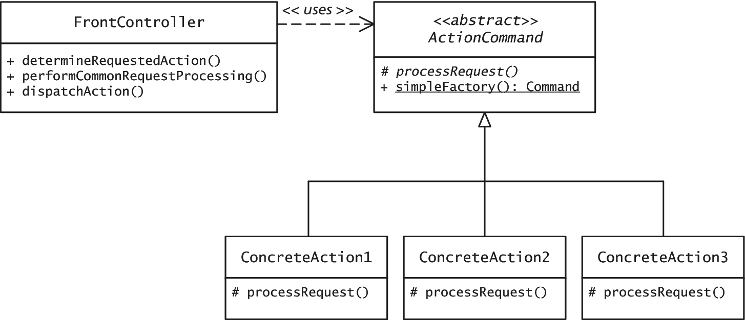
Front Controller Pattern

Slide 22
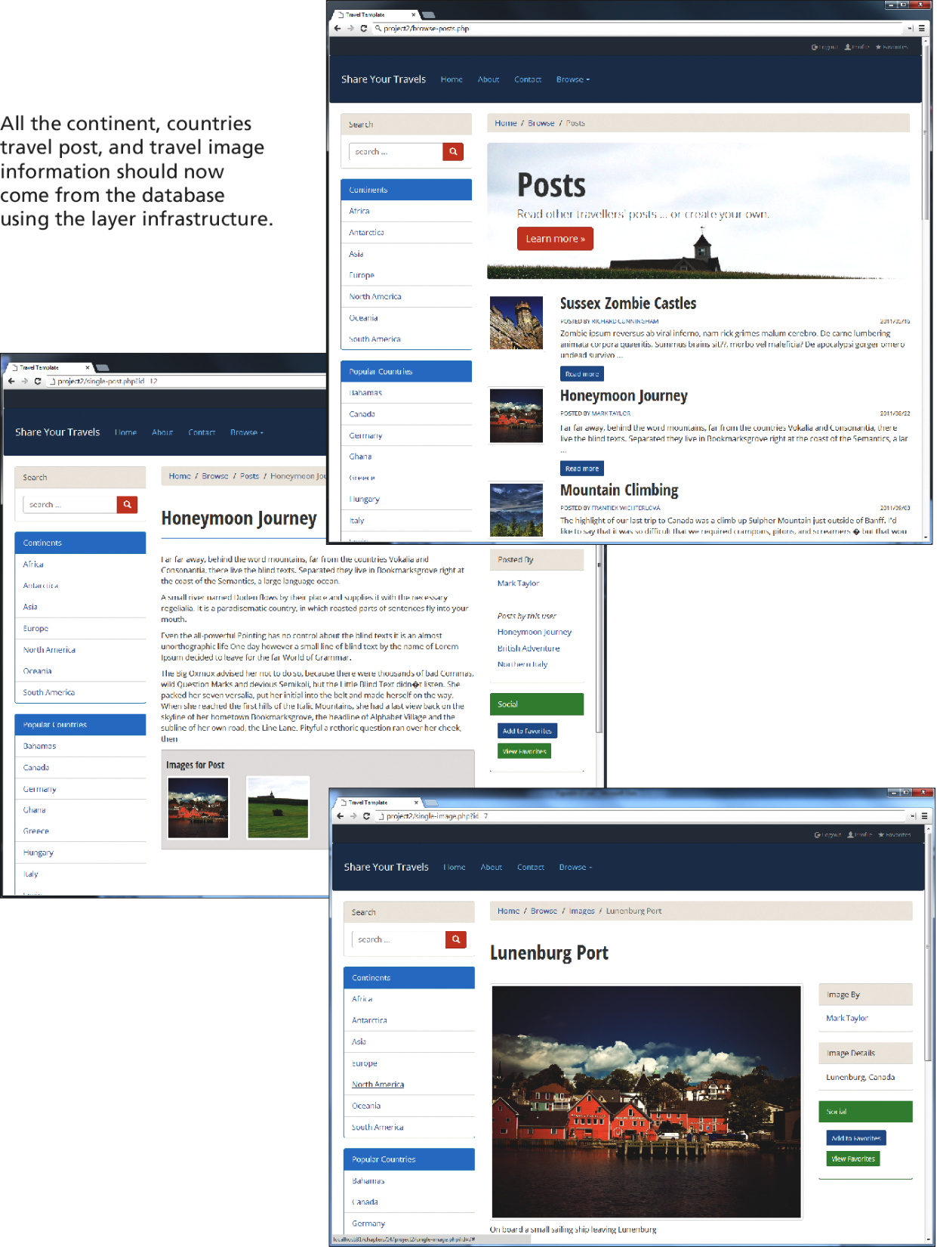
Completed Project 2

Slide 23
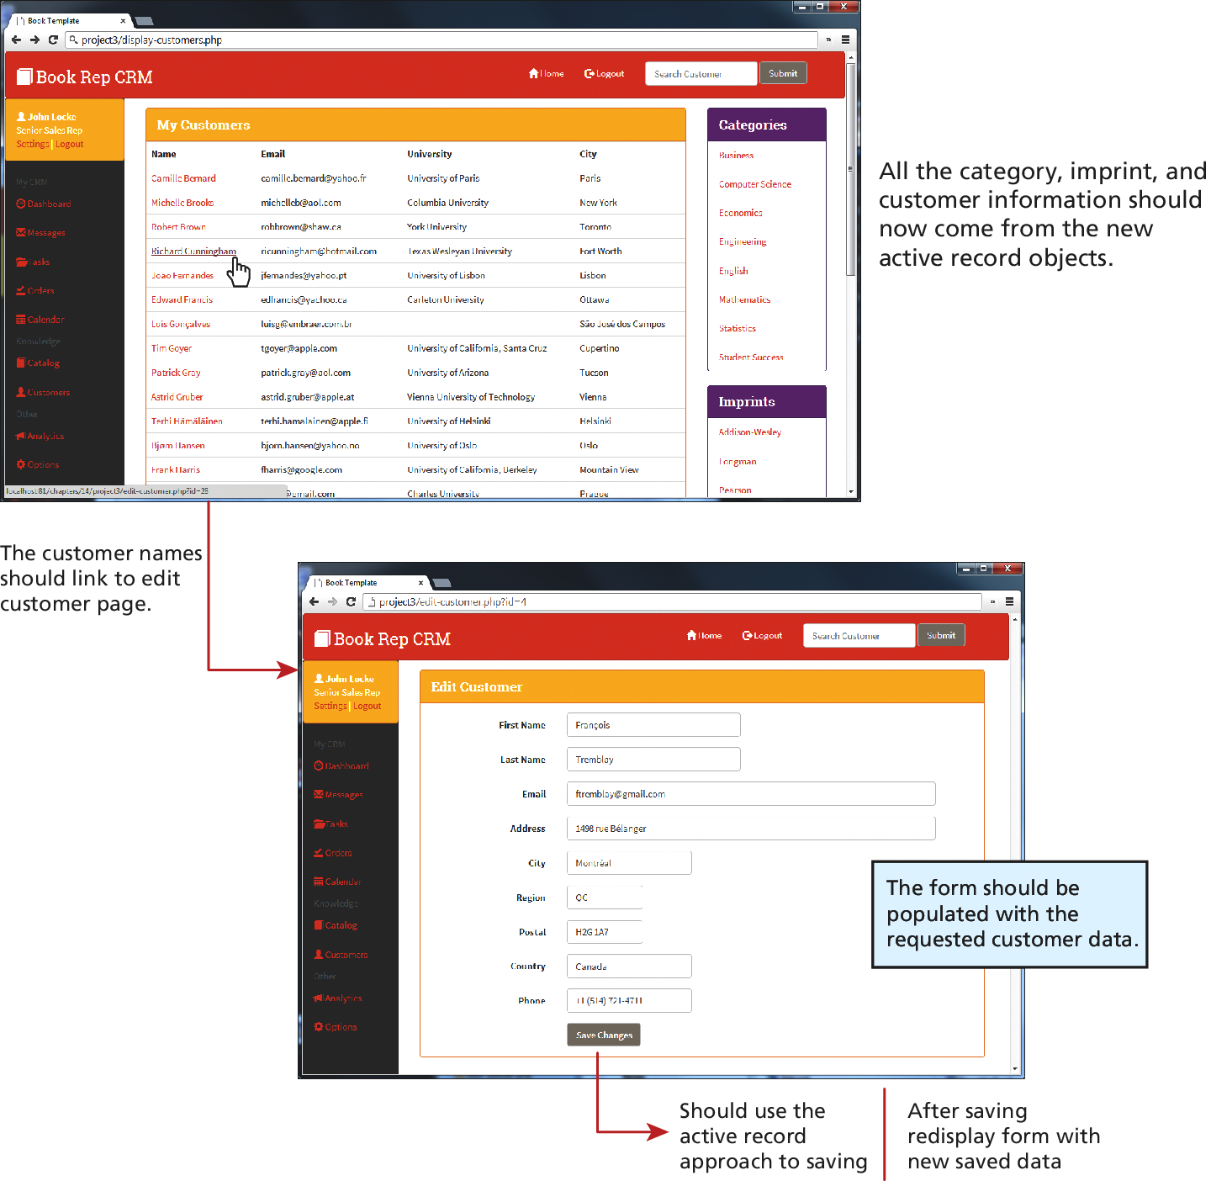
Completed Project 3

Slide 24
Summary and Conclusion
Q/A ?

