Slide 1
CPET 499/ITC 250 Web Systems
Introduction to Cascading Style Sheet (CSS)
Text Book:
* Chapter 3: Cascading Style Sheet, Fundamentals of Web Development, 2015, by Randy Connolly and Ricardo Hoar, published by Pearson
*E-Book on Building Web Applications with HTML, 2012, by Paul I. Lin, http://www.etcs.ipfw.edu/~lin/CECourses/2_HTML/CE_02WebHhtmlindex.html
* Cascading Style Sheet: An Introduction, http://www.etcs.ipfw.edu/~lin/CECourses/2_HTML/Lectures/8CCStyle.html
Paul I-Hai Lin, Professor
http://www.etcs.ipfw.edu/~lin

Slide 2
Topics
What is CSS?
CSS Syntax
Location of Styles
Selectors
The Cascade: How Styles Interact
The Box Model
CSS Text Styling
Summary

Slide 3
What is CSS?
Cascading style sheets (CSS) specification, developed by World Wide Web Consortium (W3C), provides a simple approach for separating the style (font, size, background, layout and position, etc) of document from the content.
Predefined style sheets can be used throughout a page or Web site.
Allowing multiple style sheets to affect one document
It is possible that conflicts can come up and the style referenced last generally takes precedence
What is CSS, http://www.w3.org/Style/CSS/Overview.en.html

Slide 4
What is CSS?
HTML & CSS, http://www.w3.org/standards/webdesign/htmlcss:
HTML (the Hypertext Markup Language) and CSS (Cascading Style Sheets) are two of the core technologies for building Web pages. HTML provides the structure of the page, CSS the (visual and aural) layout, for a variety of devices. Along with graphics and scripting, HTML and CSS are the basis of building Web pages and Web Applications.

Slide 5
What is CSS?
HTML & CSS, http://www.w3.org/standards/webdesign/htmlcss:
CSS is the language for describing the presentation of Web pages, including colors, layout, and fonts. It allows one to adapt the presentation to different types of devices, such as large screens, small screens, or printers.
CSS is independent of HTML and can be used with any XML-based markup language. The separation of HTML from CSS makes it easier to maintain sites, share style sheets across pages, and tailor pages to different environments. This is referred to as the separation of structure (or content) from presentation.

Slide 6
What is CSS?
The web standards model – HTML, CSS, and JavaScript, http://www.w3.org/wiki/The_web_standards_model_-_HTML_CSS_and_JavaScript : Most compelling reasons for using CSS and HTML (Advantages)
Efficient of code
Ease of maintenance
Accessibility
Device compatibility
Web crawlers/search engine

Slide 7
What is CSS?
Cascading Style Sheets – Homepage, http://www.w3.org/Style/CSS/Overview.en.html
CSS Current Status, http://www.w3.org/standards/techs/css#w3c_all
Standards
CSS 2.1, June 2011, http://www.w3.org/TR/CSS2/
CSS Selectors, Namespaces, Media Queries, CSS Color
Drafts: Candidate Recommendations
Intro to CSS 3, May 2001, http://www.w3.org/TR/2001/WD-css3-roadmap-20010523/
CSS Validation Service, http://www.css-validator.org/

Slide 8
Three Types of Style Sheets
Author Created Style Sheet
User-defined Sheet
Default Browser Style Sheet

Slide 9
CSS Syntax
A CSS document consists of one or more style rules.
A rule consists of a selector that identifies the HTML element or elements that will be affected, followed by a series of property:value pairs (each pair is also called a declaration).
CSS Selectors, http://www.w3.org/TR/CSS21/selector.html%23id-selectors

Slide 10
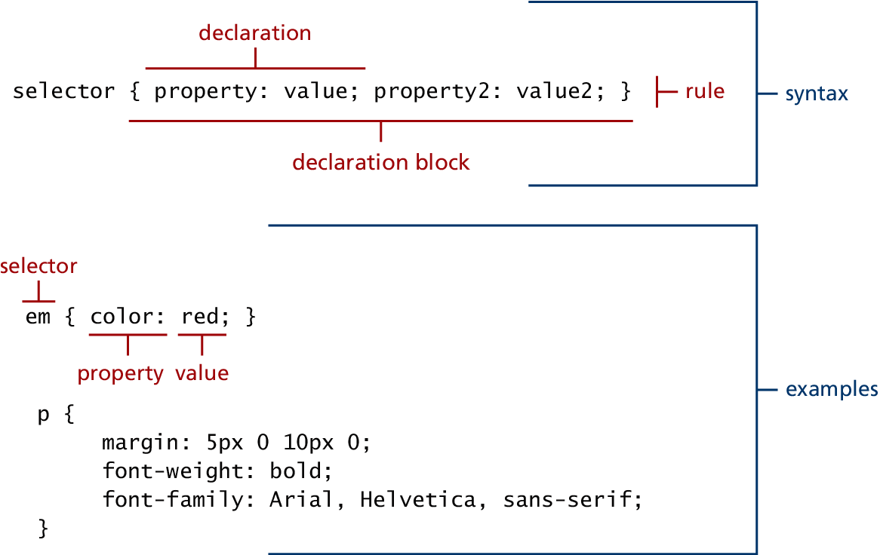
Figure 2.2 CSS Syntax

Slide 11
Location of CSS Style Sheet
Inline Styles (Listing3.1.html)
Embedded Style Sheet (Listing3.2.html)
External Style Sheet (Listing3.3.html)

Slide 12
In-Line Style Sheet
A style applied to a particular tag on a Web page
For formatting individual elements
Inline Styles (Listing3.1.html)
<h1>Share Your Travels</h1>
<h2 style="font-size: 24pt">Description</h2>
...
<h2 style="font-size: 24pt; font-weight: bold;">Reviews</h2>

Slide 13
In-Line Style Sheet Example
Inlinecss.html, http://www.etcs.ipfw.edu/~lin/CECourses/2_HTML/08CCSExs/inlinecss.html
<html>
<!-- inlinecss.html -->
<head><title>Inline Styles Example</title></head>
<body>
<!-- Declare inline Styles -->
<span style="font-weight: bold">
Web Programming Language: HTML.
</span><br>
<p style = "font-size: 20pt">Web Programming Language: HTML.</p>
<p style = "font-size: 20pt; color: #FF0000">
Web Programming Language: JavaScript
</p>
<p>Web Programming Language: Perl.</p>
</body>
</html>

Slide 14
Embedded Style Sheet
Embedded as part of the HTML document
Defined with <style> declaration block
Can be kept in a file outside the document
An Example
<style>
h1 {font-size: 24pt; font-weight: bold; color: red}
h2 {font-size: 16pt; font-style: italic; color: green}
span {font-weight: bold; font-style: italic}
</style>
After the declaration, we will be able to use <h1> </h1>, <h2> </h2>, and <span> </span> as new style definitions

Slide 15
Embedded Style Sheet: Listing3.2.html
<head lang="en">
<meta charset="utf-8">
<title>Share Your Travels -- New York - Central Park</title>
<style>
h1 { font-size: 24pt; }
h2 {
font-size: 18 pt;
font-weight: bold;
}
</style>
</head>
<body>
<h1>Share Your Travels</h1>
<h2>New York - Central Park</h2>
...

Slide 16
External CSS Style Sheet
Used for control styles across several pages or across an entire Web site
Require a style definition file that contains style definitions such as the three lines as shown below and save it as "style.css". Note that the <style> </style> tags are not included in the "style.css"
h1 {font-size: 24pt; font-weight: bold; color: red}
h2 {font-size: 16pt; font-style: italic; color: green}
span {font-weight: bold; font-style: italic}

Slide 17
External CSS Style Sheet
Then, we place the following line within <head> tags to refer to this file.
Link element, href – hypertext reference, rel - relationship
<head>
<title> TEST LINKED STYLE SHEETS </title>
<link href="styles.css" rel=“stylesheet" type="text/css">
</head>
An Example, http://www.etcs.ipfw.edu/~lin/CECourses/2_HTML/08CCSExs/linkcss.html

Slide 18
An Example, http://www.etcs.ipfw.edu/~lin/CECourses/2_HTML/08CCSExs/linkcss.html
<html>
<!-- linkcss.html -->
<head>
<title>Link Style Sheets</title>
<link href="styles.css" rel="stylesheet" type="text/css">
</head>
<body>
<span>Web Programming Applications.</span>
<h1>Web Programming Applications.</h1>
<h2>Web Programming Applications.</h2>
<h2 STYLE="font-size: 36pt">Web Programming Applications.</h2>
</body>
</html>

Slide 19
External Style Sheet
External Style Sheet (Listing3.3.html)
<head lang="en">
<meta charset="utf-8">
<title>Share Your Travels -- New York - Central Park</title>
<link rel="stylesheet" href="styles.css" />
</head>

Slide 20
CSS Selectors
For selecting individual or multiple HTML documents
Selector Types
Element Selectors
Class Selectors – for targeting different elements at once
ID Selectors – for specific elements
Attribute Selectors – for styling hyperlinks and images
Pseudo-Element and Pseudo-Class Selectors – for link states indication (visited, hover, active)
Contextual Selectors – or combinators for selecting the elements based on their ancestors, descendants or sibling
References
Class Selectors, https://developer.mozilla.org/en-US/docs/Web/CSS/Class_selectors
5 Selectors, http://www.w3.org/TR/CSS21/selector.html%23id-selectors

Slide 21
Listing3.4.css – Sample grouped selector
/* commas allow you to group selectors */
p, div, aside {
margin: 0;
padding: 0;
}
/* the above single grouped selector is equivalent to the following: */
p {
margin: 0;
padding: 0;
}
div {
margin: 0;
padding: 0;
}
aside {
margin: 0;
padding: 0;
}

Slide 22
CSS Selectors
For selecting individual or multiple HTML documents
Selector Types
Element Selectors
Class Selectors – for targeting different elements at once
ID Selectors – for specific elements
Attribute Selectors – for styling hyperlinks and images
Pseudo-Element and Pseudo-Class Selectors – for link states indication (visited, hover, active)
Contextual Selectors – or combinators for selecting the elements based on their ancestors, descendants or sibling
References
Class Selectors, https://developer.mozilla.org/en-US/docs/Web/CSS/Class_selectors
5 Selectors, http://www.w3.org/TR/CSS21/selector.html%23id-selectors

Slide 23
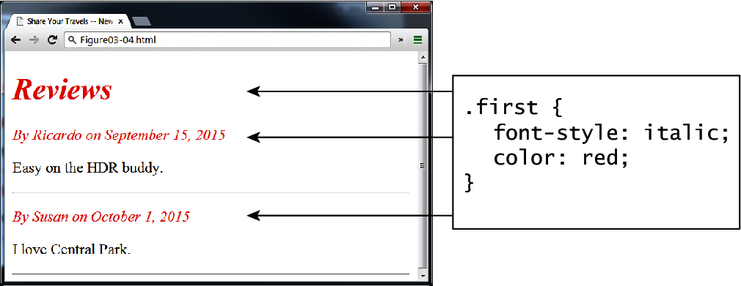
Figure 3.4 Class selector example in browser (Listing3.5.html)

Slide 24
Listing3.5.html: Class selector example
<head>
<title>Share Your Travels </title>
<style>
.first {
font-style: italic;
color: red;
}
</style>
</head>
<body>
<h1 class="first">Reviews</h1>
<div>
<p class="first">By Ricardo on <time>September 15, 2012</time></p>
<p>Easy on the HDR buddy.</p>
</div>
<hr/>
<div>
<p class="first">By Susan on <time>October 1, 2012</time></p>
<p>I love Central Park.</p>
</div> <hr/>
</body>

Slide 25
CSS Selectors
For selecting individual or multiple HTML documents
Selector Types
Element Selectors
Class Selectors – for targeting different elements at once
ID Selectors – for specific elements
Attribute Selectors – for styling hyperlinks and images
Pseudo-Element and Pseudo-Class Selectors – for link states indication (visited, hover, active)
Contextual Selectors – or combinators for selecting the elements based on their ancestors, descendants or sibling
References
Class Selectors, https://developer.mozilla.org/en-US/docs/Web/CSS/Class_selectors
5 Selectors, http://www.w3.org/TR/CSS21/selector.html%23id-selectors

Slide 26
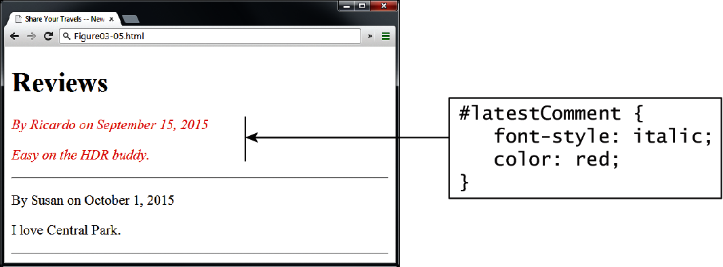
Figure 3.5 Id selector example in browser

Slide 27
<head lang="en">
<meta charset="utf-8">
<title>Share Your Travels -- New York - Central Park</title>
<style>
#latestComment {
font-style: italic;
color: red;
}
</style>
</head>
<body>
<h1>Reviews</h1>
<div id="latestComment">
<p>By Ricardo on <time>September 15, 2012</time></p>
<p>Easy on the HDR buddy.</p>
</div>
<hr/>
<div>
<p>By Susan on <time>October 1, 2012</time></p>
<p>I love Central Park.</p>
</div>
<hr/>
</body>
Listing3.6.html: ID selector example

Slide 28
CSS Selectors
For selecting individual or multiple HTML documents
Selector Types
Element Selectors
Class Selectors – for targeting different elements at once
ID Selectors – for specific elements
Attribute Selectors – for styling hyperlinks and images
Pseudo-Element and Pseudo-Class Selectors – for link states indication (visited, hover, active)
Contextual Selectors – or combinators for selecting the elements based on their ancestors, descendants or sibling
References
Class Selectors, https://developer.mozilla.org/en-US/docs/Web/CSS/Class_selectors
5 Selectors, http://www.w3.org/TR/CSS21/selector.html%23id-selectors

Slide 29
Figure 3.6 Attribute selector example in browser

Slide 30
Listing3.7.html: Attribute selector example
<head lang="en">
<meta charset="utf-8">
<title>Share Your Travels</title>
<style>
[title] {
cursor: help;
padding-bottom: 3px;
border-bottom: 2px dotted blue;
text-decoration: none;
}
</style>
</head>

Slide 31
Listing3.7.html: Attribute selector example
<body>
<div>
<img src="images/flags/CA.png" title="Canada Flag" />
<h2><a href="countries.php?id=CA" title="see posts from Canada">
Canada</a>
</h2>
<p>Canada is a North American country consisting of ... </p>
<div>
<img src="images/square/6114907897.jpg"
title="At top of Sulpher Mountain" />
<img src="images/square/6592317633.jpg"
title="Grace Presbyterian Church" />
<img src="images/square/6592914823.jpg"
title="Calgary Downtown" />
</div>
</div>
</body>

Slide 32
CSS Selectors
For selecting individual or multiple HTML documents
Selector Types
Element Selectors
Class Selectors – for targeting different elements at once
ID Selectors – for specific elements
Attribute Selectors – for styling hyperlinks and images
Pseudo-Element and Pseudo-Class Selectors – for link states indication (visited, hover, active)
Contextual Selectors – or combinators for selecting the elements based on their ancestors, descendants or sibling
References
Class Selectors, https://developer.mozilla.org/en-US/docs/Web/CSS/Class_selectors
5 Selectors, http://www.w3.org/TR/CSS21/selector.html%23id-selectors

Slide 33
<head>
<title>Share Your Travels</title>
<style>
a:link {
text-decoration: underline;
color: blue;
}
a:visited {
text-decoration: underline;
color: purple;
}
a:hover {
text-decoration: none;
font-weight: bold;
}
a:active {
background-color: yellow;
}
</style> </head>
Listing3.8.html: Styling a link using pseudo-class selector

Slide 34
Listing3.8.html: Styling a link using pseudo-class selector
<body>
<p>Links are an important part of any web page. To learn more about links visit the <a href="#">W3C</a> website.</p>
<nav>
<ul>
<li><a href="#">Canada</a></li>
<li><a href="#">Germany</a></li>
<li><a href="#">United States</a></li>
</ul>
</nav>
</body>

Slide 35
CSS Selectors
For selecting individual or multiple HTML documents
Selector Types
Element Selectors
Class Selectors – for targeting different elements at once
ID Selectors – for specific elements
Attribute Selectors – for styling hyperlinks and images
Pseudo-Element and Pseudo-Class Selectors – for link states indication (visited, hover, active)
Contextual Selectors – or combinators for selecting the elements based on their ancestors, descendants or sibling
References
Class Selectors, https://developer.mozilla.org/en-US/docs/Web/CSS/Class_selectors
5 Selectors, http://www.w3.org/TR/CSS21/selector.html%23id-selectors

Slide 36
Figure 3.7 Syntax of a descendent selection

Slide 37
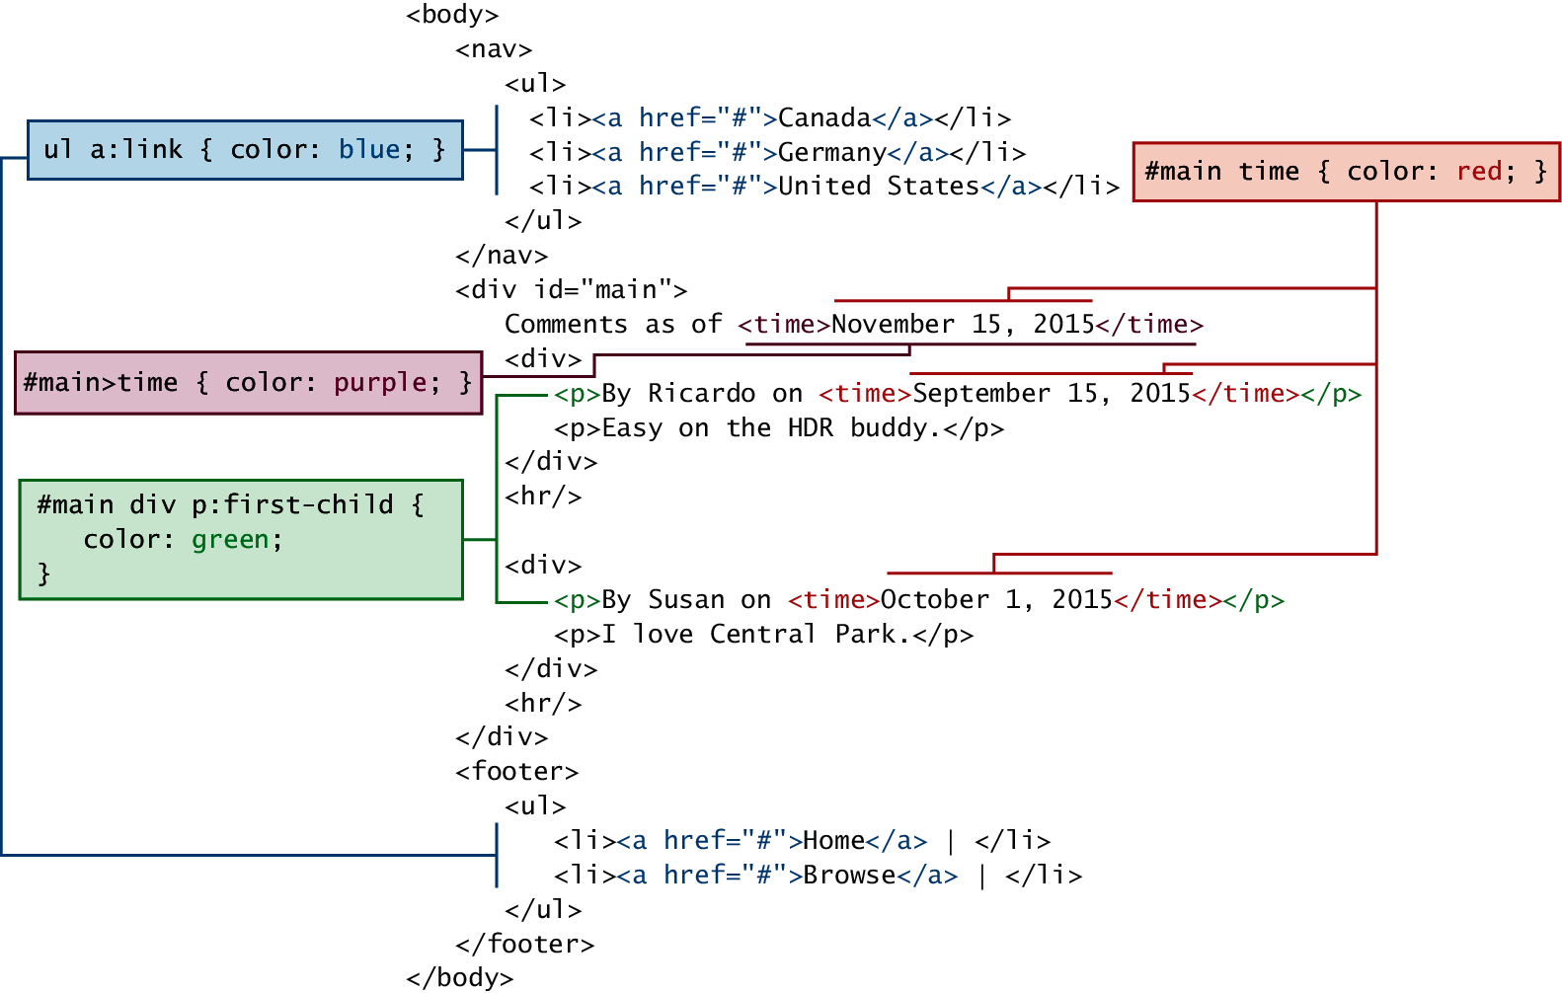
Figure 3.8 Contextual selectors in action

Slide 38
The Cascade: How Styles Interacts
Three Types of Style Sheets
Author Created Style Sheet
User-defined Sheet
Default Browser Style Sheet
Cascade principles for conflict resolution
Inheritance
Specificity
Location
Inline style override: embedded and external style sheets
Embedded style sheet override external style sheet

Slide 39
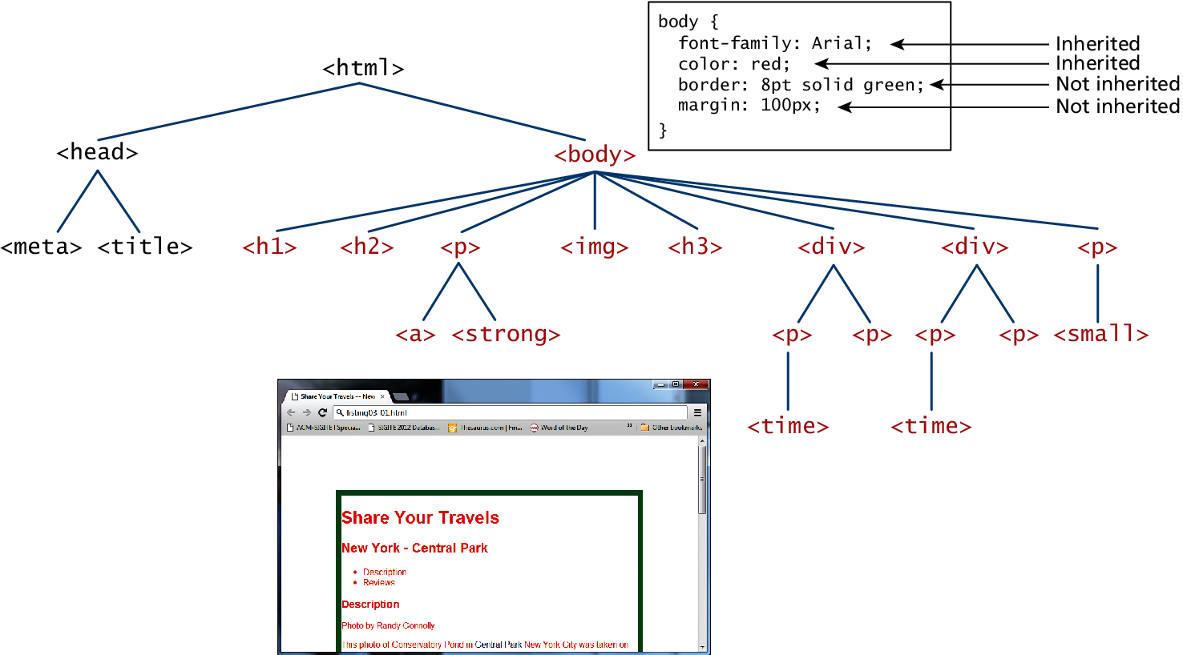
Figure 3.9 Inheritance

Slide 40
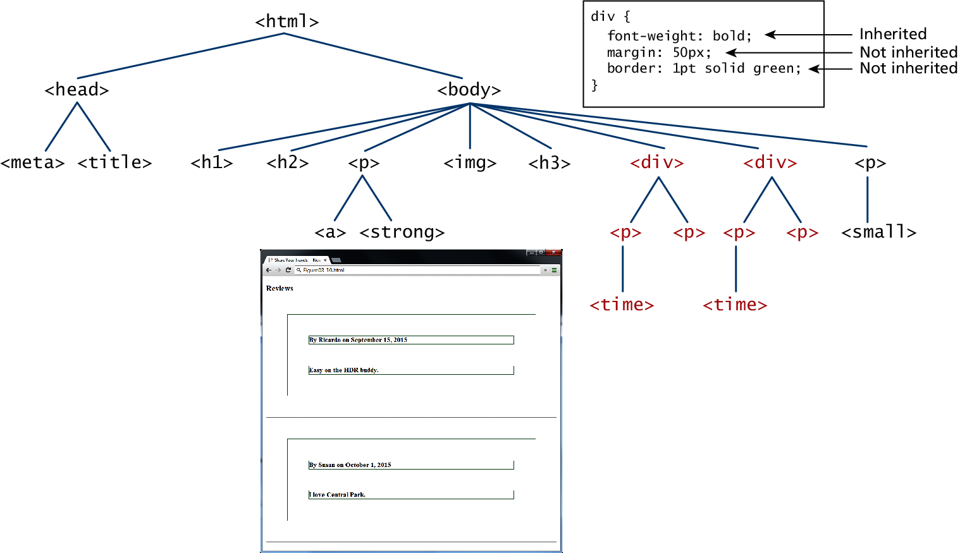
Figure 3.10 More Inheritance

Slide 41
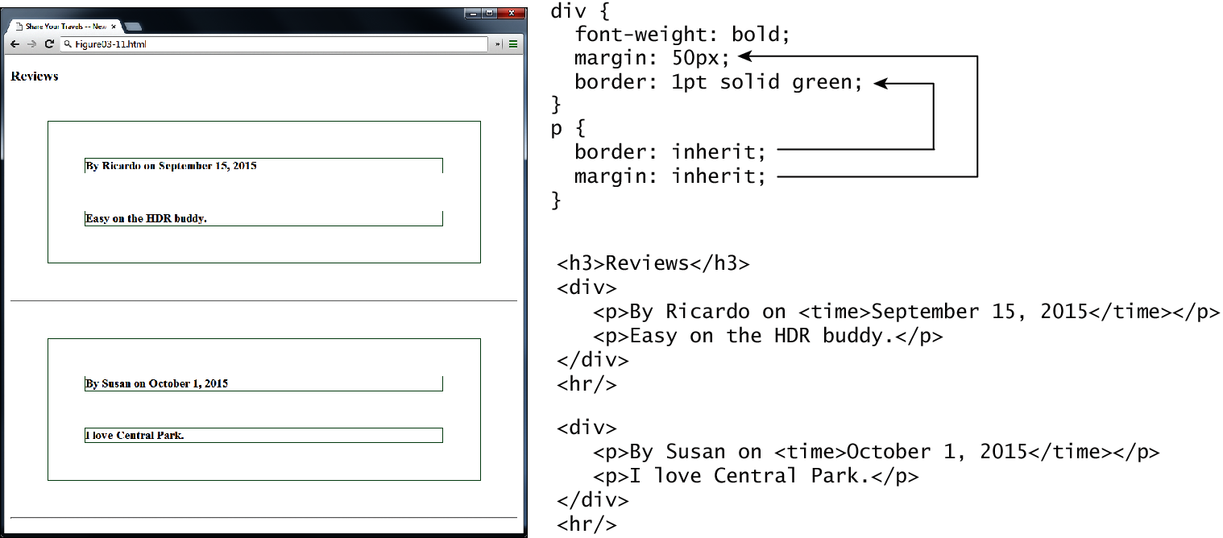
Figure 3.11 Using the inheritance value

Slide 42
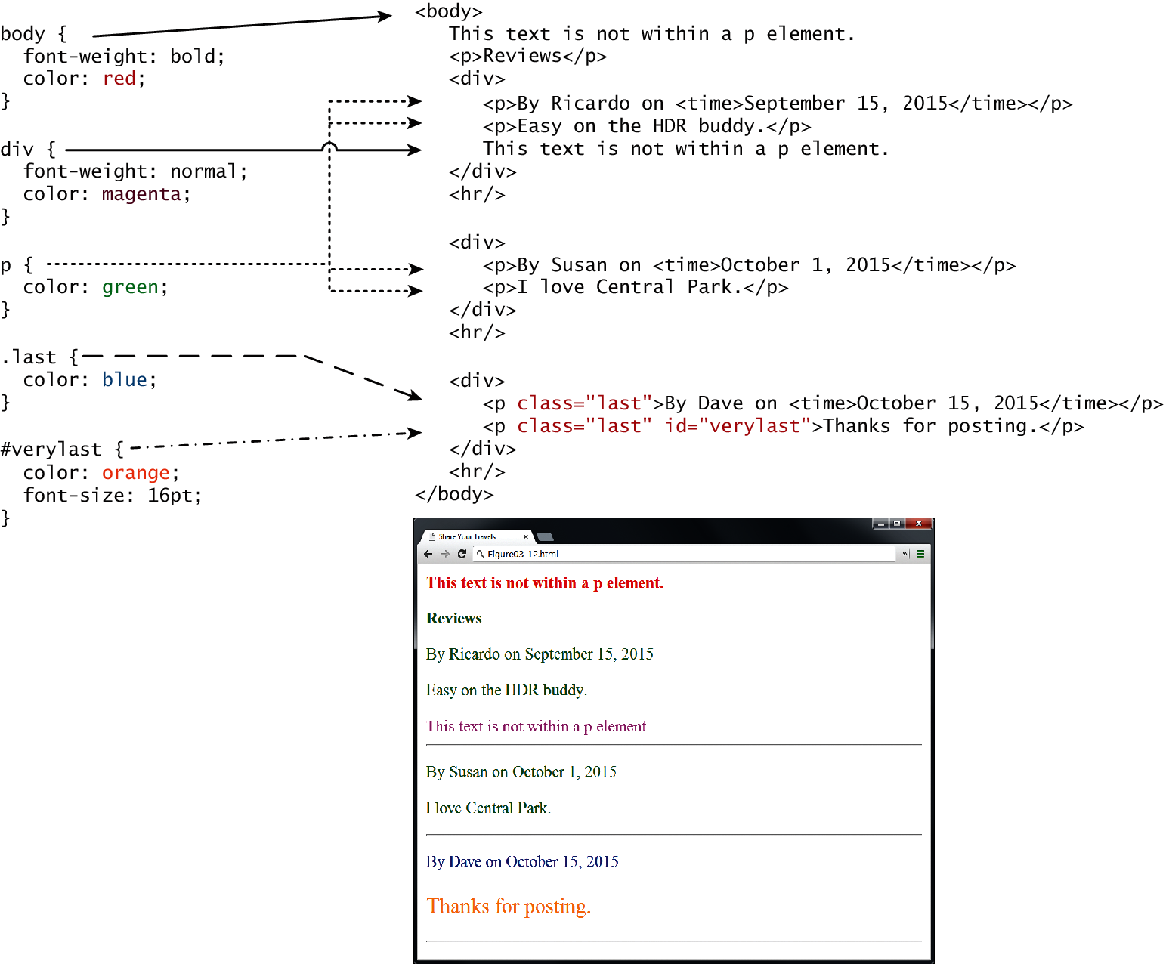
Fig 3.12

Slide 43
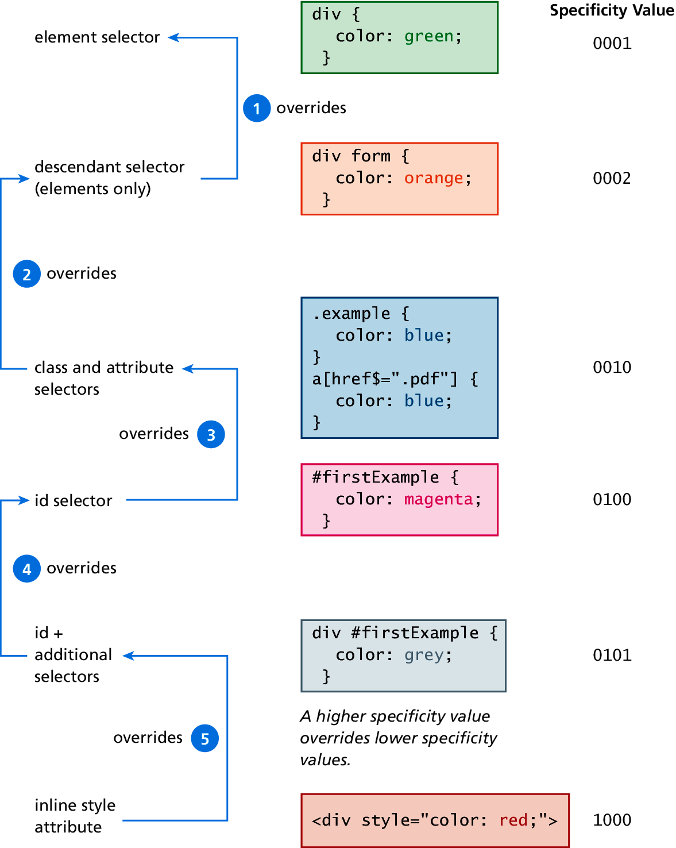
Fig 3.13 Specify Algorithm

Slide 44
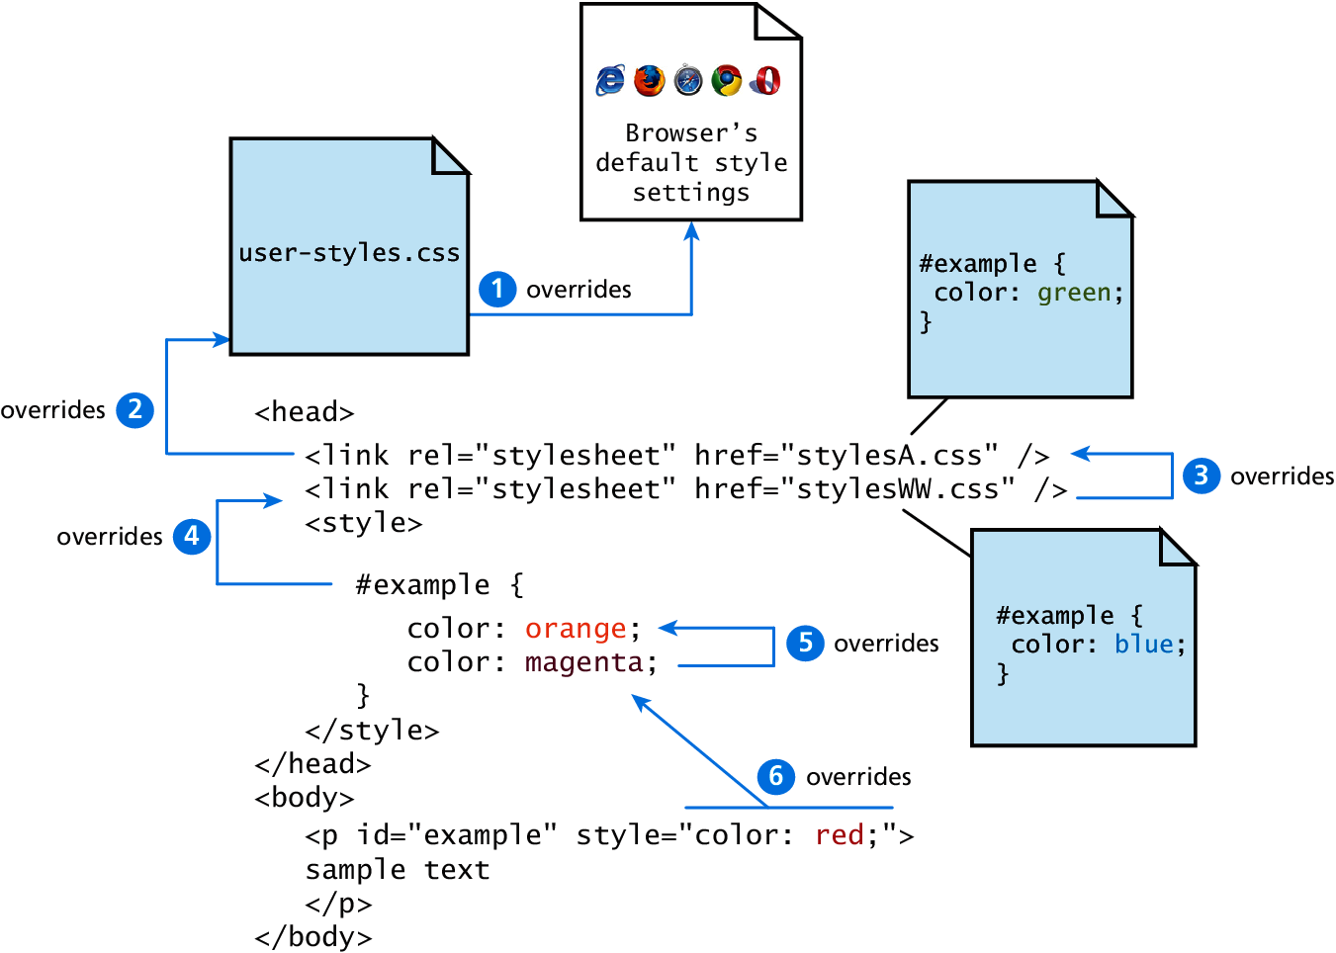
Fig 3.14 Location

Slide 45
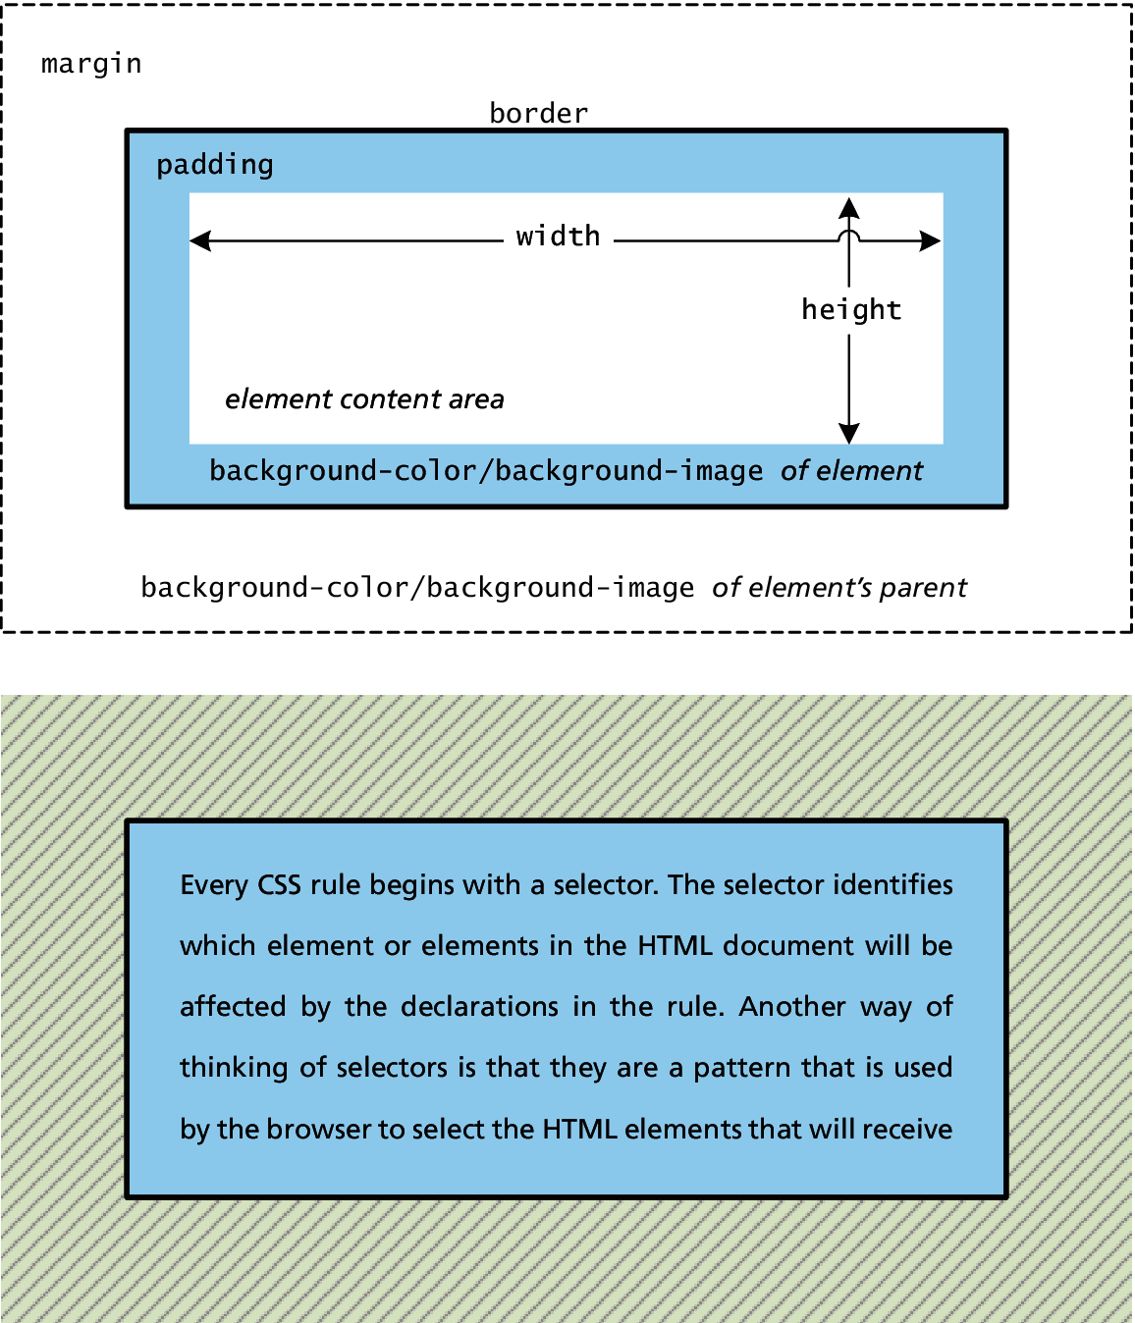
Fig 3.15 CSS Box Model

Slide 46
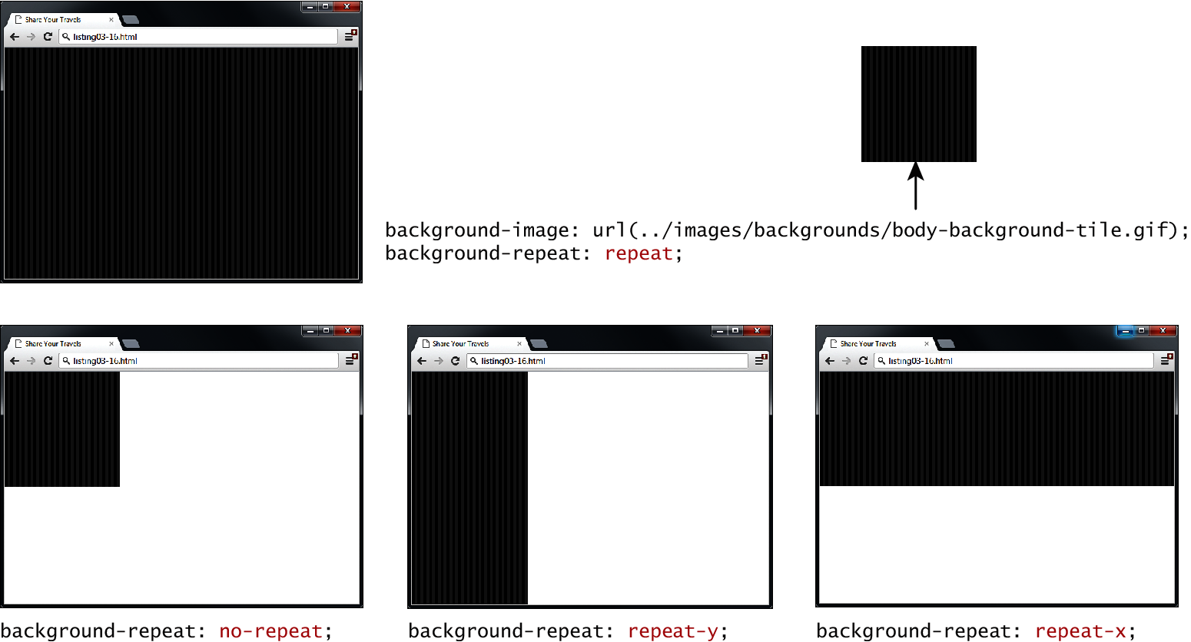
Fig 3.16 Background repeat

Slide 47
Fig 3.17 Background position

Slide 48
Fig 3.18 CSS TRBL (Trouble) shortcut

Slide 49
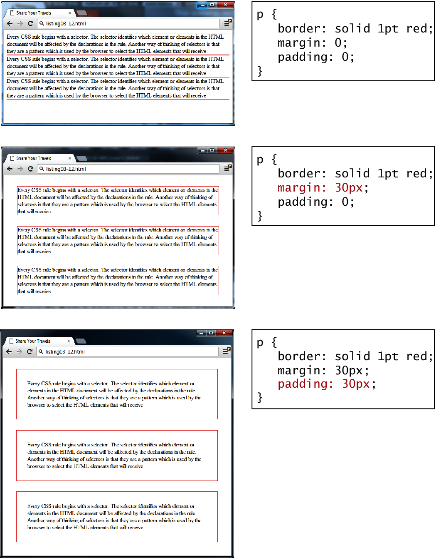
Fig 3.19 Borders, margins, and padding provide element spacing and differentiation

Slide 50
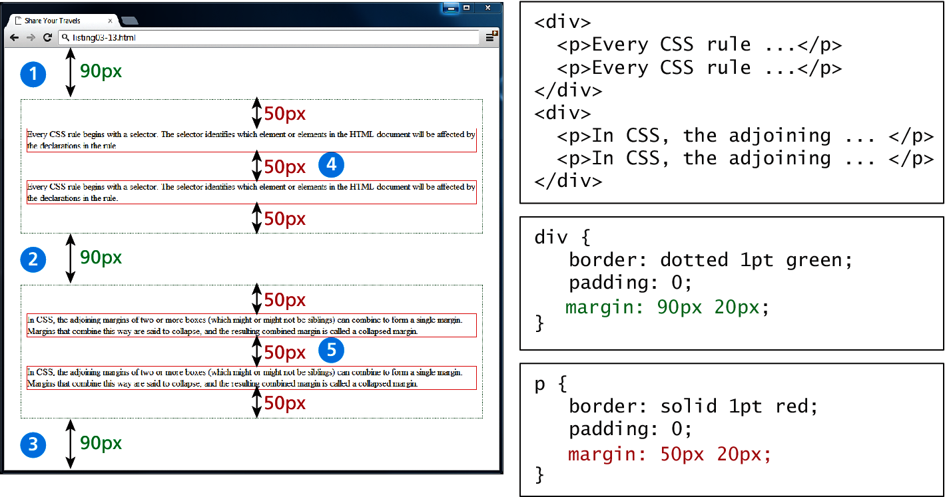
Fig 3.20 Collapsing vertical margins

Slide 51
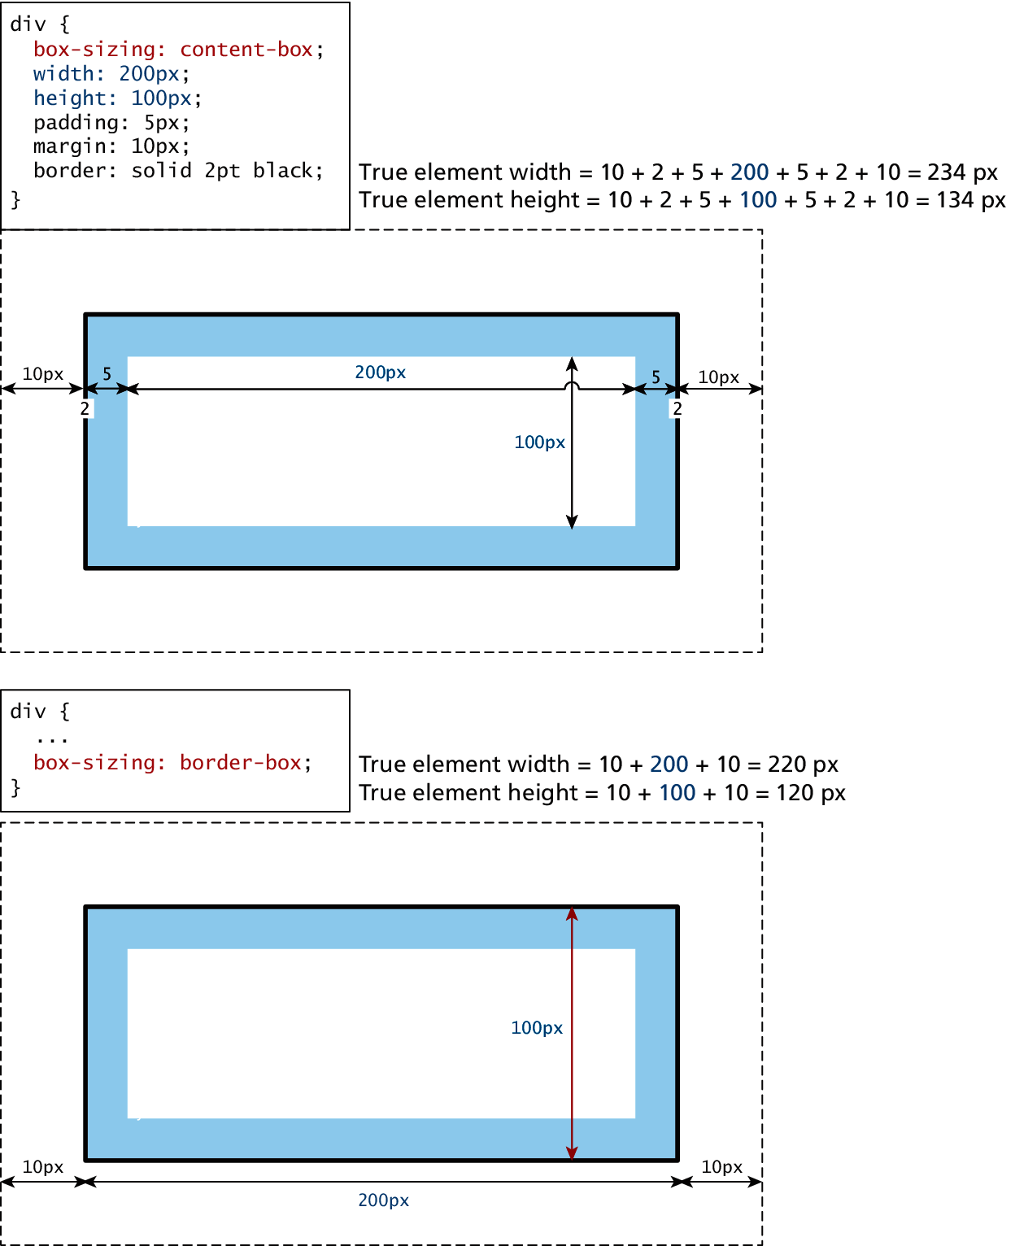
Fig 3.21 Calculating an element true size

Slide 52
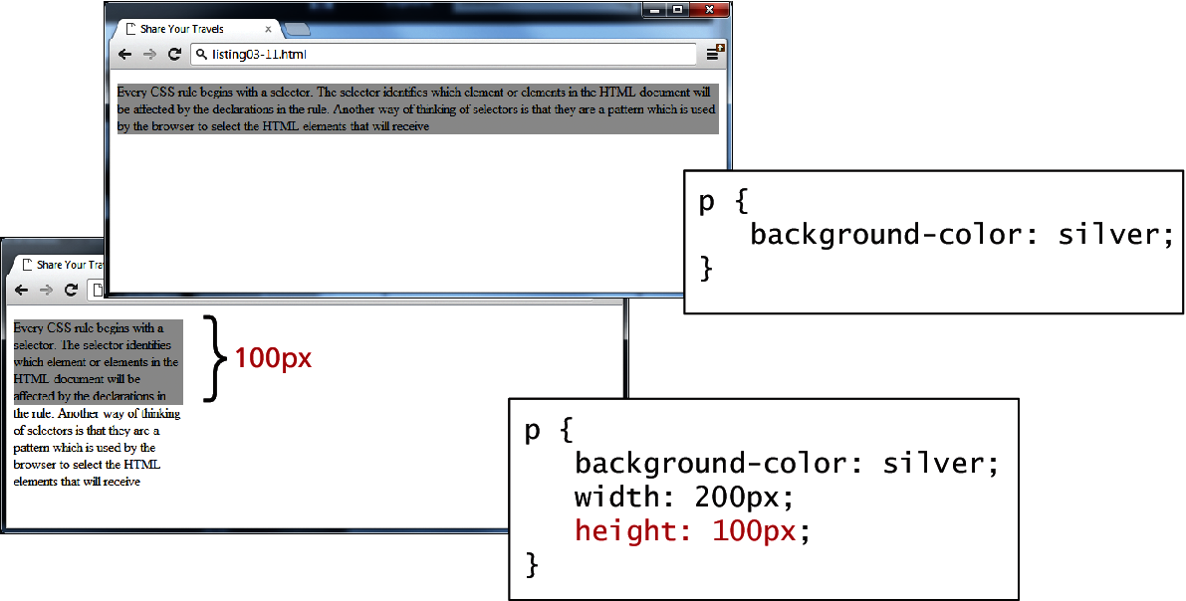
Fig 3.22 Limitations of height property

Slide 53
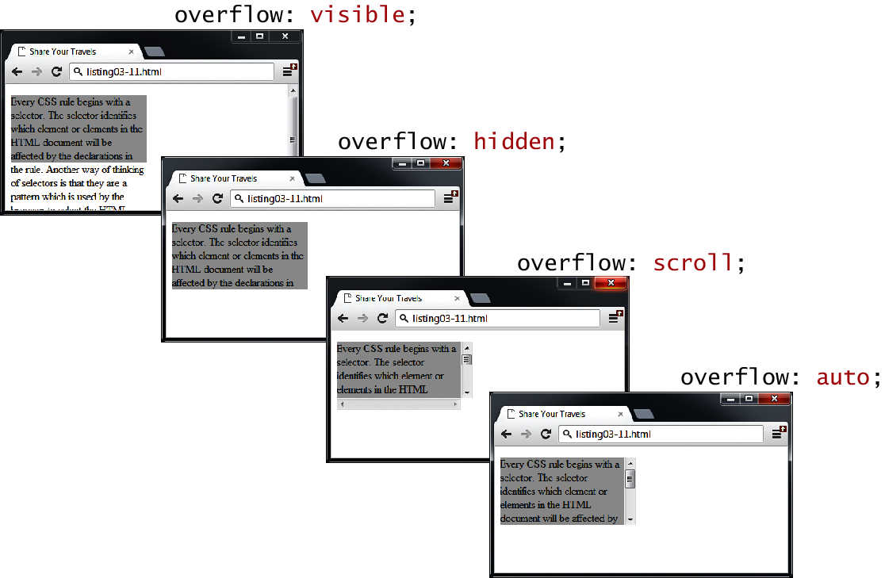
Fig 3.23 Overflow properties

Slide 54
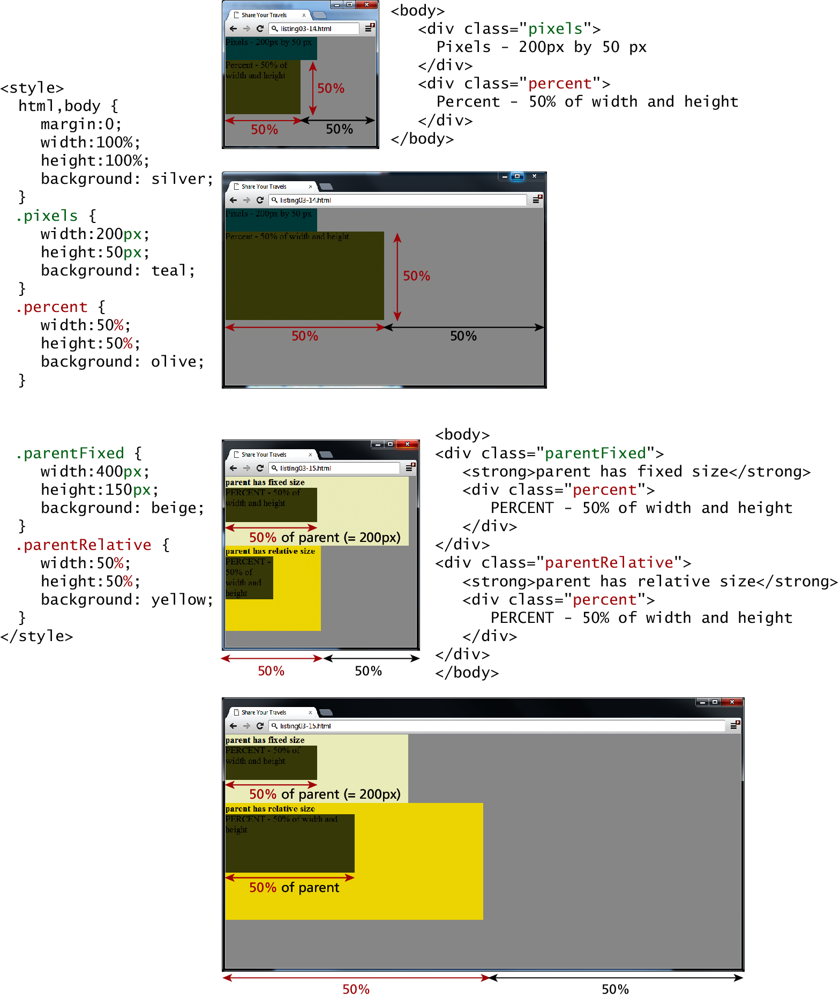
Fig 3.24 Box sizing via percents

Slide 55
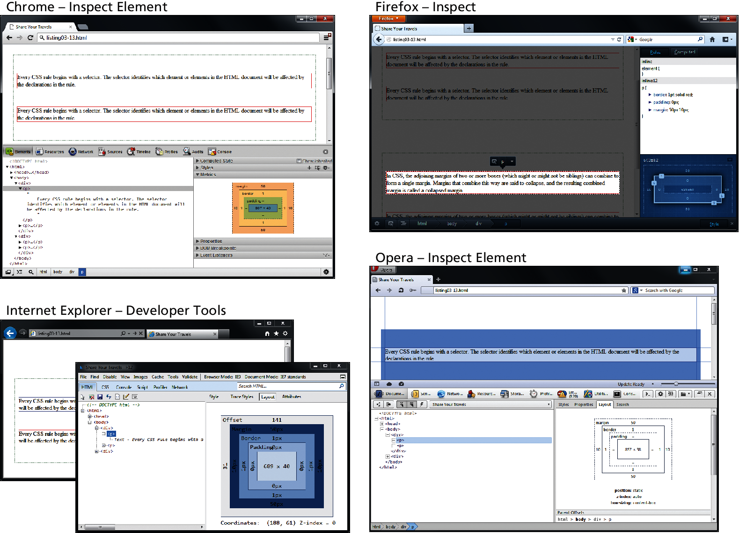
Fig 3.25 Inspecting CSS using developer tools within modern browsers

Slide 56
Fig 3.26 Specifying the font family

Slide 57
Fig 3.27 The different font families

Slide 58
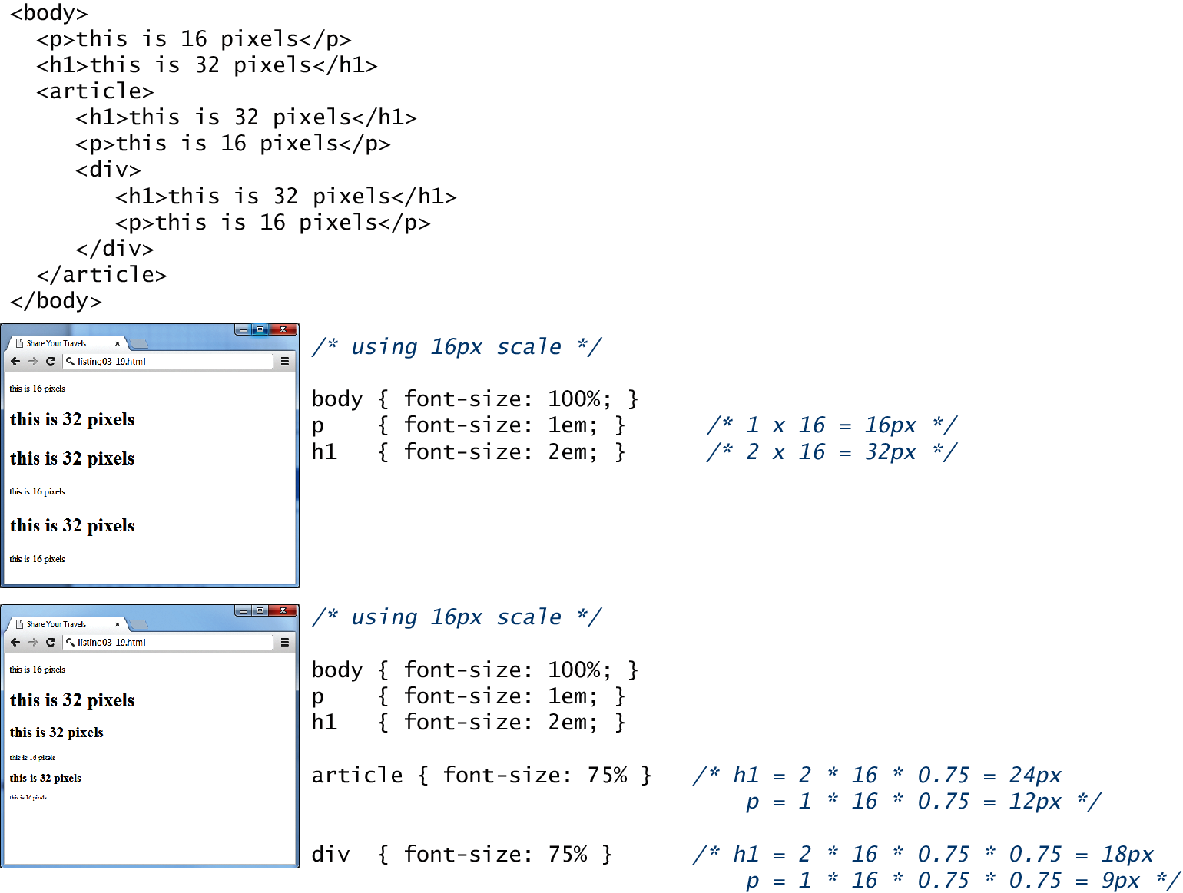
Fig 3.27 The different font families

Slide 59
Figure 3.28 Using em unit

Slide 60
Summary and Conclusion
Q/A ?

