Slide 1
CPET 499/ITC 250 Web Systems
Chapter 8
Introduction to Server-Side Development with PHP
Text Book:
* Fundamentals of Web Development, 2015, by Randy Connolly and Ricardo Hoar, published by Pearson
Paul I-Hai Lin, Professor
http://www.etcs.ipfw.edu/~lin

Slide 2
Topics
What is Server-Side Development
A Web Server’s Responsibilities
Quick Tour of PHP
Program Control
Functions

Slide 3
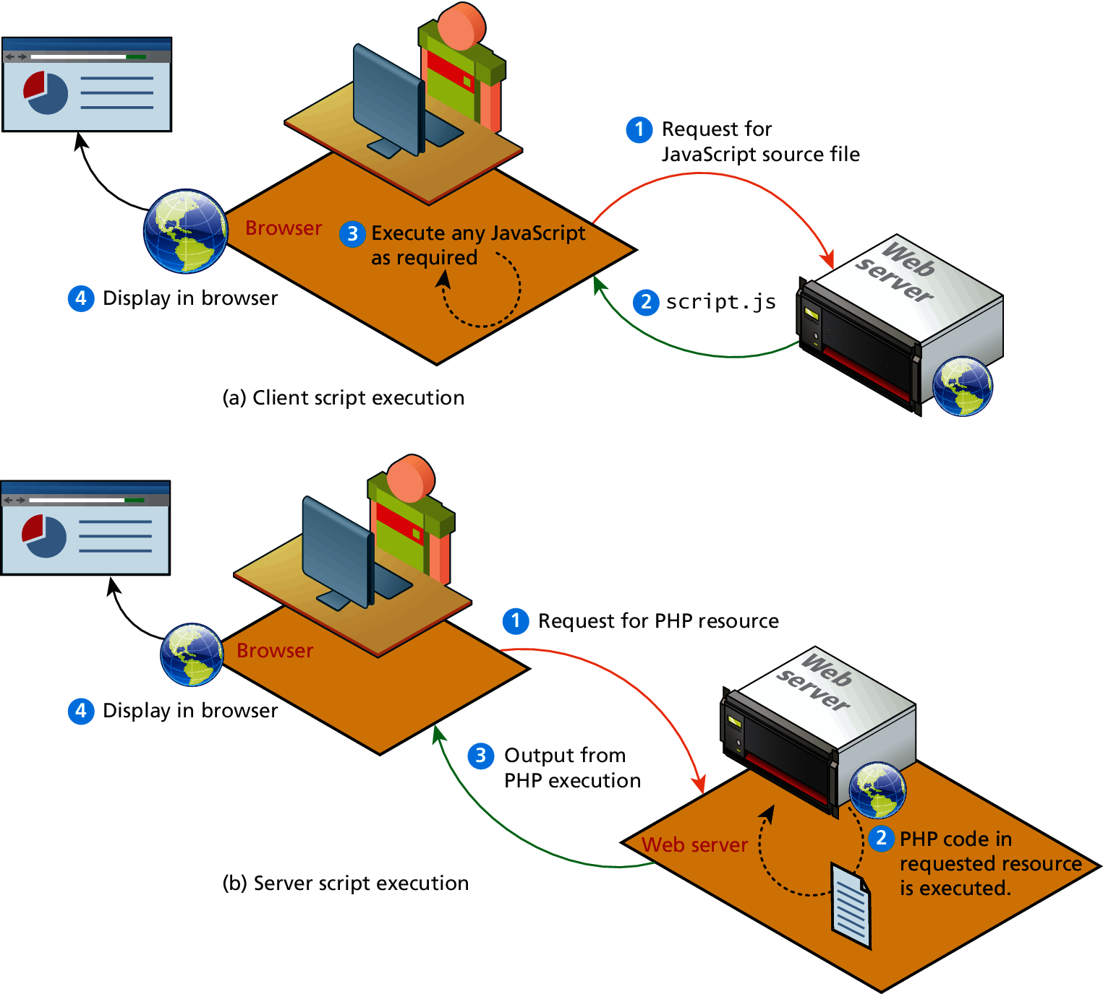
Figure 8.1 Server-Side Script vs. Client Side Script

Slide 4
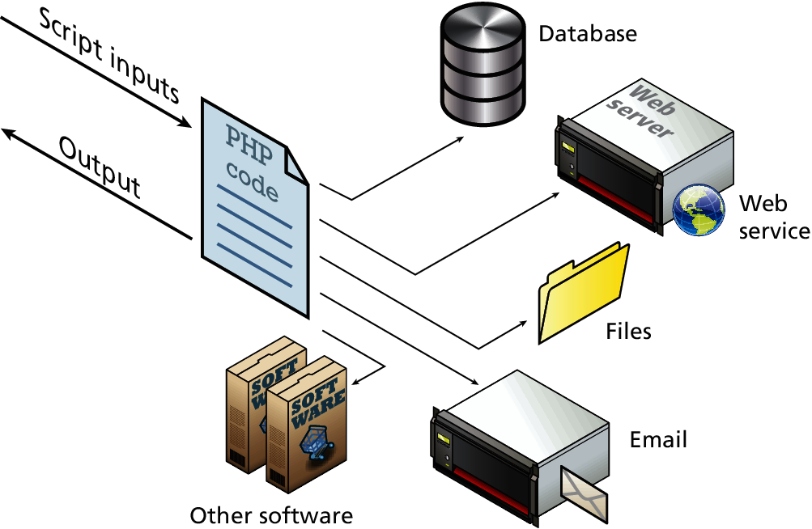
Figure 8.2 Accessible Resources for Server Scripts

Slide 5
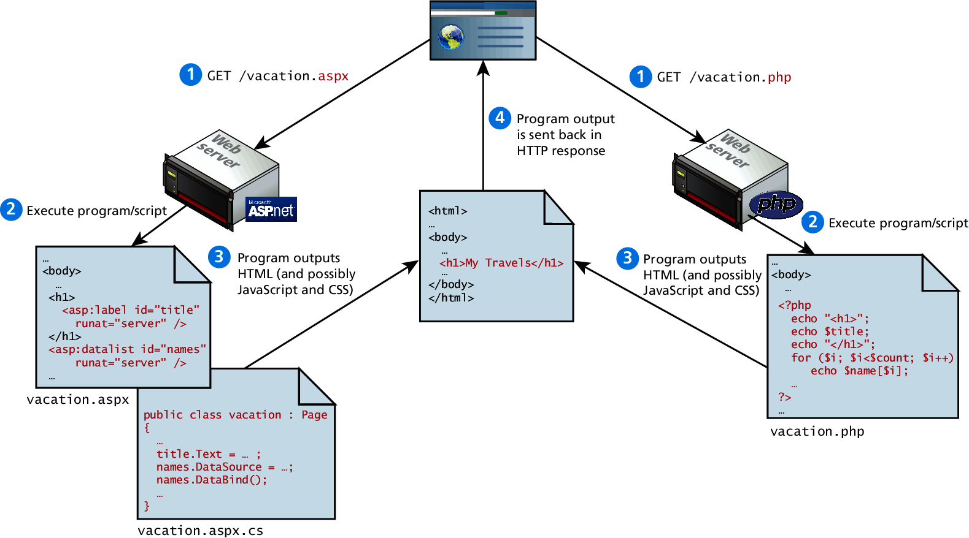
Figure 8.3 Web Development Technologies

Slide 6
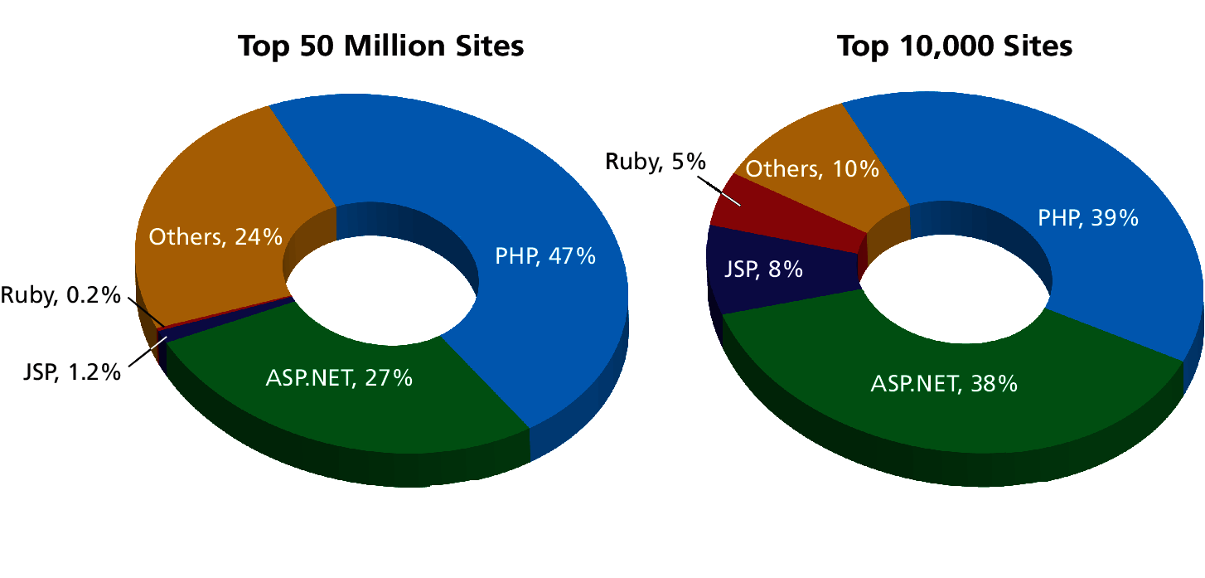
Figure 8.4 Market share of web development environments

Slide 7
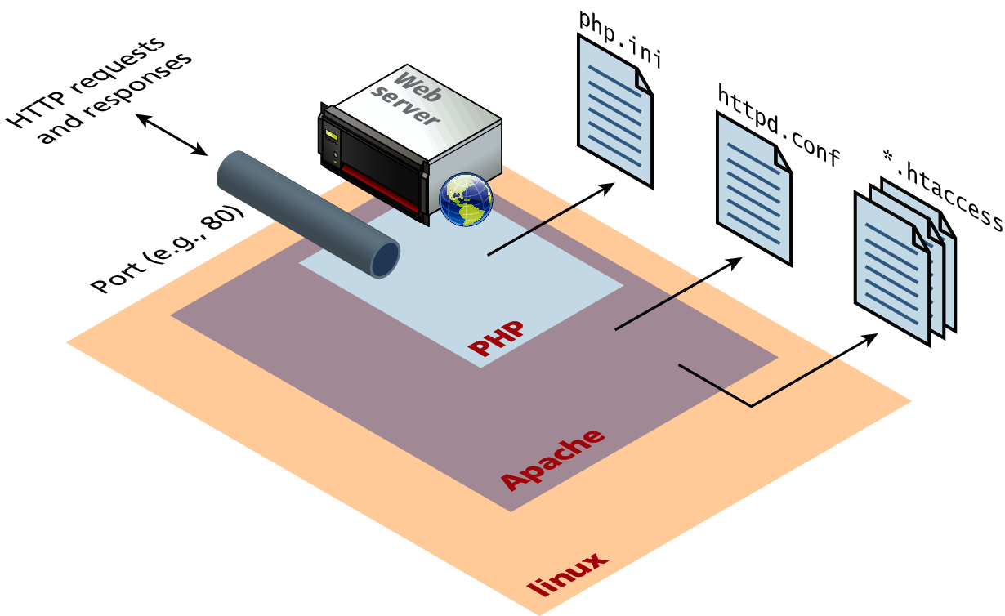
Figure 8.5 Linux, Apache, and PHP

Slide 8
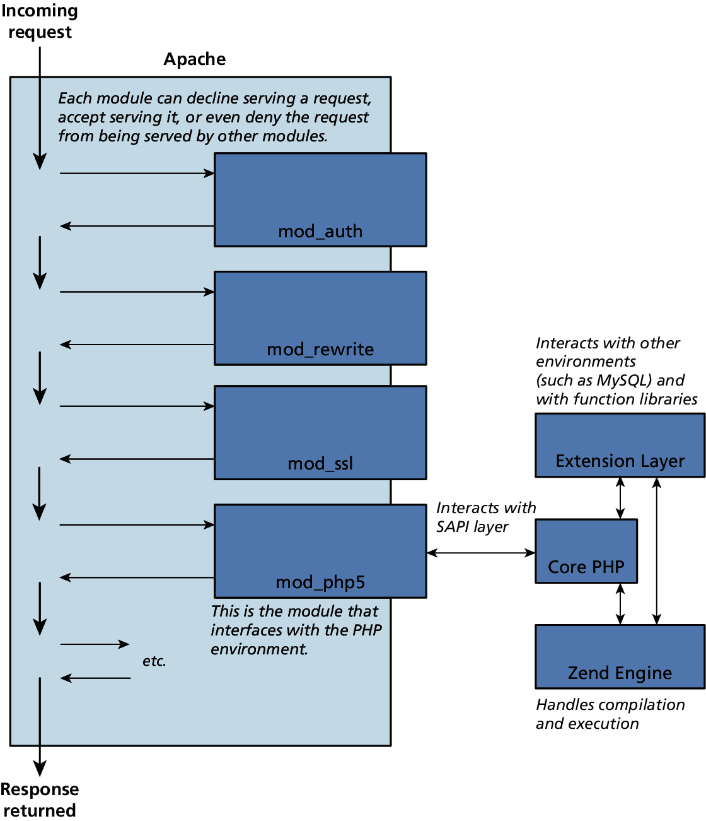
Figure 8.6 Apache Module and PHP

Slide 9
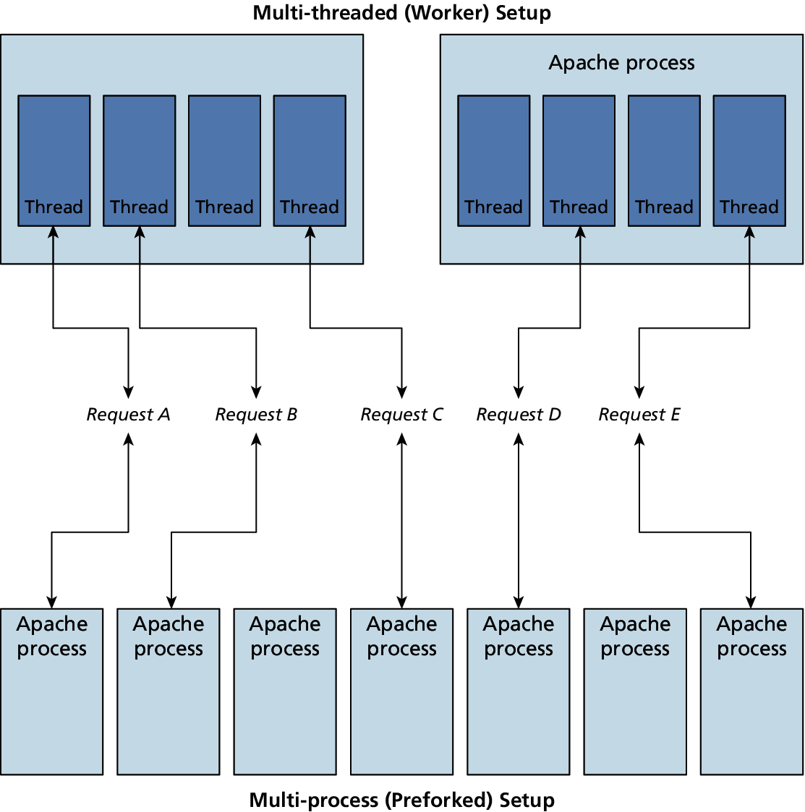
Figure 8.7 Multi-threaded vs. Multi-process

Slide 10
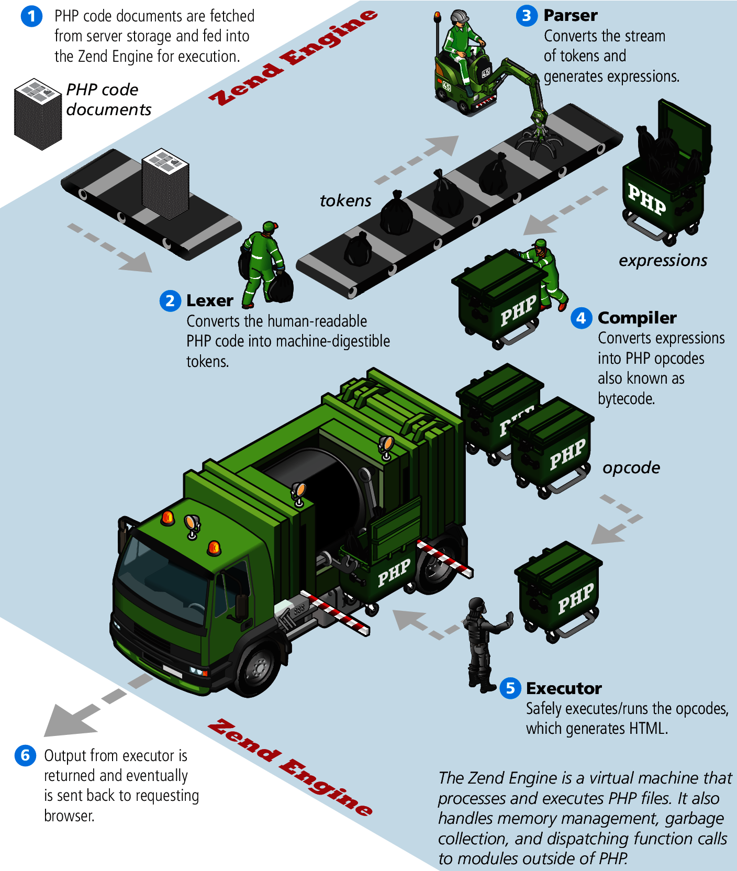
Figure 8.8 Zend Engine

