Slide 1
CPET 499/ITC 250 Web Systems
Chapter 11
Working with Databases
Part 1 of 3
Text Book:
* Fundamentals of Web Development, 2015, by Randy Connolly and Ricardo Hoar, published by Pearson
Paul I-Hai Lin, Professor of ECET
http://www.etcs.ipfw.edu/~lin

Slide 2
Topics
Database and Web Development
The Role of Database in Web Development
Database Design
Database Options
SQL (Structure Query Language)
SELECT Statement
INSERT, UPDATE, and DELETE Statements
Transactions: Local Transactions, Distributed Transactions
Data Definition Statements
Database Indexes and Efficiency

Slide 3
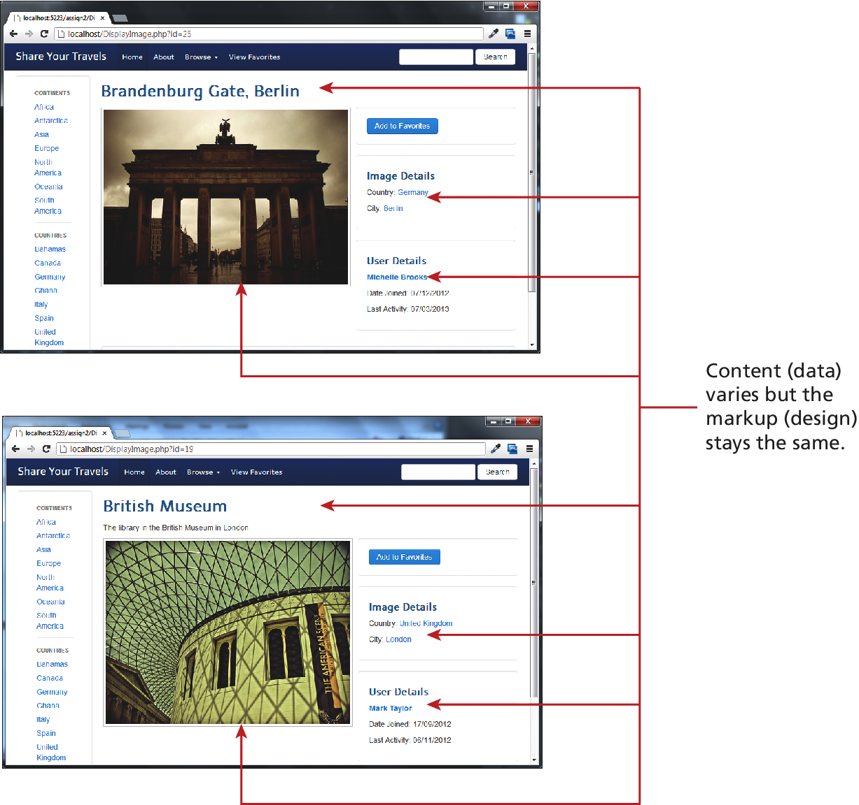
Figure 11.1 Separating content from data

Slide 4
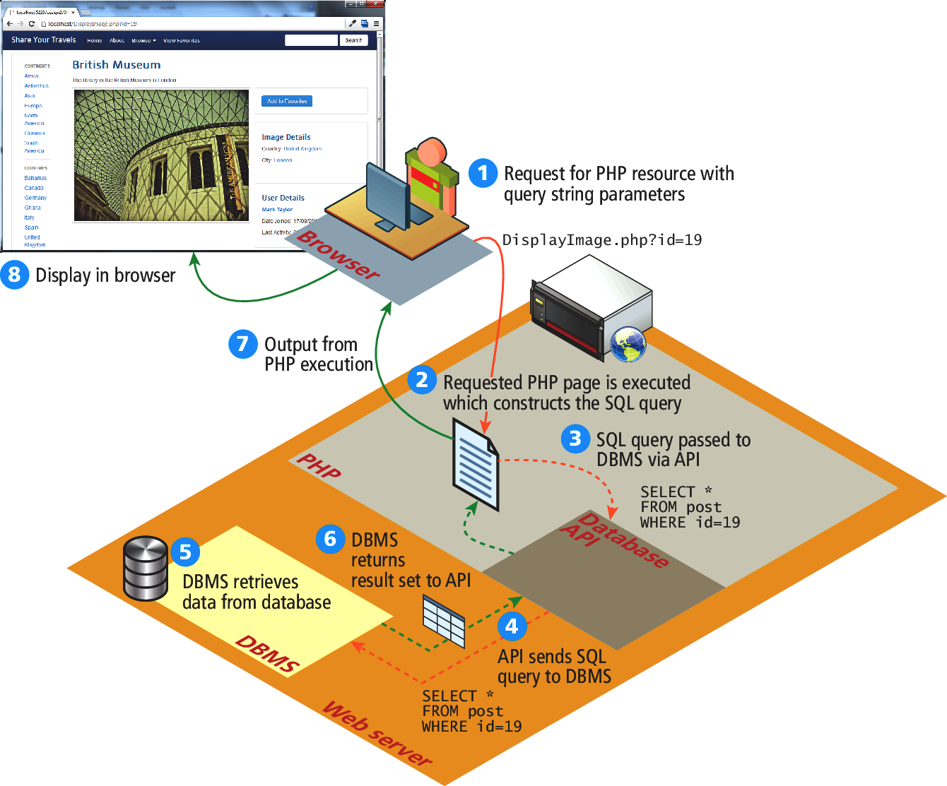
Figure 11.2 How website use databases

Slide 5
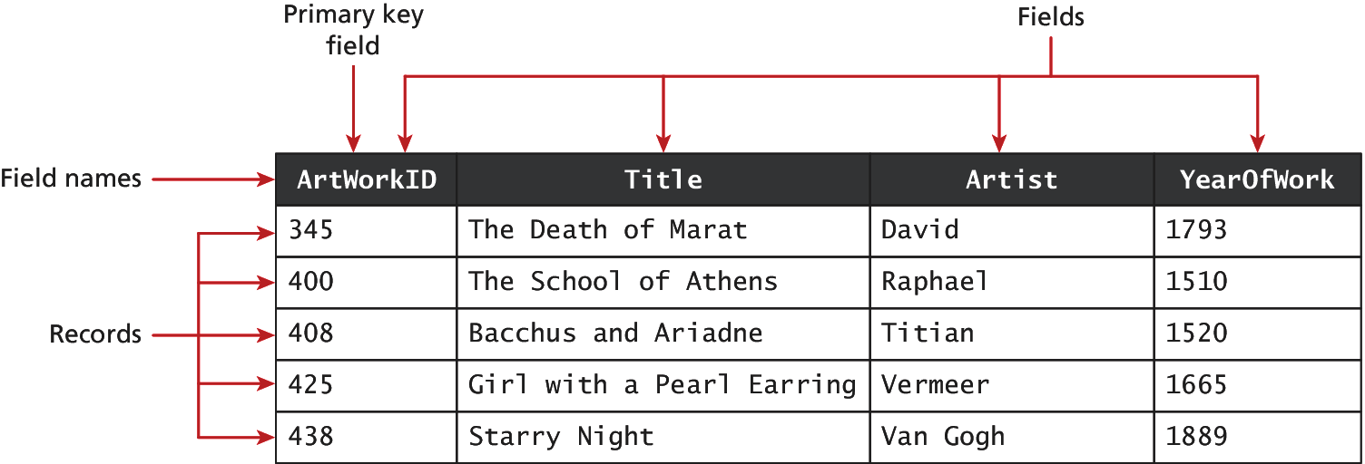
Figure 11.3 A database table

Slide 6
Figure 11.4 Diagraming a table

Slide 7
Table 11.1 Common Database Table Data Types
BIT – BOOLEAN or BOOL
BLOG – Binary Large Object (images and other data objects)
CHAR(n) – a fixed number of character (n = number of chars) that are padded with spaces to fill the field
DATE – also TIME and DATETIME data types
FLOAT - also DOUBLE, DECIMAL data types
INT - also SMALLINT data type
VARCHAR(n) – a variable number of characters (n = maximum number of chars with no space padding)

Slide 8
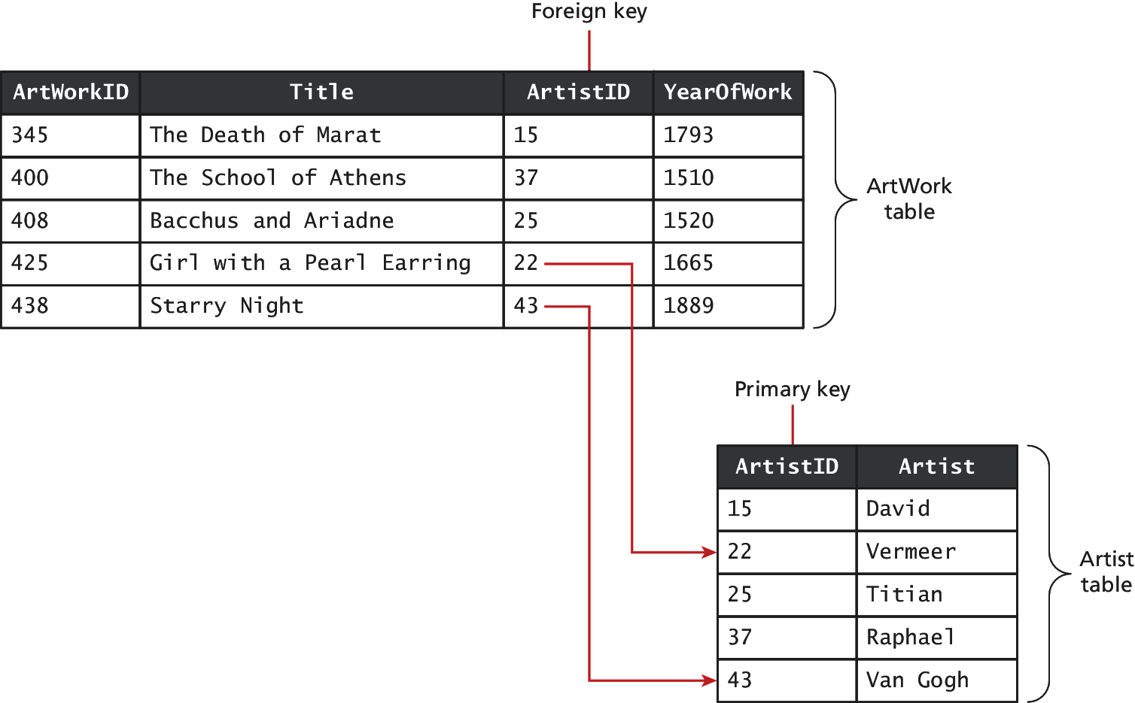
Figure 11.5 Foreign keys links tables

Slide 9
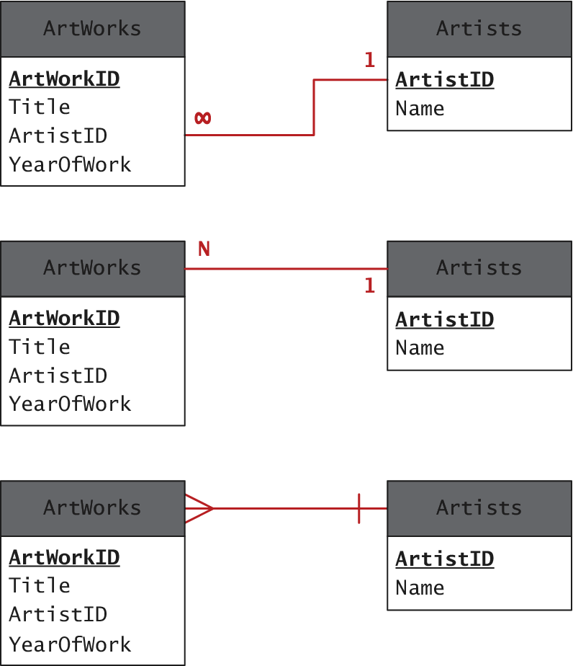
Figure 11.6 Diagraming a one-to-many relationship

Slide 10
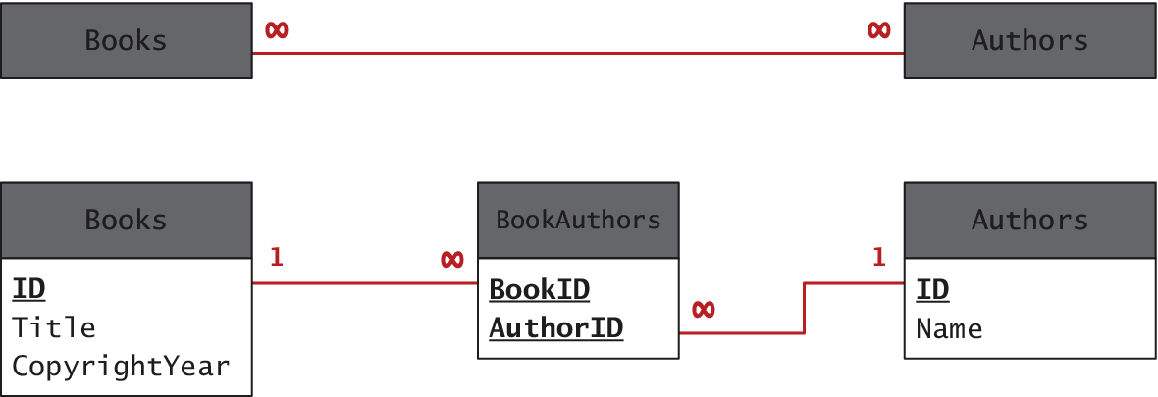
Figure 11.7 Implementing a many-to-many relationship

Slide 11
Figure 11.8 Database in the Enterprise
SQL Databases
Financial and order management systems
Manufacturing system
Point of sales
Groupware and file servers
Examples
DB2
Oracle DB
Microsoft SQL
MySQL
PostgreSQL
etc

Slide 12
Figure 11.8 Database in the Enterprise
Non-SQL Databases
Documentation oriented, No relationship among stored data
Optimized to retrieve data using simple Key-Value syntax similar to PHP associative arrays
May be very large data sets
Examples:
Web server logs, geographical data
Twitter posted information
Non-SQL DB examples:
Couch DB, monoDB
Amazon SimpleDB , Google’s Big Table

Slide 13
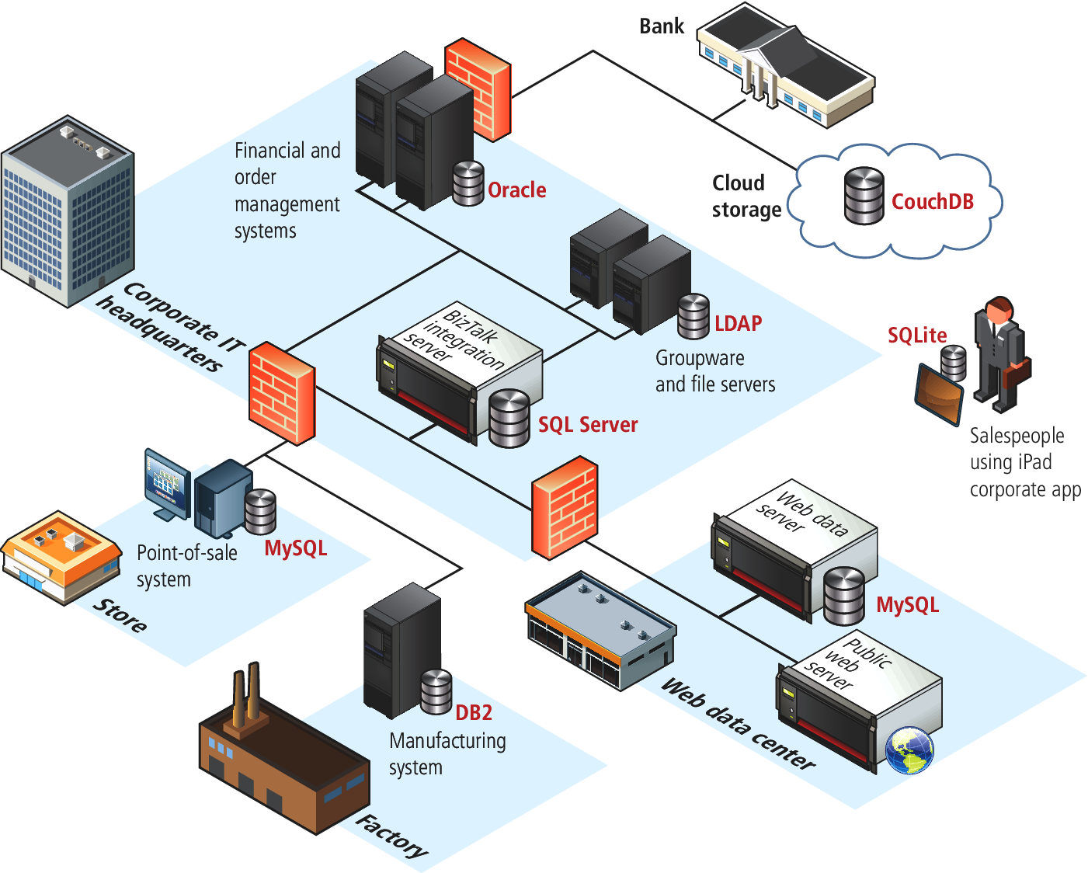
Figure 11.8 Database in the Enterprise

Slide 14
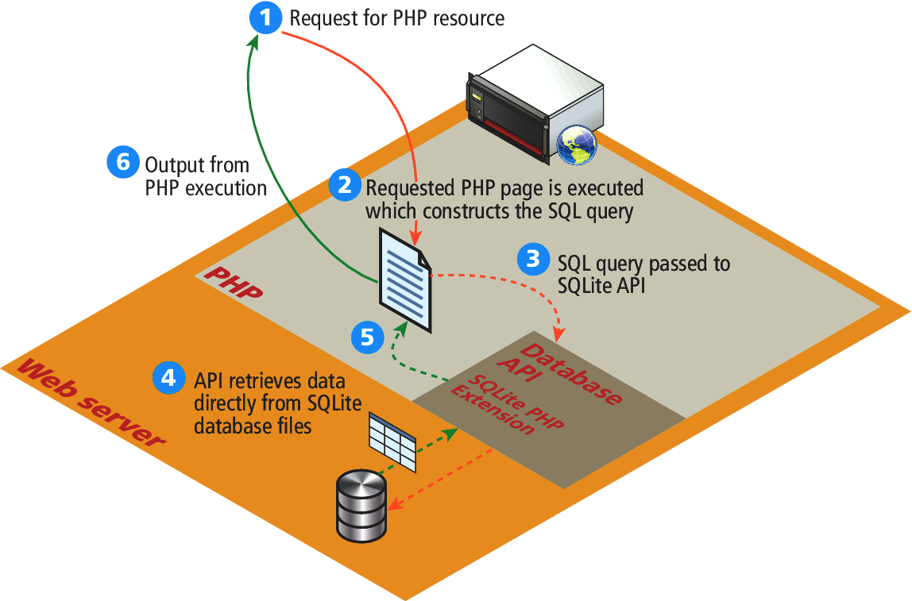
Figure 11.9 SQLite

Slide 15
SQL
SELECT statement – retrieve data from the database
INSERT statement – add new records
UPDATE statement – update existing records
DELETE statement – delete existing records

Slide 16
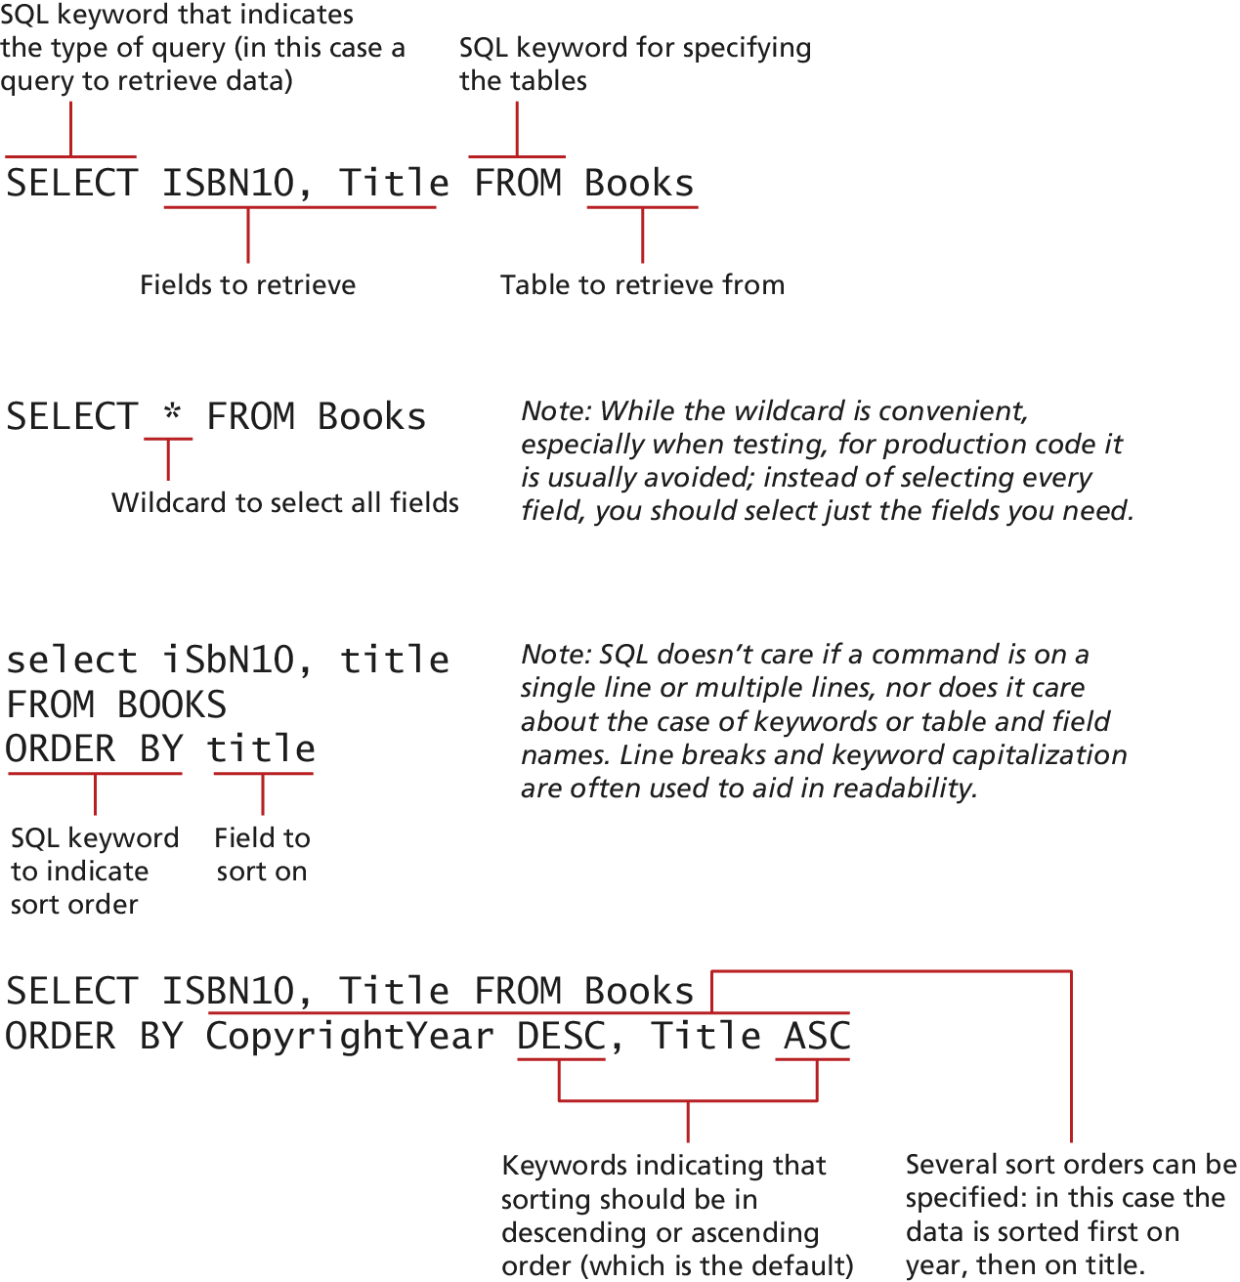
Figure 11.10 SQL SELECT from a single table

Slide 17
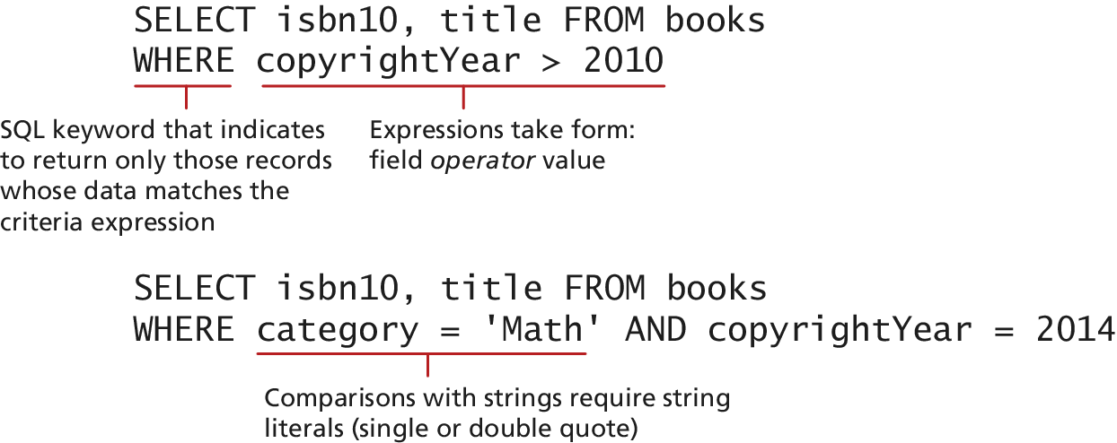
Figure 11.12 Using the WHERE clause

Slide 18
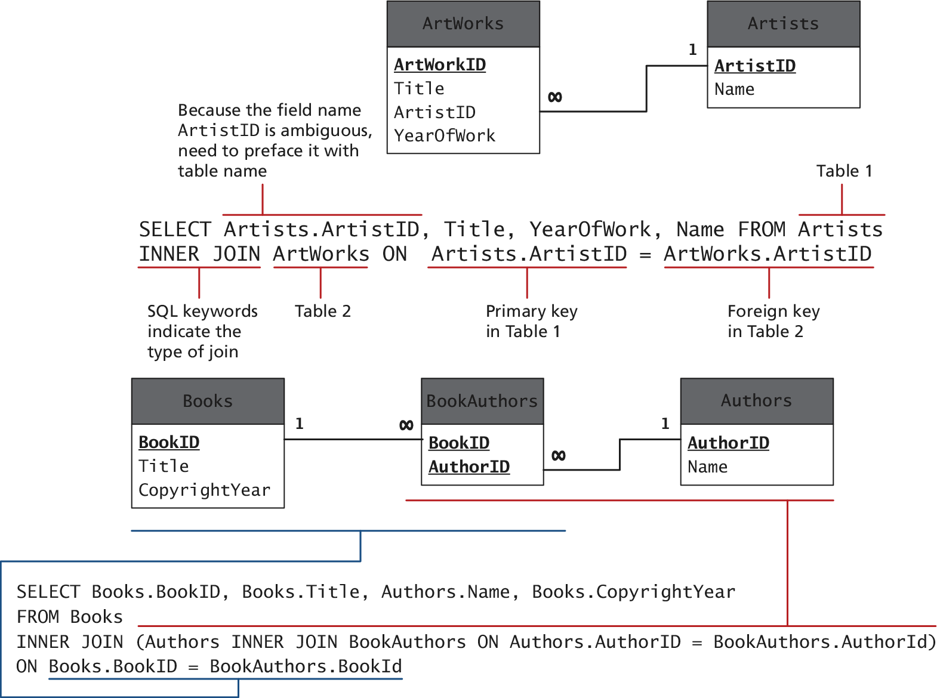
Figure 11.12 SQL SELECT from multiple table using an INNER JOINT

Slide 19
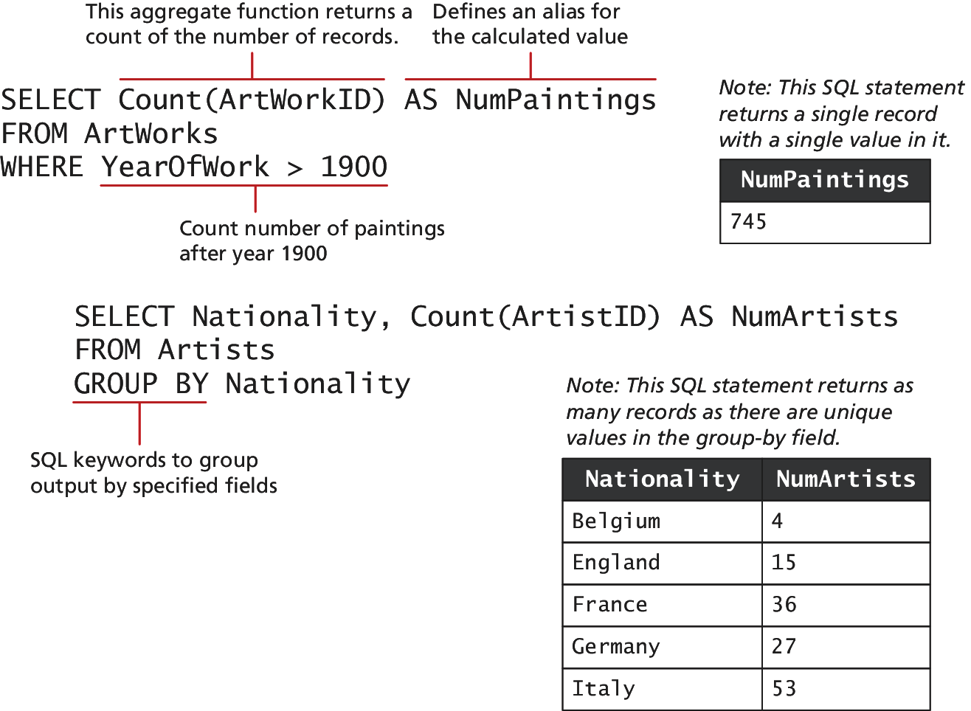
Figure 11.13 Using GROUP BY with aggregate functions

Slide 20
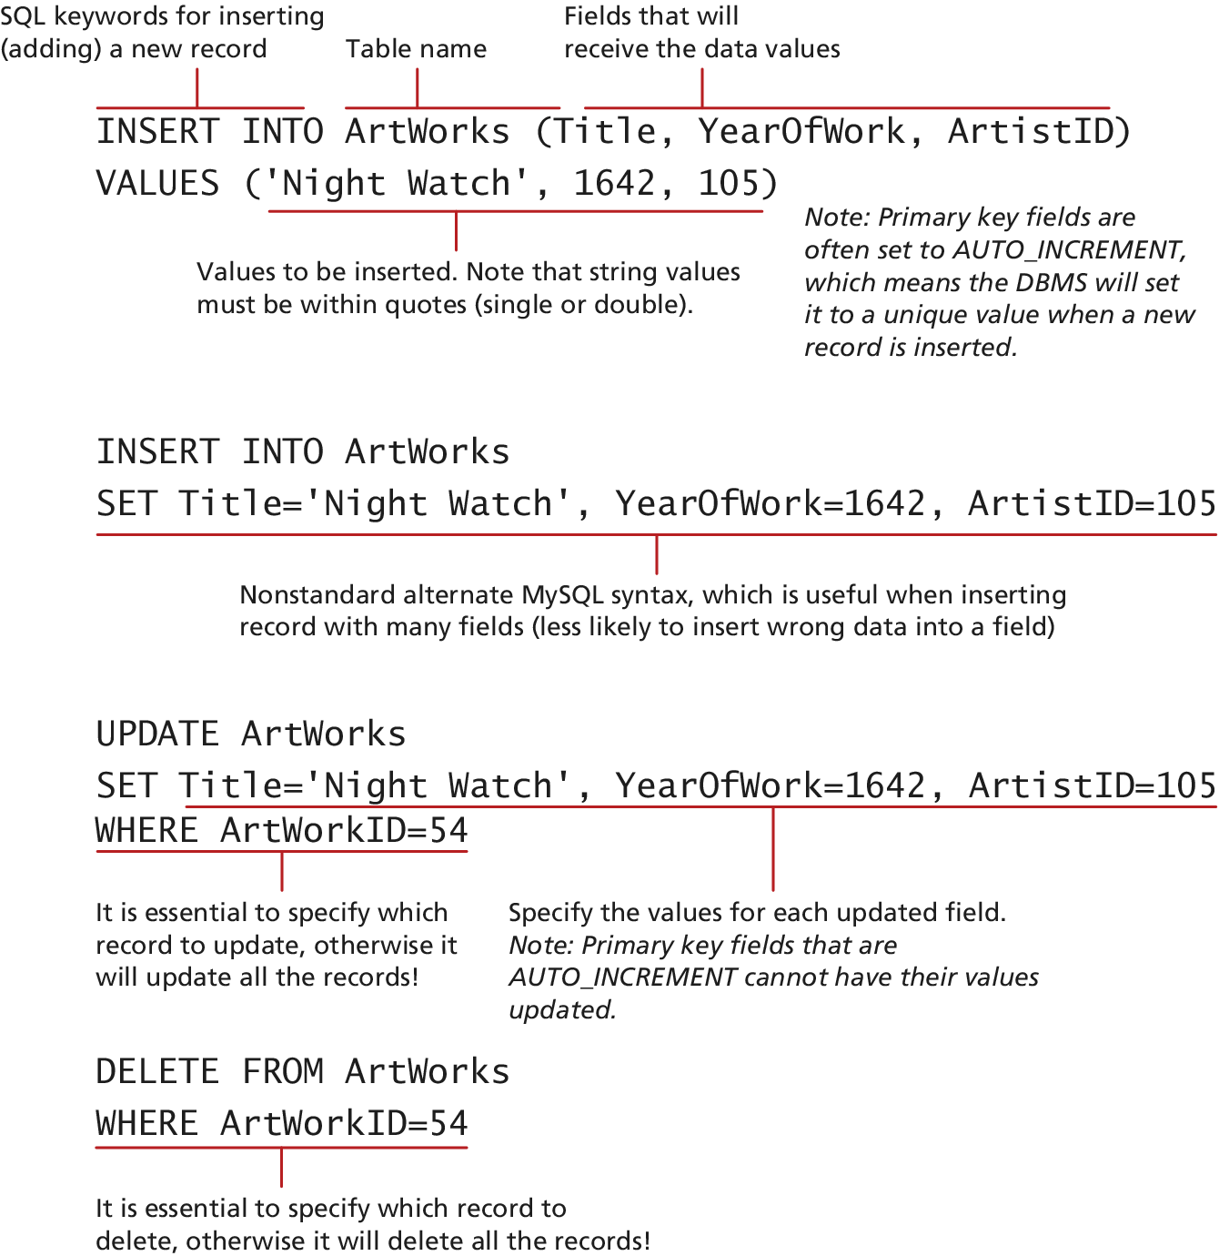
Figure 11.14 SQL INSERT, UPDATE, and DELETE

Slide 21
Local and Distributed Transactions
Transactions
A transaction refers to a sequence of steps that are treated as a single unit, and provide a way to gracefully handle errors and keep your data properly consistent when error occur.
Local Transactions: transactions handled by the DBMS
Distributed Transactions: transactions involve multiple hosts, several of which we may have no control over.

Slide 22
Local and Distributed Transactions
Web Storefront Example
A customer: Checkout, Verified address, entered credit card, select shipping option
Click Pay for Order Button, what happen?
1. Write order records to the website database.
2. Check credit card service to see if payment is accepted.
3. If payment is accepted, send message to legacy ordering system.
4. Remove purchased item from warehouse inventory table and added to the order shipped table.
5. Send message to shipping provider

Slide 23
Local and Distributed Transactions
Web Storefront Example
Distributed Transactions
Local database writes
External credit car processor
External legacy ordering system
External shipping systems

Slide 24
Local Transactions
Through SQL Statements or API calls
START TRACSACTION
COMMIT
ROLLBACK
LISTING 11.1
START TRANSACTION
INSERT INTO orders …
INSERT orderDetails …
UPDATE inventory …
COMMIT

Slide 25
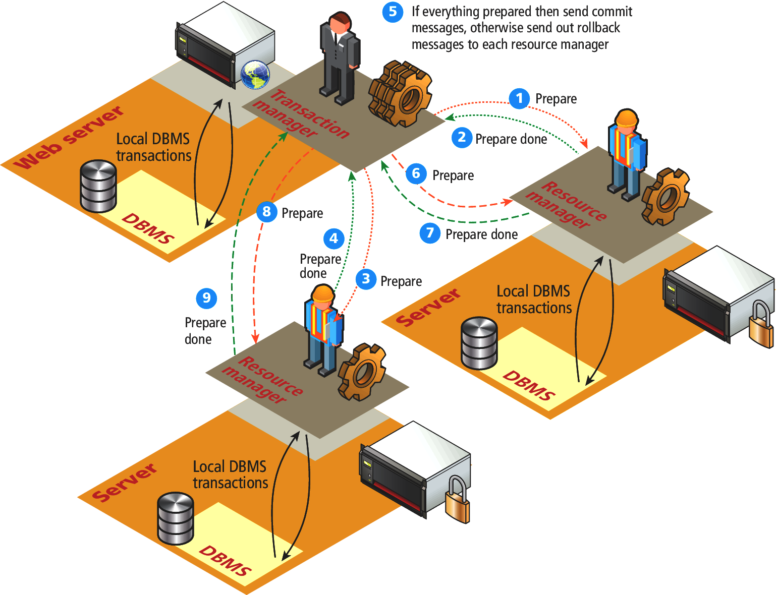
Figure 11.15 Distributed transaction processing

