Slide 1
CPET 499/ITC 250 Web Systems
Chapter 11
Working with Databases
Part 2 of 3
Text Book:
* Fundamentals of Web Development, 2015, by Randy Connolly and Ricardo Hoar, published by Pearson
Paul I-Hai Lin, Professor of ECET
http://www.etcs.ipfw.edu/~lin

Slide 2
Topics
More PHP Data Object (PDO) and mysqli Procedural Style APIS
Integrating User Input Data Into Query
PHP and MySQL Tasks
Making MySQL connection and closing connection
Display a List of Links
Search and Results Page
Editing a Record
Saving and Displaying Raw Files in the Database
Displaying BLOBs from the Database
Using Transactions
Database Schemas:
Art Database, Book CRM Database, Travel Photo Database

Slide 3
Connecting to MySQL Using PHP Data Object (PDO)

Slide 4
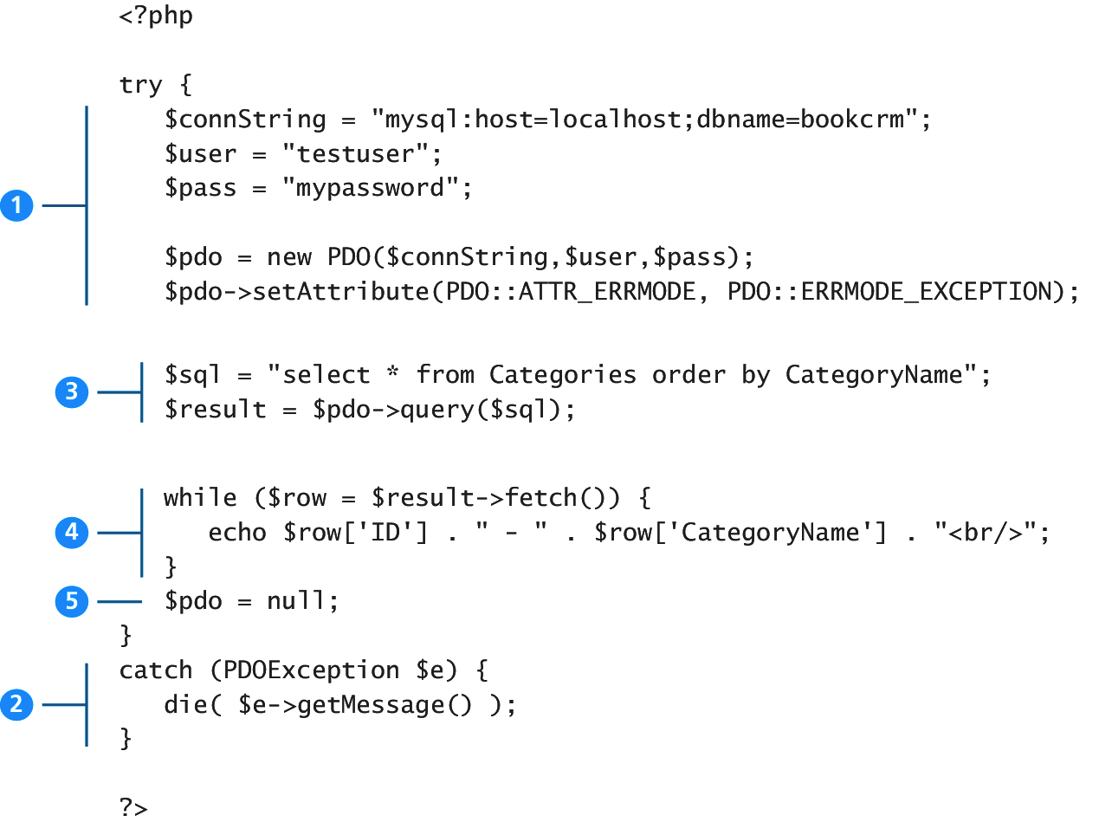
Figure 11.20 Basic Database Connection using PHP PDO

Slide 5
Executing Query

Slide 6
Listings 11.11 and 12 Executing a SELECT query (mysqli and PDO)
<?php
//Listing 11.11 Executing a SELECT query (mysqli)
$sql = "SELECT * FROM Categories ORDER BY CategoryName";
// returns a mysqli_result object
$result = mysqli_query($connection, $sql);
?>
<?php
//Listing 11.12 Executing a SELECT query (pdo)
$sql = "SELECT * FROM Categories ORDER BY CategoryName";
// returns a PDOStatement object
$result = $pdo->query($sql);
?>

Slide 7
Listing 11.13 Executing a query that doesn’t return data (mysqli) - UPDATE
<?php
//Listing 11.13 Executing a query that doesn't return data (mysqli)
$sql = "UPDATE Categories SET CategoryName='Web' WHERE CategoryName='Business'";
if ( mysqli_query($connection, $sql) ) {
$count = mysqli_affected_rows($connection);
echo "<p>Updated " . $count . " rows</p>";}
?>

Slide 8
Listing 11.14 Executing a query that doesn’t return data (PDO) - UPDATE
<?php
//Listing 11.14 Executing a query that doesn't return data (PDO)
$sql = "UPDATE Categories SET CategoryName='Web' WHERE CategoryName='Business'";
$count = $pdo->exec($sql);
echo "<p>Updated " . $count . " rows</p>";
?>

Slide 9
Integrating User Data into An Query
Sanitizing User Data
Prepare Statements

Slide 10
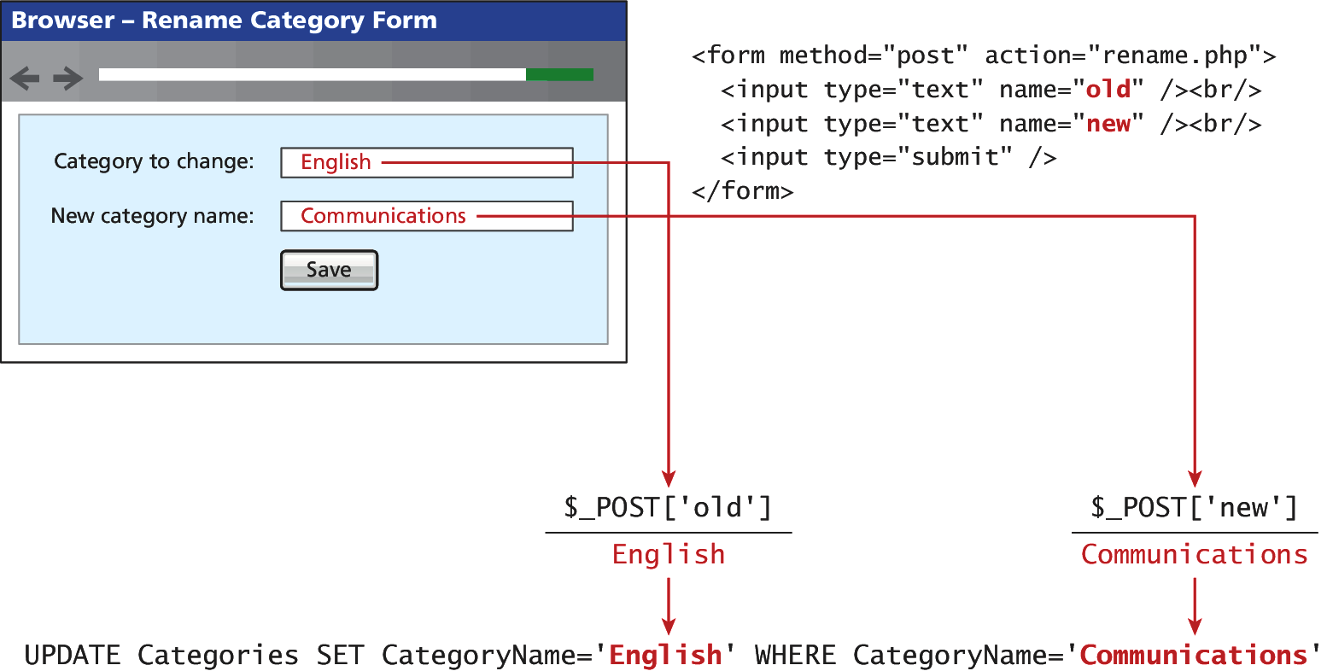
Figure 11.21 Integrating user input data into a query

Slide 11
Listing 11.15 Integrating user input into a query (first attempt)
<?php
//Listing 11.15 Integrating user input into a query (first attempt)
$from = $_POST['old'];
$to = $_POST['new'];
$sql = "UPDATE Categories SET CategoryName='$to' WHERE CategoryName='$from'";
$count = $pdo->exec($sql);
?>

Slide 12
Sanitizing User Input Data -Listing 11.16
Remove any special characters from a desired piece of text
mysqli_real_escape_string()
quote() - PDO
<?php//Listing 11.16 Sanitizing user input before use in an SQL query
$from = $pdo->quote($from);
$to = $pdo->quote($to);
$sql = "UPDATE Categories SET CategoryName=$to WHERE CategoryName=$from";
$count = $pdo->exec($sql);?>

Slide 13
Prepared Statements
Prepared Statements
A way to improve performance for queries that need to be executed multiple times
It also integrates sanitization into each user input automatically, so it can protect SQL Injection
To fully protect against attack called “SQL injection”
Go beyond “user input sanitization”
Use prepared statement technique (best)

Slide 14
Listing 11.17 Using a prepare statement (mysqli)
<?php
//Listing 11.17 Using a prepared statement (mysqli)
// retrieve parameter value from query string
$id = $_GET['id'];
// construct parameterized query – notice the ? Parameter
$sql = "SELECT Title, CopyrightYear FROM Books WHERE ID=?";
// create a prepared statement
if ($statement = mysqli_prepare($connection, $sql)) {
// Bind parameters s - string, b - blob, i - int, etc mysqli_stmt_bindm($statement, 'i', $id);
// execute query
mysqli_stmt_execute($statement);
// learn in next section how to access the returned data //...}
?>

Slide 15
Listing 11.18 Using a prepare statement (PDO)
<?php
//Listing 11.18 Using a prepared statement (PDO)
// retrieve parameter value from query string
$id = $_GET['id'];
/* method 1 */
$sql = "SELECT Title, CopyrightYear FROM Books WHERE ID = ?";
$statement = $pdo->prepare($sql);
$statement->bindValue(1, $id);
$statement->execute();
/* method 2 */
$sql = "SELECT Title, CopyrightYear FROM Books WHERE ID = :id";
$statement = $pdo->prepare($sql);
$statement->bindValue(':id', $id);
$statement->execute();?>

Slide 16
Listing 11.18 Using a prepare statement (PDO)
<?php
//Listing 11.18 Using a prepared statement (PDO)
// retrieve parameter value from query string
$id = $_GET['id'];
/* method 1 */
$sql = "SELECT Title, CopyrightYear FROM Books WHERE ID = ?";
$statement = $pdo->prepare($sql);
$statement->bindValue(1, $id);
$statement->execute();
/* method 2 */
$sql = "SELECT Title, CopyrightYear FROM Books WHERE ID = :id";
$statement = $pdo->prepare($sql);
$statement->bindValue(':id', $id);
$statement->execute();?>

Slide 17
Listing 11.19 Using named parameters (PDO)
<?php//Listing 11.19 Using named parameters (PDO)
/* technique 1 - question mark placeholders */
$sql = "INSERT INTO books (ISBN10, Title, CopyrightYear, ImprintId,ProductionStatusId, TrimSize, Description) VALUES(?,?,?,?,?,?,?)";
$statement = $pdo->prepare($sql);
$statement->bindValue(1, $_POST['isbn']);
$statement->bindValue(2, $_POST['title']);
$statement->bindValue(3, $_POST['year']);
$statement->bindValue(4, $_POST['imprint']);
$statement->bindValue(4, $_POST['status']);
$statement->bindValue(6, $_POST['size']);
$statement->bindValue(7, $_POST['desc']);
$statement->execute();

Slide 18
Listing 11.19 Using named parameters (PDO)
/* technique 2 - named parameters */
$sql = "INSERT INTO books (ISBN10, Title, CopyrightYear, ImprintId,ProductionStatusId, TrimSize, Description) VALUES (:isbn,:title, :year, :imprint, :status, :size, :desc) ";
$statement = $pdo->prepare($sql);
$statement->bindValue(':isbn', $_POST['isbn']);
$statement->bindValue(':title', $_POST['title']);
$statement->bindValue(':year', $_POST['year']);
$statement->bindValue(':imprint', $_POST['imprint']);
$statement->bindValue(':status', $_POST['status']);
$statement->bindValue(':size', $_POST['size']);
$statement->bindValue(':desc', $_POST['desc']);
$statement->execute();
?>

Slide 19
PHP mysql APIs
Process the Query Results
Displaying Content from a Result Set
Perform Calculation
Search for Something in it
Other Operation

Slide 20
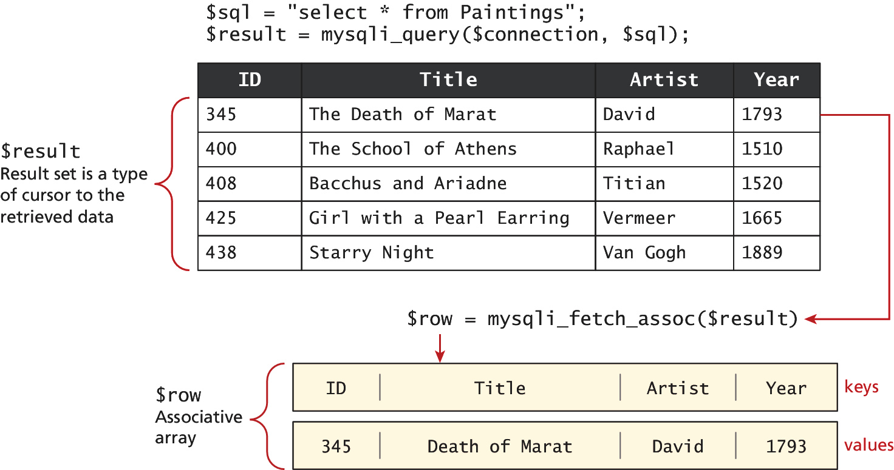
Figure 11.22 Fetching From a Result Set

Slide 21
Fetches and Displays Result Rest Listing 11.20 Looping through the result set
<?php
//Listing 11.20 Looping through the result set
// (mysqli—not prepared statements)
$sql = "select * from Categories order by CategoryName";
// run the query
if ($result = mysqli_query($connection, $sql)) {
// fetch a record from result set into an associative array while($row = mysqli_fetch_assoc($result)) {
// the keys match the field names from the table
echo $row['ID'] . " - " . $row['CategoryName'] ;
echo "<br/>";
}
}
?>

Slide 22
Fetches and Displays Result Rest Listing 11.21 Looping through the result set – using prepared statements
<?php
//Listing 11.21 Looping through the result set (mysqli—using
// prepared statements)
$sql = "SELECT Title, CopyrightYear FROM Books WHERE ID=?";
if ($statement = mysqli_prepare($connection, $sql)) {
mysqli_stmt_bindm($statement, 'i', $id);
mysqli_stmt_execute($statement);
// bind result variables
mysqli_stmt_bind_result($statement, $title, $year);
// loop through the data
while (mysqli_stmt_fetch($statement)) {
echo $title . '-' . $year . '<br/>';
}
}
?>

Slide 23
Fetches and Displays Result Rest Listing 11.22 Looping through the result set (PDO)
<?php
//Listing 11.22 Looping through the result set (PDO)
$sql = "select * from Categories order by CategoryName";
$result = $pdo->query($sql);
while ( $row = $result->fetch() ) {
echo $row['ID'] . " - " . $row['CategoryName'] . "<br/>";
}
?>

Slide 24
Fetching Into An Object

Slide 25
Book Class
class Book {
public $id;
public $title;
public $copyrightyear;
public $description;
}

Slide 26
Fetching Into an Object
<?php
//Listing 11.23 Populating an object from a result set (PDO)
$id = $_GET['id'];
$sql = "SELECT id, title, copyrightYear, description FROM Books WHERE id= ?";
$statement = $pdo->prepare($sql);
$statement->bindValue(1, $id);
$statement->execute();
$b = $statement->fetchObject('Book');
echo 'ID: ' . $b->id . '<br/>';
echo 'Title: ' . $b->title . '<br/>';
echo 'Year: ' . $b->copyrightYear . '<br/>';
echo 'Description: ' . $b->description . '<br/>';
?>

Slide 27
Fetching Into an Object
<?php
//Listing 11.24 Letting an object populate itself from a result set
class Book {
public $id;
public $title;
public $copyrightYear;
public $description;
function __construct($record) {
// the references to the field names in associative array must
// match the case in the table
$this->id = $record['ID'];
$this->title = $record['Title'];
$this->copyrightYear = $record['CopyrightYear'];
$this->description = $record['Description'];
} }

Slide 28
Fetching Into an Object
//Listing 11.24 Letting an object populate itself from a result set
//...
// in some other page or class
$statement->execute();
// using the Book class
$b = new Book($statement->fetch());
echo 'ID: ' . $b->id . '<br/>';
echo 'Title: ' . $b->title . '<br/>';
echo 'Copyright Year: ' . $b->copyrightYear . '<br/>';
?>

Slide 29
Freeing Resources and Closing Connection
<?php
//Listing 11.25 Closing the connection
// mysqli approach
$connection = mysqli_connect($host, $user, $pass, $database);
//...
// release the memory used by the result set. This is necessary if
// you are going to run another query on this connectionmysqli_free_result($result);
//...
// close the database connectionmysqli_close($connection);
// PDO approach
$pdo = new PDO($connString,$user,$pass);
//...
// closes connection and frees the resources used by the PDO object
$pdo = null;?>

Slide 30
Using Transactions
Transactions
Unnecessary when retrieving database data
Should be used for most scenarios involving any database “writes”

Slide 31
Listing 11.26 Using Transactions (mysqli)
<?php
//Listing 11.26 Using transactions (mysqi extension)
$connection = mysqli_connect($host, $user, $pass, $database);
//...
/* set autocommit to off. If autocommit is on, then mysql willcommit (i.e., make the data change permanent) each command afterit is executed */
mysqli_autocommit($connection, FALSE);
/* insert some values */
$result1 = mysqli_query($connection,"INSERT INTO Categories (CategoryName) VALUES ('Philosophy')");
$result2 = mysqli_query($connection,"INSERT INTO Categories (CategoryName) VALUES ('Art')");

Slide 32
Listing 11.26 Using Transactions (mysqli)
<?php
//Listing 11.26 Using transactions (mysqi extension)
if ($result1 && $result2) {
/* commit transaction */
mysqli_commit($connection);
}
else
{
/* rollback transaction */
mysqli_rollback($connection);}
?>

Slide 33
Listing 11.27 Using Transactions (PDO)
<?php
//Listing 11.27 Using transactions (PDO)
$pdo = new PDO($connString,$user,$pass);
// turn on exceptions so that exception is thrown if error occurs
$pdo->setAttribute(PDO::ATTR_ERRMODE, PDO::ERRMODE_EXCEPTION);
//...
try {
// begin a transaction
$pdo->beginTransaction();
// a set of queries: if one fails, an exception will be thrown
$pdo->query("INSERT INTO Categories (CategoryName) VALUES ('Philosophy')");
$pdo->query("INSERT INTO Categories (CategoryName) VALUES ('Art')");

Slide 34
Listing 11.27 Using Transactions (PDO)
//Listing 11.27 Using transactions (PDO)
// if we arrive here, it means that no exception was thrown
// which means no query has failed, so we can commit the
// transaction
$pdo->commit();
}
catch (Exception $e)
{
// we must rollback the transaction since an error occurred
// with insert
$pdo->rollback();
}
?>

Slide 35
More on PHP mysqli Fectch Functions

Slide 36
PHP MySQL Fetching Functions
mysqli_fetch_all(): Fetches all result rows as an associate array, a numeric array, or both
http://php.net/manual/en/mysqli-result.fetch-all.php
mysqli_fetch_array(): Fetches a result row as an associate array, a numeric array, or both
http://php.net/manual/en/mysqli-result.fetch-array.php
mysqli_fetch_assoc(): Fetches a result row as an associate array
http://php.net/manual/en/mysqli-result.fetch-assoc.php
mysqli_fetch_field(): Returns the definition of one column of a result set as an object. Call this function repeatedly to retrieve information about all columns in the result set.
http://php.net/manual/en/mysqli-result.fetch-field.php

Slide 37
PHP MySQL: Procedural Style Fetching Functions
mysqli_fetch_fields(): Returns an array of objects which contains field definition information or FALSE if no filed information is available
http://php.net/manual/en/mysqli-result.fetch-fields.php
mysqli_fetch_object(): Returns the current row of a result as an object
http://php.net/manual/en/mysqli-result.fetch-object.php
mysqli_fetch_row(): Fetch one row of data from the result set as an numeric array
http://php.net/manual/en/mysqli-result.fetch-row.php

Slide 38
Sample Database Techniques
Database Display Tasks in PHP
Display a List of Links
Search and Result Page
Editing a Record
Saving and Displaying Raw Files in the Database

Slide 39
Display a List of Links LAB 11 Exercise
$sql = “SELECT * FROM Categories ORDER BY CategoryName”;
$results = $pdo -> query($sql);
while ($row = $results -> fetch() {
echo ‘<li>’;
echo ‘<a href=‘list.php?category=‘ .
row[‘ID’] . ‘”>’;
echo $row[‘CategoryName’];
echo ‘</a.’>;
echo ‘</li>’;
}

Slide 40
Listing 11.28 Alternating list of links example
<?php
//Listing 11.28 Alternate list of links example
?>
<ul>
<?php
$result = getResults(); // some function that returns the result set
while ($row = $result->fetch()) {
?>
<li>
<a href="l ist.php?category=<?php echo $row['ID']; ?>">
<?php echo $row['CategoryName']; ?>
</a>
</li>
<?php } ?>
</ul>

Slide 41
Markup List Generation
<ul>
<li><a href=“list.php?category=7”>Business</a></li>
<li><a href=“list.php?category=2”>Computer Science</a></li>
<li><a href=“list.php?category=3”>Economics</a></li>
<li><a href=“list.php?category=9”>Engineering</a></li>
<li><a href=“list.php?category=4”>English</a></li>
<li><a href=“list.php?category=6”>Mathematics</a></li>
<li><a href=“list.php?category=8”>Statistics</a></li>
<li><a href=“list.php?category=5”>Student Success</a></li>
</ul>

Slide 42
Q & A

