Slide 1
CPET 499/ITC 250 Web Systems
Part 1 o 2
Chapter 12
Error Handling and Validation
Text Book:
* Fundamentals of Web Development, 2015, by Randy Connolly and Ricardo Hoar, published by Pearson
Paul I-Hai Lin, Professor
http://www.etcs.ipfw.edu/~lin

Slide 2
Topics
Why the different types of errors and how they differ from exceptions
The different forms of error reporting in PHP
How to handle errors and exceptions
What regular expressions are and how to use them in JavaScript and PHP
Some best practices in design user input validation
How to validate inputs in HTML5, JavaScript, and PHP

Slide 3
Errors and Exceptions
Exceptions
For run time errors handling
Object-oriented construct:
try … catch … exceptions
Errors
Expected errors
Warnings
Fatal Errors

Slide 4
Errors
Types of Errors
Expected errors
An error that routinely occurs during an application.
User data entering errors
isset() can be used for testing the value of a variable
empty() for checking query string values:
Return “TRUE” if a variable is NULL, FALSE, ZERO, or an EMPTY STRING
is_numeric() for testing a query string parameter to be numeric
Warnings
Fatal errors

Slide 5
Errors
Types of Errors
Expected errors
Warnings
PHP warning messages may or may not be displayed
It will halt the execution of the page
Fatal errors
Serious errors that the execution of the program will terminate unless handled in other proper ways

Slide 6
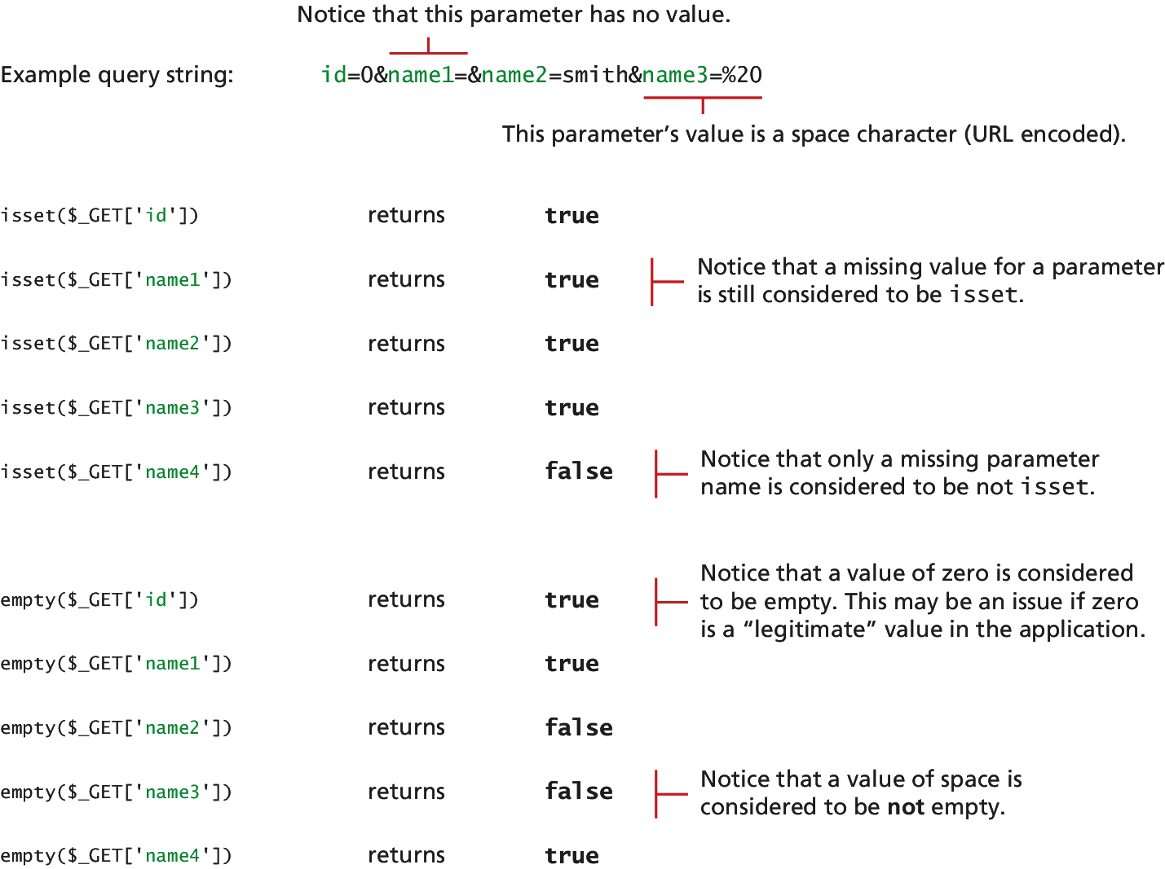
Figure 12.1 Comparing isset() and empty() with query string parameters

Slide 7
Listing 12.1 Testing a query string: existence & numeric
<?php
//Listing 12.1 Testing a query string to see if it exists and is numeric
$id = $_GET['id'];
if (!empty($id) && is_numeric($id) )
{
// use the query string since it exists and is a numeric value
//...}
?>

Slide 8
PHP Error Reporting
Runtime Configuration
http://php.net/manual/en/errorfunc.configuration.php
Three main error reporting flags
error_reporting()
error_reporting(E_ALL)
errort_reporting = E_ALL … in php.ini File
display_errors
Ini_set(‘display_errors’, ‘0’);
log_errors

Slide 9
PHP Procedural Error Handling
Runtime Configuration

Slide 10
PHP Object-Oriented Exception Handling

Slide 11
Custom Error and Exception Handling

Slide 12
Regular Expressions
Regular Expressions - Definition
A regular expressions is a set of special characters that define a pattern to be matched in strings.
Found in Unix Utilities: vi, grep, sed
In Web applications, we want to match
A phone number
Zip code
Email address, etc

Slide 13
Regular Expressions
Perl Regular Expression, https://perldoc.perl.org/perlre.html
JavaScript Regular Expression
Special characters, https://developer.mozilla.org/en-US/docs/Web/JavaScript/Guide/Regular_Expressions
RegExp(), https://developer.mozilla.org/en-US/docs/Web/JavaScript/Reference/Global_Objects/RegExp
PHP Regular Expression, http://php.net/manual/en/reference.pcre.pattern.syntax.php
MySQL Regular Expression:
Pattern Matching, https://dev.mysql.com/doc/refman/5.7/en/pattern-matching.html
Regular Expressions, https://dev.mysql.com/doc/refman/5.7/en/regexp.html

Slide 14
Regular Expressions
PHP Regular Expressions, http://php.net/manual/en/reference.pcre.pattern.syntax.php
MySQL Regular Expressions:
Pattern Matching, https://dev.mysql.com/doc/refman/5.7/en/pattern-matching.html
Regular Expressions, https://dev.mysql.com/doc/refman/5.7/en/regexp.html
.NET Regular Expression, https://docs.microsoft.com/en-us/dotnet/standard/base-types/regular-expressions

Slide 15
Regular Expression Syntax
A regular expression consists of two types of characters
Literals – characters to be matched in the target string
Metacharacters – special symbols that acts as a command to the regular expression parser
14 Metacharacters
. | [ | ] | \ | ( | ) | ^
$ | | | * | ? | { | } | +

Slide 16
Regular Expression Examples
PHP Example: begin and end with backward slahes
$pattern = ‘\ran\’;
‘randy Connolly’; ‘Sue ran to store’; “I would like a cranberry’
$check = ‘Sue ran to the store’;
If (preg_match($pattern, $check){
echo ‘Match found!’;
JavaScript Example: begin and end with forward slashes
var pattern = /ran/;
If (pattern.test(‘Sue ran to the store’)) {
Document.write(‘Match found’);}

Slide 17
Common Regular Expression Patterns
Pattern | Description
^ qwerty $ | Match the entire string between the ^ and the $ symbols.
\t | Matched a tab character
\n | Matches a new-line character
. | Matches any character other than \n
[qwerty] | Matches any single character of the set contained with the brackets
[^qwerty] | Matches any single character not contained within the brackets

Slide 18
Common Regular Expression Patterns
Pattern | Description
[a-z] | Matches any single character within the range of characters
\w | Matches any word character, equivalent to {a-zA-Z0-9}
\W | Matches any nonword character
\s | Matches any white-space character
\S | Matches any nonwhite-space character

Slide 19
Common Regular Expression Patterns
Pattern | Description
\d | Matches any digit
\D | Matched any nondigit
* | Indicates zero or more matches
+ | Indicates one or more matches
? | Indicates zero or one match
{n} | Indicates exactly n matches
{n,} | Indicates n or more matches
{n.m} | Indicates at least n but no more than m matches
| | Matches any one of the terms separated by the | character. Equivalent to Boolean OR
( ) | Groups a subexpression. Grouping can make a regular expression easier to understand

Slide 20
Extended Regular Expression Examples
^\d{3}-\d{4}$ : Matches any string containing three numbers, follow by a dash, followed by four numbers without any other characters
^[2-9]\d{2}-\d{4}$ : Matched a phone number that would NOT allow the first digit in the phone number to be a zero (“0”) or a one (“1”).
^[2-9]\d{2}[-\s\.]\d{4}$ :Allows a single space (481 6339), a period (481,6339), or a dash (481-6339) between the two sets of numbers.
^[2-9]\d{2}[-\s\.]\s*\d{4}$ :Allow multiple spaces (but only one single dash or period) in our phone.

Slide 21
Listing 12.7 A phone number validation without regular expression (partial listing)
//Listing 12.7 A phone number validation script without regular //expressions
var phone=document.getElementById("phone").value;
var parts = phone.split("."); // split on .
if (parts.length !=3) {
parts = phone.split("-"); // split on –
}

Slide 22
Listing 12.7 A phone number validation without regular expression (partial listing)
if (parts.length == 3) {
var valid=true; // use a flag to track validity
for (var i=0; i < parts.length; i++) {
// check that each component is a number
if (!isNumeric(parts[i])) {
alert( "you have a non-numeric component");
valid=false; }
else
{ // depending on which component make sure it's in range
if (i<2) {
if (parts[i]<100 || parts[i]>999) {
valid=false; } }
else { if (parts[i]<1000 || parts[i]>9999) { valid=false; } }
} // end if isNumeric
} // end for loop

Slide 23
Listing 12.7 A phone number validation without regular expression (partial listing)
if (valid) {
alert(phone + "is a valid phone number");
}
}alert ("not a valid phone number");

Slide 24
Validating User Input
Types of Input Validation
Required Information
Data fields just cannot be left empty
Emails, phones, user name, passwords, etc.
Correct Data Type
Numeric, Dates, Strings, etc.
Correct Format
Postal codes, Credit Card numbers, Social security numbers, etc.
Comparison: passwords, entered values
Range Check: Dates, number
Custom Validation:

Slide 25
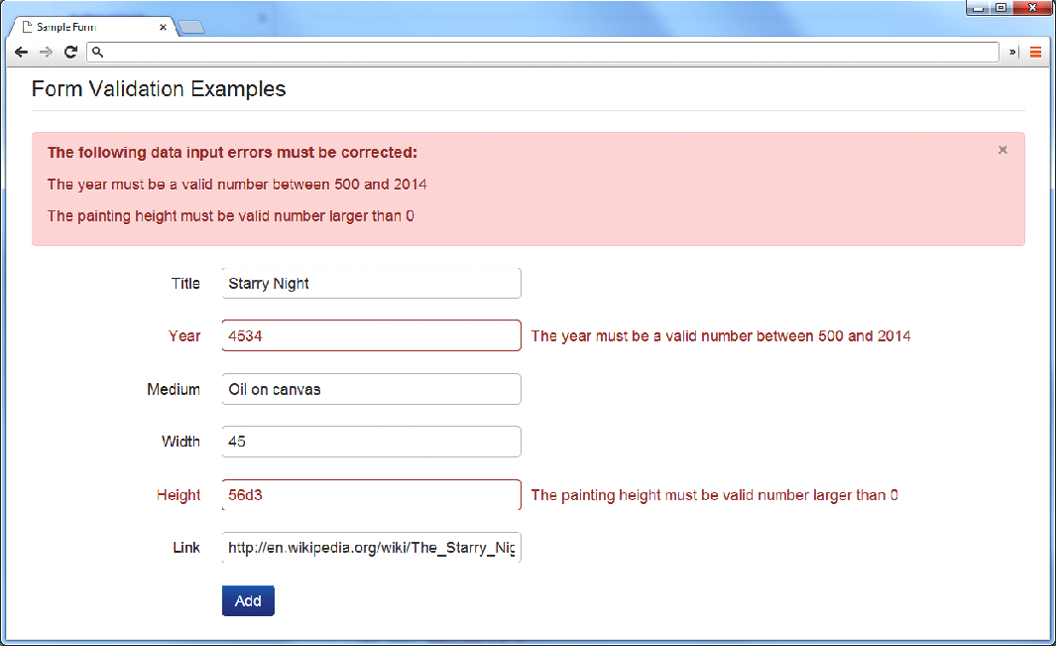
Notifying the User
What is the Problem?
Where is the Problem?
If appropriate, how do I fix it?

Slide 26
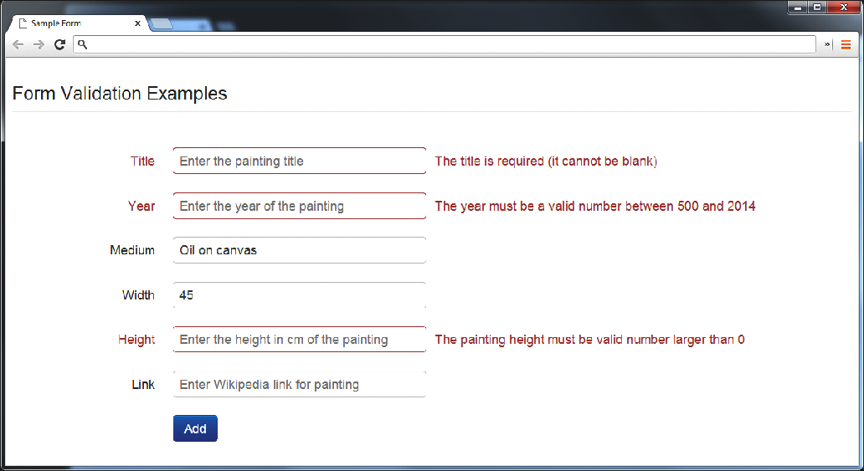
Notifying the User
Fig. 12.3 Indicating where an error is located

Slide 27
Notifying the User
Fig. 12.3 Indicating where an error is located

Slide 28
How to Reduce Validation Errors
Common ways that minimize user validation errors
Using pop-up JavaScript Alert Messages (or other popup),
Provide textual hints to the user on the form itself, Fig. 12-4
Using tool tips or pop-over to display context-sensitive help, Fig. 12. 5
Providing JavaScript-based mask, Fig. 12.6

Slide 29
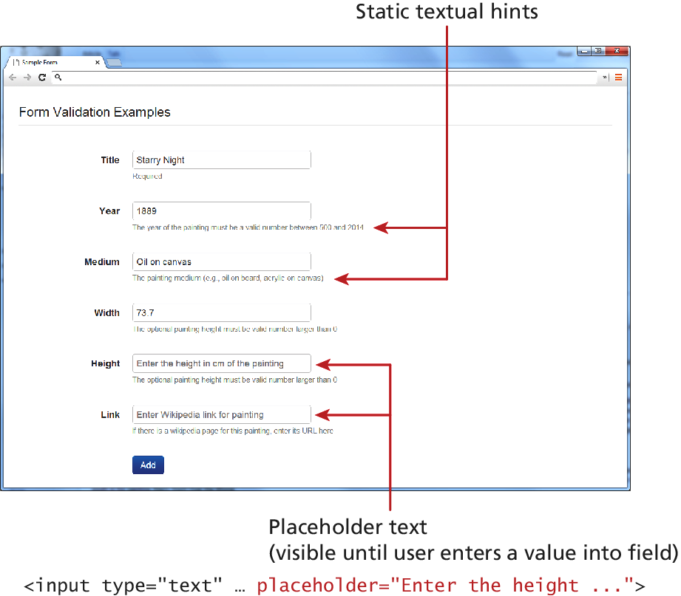
Fig. 12.4 Providing textual hints

Slide 30
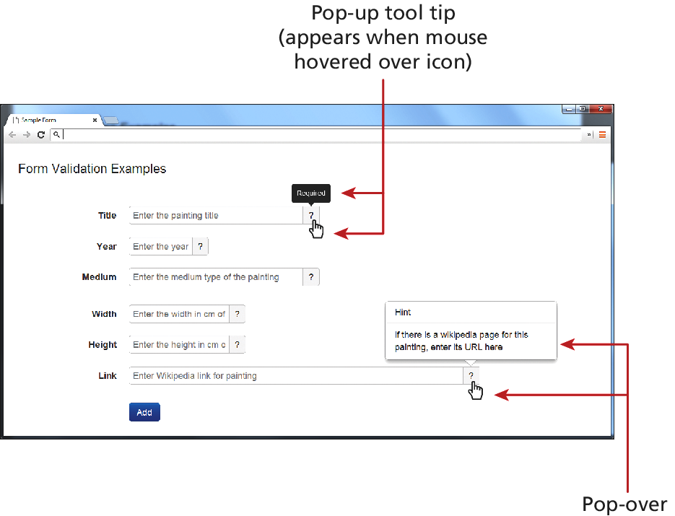
Fig. 12.5 Using tool tips or pop-over

Slide 31
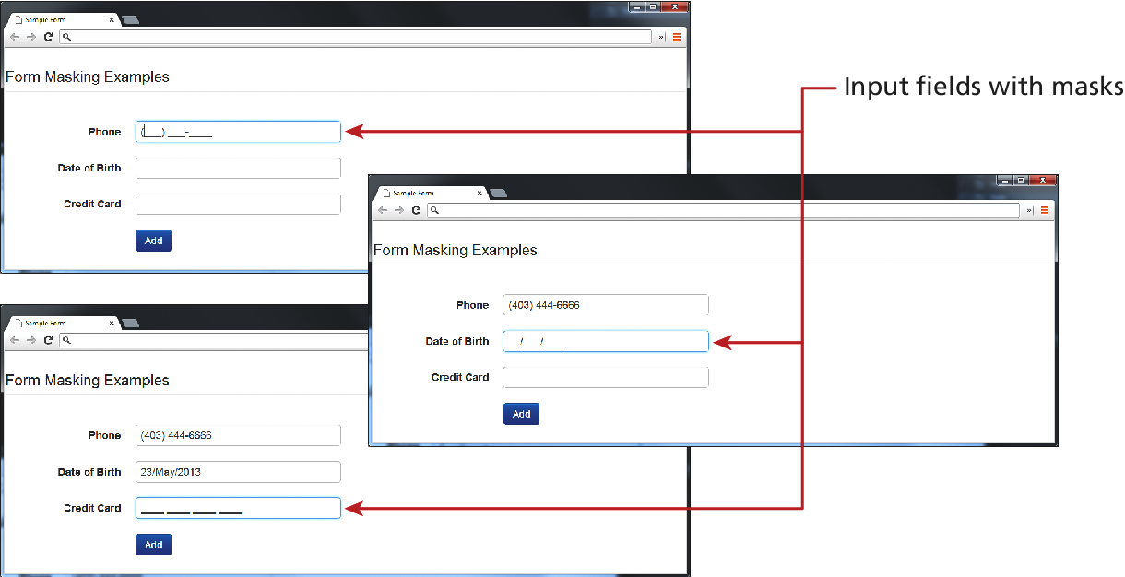
Fig. 12.6 Providing JavaScript-based mask

Slide 32
Where to Perform Validation
Performing basic validation with client browsers with HTML 5
Using JavaScript on the client side (may be turned off on the user’s browser)
Server side validation (always)
For example: Validation at the PHP Level

Slide 33
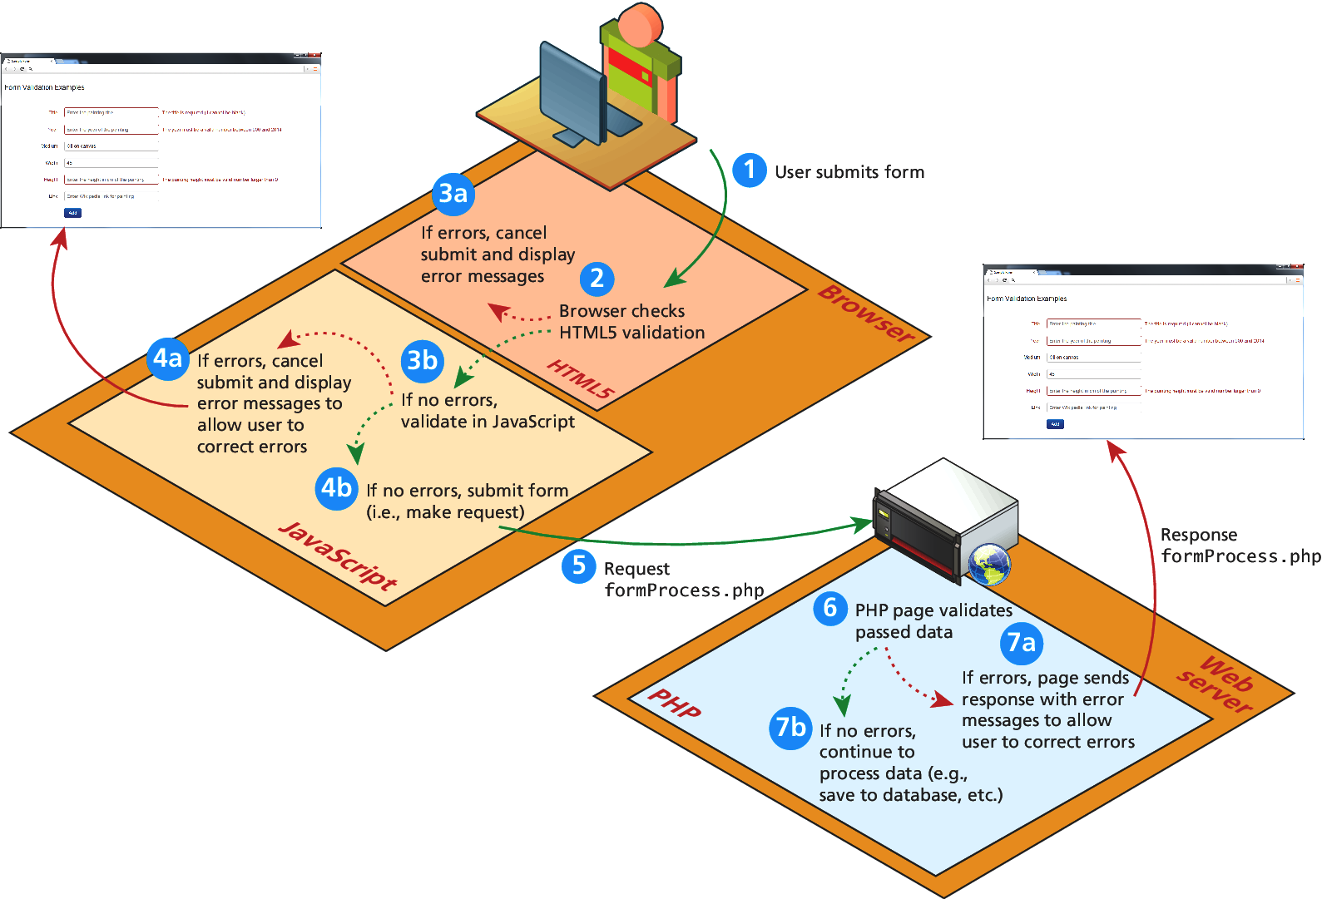
Fig. 12.7 Visualizing levels of validation

Slide 34
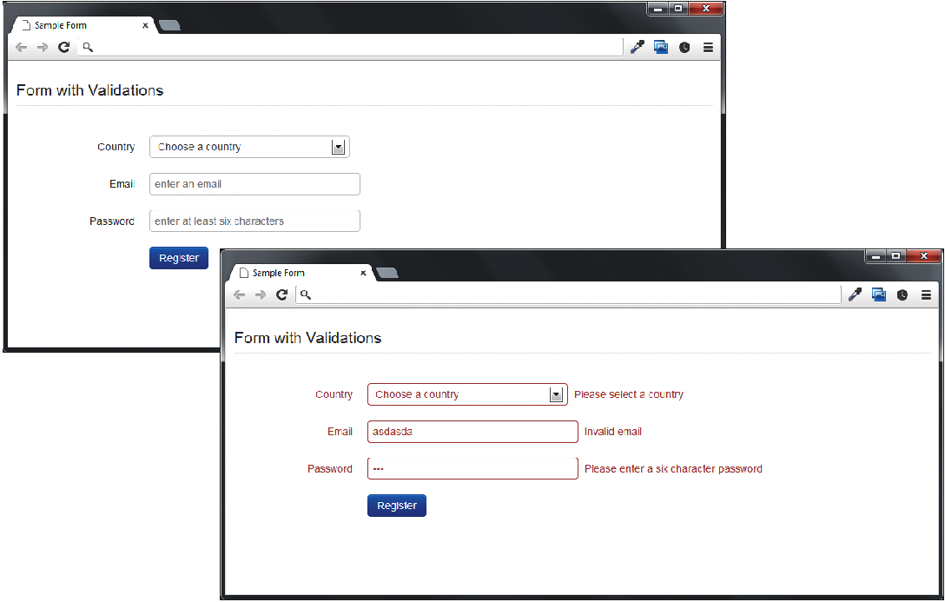
Fig. 12.8 Example form to be validated

Slide 35
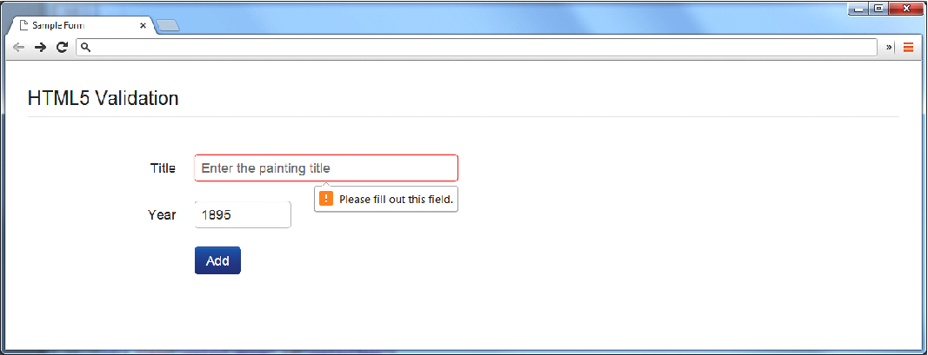
Fig. 12.9 HTML5 browser validation
Add “required attribute” to input element
<form id=“sampleForm” method=“…” action=“…” nonvalidate>
http://www.w3.org/TR/html5/forms.html

Slide 36
Listing 12.8 Example form (validationform.php) to be validated
<?php
//Listing 12.8 Example form (validationform.php) to be validated?>
<form method="POST" action=“validationform.php class="form-horizontal" id="sampleForm" >
<fieldset><legend>Form with Validations</legend>
<div class="control-group" id="controlCountry">
<label class="control-label" for="country">Country</label>
<div class="controls"><select id="country" name="country" class="input-xlarge"><option value="0">Choose a country</option><option value="1">Canada</option><option value="2">France</option><option value="3">Germany</option><option value="4">United States</option></select>
<span class="help-inline" id="errorCountry"></span>
</div>
</div>

Slide 37
Listing 12.8 Example form (validationform.php) to be validated
<div class="control-group" id="controlEmail">
<label class="control-label" for="email">Email</label>
<div class="controls">
<input id="email" name="email" type="text"
placeholder="enter an email" class="input-xlarge“ required>
<span class="help-inline" id="errorEmail"></span>
</div>

Slide 38
Listing 12.8 Example form (validationform.php) to be validated
<div class="control-group" id="controlPassword">
<label class="control-label" for="password">Password</label>
<div class="controls">
<input id="password" name="password" type="password"
placeholder="enter at least six characters" class="input-xlarge"
required>
<span class="help-inline" d="errorPassword"></span>
</div>
</div>

Slide 39
Listing 12.8 Example form (validationform.php) to be validated
<div class="control-group">
<label class="control-label" for="singlebutton"></label>
<div class="controls"><button id="singlebutton"
name="singlebutton" class="btn btn-primary">
Register</button>
</div>
</div>
</fieldset>
</form>

Slide 40
Validation at the JavaScript Lvel
<div class="control-group"><label class="control-label" for="singlebutton"></label><div class="controls"><button id="singlebutton" name="singlebutton" class="btn btn-primary">Register</button></div></div></fieldset></form>

Slide 41
Validation at the JavaScript Level
Initialize the validation function once an element loses its focus
function init(){
var sampleForm=document.getElementById(‘sampleForm’);
sampleForm.onsubmit = validateForm;
}
// Call the init() function once all the html has been loaded
window.onload = init;
Password input element is between 8 and 16 character
var passReg = /^[a-zA-Z]\w{8,16}$/;
if(! passReg.test(password.value){
// provide some type of error message
Listing 12.9 Complete JavaScript Validation

Slide 42
Validation at the PHP Level
Listing 12.10 ValidationResult Class
Listing 12.11 PHP form validation
Listing 12.12 Revised form with PHP validation messages

Slide 43
Summary and Conclusion
Q/A ?

