Slide 1
C&B Homes
Progress Report
Clark Collins and Nick Bauer
ITC 250: Web Systems

Slide 2
Project Summary
This is a website that encompasses everything you need to schedule and contact our home inspection company.
This website houses videos with do-it-yourself information to help homeowners maintain their home.
This website allows users to schedule appointments and get estimates for the cost to have their home inspected.

Slide 3
OVERVIEW
Home Inspector’s Website
User Database
Sign in Page
How-To Video Page
Business Information Page
Blog/Forum Page
Form Page
Account Page
BLOB Database for Images
Vector Image(s)

Slide 4
Project Scope
Website Requirements
Design Website
Build Website
Code the logic of the website
Design and build the database
Testing
Register an account
Login to account, log out of account
Test video playback

Slide 5
Sections in development
Search Box
Parallax/Vector Imagery
CSS file for Video preview page
JavaScript Form Page for error checking/confirmation
BLOB Database and INI file is in progress, working on uploading images
Voter counting page is in progress

Slide 6
Problems and Corrections
One of the major problems that we are working through is converting input into a PHP file as a string into an integer within the SQL Database.
Correction to this was to create the String as a VarChar and not an integer within the SQL Database.
Continually working on the CSS page to get the format of the page how we want it for the video preview.
Limit the amount of CSS coding to do due to time constraints.
Integrating regular expression links and regular correction if statements (catch verification statements) for verifying user input.

Slide 7
Project milestones and deliverables
Prototype
Database is in progress
PHP Outline complete
Researching is nearly complete

Slide 8
Web system design:

Slide 9
user login: DIAGRAM
Our website validates whether or not the user has put in the correct credentials

Slide 10
System requirements: SoFTWARE
Website Requirements:
Website
Login Page
User Data Page
Languages Used:
HTML 5
CSS
JavaScript
PHP
INI Files
SQL

Slide 11
System HARDWARE SPECIFICATIONS
Server System Requirements:
XAMPP (Latest Version)
Windows 7, 8, 10 o
Specs:
12GB RAM
8 CPU threads
20 GB of SSD Disk Space

Slide 12
Major components:
Hardware:
Windows 10 x64 Server
Windows Development PC
ASUS Router with port forwarding
Software:
Notepad++
Database Management GUI

Slide 13
Software programming tools
XAMPP
BRACKETS (An Adobe Product)
Notepad++
Hosted through NO-IP

Slide 14
schedule

Slide 15
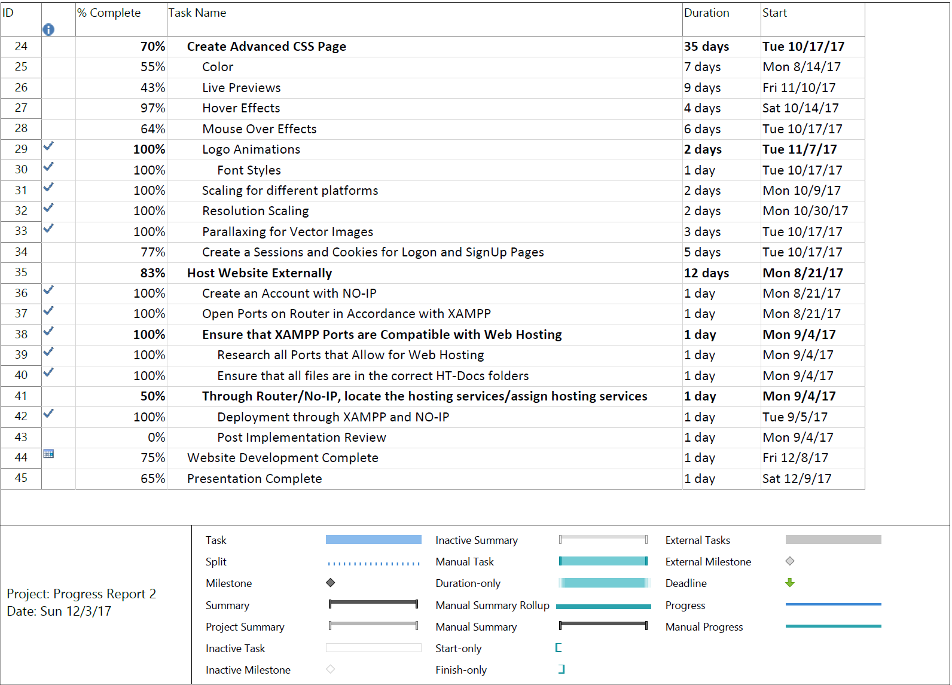
Schedule Continued

Slide 16
Summary
The website is nearly done, however, we are still working on linking the pages and getting the final touches completed.
Final security measures are being placed into the website
Working on gathering more data to be input into the databases

