Slide 1
Racine TALLA: The Journey Progress report 1:
CPET499: Web systems

Slide 2
Project Summary:
This website (project) will allow users, who are family, ex-teammates and friends to be able to navigate through my page and be a part of my journey (basketball career).
It will gather information from a database that will be displayed under a table form.
It will also have the functionality of counting the number of visits, date and IP address of the visitors.
It will have links to different pages to show more about my basketball career.
They can also insert comments and will have a page to start dialogs with myself or just contact me through email, phone and all the other contact info presented in the contact page.

Slide 3
Overview:
The log in option will be disabled
The visit count with be monitored
Emails can be sent and contain files that I can then receive and upload to the page; Everyone shouldn’t just be able to add to the page.

Slide 4
Project Scope:
Activities:
Design the mock up for the webpage
Have an abstract built of the page
Do the coding
Design an build the database
Data entered in the database
Testing
Make sure only users with log in are allowed
Make sure database coordinates appropriately
Emails and phone go through

Slide 5
Risks and problems
Risk of database not cooperating
Scope respects the time frame
Security
Everyone is not allowed to post in the page
Only one has administrative access
Possible scope change depending on milestones accomplished
I will have more update on the second progress report

Slide 6
Project Milestones and deliverables:
Prototype
Working page
Working adding images and comments
All coding correctly applied
HTML, CSS, JS, PHP and Database correctly implemented
Final Report
Progress Report 1
Progress Report 2
Final Presentation

Slide 7
Web Design

Slide 8
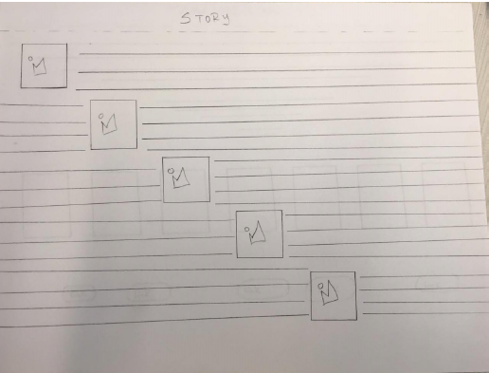
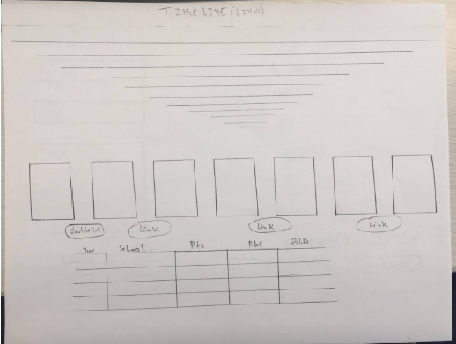
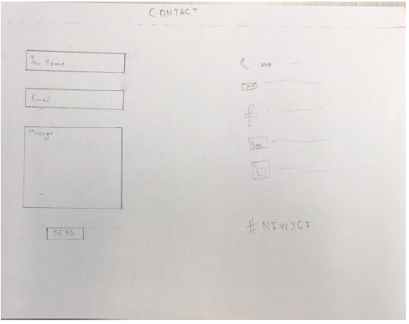
Mock Up page

Slide 9
Software/Programming tools:
Dreamweaver
For coding
SQL Server Management Studio
For database
Coding
HTML
CSS
PHP
JS
XAMPP
Apache/MySQL
Hardware
HP notebook
8Gb Ram

Slide 10
Schedule

Slide 11
Already Accomplished:
Site Map
Mock Up
Test that will be in the page
Images
Datable data

Slide 12
Progress and Changes since the first Progress Report
The scope has changed a bit:
I am no longer going with the log in page
I will have a visit counter
Deliverables:
Everything has been implemented
Database is the only thing left
I have mock data in place right now just for the design but that will be replaced by the database.
I am in the time scope and will deliver the page on time

Slide 13
THANK YOU

