Slide 1
SimpleRex – Progress Report 2
Grant Harmeyer – ITC 250
Fall 2017 – November 30, 2017
Dr. Paul I. Lin

Slide 2
Project Summary
SimpleRex is a web-based application that provides management capabilities for IT service requests within an organization
Users have the ability to log in and submit a ticket. Additionally, users can check the status of their tickets
Technicians will be able to setup users, reset passwords and add comments to tickets when working to resolve the reported issues.

Slide 3
Product Features
Role-based access
Technician
User management
Ticket management
User
Ticket submission
Ticket inquiry
Service Request
Ticket submission
Ticket inquiry and notification
Notification
Email system for notification of :
Comment
Ticket status change

Slide 4
Project Scope
Activities
Database design
Scaffolding of site
Extend scaffold for Comments
Branding and UX
Testing
Login/Logout/Registration
Roles (Technician, User)
Email updates
Deployment
Database deploy to production
Website deploy to production (http://simplerex.harmeyer.me)
11/16/2017
Scope Change
Service catalog feature is no longer considered part of the minimally viable product
11/30/2017
No change in scope from the last report.

Slide 5
Project Timeline (11/30/2017)
Task Name | Duration | Work | % Complete
SimpleRex | 80 hrs | 35 hrs
Site scaffolding | 2 hrs | 2 hrs | 100%
Branding (Foundation) | 2 hrs | 2 hrs | 100%
Database Design | 1 hr | 1 hr | 100%
Module Implementation | 48 hrs | 22 hrs
Email System | 4 hrs | 4 hrs | 80%
Authentication and User Management | 6 hrs | 6 hrs | 100%
Service Catalog | 4 hrs | 4 hrs | 0%
Ticket Entry and Management | 8 hrs | 8 hrs | 95%
Minimally Viable Product | 0 hrs | 0 hrs
Testing | 32 hrs | 8 hrs
Authentication and User Management | 1 hr | 2 hrs | 100%
Service Catalog | 1 hr | 2 hrs | 0%
Email system | 1 hr | 2 hrs | 50%
Ticket Entry and Management | 1 hr | 2 hrs | 95%
Testing Complete | 0 hrs | 0 hrs
Final Delivery | 0 hrs | 0 hrs

Slide 6
Problems and Corrections
11/16/2017
Service Catalog was determined to not be necessary for this project at this time
The email system should not be beyond the scope of the project, but is lower in priority and if time is not available, it will be removed from the minimally viable product.
11/30/2017
Emailing from the system proved to be a bit challenging, but it has been largely implemented as designed
Branding was updated and color scheme/styling updated.

Slide 7
System Software and Tools
User Interface
HTML5
Bootstrap (Responsive)
JavaScript
Client-side validation and logic
Application Logic
PHP
Cake PHP (https://cakephp.org)
MVC scaffold
View extension for Comments
MySQL for database
Tools
Visual Studio Code
FileZilla FTP Client
MySQL Workbench
Hosting
Microsoft Azure
App Service for web application
PaaS database service for MySQL database
http://simplerex.harmeyer.me

Slide 8
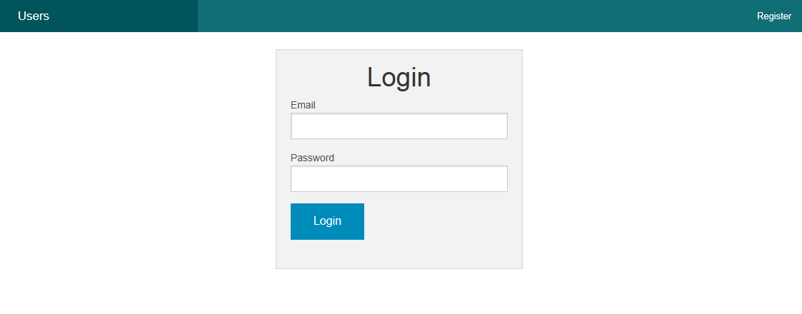
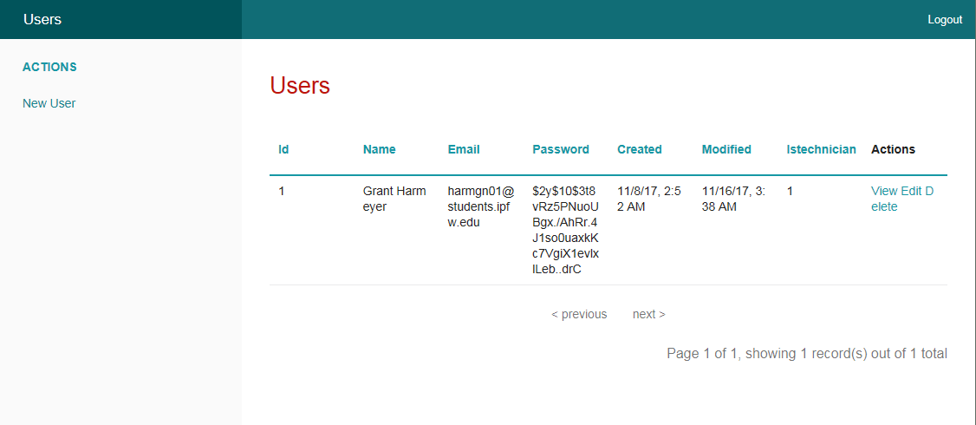
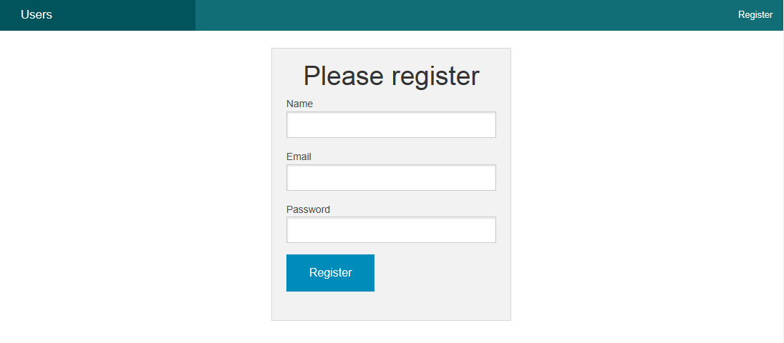
User Interface 11/16/2017
Login Register
User Management

Slide 9
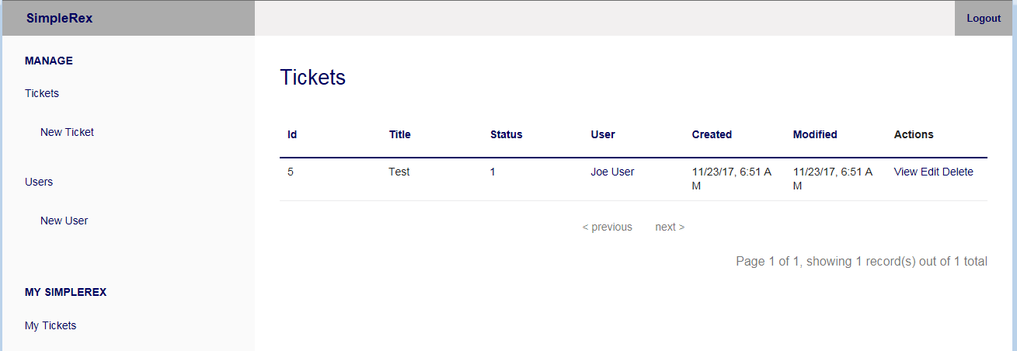
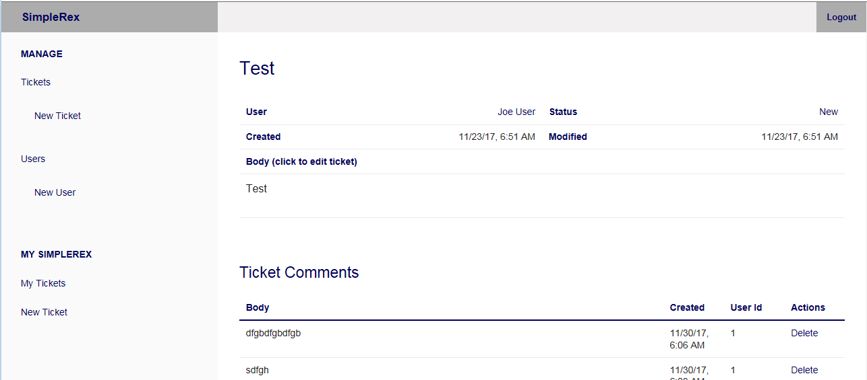
User Interface 11/30/2017 (Logged in as a technician)

Slide 10
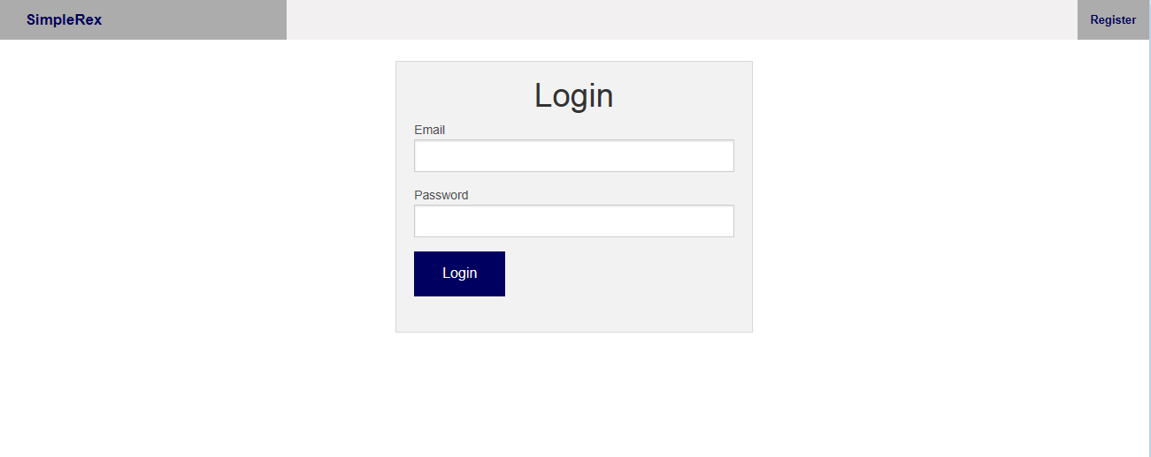
User Interface 11/30/2017 (Logged in as a user)

