Slide 1
Tic-Tac-Toe: The Game
Progress Report 2
Chance Meador
CPET 499 Web Systems

Slide 2
Project Summary
This web application contains the classic Tic-Tac-Toe game that is full functional and can display statistics for the amount of games a user wins, loses, and ties.
Users will have the ability to create a unique username in order to link their login and statistics to

Slide 3
Overview
Main Components
  Login for both player 1 and player 2, registration for new players, and ability to logout
  Selection of X or O
    Randomly selects a player to be the first picker
  Fully functional Tic-Tac-Toe gameboard
    Switches between user depending on who went first
    Places picture of x or o depending on user
    Updates statistics at conclusion of round
    Games will continue until user clicks end game button

Slide 4
Project Scope
Activities
  Designing the website
  Building the website
  Design the database
  Build the database
  Code game logic
Testing
  User registration, Login
  All scenarios that can happen in a game of Tic-Tac-Toe
  Random user selected to pick x or o

Slide 5
Problems/Corrections
MySQL
  Ran Into Query Issues with PHP – Corrected By Looking Into Correct Syntax for SQL
CSS
  Ran into centering issues – Correct By Finding Properties That Dynamically Set Position
AJAX
  Ran into issues of Needing Code Ran After the Execution of a PHP Script – AJAX Allows us to Run Specific Code Upon Competition of a PHP Script with Needed Data

Slide 6
Milestones/Deliverables
Web Application
  Front-end components completed
  Back-end components completed
  Database built
  Application tests
Final Report
Final Presentation

Slide 7
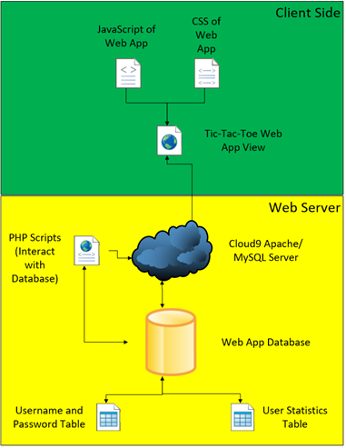
System Design - Overview

Slide 8
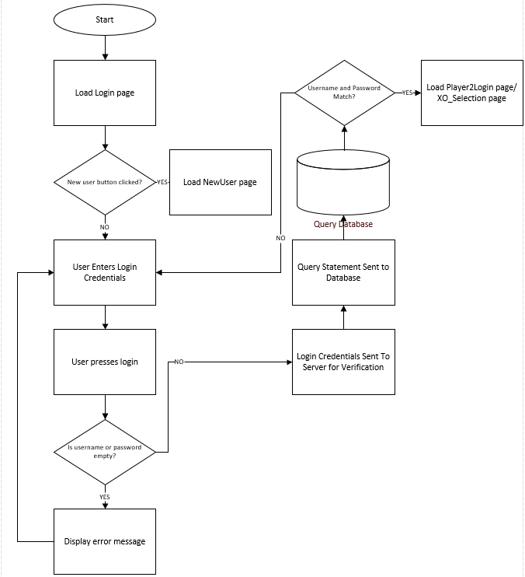
System Design – User Login

Slide 9
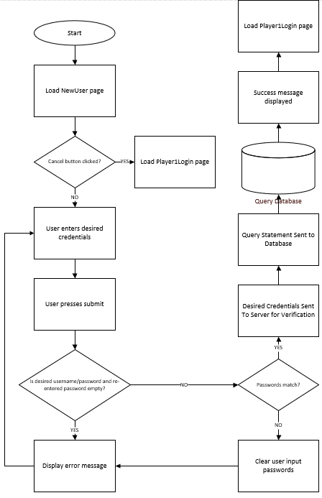
System Design – New User Creation

Slide 10
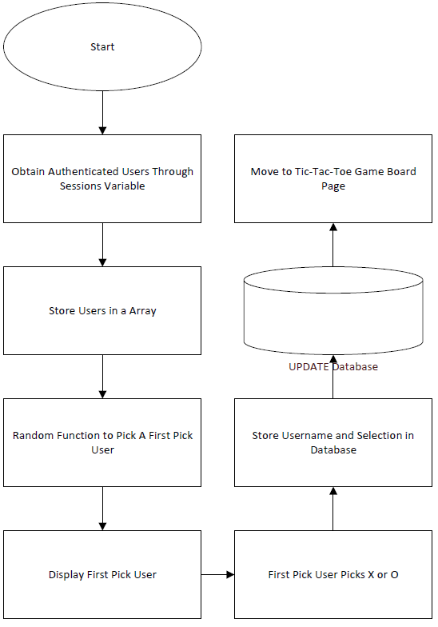
System Design – Game Piece Selection

Slide 11
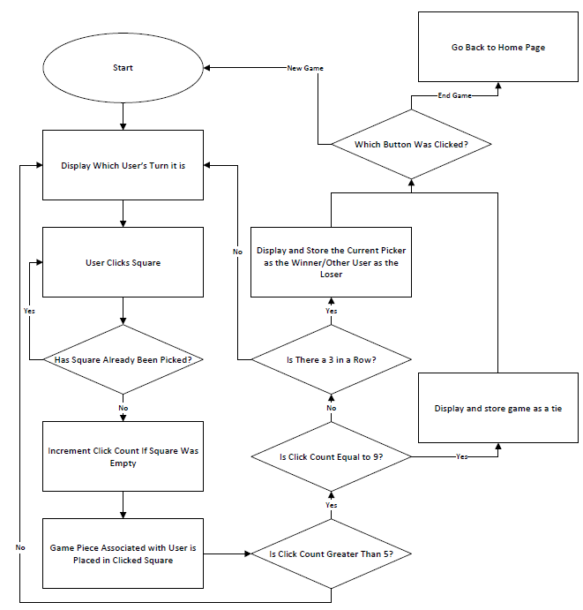
System Design – Tic-Tac-Toe Game

Slide 12
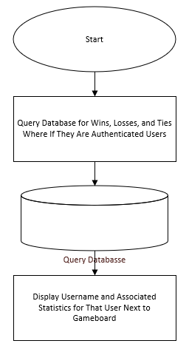
System Design – Statistics Display

Slide 13
Requirements
UI and Data Presentation
  Welcome Page
  Login Pages
    User Creation Page
  X and O Selection Page
  Tic-Tac-Toe Gameboard Page
    Wins, Losses, and Tie Statistics for Each User
Server Requirements
  Cloud9
    MySQL
    Apache/PHP – Provides Public Domain Name
    Disk Size: 2GB, Memory: 512MB, 1 CPU

Slide 14
Major Components/Tools
Hardware
  Cloud-Based Linux Virtual Machine (Cloud9)
  PC to Access Cloud9 Virtual Machine for Development
Software
  Cloud9 Web Application
    Text Editor
    Apache/PHP Web Server
      PHP
      HTML5
      JavaScript, JQuery, AJAX
      CSS
    MySQL
      Phpmyadmin for Database Management

Slide 15
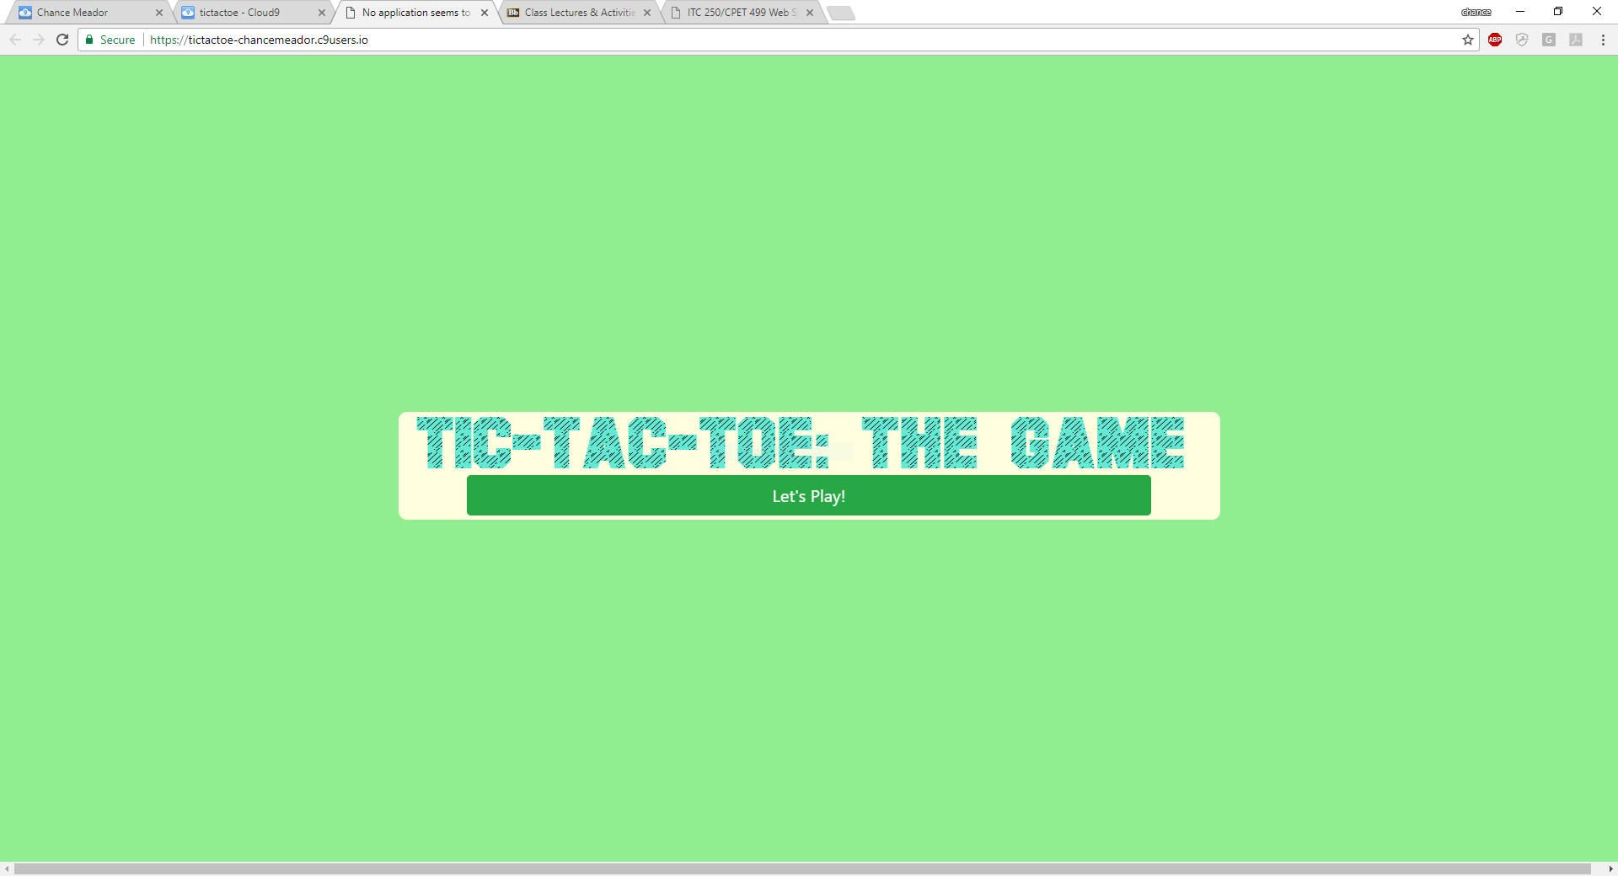
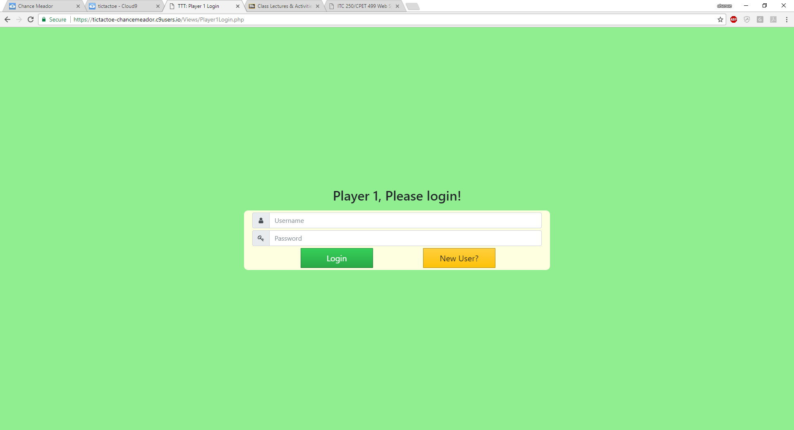
UI

Slide 16

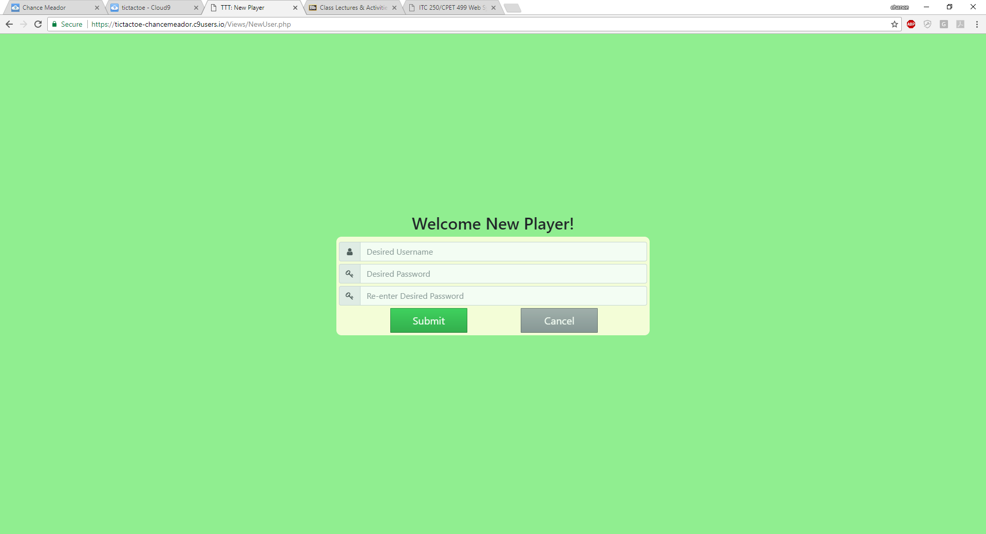
UI – Continued (1)

Slide 17
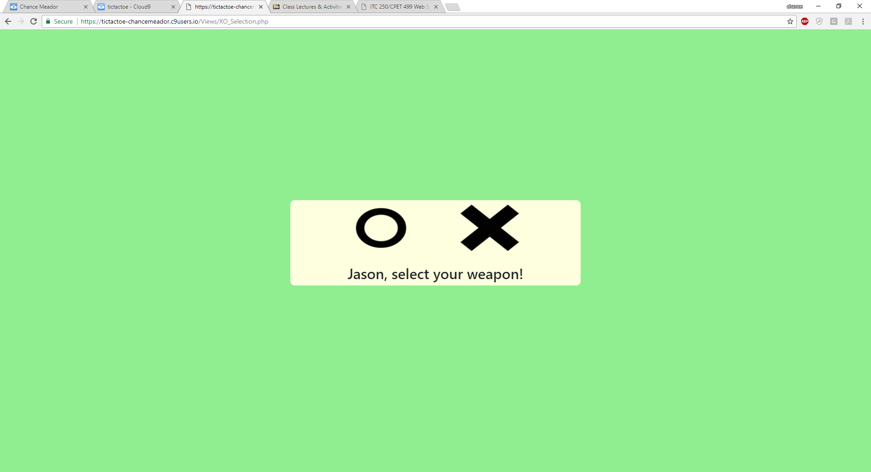
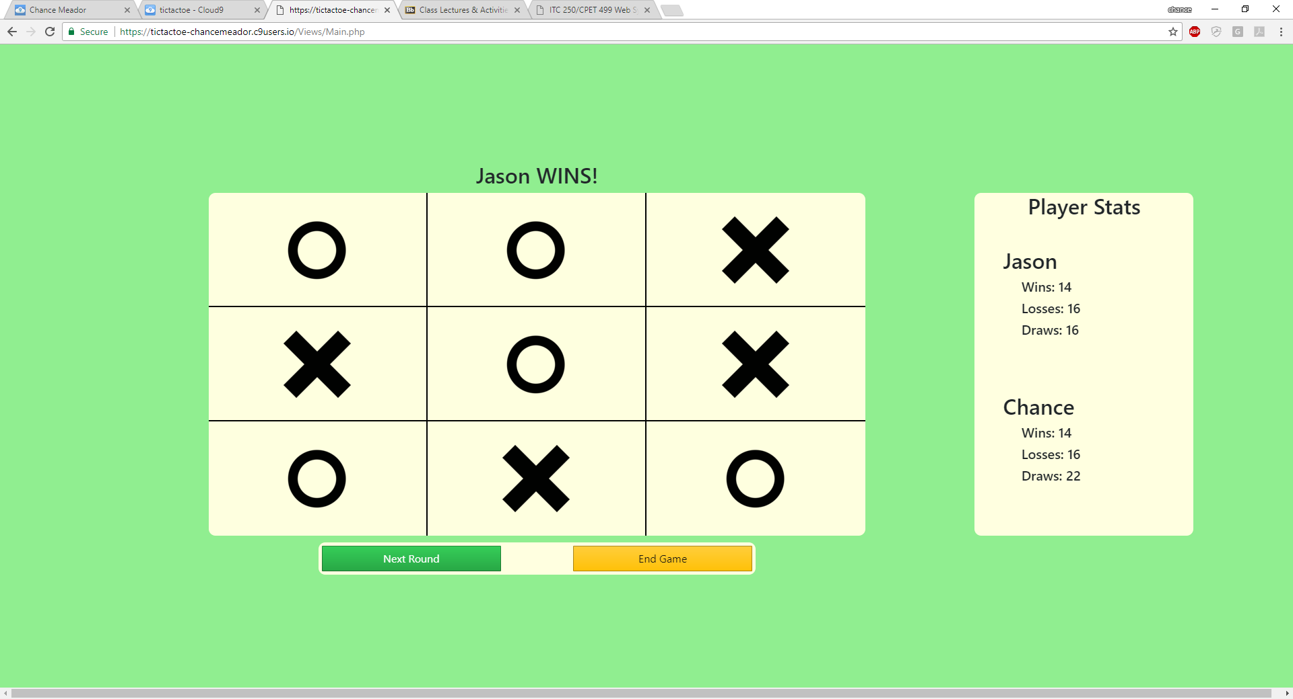
UI – Continued (2)

Slide 18
UI – To Be Completed
To Be Completed
  All UI is complete at this time, touching up styles is all that needs to be done to make it stand out more
  May add a header to the selection and gameboard view to display logged in players

Slide 19
Functionality – Completed
Completed Functionality
  Tic-Tac-Toe logic is complete and can determine win, loss, and draw
  New player can be added to database along with setting stats set to 0
  Player’s can fully login
  Alerts are given for input validation and database problems
  Player’s can select X or O on the selection screen and it tied to their username
  Next round button will clear gameboard and randomly select a player to go
  End game button will log out all player’s and go back to home screen

Slide 20
Functionality – To Be Completed
To Be Completed Functionality
  Prevent user from navigating to selection and gameboard view without having player 1 and player 2 logged in

Slide 21
Schedule
Complete Back-End Work
  Completed by: 12/5/17
Test Web System
  Completed by: 12/13/17
Present Project
  Presentation: 12/14/17, 10:30 A.M. to 12:30 P.M.

