Slide 1
College’Ty Website
Emmanuel A. Ellis
Som Amphonephong

Slide 2
Introduction
Som and Emmanuel are creating a website that college students can use to find the parties in the Fort Wayne area. This website we bring life back to Fort Wayne but more importantly make people social again.

Slide 3
Pathway
Nov. 7th – We created login page and went over all pages needed to make the website look nice.
Nov. 10th – Met and went over the background essentials to make the page actually function.
Nov. 16th – Began creating data base for the sign up page which, will be the most involved section of the website.
Nov. 20th – Began working on the login page.
Nov. 27th – Finished homepage, registration page, and login page.
Nov. 28th – finishing up with the database for pages.

Slide 4
Complications
Only complication we have is finding time to meet up. We are attacking this problem by sacrificing some of our personal time when the other is available to work.

Slide 5
The Design
Figures 1.1 – 1.3 are the different pages of the website so far.
Figure 1.4 – 1.10 are the code behind these pages.

Slide 6
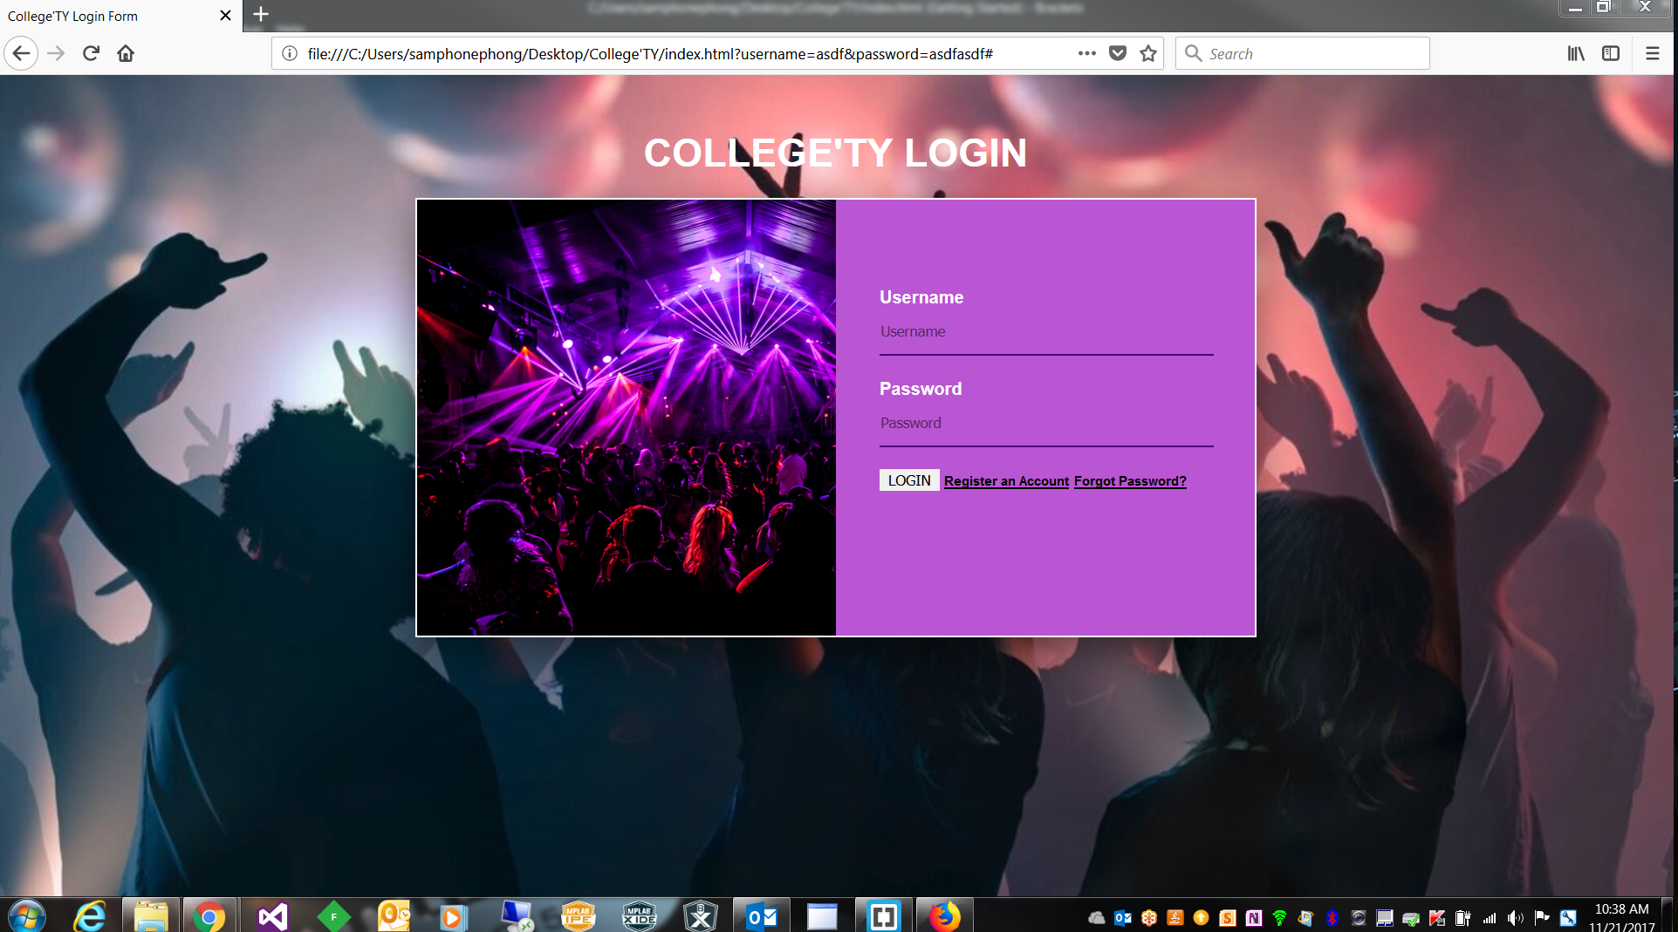
Figure 1.1

Slide 7
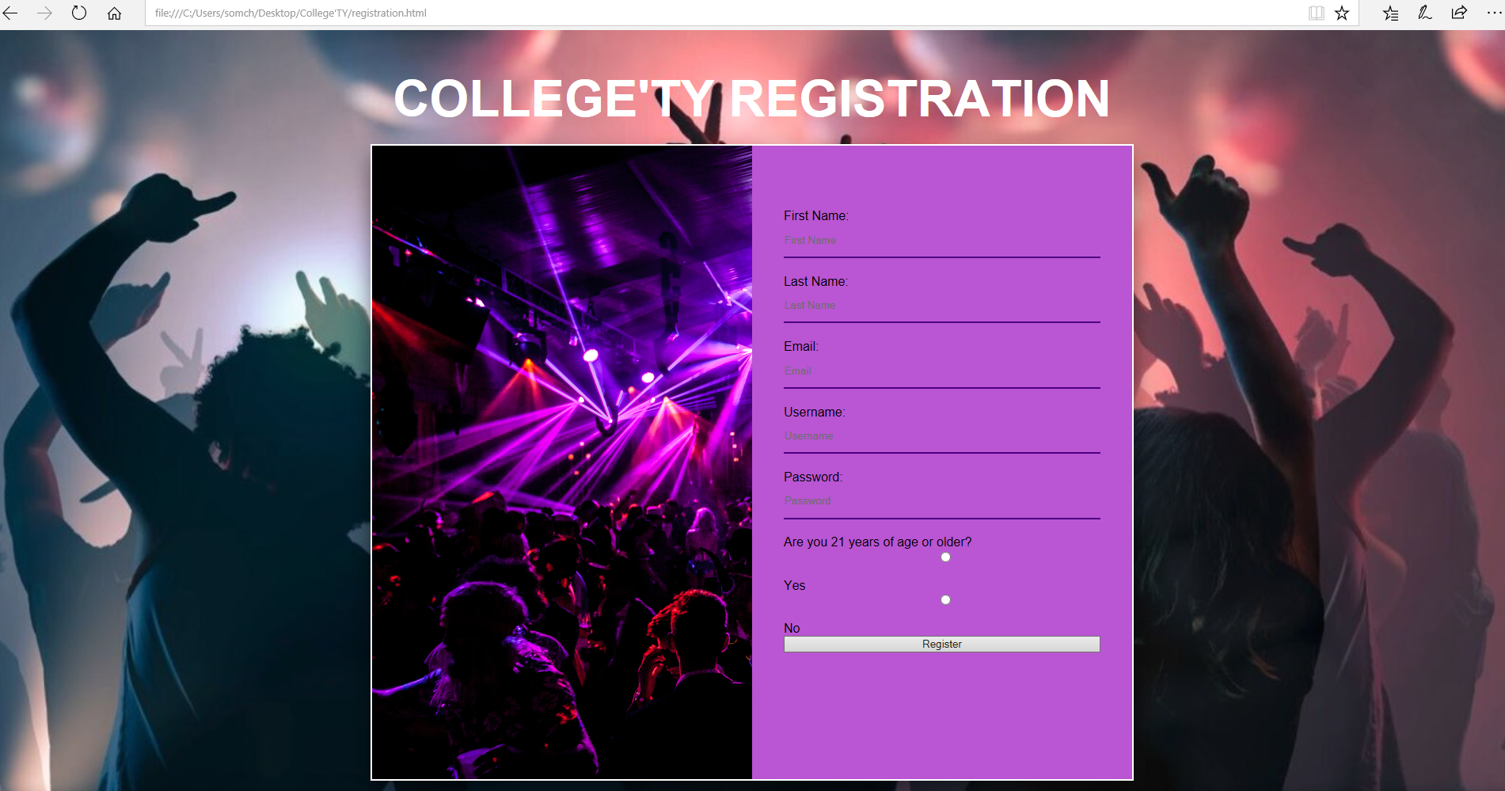
Figure 1.2

Slide 8
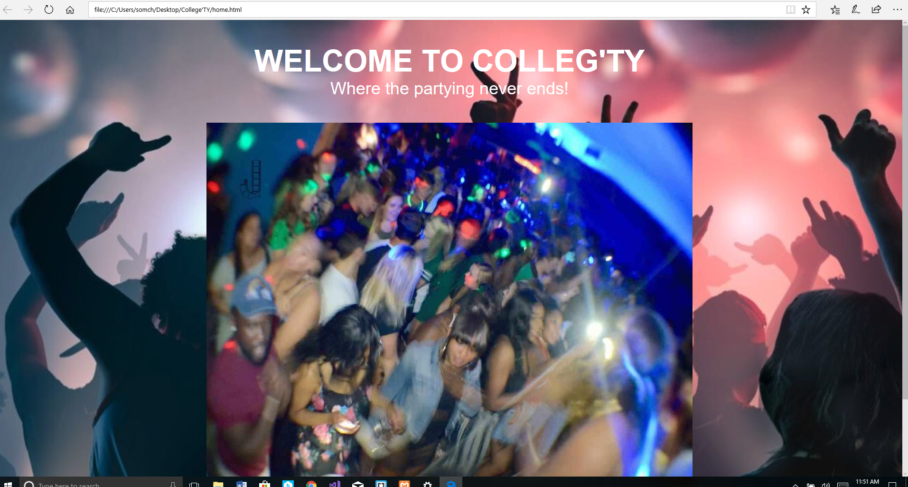
Figure 1.3

Slide 9
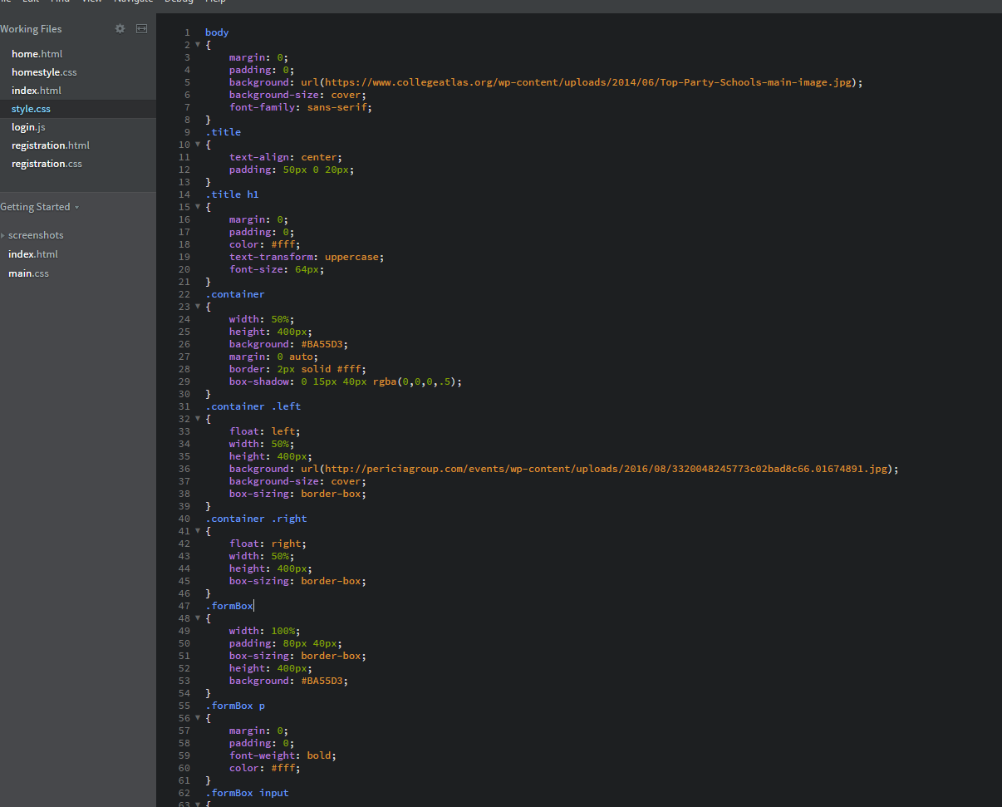
Figure 1.4

Slide 10
Figure 1.5

Slide 11
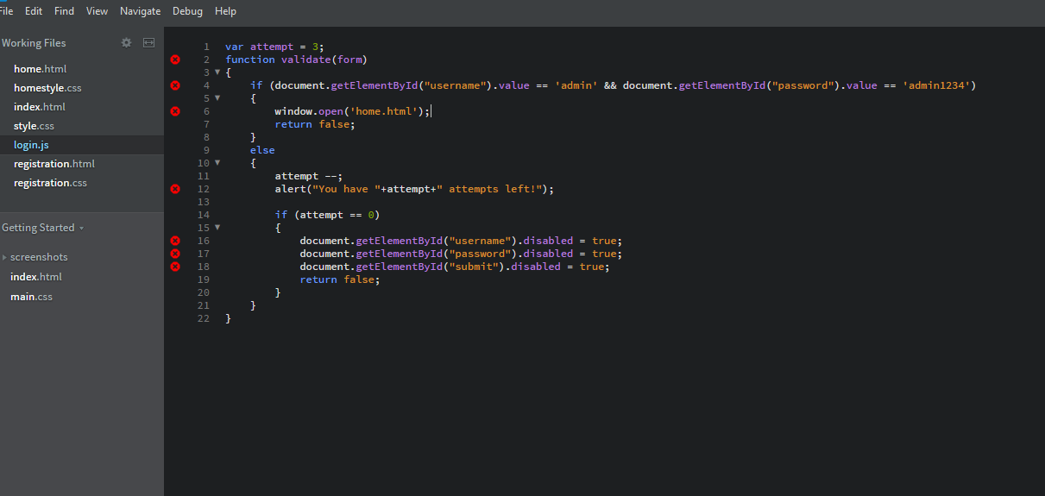
Figure 1.6

Slide 12
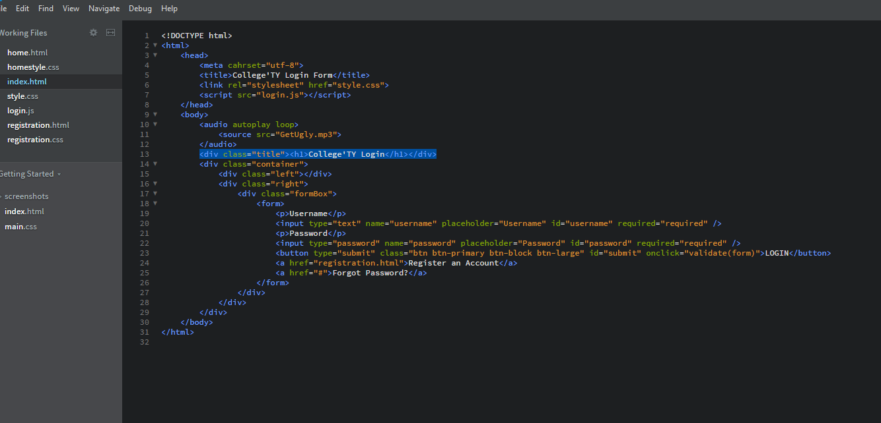
Figure 1.7

Slide 13
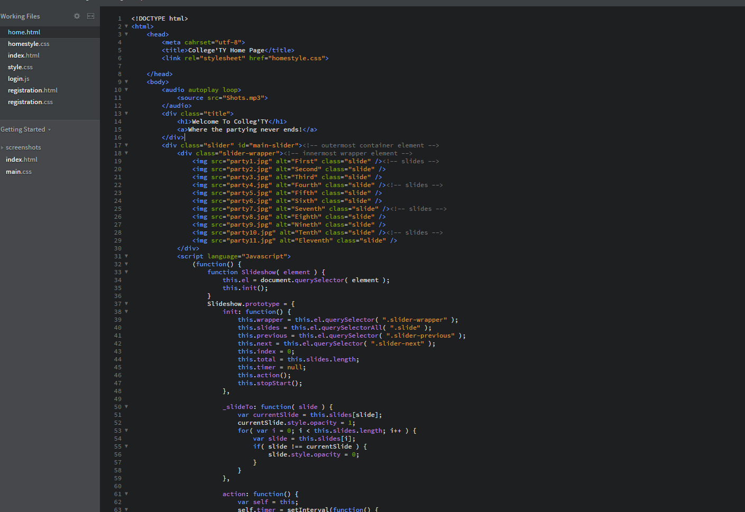
Figure 1.8

Slide 14
Figure 1.9

Slide 15
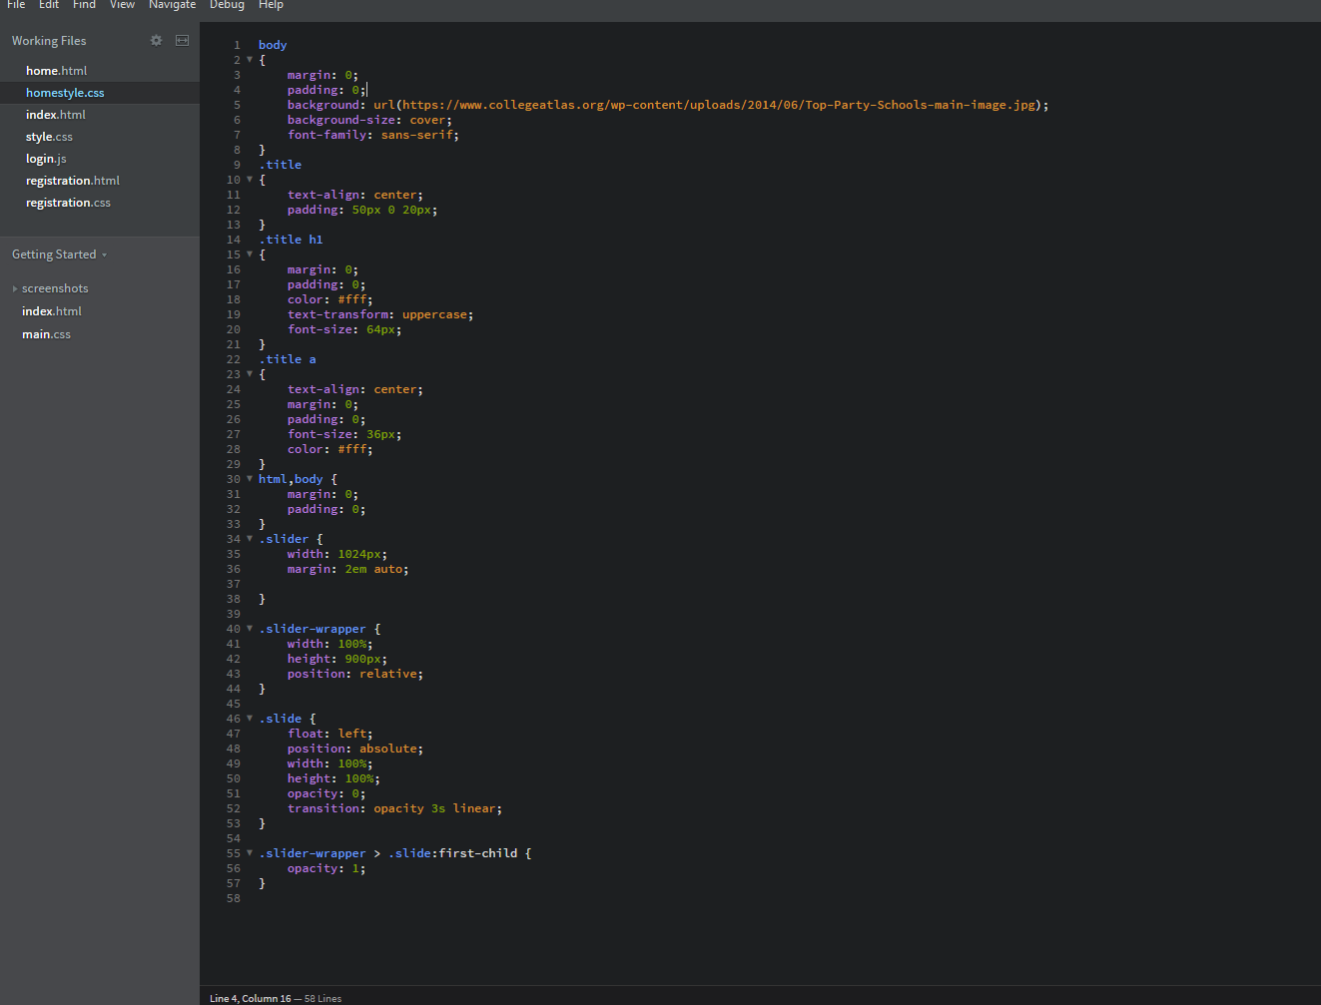
Figure 1.10

Slide 16
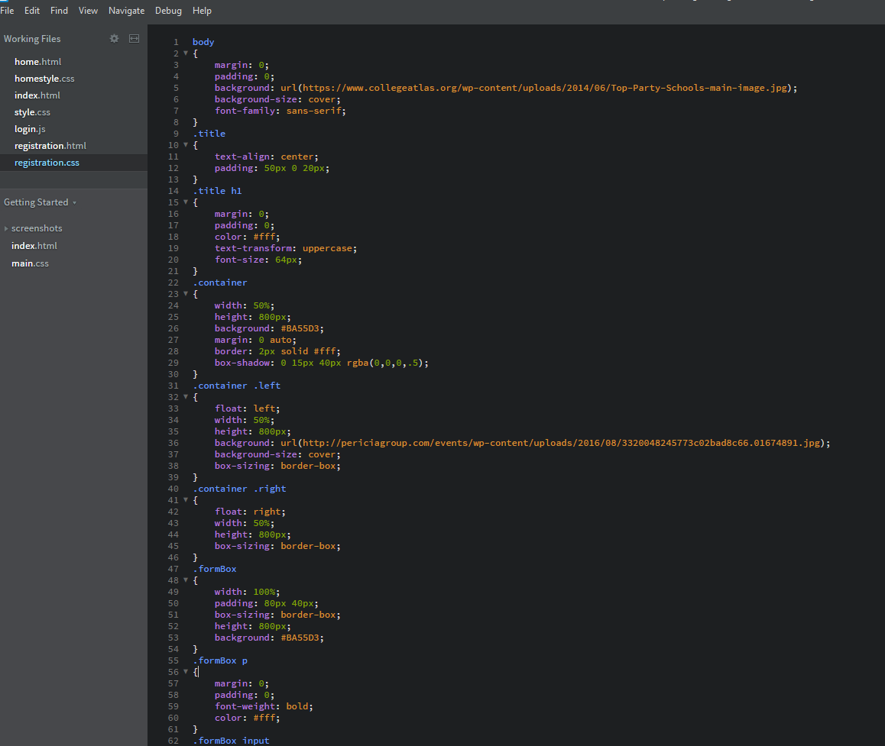
Figure 1.11

Slide 17
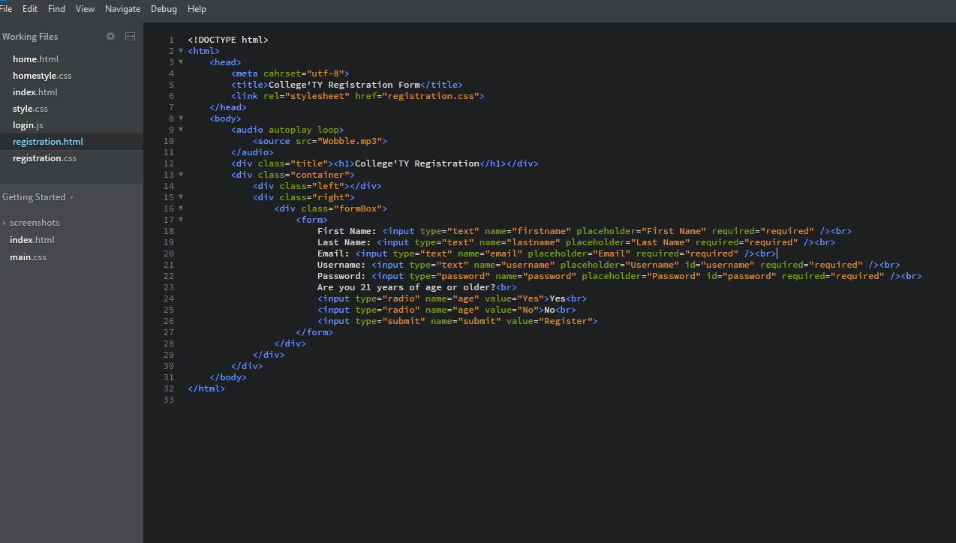
Figure 1.12

Slide 18
Technical Specifications
Programs used so far: Brackets to create the webpages, JavaScript, and MySqli for the database .
Hardware: Acer STRIX Republic of Gamers Laptop with 8GB DDR4 Ram, i7 7th Gen Processor, NVIDIA GeForce Graphics Card.

Slide 19
Conclusion
Som and Emmanuel are on track for completing the College’Ty website. They are about 75% done and they started on the harder portion of the website first. Much dedication and effort has and will be put forth for the website to be a success. They anticipate unexpected occurrences but will overcome each one!

