Slide 1
Euchre History
By: Craig Romano

Slide 2
Report Summary
Create a website that tells how to play different kinds of euchre. Then there will be a page that will let the user to input their name, if they won or lost, the score of the game. The user will be able to upload that information and it will be displayed with other peoples record.

Slide 3
Problem and Correction
Had trouble getting data into database.
  Had wrong code for entering into database.
Had trouble displaying data from database
  Didn’t write correct code for while loop

Slide 4
Project Milestones and Deliverables
Prototype
Final Report
Final Project Presentation

Slide 5
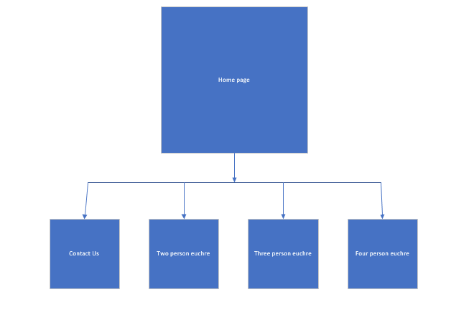
System Overview

Slide 6
System Requirments
User Interface and Data Presentation Layer
Server System Requirements
Data Storage

Slide 7
Software Programming Tools
Notepad++

Slide 8
Conclusion
Create an easy to function throw website that explains the different kinds of euchre and how to play them.

