Slide 1
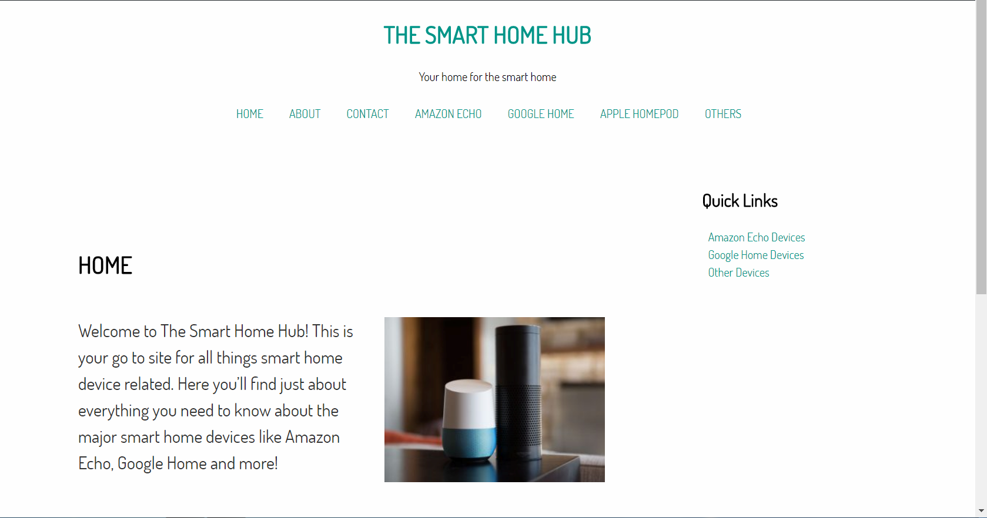
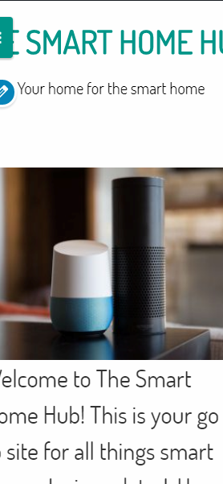
The Smart Home Hub
Progress Report 2: Kohl Smith ITC 250 Web Systems
Provides a web site for relevant information about the major smart home devices

Slide 2
Project Summary
This project consists of a web based service that gives readers information about the three major smart home devices.
Consumers can utilize the site to research and find information about the devices to make a smarter buying decision.
The site gives info on each device and compares them to determine the pros and cons of each

Slide 3
Overview
Main Deliverables
Web site containing
Text based information
Images
Graphical information
Links to products
Progress Report 1
Progress Report 2
Prototype Site
Final Presentation

Slide 4
Project Scope
Creating
Design Website
Build website code
Integrate with server
Testing
Layout and aesthetic
Bugs and errors in code
Server side useability

Slide 5
Project Milestones & Deliverables
Design Completed
Server Setup
Coding complete
Site finalized & Testing started
Each has been completed by the time of this first progress report, others will be completed by project due date

Slide 6
Problems & Corrections
Project cost: Added cost <$3
Paid for Domain hosting for easier set up
Subpages now finished
Delayed in Progress report 1
7 main pages, 3 sub pages
Home, About, Contact, Amazon Echo, Google Home, Apple Homepod, Others: main pages
Amazon Echo devices, Google Home devices, Other devices: 3 added sub pages

Slide 7
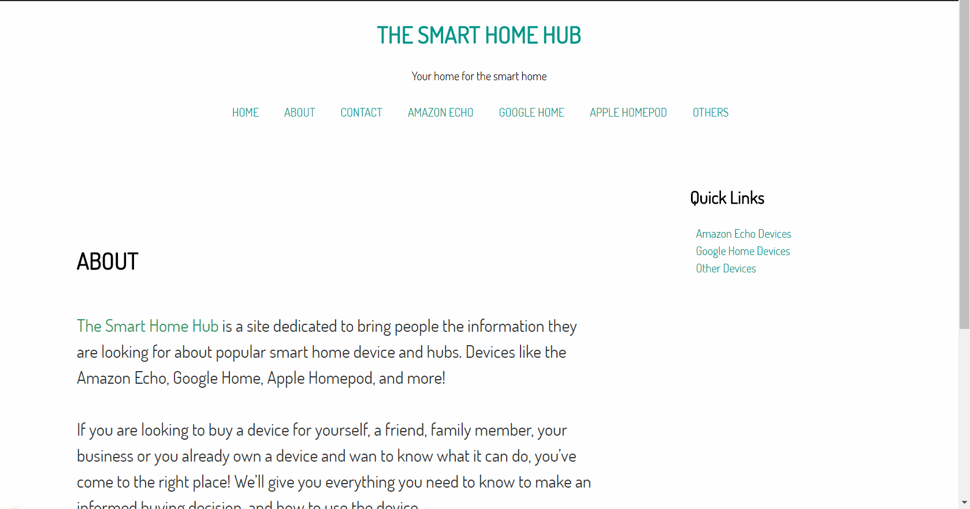
Completed Design
1
Similar to original design, but adjusted to add to aesthetics

Slide 8
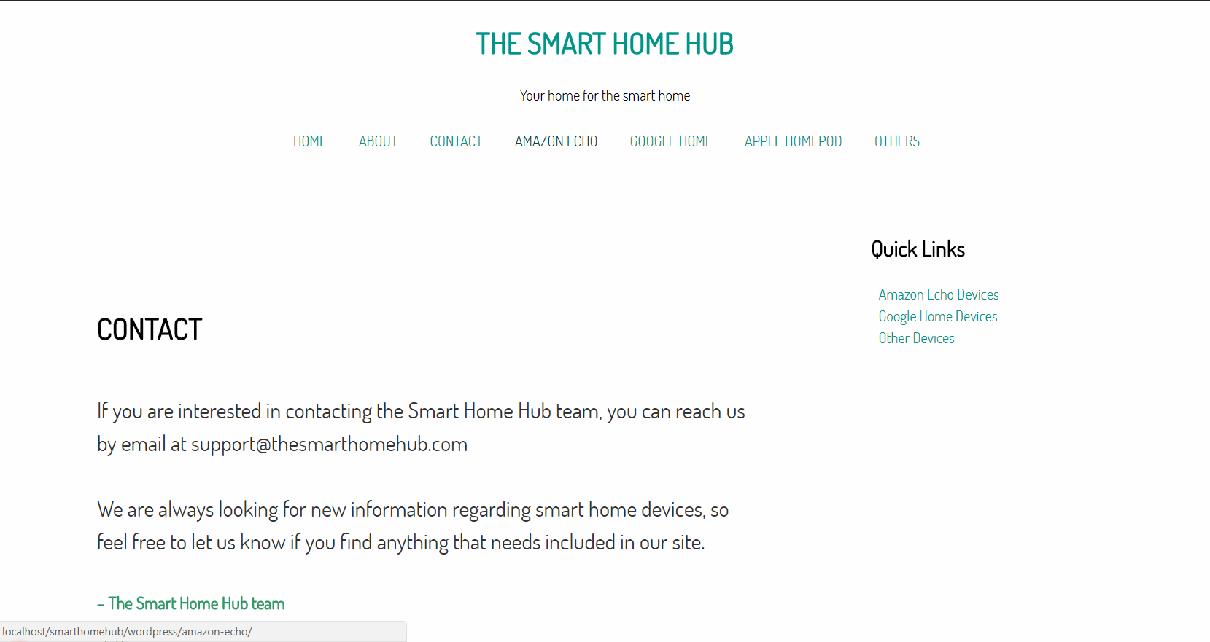
Site Pages Design

Slide 9
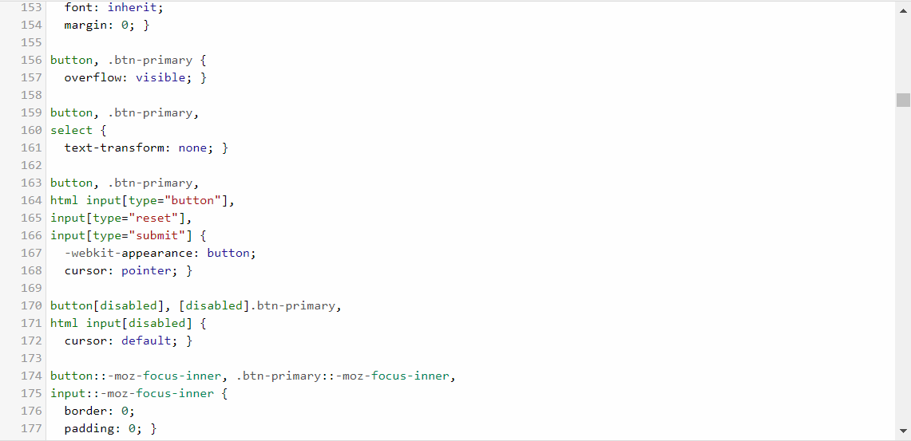
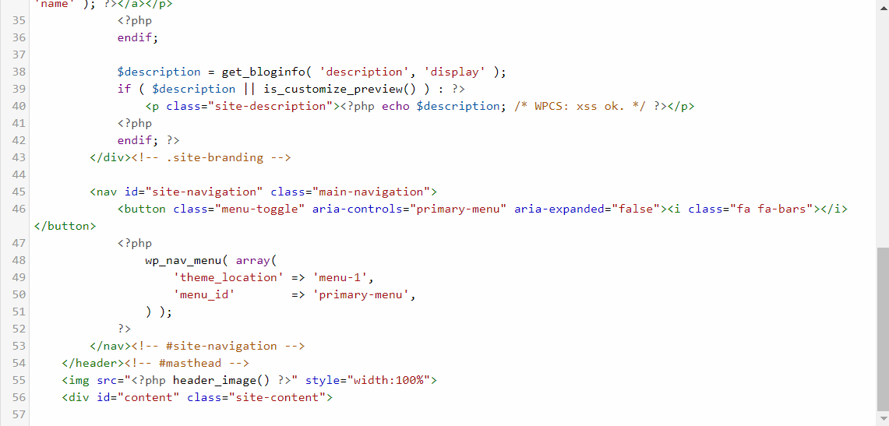
Site Coding

Slide 10
System Requirements
01
Hardware:
Windows PC
Wireless Router
Software:
XAMPP Server software
Adobe Illustrator
Notepad ++
Adobe Dreamweaver
MySQL editor
Requirements of my computer and server

Slide 11
System Requirements
02
Hardware:
Internet Capable computer or mobile device
Access to Internet
Software:
Window OS and up
Mac OS, iOS, Android, Chrome OS, or other system with web browser
HTML5 compatible web browser
Requirements for user’s system

Slide 12
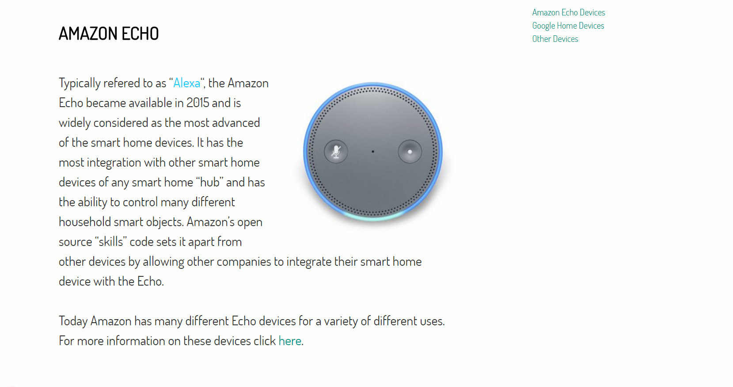
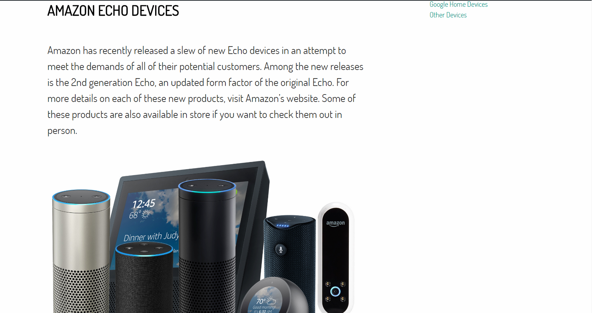
Finalized product page and subpages
01 Amazon Echo Page (with subpage)
*Subpage(child) able to be reached through a link on the parent page, or through quick link sidebar.

Slide 13
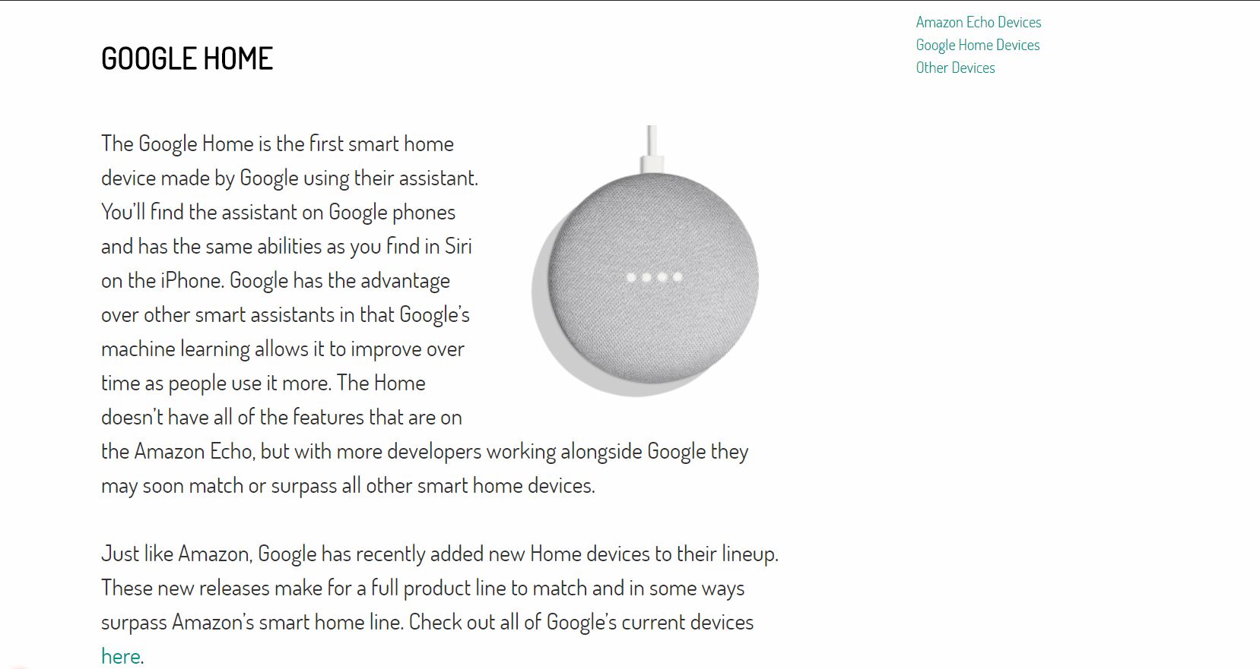
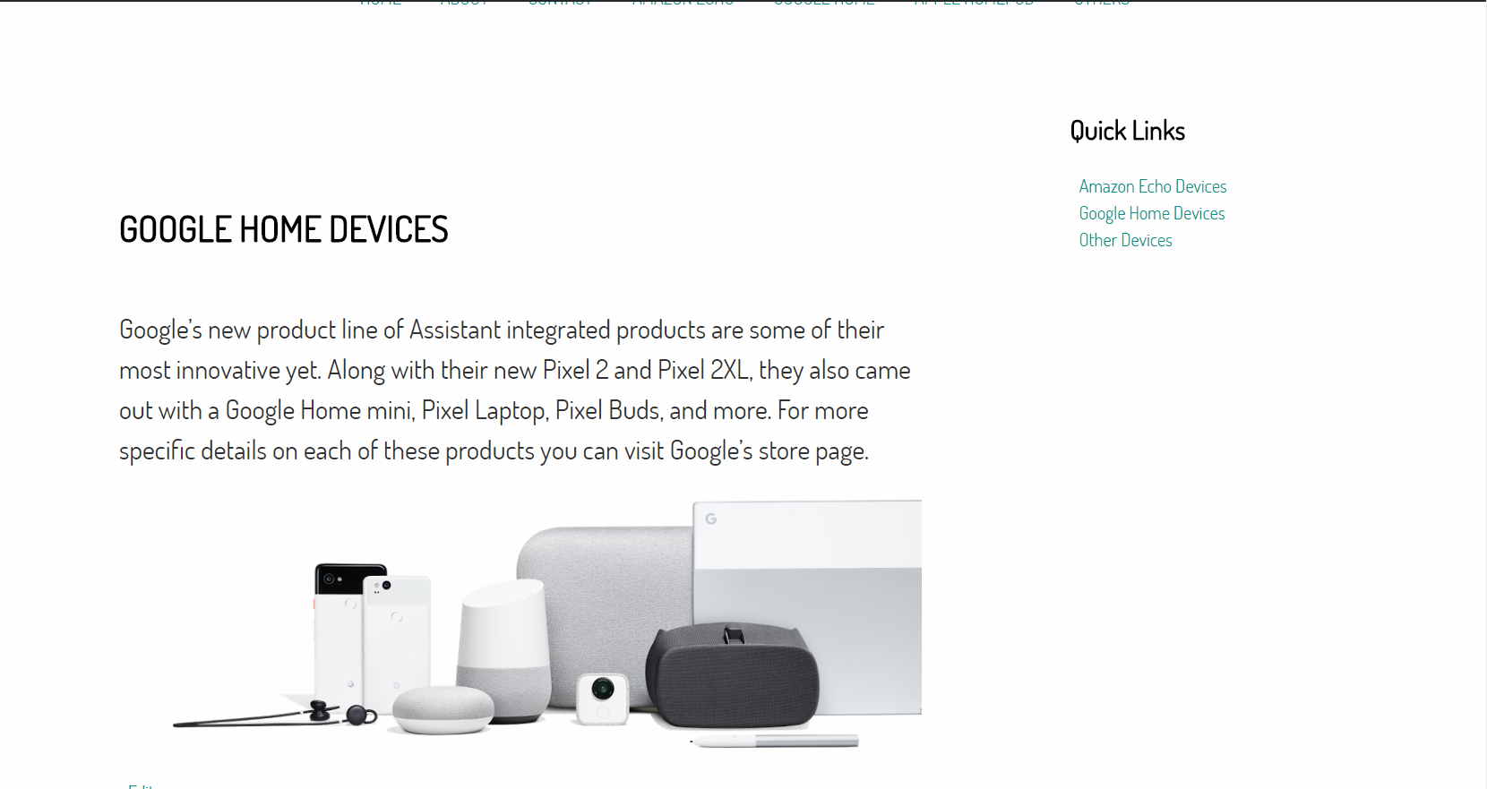
Finalized product page and subpages
02 Google Home Page (with subpage)
*Subpage(child) able to be reached through a link on the parent page, or through quick link sidebar.

Slide 14
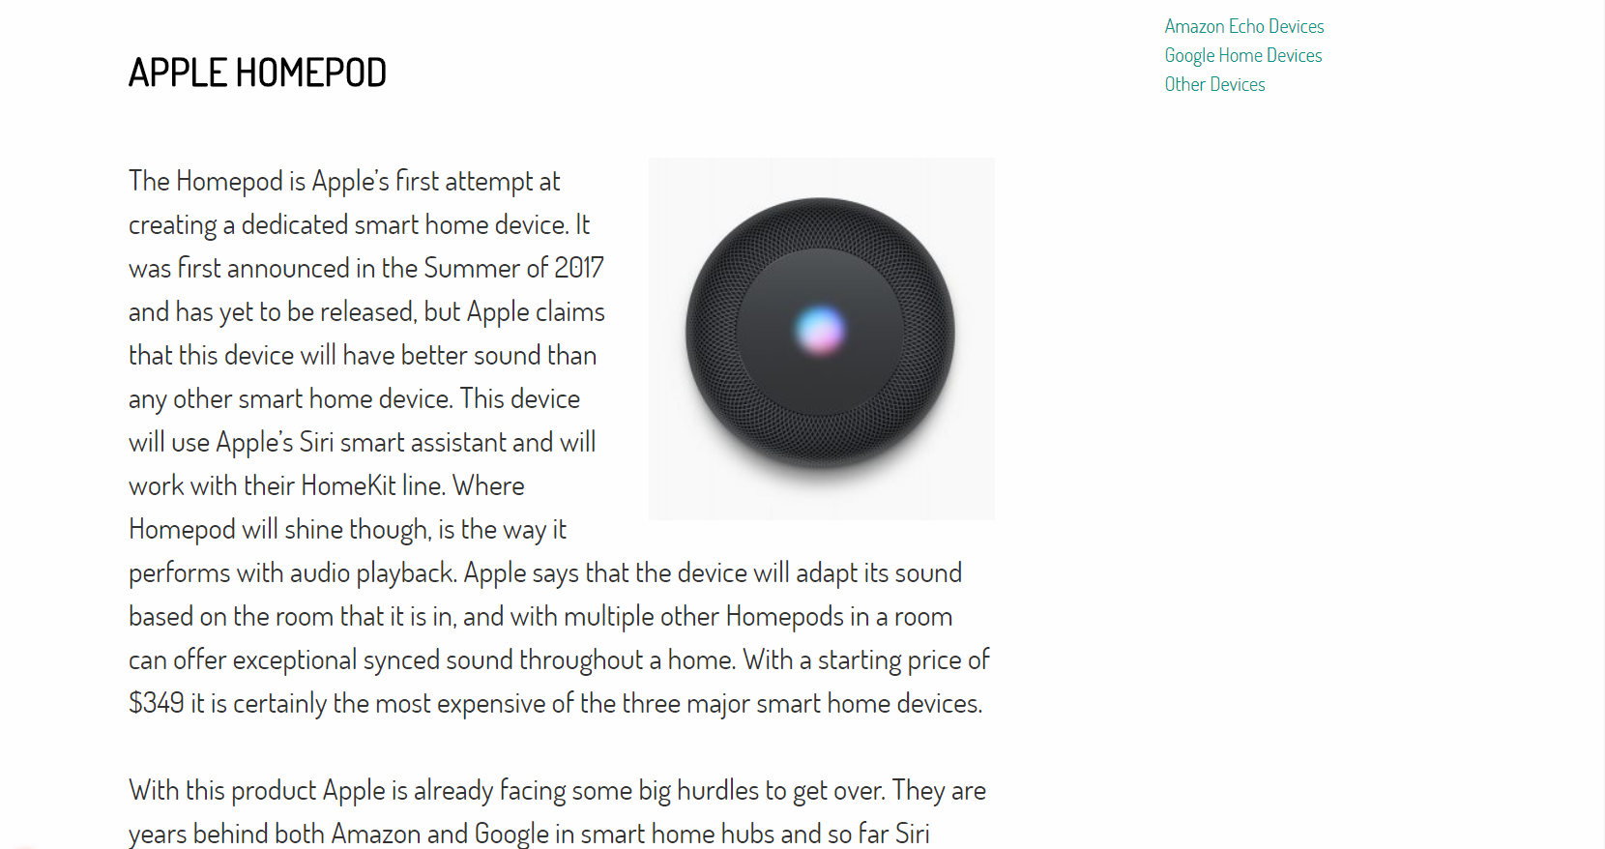
Finalized product page
03 Apple Homepod Page

Slide 15
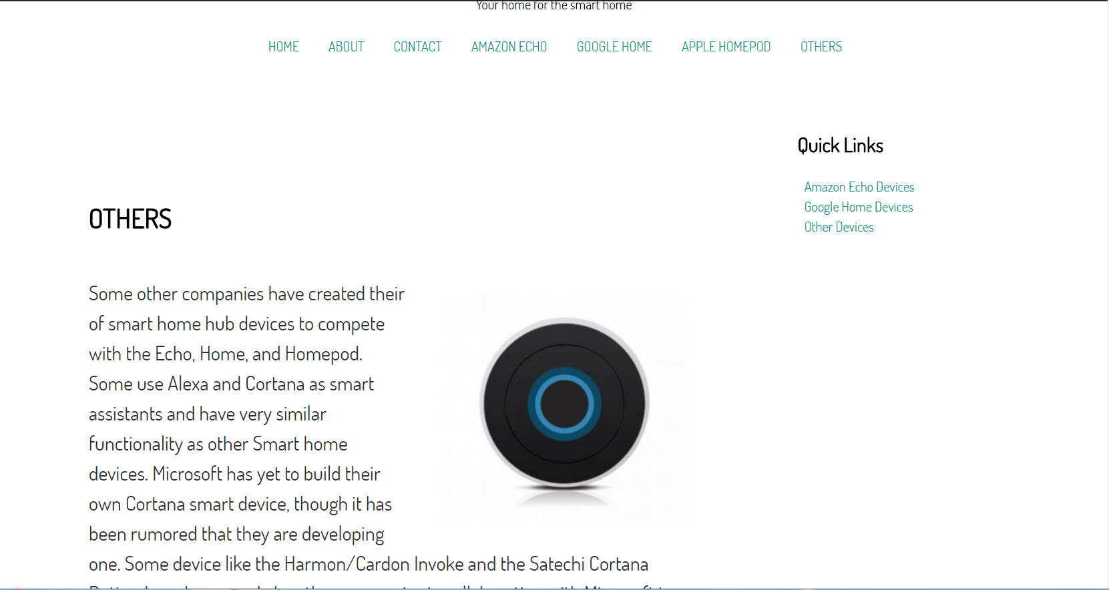
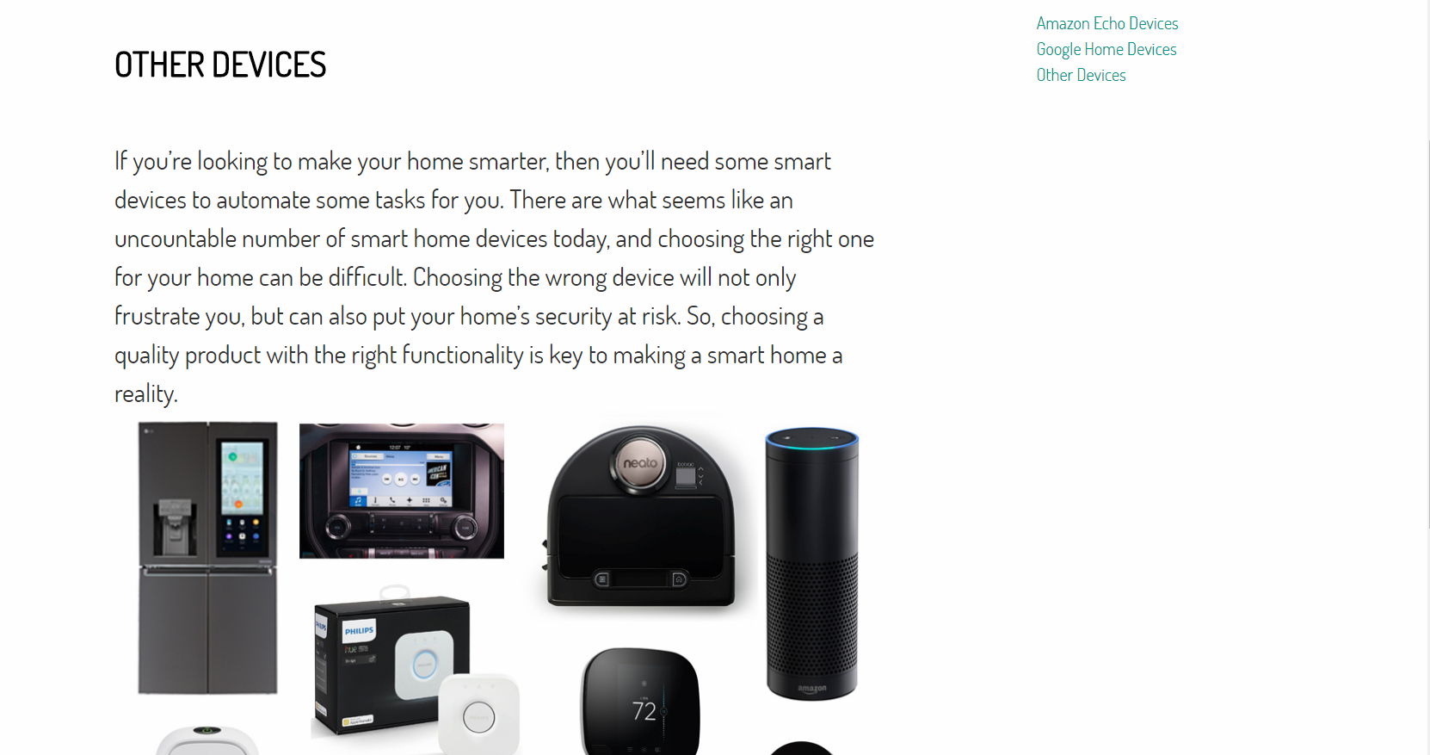
Finalized product page and subpages
02 Others Page (with subpage)
*Subpage(child) able to be reached through a link on the parent page, or through quick link sidebar.

Slide 16
Schedule of Labor | What has been done
Server Setup
3 days
Site Coding Completed
1 week
Site Design Finalized
1 week
Site Testing(In progress)
1 week
Progress Report 2
1 hour

Slide 17
Next Steps | What needs to be done
Finish Site Testing/Debugging
Project Presentation

