Slide 1
CPET 499/ITC 250 Web Systems
Chapter 14
Working with Databases
Part 1 of 3
Text Book:
* Fundamentals of Web Development, 2nd18, by Randy Connolly and Ricardo Hoar, published by Pearson
Paul I-Hai Lin, Professor of ECET
http://www.etcs.pfw.edu/~lin

Slide 2
Topics
Database and Web Development
  The Role of Database in Web Development
  Database Design
  Database Options
SQL (Structure Query Language)
  SELECT Statement
  INSERT, UPDATE, and DELETE Statements
  Transactions: Local Transactions, Distributed Transactions
  Data Definition Statements
  Database Indexes and Efficiency

Slide 3
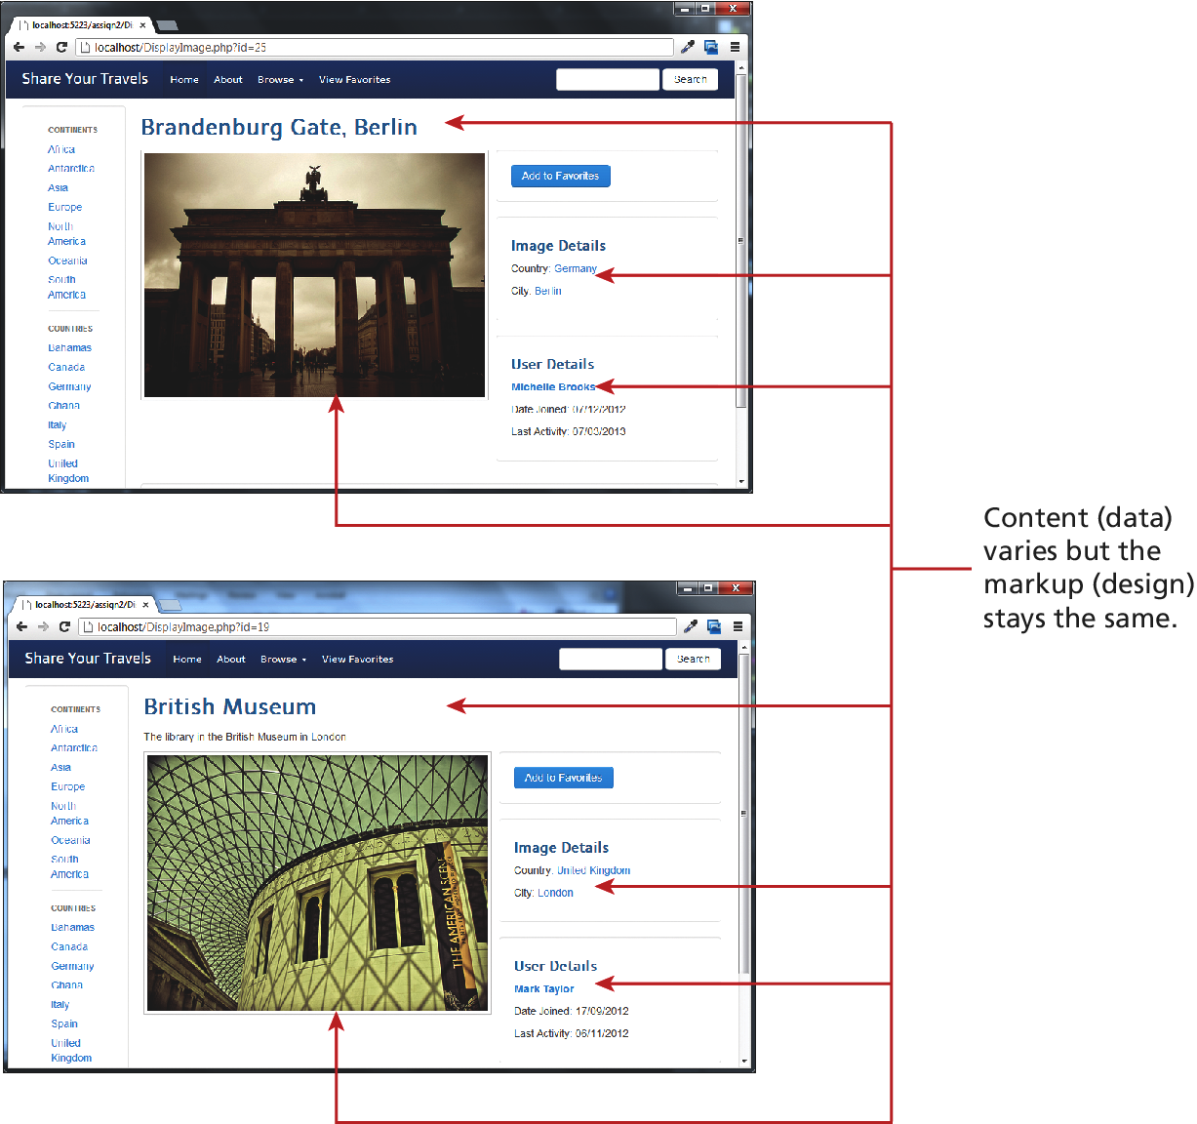
Figure 14.1 Separating content from data

Slide 4
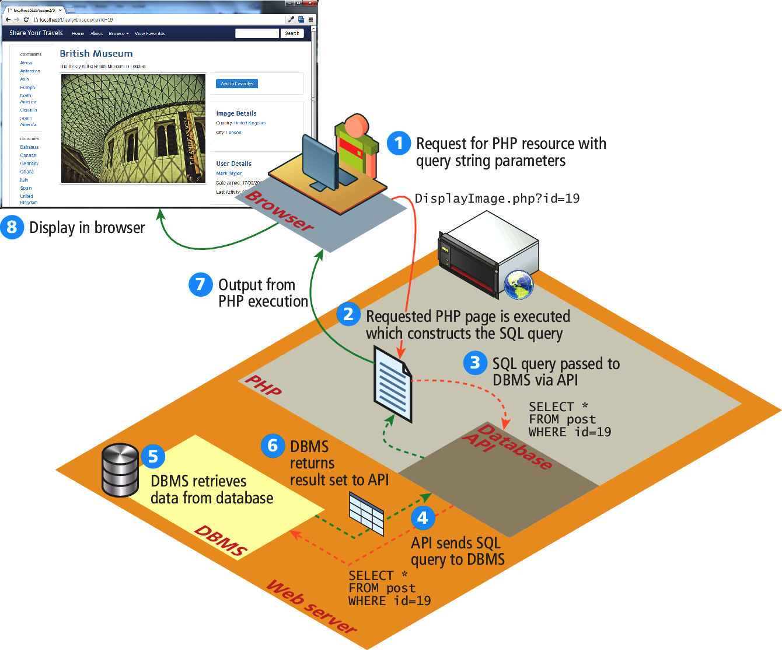
Figure 14.2 How website use databases

Slide 5
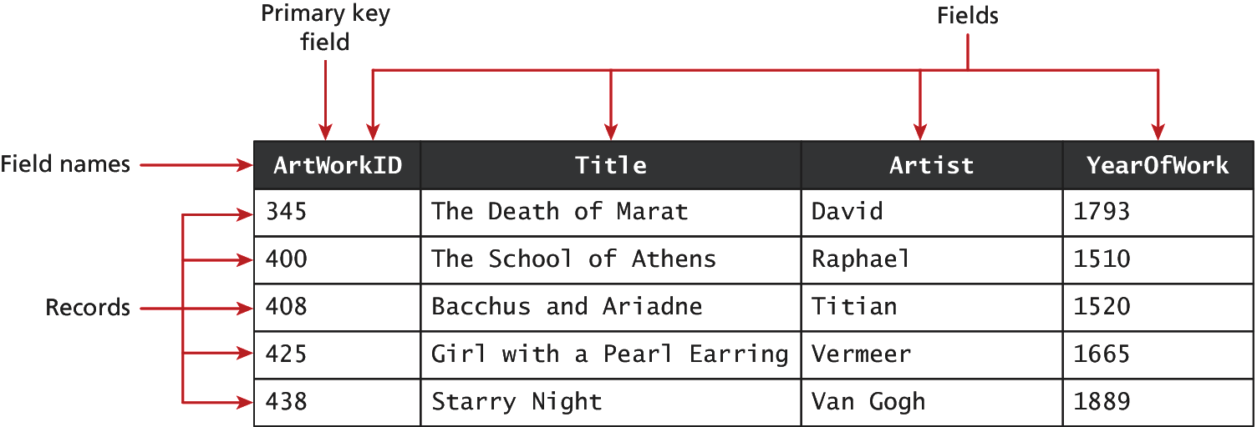
Figure 14.3 A database table

Slide 6
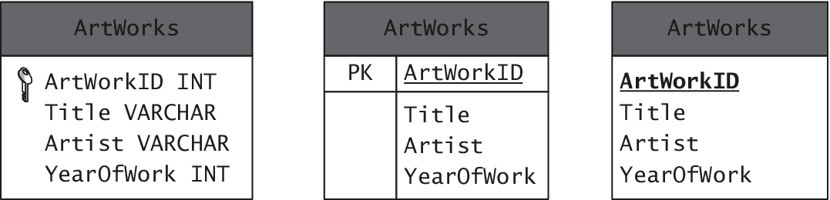
Figure 14.4 Diagraming a table

Slide 7
Table 14.1 Common Database Table Data Types
BIT – BOOLEAN or BOOL
BLOG – Binary Large Object (images and other data objects)
CHAR(n) – a fixed number of character (n = number of chars) that are padded with spaces to fill the field
DATE – also TIME and DATETIME data types
FLOAT - also DOUBLE, DECIMAL data types
INT - also SMALLINT data type
VARCHAR(n) – a variable number of characters (n = maximum number of chars with no space padding)

Slide 8
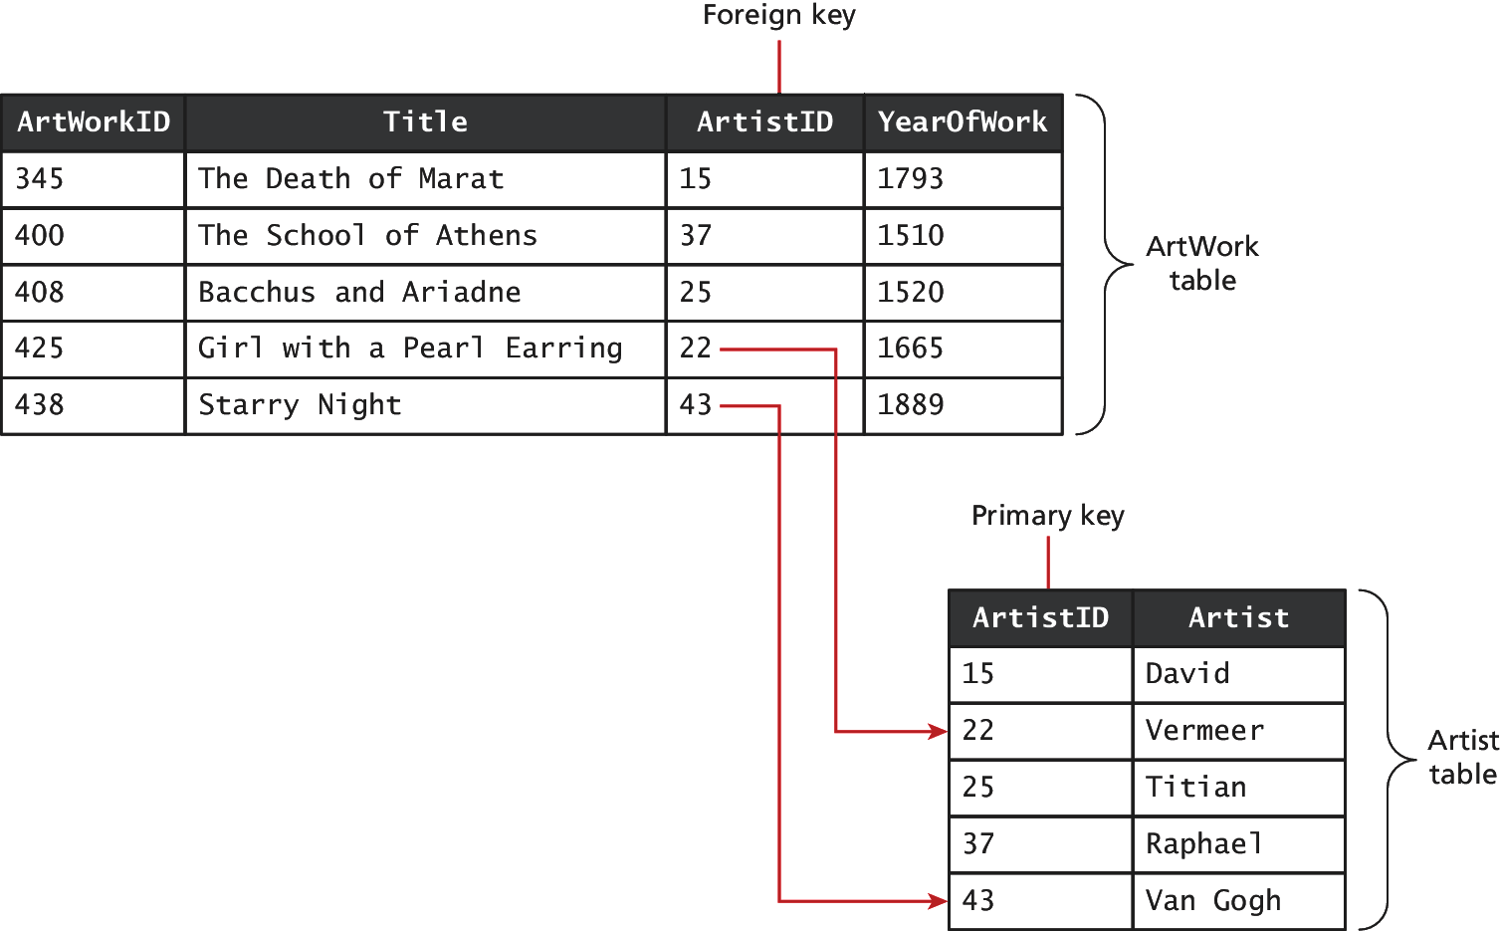
Figure 14.5 Foreign keys links tables

Slide 9
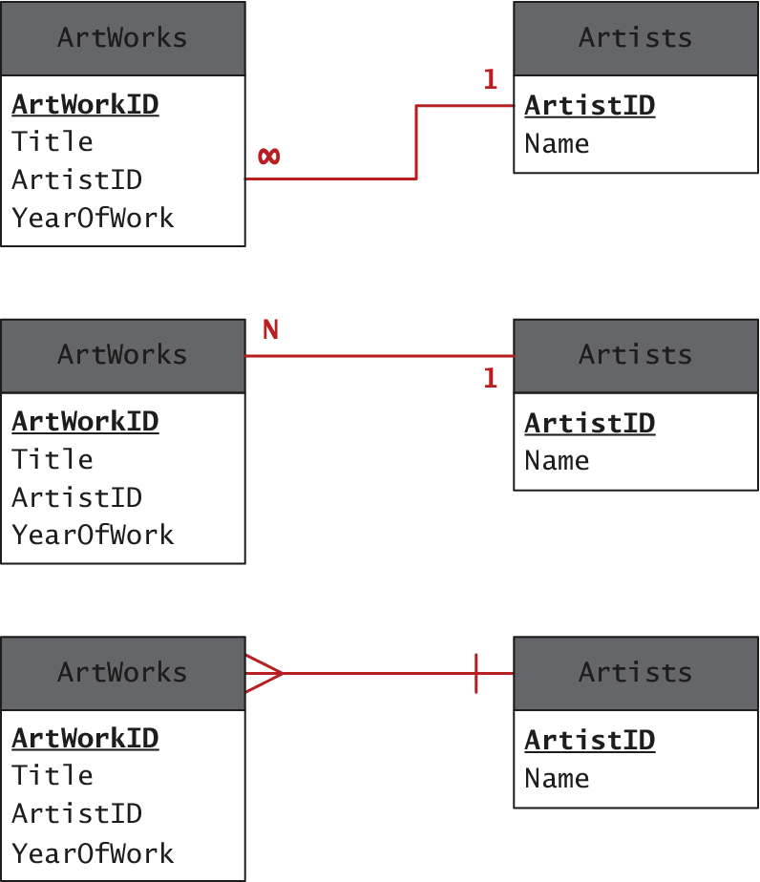
Figure 14.6 Diagraming a one-to-many relationship

Slide 10
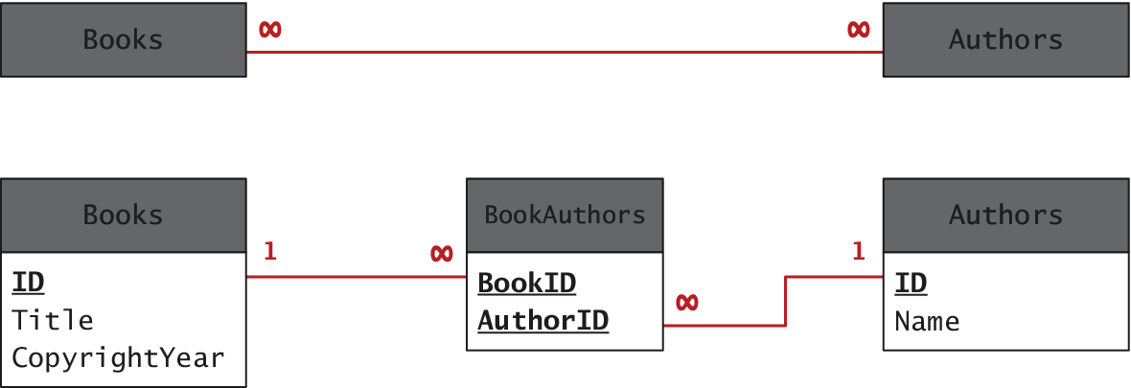
Figure 14.7 Implementing a many-to-many relationship

Slide 11
Figure 14.8 Database in the Enterprise – Database Options
SQL Databases
  Financial and order management systems
  Manufacturing system
  Point of sales
  Groupware and file servers
Examples
  DB2
  Oracle DB
  Microsoft SQL
  MySQL
  PostgreSQL
  etc

Slide 12
Figure 14.8 Database in the Enterprise – Database Options

Slide 13
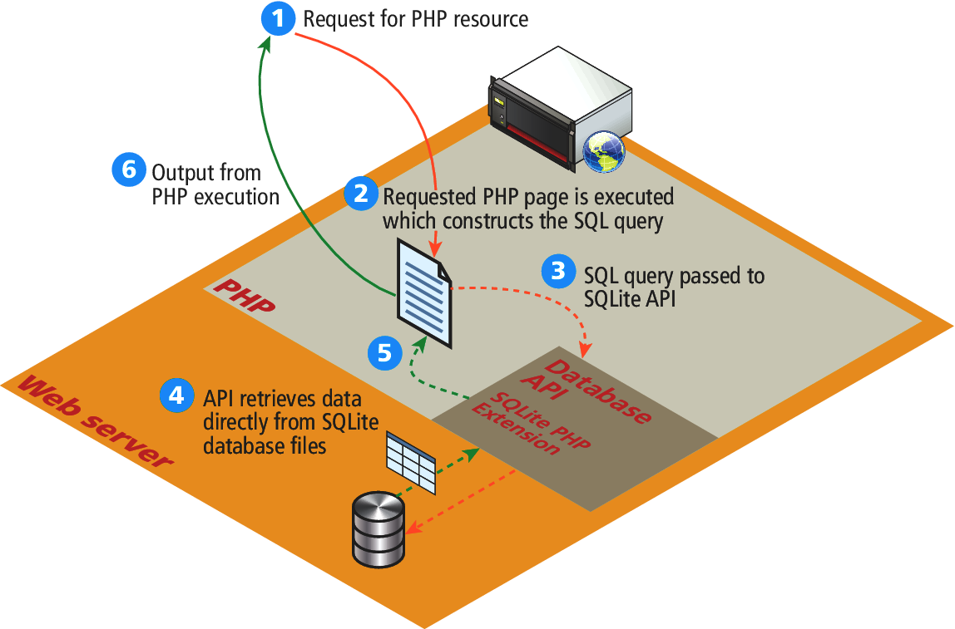
Figure 14.9 SQLite

Slide 14
SQL
SELECT statement – retrieve data from the database
INSERT statement – add new records
UPDATE statement – update existing records
DELETE statement – delete existing records

Slide 15
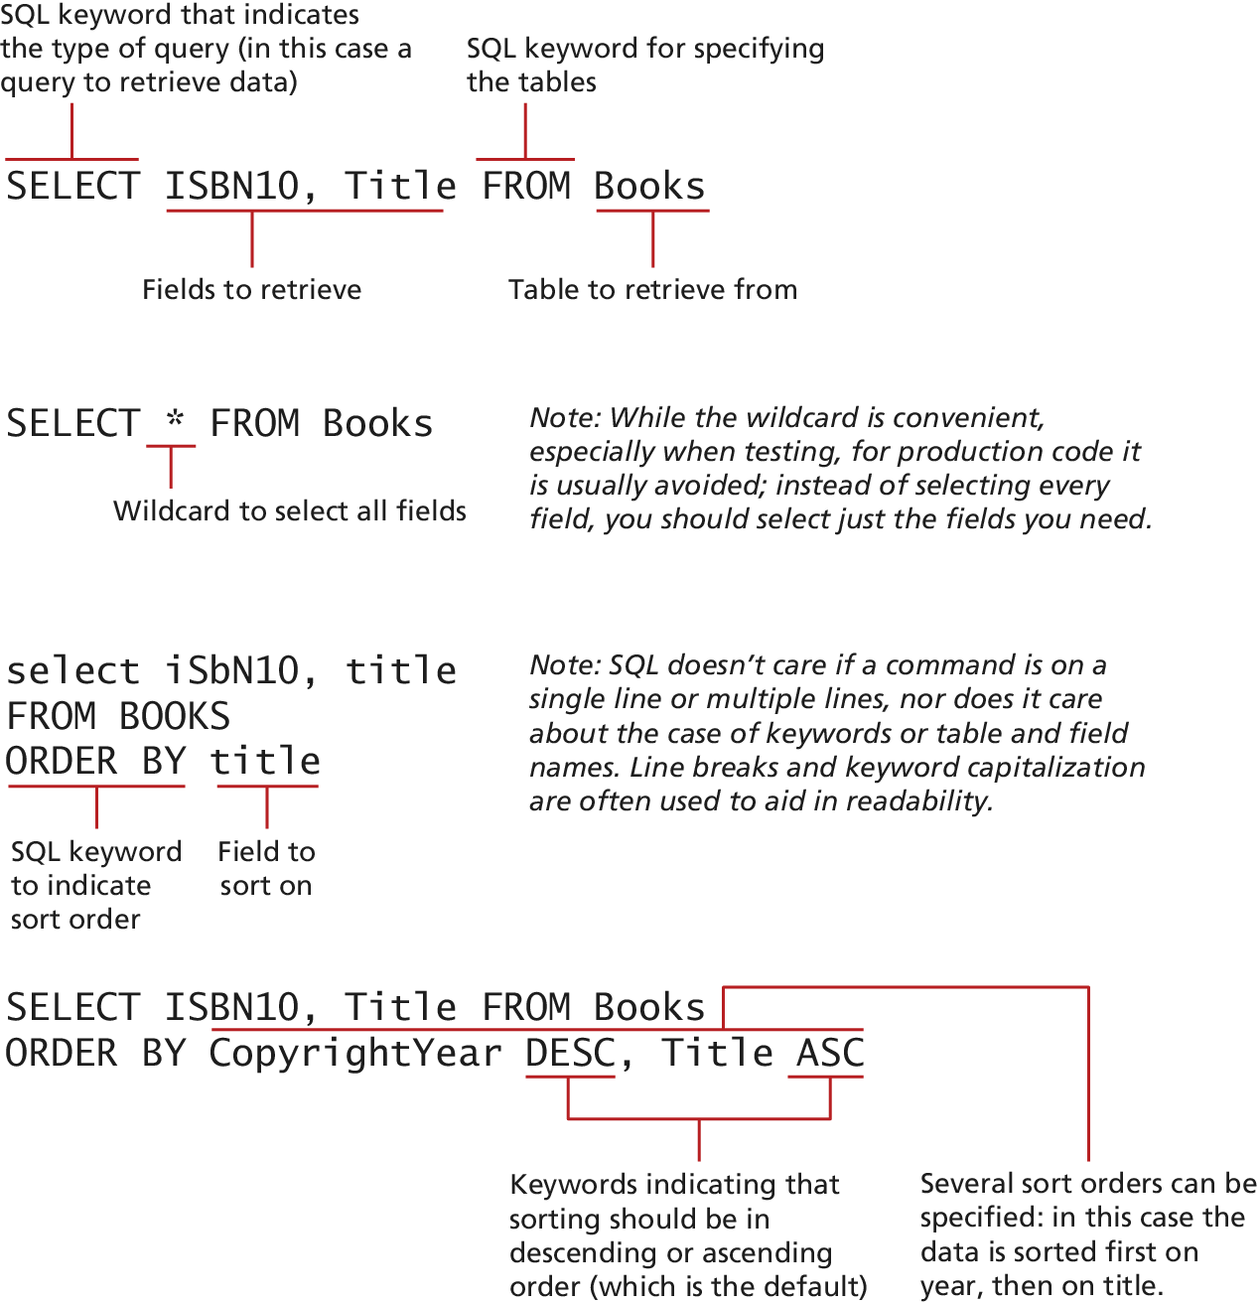
Figure 14.10 SQL SELECT from a single table

Slide 16
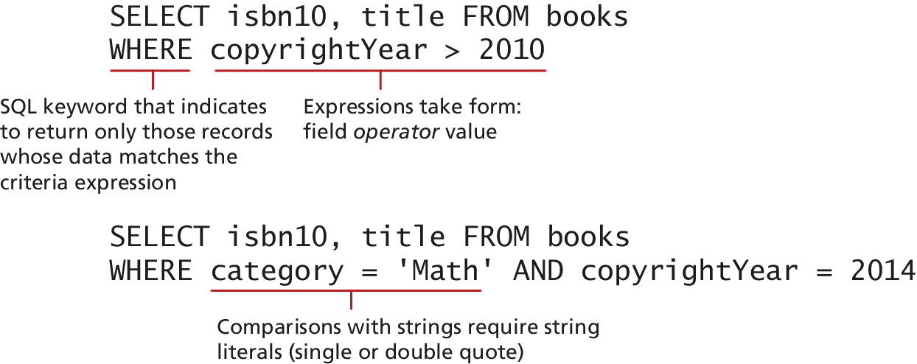
Figure 14.11 Using the WHERE clause

Slide 17
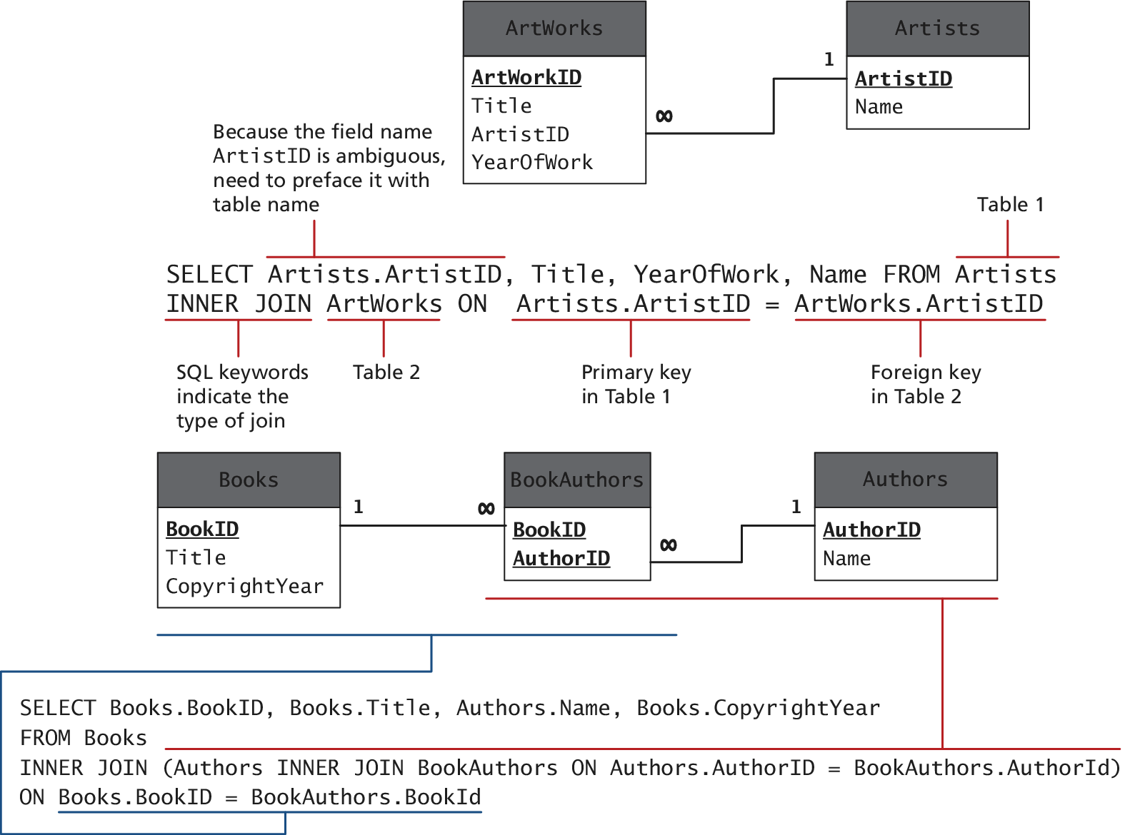
Figure 14.12 SQL SELECT from multiple table using an INNER JOINT

Slide 18
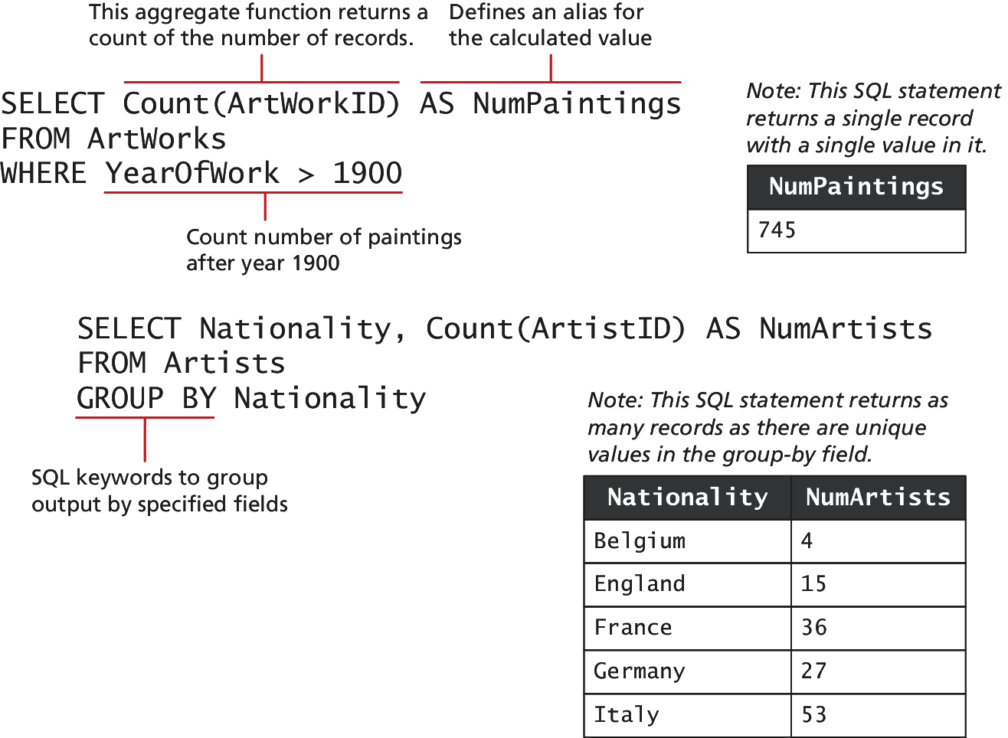
Figure 14.13 Using GROUP BY with aggregate functions

Slide 19
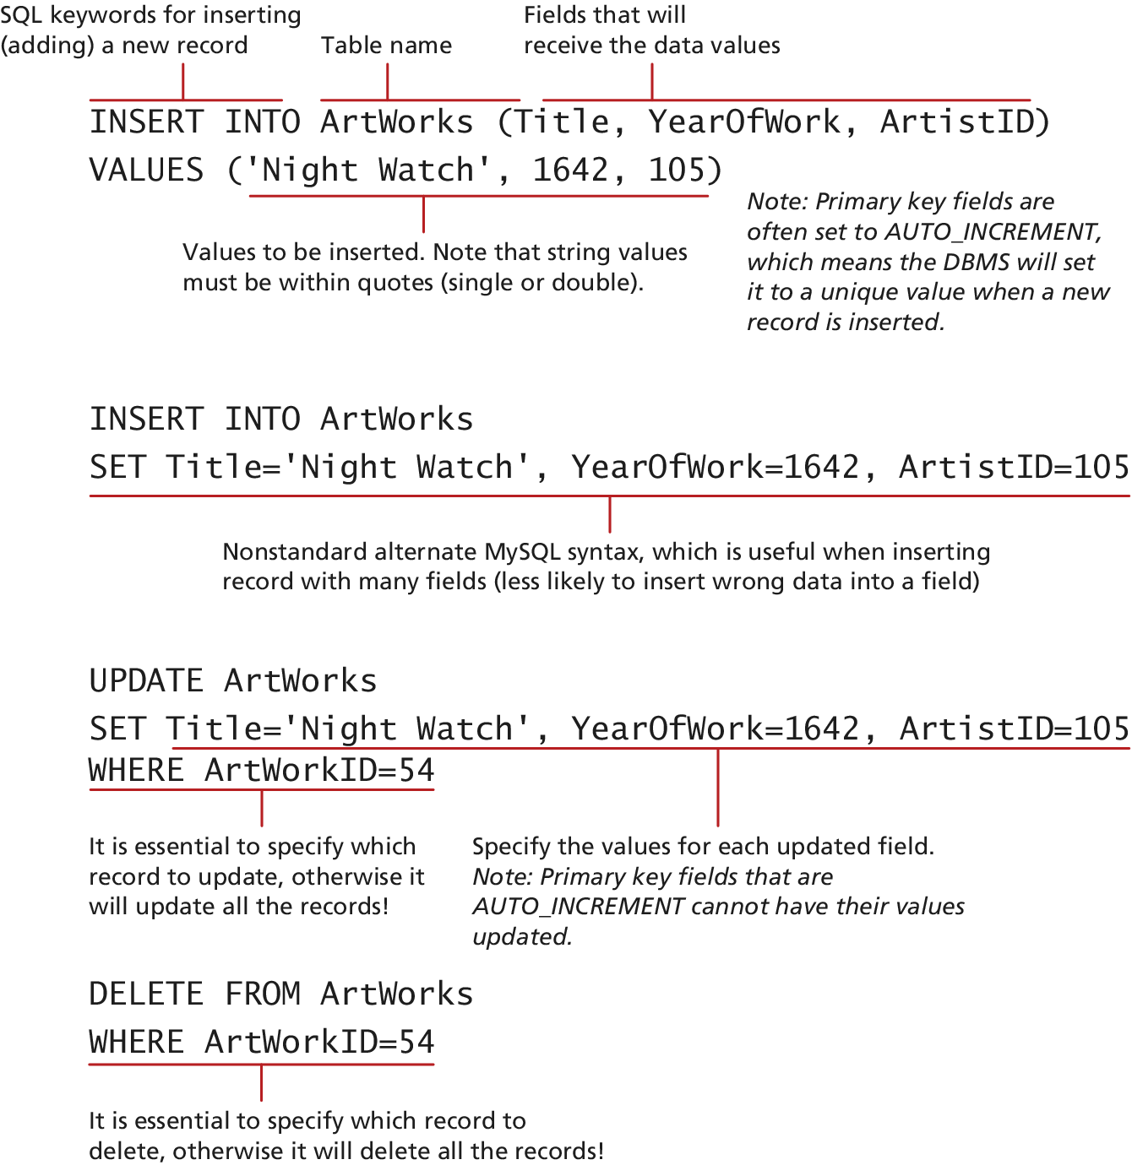
Figure 14.14 SQL INSERT, UPDATE, and DELETE

Slide 20
Local and Distributed Transactions
Transactions
  A transaction refers to a sequence of steps that are treated as a single unit, and provide a way to gracefully handle errors and keep your data properly consistent when error occur.
  Local Transactions: transactions handled by the DBMS
  Distributed Transactions: transactions involve multiple hosts, several of which we may have no control over.

Slide 21
Local and Distributed Transactions
Web Storefront Example
  A customer: Checkout, Verified address, entered credit card, select shipping option
  Click Pay for Order Button, what happen?
  1. Write order records to the website database.
  2. Check credit card service to see if payment is accepted.
  3. If payment is accepted, send message to legacy ordering system.
  4. Remove purchased item from warehouse inventory table and added to the order shipped table.
  5. Send message to shipping provider

Slide 22
Local and Distributed Transactions
Web Storefront Example
Distributed Transactions
  Local database writes
  External credit car processor
  External legacy ordering system
  External shipping systems

Slide 23
Local Transactions
Through SQL Statements or API calls
  START TRACSACTION
  COMMIT
  ROLLBACK
LISTING 14.1 SQL Commands for transaction processing
START TRANSACTION
INSERT INTO orders …
INSERT INTO orderDetails …
UPDATE inventory …
COMMIT

Slide 24
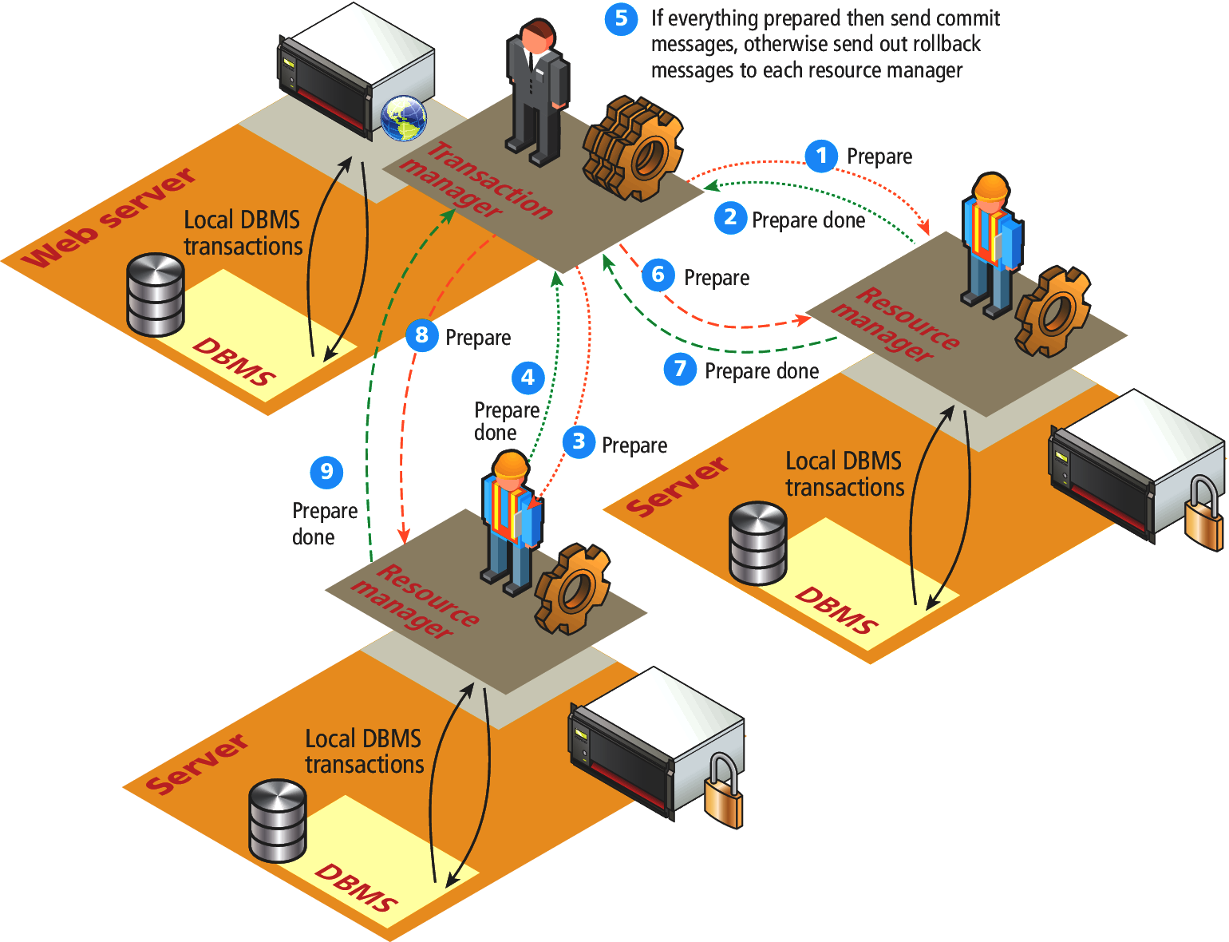
Figure 14.15 Distributed transaction processing

Slide 25
SQL
Data Manipulation Language
  SELECT, UPDATE, INSERT, DELETE
Data Definition Language (DDL)
  Creating Tables
  Modifying the structure of a table
  Deleting tables
  Creating databases
  Deleting databases
We will use database administration statements through phpMyAdmin management tool.

Slide 26
NoSQL Database in the Enterprise
Non-SQL Databases
  Documentation oriented, No relationship among stored data
  Optimized to retrieve data using simple Key-Value syntax similar to PHP associative arrays
  May be very large data sets
  Examples:
    Web server logs, geographical data
    Twitter posted information
  Non-SQL DB examples:
    Couch DB, monoDB
    Amazon SimpleDB , Google’s Big Table

Slide 27
Figure 14.17 Contrast between relational and NoSQL storage

Slide 28
Figure 14-17 NoSQL – Document Stores
Document Stores associate keys with values, but unlike key-value stores, they call that value a document.

Slide 29
Figure 14-18 Contrast between row and column wise stores

Slide 30
Database APIs – PHP MySQL APIs
MySQL extension - This was the original extension to PHP for working with MySQL and has been replaced with the newer mysqli extension.
mysqli extension - This extension provides both a procedural and an object-oriented approach. This extension also supports most of the latest features of MySQL.
PHP data objects (PDOs) - provide an abstraction layer that with the appropriate drivers can be used with any database, and not just MySQL databases. However, it is not able to make use of all the latest features of MySQL.

Slide 31
Database APIs – Deciding on a Database APIs
While PDO is unable to take advantage of some features of MySQL, there is a lot of merit to the fact that PDO can create database-independent PHP code
Like many things in the web world, there is no single best choice.
As the chapter (and book) proceed, we will standardize on the object-oriented, database-independent PDO approach.

Slide 32
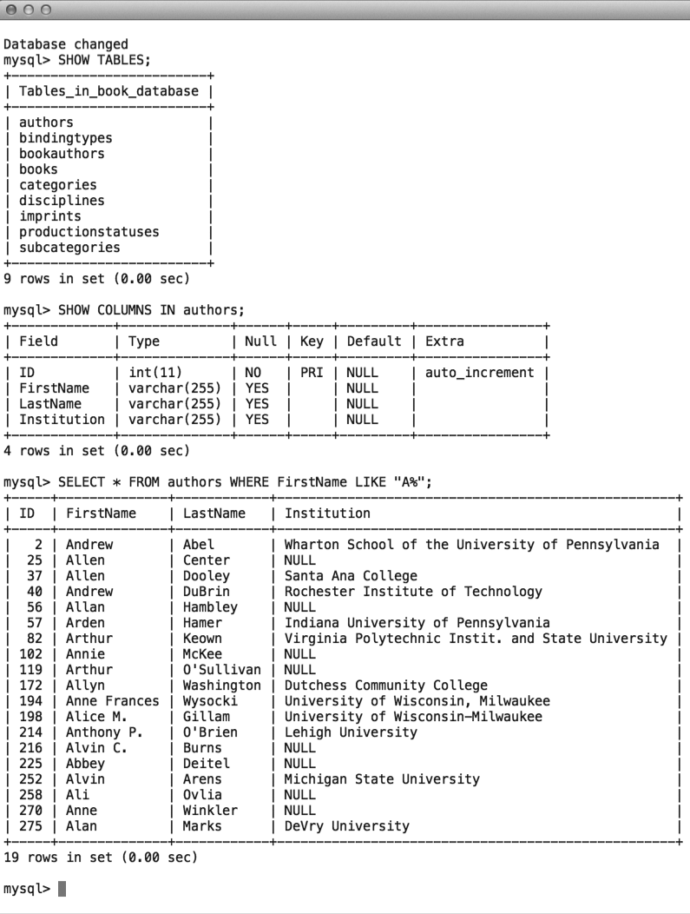
Managing a MySQL Database: Command-Line Interface

Slide 33
Managing a MySQL Database: Command-Line Interface
To launch an interactive MySQL command-line session, you must specify the host, username, and database name to connect to as shown below:
mysql -h 192.168.1.14 -u bookUser –p
To import commands from a file called commands.sql , for example, we would use the < operation:
mysql –h 192.168.1.14 –u bookUser –p < commands.sql

Slide 34
Managing a MySQL Database: phpMyAdmin

Slide 35
Managing a MySQL Database: MySQL Workbench

