Slide 1
CPET 499/ITC 250 Web Systems
Chapter 14
Working with Databases
Part 2 of 3
Text Book:
* Fundamentals of Web Development, 2nd edition, by Randy Connolly and Ricardo Hoar, published by Pearson
Paul I-Hai Lin, Professor of Electrical and Computer Engineering Technology
http://www.etcs.pfw.edu/~lin

Slide 2
Topics
Accessing MySQL in PHP
More PHP Data Object (PDO) and mysqli Procedural Style APIS
Integrating User Input Data Into Query
PHP and MySQL Tasks
  Making MySQL connection and closing connection
  Display a List of Links
  Search and Results Page
  Editing a Record
  Saving and Displaying Raw Files in the Database
  Displaying BLOBs from the Database
  Using Transactions
Database Schemas:
  Art Database, Book CRM Database, Travel Photo Database

Slide 3
Accessing MySQL in PHP
Basic Connection Algorithm
1. Connect to the database
2. Handle connection errors
3. Execute the SQL query
4. Process the results
5. Free resources and close connection

Slide 4
  Connecting to MySQL Database
  Using PHP Data Object (PDO)

Slide 5
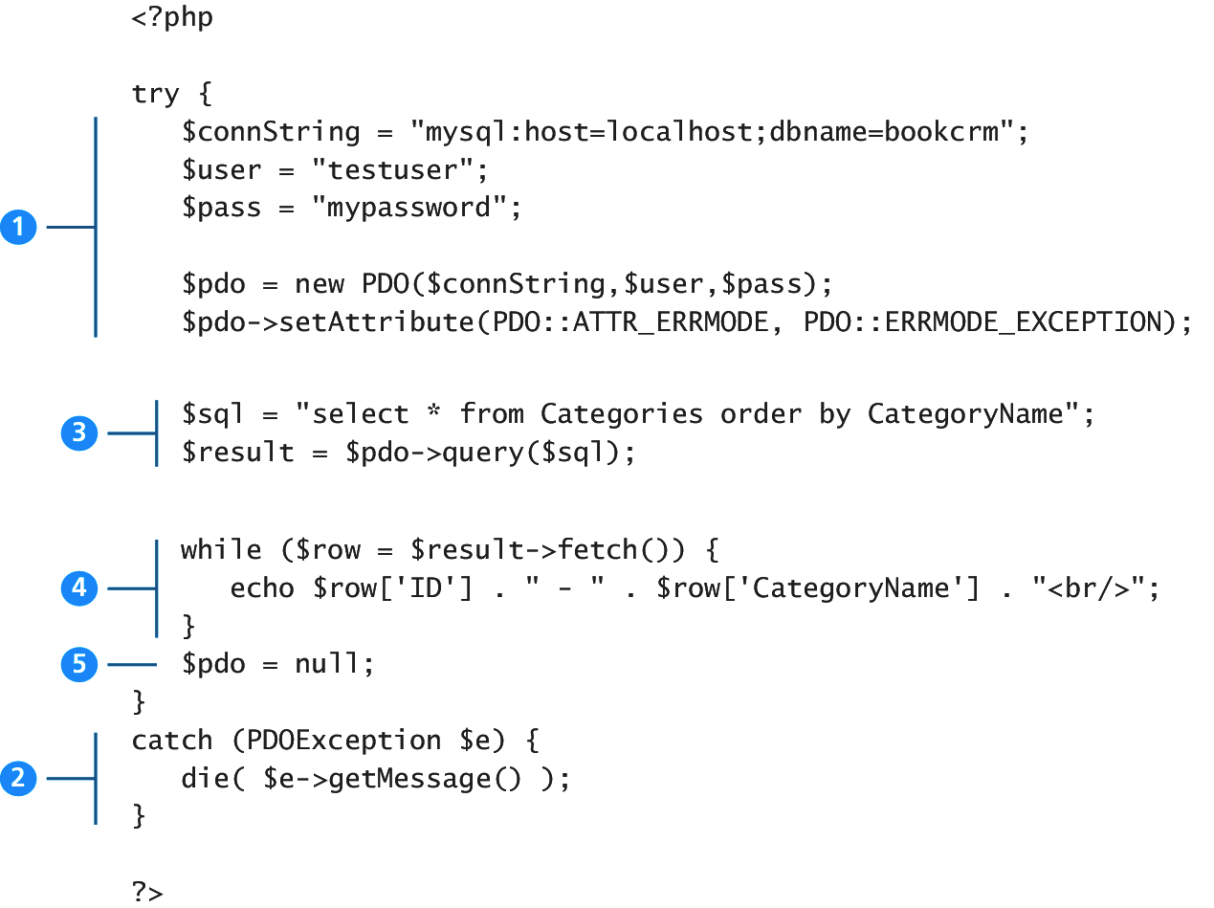
Figure 14.22 Basic Database Connection using PHP PDO

Slide 6
Listings 14-3 Connecting to a database with mysqli (procedural)
<?php
// modify these variables for your installation
$host = "localhost";
$database = "bookcrm";
$user = "testuser";
$pass = "mypassword";
$connection = mysqli_connect($host, $user, $pass,
$database);
?>

Slide 7
Listings 14-4 Connecting to a database with PDO (object-oriented)
<?php
// modify these variables for your installation
$connectionString = "mysql:host=localhost;
dbname=bookcrm";
$user = "testuser";
$pass = "mypassword";
$pdo = new PDO($connectionString, $user, $pass);
?>

Slide 8
Listings 14-5 Defining connection details via constants in a separate file (config.php)
<? php
define(‘DMHOST’, ‘localhost’);
define(‘DBNAME’, ‘bookcrm’);
define(‘DBUSER’, ‘testuser’);
define(‘DBPASS’, ‘mypassword’);
?>

Slide 9
Listings 14-6 Using the connection constants
<?php
require_once(protected/config.php);
$connection = mysqli_connect(DBHOST, DBUSER, DBPASS, DBNAME);
?>

Slide 10
Handling Connection Errors

Slide 11
Listings 14-8 Handling connection errors with mysqli (version 2)
<?php
$connection = mysqli_connect(DBHOST, DBUSER, DBPASS, DBNAME);
// mysqli_connect_errno returns the last error code
if ( mysqli_connect_errno() ) {
die( mysqli_connect_error() );
// die() is equivalent to exit()
}
?>

Slide 12
Listings 14-9 Handling connection errors with PDO
<?php
try {
$connString = "mysql:host=localhost;dbname=bookcrm";
$user = DBUSER;
$pass = DBPASS;
$pdo = new PDO($connString,$user,$pass);
. . .
}
catch (PDOException $e) {
die( $e->getMessage() );
}
?>

Slide 13
PDO Exception Modes
Three different error-handling modes/approaches
PDO::ERRORMODE_SELENT
  For normal production use
PDO::ERRORMODE_WARING
  For use during debugging/testing phase
PDO::ERRORMODE_EXCEPTION
  For use during debugging phase
  Stop the script at the point of error

Slide 14
Executing Query

Slide 15
Listings 14.11 and 12 Executing a SELECT query (mysqli and PDO)
<?php
//Listing 14.11 Executing a SELECT query (mysqli)
$sql = "SELECT * FROM Categories ORDER BY CategoryName";
// returns a mysqli_result object
$result = mysqli_query($connection, $sql);
?>
<?php
//Listing 14.12 Executing a SELECT query (pdo)
$sql = "SELECT * FROM Categories ORDER BY CategoryName";
// returns a PDOStatement object
$result = $pdo->query($sql);
?>

Slide 16
Processing the Query Results

Slide 17
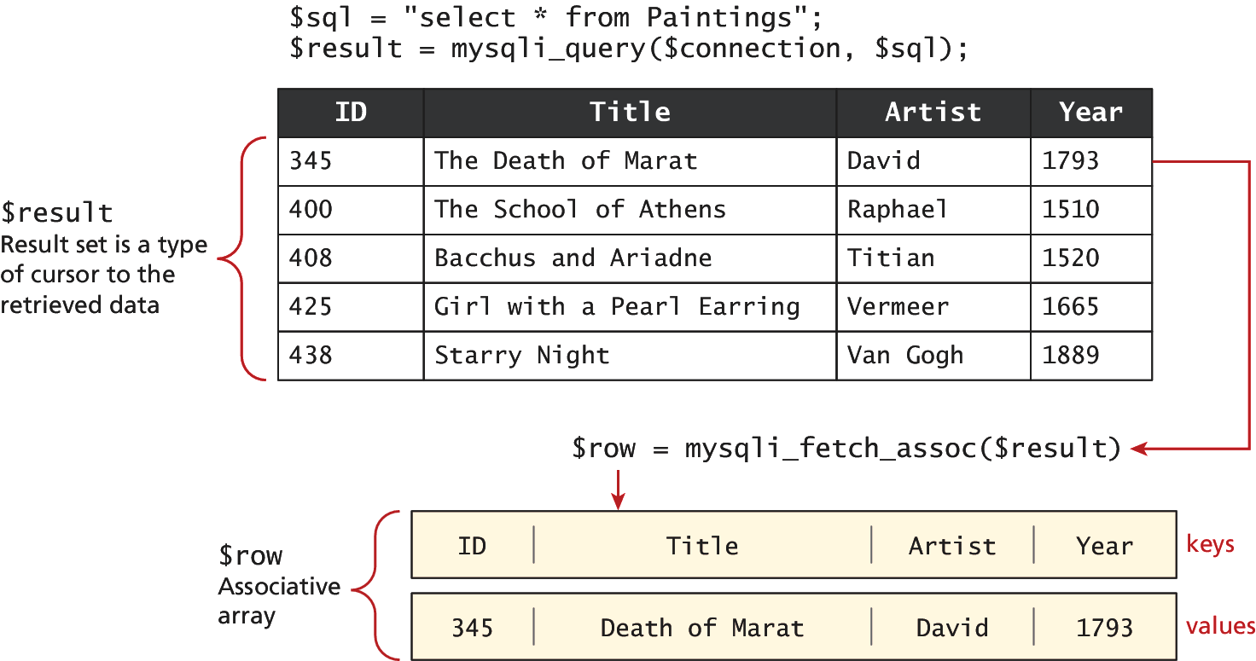
Figure 14.23 Fetching From a Result Set

Slide 18
Fetches and Displays Result Rest
Listing 14.13 Looping through the result set (PDO)
<?php
//Listing 14.13 Looping through the result set (PDO)
$sql = “SELECT * FROM Categories ORDER by CategoryName";
// run the query
$result = $pdo->query($sql);
while ( $row = $result->fetch() ) {
echo $row['ID'] . " - " . $row['CategoryName'] ;
echo "<br/>";
}
?>

Slide 19
PHP MySQL Fetching Functions
mysqli_fetch_all(): Fetches all result rows as an associate array, a numeric array, or both
  http://php.net/manual/en/mysqli-result.fetch-all.php
mysqli_fetch_array(): Fetches a result row as an associate array, a numeric array, or both
  http://php.net/manual/en/mysqli-result.fetch-array.php
mysqli_fetch_assoc(): Fetches a result row as an associate array
  http://php.net/manual/en/mysqli-result.fetch-assoc.php
mysqli_fetch_field(): Returns the definition of one column of a result set as an object. Call this function repeatedly to retrieve information about all columns in the result set.
  http://php.net/manual/en/mysqli-result.fetch-field.php

Slide 20
PHP MySQL: Procedural Style Fetching Functions
mysqli_fetch_fields(): Returns an array of objects which contains field definition information or FALSE if no filed information is available
  http://php.net/manual/en/mysqli-result.fetch-fields.php
mysqli_fetch_object(): Returns the current row of a result as an object
  http://php.net/manual/en/mysqli-result.fetch-object.php
mysqli_fetch_row(): Fetch one row of data from the result set as an numeric array
  http://php.net/manual/en/mysqli-result.fetch-row.php

Slide 21
Fetching Into An Object

Slide 22
Book Class, page 659
class Book {
public $ID;
public $Title;
public $CopyrightYear;
public $Description;
}

Slide 23
Fetching Into an Object, page 658
<?php
//Listing 14.14 Populating an object from a result set (PDO)
$id = $_GET['id'];
$sql = "SELECT * FROM Books";
$results = $pdo->query($sql);
while ($b = $result -> fetchObject('Book') )
{
echo 'ID: ' . $b->ID . '<br/>';
echo 'Title: ' . $b->Title . '<br/>';
echo 'Year: ' . $b->CopyrightYear . '<br/>';
echo 'Description: ' . $b->Description . '<br/>';
echo “<hr>”;
?>

Slide 24
Fetching Into an Object, pages 659-660
<?php
//Listing 14.15 Letting an object populate itself from a result set
class Book {
public $id;
public $title;
public $year;
public $description;
function __construct($record) {
// the references to the field names in associative array must
// match the case in the table
$this->id = $record['ID'];
$this->title = $record['Title'];
$this->year = $record['CopyrightYear'];
$this->description = $record['Description'];
} }

Slide 25
Fetching Into an Object, pages 659-660
//Listing 14.15 Letting an object populate itself from a result set
//...
// in some other page or class
$sql =“SELECT * FROM Books”;
$results = $pdo -> query($sql);
// fetch a record normally
while ($row = $result -> fetch() ){
$b = new Book($row);
echo 'ID: ' . $b->id . '<br/>';
echo 'Title: ' . $b->title . '<br/>';
echo 'Copyright Year: ' . $b->year . '<br/>';
echo ‘Description: ‘ . $b->description . </br>’;
echo “<hr>”;
?>

Slide 26
Freeing Resources and Closing Connection

Slide 27
Freeing Resources and Closing Connection, page 660
<?php //Listing 14.16 Closing the connection
// mysqli approach
$connection = mysqli_connect($host, $user, $pass, $database);
$result= mysqli_query($connection, “SELECT … FROM …”);
//...
// release the memory used by the result set. This is necessary if
// you are going to run another query on this connection
mysqli_free_result($result);
//...
// close the database connection
mysqli_close($connection);

Slide 28
Freeing Resources and Closing Connection
<?php //Listing 14.16 Closing the connection
// PDO approach
$pdo = new PDO($connString,$user,$pass);
//...
// closes connection and frees the resources used by the PDO object
$pdo = null;
?>

Slide 29
Working with Parameters

Slide 30
Working with Parameters, page 661
SQL Statements that perform action on the data
  INSERT
  UPDATE
  DELETE
Integrating User Data
Sanitizing User Data
Prepare Statements

Slide 31
Listing 14.18 Executing a query that doesn’t return data (mysqli) - UPDATE
<?php
//Listing 14.18 Executing a query that doesn't return data (mysqli)
$sql = "UPDATE Categories SET CategoryName='Web' WHERE CategoryName='Business'";
if ( mysqli_query($connection, $sql) ) {
$count = mysqli_affected_rows($connection);
echo "<p>Updated " . $count . " rows</p>";}
?>

Slide 32
Listing 14.17 Executing a query that doesn’t return data (PDO) - UPDATE
<?php
//Listing 14.17 Executing a query that doesn't return data (PDO)
$sql = "UPDATE Categories SET CategoryName='Web' WHERE CategoryName='Business'";
$count = $pdo->exec($sql);
echo "<p>Updated " . $count . " rows</p>";
?>

Slide 33
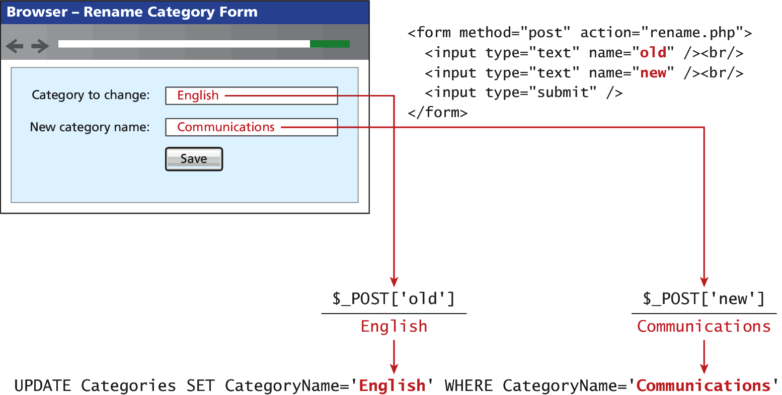
Figure 14.24 Integrating user input data into a query

Slide 34
  Integrating User Data into An Query
  Sanitizing User Data
  Prepare Statements

Slide 35
Listing 14.19 Integrating user input into a query (first attempt)
<?php
//Listing 14.19 Integrating user input into a query (first attempt)
$from = $_POST['old'];
$to = $_POST['new'];
$sql = "UPDATE Categories SET CategoryName='$to' WHERE CategoryName='$from'";
$count = $pdo->exec($sql);
?>

Slide 36
Sanitizing User Input Data
Remove any special characters from a desired piece of text
  mysqli_real_escape_string()
  quote() - PDO
<?php// Sanitizing user input before use in an SQL query
$from = $pdo->quote($from);
$to = $pdo->quote($to);
$sql = "UPDATE Categories SET CategoryName=$to WHERE CategoryName=$from";
$count = $pdo->exec($sql);?>

Slide 37
Prepared Statements
Prepared Statements
  A way to improve performance for queries that need to be executed multiple times
  It also integrates sanitization into each user input automatically, so it can protect SQL Injection
To fully protect against attack called “SQL injection”
  Go beyond “user input sanitization”
  Use prepared statement technique (best)

Slide 38
Listing 14.20 Using a prepare statement (PDO)
<?php
//Listing 14.20 Using a prepared statement (PDO)
// retrieve parameter value from query string
$id = $_GET['id'];
/* method 1 */
$sql = "SELECT Title, CopyrightYear FROM Books WHERE ID = ?";
$statement = $pdo->prepare($sql);
$statement->bindValue(1, $id);
$statement->execute();
/* method 2 */
$sql = "SELECT Title, CopyrightYear FROM Books WHERE ID = :id";
$statement = $pdo->prepare($sql);
$statement->bindValue(':id', $id);
$statement->execute();?>

Slide 39
Listing 14.21 Using named parameters (PDO)
<?php//Listing 14.21 Using named parameters (PDO)
/* technique 1 - question mark placeholders */
$sql = "INSERT INTO books (ISBN10, Title, CopyrightYear, ImprintId,ProductionStatusId, TrimSize, Description) VALUES(?,?,?,?,?,?,?)";
$statement = $pdo->prepare($sql);
$statement->bindValue(1, $_POST['isbn']);
$statement->bindValue(2, $_POST['title']);
$statement->bindValue(3, $_POST['year']);
$statement->bindValue(4, $_POST['imprint']);
$statement->bindValue(4, $_POST['status']);
$statement->bindValue(6, $_POST['size']);
$statement->bindValue(7, $_POST['desc']);
$statement->execute();

Slide 40
Listing 14.21 Using named parameters (PDO)
/* technique 2 - named parameters */
$sql = "INSERT INTO books (ISBN10, Title, CopyrightYear, ImprintId,ProductionStatusId, TrimSize, Description) VALUES (:isbn,:title, :year, :imprint, :status, :size, :desc) ";
$statement = $pdo->prepare($sql);
$statement->bindValue(':isbn', $_POST['isbn']);
$statement->bindValue(':title', $_POST['title']);
$statement->bindValue(':year', $_POST['year']);
$statement->bindValue(':imprint', $_POST['imprint']);
$statement->bindValue(':status', $_POST['status']);
$statement->bindValue(':size', $_POST['size']);
$statement->bindValue(':desc', $_POST['desc']);
$statement->execute();
?>

Slide 41
Listing 14.22 Using a prepare statement (mysqli)
<?php
//Listing 14.22 Using a prepared statement (mysqli)
// retrieve parameter value from query string
$id = $_GET['id'];
// construct parameterized query – notice the ? Parameter
$sql = "SELECT Title, CopyrightYear FROM Books WHERE ID=?";
// create a prepared statement
if ($statement = mysqli_prepare($connection, $sql)) {
// Bind parameters s - string, b - blob, i - int, etc mysqli_stmt_bindm($statement, 'i', $id);
// execute query
mysqli_stmt_execute($statement);
// learn in next section how to access the returned data //...}
?>

Slide 42
  Using Transactions

Slide 43
Fetches and Displays Result Rest
Looping through the result set (mysqli)
<?php
//Looping through the result set
// (mysqli—not prepared statements)
$sql = "select * from Categories order by CategoryName";
// run the query
if ($result = mysqli_query($connection, $sql)) {
// fetch a record from result set into an associative array while($row = mysqli_fetch_assoc($result)) {
// the keys match the field names from the table
echo $row['ID'] . " - " . $row['CategoryName'] ;
echo "<br/>";
}
}
?>

Slide 44
Using Transactions, page 666
Transactions
  Unnecessary when retrieving database data
  Should be used for most scenarios involving any database “writes”

Slide 45
Listing 14.23 Using Transactions (mysqli)
<?php
//Listing 14.23 Using transactions (mysqi extension)
$connection = mysqli_connect($host, $user, $pass, $database);
//...
/* set autocommit to off. If autocommit is on, then mysql will commit (i.e., make the data change permanent) each command afterit is executed */
mysqli_autocommit($connection, FALSE);
/* insert some values */
$result1 = mysqli_query($connection,"INSERT INTO Categories (CategoryName) VALUES ('Philosophy')");
$result2 = mysqli_query($connection,"INSERT INTO Categories (CategoryName) VALUES ('Art')");

Slide 46
Listing 14.23 Using Transactions (mysqli)
<?php
//Listing 14.23 Using transactions (mysqi extension)
if ($result1 && $result2) {
/* commit transaction */
mysqli_commit($connection);
}
else
{
/* rollback transaction */
mysqli_rollback($connection);}
?>

Slide 47
Listing 14.24 Using Transactions (PDO)
<?php
//Listing 14.24 Using transactions (PDO)
$pdo = new PDO($connString,$user,$pass);
// turn on exceptions so that exception is thrown if error occurs
$pdo->setAttribute(PDO::ATTR_ERRMODE, PDO::ERRMODE_EXCEPTION);
//...
try {
// begin a transaction
$pdo->beginTransaction();
// a set of queries: if one fails, an exception will be thrown
$pdo->query("INSERT INTO Categories (CategoryName) VALUES ('Philosophy')");
$pdo->query("INSERT INTO Categories (CategoryName) VALUES ('Art')");

Slide 48
Listing 14.24 Using Transactions (PDO)
//Listing 14.24 Using transactions (PDO)
// if we arrive here, it means that no exception was thrown
// which means no query has failed, so we can commit the
// transaction
$pdo->commit();
}
catch (Exception $e)
{
// we must rollback the transaction since an error occurred
// with insert
$pdo->rollback();
}
?>

Slide 49
Q & A

