Slide 1
CPET 499/ITC 250 Web Systems
Chapter 15
Error Handling and Validation
Text Book:
* Fundamentals of Web Development, 2nd, by Randy Connolly and Ricardo Hoar, published by Pearson
Purdue University For Wayne
School of Polytechnic
Paul I-Hai Lin, Professor
http://www.etcs.pfw.edu/~lin

Slide 2
Topics
Why the different types of errors and how they differ from exceptions
The different forms of error reporting in PHP
How to handle errors and exceptions
What regular expressions are and how to use them in JavaScript and PHP
Some best practices in design user input validation
How to validate inputs in HTML5, JavaScript, and PHP

Slide 3
Errors and Exceptions
Exceptions
  For run time errors handling
  Object-oriented construct:
    try … catch … exceptions
Errors
  Expected errors
  Warnings
  Fatal Errors

Slide 4
Errors
Types of Errors
  Expected errors
    An error that routinely occurs during running an application.
    User data entering errors
    isset() can be used for testing the value of a variable
    empty() for checking query string values:
      Return “TRUE” if a variable is NULL, FALSE, ZERO, or an EMPTY STRING
    is_numeric() for testing a query string parameter to be numeric
  Warnings
  Fatal errors

Slide 5
Errors
Types of Errors
  Expected errors
  Warnings
    PHP warning messages may or may not be displayed
    It will halt the execution of the page
  Fatal errors
    Serious errors that the execution of the program will terminate unless handled in other proper ways

Slide 6
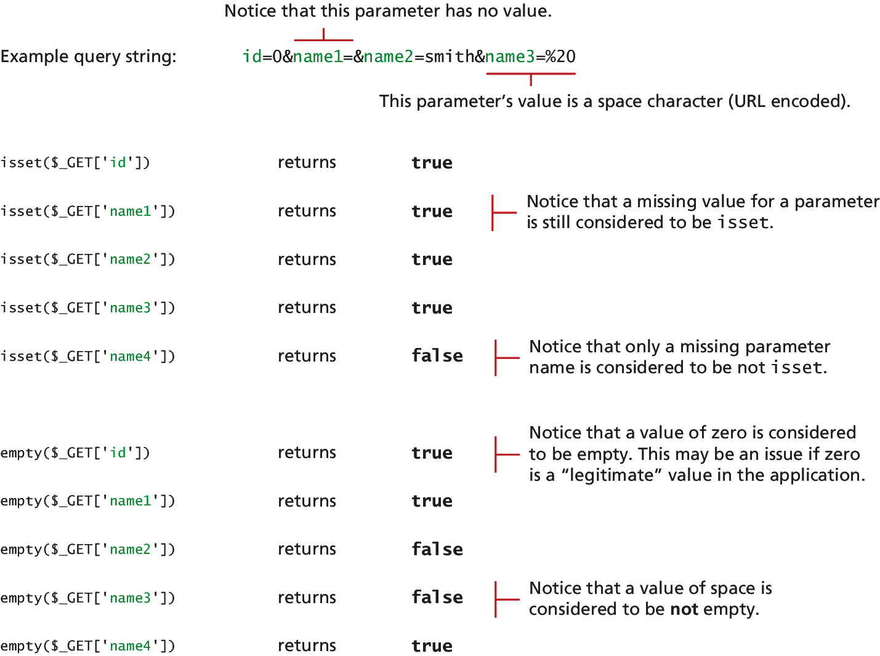
Figure 15.1 Comparing isset() and empty() with query string parameters

Slide 7
Listing 15.1 Testing a query string: existence & numeric
<?php
//Listing 15.1 Testing a query string to see if it exists and is numeric
$id = $_GET['id'];
if (!empty($id) && is_numeric($id) )
{
// use the query string since it exists and is a numeric value
//...}
?>

Slide 8
PHP Error Reporting
Runtime Configuration
  http://php.net/manual/en/errorfunc.configuration.php
Three main error reporting flags
  error_reporting
    error_reporting(E_ALL)
    errort_reporting = E_ALL … in php.ini File
  display_errors
    Ini_set(‘display_errors’, ‘0’);
  log_errors

Slide 9
PHP Error Reporting
error_reporting specifies which type of errors are to be reported:
ini_set('log_errors','1');
It can also be set within the php.ini file:
log_errors = On

Slide 10
The Display Error Setting
The display_error setting specifies whether error messages should or should not be displayed in the browser:
ini_set('display_errors','0');
It can also be set within the php.ini file:
display_errors = Off

Slide 11
PHP Error and Exception Handling (Procedural)
$connection = mysqli_connect(DBHOST, DBUSER, DBPASS, DBNAME);
$error = mysqli_connect_error();
if ($error != null) {
// handle the error
...
}

Slide 12
PHP Error and Exception Handling (Objected-Oriented)
Exception throwing function (for illustration purposes)
function throwException($message = null,$code = null) {
throw new Exception($message,$code);
}
try {
// PHP code here
$connection = mysqli_connect(DBHOST, DBUSER, DBPASS, DBNAME)
or throwException("error"); …
}
catch (Exception $e) {
echo ' Caught exception: ' . $e->getMessage();
echo ' On Line : ' . $e->getLine();
echo ' Stack Trace: '; print_r($e->getTrace());
} finally {
// PHP code here that will be executed after try or after catch
}

Slide 13
Regular Expressions
Regular Expressions - Definition
  A regular expressions is a set of special characters that define a pattern to be matched in strings.
  Found in Unix Utilities: vi, grep, sed
  In Web applications, we want to match
    A phone number
    Zip code
    Email address, etc

Slide 14
Regular Expressions
Perl Regular Expression, https://perldoc.perl.org/perlre.html
JavaScript Regular Expression
  Special characters, https://developer.mozilla.org/en-US/docs/Web/JavaScript/Guide/Regular_Expressions
  RegExp(), https://developer.mozilla.org/en-US/docs/Web/JavaScript/Reference/Global_Objects/RegExp
PHP Regular Expression, http://php.net/manual/en/reference.pcre.pattern.syntax.php
MySQL Regular Expression:
  Pattern Matching, https://dev.mysql.com/doc/refman/5.7/en/pattern-matching.html
  Regular Expressions, https://dev.mysql.com/doc/refman/5.7/en/regexp.html

Slide 15
Regular Expressions
PHP Regular Expressions, http://php.net/manual/en/reference.pcre.pattern.syntax.php
MySQL Regular Expressions:
  Pattern Matching, https://dev.mysql.com/doc/refman/5.7/en/pattern-matching.html
  Regular Expressions, https://dev.mysql.com/doc/refman/5.7/en/regexp.html
.NET Regular Expression, https://docs.microsoft.com/en-us/dotnet/standard/base-types/regular-expressions

Slide 16
Regular Expression Syntax
A regular expression consists of two types of characters
  Literals – characters to be matched in the target string
  Metacharacters – special symbols that acts as a command to the regular expression parser
14 Metacharacters (characters with special meaning)
. | [ | ] | \ | ( | ) | ^
$ | | | * | ? | { | } | +

Slide 17
Regular Expression Examples
PHP Example: begin and end with backward slahes
  $pattern = ‘/ran/;
  ‘randy Connolly’; ‘Sue ran to store’; “I would like a cranberry’
  $check = ‘Sue ran to the store’;
  if (preg_match($pattern, $check)){
  echo ‘Match found!’;
JavaScript Example: begin and end with forward slashes
  var pattern = /ran/;
  If (pattern.test(‘Sue ran to the store’)) {
  Document.write(‘Match found’);}

Slide 18
Common Regular Expression Patterns
Pattern | Description
^ qwerty $ | Match the entire string between the ^ and the $ symbols; between the very start and end of.
\t | Matches a tab character
\n | Matches a new-line character
. | Matches any character other than \n
[qwerty] | Matches any single character of the set contained within the brackets
[^qwerty] | Matches any single character not contained within the brackets

Slide 19
Common Regular Expression Patterns
Pattern | Description
[a-z] | Matches any single character within the range of characters
\w | Matches any word character, equivalent to {a-zA-Z0-9}
\W | Matches any nonword character
\s | Matches any white-space character
\S | Matches any nonwhite-space character

Slide 20
Common Regular Expression Patterns
Pattern | Description
\d | Matches any digit
\D | Matched any non-digit
* | Indicates zero or more matches
+ | Indicates one or more matches
? | Indicates zero or one match
{n} | Indicates exactly n matches
{n,} | Indicates n or more matches
{n.m} | Indicates at least n but no more than m matches
| | Matches any one of the terms separated by the | character. Equivalent to Boolean OR
( ) | Groups a subexpression. Grouping can make a regular expression easier to understand

Slide 21
Extended Regular Expression Examples
^\d{3}-\d{4}$ : Matches any string containing three numbers, follow by a dash, followed by four numbers without any other characters
^[2-9]\d{2}-\d{4}$ : Matched a phone number that would NOT allow the first digit in the phone number to be a zero (“0”) or a one (“1”).
^[2-9]\d{2}[-\s\.]\d{4}$ :Allows a single space for example (481 6339), a period (481,6339), or a dash (481-6339) between the two sets of numbers.
^[2-9]\d{2}[-\s\.]\s*\d{4}$ :Allow multiple spaces (but only one single dash or period) in our phone.

Slide 22
Listing 15.7 A phone number validation without regular expression (partial listing)
//Listing 15.7 A phone number validation script without regular //expressions
var phone=document.getElementById("phone").value;
var parts = phone.split("."); // split on .
if (parts.length !=3) {
parts = phone.split("-"); // split on –
}

Slide 23
Listing 15.7 A phone number validation without regular expression (partial listing)
if (parts.length == 3) {
var valid=true; // use a flag to track validity
for (var i=0; i < parts.length; i++) {
// check that each component is a number
if (!isNumeric(parts[i])) {
alert( "you have a non-numeric component");
valid=false; }
else
{ // depending on which component make sure it's in range
if (i<2) {
if (parts[i]<100 || parts[i]>999) {
valid=false; } }
else { if (parts[i]<1000 || parts[i]>9999) { valid=false; } }
} // end if isNumeric
} // end for loop

Slide 24
Listing 15.7 A phone number validation without regular expression (partial listing)
if (valid) {
alert(phone + "is a valid phone number");
}
}alert ("not a valid phone number");

Slide 25
Validating User Input
Types of Input Validation
  Required Information
    Data fields just cannot be left empty
    Emails, phones, user name, passwords, etc.
  Correct Data Type
    Numeric, Dates, Strings, etc.
  Correct Format
    Postal codes, Credit Card numbers, Social security numbers, etc.
  Comparison: passwords, entered values
  Range Check: Dates, number
  Custom Validation:

Slide 26
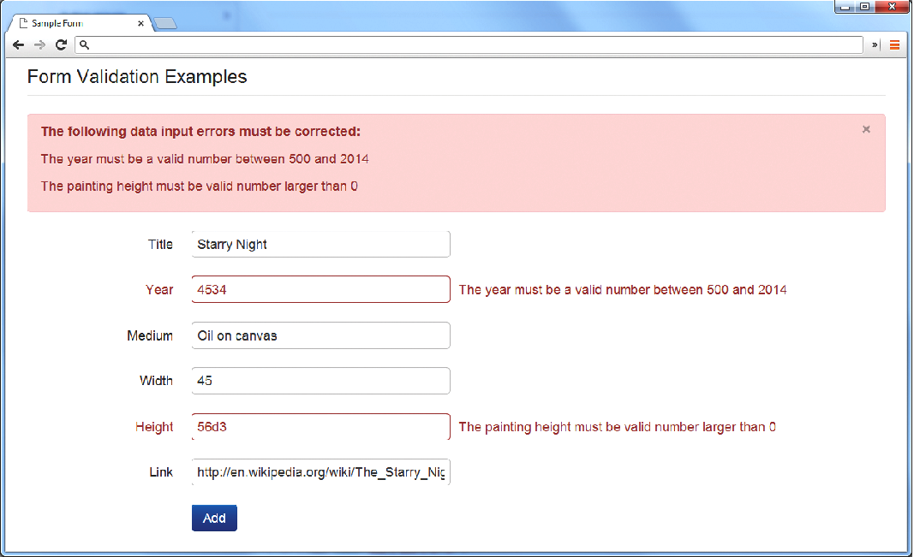
Fig. 15.2 Displaying error messages
What is the Problem?
Where is the Problem?
If appropriate, how do I fix it?

Slide 27
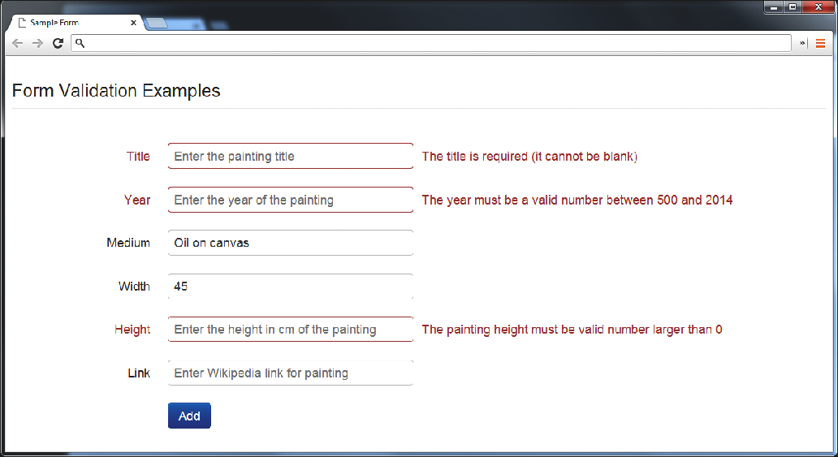
Notifying the User
Fig. 15.3 Indicating where an error is located

Slide 28
How to Reduce Validation Errors
Common ways that minimize user validation errors
  Using pop-up JavaScript Alert Messages (or other popup),
  Provide textual hints to the user on the form itself, Fig. 15-4
  Using tool tips or pop-over to display context-sensitive help, Fig. 15. 5
  Providing JavaScript-based input mask, Fig. 15.6

Slide 29
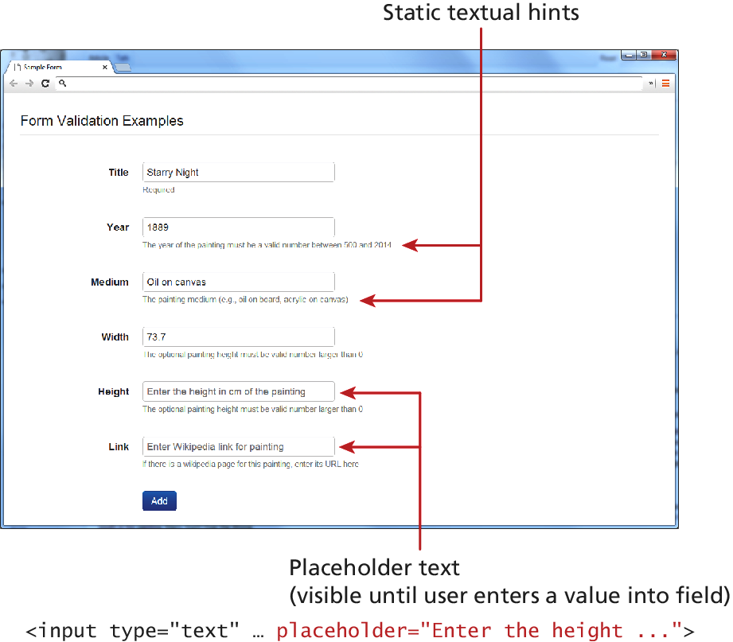
Fig. 15.4 Providing textual hints

Slide 30
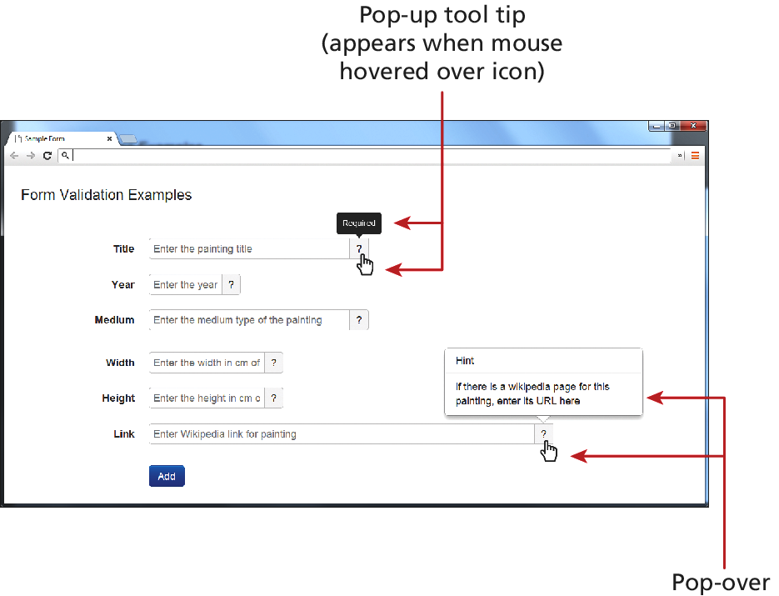
Fig. 15.5 Using tool tips or pop-over

Slide 31
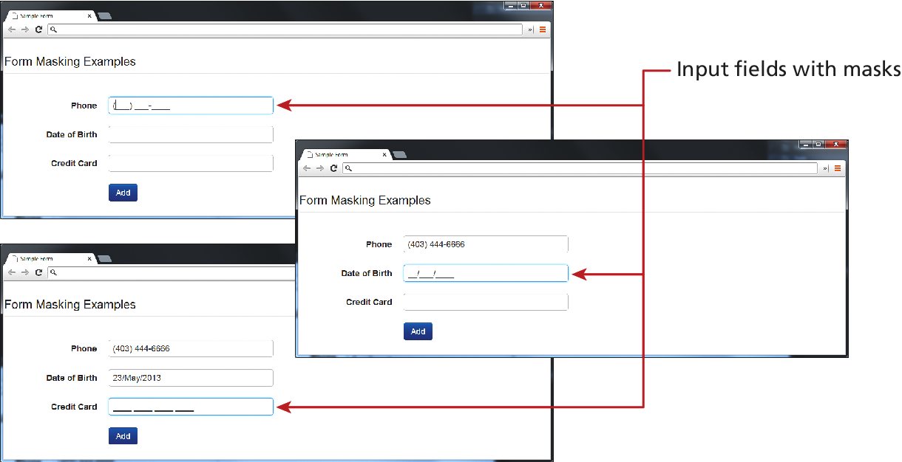
Fig. 15.6 Providing JavaScript-based input mask

Slide 32
Where to Perform Validation
Performing basic validation with client browsers with HTML 5
Using JavaScript on the client side (may be turned off on the user’s browser)
Server side validation (always)
  For example: Validation at the PHP Level

Slide 33
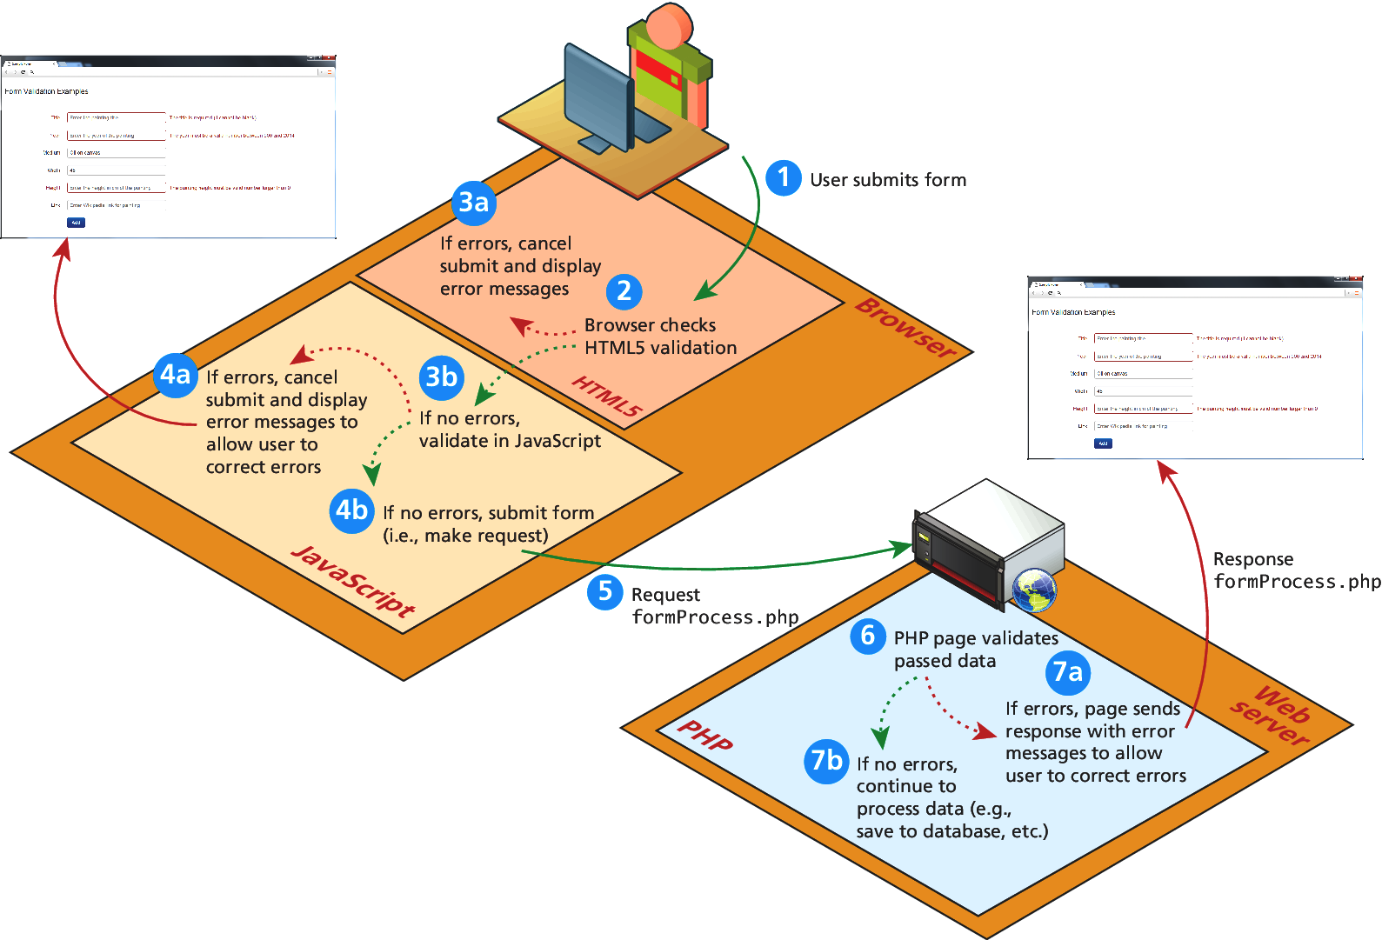
Fig. 15.7 Visualizing levels of validation

Slide 34
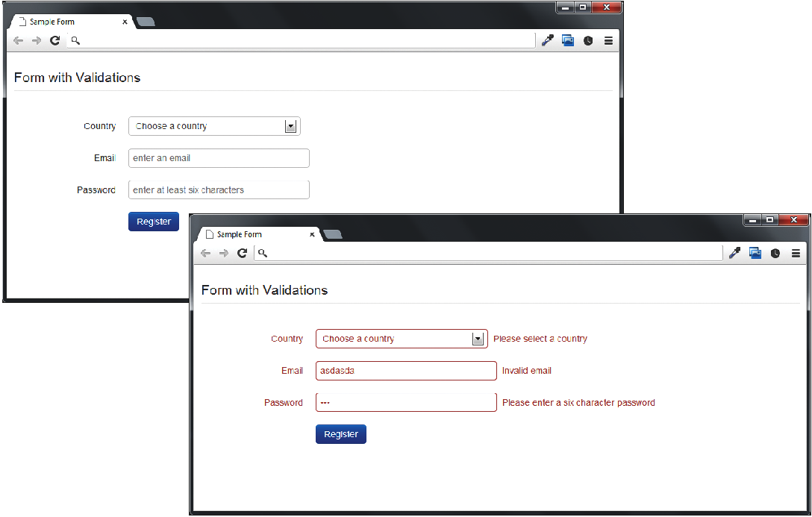
Fig. 15.8 Example form to be validated

Slide 35
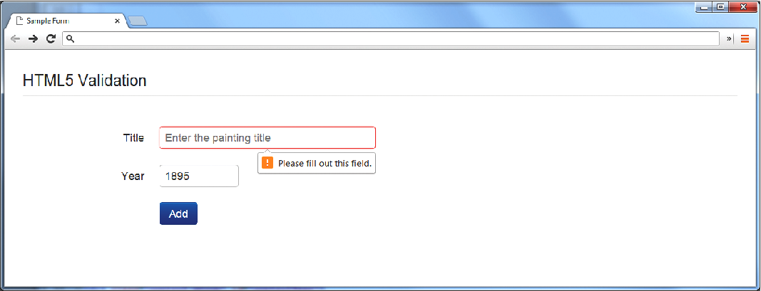
Fig. 15.9 HTML5 browser validation
Add “required attribute” to input element
<form id=“sampleForm” method=“…” action=“…” nonvalidate>
http://www.w3.org/TR/html5/forms.html

Slide 36
Listing 15.8 Example form (validationform.php) to be validated
<?php
//Listing 15.8 Example form (validationform.php) to be validated?>
<form method="POST" action=“validationform.php class="form-horizontal" id="sampleForm" >
<fieldset><legend>Form with Validations</legend>
<div class="control-group" id="controlCountry">
<label class="control-label" for="country">Country</label>
<div class="controls"><select id="country" name="country" class="input-xlarge"><option value="0">Choose a country</option><option value="1">Canada</option><option value="2">France</option><option value="3">Germany</option><option value="4">United States</option></select>
<span class="help-inline" id="errorCountry"></span>
</div>
</div>

Slide 37
Listing 15.8 Example form (validationform.php) to be validated
<div class="control-group" id="controlEmail">
<label class="control-label" for="email">Email</label>
<div class="controls">
<input id="email" name="email" type="text"
placeholder="enter an email" class="input-xlarge“ required>
<span class="help-inline" id="errorEmail"></span>
</div>

Slide 38
Listing 15.8 Example form (validationform.php) to be validated
<div class="control-group" id="controlPassword">
<label class="control-label" for="password">Password</label>
<div class="controls">
<input id="password" name="password" type="password"
placeholder="enter at least six characters" class="input-xlarge"
required>
<span class="help-inline" d="errorPassword"></span>
</div>
</div>

Slide 39
Listing 15.8 Example form (validationform.php) to be validated
<div class="control-group">
<label class="control-label" for="singlebutton"></label>
<div class="controls"><button id="singlebutton"
name="singlebutton" class="btn btn-primary">
Register</button>
</div>
</div>
</fieldset>
</form>

Slide 40
Validation at the JavaScript Level
<div class="control-group">
<label class="control-label" for="singlebutton"></label>
<div class="controls">
<button id="singlebutton" name="singlebutton" class="btn btn-primary">Register</button>
</div></div></fieldset></form>

Slide 41
Validation at the JavaScript Level
Initialize the validation function once an element loses its focus
function init(){
var sampleForm=document.getElementById(‘sampleForm’);
sampleForm.onsubmit = validateForm;
}
// Call the init() function once all the html has been loaded
window.onload = init;
Password input element is between 8 and 16 character
var passReg = /^[a-zA-Z]\w{8,16}$/;
if(! passReg.test(password.value){
// provide some type of error message
Listing 15.9 Complete JavaScript Validation

Slide 42
Validation at the PHP Level
Listing 15.10 ValidationResult Class
Listing 15.11 PHP form validation
Listing 15.12 Revised form with PHP validation messages

Slide 43
Summary and Conclusion
Q/A ?

