Slide 1
Web Systems
Lecture 1
An Overview of Web Systems
Paul I-Hai Lin, Professor of Electrical and Computer Engineering Technology
School of Polytechnic
College of Engineering, Technology, and Computer Science
Purdue University Fort Wayne
http://www.etcs.pfw.edu/~lin

Slide 2
Web Systems
A study of essential knowledge and skills that an effective web administrator must know. Introduction to fundamental topics of web technologies, web-based systems, and web page design. Topics covered include Internet applications, web site development and publishing, information architecture, client and server-side programming, multimedia technologies and publishing, vulnerabilities, and web site implementation and maintenance.

Slide 3
Web Systems
Web Systems utilize
  Computer Systems
  Communications and Networking Technology
  The Internet Technology & Services
  Web Clients, Web Sites & Servers
    Web sites, Web pages, contents, apps, services
  Cloud Data Centers and Storage Systems
Web Enabled, Assisted Applications
  Online E-Commerce & E-Business
  Web Content Sharing
  Web Services
  Enterprise Computer System & App Integration
  Enterprise Data Integration
  etc

Slide 4

Web Systems – need to utilize
Computer Systems
  Main Frames (IBM z14)
  Networked Computers in Data centers
  Server computers
  Workstation computers
  Desktops/Laptops
  Embedded computers
  Mobile Devices (smart phones, tablet, iPad, etc)

Slide 5
Web Systems – need to utilize
Networking & Communication Systems

Slide 6
Web Systems – use Internet infrastructure
Internet, https://en.wikipedia.org/wiki/Internet
The Internet is the global system of interconnected computer networks that use the Internet protocol suite (TCP/IP) to link devices worldwide. It is a network of networks that consists of private, public, academic, business, and government networks of local to global scope, linked by a broad array of electronic, wireless, and optical networking technologies. The Internet carries an extensive range of information resources and services, such as the inter-linked hypertext documents and applications of the World Wide Web (WWW), electronic mail, telephony, and file sharing.

Slide 7
Internet
Interconnected Global Computer Networks
  Networks of networks
  A collection of LANs, WiFi, and WANs systems and network enabled devices and/or computers from private, public, government, and business networks
  TCP/IP Protocols and Applications
  Carry and support an extensive range of information resources and services

Slide 8
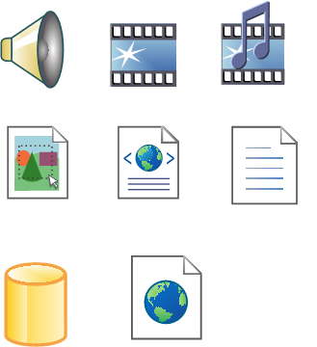
Web Systems – share and deliver
Data and Information Resources and Services:
  Voice
  Multimedia
  Video
  Medical record
  Images
  Web pages
  Document
  etc

Slide 9
Remote Measurement/Monitoring/Control – Web Enabled

Slide 10
Internet- and Web-enabled Enterprise IT Services & Operation Environment: An Example

Slide 11
Enterprise Applications and Data Integration

Slide 12
Web Servers for Enterprise Applications and Data Integration

Slide 13
Web Browser/Web Server Interaction

Slide 14
Web Clients
Browser Statistics, https://www.w3schools.com/Browsers/default.asp
2018 | Chrome | Edge/IE | Firefox | Safari | Opera
July | 80.1 % | 3.5 % | 10.8 % | 2.7 % | 1.5 %
June | 79.4 % | 3.8 % | 10.9 % | 3.0 % | 1.6 %
May | 79.0 % | 3.9 % | 10.9 % | 3.2 % | 1.6 %
Apr | 78.6 % | 3.9 % | 11.2 % | 3.3 % | 1.5 %
Mar | 78.1 % | 4.0 % | 11.5 % | 3.3 % | 1.6 %
Feb | 77.9 % | 4.1 % | 11.8 % | 3.3 % | 1.5 %
Jan | 77.2 % | 4.1 % | 12.4 % | 3.6 % | 1.6 %

Slide 15
Web Browser Architecture

Slide 16
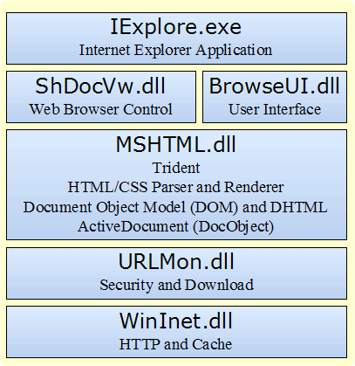
IE Web Browser Architecture
https://msdn.microsoft.com/en-us/library/aa741312(v=vs.85).aspx [accessed 2017/8/22]

Slide 17
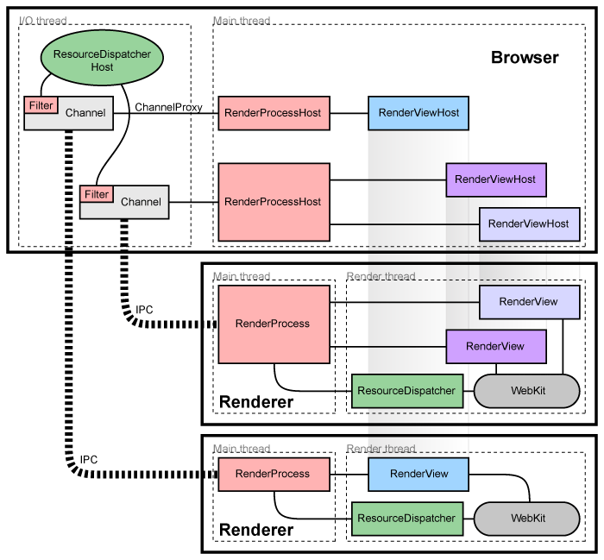
Chrome Browser Architecture
The Chromium Project - Multiprocess Architecture, https://www.chromium.org/developers/design-documents/multi-process-architecture [accessed 2017/8/22]

Slide 18
Web Servers/Web Sites
Netcraft Web Server Survey
May 2017 Web server survey, https://news.netcraft.com/archives/2017/05/25/may-2017-web-server-survey.html
  Microsoft IIS – 49.1%
  Apache - 20.95%
  NGINX – 29.22%
  Google – 1.05%
July 2018 Web server survey, https://news.netcraft.com/archives/2018/07/19/july-2018-web-server-survey.html
  Apache - 41.13%
  NGINX – 21.64%
  Google - 8.18%
  Microsoft – 6.62%

Slide 19
Web Servers (HTTP Server)
HTTP (HyperText Transfer Protocol – Port 80)
HTTPs (HyperText Transfer Protocols Secured – Port 443) protocols

Slide 20
Internet Service Providers (ISPs)
Basic Services Provided
DNS (Domain Name Resolution Service): translating domain name into an IP address.
RADIUS: User Authentication Dial-In User Services, and accounting
WWW: Basic web hosting and server functionality; FTP, etc
Email: Providing POP3 (post office protocol), IMAP (Internet Message Access Protocol) and SMTP (Simple Mail Transfer Protocols) services

Slide 21
Internet Service Providers (ISPs)
ISP Connection Types
DSL (Digital Subscriber Line): DSL modem, Router
Fiber: Verizon FIOS, https://en.wikipedia.org/wiki/Verizon_Fios
Cable: Cable Internet Access, https://en.wikipedia.org/wiki/Cable_Internet_access
Satellite: The Best Satellite ISP in 2017, http://www.reviews.org/internet-service/best-satellite-internet-providers/
Wireless ISP: http://www.wispa.org/
Cellular
  https://www.wireless.att.com/businesscenter/solutions/network/wwan.jsp

Slide 22
Internet Service Providers (ISPs)
Internet Providers in Fort Wayne, https://www.highspeedinternet.com/in/fort-wayne [accessed 2017/8/20]
  Verison DSL, Fiber
  Frontier FiOS – Fiber, DSL
  Xfinity (Comcast) - cable
  CenturyLink – DSL, Fiber
  HiughesNet - Satellite

Slide 23
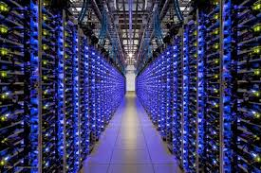
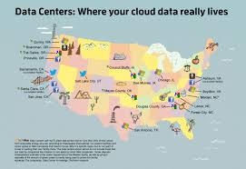
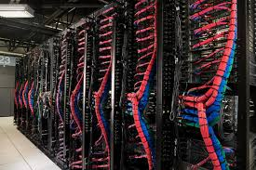
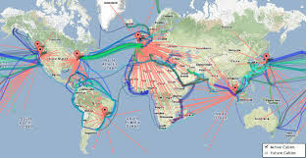
Web Systems May use Data Centers
Networked Computer Systems in Data Centers
Globaldots.com
Consulttech.us
Datacenters.com
Stackoverflow.com

Slide 24
AWS Global Infrastructure
(Amazon Web Services)
AWS Global Infrastructure (Accessed 2018/8/23), https://aws.amazon.com/about-aws/global-infrastructure/
  The AWS Cloud operates 55 Availability Zones within 18 geographic Regions around the world, with announced plans for 12 more Availability Zones and 54more Regions in Bahrain, Hong Kong SAR, Sweden, and a second AWS GovCloud Region in the US.

Slide 25
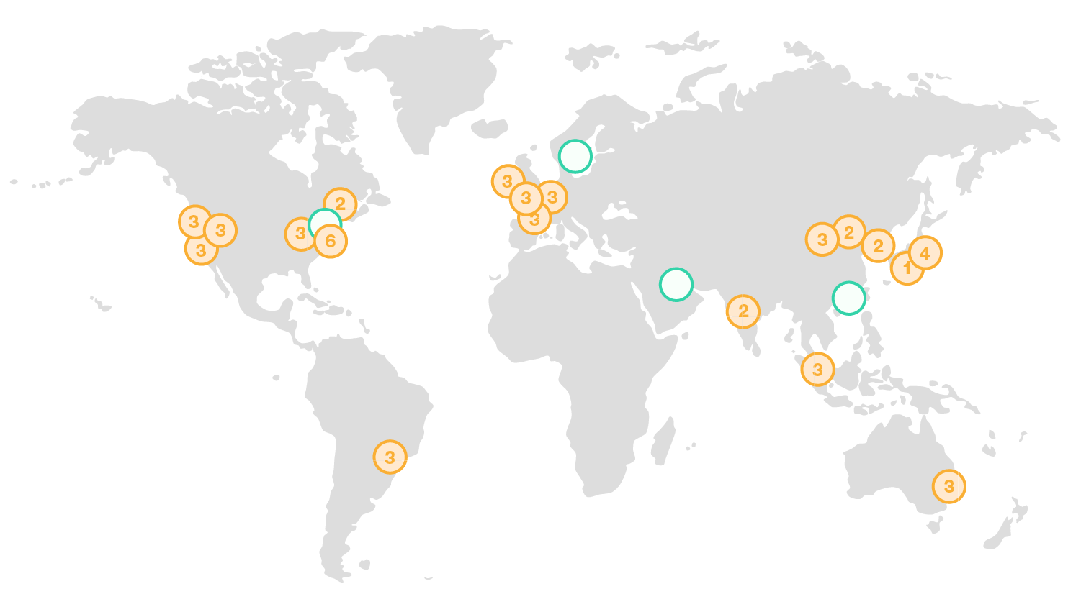
AWS Global Infrastructure
AWS Global Infrastructure, https://aws.amazon.com/about-aws/global-infrastructure/

Slide 26
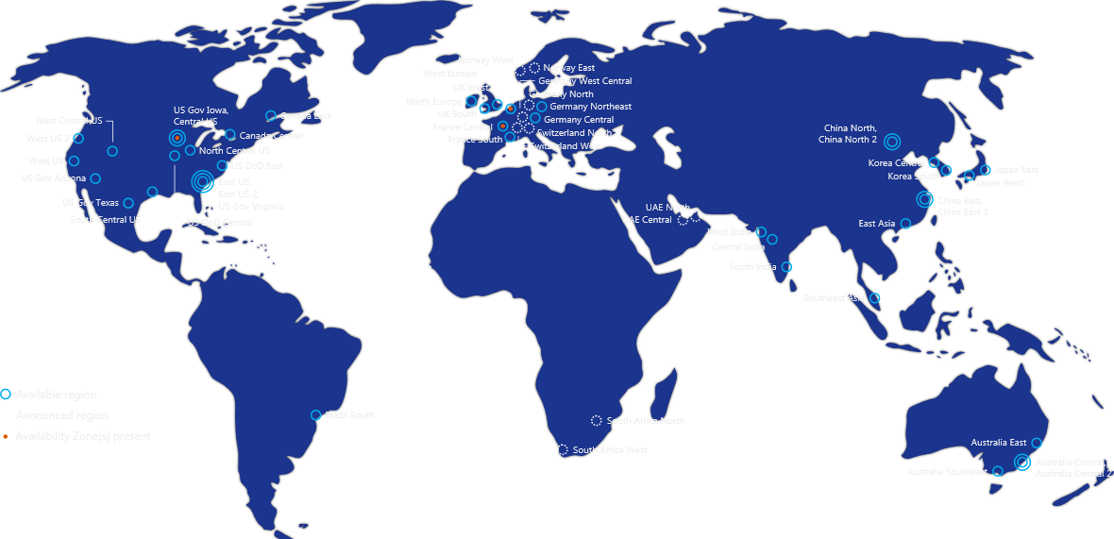
AWS Global Infrastructure
Azure Regions (54 regions worldwide, 140 countries), https://azure.microsoft.com/en-us/regions/ [accessed 2018/8/21]

Slide 27
Hot Topics in Web Systems and Technologies
HotWeb 2017, Oct. 14, 5th ACM/IEEE Workshop, San Jose, CA, https://hotweb2017.github.io/cfp.html
Web of Things (Internet of Things)
Applications
Caching and replication,
Crowdsourcing Systems and Social Media
Data mining and analytics
Ecommerce and monetization
Infrastructure (Datacenters, Content Networks and Cloud Computing)

Slide 28
Hot Topics in Web Systems and Technologies
Internet Telephony
Measurement studies of deployed systems
Mobility and pervasive Web
Multimedia content distribution
Security and privacy
Social networks and graph analysis
Searching and Information Retrieval, and
Web/Database integration.

Slide 29
Summary

