Slide 1
Web Systems
Lecture 2
Web System Infrastructure, Protocols, and Applications
Paul I-Hai Lin, Professor of Electrical and Computer Engineering Technology
School of Polytechnic
College of Engineering, Technology, and Computer Science
http://www.etcs.pfw.edu/~lin

Slide 2
Web System Infrastructure, Protocols, and Applications
Computer Systems:
  Client and Server computers, Mobile Devices
  Client/Server Computing
  Cloud computing
Communications and Networking
  Wired, Wireless, Cellular communications
  Internetworking
  TCP/IP Protocols and Application Programs
  Internets, Extranet
The Internet Technology
  Internet, Web, Packet Switching, TCP/IP Architecture, IP Addresses; Domain Names, DNS, and URLs;

Slide 3
Web System Infrastructure, Protocols, and Applications
The Development of Web
  Web Browsers & Web Servers
    Search Engine
    Online Forums and Chat
    Streaming Media (audio, video, images and pictures)
    E-commerce, E-business Enterprise app, Social media
    E-mail, Text Messaging, Multimedia messaging

Slide 4
Web System Infrastructure, Protocols, and Applications
The Development of Web
  Web Browsers & Web Servers
  Web 2.0 and Services
    Participative Web and Social Web
    User create contents and interact with sites and with each other through social media
    Use: Blogs, Social Networking, Social Collaborative Tools
    May Offer: Podcasting, Wikis, Music and Video Services, VoIP, IPTV, Online software, Web Services

Slide 5
Web System Infrastructure, Protocols, and Applications
Web 3.0 (2006.. Now)
  Five Main Features of Web 3.0, https://www.expertsystem.com/web-3-0/
    Semantic Web – generate, share, and connect content through search and analysis based on the ability to understand the meaning of words.
    Artificial Intelligent – can understand the information like humans in order to provide faster and more relevant results.
    3D Graphics
    Connectivity
    Ubiquity

Slide 6
The Internet
Internet
  A TCP/IP networked, distributed information system
  A collection of computer networks spread around the world
  The name for a group of worldwide client/server-based information system for sharing resources and for communications
  A global, interactive, dynamic, cross-platform, distributed, hypertext and hypermedia information system
Examples of Internet-enabled Services
  Email, File downloading and uploading, WWW Client/Server applications

Slide 7
TCP/IP Protocol Stacks
TCP/IP RFC (Request for Comments – Standards) - Internet Engineering Task Force, https://www.ietf.org/
System Administration Guide: IP Services, http://docs.oracle.com/cd/E19253-01/816-4554/ipov-10/index.html
TCP/IP Protocol Architecture, https://technet.microsoft.com/en-us/library/cc958821.aspx
TCP/IP Tutorial and Technical Overview - IBM Red Book, 1004 pages https://www.redbooks.ibm.com/redbooks/pdfs/gg243376.pdf
Connecting all the Things in the Internet of Things, May 2017, https://www.ibm.com/developerworks/library/iot-lp101-connectivity-network-protocols/index.html

Slide 8
TCP/IP Protocol – Five Layers

Slide 9
TCP/IP Layer Model
Five Layers
(Encapsulation of data units)
  Layer 5: Application Layer
    Message
  Layer 4: Transport Layer
    Segment or User Datagram
  Layer 3: Network Layer
    Datagram
  Layer 2: Frame
    Data Link Layer
  Layer 1: Physical Layer
    Bits

Slide 10
Layered Tasks
Sender, Receiver, Carrier
Hierarchy
  Preparation
  Sending
  Delivering
Services
  Higher layer uses lower layer service

Slide 11
Networking
Involves
  Applications
  Connections of Computers
  Networking Protocols
  Transmission Media
  Networking Devices

Slide 12
Computer Networks & Distributed Computer Systems
Distributed Processing
  Loosely connected computer networks
  Many computers collaborating with each other
  Client-Server Computing

Slide 13
Local Area Networks

Slide 14
Multipoint Line Configuration
Multi-drops
Sharing a single link:
  Spatially
  Time sharing

Slide 15
Wide Area Networks (WANs)

Slide 16
TCP/IP Protocol Stack
TCP/IP Layers | TCP/IP Protocol Examples
5 – Application Layer | Standard TCP/IP services: ftp, tftp, telnet, ping commands, etc Linux/Unix commands: rlogin, rsh Name services: NIS, DNS (domain name system), Directory services: LDAP File services: NFS Network administration/management: SNMP (simple network management) Route management: RDISC (router discover server protocol), RIP (routing information protocol)
4 – Transport Layer | TCP UDP – User Datagram Protocol SCTP – Reliable connection-oriented transport protocol (for supporting connections between systems with more than one address)
3 – Internet Layer | IPv4, IPv6 ARP – Address Resolution Protocol IMCP – Internet Control Message Protocol
2 – Data Link Layer | PPP – point-to-point protocol IEEE 802.3 (Ethernet) Token Ring
1 – Physical Layer | RS 232, 485, ADSL (Asymmetric Digital Subscriber Line), DSL FDDI (Fiber Distributed Data Interface)

Slide 17
TCP/IP Protocol Suite
TCP/IP (Transmission Control Protocol/Internetworking Protocol) Layering Model
TCP/IP Applications
Domain Names
TELNET
FTP (File Transfer Protocol)
HTTP (HyperText Transfer Protocol)
HTTPS (secure)
And more

Slide 18
Internet Applications and Addressing
Email addressing
Web server addressing (domain name, IP address)
TELNET addressing (Web)
FTP address

Slide 19
Internet Content/File Types
Email text
HTML (Hypertext Markup Language) document
Hypertext -- a technique used to link one word or phrase to another word or phrase in a virtual digital publishing system
Hypermedia -- a technique used in the Web documents to link one media to another media in the forms of words, color graphics, video clip, etc

Slide 20
Internet Content/File Types
RTF (Rich Text) - a super ASCII format established by Microsoft in 1980, can be imported to many other systems such as all Windows word processors, and Macs.
Postscript - a highly sophisticated and precise page description language that is used for formatting and typesetting the print media. It is a proprietary format owned by Adobes

Slide 21
Internet Content/File Types
MIME (Multipurpose Internet Mail Extension) for sending binary data
Color Graphics File
  GIF – Graphics Interchange Format
  JPEG – Joint Photographic Experts Group
Video – Digital motion video
  .mov – QuickTime Movie (plug-in player)
  .avi – Audio/Video Interleaved (1992, Microsoft)
  .mpg – a multimedia standard supporting video, audio, and streaming by Moving Picture Expert Group
Embedded Programs: JavaScript, Java Applet

Slide 22
Internet Content/File Types
Audio File formats:
wav – Waveform Audio File for PC (uncompressed, CD-quality sound file)
mp3 – the MPEG Layer 3 format (Moving Picture Experts Group)
aiff – Audio Interchange File Format for the MAC
avi – Audio, Video Interleaved
au – standard audio file format used by Sun, Unix and Java
midi: Music Instrument Digital Interface, non-streaming audio file
Real Audio/Video (not-in-real-time audio/ video) - steaming audio/video

Slide 23
Enterprise Applications
E-commerce
  high availability and security
Messaging/Groupware
Content monitoring
Security
Network Management
Servers:
  Web server
  File and Print server
  Database server
  Mail server

Slide 24
Enterprise Applications
Intranet:
  A network within an enterprise uses TCP/IP, HTTP, and other Internet protocols
Extranet:
  A private secure extension of an enterprise via a corporate intranet that allows you and your customer, vendors, and other business partners to communicate and do business using standard Internet technology.
Virtual Private Network (VPN)
  A private network uses public telecommunication infrastructure. Privacy is maintained by the use of tunneling protocol, encryption, and other security procedures.

Slide 25
Internet Web-Enabled Applications
E-Commerce: B2C (Business to Customer), B2B (Business to Business)
E-Health
Smart Power Grid
Electronics publishing with multimedia technology
Database applications
Application Service Provider
Customer Relationship Management (CRM)
Supply Chain Management (SCM)
Enterprise Management (ERP)
Connected smart infrastructure (smartphone, IoTs, smart cities, etc)

Slide 26
Internet Web-Enabled Applications
Distance Education
Email/Messaging
Teleconferencing
Entertainment
Content Delivery/Advertisement
Machine Control and Monitoring
Cloud-based Services

Slide 27
TCP/IP and Internet
Internet
  A virtual network system that is formed by using routers to connect physical networks around the world
Routers
  Special purpose computers dedicated to interconnecting heterogeneous networks
Internet Activities Board (IAB)
  The Internet Engineering Task Force (IETF)
  The Internet Research Task Force (IRTF)
  Request For Comments (RFC) process
  Proposed Standard - Draft Standard - Full-fledged Standard
  http://www.w3.org

Slide 28
TCP/IP Applications
Ping (echo service)
Telnet (RFC 854)
  Remote Login terminal emulation protocol that enable clients to log on to remote hosts on the network
  Provide access to a computer connected to the network
FTP – File Transfer Protocol, (RFC 959)
  RFC 959
  File transfer applications that enables users to transfer files between hosts across network
  Provides two virtual connections:
    Data transfer or exchange (port 20, TCP)
    Control (commands, replies, process updates; port 21, TCP)
SMTP (Simple Mail Transfer Protocol, RFC 821)
  Mail service

Slide 29
Ping – An Echo Service Example
  C:\Users\Administrator>ping www.mit.edu
  Pinging e9566.dscb.akamaiedge.net [23.63.195.47] with 32 bytes of data:
  Reply from 23.63.195.47: bytes=32 time=17ms TTL=53
  Reply from 23.63.195.47: bytes=32 time=91ms TTL=53
  Reply from 23.63.195.47: bytes=32 time=99ms TTL=53
  Reply from 23.63.195.47: bytes=32 time=16ms TTL=53
  Ping statistics for 23.63.195.47:
  Packets: Sent = 4, Received = 4, Lost = 0 (0% loss),
  Approximate round trip times in milli-seconds:
  Minimum = 16ms, Maximum = 99ms, Average = 55ms

Slide 30
Ping – An Application Example
C:\Users\Administrator>ping www.microsoft.com
Pinging e13678.dspb.akamaiedge.net [23.53.232.243] with 32 bytes of data:
Reply from 23.53.232.243: bytes=32 time=15ms TTL=57
Reply from 23.53.232.243: bytes=32 time=20ms TTL=57
Reply from 23.53.232.243: bytes=32 time=16ms TTL=57
Reply from 23.53.232.243: bytes=32 time=16ms TTL=57
Ping statistics for 23.53.232.243:
Packets: Sent = 4, Received = 4, Lost = 0 (0% loss),
Approximate round trip times in milli-seconds:
Minimum = 15ms, Maximum = 20ms, Average = 16ms

Slide 31
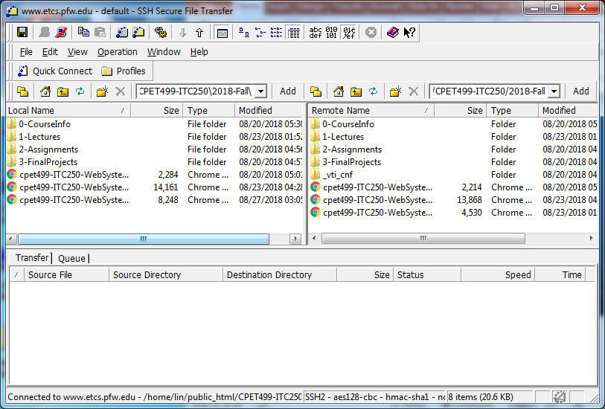
SSH Application – A FTP Application

Slide 32
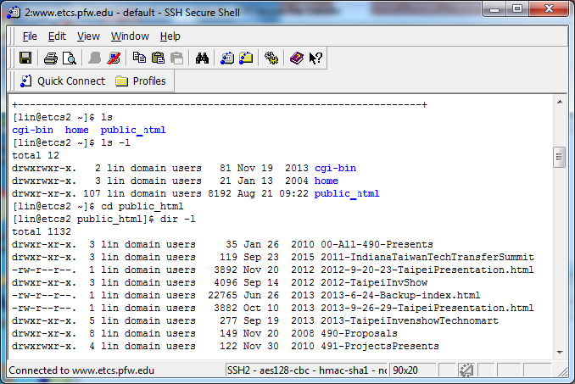
SSH Secure Shell – Terminal Window
(A Telnet Example)

Slide 33
TCP/IP Applications
SNMP (Simple Network Management Protocol)
  RFC 821
  Simple Network Management Protocol) - used to remotely manage and monitor network devices
DNS (Domain Name Services) - domain names to IP address translation

Slide 34
TCP/IP Applications
HTTP (HyperText Transfer Protocol)
  Establish a connection between the client and server
  For transferring hypertext (mixed media) documents through WWW
  Use TCP/IP to support communications between Web servers and Web clients
  HTTP Communications:
    A Request from a Web client (client → Server)
    A Response from the Web server (server → client)
    Close or terminate the connection

Slide 35
HTTP Web Server
HTTP Port 80
HTTPs Port 443

Slide 36
TCP/IP Applications
NFS (Network File System) - File Access Protocol
POP (Post Office Protocol)
Network News Transfer Protocol
RPC (Remote Procedure Call) - Transfer Procedure (function) Call to another machine
TFTP (Trivial File Transfer Protocol))

Slide 37
Transport Layer
Transport Layer
  Specify how to ensure reliable transfer
  Defines two protocols
    Transmission Control Protocol (connection oriented, reliable)
    User Datagram Protocol (connectionless, not reliable)

Slide 38
Domain Names
Human-friendly reference names associated with IP address
For TCP/IP based network system
Standardized in hierarchical fashion
An example:
  www.purdue.edu
  edu - Top level domain name
  purdue - main or network specific domain name
  www - Web server

Slide 39
Domain Name System (DNS)
DNS identifies each host on the Internet
Similar to the Telephone Number System (country code, area code, number)
A Name Server using Client-Server model
Tree Structure (Root, Leaves):
  Organization (Generic) domain
  Country domain
  Reverse
Unique Domain Name → Unique IP address

Slide 40
Domain Organizations
ICANN (Internet Corporation for Assigned Names and Numbers), http://www.icann.org/
  The authority governs global Internet domain name system
  com Commercial Organization
  edu Educational Institution
  gov Government Institution
  int International Organization
  mil Military Groups
  net Network Support Center
  org Non-profit Organizations
gTLD (Generic Top-Level Domain) Program, http://www.icann.org/en/registries/

Slide 41
Domain Organizations
ICANN (Internet Corporation for Assigned Names and Numbers), http://www.icann.org/
  The authority governs global Internet domain name system
  com Commercial Organization
  edu Educational Institution
  gov Government Institution
  int International Organization
  mil Military Groups
  net Network Support Center
  org Non-profit Organizations

Slide 42
Domain Organization
November 16, 2000: ICANN, the authority that governs global Internet domain name system, has approved seven new domains extensions, in addition to .com, .net and .org:
biz, info, name, pro, aero, coop, museum
New gTLD (Generic Top-Level Domains), http://newgtlds.icann.org/en/

Slide 43
Summary

