Slide 1
Wayne Incorporated;
An E-Commerce Project
Team 4: Vicky, Peter, & Stephen
Final Project Presentation
May 1, 2012
Notes:
This presentation focuses on the following topics pertaining to our e-commerce website project:
Project Management
a. Scope
b. Time
c. Cost
d. Quality
e. Risk
g. Review and reassess the identified Risk Analysis Matrix
k. Web system design
Marketing Plan and Methods
Viability Assessment

Slide 2
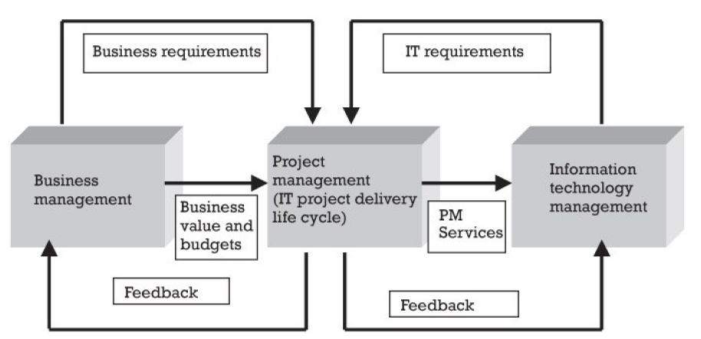
Integrated IT Project Management Model (Framework)
[1]
IPM-IT conceptual model
Notes:
Because both business and IT management are vital to the success of a project, the responsibilities are defined in the context of the company's IPM-IT framework.
This figure is a representation of the IPM model that shows a conceptual view and the linkages with business management, project management, and IT management.

Slide 3
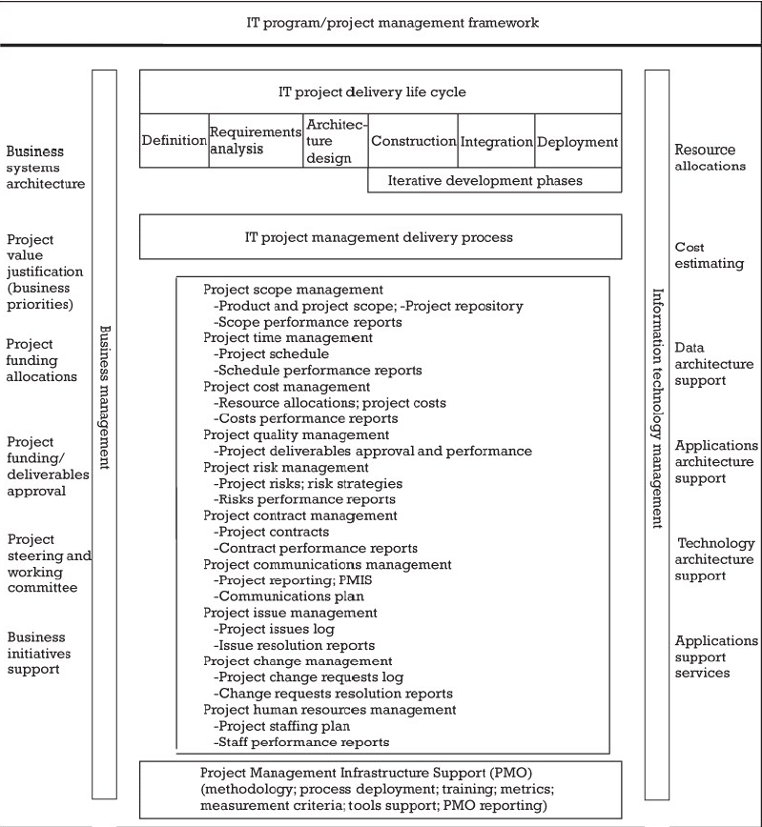
IPM-IT components model
[1]
Notes:
Here is a more detailed representation of the IPM model, which shows the components of business management, project management, and IT management and the linkages among them. Assignment 6 focuses on the center of the model - IT project management delivery processes:
Project scope management (PSM)
Project time management (PTM)
Project cost management (PCM)
Project quality management (PQM)
Project risk management (PRM)

Slide 4
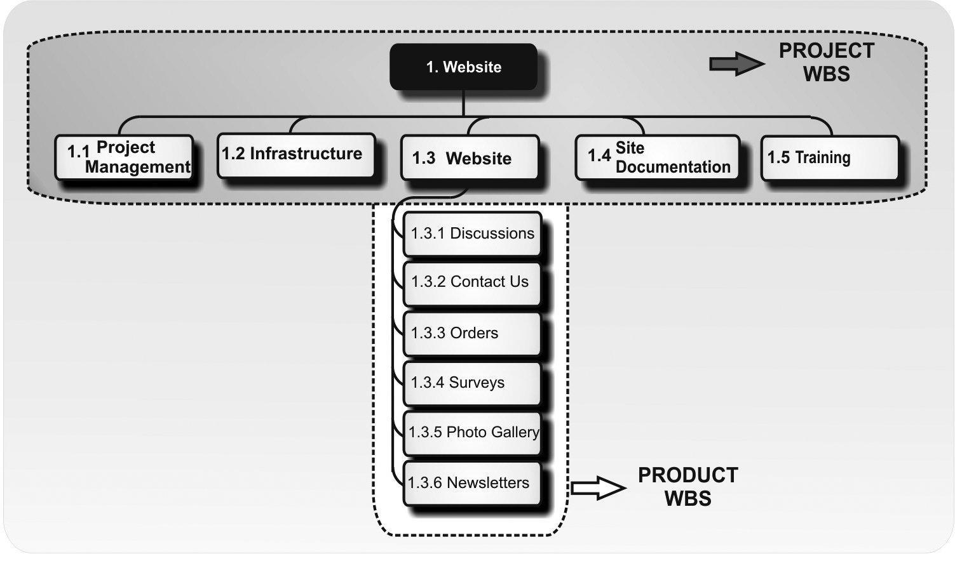
Project Scope Management
[1]
Notes:
Our project scope is to create the website and also to execute the work related to managing the project such as acquisitions, quality, risks, human resources, costs, time, and communications. It’s concerned with the website infrastructure, the documentation, training materials, and associated business processes. Marketing and promotion of the website launch and website content are aspects of the project that have been defined and planned.
The product scope is concerned with the website features, functions, and functionality. The concerns related to the product scope include a customer newsletter, order tracking, a photo gallery, and surveys.
The project scope is managed by the project manager and the product scope is managed by our technical lead.

Slide 5
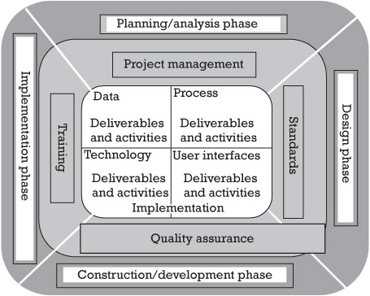
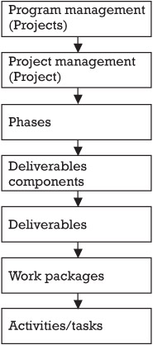
Project Scope Management
WBS solution
[1]
WBS hierarchy
Notes:
The core deliverables of any IT project consist of data, process, user interface, and technology deliverables to support both business and IT processes. The key infrastructure deliverables that support the implementation of these core deliverables consist of project management, standards, training, and QA deliverables to ensure that these core deliverables fit within the context of the existing business and IT environments. The initiation, planning, execution, controlling, and closing of the project deliverables (core and infrastructure) are managed using the orderly project phased progression: planning/analysis, design/prototype, construction/development, and implementation.
The WBS hierarchy principle forms the basis for the development of our WBS structure. First, we specify and break down the deliverables into valuable and measurable work packages. Second, we assign major activities to each of the work packages. Finally, we allocate effort, costs, and schedule to each of the work packages based on an allocation scheme to estimate the value of each deliverable.

Slide 6
Project Scope Management
1.3 Construction
1.3.1 Detailed Design Development
1.3.1.1 Data Design
1.3.1.2 Business Logic Design
1.3.1.3 User Interface Design
1.3.1.4 Internal Design Standards Consultation
1.3.1.5 Industry Design Standards Consultation
1.3.2 High-Level Test Plan Development
1.3.3 System Components—Code, Unit Test
1.3.3.1 Database Components
1.3.3.2 Code/Logic Components
1.3.3.3 Web GUI Interface Components
1.3.4 System Installation (Configure)
1.4 Testing
1.4.1 Testing Execution
1.4.1.1 System Test
1.4.1.2 User Acceptance Test
1.4.1.3 Performance Test
1.4.2 Analyze Defects/Correct
1.4.3 Production Readiness Verification
1.5 Deployment
1.5.1 Transition
1.5.1.1 Support Personnel Training
1.5.1.2 Support Procedures Documentation
1.5.1.3 Software
1.5.1.4 Hardware
1.5.2 Legacy System Decommissioning
1.6 Project Management
1. WBS for Web Design Project
1.1 Planning
1.1.1 Product Definition
1.1.2 Stakeholder Approval
1.2 Definition
1.2.1 Requirements Development
1.2.1.1 Business Requirements Development
1.2.1.2 System Requirements Development
1.2.2 Conceptual Design Development
1.2.2.1 Conceptual Data Design
1.2.2.2 Conceptual Process Design
1.2.3 Architectural Design Development
1.2.3.1 Web Design Methods Evaluation
1.2.3.2 Web Design Method Selection
1.2.4 Bill of Materials (BoM) Creation
1.2.5 Resource Procurement
1.2.5.1 Human Resources Procurement
1.2.5.2 Hardware Procurement
1.2.5.3 Software Procurement
1.2.5.4 Telecommunications Procurement
Notes:
This is a list of our WBS to design, build and deploy a commercial Internet Web site that sells sporting goods within our country. The high-level phases of the development lifecycle are placed at Level 1 of the WBS. Major work within that phase is further elaborated within each area.

Slide 7
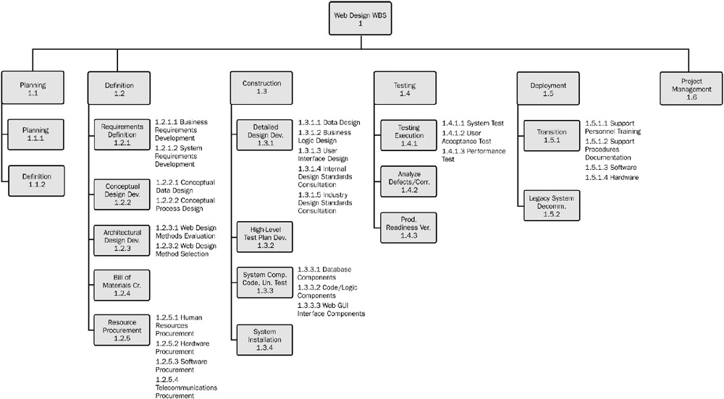
Project Scope Management
[2]
Notes:
This is our WBS Tree Structure which each “child” element shown as a box with a line connecting it to the “parent” element of which it is a component. This representation shows the way in which the project and the subordinate components are hierarchically decomposed into smaller and smaller elements.

Slide 8
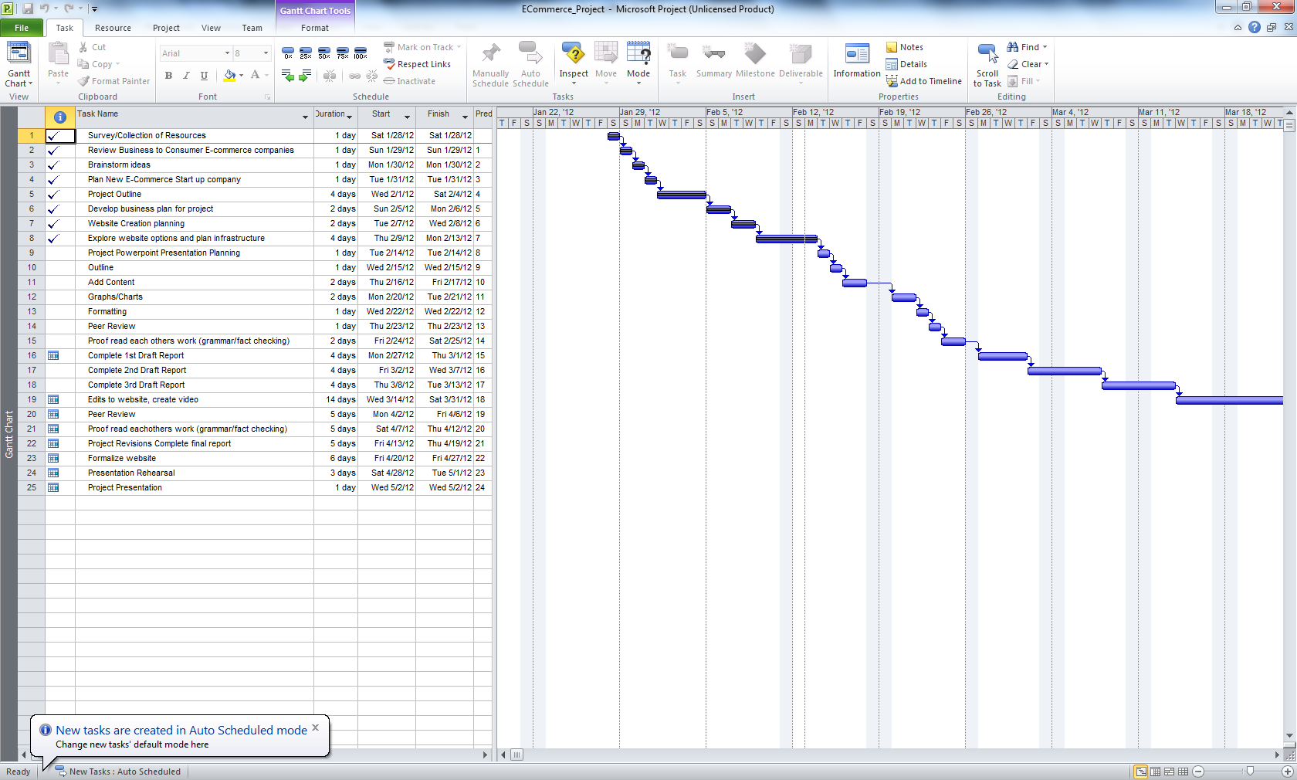
Project time management
Notes:
We used Microsoft Project 2007 to create a Gantt chart to schedule a timeline for our business plan project. This timeline begins with the initial brainstorming to find a business of interest, beginning in January, up through the final presentation to be given on May 1, 2012.

Slide 9
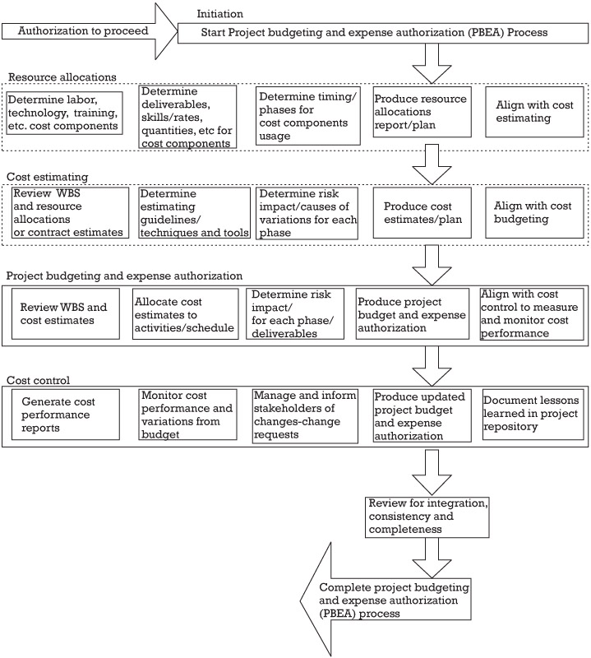
Project Cost Management PBEA process—flow
[3]
Notes:
This process flow shown here highlights the major processes to produce the cost management deliverables. These processes reference the deliverables to show the integrated nature and dependencies of the deliverables.

Slide 11
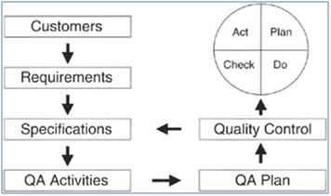
Project Quality Management
[4]
Framework for project quality management
Notes:
In order to manage the quality of our project we will follow the framework specified in this Figure.
The purpose of this practice is to provide a means for the project manager and team to oversee and manage quality associated with deliverable design and development. It ensures that our requirements are properly translated into results that will be accepted by our customer. It illustrates that quality is a multitier management effort: project staff members perform quality control, project managers perform quality assurance, and management performs quality audits.
Project Quality Management transcends the phases of project management, from initial requirements gathering and planning to testing, acceptance, and closeout. The prominent project quality management effort is achieved in the Perform Phase.
There are three activities associated with Project Quality Management:
Manage Quality Assurance
Manage Quality Control
Manage Quality Test and Acceptance

Slide 12
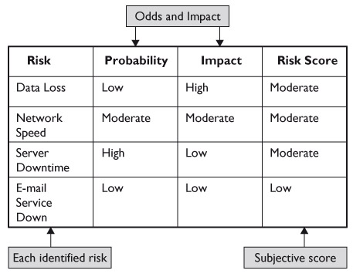
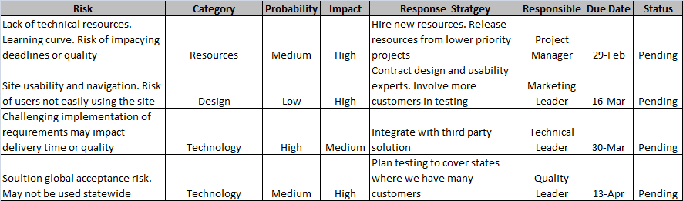
Project Risk Management
Risk Registry
Notes:
Our Risk Registry lists the most important risks, and associates a probability and impact to each risk. The project team will address first the risks with higher probability and impact. The registry also indicates what the response strategies per risk are, and a single person is named as the responsible for each risk. A due date and status of the risk is assigned. The registry is one of the key tools in risk management to follow up on risk’s status during risk meetings

Slide 13
Risk Management PLAN
A risk management plan is a document which is created by a project manager so as to foresee risks, and create response plans to mitigate them.
A risk is an uncertain event that if it occurs, it can have a positive or a negative effect on a project’s objectives.
Notes:
Our risk management plan includes involves identifying the risk, analyzing the risk, evaluating the risk, and treating the risk. The diagram on the next slide describes our risk management plan.

Slide 14
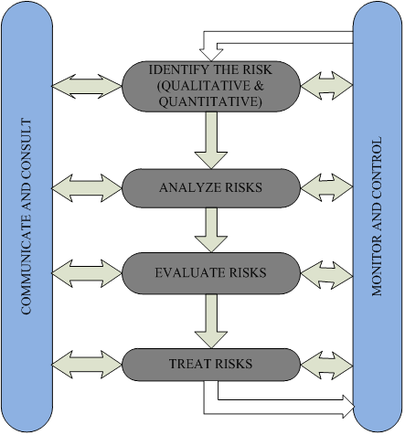
Risk Management Flow Diagram
Notes:
Identify the risk
-In this section, we identify the risk affecting our business; the risk can either be quantitative or qualitative. A quantitative risk is a risk which we are able to have a dollar amount of the risk while a qualitative risk is one that we cannot be able to have a dollar amount of the risk.
Analyze Risk
- This involves analyzing the risk and trying to determine if the risk has already caused some damage to our business or we detected it in time before causing any damage.
Evaluate risk
Involves trying to evaluate the different options we have of treating the risk and which is the best cost effective and efficient way of eliminating the risk.
Treat Risk
-Involves getting rid of the risk and putting measures to prevent the risk from affecting our business again.
Monitor and Control
-Monitor and control department always monitors the databases and the web servers so as to make sure there are no new risks. They also try to fix the simple risks experienced by the company that can be fixed easily.
Communicate And Consult
Communicate and control involves all the departments of our risk management team communicating to each other so as to make their work much easier and efficient

Slide 15
RISK ASSESMENT
Trend | Item | Knowledge and Experience risk | Approach
Decreasing | K1 | Database management | Research
Increasing | K2 | Advertising | Mitigate
New | K3 | Customer service | Mitigate
Unchanged | K4 | Technology | Research
Trend | Item | Budget Risk | Approach
Unchanged | B1 | Government sanctions | Research
Unchanged | B2 | Government restrictions | Research
Increasing | B3 | Substitute Product | Mitigate
Unchanged | B4 | Bad Economy | Accept
Unchanged | B5 | Lawsuits | Mitigate
Unchanged | B6 | Exchange Rate | Watch
New | B7 | Employee Theft | Mitigate
Trend | Item | Competition Risk | Approach
Increasing | C1 | Substitute Products | Research
Increasing | C2 | Competitors product | Research
Decreasing | C3 | Consumer Review | Mitigate
Trend | Item | Unplanned Risks | Approach
Unchanged | U1 | Fire Disaster | Accept
Unchanged | U2 | Natural calamity | Accept
Decreasing | U3 | Security | Research
Unchanged | U4 | Supplier | Research
Unchanged | U5 | Team Factor | Mitigate
Notes:
-Natural Calamity
We rated natural calamity as Catastrophic and Improbable. Natural calamities such as flooding and hurricanes would destroy our company because they would affect our servers and factory which would render us incapable to conduct our business.
-Customer service
Customer service was ranked as Marginal and Improbable because, as our company grows bigger, we will hire more employees to assist us with running the company. Even though we will train all our employees on good customer service, there will always be some who would be rude to our customers once in a while. This will not affect the company greatly as the affected customers will report the employees to the company through email or phone.

Slide 16
RISK ANALYSIS MATRIX
Severity of Consequences | F Impossible | E Improbable | D Remote | C Occasional | B Probable | A Frequent
Catastrophic | B1 | -K4 -U1 -U2
Critical | B2 | -U4 | -U3 | -U5 | -B4
Marginal |  | -C1 -K3 |  |  | -C3 | -B6 -C2
Negligible |  |  |  | -B5 |  | -B7

Slide 17
PROJECT MATURITY VS RISKS
PROJECT / BUSINESS MATURITY | RISKS
Planning and Designing | Budget, Team Factor
Introduction | Technology, Fire Disaster, Natural Calamity, Supplier, Customer Service, Security, Budget, Team Factor, Bad economy, Exchange rate
Growth | Government Sanctions, Government restrictions, Technology, Fire Disaster, Natural Calamity, Supplier, Substitute products, Customer Service, Security, Team Factor, Lawsuits, Bad economy, Customer review, Exchange rate, Competitor products, Employee theft.
Maturity | Government Sanctions, Government restrictions, Technology, Fire Disaster, Natural Calamity, Supplier, Substitute products, Customer Service, Security, Budget, Team Factor, Lawsuits, Bad economy, Customer review, Exchange rate, Competitor products, Employee theft.
Decline | Fire Disaster, Natural Calamity, Supplier, Substitute products, Customer Service, Security, Budget, Team Factor, Lawsuits, Bad economy, Customer review, Exchange rate, Competitor products, Employee theft.
Notes:
This table compares and shows how the risks are related to the degree of project maturity.

Slide 18
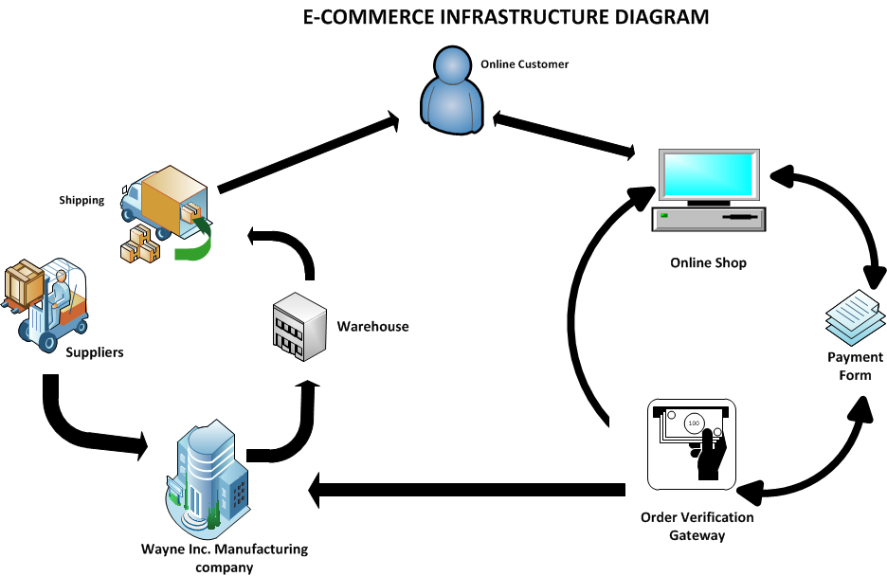
Web Site Design
Notes:
Online Customer: This is a person that purchases our products or services over the Internet.
Online Shop: This is the channel through which customers and prospective customers connect and do business with Wayne Inc. over the Internet.
Payment Form: This is an online document that a Wayne Inc. uses to get customers information before any transaction is conducted.
Order Verification Gateway: This is where all financial materials are cross examined and before and order is confirmed.
Wayne Inc. Manufacturing Company: This is where all raw materials are converted to finished products.
Warehouse: This is where all finished products are stored after production.
Suppliers: These are the companies that supplies Wayne Inc. with raw materials for production.
Shipping: This is the department that is in charge of making sure that ordered products gets to the customer.

Slide 19
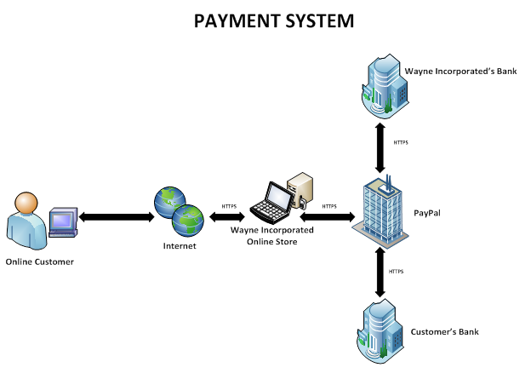

Slide 20
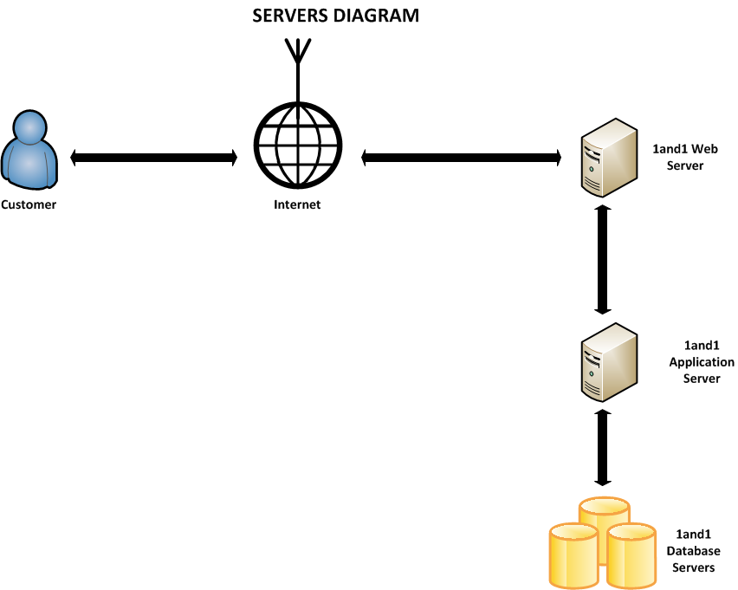
Notes:
A Customer connects to the Internet and sends HTTP request for a Web Page; the request is sent to 1 and 1’s Web Server which connects to the Application Server which then finally connects to the 1 and 1 Database Server( where Wayne Inc. stores it’s products and services information) to check for the availability of the requested Web Page. Once the Web Page is found or not found, the response is sent back to the customer.

Slide 21
Notes:
Once an Online Customer goes to our website to view our Catalog, the request goes through our website to our Catalogue database stored on the 1 and 1 database server. After the request is sent to the database server, the response is sent back to the customer. There is a form available on our website for a customer that sees what he or she likes and wants to purchase it. Once the customer fills in his or her information on the form, the information is sent to our customer database which is also stored on the 1and1 database server. If the information (credit, debit card information or other financial information) is accepted, an identification of the product will be stored for record purpose on our Order database which is also stored on the 1and 1database server. After that, the product will be shipped to the customer.

Slide 22
Internet Marketing Plan for Wayne, Inc.

Slide 27
MARKETING METHODS
A. Permission Marketing
B. Affiliate Marketing
C. Viral Marketing
D. Blog Marketing
E. Social Network Marketing
F. Mobile Platform Marketing
G. Local Marketing
H. Brand Leveraging
I. One-on-One Marketing

Slide 28
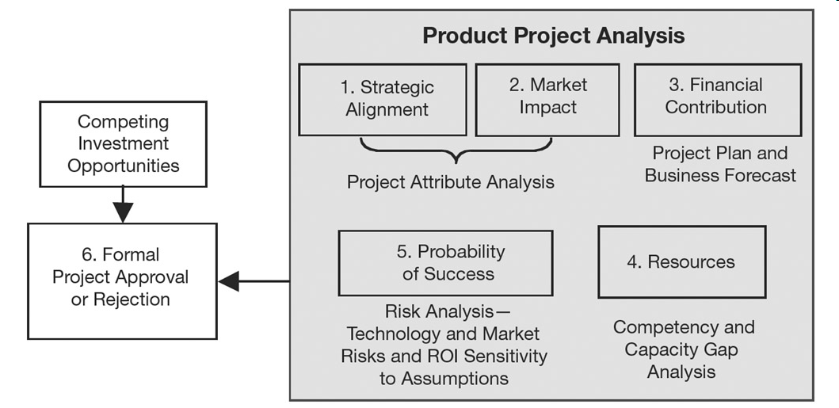
VIABILITY ASSESSMENT
Notes:
Our Viability assessment is a six-step process as shown in this Figure.
Our startup business is evaluated based on impact on strategic objectives and our internal and external driving factors.
In Step 1, alignment of the proposed product with the firm’s strategic objectives is appraised by measuring its contribution to enabling the objectives.
Market opportunity, competitive factors, and value chain impact are quantified in Step 2.
Our project plan is prepared in Step 3 to determine the scope of developing our e-Commerce website and the required investment to complete the company successfully.
Return On Investment analysis was performed to establish the potential benefits of starting our e-Commerce business.
Step 4 evaluates the required and available resources for execution, in both capacity and competency, and identifies any gaps.
The probability of success is assessed in Step 5 based on technology and market risks as well as sensitivity of Return On Investment to the assumptions in the product business plan.
The outcome of this process was the determination that our business has an attractive risk versus reward potential, with a manageable risk, and it ranks higher than other businesses that are competing for the same customers. The viability assessment process ends with a formal approval in Step 6.

Slide 29
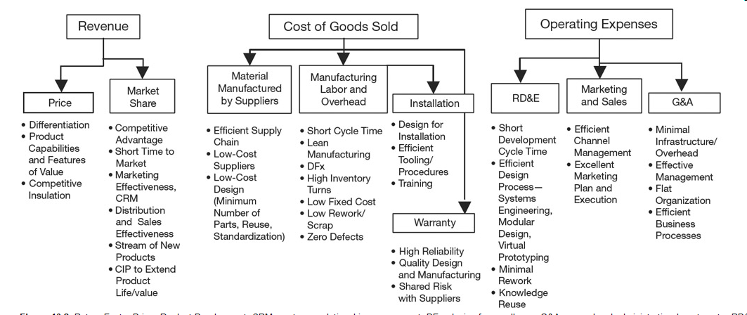
RETURN-ON-INVESTMENT MODEL
Notes:
This is the ROI model that we followed for our company.
(CRM) customer relationship management;
(DFx) design for excellence;
(G&A) general and administrative;
(RD&E) research development & engineering;
(CIP) community investment portfolio;
Investment = research, development, and engineering cost + commercialization cost;
Profit = revenue — cost of goods sold — operating expenses;
RF = cumulative profit/cumulative investment.

Slide 30
VIABILITY OF WAYNE INC.
We are not subject to high capital cost or intellectual property barriers.
We have potential suppliers from all over the world especially the USA and China that are ready to do business with us.
We have the power to choose between different suppliers if one chooses to raise its price unreasonably.

Slide 31
VIABILITY OF WAYNE INC.
We have taken steps to ensure that we promote and maintain the uniqueness of our brand.
Online shopping comfort ability
Future partnership with the United States Postal Service.

Slide 32
VIABILITY OF WAYNE INC.
Our unique competencies and skills in information technology and item delivery will give us the ability to survive for a long period of time.
We are doing further research in information technology to see how we can further strengthen our firm and prepare for changes in technology and use it to our advantage.
We have the right technology to handle and sustain our e-commerce company.
We have budgeted some money for further development and management of our business.

Slide 33
VIABILITY OF WAYNE INC.
Our supply chain management system has been carefully mapped out to ensure quick delivery of our products to our prospective online customers.
We are using Hyper Text Transfer Protocol Secure(HTTPS) system to ensure customer information is safe.
Our firm is not subject to lawsuits because we sell our brand products.
Changes in Internet taxation laws or other foreseeable statutory developments will affect our company as well as our competitors.

Slide 34
SELF ASSESSMENT
ASSESMENT
 | 1 | 2 | 3 | 4 | 5
Key Industry Strategic Factors
Barrier to entry |  |  |  |  | X
Power of Suppliers |  |  |  | X
Power of customers |  |  | X
Existence of substitute products |  |  |  | X
Industry value chain |  |  | X
Nature of intra-industry competition |  |  |  |  | X
Firm Related Factors
Firm value chain |  |  |  | X
Core competencies |  |  |  | X
Synergies |  |  | X
Technology |  |  | X
Social and Legal challenges | X

Slide 35
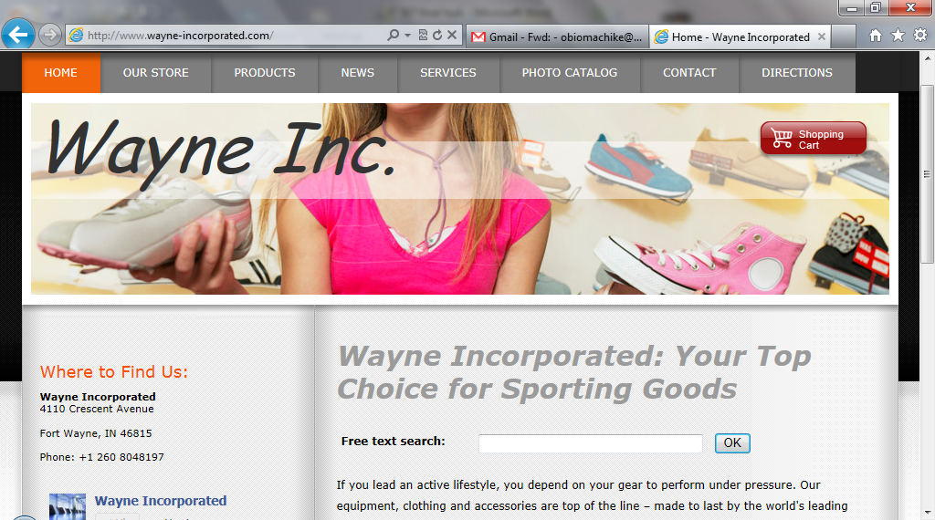
www.wayne-incorporated.com
Notes:
Home: This button links the website user to the home page.
Our Store: This button links the website user to a brief history of our company.
Products: This button the website user to a list of products that is available on the Wayne Inc. store.
News: This links the website user to latest news that Wayne Inc. has available for them.
Services: This button links the user to a list of services that Wayne Inc. offers.
Photo Catalog: This links the website user to our catalog, where they can make selections from our wide variation of products.
Contact: This buttons links the website user to our contact information.
Directions: This button links the customers to a Google map that makes it easier for them to find our company.

Slide 36
References
Notes:
References sited with figures.

