Slide 1
WaynePC Tech
Business Plan
By
Sayed Nayab Hassan
Meng-Wei
Cesar Ruiz
Professor: Paul Lin
IPFW
May, 01, 2012

Slide 2
Outline
Description
Wayne PC Tech System Diagram
Corporate Leadership
Security Threats
Risk Analysis Matrix
Marketing Plan & Strategy
Online Payment System Diagram
Shopping Cart Diagram
Synergy
Demonstration
Conclusion

Slide 3
Wayne PC Tech Description
Wayne PC Tech is an Limited Liability Company located in Fort Wayne, IN. owned by Cesar Ruiz. One-employee company based in the owner's garage and spare room, but plans to grow within a year
The owner, Cesar Ruiz, has over 10 years of experience in the technology fields and IT support, networking, computer training and repair and over 2 years on Mobile support.

Slide 4
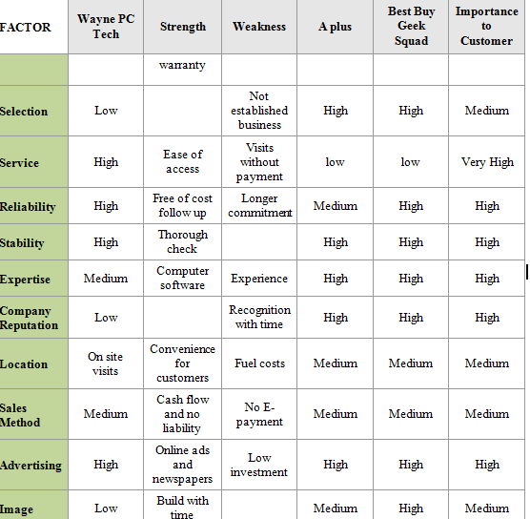
Competitors

Slide 5
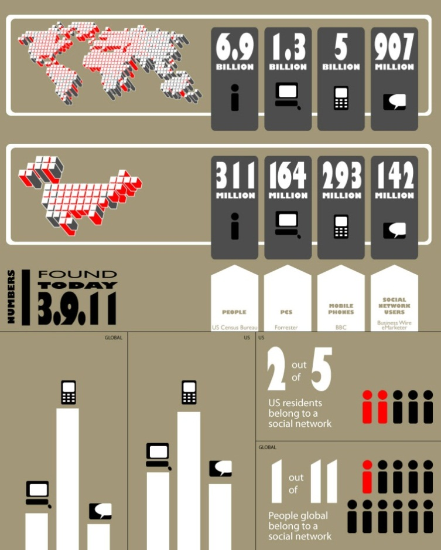

Slide 7
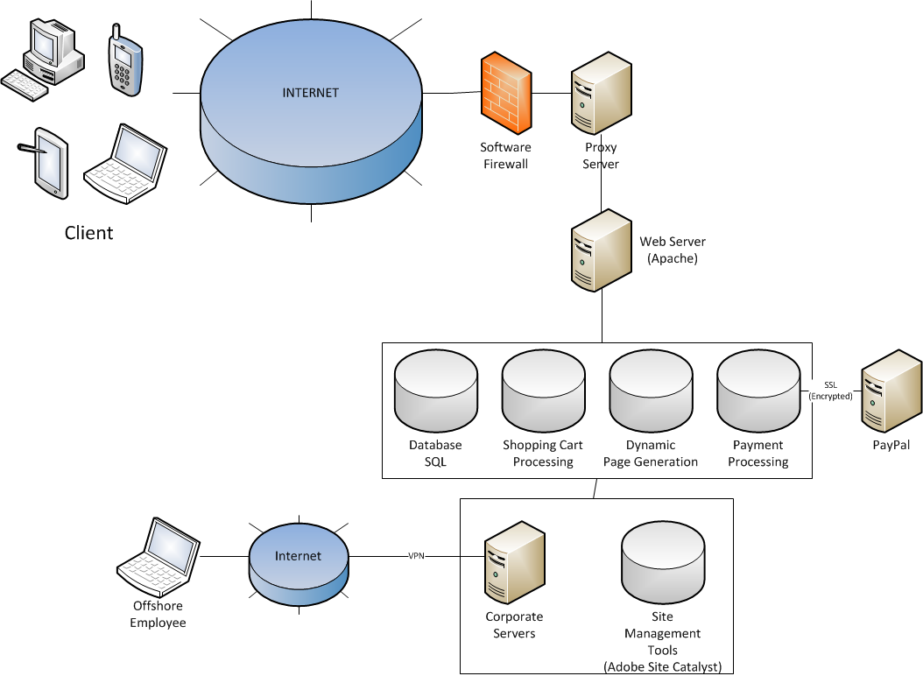
System Diagram

Slide 8
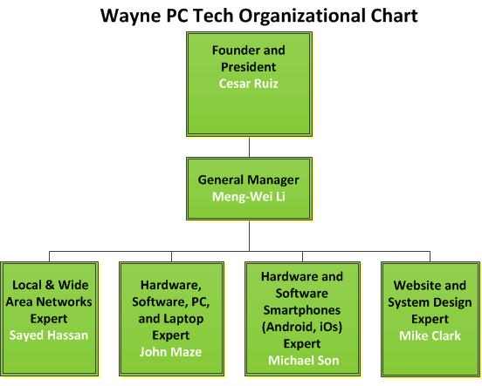
Future Leadership

Slide 9
Wayne PC Tech SWOT Analysis
Strengths | Weaknesses
Innovative Company | No Physical Location
Great Customer Service | Investors’ Confidence
Flat Rate Fee | Not Enough Employees
Bi-lingual Service | Low Budget
No waiting time | No Name-Branded
Extensive Skills and Experience Free Diagnose and On-site Visits
Opportunities | Threats
Advantage of Social Media Advertising | Too Many Comp. Repair Shops
Advantage of Globalization | Competitors Charging Low Fee
Develop Android Applications | Bad Economy
Consumers Demand | New Close-ended Computer Platforms
Competitors Bad Reputation
Increase Virus

Slide 10
Key External Factors | Weight | Rating | Weighted Score
Opportunities
Advantage of Social Media Advertising & Advantage of Globalization | 0.10 | 4 | 0.4
Develop Android Applications | 0.24 | 4 | 0.96
Consumers Demand | 0.15 | 3 | 0.45
Competitors Bad Reputation | 0.10 | 2 | 0.2
Increased Virus | 0.08 | 2 | 0.16
Threats
Too Many Comp. Repair Shops | 0.07 | 2 | 0.14
Competitors Low Fee | 0.06 | 3 | 0.18
Bad economy | 0.12 | 1 | 0.12
New Close-ended Computer Platforms | 0.08 | 2 | 0.16
TOTAL | 1.00 |  | 2.77

Slide 11
Marketing Plan
The Wayne PC Tech market strategy is mixed bricks-and-clicks strategy based on our customer’s location
  Remote assistance - this method is convenient and customer’s computer equipment don’t leave their location.
  In-store- customer can bring their computer equipment to Wayne PC Tech and have our technicians diagnose and fix their computers.
  Onsite - Customer can call Wayne PC Tech and schedule an onsite visit to diagnose the computer issues

Slide 12

Marketing Strategy
Brand Awareness
Customer Acquisition
Customer Retention

Slide 13
Brand Awareness
Affiliate Marketing
Blog Marketing
Customer Acquisition
Viral Marketing
Search Engine Advertising
Customer Retention
Permission Marketing
Email Opt-In
Social Network Marketing
Google Adsense
Rich Media Ads
Display Ads/Banners
Video Ads
Google Adwords
Ad Exchange
Loyalty Bonus
Local Magazines
Local TV Ads
SmartPhone App

Slide 14

Marketing Performance Gauges
Marketing
Performance Gauges
Strategy

Slide 15

Marketing Performance Gauges
Traditional Media Marketing
(Performance Gauges)
Feed Back Surveys
Reviews
Polls

Slide 16


Marketing Performance Gauges
Online Marketing
(Performance Gauges)
Stickiness
Click Thorugh Rate
Impressions
View Through Rate
Hits
Unique Visitors
Loyalty
Recency
Acquisition Rate
Conversion Rate
Browse to Buy Ratio
View to Cart Ratio
Abandonment Rate
Retention Rate
Attrition Rate

Slide 17
Security Threats
Malicious Code
  Drive-by download, virus, worms, Trojan Horse, Spware and Malware
Preventive Measures
  Anti-virus installed and regularly updated, Up-dated software versions of platforms such as OS

Slide 18
Security Threats
Data Breach of customer and credit card information
  SQL injection, Hacking
Preventive Measures
  Encrypt customer information

Slide 19
Security Threats
Spoofing/ Pharming
  Website masquerading as business website and alter/disrupt orders
  Tracking order placements and credit card thefts
Preventive Measures
  IT security team identifying Spoofing sites and reporting to authorities
  Use SSL and Sophisticated encryption during exchange of valuable information

Slide 20
Risk Analysis Matrix
Item | Knowledge and experience risk | Mitigations
K1 | an issue outside of the scope | Pre-Testing to identify issues
K2 | Human error | System backup
K3 | highly intricate UNIX issues | Increase expertise by certifications
K4 | consequences due to issues resolution by trial and error | System backup
Item | Budget | Mitigations
B1 | Inadequate allowance for inflation | Careful budgeting
B2 | Underassessment of service demands from customers | outsource
B3 | Unexpected increased cost of Partnership Arrangements | Redundant partners
B4 | Increased/unexpected competition | Vigilant pricing policy
B5 | Downturn in the economy | Adjust prices
Item | Technology | Mitigations
T1 | technology being obsolete | Keep updated with latest trends
T2 | no compatibility of current software and very high up-gradation fees
T3 | Hardware out of date | Schedule timely up-gradations
T4 | High cost of certifications to service operating system
T5 | Intrusion of hackers into system infrastructure | Firewalls, secure shell, close insecure ports
T6 | Technical failure | Redundancy
Item | Team factor | Mitigations
F1 | Conflicts | Synergy
F2 | High turnover ratio | Career oriented jobs, create redundancy in skill set

Slide 21
Risk Analysis Classification
Severity of consequences | Impossible | Improbable | Remote | Occasional | Probable | Frequent
Catastrophic |  |  | T6 |  | T5
2. Critical |  | B5,F2 | K3,K4,T1 | K2, B4 | B3,T2,T4
3. Marginal |  | B1,F1 | K1,B2,T3
4. Negligible

Slide 22
Online Payment System

Slide 23
Shopping Cart Detail

Slide 24
Synergy
We didn’t assign specific roles; instead, we assigned weekly task to each team member.
We met at least once a week for a minimum of 3 hours.
Every time we met, we discuss the assigned tasks and then we wrote the weekly report

Slide 25
Demonstration Waynepctech.com
Demo of waynepctec.com eC0mmerce website
www.waynepctech.com

Slide 26
Conclusion
In this project we identified various cutting edge e-commerce technologies prevalent in the market. We combined class materials together with online research to successfully achieve the deliverables of the ecommerce project.
This project gave us a detailed insight on project management from the conception to the completion phase. We identified various key aspects that determined the success of the project. Different facets of the project including budget, finance, risk management, quality management and marketing helped us to see the big picture pertaining to project management in real world applications.
Another significant aspect of this project was that we did not only identify the managerial constraints but also delved deep into the technical challenges. During the scope of the project we had to take technical decisions ranging from web hosting to the identification of security threats in an ecommerce environment. This has greatly increased our technical skills and understanding of innovative technologies.
When we land in an industry we will be just responsible for one of the aspects of a project but because of this class project experience we can better quantify the constraints of other departments involved in the project.
This project has also enabled us to understand the significance of synergy and making things possible by team effort.

Slide 27
Thank You

