Slide 1
HRJ Farmer’s Inc.
Hemchand Lallad
Ryan Van De Weg
Joseph Ko
Indiana University Purdue University Fort Wayne
CPET 581 E-Commerce & Business technology
Professor Paul Lin
April 24, 2012

Slide 2

Purpose, Scope, and Objectives
Book Domain Name
Design and develop the website
Host website
Promote website to potential customers
Accept Payments through website
Maintain website
Update website and technology as and when required

Slide 3
Executive Summary
Provide an online platform the connect all entities in the fresh produce market value chain a place to connect, communicate, provide quotation, buy and sell their products.
All-inclusive site that offers these parties a place to connect with each other allowing them to lower overhead, decrease cost, expand their market, increase sales and profits,

Slide 4
Keys to Success
Promote information flow between each party with the value chain.
Facilitate market coordination between each party within the value chain
Reduce and eliminate unnecessary transaction costs.

Slide 5

Mission Statement
“To generate a profit by providing an online platform that allows all enterprises in the fresh produce value chain a place to connect, communicate, provide quotations to buy and sell their products in an expanded market”

Slide 6

Market Background
Perishability
Seasonality
Weather variability
Traditional distribution channels

Slide 12
HJR FARMERS RISK ANALYSIS MATIX

Slide 13
Security Threats
Customer credential alter/destroy
Shopping cart information alter/destroy
Alter/Modification of order data
Alter/Modification/destroy of Payment information
Theft of customer’s personal information
Unauthorized access to website
Fictitious emails to individuals from HRJ website
Transmit user to other website
Virus attack on HRJ Farmers website
Spread heavy traffic to HRJ website to make website operation slow or unusable

Slide 14

Security Threats
Theft of customer’s personal information
Unauthorized access to website
Fictitious emails to individuals from HRJ website
Transmit user to other website
Virus attack on HRJ Farmers website
Spread heavy traffic to HRJ website to make website operation slow or unusable

Slide 15
Plan to Defeat Security Threats
Virus protection tool at server and client side
Access control and authentication protection with appropriate firewall and proxy server setting
Cryptography technology to convert client information to cipher text format
Enable secure socket layer for payment process
Monitoring tool for abnormal behavior on the website
Regular data backup
Educational information for first time and regular customer to access website
Enabling digital certificate for the website

Slide 16
DigiCert Advantages
Unlimited Free Reissues
2048-bit SSL Secure Sockets Layer with TLS Encryption
Compatible with all major browsers
Solid vetting to ensure strong Authentication
Secure Site Seal
Phone, Email, and Chat Support
Compatible with Apache, IIS, Tomcat, Exchange Server, and other servers
Compatible with Linux, Windows, and other operating systems

Slide 17
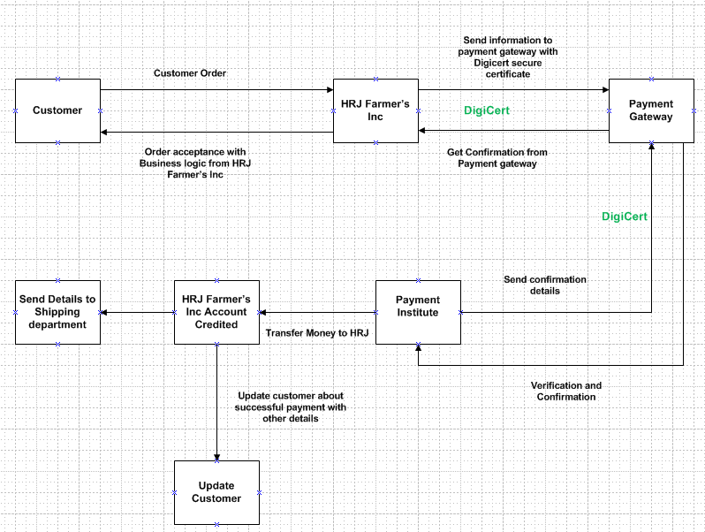
Payment Process

Slide 18

Marketing Strategy
Brand Leveraging
Permission Marketing
Affiliate Marketing
Viral Marketing
Social Network Marketing
Mobil Marketing

Slide 19

Firm Related Factors
Firm value chain
Core competences
Synergies
Technology
Social and legal challenges

Slide 20
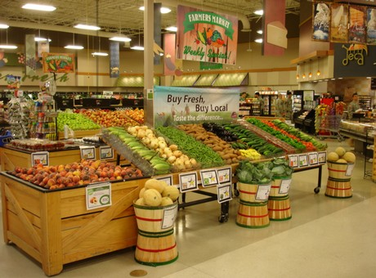
Industry Related Factors
Barrier to entry
Power of suppliers
Power of customers
Existence of substitute products
Industry value chain
Nature of intra‐industry competition

Slide 21

Achievements and Future Plan
Achievements
Future Plans

Slide 22
www.hrjfarmers.com
Shopping Cart and Purchase
Contact Us
Product Search
Sort Product
Send Recommendation to Friend
Site Map
Reports
User Accounts login and see order history
Product Return Feature
Email notification for order confirmation
Access HRJ Farmers Inc. from order confirmation link

