Slide 1
I I I Predictions
By: Gregory Scalet, Dorian Mirchandani and Kevin Locascio

Slide 2
Industry Re-Cap
prediction market allows individuals to take positions (or trade 'contracts') on whether future events will or will not occur
Example - political election, settled in a well-defined and easily verifiable manner.
"Barack Obama to win 2012 U.S. presidential election."
"NASDAQ Average to close higher today."
market facilitates trades between members, charging a monthly fee, but does not participate in trading itself

Slide 3
Basic operations

Slide 4
Basic operations

Slide 5
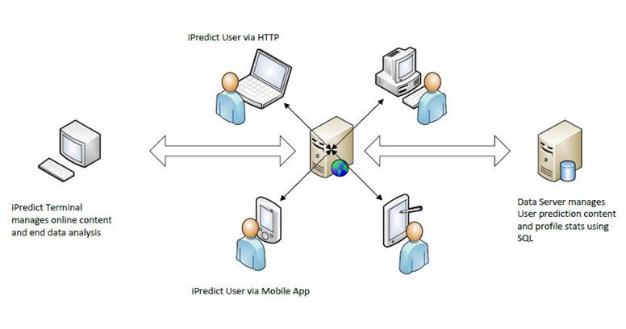
Basic Operations

Slide 6
Mission statement
“iiI Predictions’ Mission is to provide a safe, cost effective and lucrative trading environment for users across the globe. We will strive to ensure you, our users receive the best available benefits from dealing with an organization that locates and delivers exciting world events tailored specifically to you and your online community.”
“We strive to maximize business potential by offering a comprehensive and seamless demographic data acquisition and data management system for all world events.”

Slide 7
Organizational structure
III Predictions
Primary Owners / Management
Gregory Scalet - President / CEO:
Business Manager
Logistics Manager
Dorian Mirchandani - VP:
Director - Information Technology
Kevin Locascio - VP: Director - Sales / Marketing & Promotions

Slide 8
Management plan
PHASE
Research & Strategy
STEPS
Interview users
Understand target audience
Competitive Analysis
Research
Manage Objectives & User Expectations
OUTCOME
We will know what our users want to see and predict. This knowledge will help us provide the best experience possible in a format users want.

Slide 9
Management plan
PHASE
Planning
STEPS
Prioritize target audiences
Determine functional requirements / technical requirements
Embrace creativity
OUTCOME
We will translate the needs of our users and our business into a functional content with which we can interact.

Slide 10
Management plan
PHASE
Information Architecture
STEPS
Navigation tree
Theme architecture
Detailed design
User experience guidelines
OUTCOME
We will create a clear visual and aural site as a method to communciate users on multiple platforms.

Slide 11
Web site

Slide 12
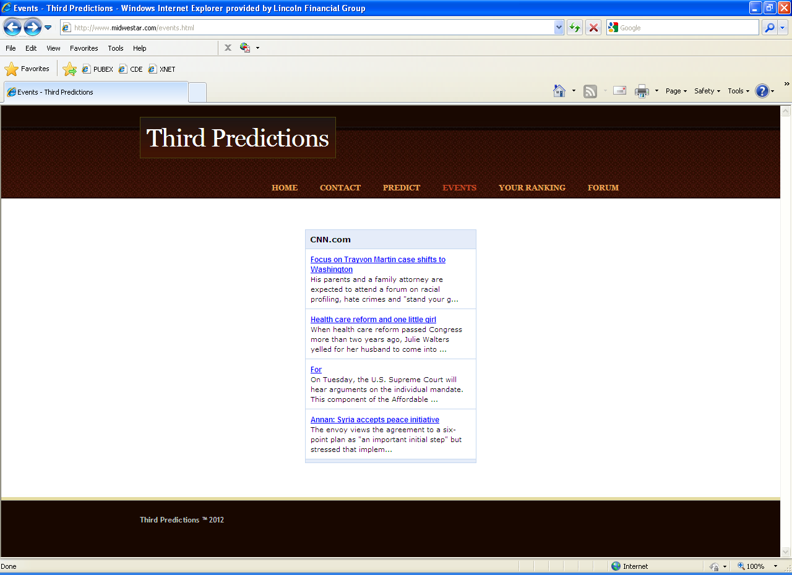
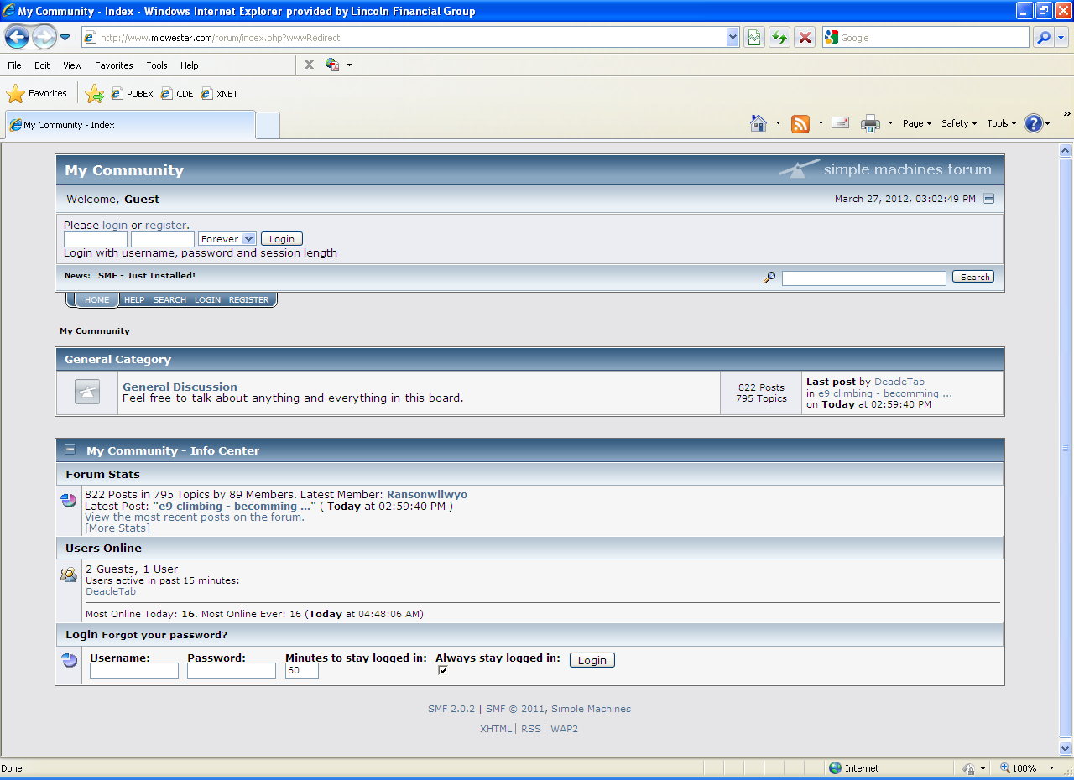
Web site activity / transaction log

Slide 13
Market Research
intrade.com
Current site providing online trade forum
users are all individuals interested in particular events – Much like Amazon’s Recommender system, iiI will “Recommend Events”
Demographic trends will not exist at beginning
Friendships will have moderate effect
Professional relationships and functional positions will have strong effects
Shared interests will have major effects

Slide 14
Marketing Strategies
permission marketing
affiliate marketing
viral marketing (in Web 2.0)
blog marketing
social network marketing
mobile platform marketing
local marketing
brand leveraging
others

Slide 15
Permission marketing
marketers obtain or attempt to obtain permission from potential customers before advancing to the sales pitch in the purchasing process
requires prospective customer to give explicit permission to send their promotional message (email or catalog request) or implicit permission (querying search engine)
done on one-to-one basis rather than using broad aggregated concepts like market segment or target market

Slide 16
Affiliate marketing
employed when businesses reward one or more affiliates for each visitor or customer brought in by affiliate's marketing efforts
four core players in this system
Merchant (retailer)
Network (offers for the affiliate and payments)
Publisher (affiliate)
Customer
overlaps with other Internet marketing methods including: organic search engine optimization, paid search engine marketing, e-mail marketing, and display advertising

Slide 17
Viral marketing (in Web 2.0)
encourages individuals to pass on a marketing message to others (networking)
these people become part of marketing team, for free
people e-mail links to ad to friends and those friends send to other friends creating a huge spread of interest
Example: produce a TV commercial to be put on YouTube. commercial is available for viewing 24 hours a day 7 days a week. can be linked, copied and sent to anyone the viewer chooses.

Slide 18
Blog marketing
any process that publicizes or advertises using blogs
ads placed on blogs, recommendations and reviews by a blogger, promotion via entries on third party blogs and cross-syndication of information across multiple blogs
news travels very fast via blogs
snowball effect that can be started with just a few strategically placed blog entries and comments on blogs
a nod of approval from a trusted blogger can result in considerably higher sales for business

Slide 19
Social network marketing
gaining website traffic or attention through social media sites
message spreads from user to user and (presumably) resonates because it appears to come from a trusted, third-party source
personal interaction can instill a feeling of loyalty into followers and potential customers
by choosing whom to follow on these sites, products can reach a very narrow (yet profitable) target audience

Slide 20
Mobile platform marketing
practices that enable organizations to communicate and engage with audience in interactive and relevant manner through any mobile device or network
Example: Motorola/House of Blues campaigns - brand allows the consumer to send mobile photos to LED board in real-time and blog images online
very powerful tool for initiating consumer engagement at time when marketing piece is triggering most emotional (and lucrative) response — impulse moment

Slide 21
platforms

Slide 22
Local marketing
use Internet as part of comprehensive marketing plan to drive traffic to local, “brick and mortar” businesses
targeted to wants and needs of local customer groups, (trading areas, neighborhoods, individual stores).
methods include:
Print - promotions and coupons (costly), limited tracking, does give business ability to know ROI
Radio – no tracking, never know results, costly, helpful with brand recognition.
Local TV – expensive, highly targeted to market, limited tracking, ROI estimated at best

Slide 23
Brand leveraging
uses power of existing brand to support a new entry in related market
communicates valuable product information
sense of familiarity - carry positive brand attitudes into new category
More products mean greater shelf space
Cost of introducing brand-leveraged product is less than introducing independent new product
Full line permits coordination of product offerings
Greater number of products increase efficiencies

Slide 24
Others
Search Engine Optimization (SEO)
Marketing strategy to help search engines rank our website higher in search results

Slide 25
Measurement Strategy
allows us to figure out which marketing strategies are producing the highest return on investment
focus our efforts on strategies that work
Survey customers who make predictions on select events
Track prediction vs. win ratios for all demographics
Track current user leads (how many friends?)
Track visitor turned to bidder ratio

Slide 26
Capital requirement

Slide 27
Internet service options

Slide 28
Internet service options

Slide 29
Isp summary
Charter Communications Ultra 60 plan
most download and upload
provides web access using their network so there would be no need for an additional web page expense.
Storage could be outsourced on the cloud
Email accounts could be allocated as more employees are hired
Support is available at all hours of the day which is extremely helpful when performing activities for all parts of the world.

Slide 30
Conclusions / Lessons learned
We are now fully prepared to research and develop an E-Commerce business of any scale and caliber.
Much work is involved in the research and development of key ideas and forms.
Ideas become the foundation of the company, and much work is needed on a daily basis to enact the principles and lessons learned outlined in this proposal.
With full confidence our team can approach any E-Commerce opportunity with a quality top level design and project management approach, designed to succeed and sustain itself amidst an ever changing Technological world.

Slide 31
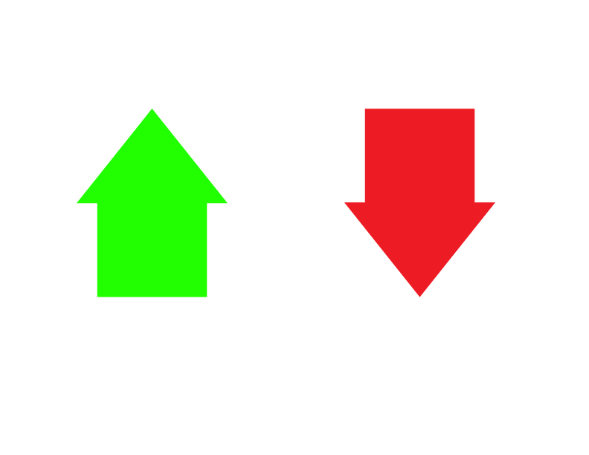
What do you Predict? Is this a plan for success?

Slide 32
Comment, Question, concern
. ? !

