Slide 1
Q&A Web Application
Adam Frisby
December 13, 2013
Advisor: Hongli Lou
CPET 491 Instructor: Paul Lin

Slide 2
Project Outline
Problem Statement and Solution
Application Overview
Programming Language and Software
Application Infrastructure
Software Architecture
Security Concerns
Ranking Algorithms
Testing
Conclusion

Slide 3
Problem Statement and Solution
Problem: When large amounts of users are involved, contributions by users are disorganized. With most social media platforms, it is difficult to gauge the general vibe of the audience.
Solution: New platform which allows ranked communication. Users will voluntarily host Interviews. Other users of the application will have the ability to vote up or down on questions and questions submitted.

Slide 4
Application Overview
User System
  Profiles
  Moderators
Interview System
  Questions & Answers
  Comments
Voting Systems
Interview Categories
Messaging System

Slide 5
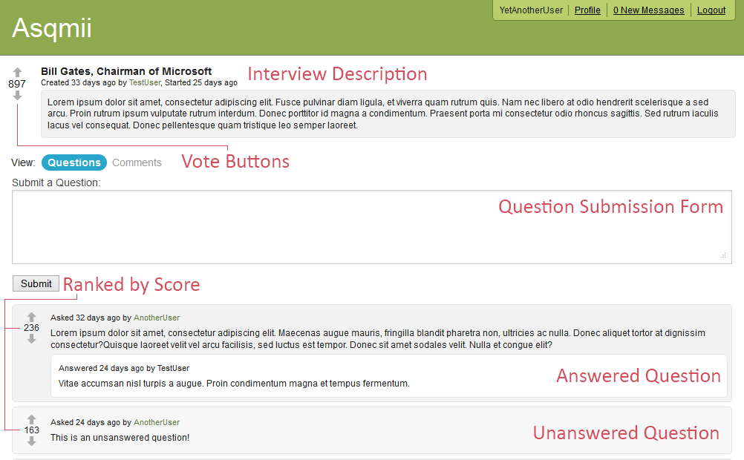
Application Overview

Slide 6

Programming Language and Software
Server
  Go (golang) – Garbage collected, compiled language developed at Google
  Revel – Go web framework
  PostgreSQL – Open Source Database Management System
Frontend
  jQuery – JavaScript library used to simplify JavaScript

Slide 7
Cloud-Based Application Infrastructure
Amazon EC2 t1.micro (free tier) instance [1]
  OS: 64 bit Linux (Amazon Linux AMI)
  Memory: 613 MB
Amazon RDS db.t1.micro (free tier) instance [1]
  Engine: PostgreSQL 9.3.1
  Storage: 5 GB
  Memory: 613 MB
Shared Bandwidth: 15 GB/Month

Slide 8
Network Diagram

Slide 9
Software Architecture

Slide 10
Controllers & Actions
Each controller in the application contains several actions
Examples:
  “Register.Submit” – Validates the user’s input and creates a new user account if user input is valid
  “Interviews.View” – Pulls interview data from database and returns a view of the to the user
Most actions return views, but some actions return data objects (in JSON format)

Slide 11
Interceptors
An interceptor is a function which is called before or after a controller action is invocated.
There are four times at which interceptors can be registered to run: BEFORE, AFTER, PANIC, FINALLY
Interceptors are used to being/committing/rolling back database transactions and enforcing user permissions.

Slide 12
URL Router
URL Router routes certain URLs to certain controller actions
For example http://site.com/register routes to the “Register.Index”
GET /logout Logout.Index
GET /register Register.Index
POST /register Register.Submit

Slide 13
Models
Models handle the interaction with the database.
InsertUser(tx *jet.Tx, username string, password string, email string, ipAddress string)
When a row is requested from the database through the model it is returned as a struct

Slide 14
Views
In the context of the web application, views are the web pages which are displayed in the user’s web browser.
The application makes use of Go’s built in template library.

Slide 15
AJAX
AJAX - Asynchronous JavaScript and XML
XML is not required, JSON is used instead
A request is made from the web browser in the background. The server will respond with a response and the page (view) is updated to reflect the results

Slide 17
Security Considerations
Passwords are stored as cryptographic hashes using the bcrypt hash function
Bcrypt has a “cost” which will increase the execution time of the function as well as using random salts
  Longer time to brute force
  Protected against rainbow tables

Slide 18
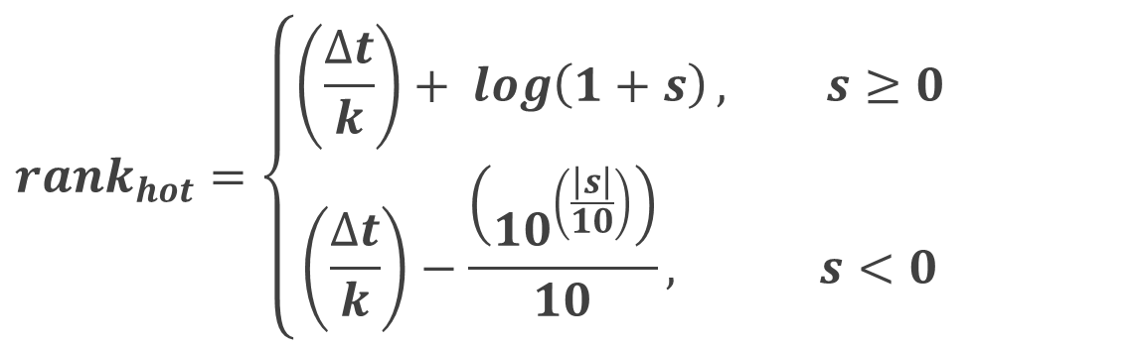
Ranking Algorithms
$$rank_{hot}=\left\{\begin{aligned}\left(\frac{∆t}{k}\right)+ \log\left(1+s\right), s≥0 \\ \left(\frac{∆t}{k}\right)−\frac{\left({10}^{\left(\frac{\left|s\right|}{10}\right)}\right)}{10}, s<0\end{aligned}\right.$$
Δt = Number of seconds between Jan 1, 2013 and
interview creation [0, ∞)
k = 201570.0
s = Score [-∞,∞]

Slide 19
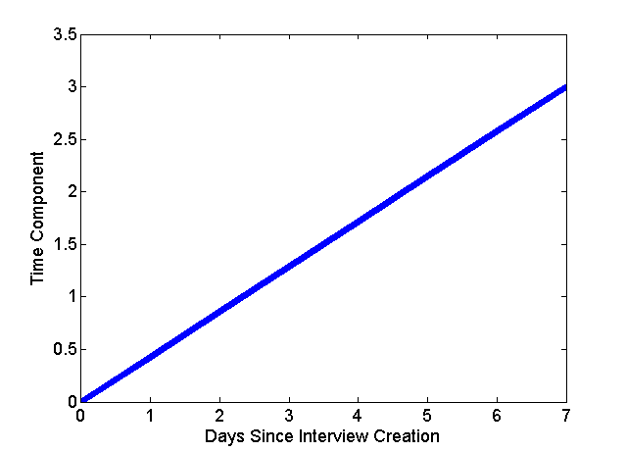
Ranking Algorithms – Time Component

Slide 20
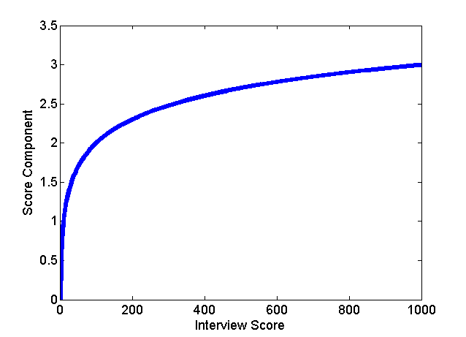
Ranking Algorithms – Positive Score Component

Slide 21
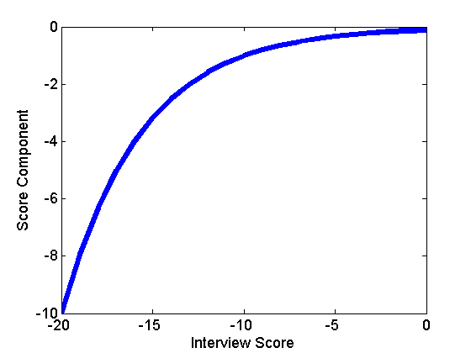
Ranking Algorithms – Negative Score Component

Slide 22
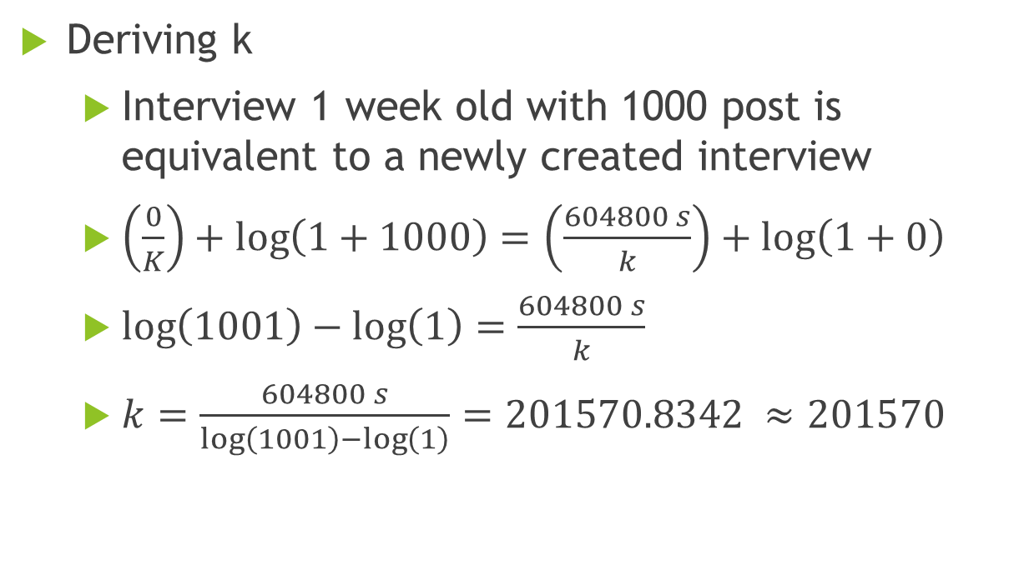
Ranking Algorithms
Deriving k
  Interview 1 week old with 1000 post is equivalent to a newly created interview
  $\left(\frac{0}{K}\right)+\log\left(1+1000\right)=\left(\frac{604800 s}{k}\right)+log\left(1+0\right)$
  $\log\left(1001\right)−\log\left(1\right)=\frac{604800 s}{k}$
  $k=\frac{604800 s}{\log\left(1001\right)−\log\left(1\right)}=201570.8342 ≈201570$

Slide 23
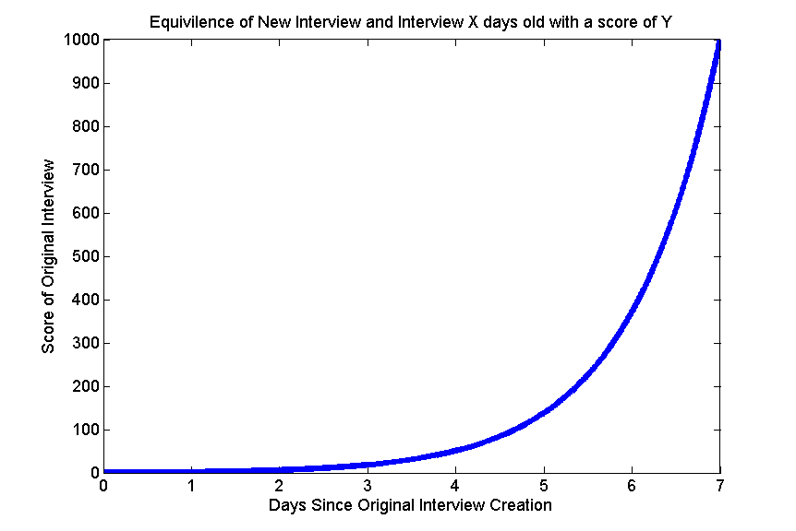
Ranking Algorithms

Slide 24
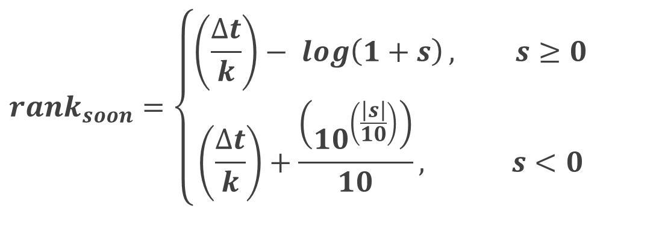
Ranking Algorithms
$$rank_{soon}=\left\{\begin{aligned}\left(\frac{∆t}{k}\right)− \log\left(1+s\right), s≥0 \\ \left(\frac{∆t}{k}\right)+\frac{\left({10}^{\left(\frac{\left|s\right|}{10}\right)}\right)}{10}, s<0\end{aligned}\right.$$
Δt = Number of seconds between Jan 1, 2013 and
scheduled time [0, ∞)
k = 201570.0
s = Score [-∞,∞]

Slide 25
Database Schema

Slide 26
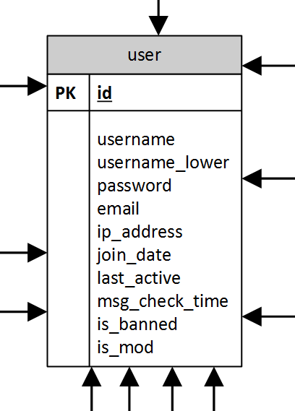
Database Schema - Users

Slide 27
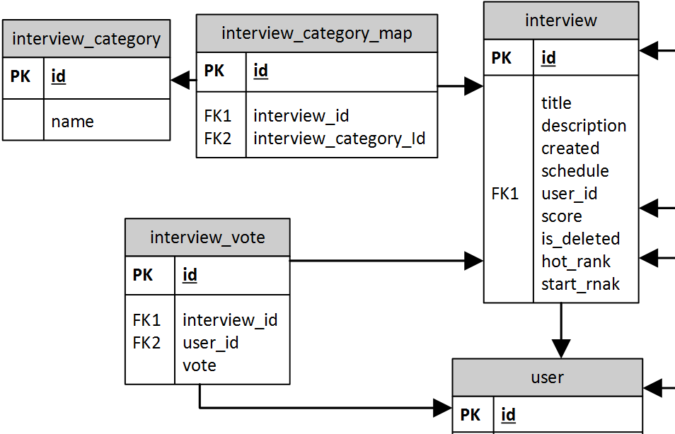
Database Schema - Interviews

Slide 28
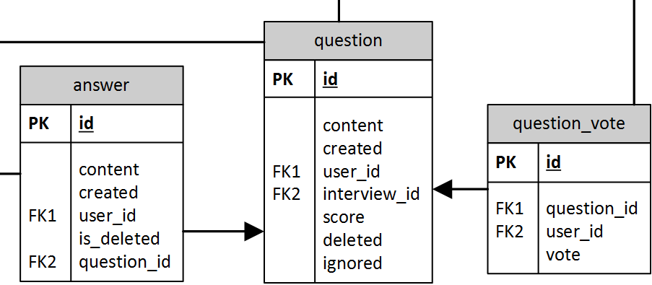
Database Schema - Questions

Slide 29
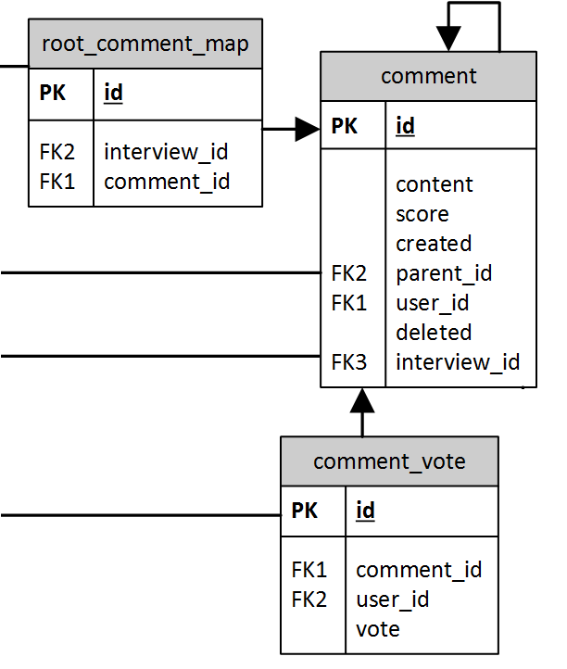
Database Schema - Comments

Slide 30
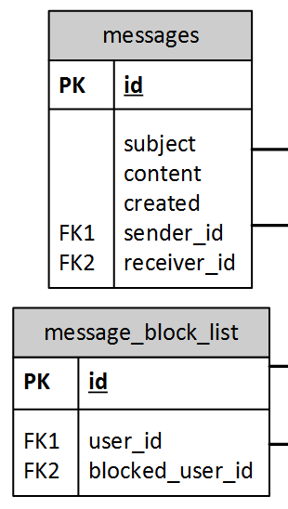
Database Schema - Messages

Slide 31
Select Requirements
ID | Requirement | Method | Result
F8 | Application shall allow visitors to register user accounts | Demo | Pass
F9 | Users shall have profile with questions/answer/comment history | Demo | Pass
F10 | Application shall allow user to schedule a Q&A session | Demo | Pass
F18 | Application shall allow user to submit questions before & during Q&A session | Demo | Pass
F21 | Comments shall allow children comments | Demo | Pass
F23 | Application shall rank Q&A sessions by votes | Demo | Pass
F24 | Application shall allow user to vote up or down on questions | Demo | Pass
F26 | Application should allow certain users to be moderators | Demo | Pass
F31 | Application should allow users to private message each other | Demo | Pass
F32 | Application should allow users to block members from messaging them | Demo | Pass

Slide 32
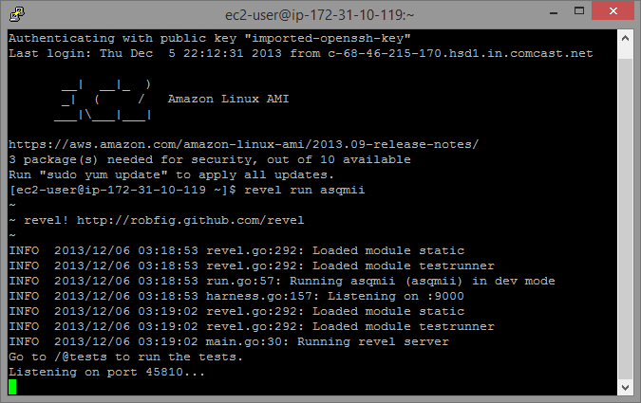
Running Web Server

Slide 33
Performance Testing
Loading Home Page Performance Test
  Script was used to open 5 instances of Firefox and load the homepage, delay 5 seconds, and repeat
  Ran for 10 minutes
  Analyze: Application should handle about 40 concurrent users reloading every 5 seconds.
  Limiting factor: Web Server CPU usage.

Slide 34
Performance Testing
Scheduling Interview Performance
  Script was used to open 5 instances of Firefox and load the “Schedule an Interview” page, fill the form with valid data, submit the form, delay 5 second, and repeat
  Ran for 10 minutes
  Analyze: Application should handle about 20 concurrent users scheduling interviews every 5 seconds.
  Limiting factor: Database CPU usage.

Slide 35
Cost
One-Time Costs
Item | Price
Software Tools | $0.00
Software Libraries | $0.00
Total Cost: | $0.00
Reoccurring Costs
Item | Price
t1.micro EC2 Instance [2] | $23.00/year
Elastic IP [3] | $0.00/year
Micro Standard Deployment RDS PostgreSQL Instance [4] | $23.00/year
Total Cost: | $46.00/year

Slide 36
Knowledge Gained
Go - Learned much about the language including the syntax, common design patterns of Go, and development environment.
Git - Use of command line Git to initiate, clone, pull, and commit as well as the use of Go’s get command to clone Github repositories

Slide 37
Lessons Learned
Time Management
  Project encompassed a wide range of activities
  Begin early
  Keep at it

Slide 38
Conclusion
Project meets all requirements set in Phase I of Senior Design
Possible Future Improvements
  Caching
  Social Media Integration
  Spam Protection & Email Verification
  Private & Group Interviews
  Notifications and Alerts

Slide 39
References
[1] "AWS Free Usage Tier," Amazon, [Online]. Available: http://aws.amazon.com/free/. [Accessed 4 December 2013].
[2] "Amazon EC2 Pricing," Amazon, [Online]. Available: http://aws.amazon.com/ec2/pricing/#reserved. [Accessed 1 December 2013].
[3] "Amazon EC2 Pricing - Elastic IP Addresses," Amazon, [Online]. Available: http://aws.amazon.com/ec2/pricing/#elastic-ip. [Accessed 1 December 2013].
[4] "Amazon Relational Database Service Pricing," Amazon, [Online]. Available: http://aws.amazon.com/rds/pricing/. [Accessed 1 December 2013].

Slide 40
Questions?

Slide 41
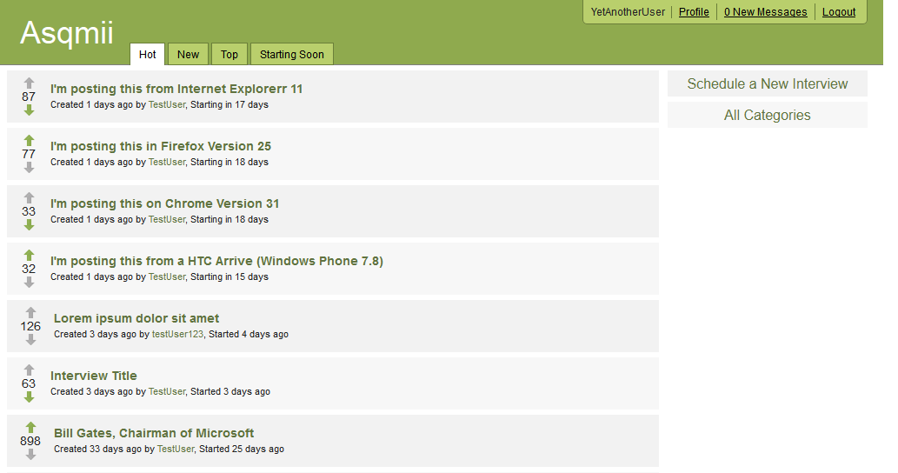
Demonstration
URL: http://54.213.46.161:9000/

