Slide 1
Web Monitoring for Greenhouse Environment
Date: May 3, 2013
Members: Tuyen Le & Patrick Maina
Faculty Advisor: Professor Paul Lin & Hal Broberg
Prof. Paul I. Lin, Instructor of ECET 491 Senior Design II
Department of Computer, Electrical, and Technology
College of Engineering, Technology, and Computer Science
Indiana University-Purdue University Fort Wayne, Indiana

Slide 2
Project outline
Introduction
Problem Statement/Solution
System Design
Hardware Interface
Network
Testing
Lessons Learned
Conclusion

Slide 3
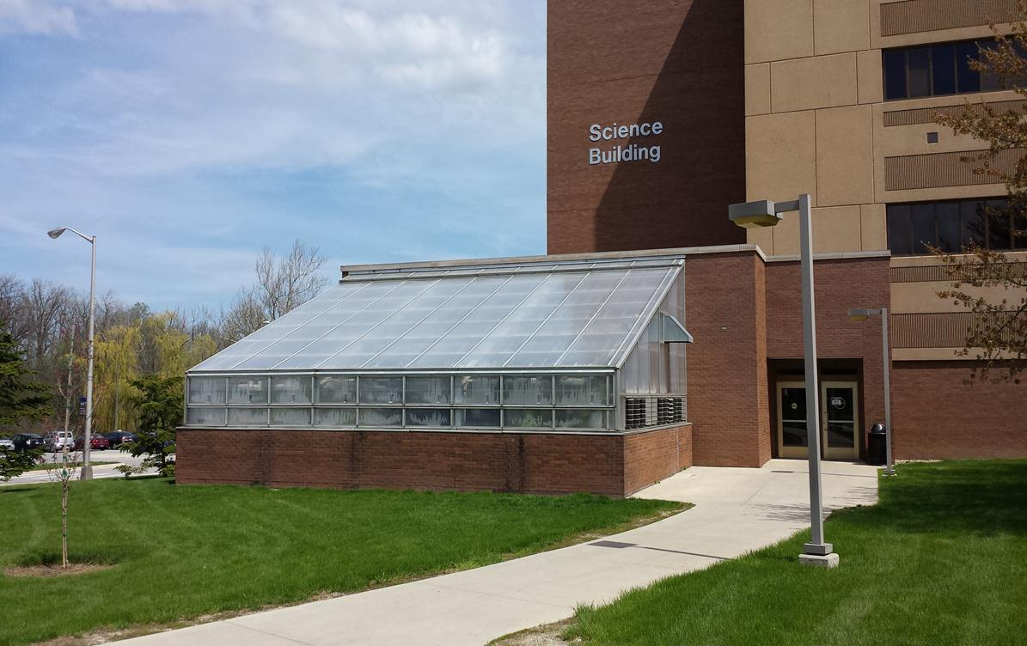
Introduction
Web Monitoring Greenhouse Environment

Slide 4
Background
Combining our Senior Design one
Prof Lin
Ipfw Biology Department Requirements

Slide 5
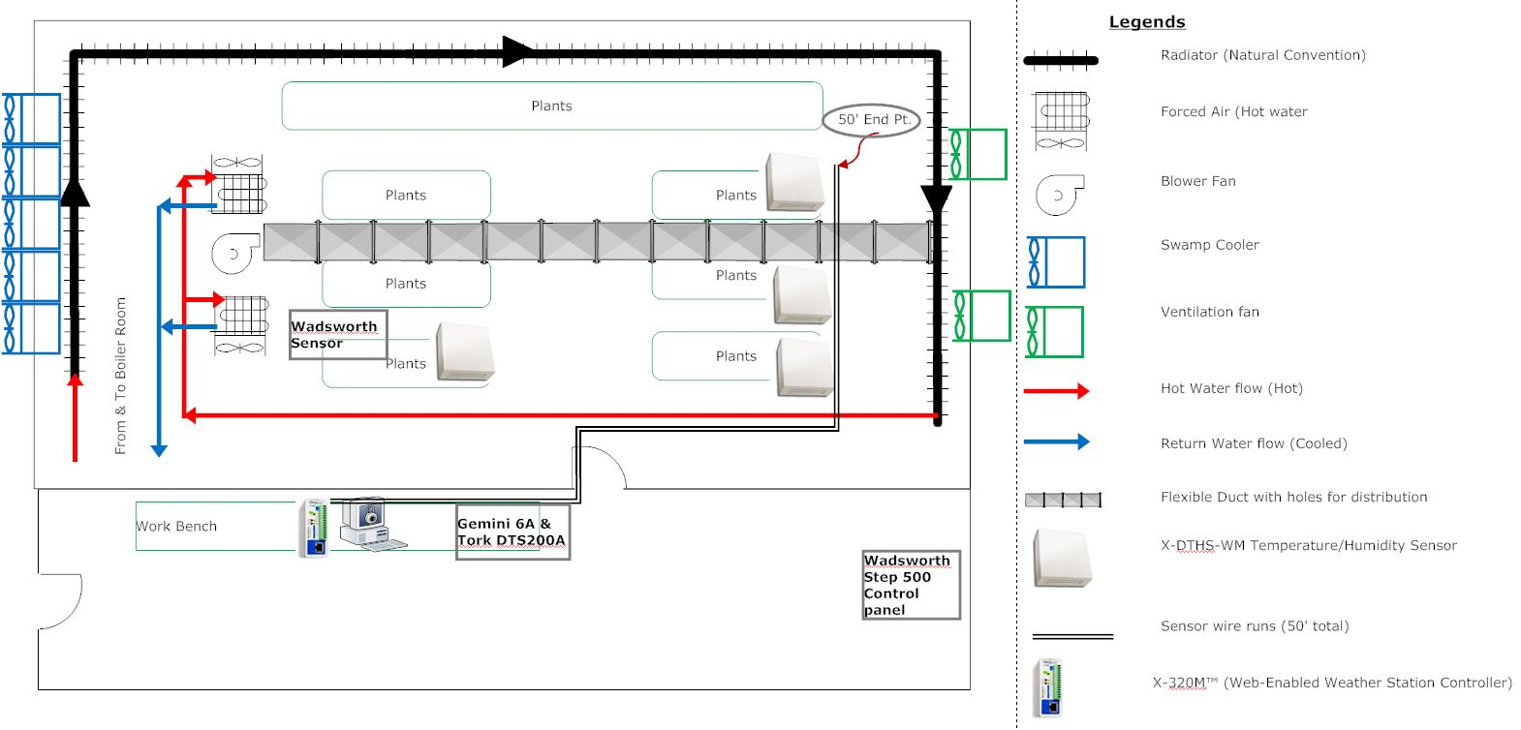

Slide 6
Problem Statement/ Solution
Worker
Heat management issues
Misting Frequency
Accuracy in Settings

Slide 7
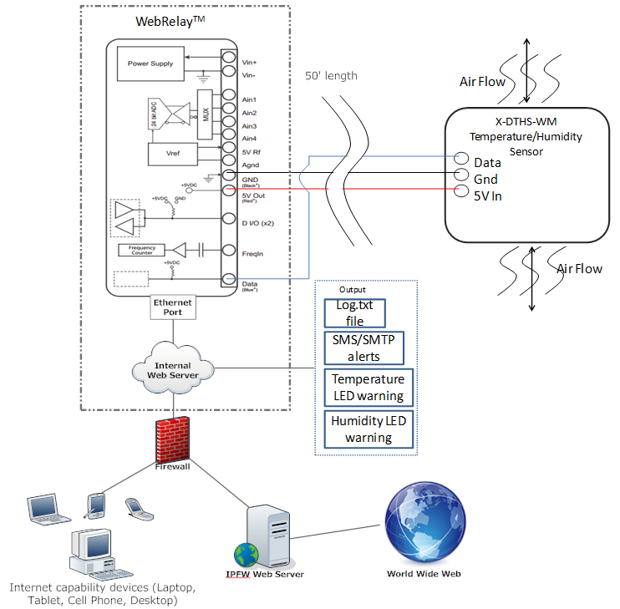
System Design

Slide 8
System Requirement
Password protected login, setup and HTML status page
Monitoring temperature and humidity including remotely
Email alerts based on user define
Built-in web server
SMS alert
512kB storage for logging memory.
Unlimited data log storage through web services
Statistical Analysis of the data

Slide 9
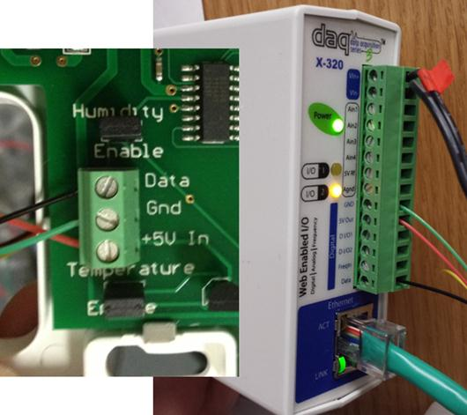
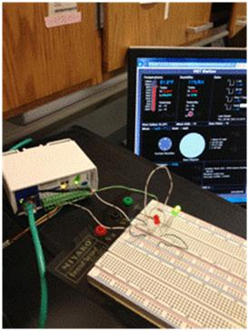
Hardware Interface
115v power supply
22 Awg wires
Verification using Led’s

Slide 10
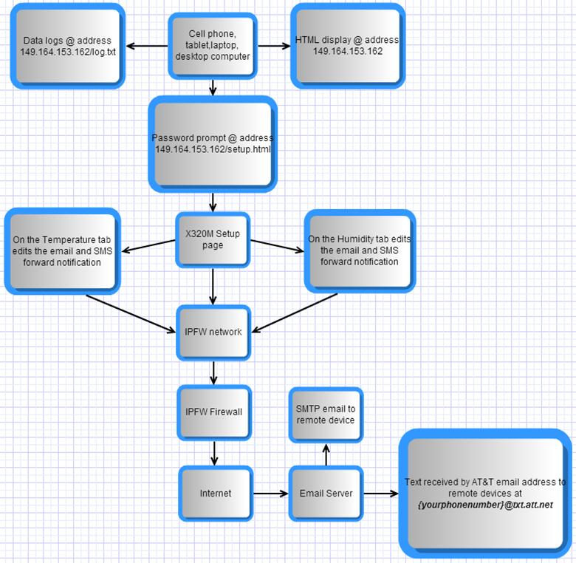
Network

Slide 11
Testing
VIDEO
DEMO

Slide 12
Cost
ITEM | QUANTITY | PRICE(approx. in dollars)($) | TOTALS IN DOLLARS ($)
X-320 M | 1 | 400.00 each | 400.00
Temperature and Humidity Wall mounted sensor | 1 | 93 each | 93.00
Led’s | 6 | 0.99 each | 5.94
22 Awg wire | 50 feet | 9.00 for 50 feet | 9
Total |  |  | 507.94

Slide 13
Software Used
Item | Quantity | Price | Total
Microsoft Project 2010 | 1 | 0 | 0
SmartDraw 2010 | 1 | 0 | 0
Microsoft Office 2010 | 1 | 0 | 0

Slide 14
Lesson learned
Bureaucracy-IPFW IT department
Time Management
  New idea and research on web servers
  School, work, real life
  Scheduling meeting etc etc
Video editing
Installing and moving sensor,
Flexibility: Difficult to work with different peoples schedules.
Meeting difficult people- Communication issues
Statistical Analysis

Slide 15
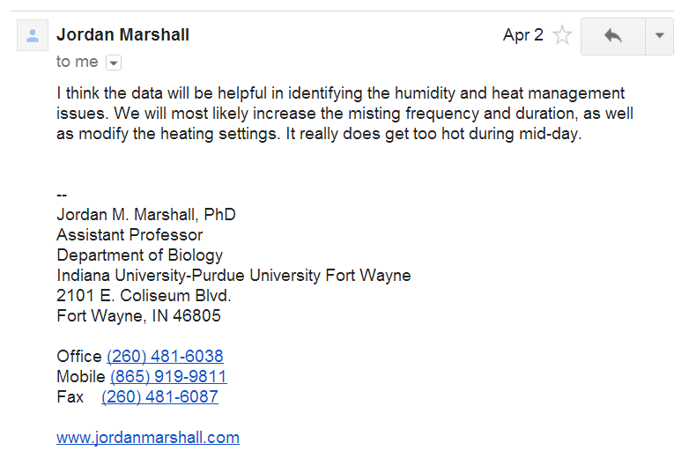
Conclusion

Slide 16
Future Developments
Integrate the various control systems and automize them .
Install hydroponic system
Use our progress report and presentation to ask for Green house Budget

Slide 17

Questions…..

