Slide 1
Web Based Point Of Sale System
Jeremiah Bauer
Student of Computer Engineering Technology
Gary Steffen Faculty Advisor
Paul Lin CPET 491 Professor
May 2, 2014
Notes:
Hello, My name is Jeremiah Bauer and my senior design project was a web based point of sale system.

Slide 2
Topics
Introduction
Previous system
System Design
System Integration and Testing
Project Schedule
Labor and Monetary costs
Risk Management
Lessons Learned
Demonstration
Notes:
These are the main points of my presentation, a review of the previous system, the new system design, a brief review of requirements, project schedule, labor costs, monetary costs, the risks encountered, and the lessons learned. Finally you will get to see the system I have built.

Slide 3
Introduction
Sponsored By Dan’s Pies in North Webster, IN
  Opened in 1990
  Small business opened it’s first retail location in 2010
Project was a success
Completed on time and under budget
Meets all requirements set forth in phase 1
Notes:
My project was sponsored by Dan’s Pies in North Webster, IN. Dan’s Pies was opened in 1990 and opened it’s first retail location in 2010.
The project was a success and the final product has been deployed at Dan’s Pies and will be used this summer beginning on Memorial Day weekend. I am happy to report that it was completed on time and under budget.
The project met all the requirements that were produced in Phase 1.

Slide 4
Previous System
Only process sales with 7 categories of items
  Uses cookies to pass sales data
    Sales data was larger than maximum size of cookie
Web based
MySQL Backend
PHP server side Programming
HTML
JavaScript
CSS
Notes:
When Dan’s Pies first opened a free point of sale system was deployed. After using this system for 2 summers, there was a serious shortcoming discovered, it could only process sales with 7 categories of items or less. For example if a customer ordered 7 cherry pies and 3 apple pies the system would work. But if the customer ordered 7 different types of pies like , cherry, apple, chocolate, tollhouse, banana, lemon, rhubarb, and blueberry the system would act like the sale was a success but would only record the sale of the first 7 items.
The was because all sales data was passed back to the webserver using a cookie. The data being passed exceeded the maximum cookie size which is about 4 kilobytes, but depends by a few bytes depending on the browser being used.
The previous system was web based, used MySQL <read slide>

Slide 5
System Design
Ruby On Rails
Apache Webserver
Phusion Passenger (mod_rails)
PostgreSQL
CentOS 6.5
HTML5
JavaScript (jQuery)
CSS3 (Bootstrap)
Notes:
The new system design used Ruby on Rails. Ruby on Rails is a model view controller web (MVC) framework that is written in the programming language Ruby. The system was deployed using the Apache Webserver with the mod_rails plugin on CentOS 6.5. The sales data is stored in a PostgreSQL 9.3 database server which runs on the same hardware as the webserver, which we will see in a little while in the top level system diagram.
The markup language used for the webpages is HTML5, styled using bootstrap. Bootstrap is a CSS framework developed by Twitter to speed up web page development The client side interactive functionality is provided by Javascript using the jQuery framework, like most web applications.

Slide 6
Tasks in Scope
Processing Sales
Designing a database schema
Reading and writing barcodes
Printing receipts
Sales reporting
Create, update, and delete items

Slide 7
Out of Scope
Credit card processing
Inventory control system
Invoice generation system
Reservation system

Slide 8
Top level System Diagram

Slide 9
Database Schema

Slide 10
Rails Model Class diagram

Slide 11
Rails Controller Class Diagram

Slide 12
Rails Views
Welcome Landing Page
Application Layout
Application Header Layout
Item New/Edit/Show
Configuration New/Edit/Show
Sales Page
Reporting Page

Slide 13
Find Item Sequence of Operations

Slide 14
Sales Sequence of Operation

Slide 15
JavaScript Function List
lookupItemById()
insUpdProductRow(product)
updateOrderTotals()
applyPayment()
runReport()
completeSale()

Slide 16
CSS Classes
logo
barcode
totalContainer
itemContainer
sales-container
noItemsCell
total
receiptLogo
receiptQuantity

Slide 17
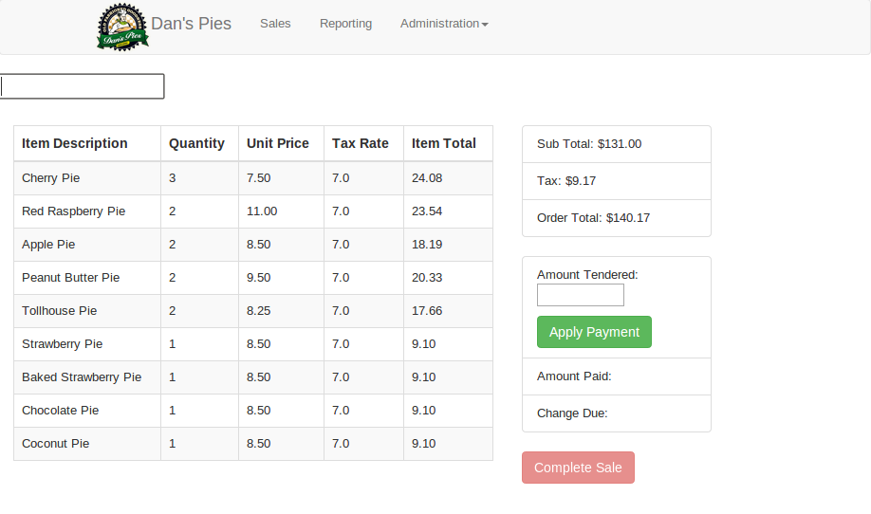
Most important requirement
The system shall be able to process a sale with more than 7 items.

Slide 18
Secondary Requirements
The system shall be able to generate bar codes by using a Ruby image processing library.
The system shall be able to print a receipt.
The system shall be able to generate a sales report.

Slide 19
Receipt Printing
Uses a USB Epson ReadyPrint T20 Direct Thermal Printer
Cost $157.24
Uses JavaScript, HTML, and CSS to generate the receipt
Created only after sale is successfully inserted into database

Slide 20
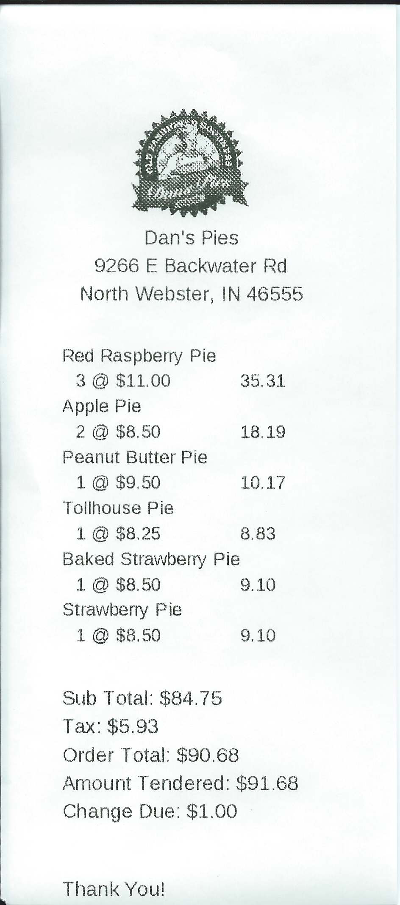
Sample Receipt

Slide 21
Barcode Generation
Uses barcode encoding 39
USB Barcode Scanner
Generated using the “barby” barcode library
Generated based on the items id in the items table
def generateBarcode()
barcode = Barby::Code39.new(self.id.to_s)
fileName = "public/" + self.id.to_s + ".png"
File.open( fileName , 'w' ){|f|
f.write barcode.to_png
}
return fileName
end

Slide 22
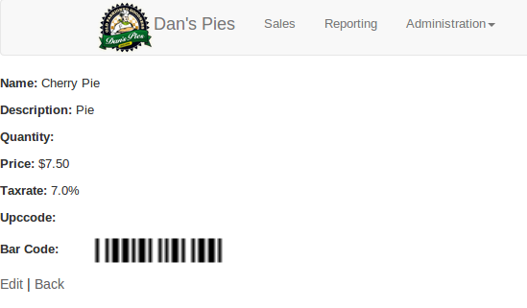
Sample Barcode

Slide 23
Project Schedule
Required approximately 16 weeks of effort
Most tasks were completed on time
Receipt printing and main sales page were minor road blocks

Slide 24
Labor Costs
175 Estimated hours
107 actual hours

Slide 25
Monetary costs
$200.00 Estimated cost
$157.24 Actual cost

Slide 26
Risk Management
Highest risk identified in Phase 1 was that the system would not be able to process 7 categories of items.
  Was not encountered
Project schedule was second highest risk
  Not encountered project was completed on time and under budget
Not being able to create barcodes
  Encountered and mitigated by avoided by reading documentation

Slide 27
Lessons Learned
Learned a new web framework (Ruby on Rails)
Learned a new CSS framework (Bootstrap)
JavaScript floating point calculations issues

Slide 28
Conclusion
Project was a success
Met all requirements set forth in Phase 1

Slide 29
Demonstration

