Slide 1
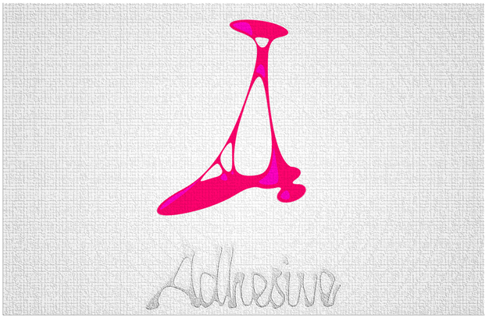
Topic: Adhesive- Social Media Aggregator
ECET 491: Senior Project Phase II
Monday, April 21, 2014
A presentation by Ekenedilichukwu Oduah
Project Coordinator: Paul Lin

Slide 2
Topics to be covered
Problem Statement
Options Considered
Node.js
Project Management
Brainstorming and Considerations
Program Logic
Troubleshooting and Testing
Benefits and Improvements

Slide 3
Problem statement
In today’s world, the need to stay ever so connected is constantly there and so therefore new social media ideas and solutions keep sprouting; each idea more versatile and different from its counterparts. The problem therefore is how a user manages to constantly keep up and manage all his/her existing profiles while navigating through the different profiles in the easiest manner.

Slide 4
Options: Programming language tools
ASP.NET with C#
PHP
Node.js

Slide 5
Node.js
Node.js is a platform built on Chrome's JavaScript runtime for easily building fast, scalable network applications. Node.js uses an event-driven, non-blocking I/O model that makes it lightweight and efficient, perfect for data-intensive real-time applications that run across distributed devices.

Slide 6
Chrome's JavaScript runtime: V8
V8 is Google's open source JavaScript engine.
V8 is written in C++ and is used in Google Chrome, the open source browser from Google.
V8 can run standalone, or can be embedded into any C++ application.

Slide 7
Chrome's JavaScript runtime: V8
V8 gives a huge boost in performance because it cuts out the middleman, preferring straight compilation into native machine code over executing byte code or using an interpreter.

Slide 8
Project management: labor

Slide 9
Activity | Days
Review and update Requirements | 10
Create state diagrams | 5
Create algorithms | 10
Procure suitable server | 5
Test server | 1
Build registration and login modules | 10
build system logic and design | 10
Setup and design storage technology | 10
System integration | 5
Troubleshoot | 10
Modifications and code deployment | 5
Design update | 2
Data validation and testing | 5
Code Testing and implementation | 5
Verify system testing | 2

Slide 10
Rough draft | 10
Update first draft | 5
Rewrite final report | 5
Final report complete | 1
write rough presentation | 5
update presentation | 2
rewrite the presentation | 1
presentation complete | 1
Total | 125 days

Slide 11
Project management: cost
Parts | Dollar ($)
Dedicated Server | 900 (150/ month for 6 month period)
Domain Name | 75
Total | $975

Slide 12
Brainstorming and considerations
*Initial Approach*

Slide 14
Program logic

Slide 15
flowcharts
On Load Event
Connection Event

Slide 16
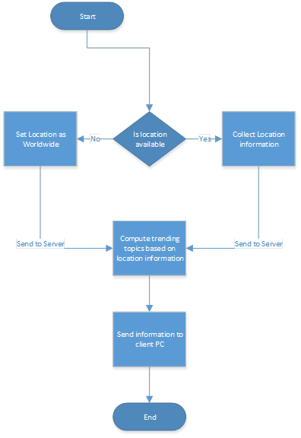

Slide 18
Troubleshooting and testing

Slide 19
Benefits
As of now, all websites and online resources alike, all act independent of one another and truly they are independent. However this project aims to bridge that gap, so that sharing an Instagram picture to your Facebook friends becomes as easy as a simple drag and drop action or sharing a CNN article to your blog followers becomes easy and virtually connected.

Slide 20
Improvements
Better connection management
Improved user interface
Semantic data application and utilization
Possible contacts management and Hub application

Slide 21
demonstration

