Slide 1
ITC 250/CPET 499 Web Systems
E-Commerce & Business: an Introduction
References: *Chapter 1 of the text book: e-Commerce: Business, Technology, and Society, 8th edition, 2012, by K. C. Laudon and C. G. Traver, publisher Pearson Education Inc., * World Street Journal * U.S. Census Bureau
Paul I-Hai Lin, Professor
http://www.etcs.ipfw.edu/~lin
A Specialty Course for

Slide 2
Topics
Facebook: IPO
PART I
E-Commerce
Major Trend in E-Commerce
E-Commerce Definitions
E-Commerce vs. E-Business
Unique Features of E-Commerce Technology
Types of E-Commerce
Origins and Growth of E-Commerce
Technology and E-Commerce in Perspective
Insights on Technology

Slide 3
Topics (continue)
PART II
E-Commerce: A Brief History
E-Commerce 1995-2000: Innovation
E-Commerce 2001-2006: Consolidation
E-Commerce 2006-Present: Re-innovation
Insight on Business
Assessing E-Commerce: Success, Surprises, and Failure
Prediction for the Future

Slide 4
Topics (continue)
PART III
Understanding E-Commerce
Technology: Infrastructure
Business: Basic Concepts
Society: Taming the Juggernaut
Insight on Society
Online Privacy
Case Study: The Pirate Bay

Slide 5
Facebook -
Breaking news, https://www.facebook.com/BreakingNews
How News Feed Works, https://www.facebook.com/help/327131014036297/
Why teens are tiring of Facebook, by Jennifer Van Grove, CNET, March 2, 2013, http://www.cnet.com/news/why-teens-are-tiring-of-facebook/
Facebook unethical experiments: It made news feeds, June 2014, by Katy Waldman, http://www.slate.com/articles/health_and_science/science/2014/06/facebook_unethical_experiment_it_made_news_feeds_happier_or_sadder_to_manipulate.html

Slide 6
Facebook - Innovations
Facebook Innovations, Sept. 2011, http://rocketpopmedia.com/discover/2011/09/23/5-new-facebook-innovations/
1. Newsfeed: Top stories, Most recent
2. The Ticker: Real-time friendly activity update
3. Lists
4. Timeline: “all the stories, all your apps, a new way to express who you are.”
5. Spotify and App Integration

Slide 7
Facebook - Innovations
Facebook Graph Search Could be Its Greatest Innovation, http://mashable.com/2013/01/15/facebook-graph-search-great/
3 Recent Facebook Innovations Nonprofits Need to Know, Jan. 29, 2014, http://www.thenonprofittimes.com/news-articles/3-recent-facebook-innovations-nonprofits-need-to-know/
1. Mobile
2. Apps and Games
3. Post Reach

Slide 8
Facebook - IPO
Is Facebook Ready for the Big Time? Interviewed by Shayndi Raice, WSJ, Jan. 14-15, 2012, pp. B1+B3,
CEO Mark Zuckerberg, 27, who built Facebook out of his Harvard College dorm room in 2004, and COO Sheryl Sanderberg, 42, a former Google Inc, executive
Is Facebook Ready for Its IPO?, San Francisco, via Skype, 4:19 minute, Sheryle Sanderberg
Facebook Sets Historic IPO, by Shayndi Raice, Feb. 2, 2012,

Slide 9
Facebook – IPO (cont.)
Facebook: a social networking service, based at Menlo Park, California
Mr. Zuckerberg has focused on building social features for the site
Ms. Sanderberg has spent the last 3 ½ years: cultivating relationships with Global Brands and developing new ways for marketers to reach Facebook’s users.
Facebook’s advertising revenue
$264 million in 2008
$3.8 billion in 2011
$6 billion by the end of 2012 (estimated by eMarketer)
As Facebook social network move toward an IPO, It must prove to investors that it is ready for the big time.

Slide 10
Facebook – WSJ Interview (Mark Zuckerberg)
WSJ: How has Facebook changed when it comes to trying to make money?
WSJ: How does that work?
WSJ: What do you say to those who suggest Facebook can’t grow revenue without alienating users?
Notes:
WSJ: How has Facebook changed when it comes to trying to make money? (built it as a product, not initially as a company)
WSJ: How does that work? (mission: getting people to connect; need to build a really strong business: marketing side; attract, grow, keep attract)
WSJ: What do you say to those who suggest Facebook can’t grow revenue without alienating users? (not mutually exclusive: serving more people, increasing customer base, making them more deeply engaged => good business)

Slide 11
Facebook – WSJ Interview (Mark Zuckerberg)
WSJ: What’s the company’s first focus, business or product?
WSJ: What companies do you admire?
WSJ: Do you place Facebook in the same category as those businesses?
Notes:
WSJ: What’s the company’s first focus, business or product? (right strategy: product first, building business for the long term)
WSJ: What companies do you admire? (Amazon: focusing on the long term and accepting shorter margins on the short term; Apple: quality of stuff that they do; Google too for the same thing)
WSJ: Do you place Facebook in the same category as those businesses? (focused on building things for the past 5 or 6 years, have lasting value for people, have a good shot at that)

Slide 12
Facebook – WSJ Interview (Sheryl Sandberg)
WSJ: What steps does Facebook still need to take to solidify its position?
WSJ: How does that help Facebook make money?
WSJ: What is the long-term vision for Facebook?
Notes:
WSJ: What steps does Facebook still need to take to solidify its position?(Ms. Sandberg: want to see sharing increase, users continue to grow)
WSJ: How does that help Facebook make money? (Ms. Sandberg: sharing activity drives advertising revenue; advertisings for both big & small businesses; driving users and driving engagement)
WSJ: What is the long-term vision for Facebook? (Ms. Sandberg: like everyone who builds products to use Facebook, vision: industries get disrupted and rebuilt with people at the center)

Slide 13
Facebook – Financial Reports
Facebook – Investor Relations, http://investor.fb.com/results.cfm
Earnings: 2012, 2013, 2014 (Third Quarter),
Facebook Shares Surge on First Ever $1 billion Mobile Ad Revenue Quarter, Jim Edwards, Jan. 29, 2014, http://www.businessinsider.com/facebook-q4-2013-earnings-2014-1

Slide 14
Types of Business & E-Commerce
U.S. Census Bureau Definitions, http://www.census.gov/econ/estats/definitions.html#e
E-Commerce: This term describes transactions sold on-line whether over open networks such as the Internet or proprietary networks running systems such as Electronic Data Interchange (EDI).
Brick-and-mortar retailers: This is a business model by which a company integrates both offline (bricks) and online (clicks) presences.

Slide 15
Types of Business & E-Commerce
Business-to-business (B-to-B or B2B): This term describes commerce transactions between businesses, such as between a manufacturer and a wholesaler, or between a wholesaler and a retailer. In regards to the E-Stats report, this by definition is transactions by Manufacturers and Merchant Wholesalers.
Business-to-consumer (B-to-C or B2C): This term describes activities of businesses serving end consumers with products and/or services. An example of a B2C transaction would be a person buying a pair of shoes from a retailer.

Slide 16
Major Types of E-Commerce
Classified by Market Relationship
Business-to-Consumer (B2C)
Business-to-Business (B2B)
Consumer-to-Consumer (C2C)
Classified by Technology
Peer-to-Peer (P2P)
Mobile Commerce (M-commerce)

Slide 17
Major Types of E-Commerce
Classified by Market Relationship
Business-to-Consumer (B2C)
Portals Model (with search engines)
Horizontal portals (Yahoo, Google, Bing, Altivista, etc)
Vertical portals (WebMD)
Online Retailers (Store-Front Model with shopping cart: Amazon.com)
Content Providers
Transaction Brokers
Market Creators
Service Providers
Community providers, …

Slide 18
Major Types of E-Commerce
Classified by Market Relationship
Business-to-Consumer (B2C)
Business-to-Business (B2B)
E-Distributors
E-Procurement companies
Exchanges and Industry Consortia
Industrial Networks: single firm networks, industry-wide networks
Consumer-to-Consumer (C2C)

Slide 19
Major Types of E-Commerce
Classified by Market Relationship
Business-to-Consumer (B2C)
Business-to-Business (B2B)
Consumer-to-Consumer (C2C)
Auction Model: eBay

Slide 20
Major Types of E-Commerce
Classified by Market Relationship
Business-to-Consumer (B2C)
Business-to-Business (B2B)
Consumer-to-Consumer (C2C)
Classified by Technology
Peer-to-Peer (P2P)
Mobile Commerce (M-commerce)

Slide 21
E-Commerce: An Introduction
E-Commerce Statistics in 2011 (from pp. 6-7)
Online consumer sales (expected to grow 14% vs. 4% of traditional retail)
The major source of online retail growth in the U.S. (existing buyers rather than new buyers)
Mobile commerce
Online population and activities

Slide 22
E-Commerce: Online User Activities
Online Users Activities Survey 2011, Pew Internet & American Life Project, May 2011 Survey, http://www.pewinternet.org/Static-Pages/Trend-Data/Online-Activites-Total.aspx
78% of American adult (18 and older) use the Internet
92% send/read emails (11/1/2010)
92% use search engine (5/1/0211)
76% get news (5/1/2011)
61% do online banking (5/1/2011)
65% use social network: MySpace, Facebook or LinkedIn (5/1/2011)
71% watch an online video: YouTube or Vimeo (5/1/2011)
71% buy a product (5/1/2011), …

Slide 23
E-Stats from U.S. Census Bureau
The 2009 E-commerce multi-section “E-Stats” report, released May 26, 2011, http://www.census.gov/econ/estats/
U.S. Shipments, Sales, Revenue and E-Commerce: 2009 and 2008 (in billions of dollars)
Sector Analysis
Manufacturing
Merchant Wholesale
Retail
Selected Services

Slide 24
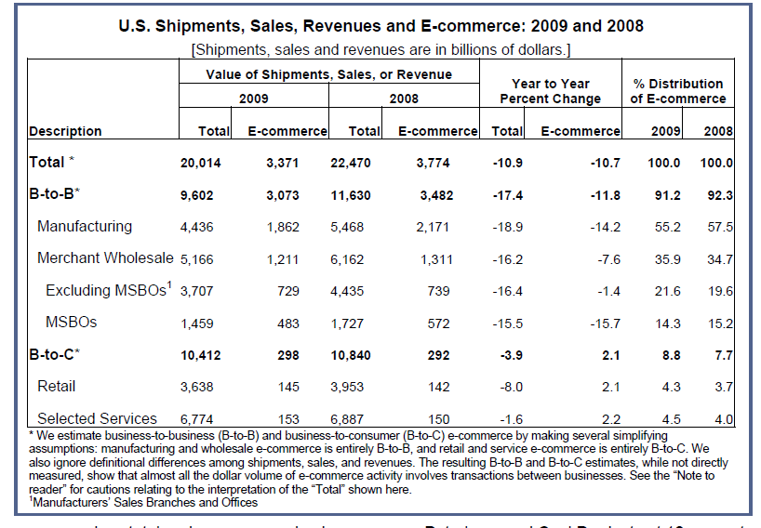
U.S. Shipments, Sales, Revenues and E-Commerce: 2009 and 2008

Slide 25
U.S. Shipments, Sales, Revenues and E-Commerce
2011 E-commerce Multi-sector Data Tables (released May 23, 2013), https://www.census.gov/econ/estats/2011/all2011tables.html

Slide 26
E-Commerce: Innovation, Consolidation, and Re-innovation
E-Commerce: A Brief History
E-Commerce 1995-2000: Innovation
E-Commerce 2001-2006: Consolidation
E-Commerce 2006-Present: Re-innovation
Insight on Business
Assessing E-Commerce: Success, Surprises, and Failure
Prediction for the Future

Slide 27
Summary

