Slide 1
CPET 499/ITC 250 Web Systems
Lecture 3
Introduction to HTML and XHTML,
Web Browsers, and Web Servers
References:
*Chapter 2 of the Text Book: Programming the World Wide Web, 8th ed, by Robert W. Sebesta, from Pearson
*Internet & World Wide Web How to Program, 5th ed, by Paul Deitel, et. al.,
From Pearson
*Webmaster in a Nutshell, by Stephen Spainbour & Robert Eckstein, from O’Reilly
*E-Book on Building Web Applications with HTML, 2012, by Paul I. Lin, http://www.etcs.ipfw.edu/~lin/CECourses/2_HTML/CE_02WebHhtmlindex.html
Paul I-Hai Lin, Professor
http://www.etcs.ipfw.edu/~lin
A Specialty Course for
M.S. in Technology IT/Advanced Computer Applications Program
Purdue University Fort Wayne Campus

Slide 2
Topics
Introduction to HTML Documents
Versions of HTML
HTML5 Standards
Topics on Web Browsers and Web Servers
A Basic Web Site - Design

Slide 3
HTML Documents
HTML
  A structured language defines syntax and placement of WWW document for Web browsers.
  The HTML syntax contains definitions of tags and attributes that allows the separation of the presentation and structure of a document.
  It enables the creation of machine independent WWW documents.
References of HTML standards
  HTML 5 – A vocabulary and associated APIs for HTML and XHTML, Draft 4 Sept 2014, http://www.w3.org/html/wg/drafts/html/CR/

Slide 4
HTML Documents
A HTML web page may include the following information
  Text of its document with appropriate layout settings such as front, color, alignment, numbered and bulleted lists, etc; any hypertext links to other documents, images, and other media; tables and user feedback form
  Embedded client-side scripts such as JavaScript
  Embedded images and media
  Embedded other objects such as Java Applet program, ActiveX, audio, video, and VRML objects
  Embedded video, audio, and other formats via Plug Ins

Slide 5
Evolution of HTML Specifications
1993 Original version of HTML was defined with SGML (Standard Generalized Markup Language)
HTML 2.0 - 1995, HTML 3.2 - 1997,
HTML 4.0 - 1997, HTML 4.01 - 1999, http://www.w3.org/TR/html4/
XHTML 1.0 - 2000
XHTML2 Working Group, http://www.w3.org/MarkUp/
Drop XHTML 2.0 development effort in 2009
HTML5, A vocabulary and associated APIs for HTML and XHTML, W3C, http://dev.w3.org/html5/spec/Overview.html
HTML5 and Web Standards, Apple – HTML5, http://www.apple.com/html5/

Slide 6
HTML5 Semantics, Structure and APIs
  HTML 5 – A vocabulary and associated APIs for HTML and XHTML, Draft 4 Sept 2014, http://www.w3.org/html/wg/drafts/html/CR/
Documents elements are defined by tags
  Opening tag: <name_of_the_tag>
  Document Contents
  Closing tang: </name_of_the_tag>
  Comments: <!-- …… -->
Elements
  Content Models
  Global Attributes

Slide 7
HTML5 Semantics, Structure and APIs
HTML 5, http://www.w3.org/html/wg/drafts/html/CR/
The Elements of HTML
  The root element: <html> </html>
  Document Metadata: <head> </head>, <title> </title>, <base> </base>, <link> </link>, <meta> </meta>
  Sections: <body>, <article>, <section>, <nav>, <aside>, <h1>, <h2>, <h3>, <h4>, <h5>, <h6>, <header>, <footer>, <address>
  Grouping content: <p>, <hr>, <pre>, <blockquote>, <ol>, <ul>, <li>. <dl>, <dt>, <dd>, <figure>, <figcaption>, <div>, <main>
  Text-Level Semantics: <a>, <em>, <strong>, <small>, <s>, <cite>, <q>, <dfn>, <abbr>, <data>, <time>, <code>, <var>, <samp>, <kbd>, <sub>, <sup>, <i>, <b>, <u>, <mark>, <ruby>, <rb>, <rt>, <rtc>, <rp>, <dbi>, <bdo>, <span>, <br>, <wbr>

Slide 8
HTML5 Semantics, Structure and APIs
HTML 5, http://www.w3.org/html/wg/drafts/html/CR/
The Elements of HTML (continue)
  Edits: <ins> <del>
  Embedded contents: <img>, <iframe>, <embed>, <object>, <param>, <video>, <audio>, <source>, <track>, <map>, <area>
  Links: <a>, <alternate>, <author>, <bookmark>, <help>, <icon>, <license>, <nofollow>, <noreferrer>, <prefectch>, <search>, <stylesheet>, <tag>, <next>, <prev>
  Tabular Data: <table>, <caption>, <colgroup>, <col>, <tbody>, <thread>, <tfoot>, <tr>, <td>, <th>
  Forms: <form>, <label>, <input>, <type>, <button>, <select>, <datalist>, <optgroup>, <option>, <textarea>, <keygen>, <output>, <progress>, <meter>, <fieldset>, <legend>, …
  Scripting: <script>, <noscript>, <template>, <canvas>

Slide 9
Web Browsers and Web Pages
HTML 5, http://www.w3.org/html/wg/drafts/html/CR/
The Window object
  The WindowProxy object
Session History and Navigation
  The History interface, The Location interface
Web application APIs
  The ErrorEvent interface
  Events: Document objects and Window objects
  Dynamic markup insertion: document.write(), ocument.writeln()
  Timers
  User prompts
  System state and capabilities
  User interaction

Slide 10
Standard XHTML Document Structure
Every XHTML document must begin with:
<!DOCTYPE html>
<html>, <head>, <title>, and <body> are required
in every document (in XHTML, not HTML)
The whole document must have <html> as its root
html must have the lang attribute:
<html lang = ″en″> (this one is for English)
A document consists of a head and a body
The <title> tag is used to give the document a title,
The meta tag is used to provide the character set used
<meta charset = ″utf-8″ />
UTF-8: 8-bit Unicode Transformation Format or ASCII characters

Slide 11
Basic Text Markup
Paragraph elements: <p> tag
<!DOCTYPE html>
<!– welcome.html -- >
<html lang = ″en″>
<head>
<title> Welcome to our Web site </title>
<meta charset = ″utf-8″ />
</head>
<body>
<p> Greeting from all of us!
</p>
</body>
</html>

Slide 12
welcome.html
Microsoft Expression Web 4 – Web page authoring software
<!DOCTYPE html PUBLIC "-//W3C//DTD XHTML 1.0 Transitional//EN" "http://www.w3.org/TR/xhtml1/DTD/xhtml1-transitional.dtd">
<html xmlns="http://www.w3.org/1999/xhtml">
<head>
<meta content="text/html; charset=utf-8" http-equiv="Content-Type" />
<meta content="en-us" http-equiv="Content-Language" />
<title>Greeting from all of us</title>
</head>
<body>
<p>Greeting from all of us</p>
</body>
</html>

Slide 13
URL for the Web Page: htmlstruc.html
http://www.etcs.ipfw.edu/~lin/CECourses/2_HTML/Lectures/3_HTMLBasics.html
<html>
<!-- htmlstruc.html
Author:
Version:
-->
<head>
<title> Basic html Document Structure/Template </title>
</head>
<body>
<!-- Contents of html Document -->
<h1> Basic html Document Structure/Template </h1>
</body>
</html>

Slide 14
URL for the Web Page: htmlstruc.html
Structured Markup Tags (for overall document)
Begin Tag End Tag Meaning
<html> </html> Placed at the beginning and end of
the document
<head> </head> Define the header portion
<title> </title> Define the title of the document
<body> </body> Define document body
<!-- --> One line comment
<!-- This is a comment -->

Slide 15
Optional Elements
<base> -- Establish the document base location
<meta> -- Provide keywords, descriptions to search engines, and client pull functions
<link> -- Link a document to another document or an external style sheet
<script> -- Add JavaScripts and VBScripts
<style> -- Add embedded style sheet

Slide 16
Base Tag Example, http://www.etcs.ipfw.edu/~lin/CECourses/2_HTML/03HTMLBasicsExs/basehref.html
<html>
<!-- basehref.html -->
<title> BASE href testing </title>
<head>
<base href="http://www.etcs.ipfw.edu/~lin/html/">
</head>
<body>
<h1>
<!-- The file "headers.html" is loacted in the <BASE
href="http://www.etcs.ipfw.edu/~lin/html/"> -->
<a href="headers.html"> Header Example
<br>
</h1>
</body>
</html>

Slide 17
Web Browsers Monitoring Tools
Employee Monitoring Software
  Program activity
  Screen shots
  Email/Webmail
  Document Tracking
  Websites visited
  Online Searches
  Chat/IM
  Detected Keywords
  Keystrokes
  Logon/Logoff

Slide 18
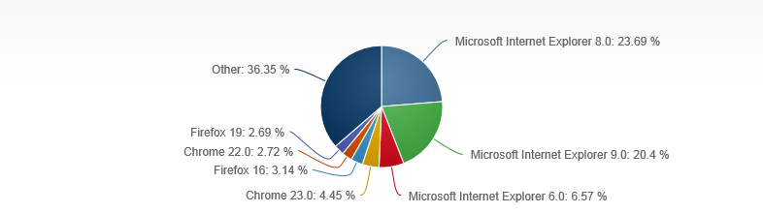
Web Browsers Market Shares
Web Browsers Market Share
  Net Market Share, http://www.netmarketshare.com/browser-market-share.aspx?qprid=2&qpcustomd=0
  Browser Statistics, http://www.w3schools.com/browsers/browsers_stats.asp

Slide 19
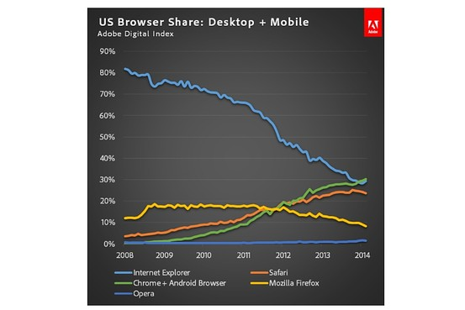
Web Browsers and Web Server Market Shares
Web Browsers Market Share
  Google Passes Microsoft in U.S. Browser Market Share, http://blogs.wsj.com/digits/2014/06/05/google-passes-microsoft-in-u-s-browser-market-share/

Slide 20
Web Server Market Shares
NetCraft May 2014 Web Server Survey, http://news.netcraft.com/archives/2014/05/07/may-2014-web-server-survey.html
  Microsoft threatening Apache’s market lead
  Total number of web sites
  Web server developers: Market share of all sites
  Web server developers: Market share of active sites
Server Hardware Stat (4Q13), http://www.gartner.com/newsroom/id/2671315
  HP 28.1%, IBM 26.5%, Dell 15.2%, Cisco 4.7%, Oracle 4.2%, other Vendors 21.3%.

Slide 21
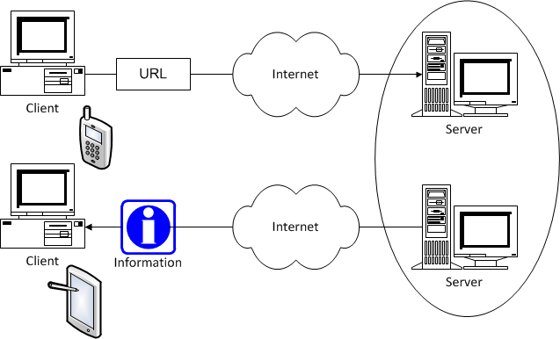
Web Client-Server Computing Model

Slide 22
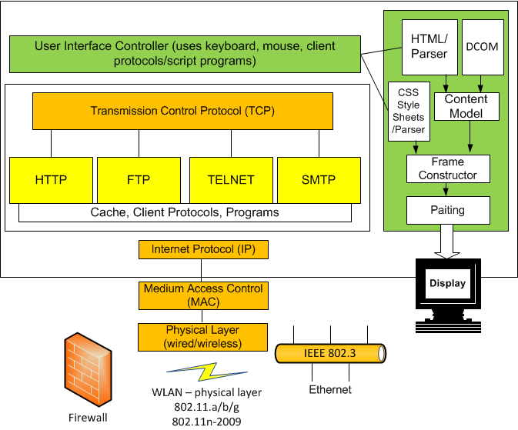
Web Browser and Supporting Protocols

Slide 23
Design & Build A Web Site
Web Site Design
  Types of Web Site: E-commerce, Business and Services, Topic sites, personal sites,
  System requirements – Analysis Phase
  Modular Design – Design Phase
    Presentation tier, Business logic tier, Data tier
  Web server
    Apache, IIS (Microsoft Internet Information Server), IBM WebShpere
  Application server
  Database server
  Application authoring and Programming Tools

Slide 24
Software for Web Site Design
HTML (HyperText Markup Language) Web page authoring
XML (eXtensible Markup Language) page authoring
Common Gateway Interface programming
Generating and parsing HTML and XML
Creating dynamic HTML pages
HTTP clients and server Apps
Web site management
Databases and Apps
Web applications

Slide 25
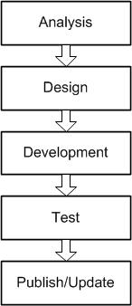
Design & Build An E-Commerce Site
Web Site Design
  Business and Services
  System requirements
  Modular Design
  Web server
  Database server
  Application server
  Programming Tools

Slide 26
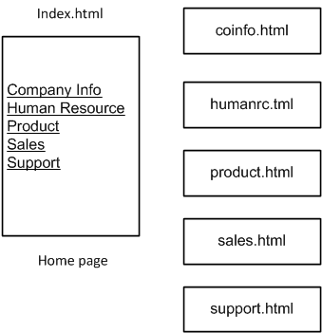
Design A Company Web Site

Slide 27
Summary

