Slide 1
CPET 499/ITC 250 Web Systems
Lecture 2
Web System Infrastructure and Protocols
(continue)
References: *Chapter 3. E-Commerce Infrastructure: The Internet, Web, and Mobile Platform of text book: e-Commerce: Business, Technology, and Society, 8th edition, 2012, by K. C. Laudon and C. G. Traver, publisher Pearson Education Inc.,
Paul I-Hai Lin, Professor
http://www.etcs.ipfw.edu/~lin
A Specialty Course for
M.S. in Technology IT/Advanced Computer Applications Program
Purdue University Fort Wayne Campus

Slide 2
Topics
Internet Network Architecture
Network Categories and Topologies
Web Infrastructure & Enabling Technologies
Web Client-Server Computing Model
Web Browser Architecture
Apache Web Server
Software Tools
An Introduction - Design & Build A Web Site
Common Gateway Interface

Slide 3
Internet Network Architecture
Backbone
High-bandwidth fiber-optic cable networks
Private networks owned by a variety of NSPs
Bandwidth: 155 Mbps–2.5 Gbps
Built-in redundancy
Internet eXchange Points (IXP)
Hubs where backbones intersect with regional and local networks, and backbone owners connect with one another
Campus Area Networks
LANs operating within a single organization that leases Internet access directly from regional or national carrier

Slide 4
Internet2 100 Gigabit Network
Internet2 Network, http://www.internet2.edu/network/

Slide 5
High-Speed Optical Bandwidth Standards
TI 1.544 Mbps
T3 43,231Mbps
OC-3 155 Mbps
OC-12 622 Mbps
OC-48 2.5 Gbps
OC-192 9.6 Gbps

Slide 6
ISP Service Levels and Bandwidth Choices (speed to desktop)
Telephone modem 30-56 Kbps
DSL 768 Kbps-7 Mbps
Cable Modem 1 Mbps – 20 Mbps
FiOS 15 Mbps – 50 Mbps
Satellite 768 Kbps- 5 Mbps
T1 1.54 Mbps
T3 45 Mbps

Slide 7
Categories of Network
Local Area Network (LAN)
Data rates: 2 Mbps, …, 10 Mbps, 100 Mbps, Gigabits
Metropolitan Area Network (MAN)
City wide coverage
Free WiFi Hotspots in Fort Wayne, http://www.openwifispots.com/city_free_wifi_wireless_hotspot-Fort_Wayne_IN.aspx#41.076945,-85.133966,14
Hong Kong Government Wi-Fi Progamme, http://www.gov.hk/en/theme/wifi/program/index.htm
Taipei expands coverage of free wireless service, http://www.taipeitimes.com/News/taiwan/archives/2011/10/01/2003514656
2,000 access points, min 512kbps connection speed

Slide 8
Wireless Internet Access Technology
WiFi (IEEE 802.11 a/b/g/n)
300 ft/11-70 Mbps
WiMax (IEEE 802.16)
30 miles/50-70 Mbps
Bluetooth (wireless Personal Area Network)
1-30 meters/1-3 Mbps
Ultra-Wideband (UWB) – wireless personal area network:
30 ft/5-10 Mbps
Intel UWB technology, http://www.intel.com/technology/comms/uwb/download/Ultra-Wideband.pdf
WiMedia Alliance, http://www.wimedia.org/en/index.asp
ZigBee (wireless personal area network)
30 ft/250 Kbps

Slide 9
Web Infrastructure & Enabling Technologies
Computing Architecture/Systems:
Client/Server Computers
Cloud computing
Mobile devices: Smartphone, Tablet, iPad
Web servers
Wired/Wireless Network protocols: TCP/IP, 802.11a/b/g/n, etc
Web Languages:
HTML, CSS, XML
Programming Languages
Client side: Javascript, Ajax (Asynchronous JavaScript and XML), Flash; Plug-ins and Filters
Server side: Java Servlets, Server Pages.NET, PHP, Perl, Ruby, Rails

Slide 10
Web Client-Server Computing Model

Slide 11
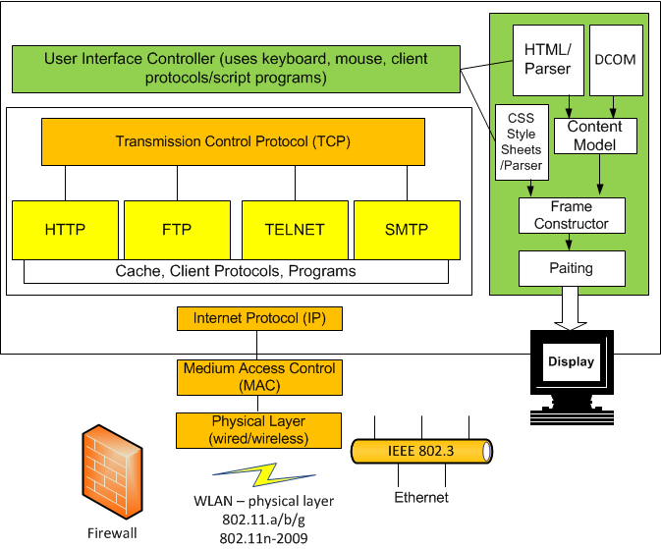
Web Browser Architecture

Slide 12
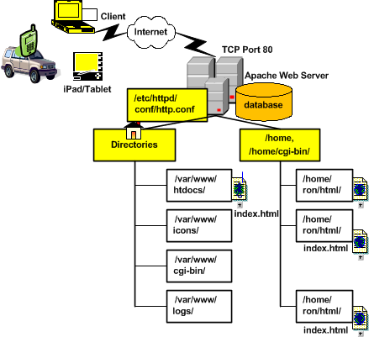
An Apache Web Server

Slide 13
Software Tools: W3C Standards
W3C Standards, http://www.w3.org/
Web Design and Applications, http://www.w3.org/standards/webdesign/
HTML & CSS, JavaScript Web APIs, Graphics, Audio and Video
Accessibility, Internationalization, Mobile Web, Privacy
Web Architecture, http://www.w3.org/standards/webarch/
Architecture Principles; Identifiers: URL, URI, IRI; Protocols: HTTP, XML, SOAP (Simple Object Access Protocol), etc
XML Technology
Semantic Web
Web of Services
Web of Devices
Browsers and Authoring Tools

Slide 14
Design & Build A Web Site
Web Site Design
Business and Services
System requirements – Analysis Phase
Modular Design – Design Phase
Presentation tier, Business logic tier, Data tier
Web server
Apache, IIS (Microsoft Internet Information Server), IBM WebShpere
Application server
JBoss, Tomcat, Oracle WebLogic
Database server
Application authoring and Programming Tools

Slide 15
Software for Web Site Design
HTML (HyperText Markup Language) Web page authoring
XML (eXtensible Markup Language) page authoring
Common Gateway Interface programming
Generating and parsing HTML and XML
Creating dynamic HTML pages
HTTP clients and server Apps
Web site management
Databases and Apps
Web applications

Slide 16
Software Tools
HyperText Markup Language
HTML 4.01 Specifications, http://www.w3.org/TR/html4/
XHTML2 Working Group, http://www.w3.org/MarkUp/
HTML5, A vocabulary and associated APIs for HTML and XHTML, W3C, http://dev.w3.org/html5/spec/Overview.html
HTML5 and Web Standards, Apple – HTML5, http://www.apple.com/html5/
Java Applet, Java Servlet, JSP
JavaScript/Jscript

Slide 17
Software Tools
HTML
Java Applet, Java Servlet, JSP
JavaScript/Jscript
AJAX (Asynchronous JavaScript and XML)
Microsoft AJAX Overview, http://msdn.microsoft.com/en-us/library/bb398874.aspx
Microsoft ASP.NET – AJAX: Enhanced Interactivity and Responsiveness, http://www.asp.net/ajax
AJAX Programming, http://en.wikipedia.org/wiki/Ajax_%28programming%29
Perl (Practical Extraction and Report Language)
The Perl Programming Language, http://www.perl.org/
ActivePerl, http://www.activestate.com/activeperl

Slide 18
Software Tools
JavaScript
Client-Side JavaScript References, http://docs.oracle.com/cd/E19957-01/816-6408-10/
JavaScript.com, http://www.javascript.com/
Building your first Windows Metro Style App using JavaScript, Microsoft, http://msdn.microsoft.com/en-us/library/windows/apps/br211385.aspx

Slide 19
Design & Build An E-Commerce Site
Web Site Design
Business and Services
System requirements
Modular Design
Web server
Database server
Application server
Programming Tools

Slide 20
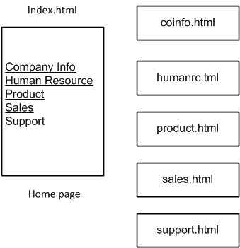
Design A Company Web Site

Slide 21
Software Tools
AJAX (Asynchronous JavaScript and XML)
ASP.NET AJAX 2.0 download, http://www.microsoft.com/download/en/details.aspx?displaylang=en&id=971
Microsoft AJAX Overview, http://msdn.microsoft.com/en-us/library/bb398874.aspx
Microsoft ASP.NET – AJAX: Enhanced Interactivity and Responsiveness, http://www.asp.net/ajax
AJAX Programming, http://en.wikipedia.org/wiki/Ajax_%28programming%29

Slide 22
Software Tools
PHP (Hypertext Processor)
PHP, http://www.php.net/
PHP Manual, http://php.net/manual/en/index.php
What is PHP? http://www.php.net/manual/en/intro-whatis.php
What can PHP do?
Server-side scripting
Command line scripting
Writing desktop applications

Slide 23
Software Tools
Java Applet, Oracle – Sun Developer Network (SDN), http://java.sun.com/applets/
Lesson: Java Applets, http://docs.oracle.com/javase/tutorial/deployment/applet/
Applets Demos, http://docs.oracle.com/javase/1.5.0/docs/relnotes/demos.html
Java Plugin Technology, http://www.oracle.com/technetwork/java/index-jsp-141438.html
Java Servlet
Java Servlet Technology Tutorial, http://java.sun.com/j2ee/tutorial/1_3-fcs/doc/Servlets.html
Apache Tomcat, http://tomcat.apache.org/
Java Servlet
JavaServer Pages

Slide 24
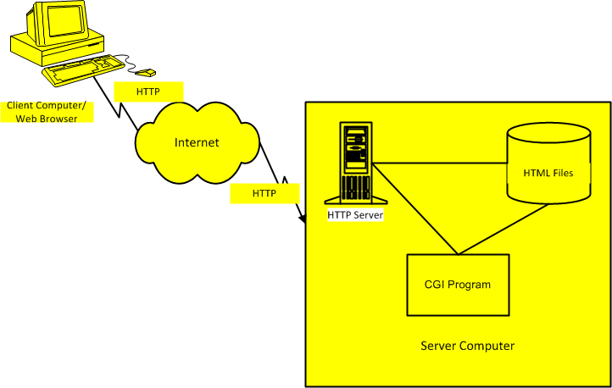
Common Gateway Interface

Slide 25
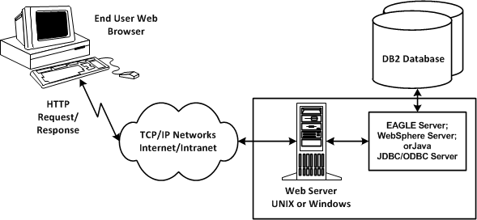
Database Server Interface

Slide 26
Summary

