Slide 1
Clash of Clans Wiki
Adam Flagg

Slide 2
Summary
This website will help players focus on specific areas of the game, as upgrading costs time and in-game resources. The website will give players the ability to plan there next major upgrades, and attack and defense strategies. This website will hopefully give the players an advantage when playing.
This project will be a multipage website that people can view using most web browsers and computer systems. I will be using Apple’s Safari and OSX during testing and use Text Wrangler for HTML editing. I plan on creating the website over a few week period, which will allow me to continue to think of new and different ideas for the page.

Slide 3
Project Schedule

Slide 4
Project Schedule

Slide 5
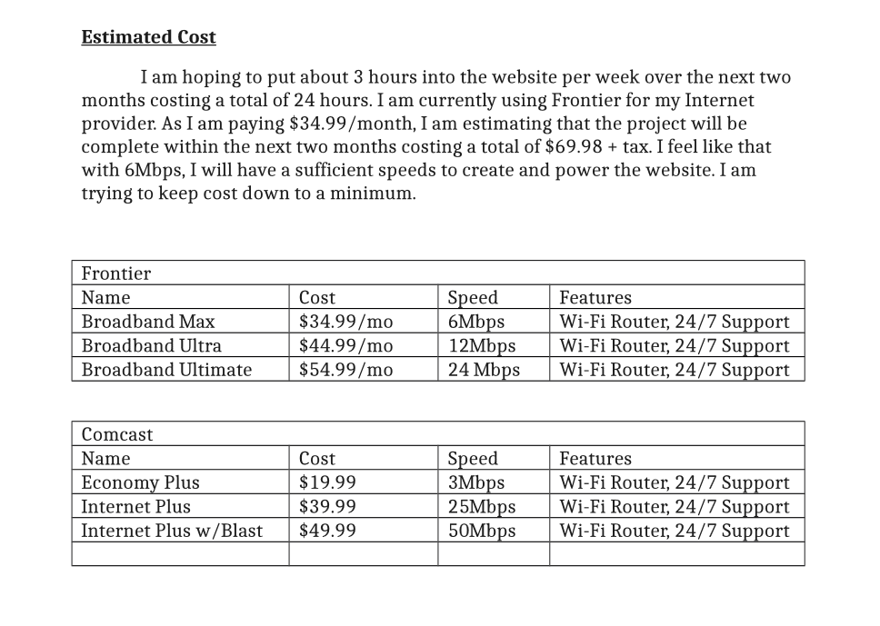
Cost

Slide 6
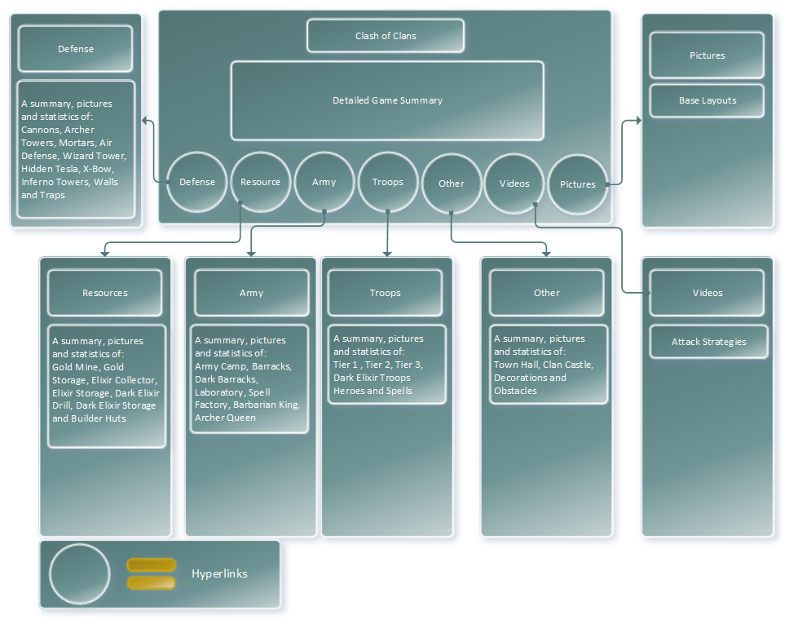
Web System Design- Homepage

Slide 7
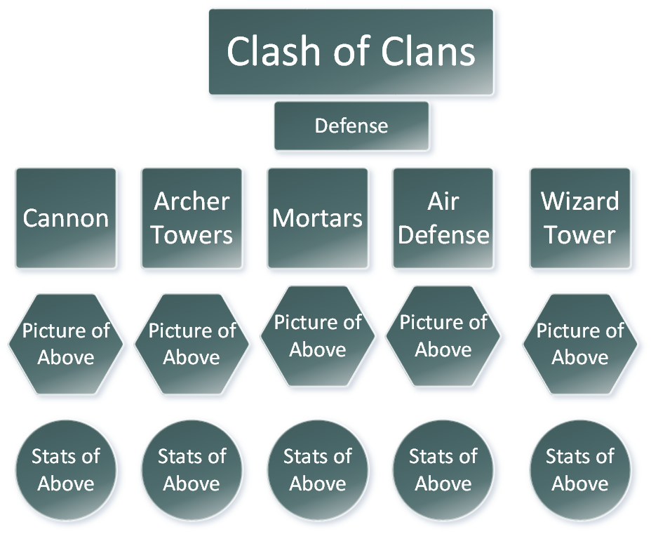
Defense Hyperlink

Slide 8
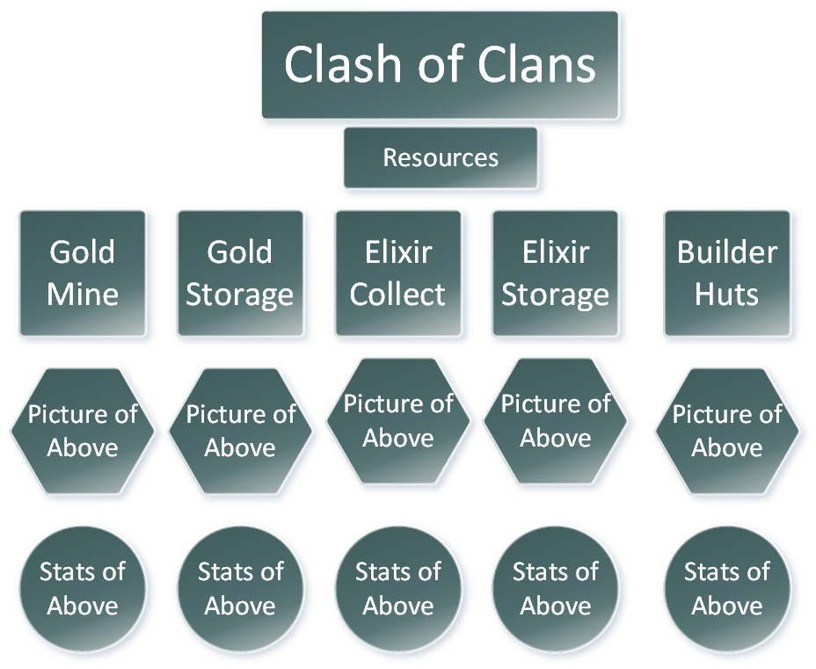
Resources Hyperlink

Slide 9
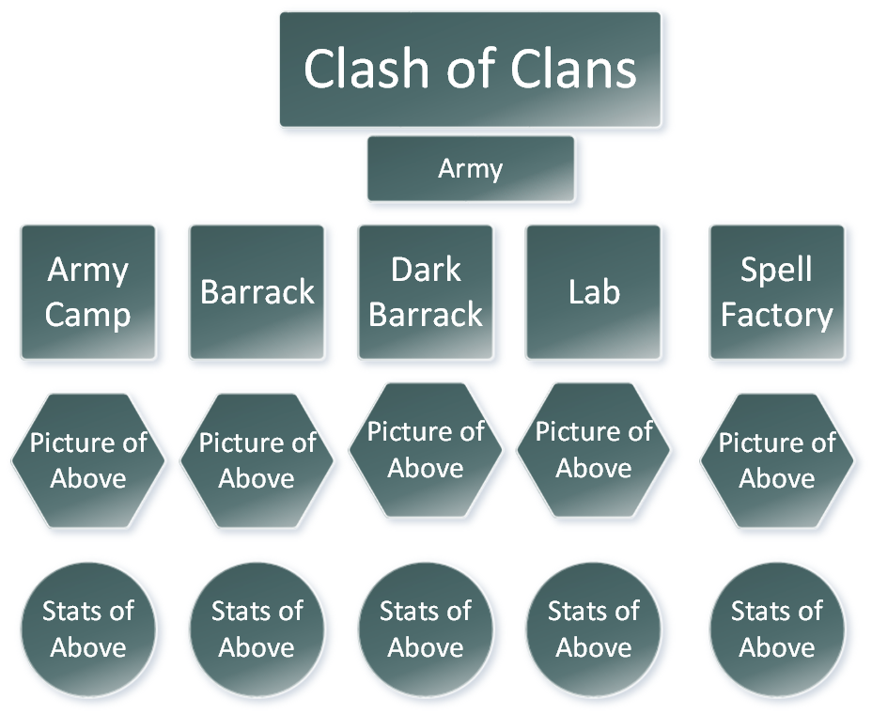
Army Hyperlink

Slide 10
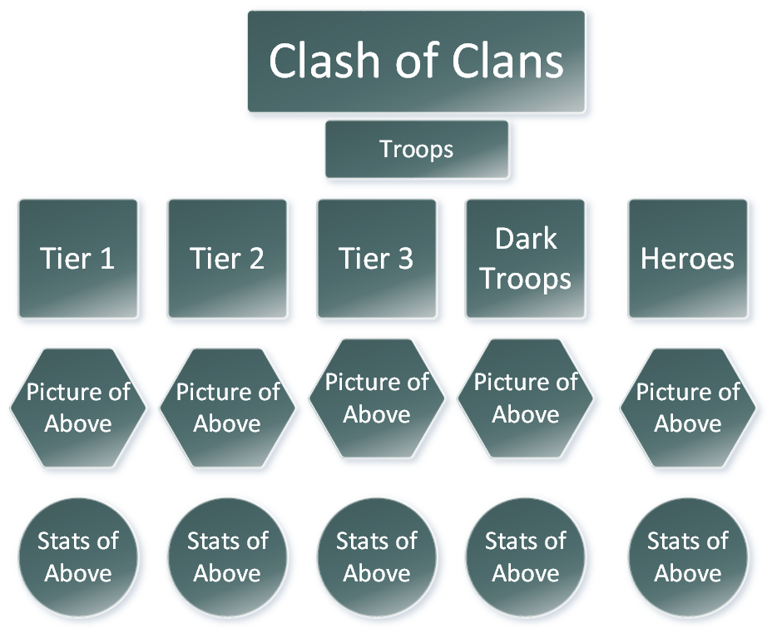
Troops Hyperlink

Slide 11
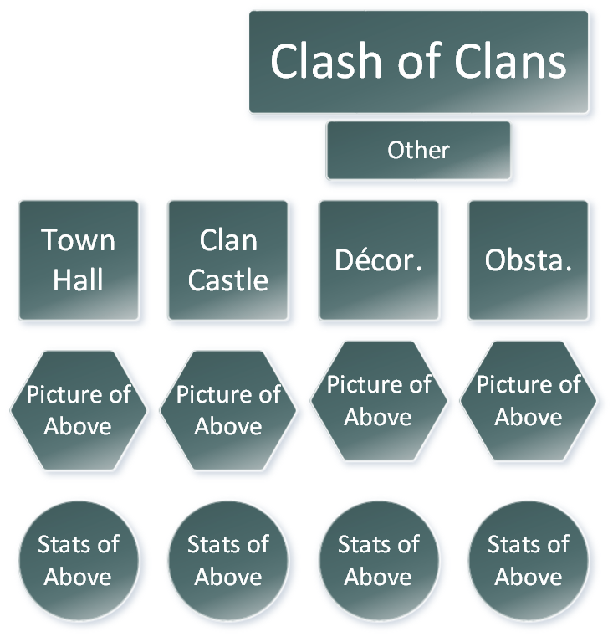
Other Hyperlink

Slide 12
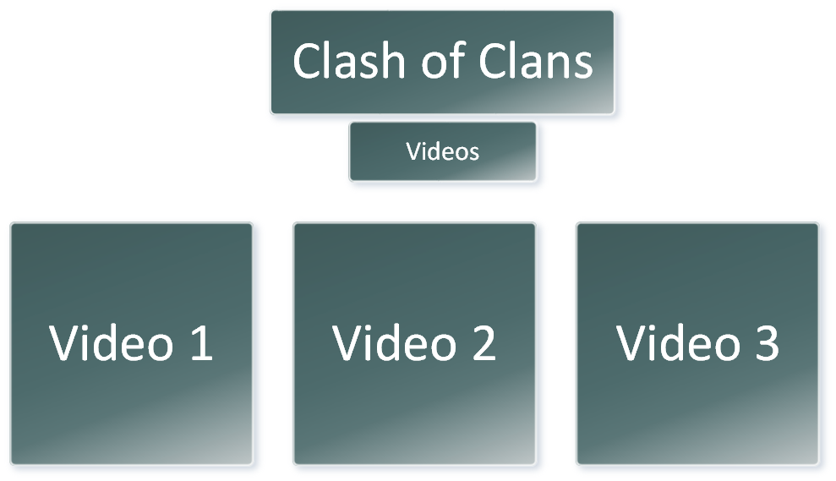
Videos Hyperlink

Slide 13
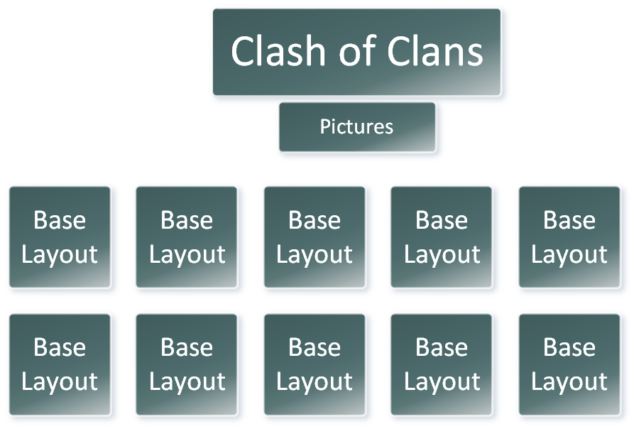
Pictures Hyperlink

Slide 14
The End

