Slide 1
ITC250 HW8 Final Project System Characteristics
David Rash | Chris Meisner
11-4-14

Slide 2
Executive Summary
The company that David works for, Overman Telephone Services, caters to a client-base of several thousand businesses in the Northeast Indiana area. OTS has a fully dedicated mobile technician fleet and is a gold partner with several of the vendors they sell. Their website, however, is very underdeveloped.
Our project is to create a functional and appealing website which reflects the quality and type of service OTS provides. This could improve customer relation and increase their legitimate web presence.

Slide 3
Project Schedule

Slide 4
System Design
The system will produce a relatively simple web layout that describes the services OTS offers, and how the potential customer can benefit from their support.
Functionally, the website must be fast and free of unnecessary graphics and distracting objects.
Because it is an informational website, JavaScript and other scripting is widely unnecessary, but may be included at OTS’ discretion.

Slide 5
System Design
System Requirements (User Interface):
The website must be fast and easy to navigate.
The website must be free from unnecessary graphics and superfluous “fluff” information.
The website must be visually appealing and use original or royalty-free images.
The website must use “web-safe” designs, that render properly on all modern browsers.

Slide 6
System Design
System Requirements (Technical):
The website will utilize on OTS’ domain.
The website will be hosted using OTS’ current service (Homestead Hosting).
The website does not require server or client-side extensions.
The website does not receive large traffic volumes, and is likely suitable running with the webserver’s minimum requirements (IIS 7.5)

Slide 7
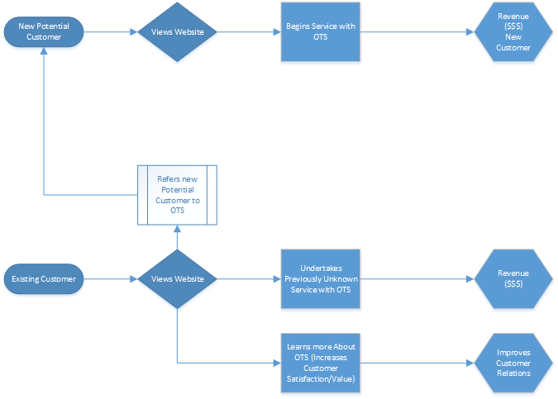
System Design
System Requirements (Process Logic):

Slide 8
System Design
Major Components:
Homepage
Introduction
Services
Services Offered
Potential Flash/Image Rotation
Products
Manufacturers / Products Offered
About Us
Brief company history
Contact
Contact Details / Location
Potential Automated Email Form

Slide 9
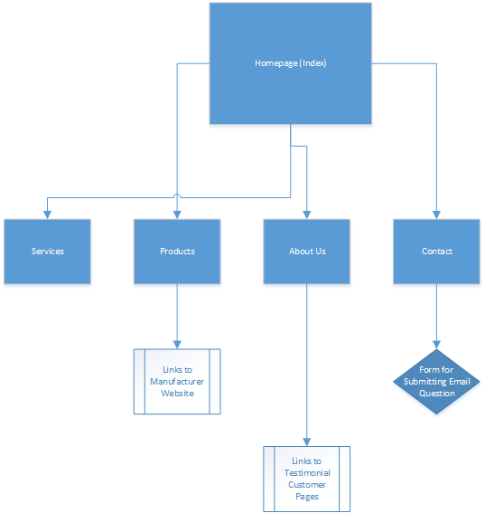
System Design

