Slide 1
Lawn Care Website Demonstration
Drew Baumgartner

Slide 2
Goals
This project is designed to create a simple website for a lawn care company.
It will simulate the ability for a user to log in as an existing customer or create an account as a new customer.
It will also provide an interactive webpage that users can view the available services offered by the lawn care company.
The list of services page will feature information about the selected service and provide details about the type of chemical being applied.

Slide 3
Main Tasks
The main tasks are to design and implement the 4 web pages that form the complete website (Main page, new customer creation, existing customer login, and list of services).
Main Tasks
Schedule | Time
Design main web page (Home screen) | 1 week
Design available services web page | 2 weeks
Design existing customer login page | 1 week
Design new customer creation page | 1 week
Project report & presentation slides | 1 week

Slide 4
Sub Task (Main Page)
The main page design and implementation should take the least amount of time as it will just have links directing the user to the other core parts of the webpage.
The main page will also display a simple “About Us” information page.
Sub Tasks (Main Page)
Schedule | Time
Design the layout and color scheme | 2 days
Design links to other pages | 2 days
Design an "About Us" page | 2 days
Buffer time | 1 day

Slide 5
Sub Task (List of services page)
This subtask provides details about implementing the interactive list of lawn care services page.
Sub Tasks (Available Services Page)
Schedule | Time
Create a list of available services | 1 day
Design an interactive list of services | 5 days
Buffer time | 1 day

Slide 6
Sub Task (Existing customer login)
This subtask will detail how I plan to design a login screen for existing customers.
Sub Tasks (Existing Customer Page)
Schedule | Time
Design GUI for existing customer login | 2 days
Design the login code for GUI | 5 days

Slide 7
Sub Task (New customer creation)
This last subtask will be for new customers to create their own login information.
Sub Tasks (New Customer Page)
Schedule | Time
Design GUI for new customer creation | 2 days
Implement server side code to receive information | 5 days

Slide 8
Webpage Example Diagram
The website will feature a navigation bar that will stay the same across all webpages to give the user easy access to navigate to a specific page no matter where they are within the website.
The website will also have similar color schemes of varying shades of green throughout the website. I have not decided which color to make the text or the exact GUI design.

Slide 9
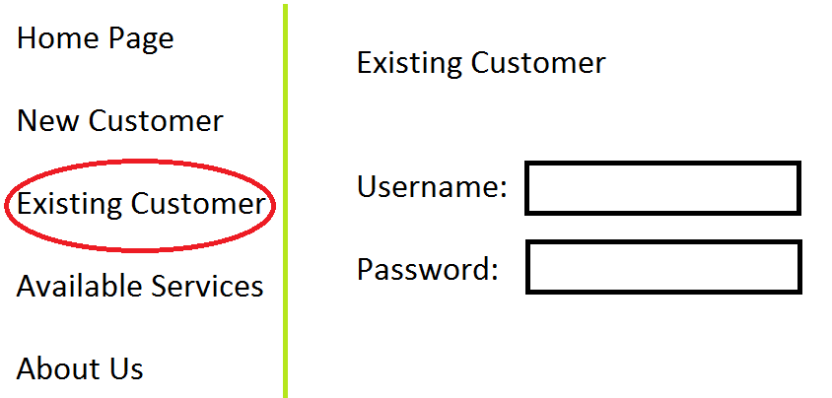
Webpage Example Design
This picture is an example of a user accessing the existing customer login page. Notice the navigation bar will be on the left side of the screen. If a user navigates to the list of services page, the navigation bar will still remain in the same place.

Slide 10
Server Requirements
I will simply be hosting this website on my local computer using the XAMPP Apache web server, therefore the requirements will be 1 Windows 7 PC.
I do plan on testing the webpage in multiple web browsers but I expect it to function just fine regardless of browser that is being used.

Slide 11
Types of Data
I plan on using documents and webpages as the primary means of displaying data to the user.
The list of services webpage will contain one picture per product and/or service provided and maybe a few videos of the application process.
The list of services webpage will also list the EPA numbers and rates of the specific products being applied.
To keep it simple and to make sure that I can finish the project in time there will be no database structure of any kind. I plan on completing the webpage using only HTML, JavaScript, PHP, and if possible Perl/XML.

Slide 12
Cost and Time
I expect this website to take roughly 4-5 weeks to develop. I plan on spending about 40-50 hours to complete this website.
The cost should be $0.00 as I plan on using the XAMPP client to locally host the website.

