Slide 1
ITC 250/CPET 499 Web System Project
Instructor: Paul Lin
Presenter: Don Ohlwine

Slide 2
Overview
Objective
Scope
Project Schedule
System Design
Functional Description
System requirements
User Interface
Server System Requirements
Process Logic
Major Components
System Infrastructure
System Interaction

Slide 3
Objective:
Design, build, and test a prototype of a simple ecommerce website.
The finished website will allow the user to view products, make product selections for purchase, and collect payment information when the user is ready to make purchase.

Slide 4
Overview
Objective
Scope
Project Schedule
System Design
Functional Description
System requirements
User Interface
Server System Requirements
Process Logic
Major Components
System Infrastructure
System Interaction

Slide 5
SCOPE:
That which will be included:
Design of an ecommerce webpage using Netbeans (an open source software package).
Design of an ecommerce server using XAMPP (another open source software package).
Design of a ecommerce database using MySQL (if time permits).
Testing of site by simulating a customer visiting the site from the web.
Writing a report of the project’s results.
Giving a presentation of the project’s results.

Slide 6
Scope (continued)
That which will not be included:
Accessing the Ecommerce site from outside of the local (home) network.
Actual financial transactions (credit card or other payment forms) being processed.

Slide 7
Overview
Objective
Scope
Project Schedule
System Design
Functional Description
System requirements
User Interface
Server System Requirements
Process Logic
Major Components
System Infrastructure
System Interaction

Slide 8
Project Schedule

Slide 9
Overview
Objective
Scope
Project Schedule
System Design
Functional Description
System requirements
User Interface
Server System Requirements
Process Logic
Major Components
System Infrastructure
System Interaction

Slide 10
System Design

Slide 11
Overview
Objective
Scope
Project Schedule
System Design
Functional Description
System requirements
User Interface
Server System Requirements
Process Logic
Major Components
System Infrastructure
System Interaction

Slide 12
Functional Description
The Ecommerce site will:
Allow visitor (customer) to view the sites home webpage
Allow visitor to select items and quantities
Upon a visitor’s request to purchase an item(s), the site will record the request details and if sufficient quantities are in stock the site will request payment details
For items with insufficient quantities in stock, an “out of stock” or “partial quantity available” message will be sent to the customer
For partial quantities available, ask customer their preference from the following:
Accept reduced quantity to amount in stock
Back order item(s) not in stock
Cancel request for this item
For all items in stock, a confirmation of the sale will be sent to the customer

Slide 13
Functional Description (continued)

Slide 14
Overview
Objective
Scope
Project Schedule
System Design
Functional Description
System requirements
User Interface
Server System Requirements
Process Logic
Major Components
System Infrastructure
System Interaction

Slide 15
System Requirements
The main Ecommerce webpage shall be sent to website visitor upon request
The Ecommerce website shall record the customer’s purchase request details
The Ecommerce website shall send the customer confirmation of purchase details
The Ecommerce website shall update the site’s product database (e.g. reduce quantities of items sold)

Slide 16
User Interface
Laptop computer
LAN connection
Web browser
Internet Explorer
Firefox

Slide 17
Server System Requirements
The Apache server and MySQL requirements are as follows:
Operating System:
Windows 7
Windows 8
Windows Vista
Hard drive (total):
480 Mb

Slide 18
Process Logic

Slide 19
Overview
Objective
Scope
Project Schedule
System Design
Functional Description
System requirements
User Interface
Server System Requirements
Process Logic
Major Components
System Infrastructure
System Interaction

Slide 20
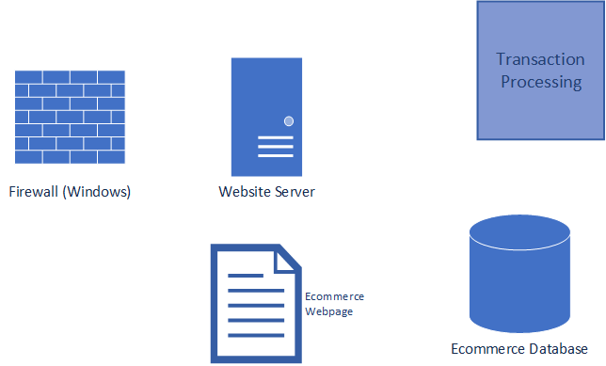
Major Components
Ecommerce Website

Slide 21
Overview
Objective
Scope
Project Schedule
System Design
Functional Description
System requirements
User Interface
Server System Requirements
Process Logic
Major Components
System Infrastructure
System Interaction

Slide 22
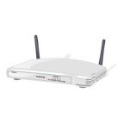
System Infrastructure
LAN Layout
ISP and Internet
Cable Modem
Coax cable
Wired connections
Ethernet cable (cat. 5)
Wireless Router
Wireless connection
Laptop
Desktop
Computer

Slide 23
Overview
Objective
Scope
Project Schedule
System Design
Functional Description
System requirements
User Interface
Server System Requirements
Process Logic
Major Components
System Infrastructure
System Interaction

Slide 24
System Interaction

Slide 25
Conclusion

