Slide 1
The Entertainment Website
By: Troy Waidelich, Andrew Inherst, Jason Arango
Professor Lin
12/5/2015
Notes:
Jason

Slide 2
LOGO!
Notes:
FUN-TANE-E-UM

Slide 3
Outline
Executive Summary
Problem and Solutions
Technology Used
Notes:
Jason

Slide 4
Outline Cont.
Purpose
Layout
Task List
Schedule
Notes:
Drew

Slide 5
Executive Summary
Entertainment Website
Educational / Informative
Simple / Ad Free
Random Post
Lack of middle
Notes:
Troy

Slide 6
Problem
Sporadic
Lack of educational info
Riddled with Ads
Small audience
Notes:
Jason

Slide 7
Solution
Organized material
Educational info with entertainment
No ads
Wider audience
Notes:
Drew

Slide 8
Technology Used for Implementation
Coding
HTML
PHP
Javascript
CSS
Notes:
Troy

Slide 9
Technology Used for Implementation
Programs
Microsoft Expression Web 4
XAMPP Web Server
Mozilla Firefox
Google Chrome
Internet Explorer
Notes:
Jason

Slide 10
Purpose
Simple page to navigate through while being entertained
Wide range of subjects and ideas
Obtain more experience with HTML, PHP, CSS and Javascript
Have access to free information.
Notes:
Drew

Slide 11
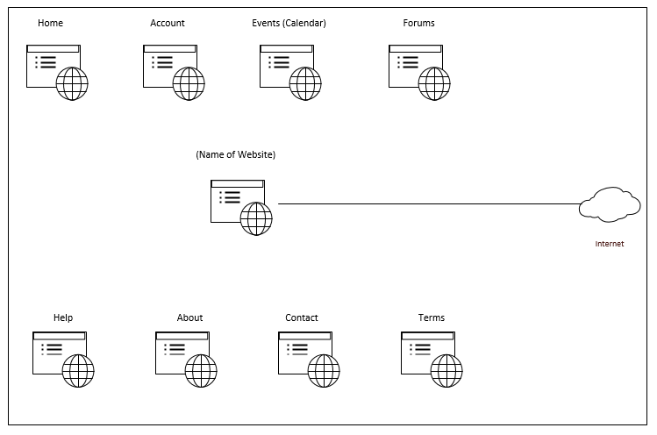
Initial Layout
Notes:
Drew

Slide 12
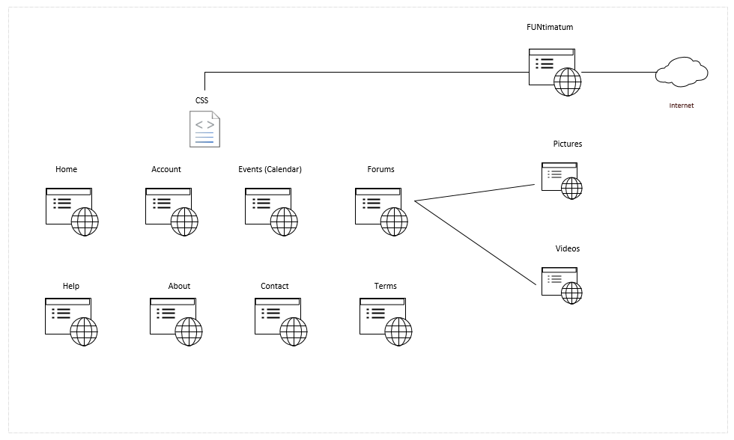
Final Layout
Notes:
Drew

Slide 13
Task List
Determine type of website / Research similar
Research PHP, HTML, Javascript
Create CSS layout for site
Create unique content
Format and implement content
Test site on multiple web browsers
Continuously research improvements
Notes:
Troy

Slide 14
System Analysis / Design
Interactive website
Intended for desktop / tablet viewers
Incorporate database
Forums
Seek feedback
Notes:
Jason

Slide 15
System Integration / Testing
Build page
Insert content
Test in browser
Backup content
Notes:
Drew

Slide 16
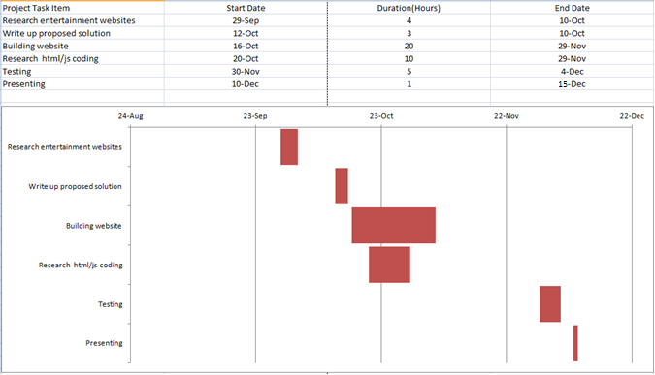
Schedule
Notes:
Troy

Slide 17
Cost
Total Hours: 52
Notes:
Jason

Slide 18
Conclusion
Avoid mixing HTML and PHP code
Keep files/folders well organized
Document steps and solutions
Get feedback
Test, test, test
Notes:
Drew

Slide 19
Questions?
Notes:
Troy

Slide 20
Demonstration
Notes:
Jason

