Slide 1
Mastodon Gamezone
By: Kevin Hjelm and Zack Mezera
Instructor: Paul Lin
12-15-15

Slide 2
Introduction
We are individuals who are into gaming. Whether that be FPS, MOBA, MMO, or Fighting.
Goal: Create a website dedicated to these genres and have the ability to watch and learn about these games.
With the right login credentials, you’ll have access to this site.

Slide 3
Executive Summary
The website we created will allow the user to pick a genre of game and then choose a game within the genre to learn about. There will be three different games within the genre that we felt are popular within the industry of gaming. After choosing the game the user will be able to read a brief history of the game and how the game works. There will also be pictures and a link to the game’s stream.

Slide 4
System/Hardware Requirements
You wont need a high end machine to access this website. Although there are a couple things that we could suggest that you have in order to use our website smoothly.
Have Core 2 duo or better
2 GB of RAM or more
80 GB HDD or better
On board graphics or better
Updated Flash and Java
Using Chrome or Firefox

Slide 5
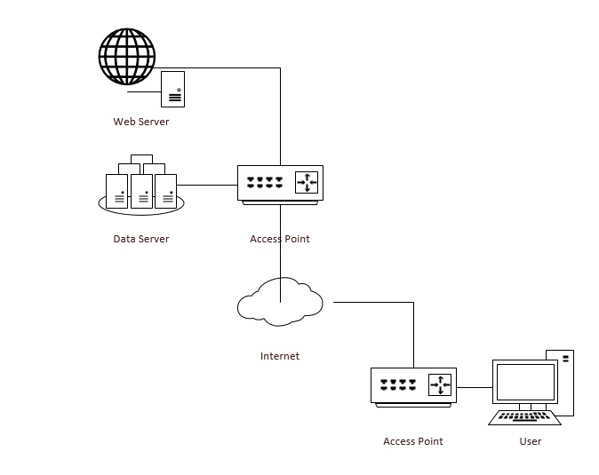
System Software/Hardware Design

Slide 6
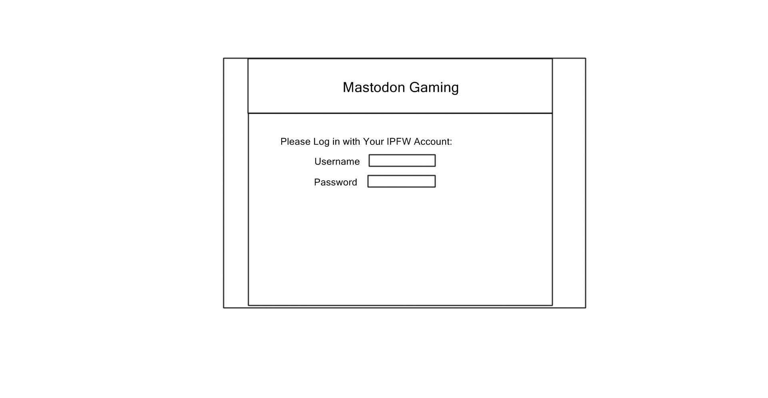
Login Page

Slide 7
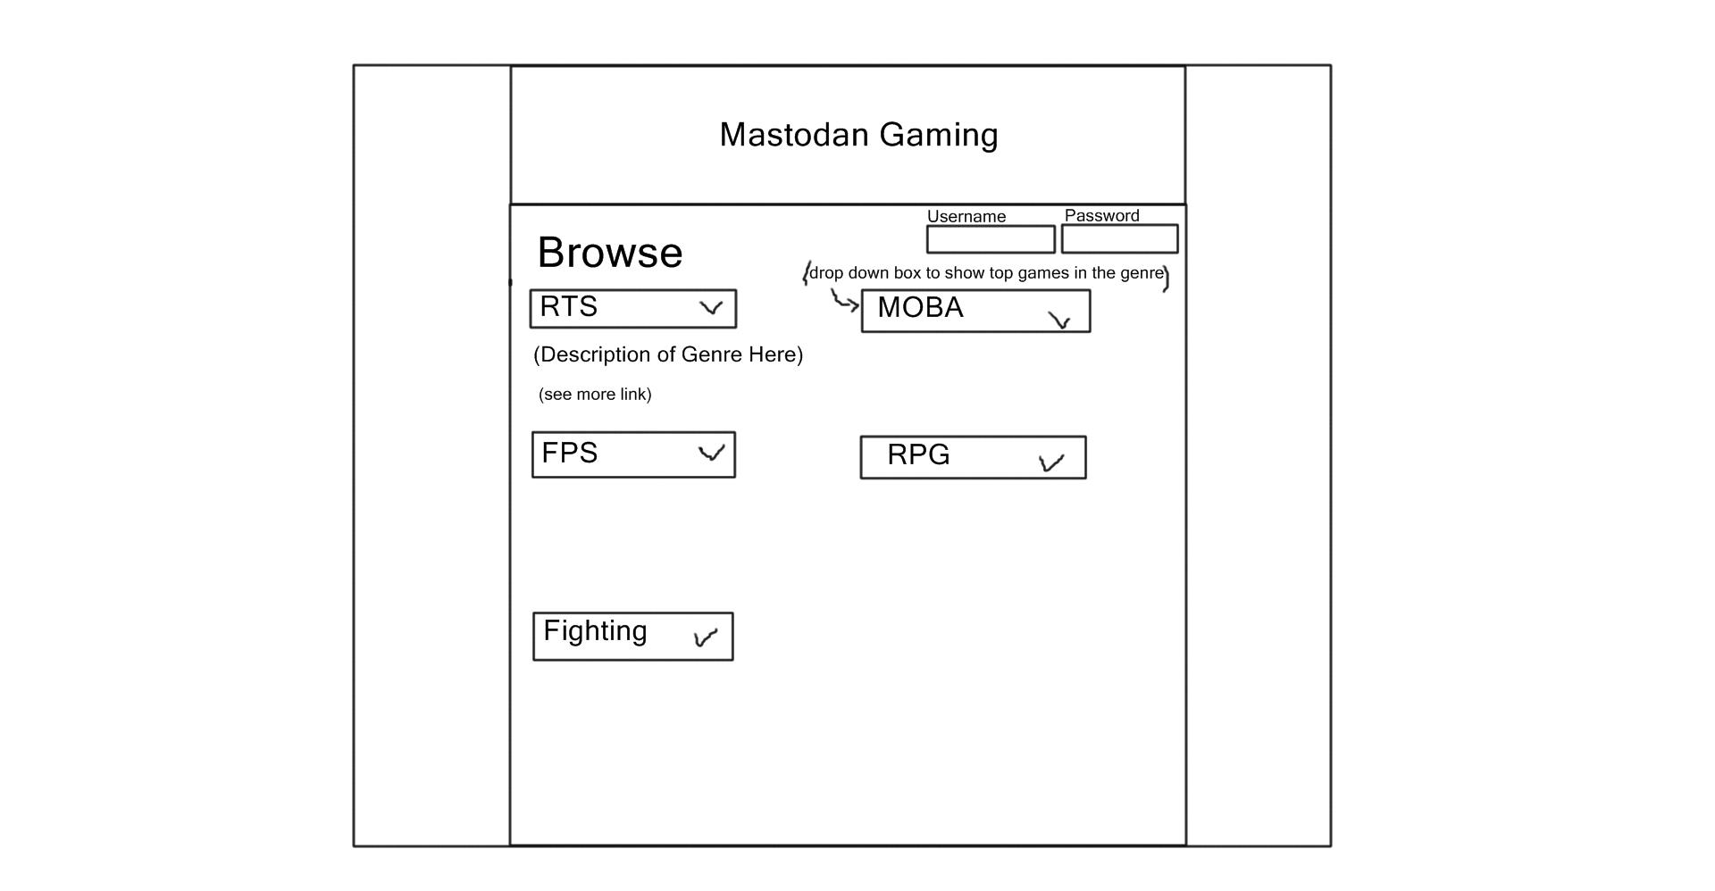
Main Page

Slide 8
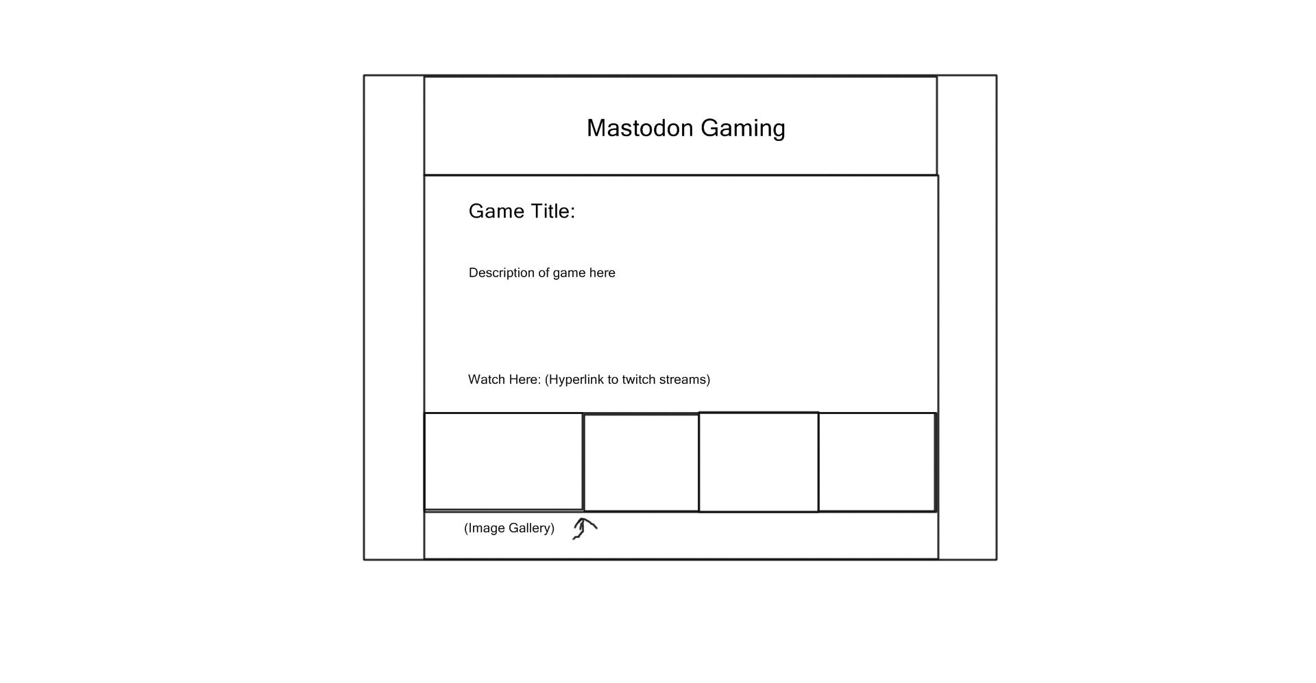
Game Page

Slide 9
PHP My Admin
The first step to creating the database and table was to log into the PHP MyAdmin. To get to this, click on the admin button in XMAPP.

Slide 10
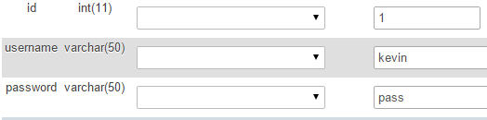
Setting Up The Database
Started with creating a table called users and making 3 different rows. One called username, password, and ID. We made the username and password both varchar and the id INT. We also made the ID PRIMARY and Auto Increment.
We filled the rows with the username and password. Those will be the login credentials for the website.

Slide 11
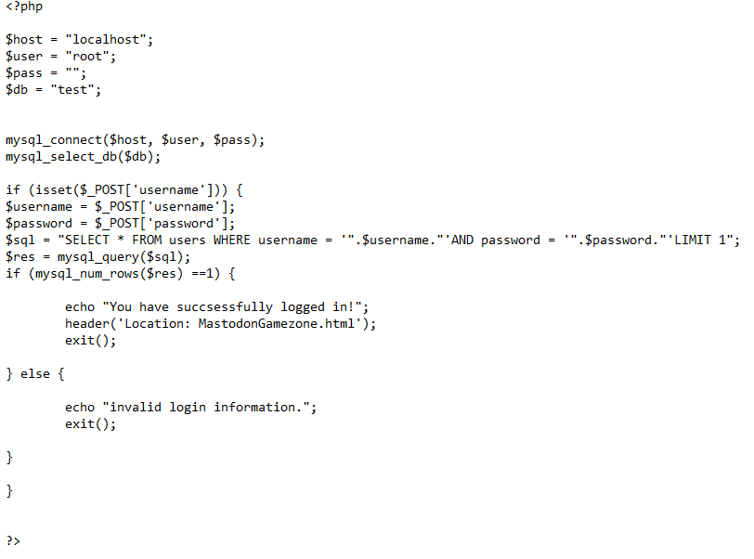
The Code For DB and Login

Slide 12
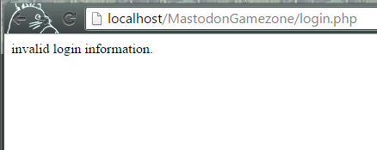
Testing the Code
The way we coded the login page was pretty simple. The code would throw an error if the wrong credentials were put in, or if nothing was put into the textboxes at all.

Slide 13
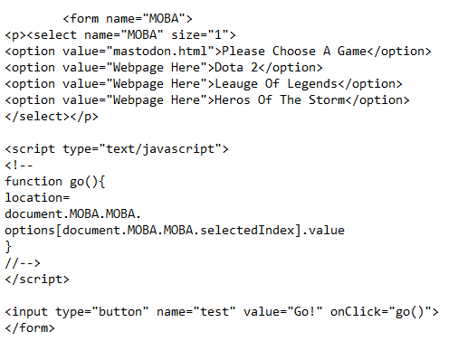
Testing The Code
At first, the code we had for the main page would only allow us to get into the fighter genre of gaming. Anytime we tried to get into another genre, it would throw an error. This is the code design we had at first.

Slide 14
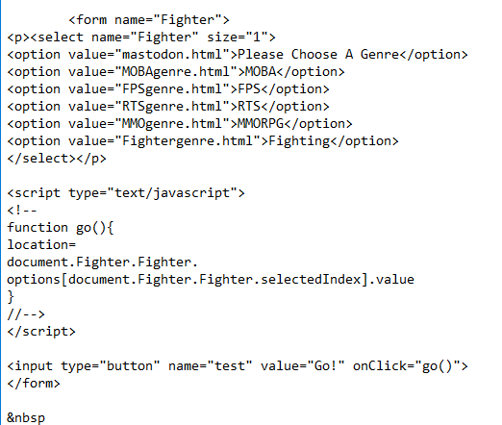
Fixed Main Page
Here is the code that fixed the issue of us not being able to access the other games in different genres. We had to add one more step in the process, but after adding it in, we thought it better suited the website.

Slide 15
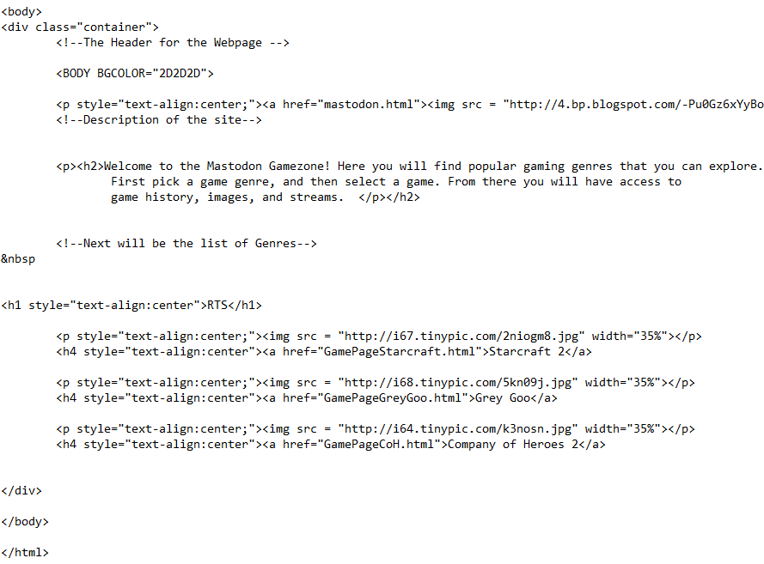
Updated Genre Code
Here we updated the code for the genres to fit the new design of the main page.

Slide 16
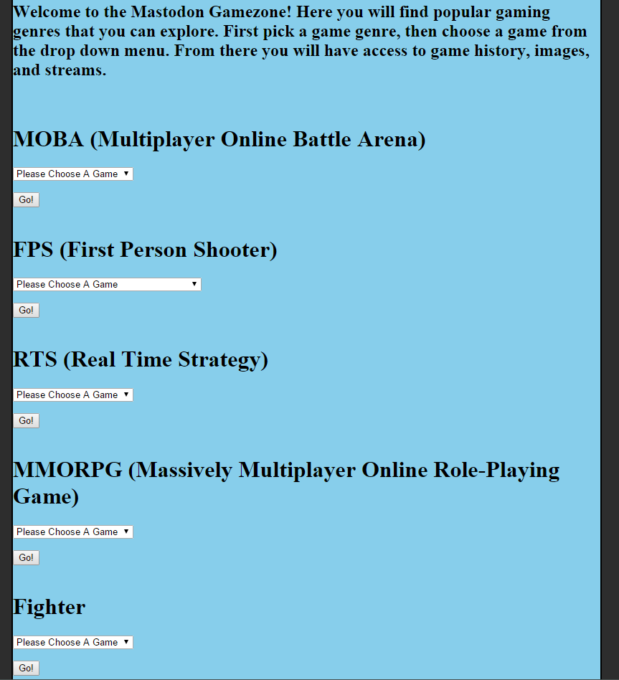
Error Version

Slide 17
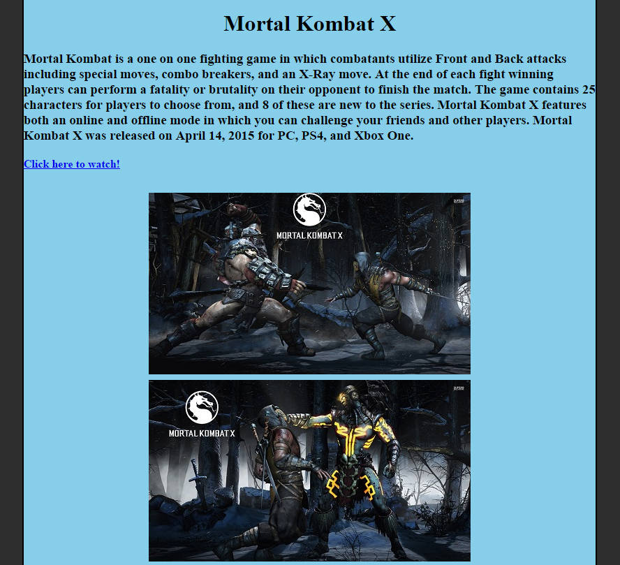
Error Version

Slide 18
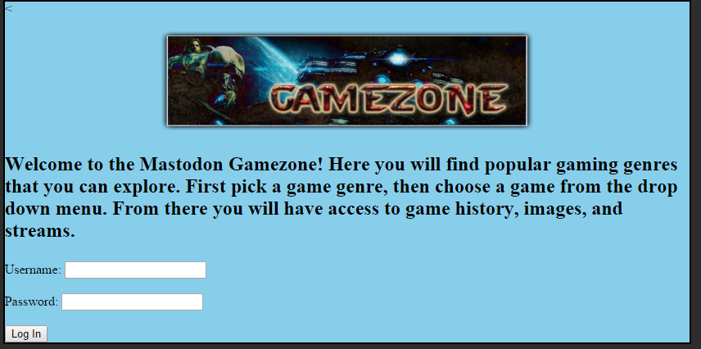
Final Version

Slide 19
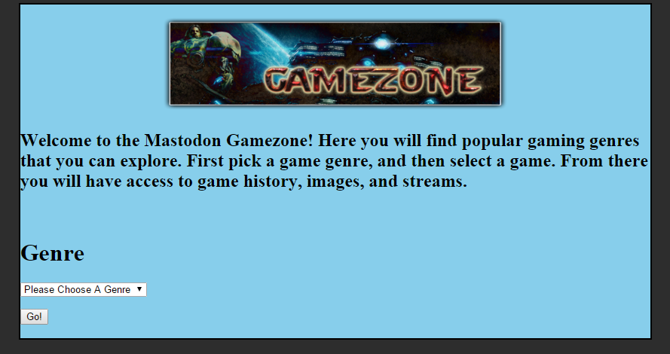
Final Version

Slide 20
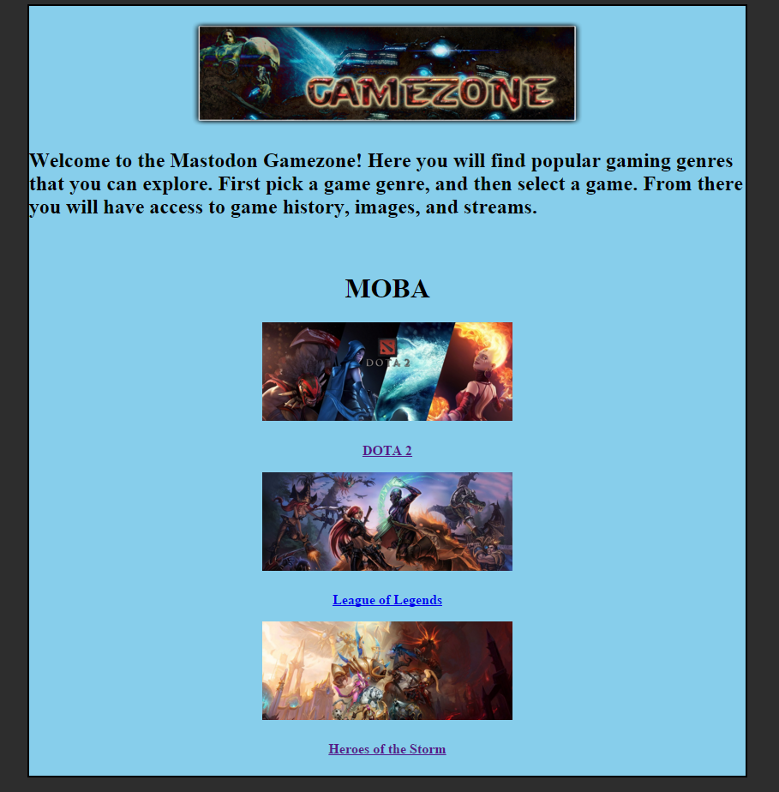
Final Version

Slide 21
Conclusion
This project was a great way to display the fundamentals we have learned over the semester. For Zack and me, we stressed our project over HTML, CSS, and PHP. We had never dug this deep into making a website like this before. It was a challenge for both of us. There were late nights, head-throbbing confusion, and eureka moments of glory. In the end we were able to create something that we are passionate about.

Slide 22
Lesson Learned
HTML, Javascript, PHP, and CSS are essential for any webpage that will need security, an elegant look, and an overall well-structured site. All of these are the fundamental back bone structure for any webpage. A lesson learned throughout this whole process is don’t bite off more than you can chew. We originally wanted to do a home automation project, but realized that it was more than we could handle. Even when we decided to scratch everything and go with the webpage, it was still a huge undertaking for us. Taking time to formulate every little detail in the project process will ensure that the possibilities of problems occurring are knocked down to a minimum.

Slide 23
Q/A?????????????????????????
Feel free to ask us some questions

Slide 24
DEMO
Now Time For The

