Slide 1
Project CampusList
Austin Szilagyi & Nicholas Stevens
ITC-250 with Prof. Paul lin

Slide 2
Outline
The Problem
The Solution
How It Works
Web System Design
Infrastructure
Data Flow
System Overview
Software Overview
Design
Time and Cost
Conclusion

Slide 3
The Problem
Online classifieds are monopolized by Craigslist
Not everyone feels safe
Incredibly broad scope for a website
Unpredictability
Textbooks, computers, tablets, furniture, and other items used every day by college students are very expensive while college students are usually on a strict budget.
No websites exist specifically for college students to buy, sell, and trade, even though college students are in dire need of an easy marketplace for school, living, and other materials.

Slide 4
The Solution
CampusList.org
Allow students, alumni, and other local citizens to post classified ads
Buy, Sell, Trade goods
Textbooks
Computers
Furniture
& More
Job/Internship/Apprenticeship postings
Apartment/House Rentals
Discussion/Study Groups for classes

Slide 5
How It Works
Revenue
Generated much like Craigslist
Fee for posting job ads
No Advertisements
Limited number of free postings per account, per month
Would need to be judged for the growth of the site whether or not it is sufficient

Slide 6
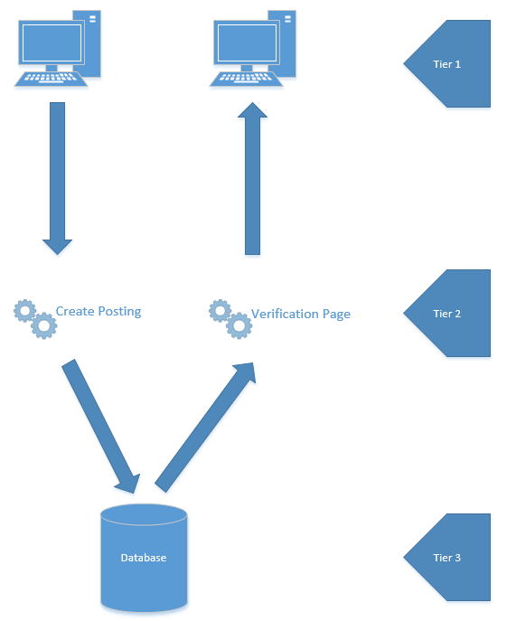
Web System Design
Three tier architecture
Tier 1 – Webpages
Tier 2 – Application Server
Tier 3 – Database server

Slide 7
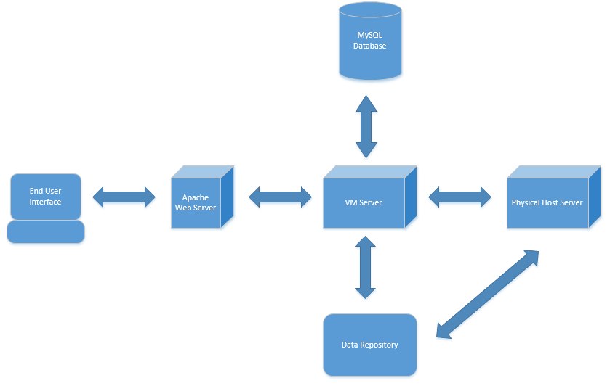
Infrastructure

Slide 8
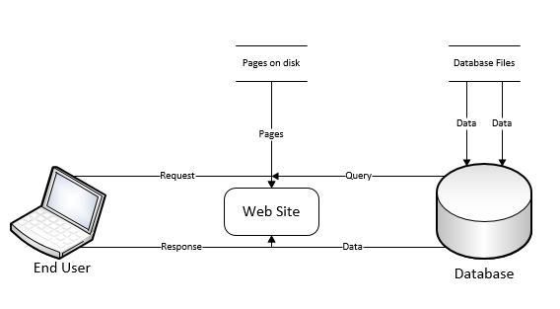
Data Flow

Slide 9
System Overview
Hosted externally
Help gauge actual server requirements and best decide how to host multiple iterations of the site
Hardware Req. (of external host)
Processor – Current generation Intel Xeon Processor with 4 or more cores
Memory – 4 GB of RAM
Storage – 1 TB of storage
This may seem high, but this if for the sake of future-proofing and the fact that there may be many postings with multiple pictures at any given time

Slide 10
System Overview Cont.
Though we are hosting off site initially, we still need to be sure that we purchase an off-site host that is capable of running our site and ensuring maximal uptime as well as quality of service
We intend to use one server per site
We assume that maximum traffic would be equal to or lesser than half of IPFW’s current enrollment at any given time.
Though people who are not students CAN access the site, we feel safe to assume that the traffic would not exceed this number.
That number is not hard to host on a server, thus the requirements are relatively simple

Slide 11
Software Overview
We would use the following software titles mostly for the sake of ease of support and maintenance, as they are usually the industry standard
VMWare ESXi – On physical server to host virtual machines
VMWare vShpere – Manage and maintain multiple virtual machines
Windows 2012 Server - Easy to maintain server OS with tons of compatibility and support, this will be the OS of the virtual machines
XAMPP stack - Free, easy to maintain web system stack that is used by a very large percentage of websites in use today
Java Eclipse - develop site as well as maintain and make changes to the code in the future

Slide 12
Design – Keep it Simple

Slide 13
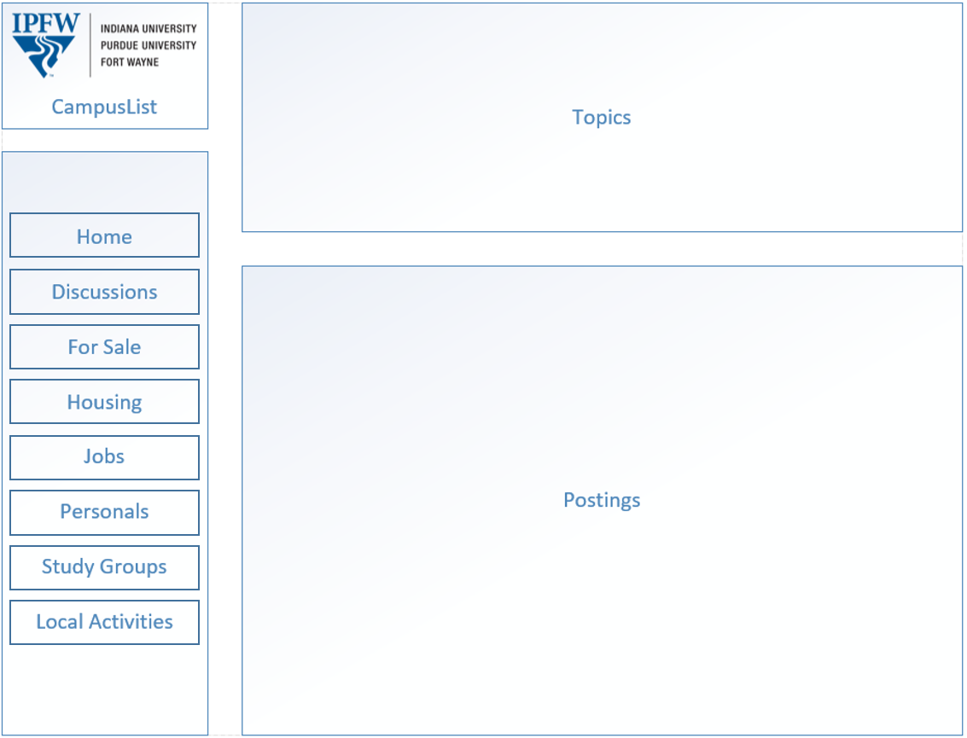
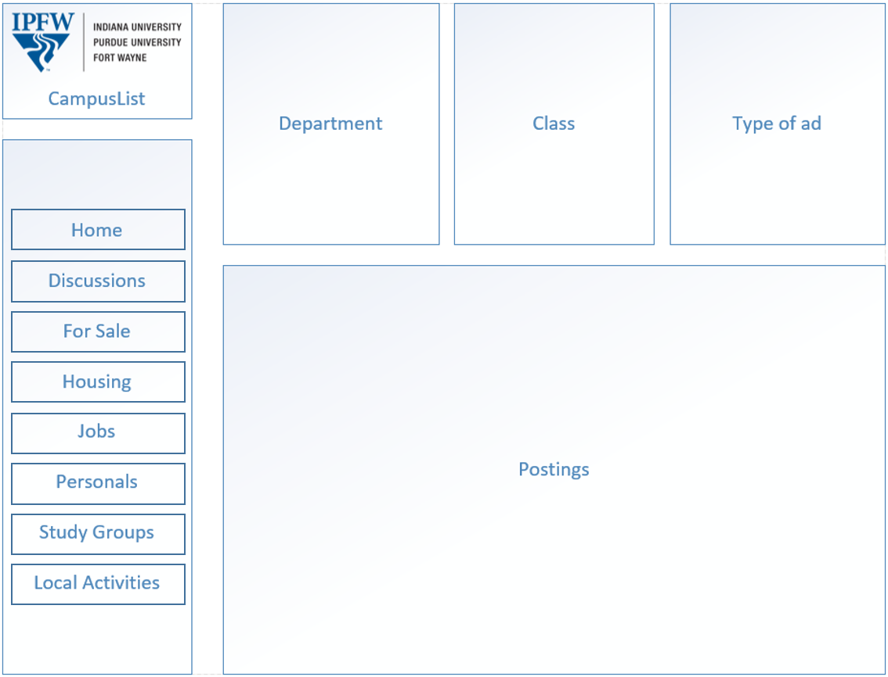
Design Cont.

Slide 14
Design Cont.
The idea behind CampusList is to directly compete with Craigslist.org
Familiar design for Craigslist users
More modern and appealing to younger user base
Includes visual cue for current page (IPFW logo)
Keeping it simple
Very easy to code and maintain
Very simple to navigate
Trade off – not the most visually appealing
Easy to learn
Fewer needed resources to host and run

Slide 15
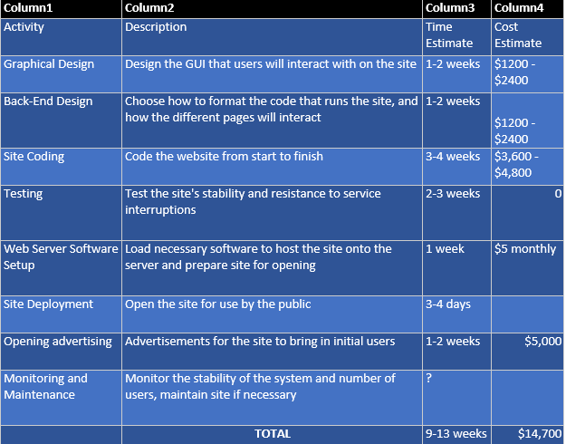
Time and Cost

Slide 16
Conclusion
Great potential for market share
Appeals to a large but still niche market
Appeals to a market dominated by tech-savvy individuals
Easy to maintain
Easy to grow
Hardware requirements are linear for the most part, meaning it is easy to gauge necessary investments in hardware as we grow\
Multiple sites would use nearly identical source code
Would differentiate from Craigslist by the specificity of the site

Slide 17
Q&A
Ask any questions that you might have

Slide 18
Demo

