Slide 1
The BIG Event
Amanda Necessary, Matt Ranochak, Ben Rairigh
Paul Lin
12/15/2015

Slide 2
Executive Summary
This project was designed to:
Create a new way for volunteers to register
Improve the communication process
Create an innovative way to pair agencies and volunteers

Slide 3
Introduction
The BIG Event is:
A day of service
Universities around the country participate in this event
IPFW has participated since 2012

Slide 4
Problem Statement
3 time constraints
Current registration software
Way agencies are paired
Communication process

Slide 5
Solution
Web based application
This application allows for:
Volunteers to register more easily
An effective communication process
Cut the time it takes to make pairings

Slide 6
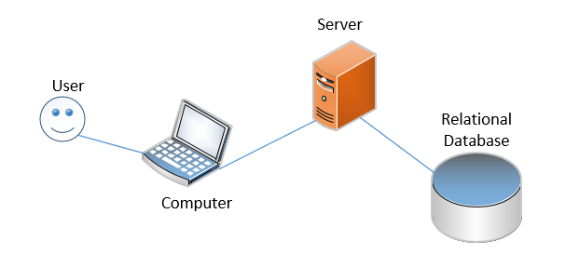
System Infrastructure Diagram - Proposed

Slide 7
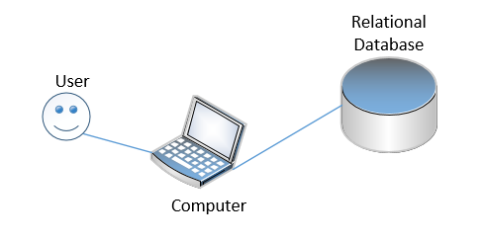
System Infrastructure Diagram - Current

Slide 8
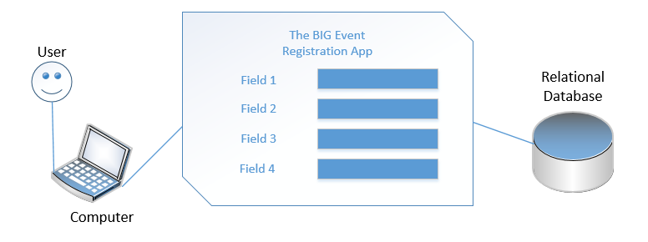
System Interaction Diagram

Slide 9
System Requirements - Software
Microsoft Access
Microsoft Database Management System using the Jet Database Engine and a graphical user interface
Can link directly to or import data stored in other applications and databases

Slide 10
System Requirements - Hardware

Slide 11
System Testing and Validation
Peer testing
We had past volunteers and group leaders test the database
Based on their feedback changes were made
All found this system much better than the current system

Slide 12
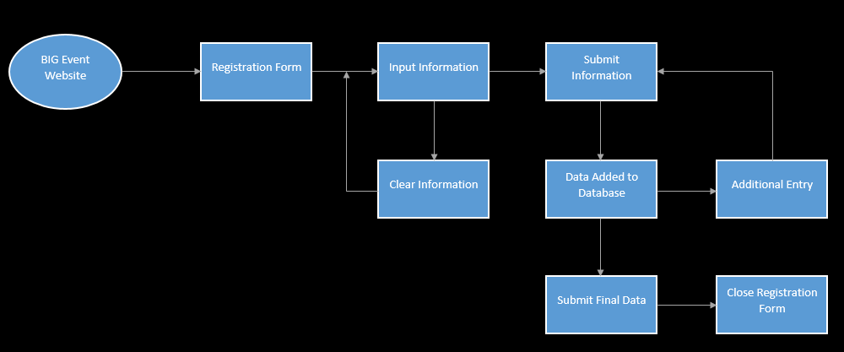
System Analysis

Slide 13
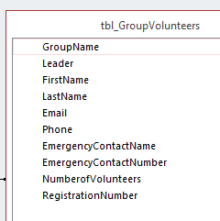
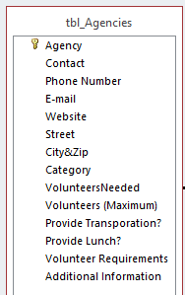
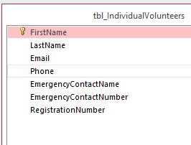
System Design
Software Architecture

Slide 14
System Design
GUI
DATABASE
New entry information is sent to the database
The new information is then added to the database

Slide 15
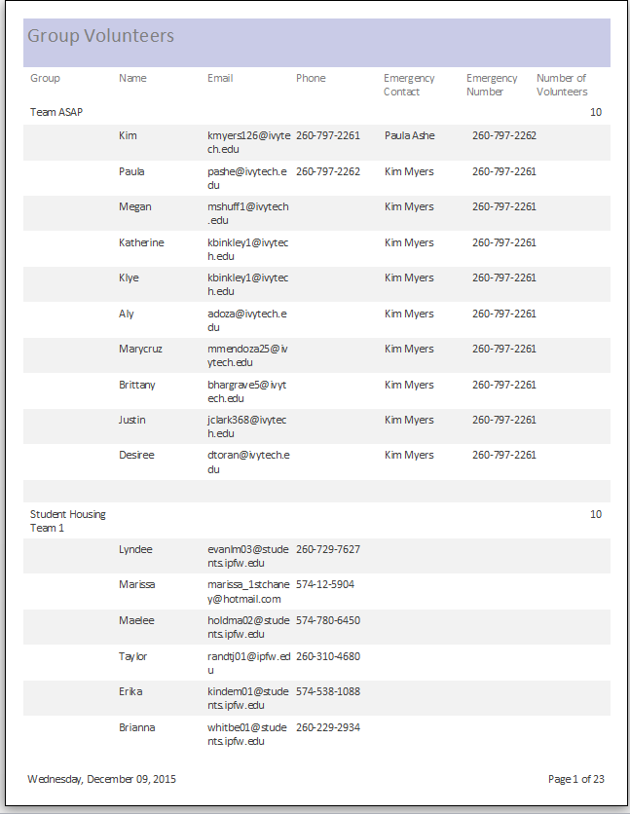
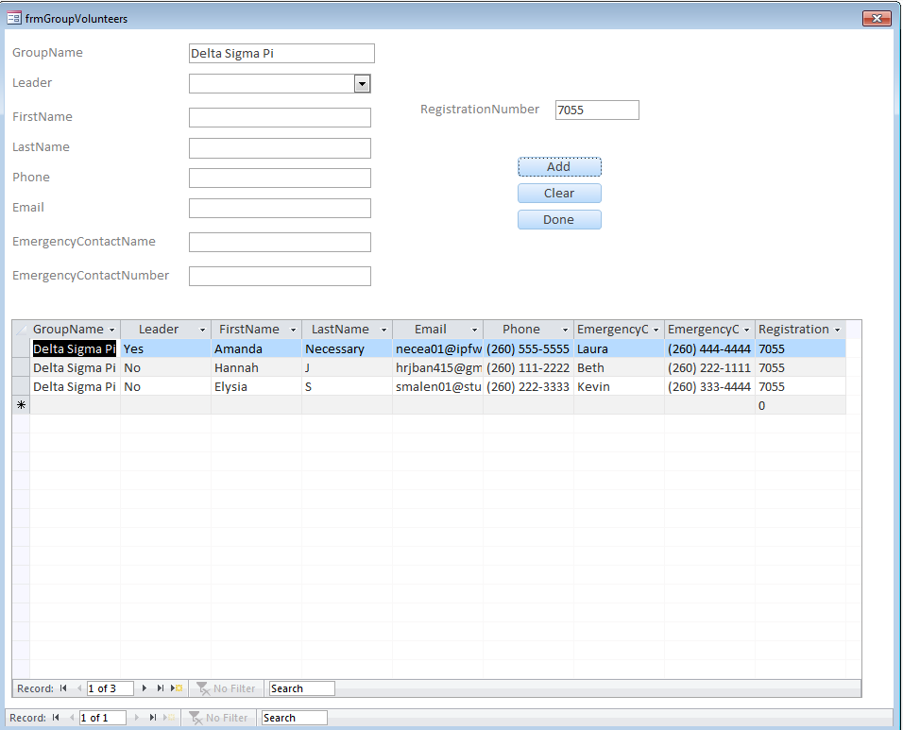
Simulation

Slide 16
System Integration
Database Application
web based after committee meeting

Slide 17
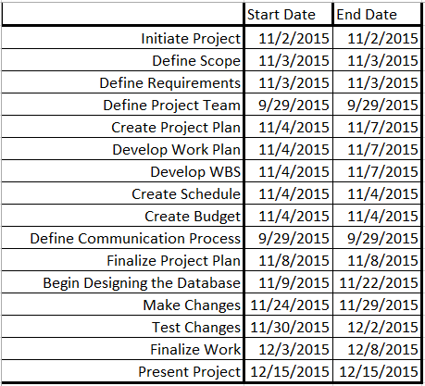
Schedule

Slide 18
Conclusion
Addresses and enhances the time constraint items
Provides an
efficient and more effective way to register
innovative way to pair agencies with volunteers
Effective communication process

